Slide 1
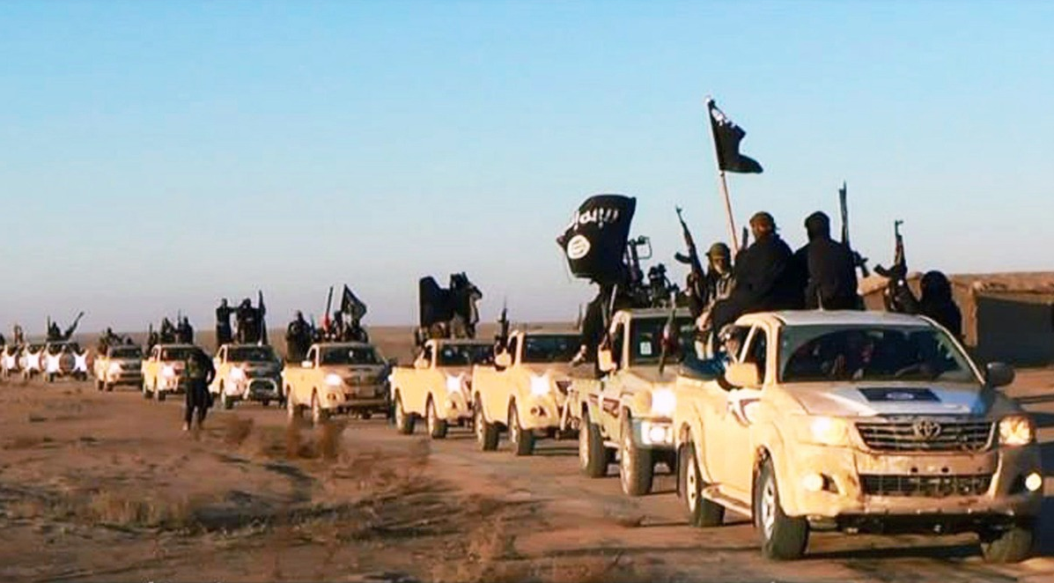
Al-Qa’ida, Islamic State &
the Re-Claiming of the Arab Poetic Tradition
Dr Elisabeth Kendall, Pembroke College, University of Oxford

Slide 2
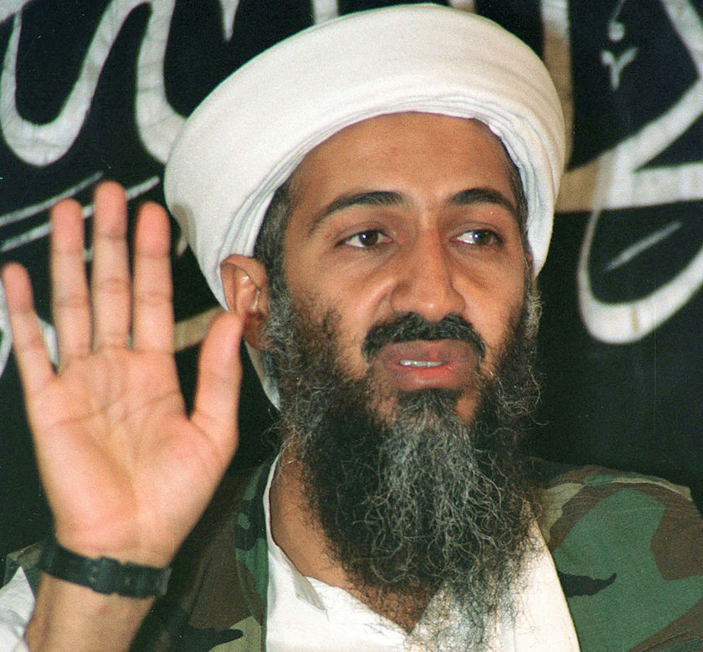
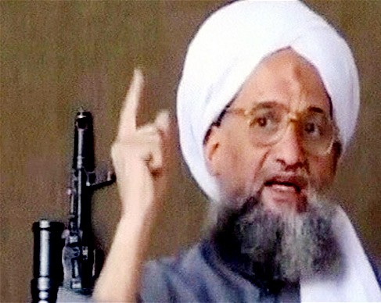
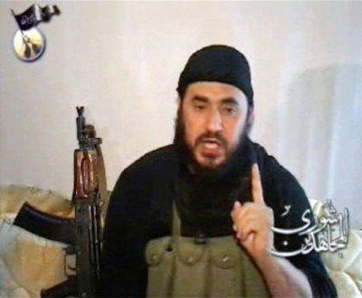
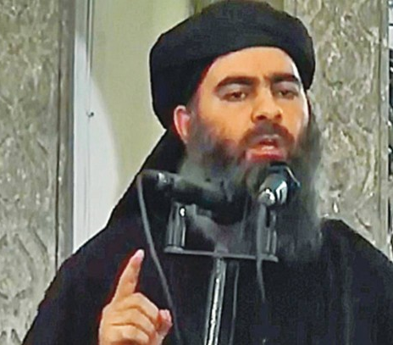

Slide 3
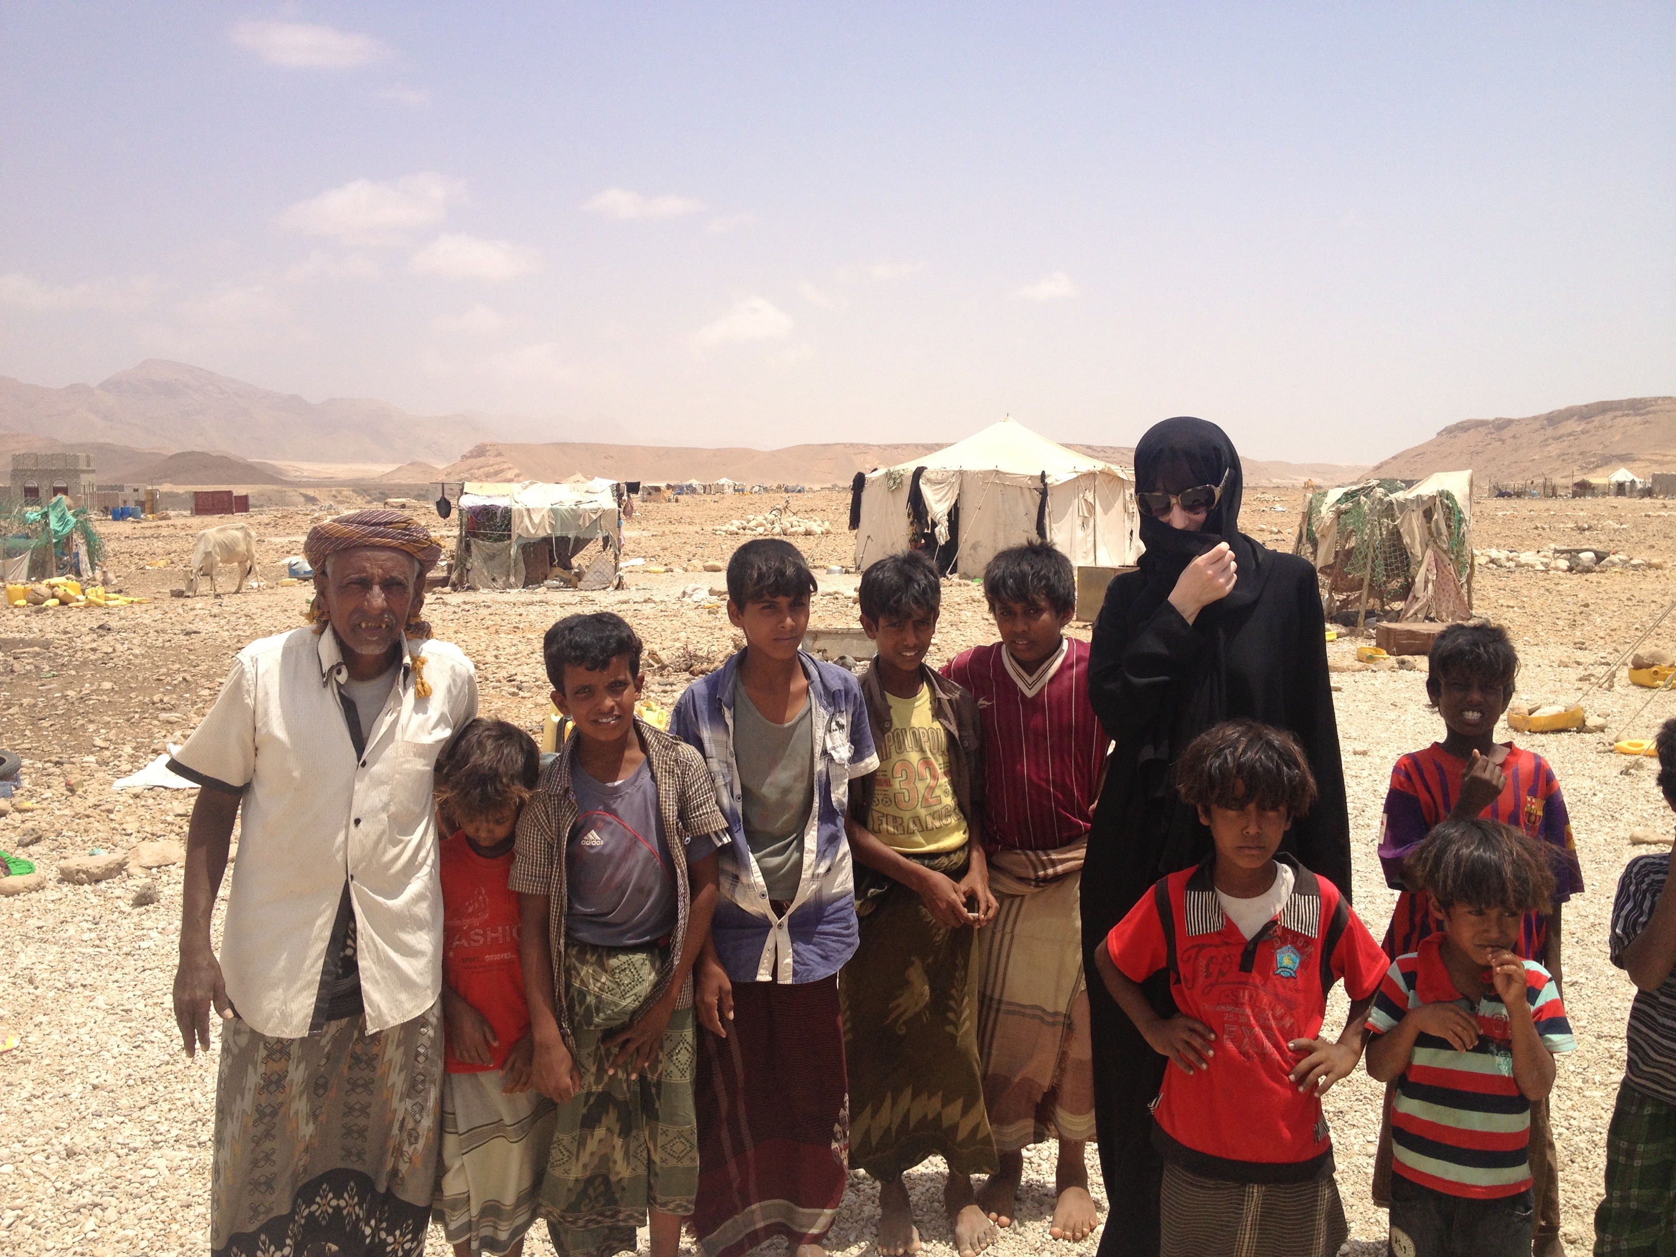

Slide 4
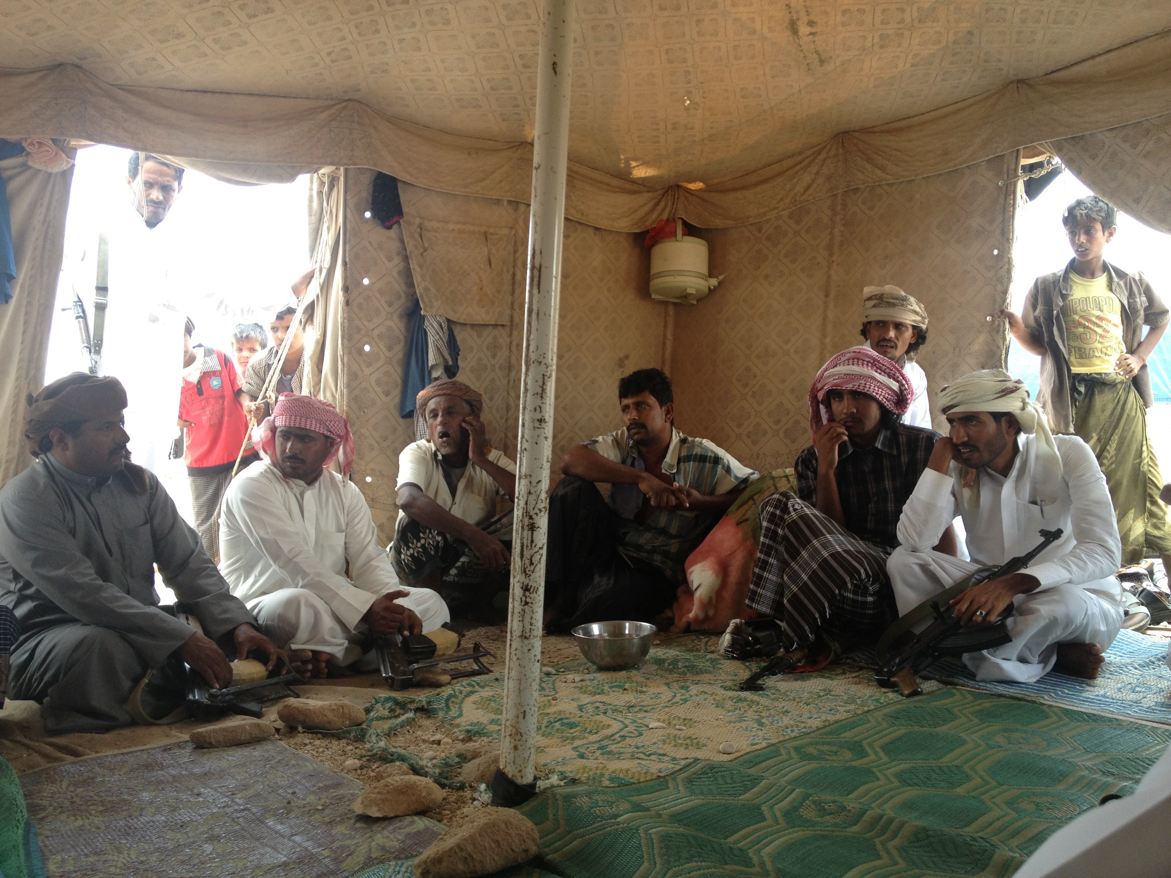

Slide 5
Will poetry retain its importance – how deeply rooted is it still in Yemen?
I looked at:
Location – desert vs coast
Age
TV
Education
Money
Religion

Slide 6
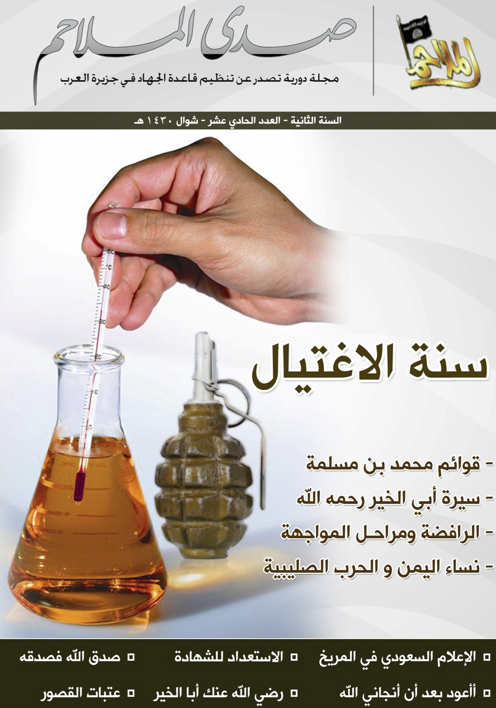
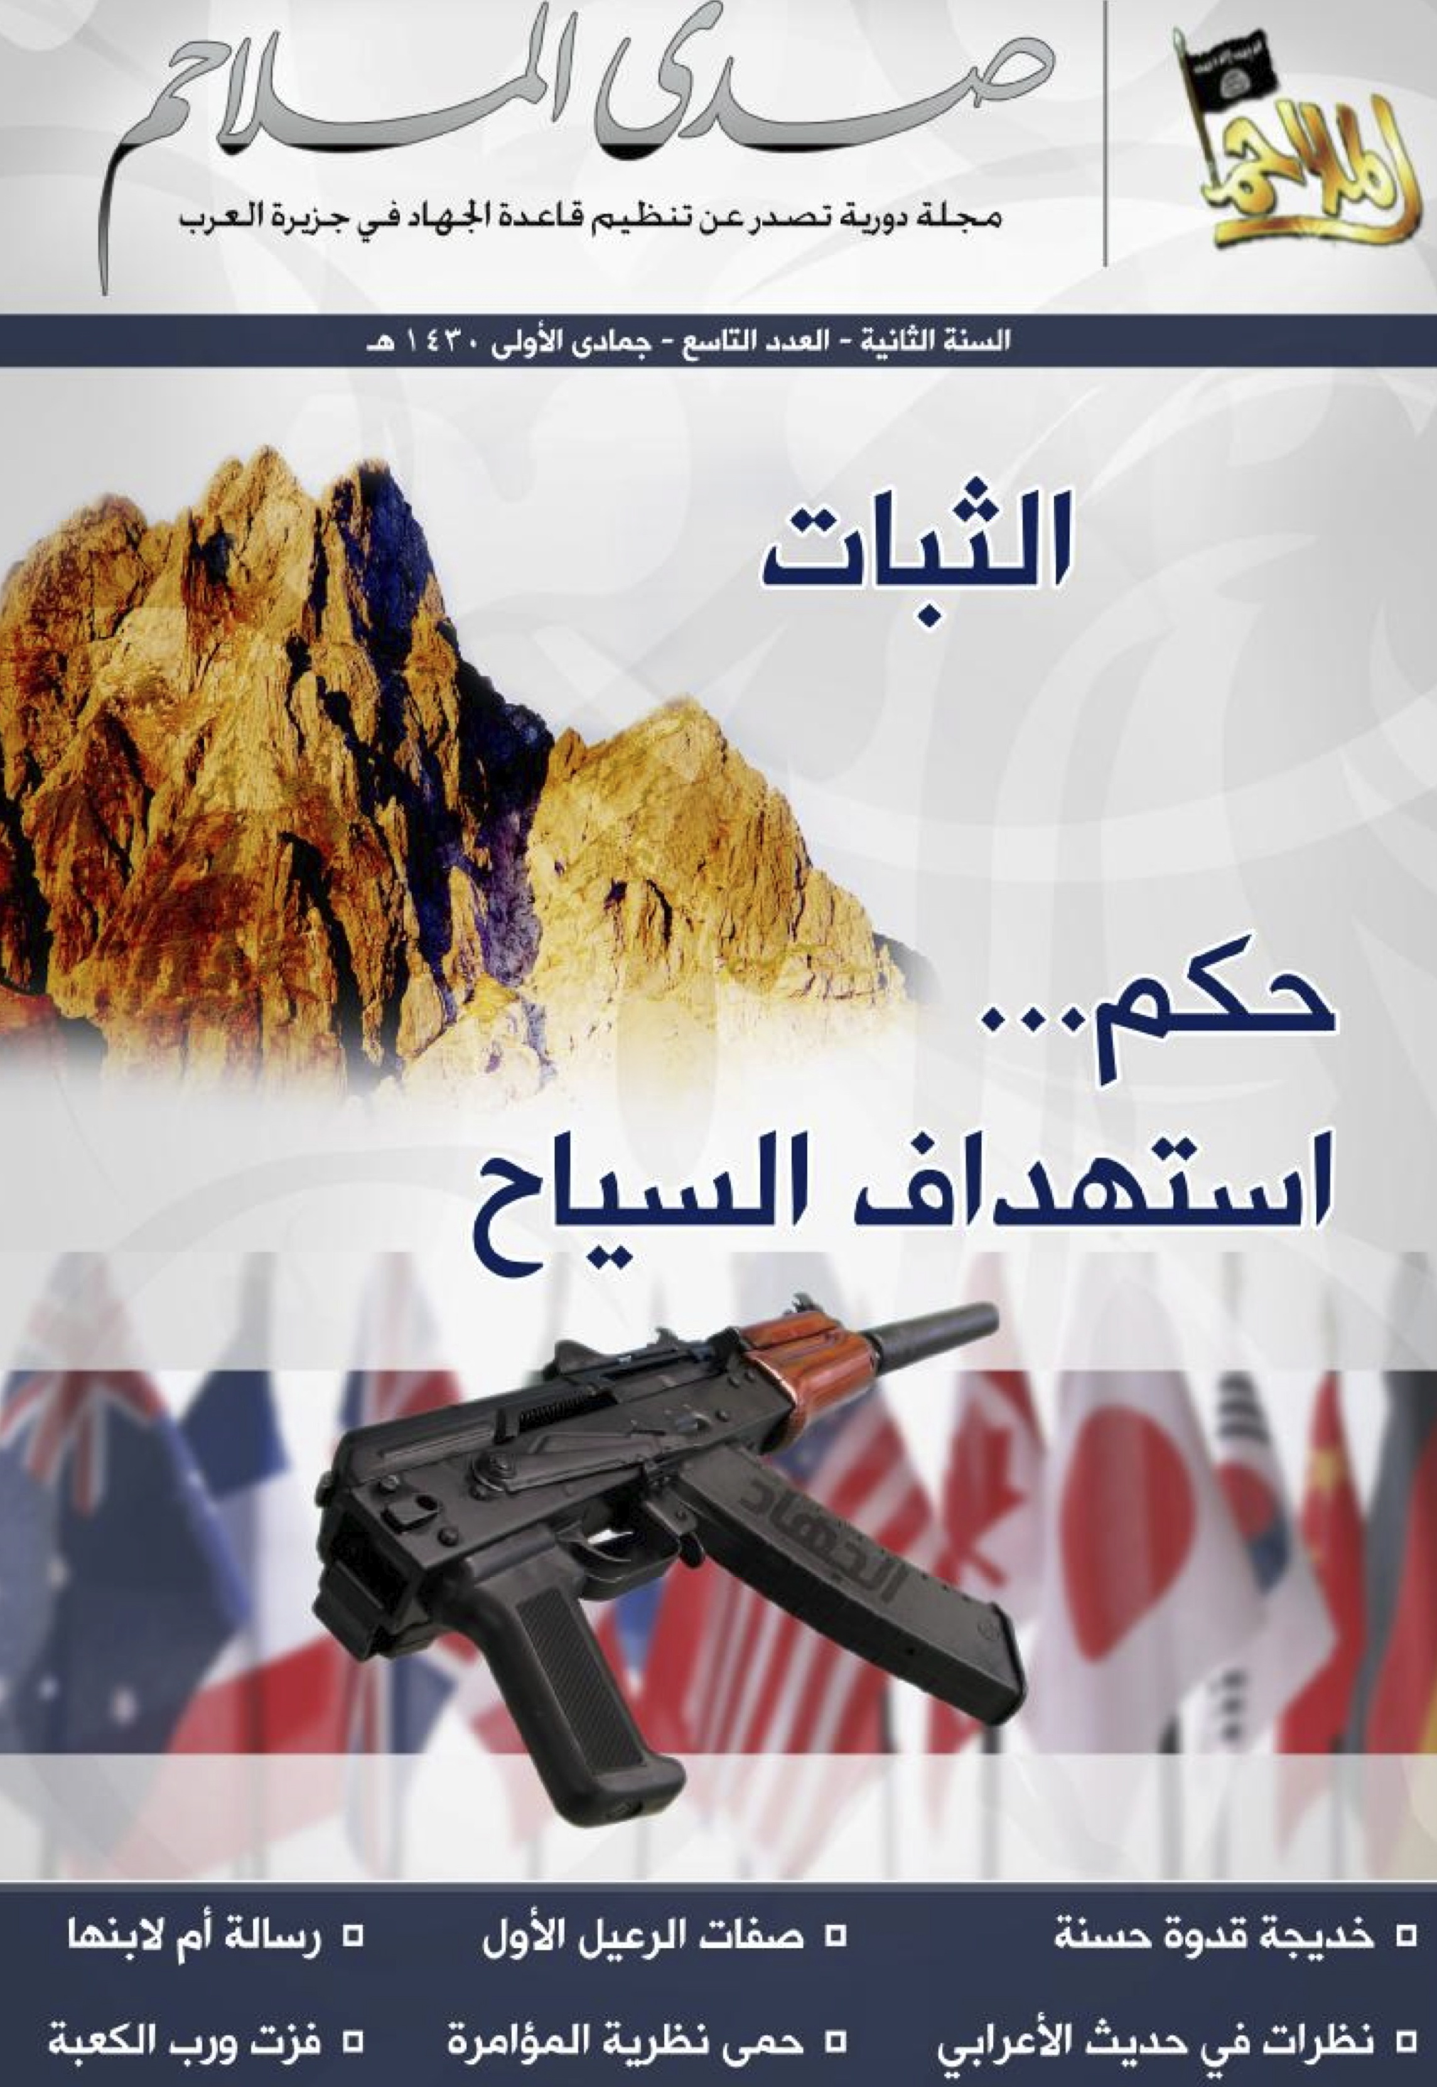
Analysts completely overlooked that 1 in every 5 pages features poetry

Slide 7
How important is the classical poetic heritage for today’s jihadists?
Less than ¼ of the poetry in al-Qa’ida’s Yemen journal is attributed.

Slide 8
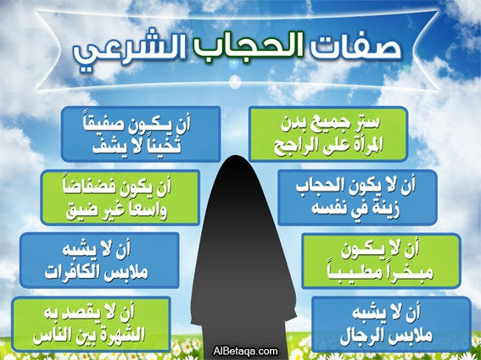
Selective reconstruction of the heritage to drum home instructions…

Slide 10
Top 5 Functions
To legitimate acts of terror
To provoke outrage
To reassure current/future recruits
To present an alternative reality
To construct a coherent ‘enemy’

Slide 11
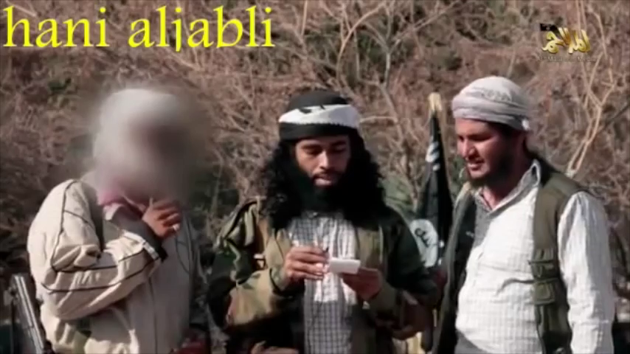
AQAP Celebration (April 2014)

Slide 12
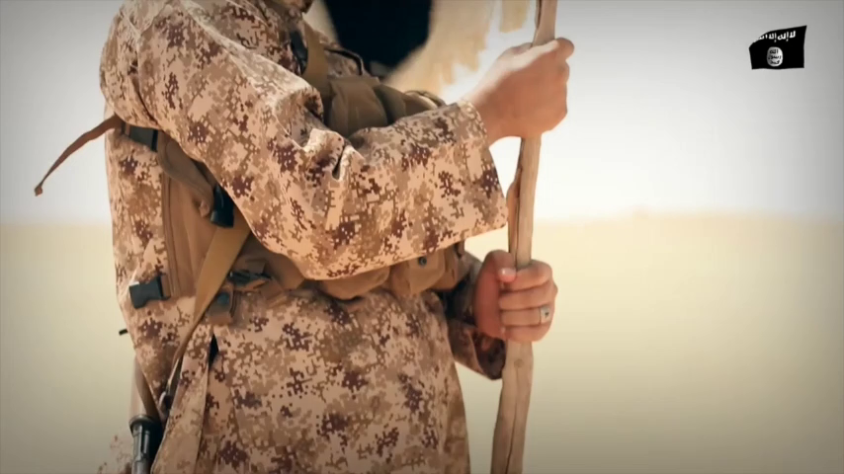
Islamic State Yemen (April 2015)

Slide 13
