Slide 1
“The instruments of darkness tell us truths” Recent discoveries of ritual protection marks at Knole
James Wright
Senior Archaeologist
Notes:
Standard title slide.

Slide 2
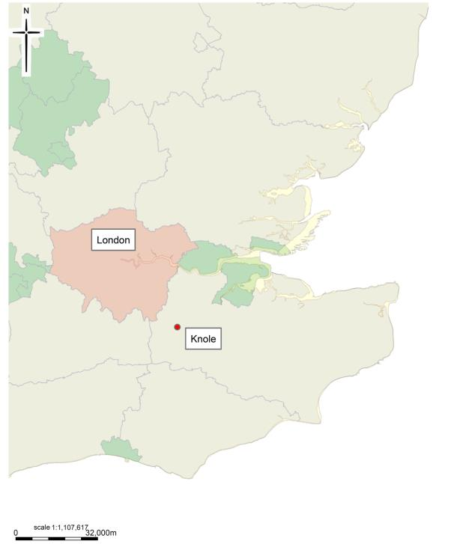
Knole, Kent

Slide 3
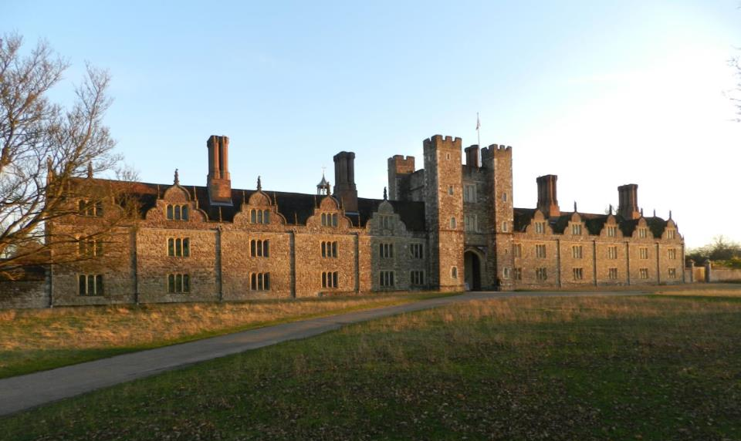
Knole, Kent

Slide 4
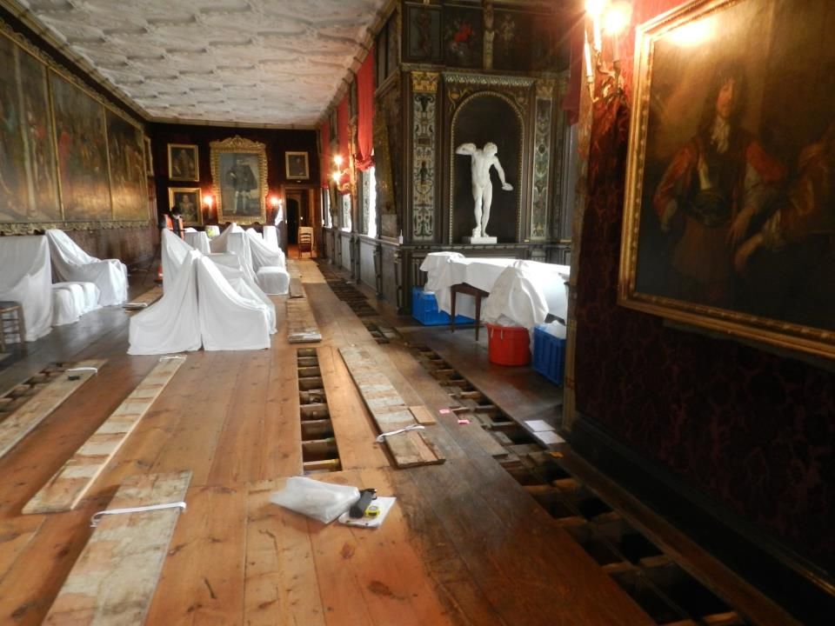

Slide 5
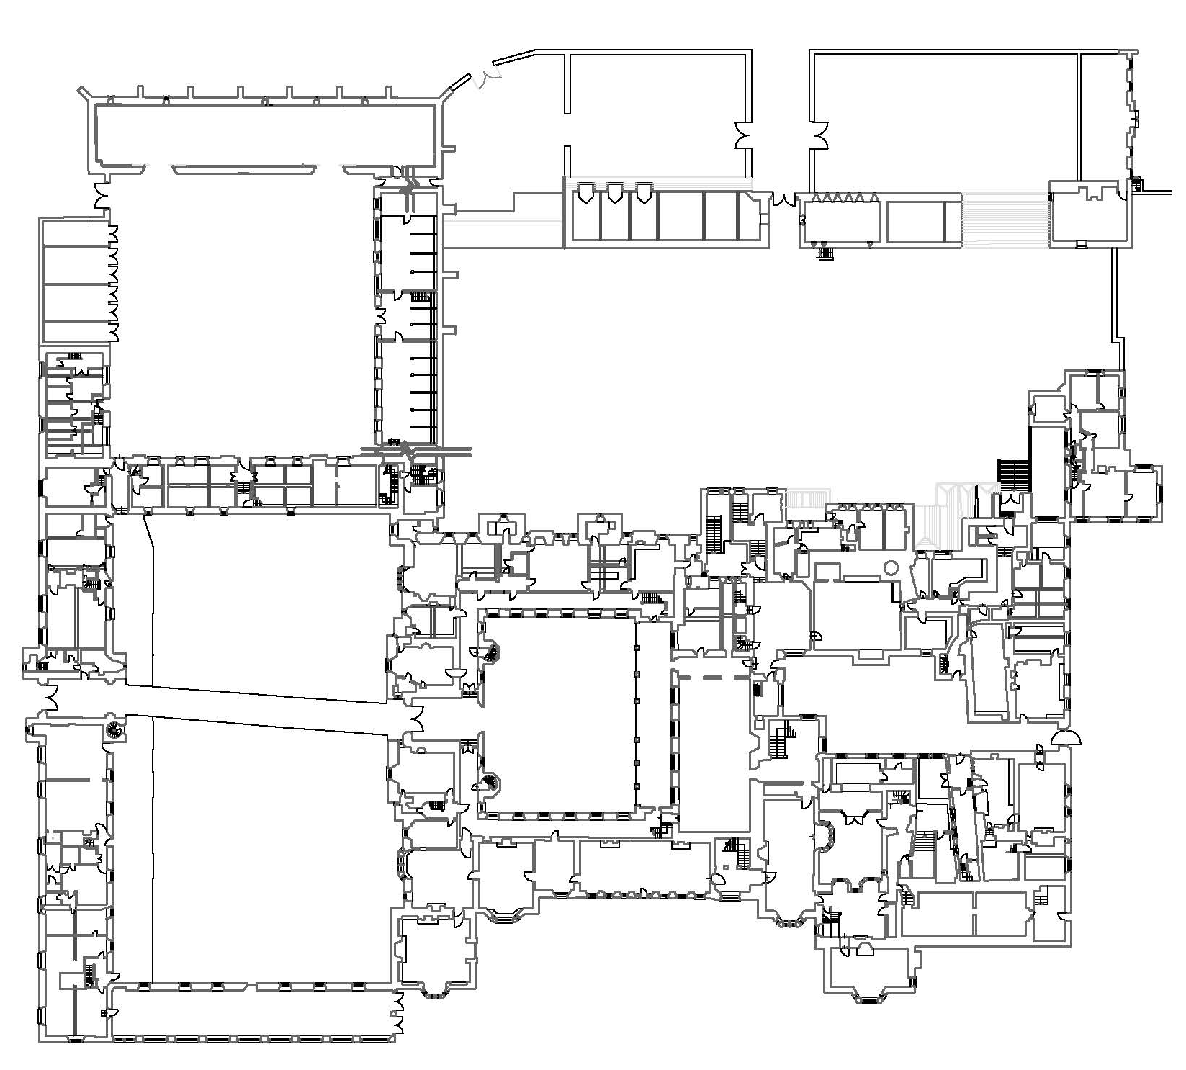
Knole, Kent
King’s Tower
Image courtesy of the National Trust

Slide 6
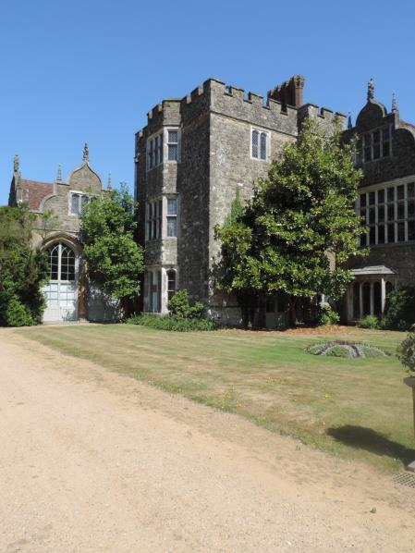
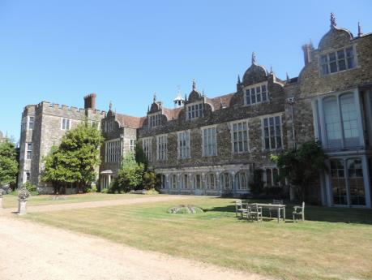
King’s Tower
South elevation
Image courtesy of the National Trust

Slide 7
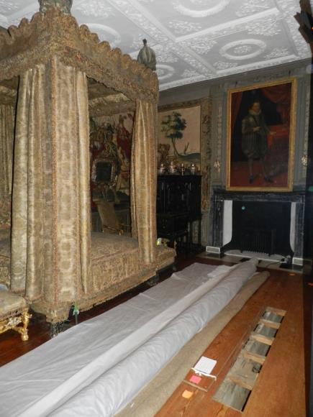
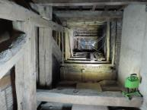
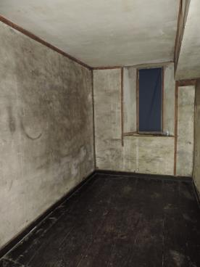
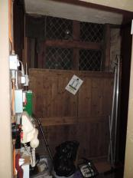
King’s Tower
First floor
Image courtesy of the National Trust

Slide 8
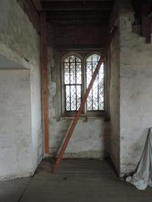
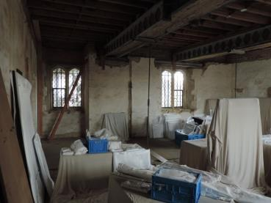
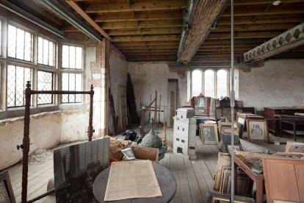
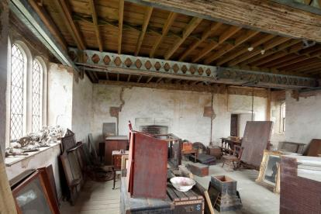
King’s Tower
Second floor
Images courtesy of the National Trust

Slide 9
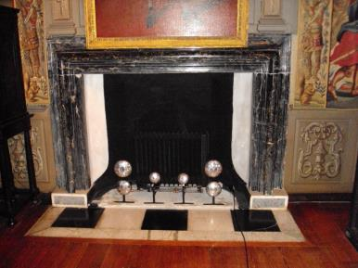
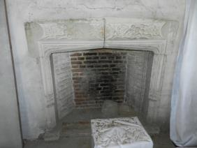
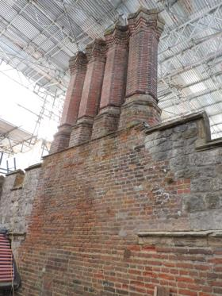
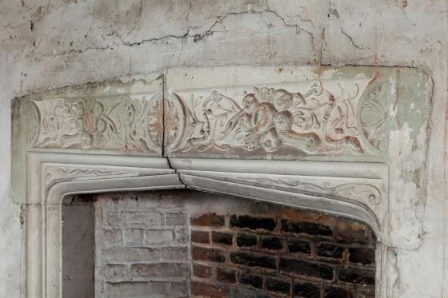
King’s Tower
Fireplaces
Image courtesy of the National Trust
Image courtesy of the National Trust

Slide 10
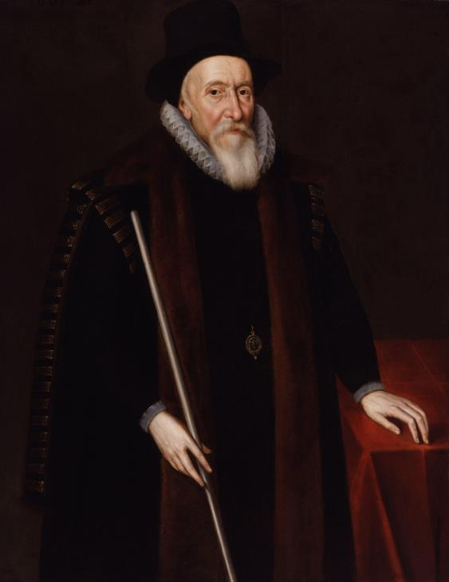
Thomas Sackville
1st Earl of Dorset
Lord Treasurer
Thomas Sackville, 1st Earl of Dorset
by Unknown artist oil on panel, 1601
National Portrait Gallery

Slide 11
Thomas Sackville
1st Earl of Dorset
Remodelling of Knole 1605-8
Image courtesy of the National Trust

Slide 12
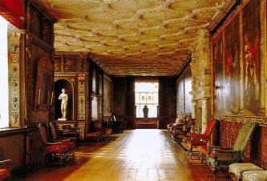
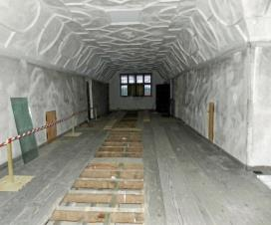
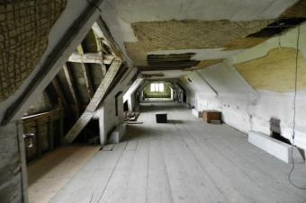
King’s Tower
Floor plans
Cartoon Gallery Retainer’s Gallery South Barracks
First floor
Second floor
Images courtesy of the National Trust

Slide 13
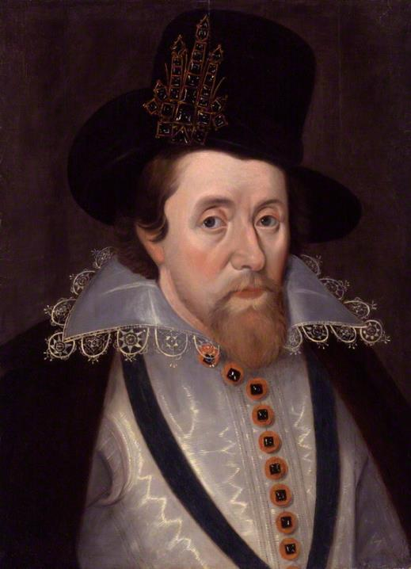
James VI of Scotland
& I of England
King James I of England and VI of Scotland
after John De Critz the Elder oil on panel, early 17th century (circa 1606) National Portrait Gallery

Slide 14
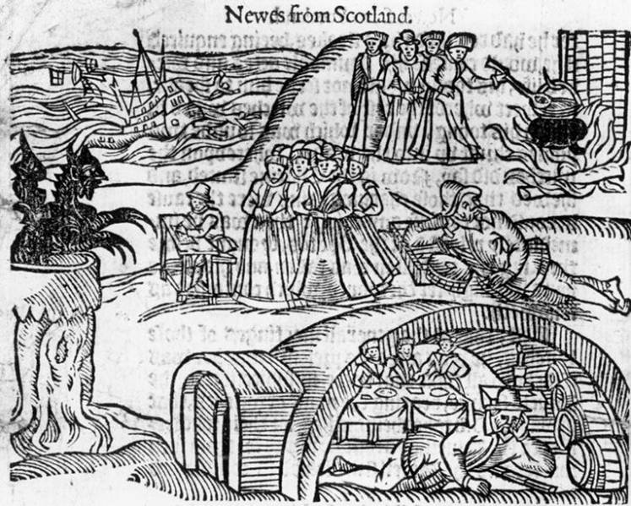
James VI of Scotland
& I of England
North Berwick witch trials 1590-2
Newes from Scotland - declaring the damnable life and death of Dr. John Fian
Pamphlet by James VI of Scotland
Printed in London, 1591

Slide 15
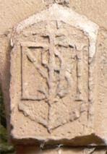
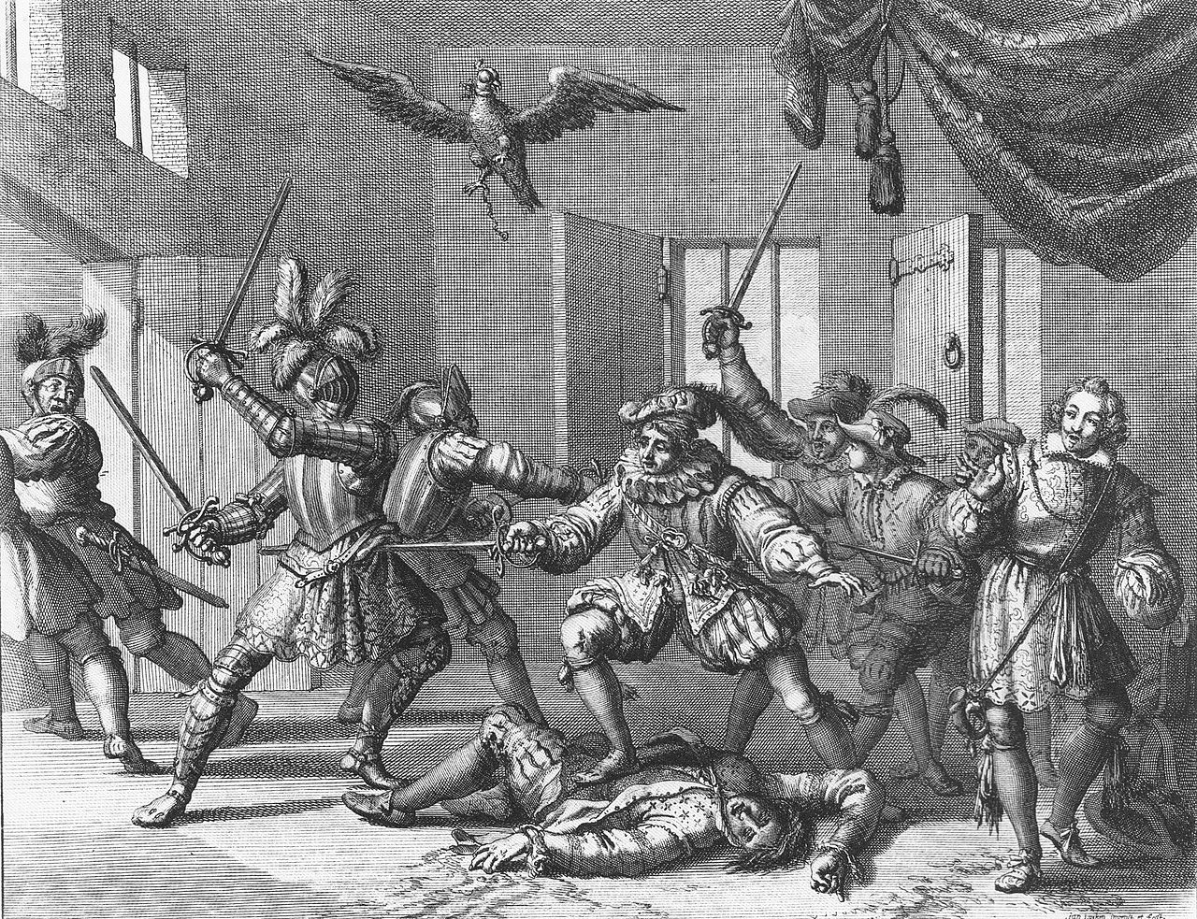
James VI of Scotland
& I of England
Plots with occult connections
North Berwick witch trials, 1590-2
Coven of witches admit trying to drown James
Bothwell Plot, 1593
Accused of involvement in 1590,
repeated accusations of witchcraft in 1593
Gowrie Plot, 1600
Magic formulas found on body of assassin

Slide 16
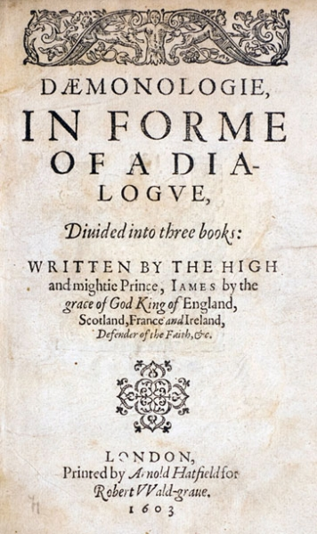
James VI of Scotland
& I of England
Daemonologie - 1597, reprinted 1603

Slide 17
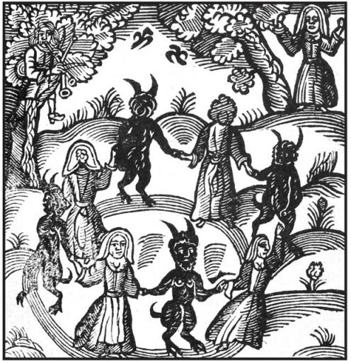
James VI of Scotland
& I of England
An Act against Conjuration, Witchcraft and dealing with evil and wicked spirits, 1604

Slide 18
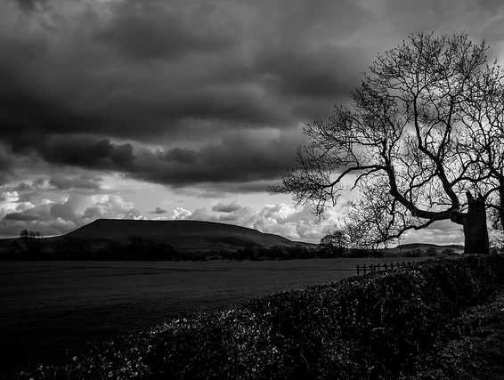
James VI of Scotland
& I of England
Pendle witch trials, 1612
Picture Source: Dave Spellman via flickr.com

Slide 19
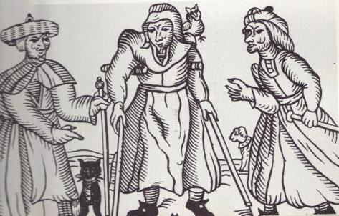
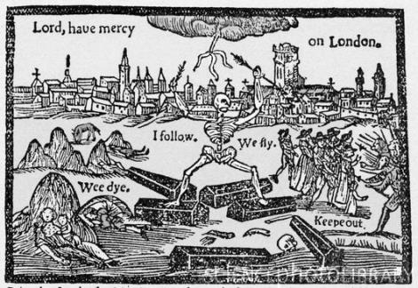
Witchcraft
“There’s little evidence that the lives of early modern men and women resembled our own.”
Childhood brief, adolescence spent away from family
Households, rather than families the basic social unit
Privacy a modern construct
Average marriage at 25, one in five remained unmarried
Women often managed property and possessions
Recurrent outbreaks of plague
Death in childbirth, harvest failure, infant mortality
Life expectancy average mid-forties
Religion shaped all concepts of life, death and after-life
“Pre-modern conceptions of self and one’s place in the world were not identical to our own… those who view the lives of early modern men and women through the lens of modernity ought to proceed with caution.”
Contested Will - James Shapiro, 2010
The wonderful discoueries of the witchcrafts of Margaret and Phillip Flower Printed in London, 1618
Contested Will - James Shapiro, 2010
The Wonderfull Yeare
Thomas Dekker
Printed in London, 1603

Slide 20
Witchcraft
Religious change – Reformation
Social change – doubling of population 1530-1630
Agricultural change – Enclosure
Lack of food
Drop in wages – expansion of gap between rich and poor
Class tension – slightly richer members of society accused slightly poorer members of witchcraft
Witchcraft enshrined in law by the state 1542, 1562 & 1604
The wonderful discoueries of the witchcrafts of Margaret and Phillip Flower Printed in London, 1618
The Wonderfull Yeare
Thomas Dekker
Printed in London, 1603

Slide 21
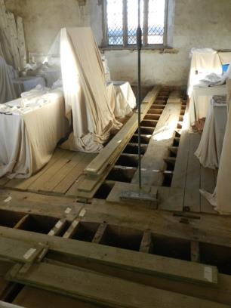
King’s Tower
Apotropaic marks
Image courtesy of the National Trust

Slide 22
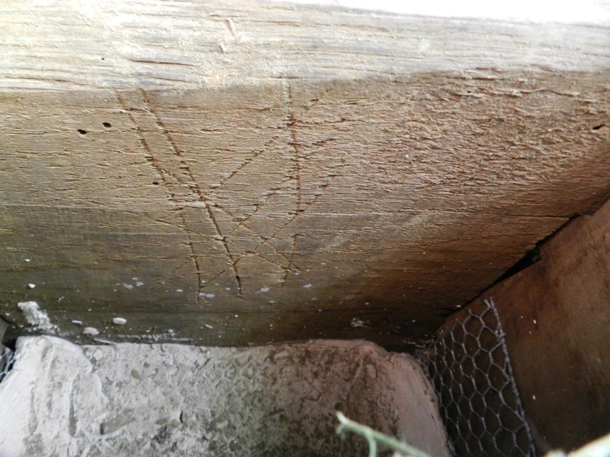
King’s Tower
Apotropaic marks

Slide 23
King’s Tower
Apotropaic marks

Slide 24
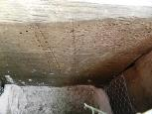
King’s Tower
Apotropaic marks
Image courtesy of the National Trust

Slide 25
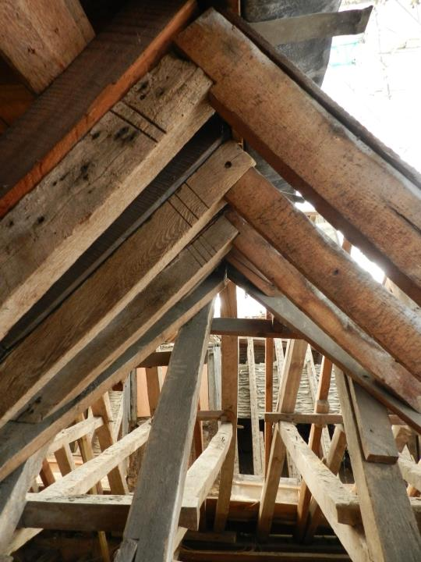
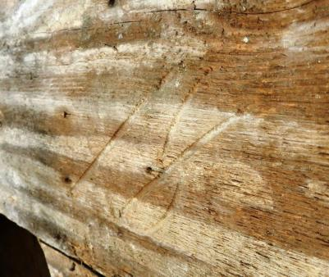
King’s Tower
Carpenter’s and merchant’s marks

Slide 26
Apotropaic symbols
APOTROPAIC
Supposedly having the power to avert evil influences or bad luck
Origin:
Ancient Greek ἀποτρόπαιος (apotrepein)
Meaning:
Turn away or from

Slide 27
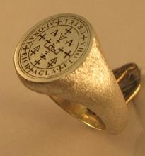
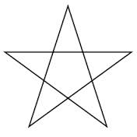
Apotropaic symbols
Seal of Solomon
Jewish tradition
Tractate Gittin from the Babylonian Talmud in which Solomon is given a seal ring which had the power to repel demons
Arabic tradition
Moroccan 4 falus coin
Western tradition
Five pointed star

Slide 28
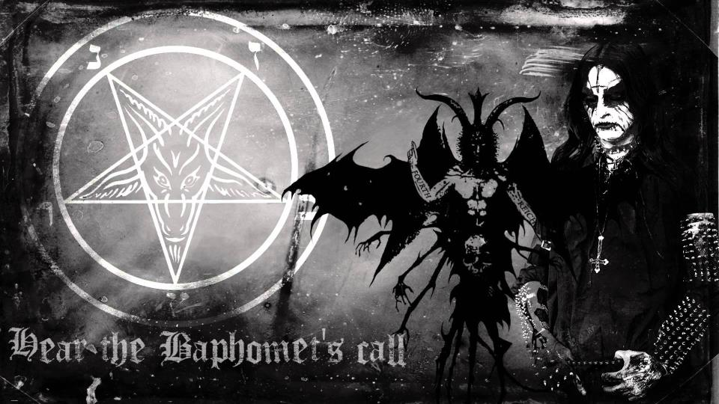
Apotropaic symbols
Pentagram
Picture Source: Baphomet’s Call by Behexen, 2000

Slide 29
Apotropaic symbols
Pentagram
NO!!
Picture Source: Baphomet’s Call by Behexen, 2000

Slide 30
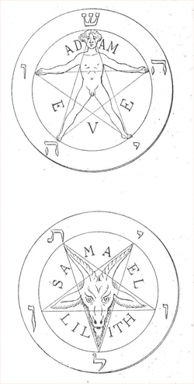
Apotropaic symbols
Pentagram
Stanislas de Guaita, La Clef de la Magie Noire, 1897
Aleister Crowley, The Book of the Law, 1904
Anton LaVey, Sigil of Baphomet – The Satanic Bible, 1969

Slide 31
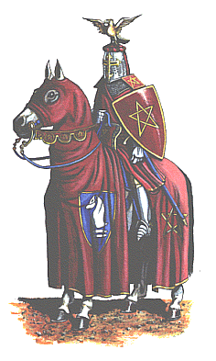
Apotropaic symbols
Sir Gawain and the Green Knight
Mid-late 14th century
“It is a sign that Solomon once set on a time
to betoken Troth, as it is entitled to do;
for it is a figure that in it five points holdeth,
and each line overlaps and is linked with another,
and every way is endless; and the English, I hear,
everywhere name it the Endless Knot.
… So there
the pentangle painted new
he on shield and coat did wear.”
J.R.R.Tolkien (trans.) 1979, 8th ed., 30
Picture Source: http://www.msschafer.com

Slide 32
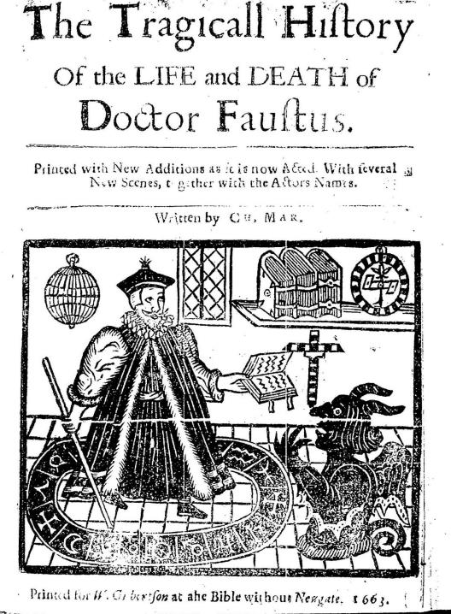
Apotropaic symbols
Literary references
“The great arch-ruler, potentate of hell
Trembles when Bacon bids him or his fiends
Bow to the force of his pentageron”
Friar Bacon and Friar Bungay
Robert Greene c 1588 – c 1592
Mephistopheles:
I must confess, my stepping o'er
Thy threshold a slight hindrance doth impede;
The wizard-foot [Drudenfuss] doth me retain.
Faust:
The pentagram thy peace doth mar?
To me, thou son of hell, explain,
How camest thou in, if this thine exit bar?
Could such a spirit aught ensnare?
Faustus
Johann Wolfgang von Goethe, 1808

Slide 33
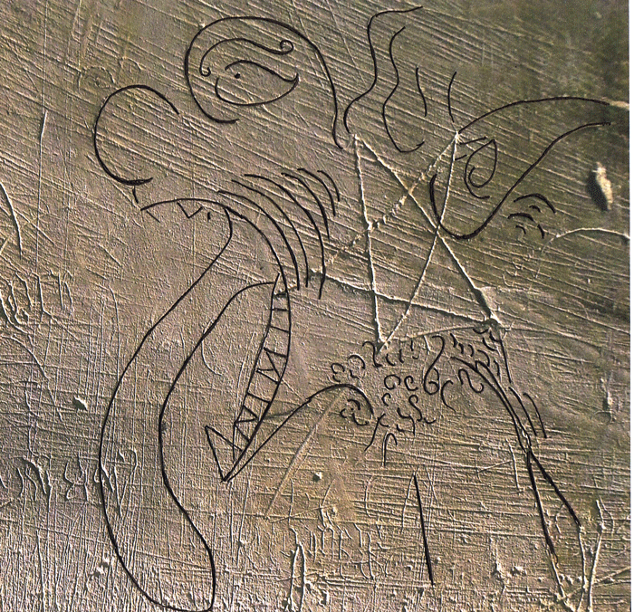
Apotropaic symbols
Demon traps
St Mary’s, Troston, Norfolk
Matthew Champion
Norfolk Medieval Graffiti Survey
http://www.medieval-graffiti.co.uk/

Slide 34
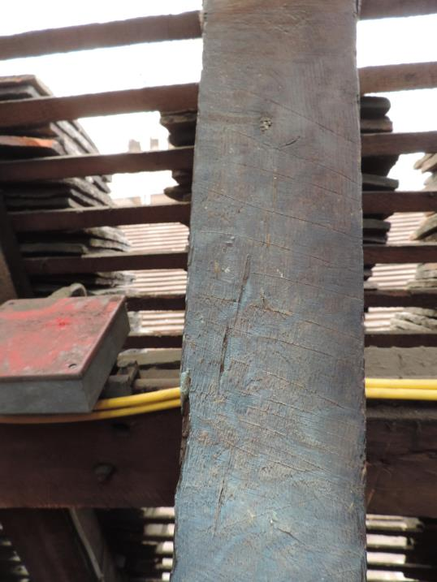
Apotropaic symbols
Mesh patterns
Queens House, Tower of London

Slide 35
Apotropaic symbols
Chequerboards
St Martin’s, Fincham, Norfolk

Slide 36
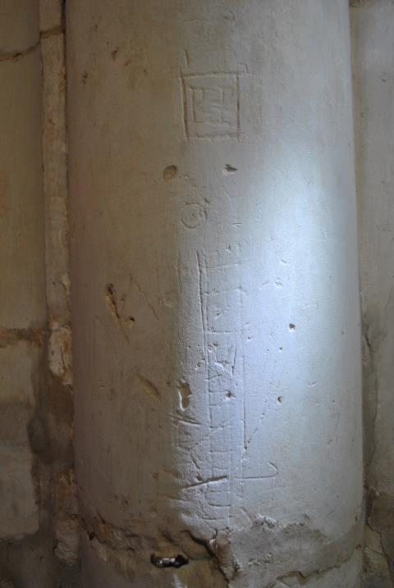
Apotropaic symbols
Jacob’s Ladders
St Martin’s, Fincham, Norfolk

Slide 37
Apotropaic symbols
Marian symbols
St Martin’s, Fincham, Norfolk

Slide 38
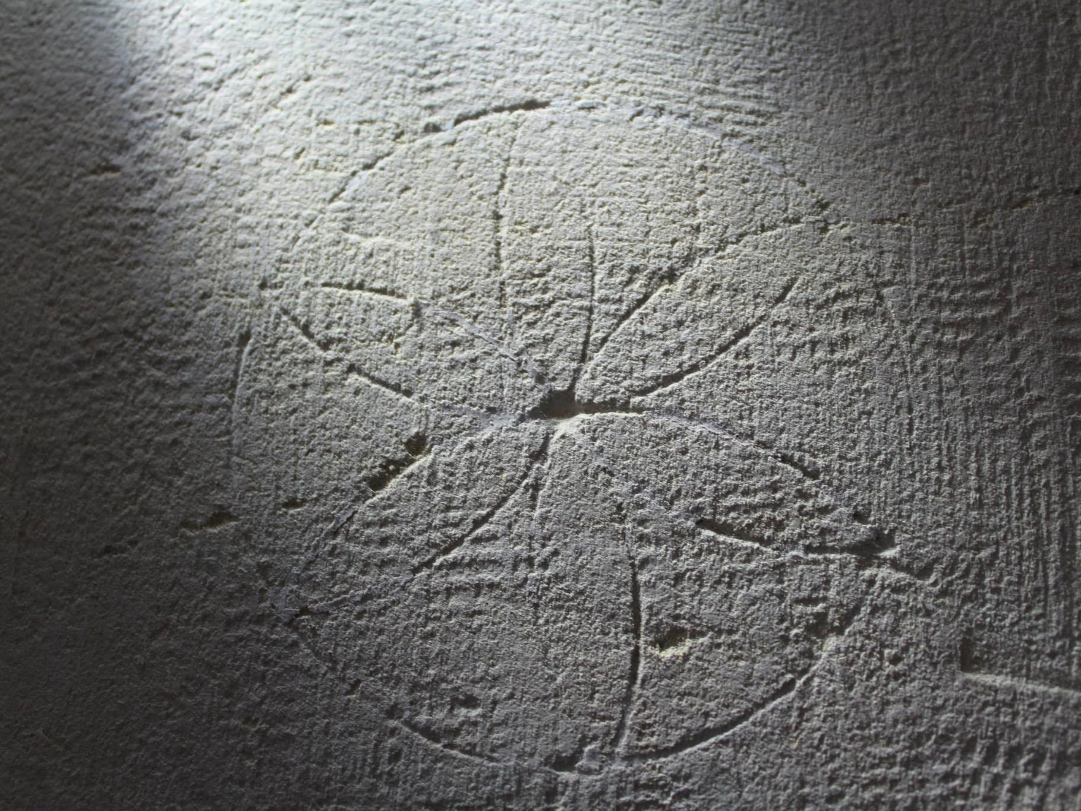
Apotropaic symbols
Daisywheels
St Mary’s, Happisburgh, Norfolk

Slide 39
Apotropaic symbols
Burn marks
Queens House, Tower of London

Slide 40
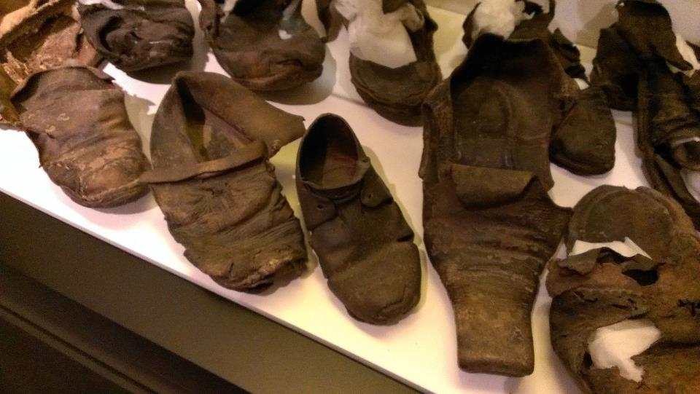
Apotropaic symbols
Concealed footwear and clothing
Collection of St Edmundsbury Heritage Service,
St Edmundsbury Borough Council

Slide 41
Apotropaic symbols
Distribution
“But the third way of their comming to their conuentions, is, that where in I think them deluded: for some of them sayeth, that being transformed in the likenesse of a little beast or foule, they will come and pearce through whatsoeuer house or Church, though all ordinarie passages be closed, by whatsoeuer open, the aire may enter in at.”

Slide 42
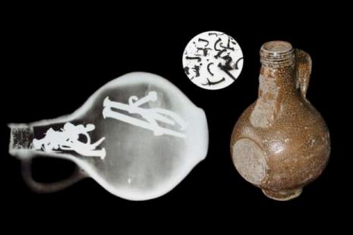
Apotropaic symbols
Distribution

Slide 43
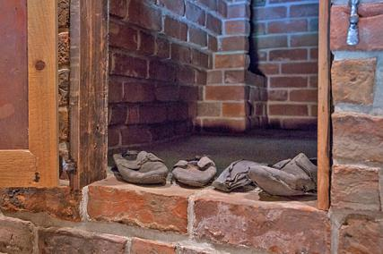
Apotropaic symbols
Distribution

Slide 44
Apotropaic symbols
Distribution
Gluggagægir
“Window-Peeper”

Slide 45
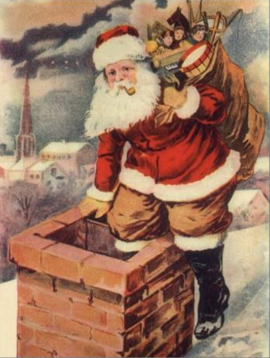
Apotropaic symbols
Distribution
Gluggagægir
“Window-Peeper”

Slide 46
Apotropaic symbols
Distribution
Hort an new schrecklich abenthewr Von den vnholden vngehewr
(Listen to new terrifying adventures of the sinful monsters)
Anonymous
etching, circa 1600 Trustees of the British Museum
1880,0710.1582

Slide 47
King’s Tower
Apotropaic marks

Slide 48
King’s Tower
Apotropaic marks

Slide 49
King’s Tower
Apotropaic marks

Slide 50
King’s Tower
Apotropaic marks

Slide 51
King’s Tower
Apotropaic marks

Slide 52
King’s Tower
Apotropaic marks

Slide 53
King’s Tower
Apotropaic marks

Slide 54
King’s Tower
Apotropaic marks

Slide 55
King’s Tower
Apotropaic marks

Slide 56
King’s Tower
Apotropaic marks

Slide 57
King’s Tower
Apotropaic marks

Slide 58
King’s Tower
Apotropaic marks

Slide 59
Images courtesy of the National Trust
King’s Tower
Apotropaic marks

Slide 60
King’s Tower
Apotropaic marks

Slide 61
King’s Tower
Apotropaic marks
“Blisse this hous fro euery euyl wyght, ffor the nyghtesmare”
The Miller’s Tale
Geoffrey Chaucer, late 14th century
Hypnagogia wake to sleep
Hypnopompic sleep to wake
Also known as Sleep Paralysis

Slide 62
King’s Tower
Apotropaic marks

Slide 63
King’s Tower
Matthew Banks - Carpenter
Carpenters
By Hendrick Corneliszoon van Vliet, c 1635
Art Institute of Chicago

Slide 64
King’s Tower
Matthew Banks - Carpenter
Carpenters
By Hendrick Corneliszoon van Vliet, c 1635
Art Institute of Chicago

Slide 65
King’s Tower
Matthew Banks - Carpenter
Carpenters
By Hendrick Corneliszoon van Vliet, c 1635
Art Institute of Chicago

Slide 66
King’s Tower
Matthew Banks - Carpenter
Carpenters
By Hendrick Corneliszoon van Vliet, c 1635
Art Institute of Chicago

Slide 67
Apotropaic Knole

Slide 68
Apotropaic Knole

Slide 69
King’s Tower
Dendrochronology
Image courtesy of the National Trust
Bridge, M. (2010) The tree-ring dating of timbers from Knole, Sevenoaks, Kent
Tyers, I. (2014) Tree-ring analysis of timbers from a building: Knole, Sevenoaks, Kent

Slide 70
The Powder Treason
5th November 1605
The Gunpowder Plot Conspirators, 1605
by Unknown artist collotype, (circa 1605) National Portrait Gallery D2334

Slide 71
The Powder Treason
5th November 1605
Mischefes Mysterie
John Vicars, 1617

Slide 72
The Powder Treason
Interrogation and Trials November-January 1605-6

Slide 73
The Powder Treason
Executions 30th and 31st January 1606
The Execution of the Conspirators
in the Gunpowder Plot' (Guy Fawkes)
by Claes Jansz Visscher etching, 1606 National Portrait Gallery D20306

Slide 74
The Powder Treason
A Treatise of Equivocation c 1598
Father Henry Garnet

Slide 75
The Powder Treason
Execution of Father Henry Garnet, 3rd May 1606
Societas Jesu usque ad sanguinis et vitae profusionem
Mathias Tanner, 1675

Slide 76
The Powder Treason
Official reaction
James I’s own personal interpretation of events given to Parliament
Public sermons by leading churchmen
Censorship of literature and plays
Tracts denouncing Catholicism
An Oath of Allegiance, June 1606
Official anniversary sermons
Original source unknown
Reprinted in What was the Gunpowder Plot?
John Gerard, 1897

Slide 77
The Powder Treason
Official reaction
“It may well be called a roaring, nay a thundering sin of fire and brimstone from the which God hath miraculously delivered us all.”
James I to Parliament,
9th November 1605
The powder treason ... founded in hell, confounded in heaven
Printed by Michael Droeshout line engraving, published 1620-25 British Museum 1852,1009.248

Slide 78
The Powder Treason
Official reaction
"abominable practice of Rome and Satan”
Robert Cecil, Earl of Salisbury,
November 1605
Invented by Samuel Ward, Preacher, of Ipswich.
Imprinted at Amsterdam, 1621
Reprinted 1689

Slide 79
The Powder Treason
Official reaction
“Tell me now if this were not His doing, and if it should not have beene a day of His making, the Devils owne making… All these were undone, and blowen over, all the undermining dissappointed; all this murder, and crueltie, and desolation defeated. The mine is discovered, the snare is broken and we are delivered… The blow was the Devils. The ward was Gods.”
Lancelot Andrewes, Bishop of
Chichester at Whitehall,
5th November 1606
Portrait of Lancelot Andrewes, Bishop of Winchester, half-length, slightly to right, in ecclesiastical garb, in an oval; decorated framework surmounted by arms.
Print made by Simon van der Passe
1618
Engraving
Collection: Trustees of the British Museum

Slide 80
The Powder Treason
'that monstrous birth of the Roman harlot... the quintessence of Satan's policy, the furthest reach and stain of human malice and cruelty‘
Popish Pietie by Francis Herring

Slide 81
The Powder Treason
“The city is in great uncertainty; Catholics fear heretics, and vice-versa; both are armed; foreigners live in terror of their houses being sacked by the mob that is convinced that some, if not all, foreign Princes are at the bottom of the plot.”
Nicolo Molino, Venetian Ambassador,
21 November 1605
Nicolò Molino, Venetian Ambassador
by Daniel Mytens
1622
Oil on canvas
Collection: National Trust

Slide 82
Powder Plays
1606-7
Sophonisba
John Marston
1606
Children of the Revels
The Devils Charter
Barnabe Barnes
1607
King’s Men
The Whore of Babylon
Thomas Dekker
1606
Prince Henry’s Men
Macbeth
William Shakespeare
1606
King’s Men

Slide 83
Powder Plays
Themes
Apocalyptic destruction of a kingdom
Undermining
Plots
Equivocation
Aislín McGuckin & Jonathan Slinger
Macbeth
Directed by Michael Boyd
Photographs: Ellie Kurttz
Royal Shakespeare Company 2011

Slide 84
Powder Plays
The Weird Sisters
Macbeth and Banquo encountering the witches
Raphael Holinshead’s Chronicles, 1577
Macbeth Act I Scene I
Connecticut Repertory Theatre, 2006-7

Slide 85
Powder Plays
Macbeth Act II, Scene III
Knock, knock! Who's there, in the other devil's name? Faith, here's an equivocator, that could swear in both the scales against either scale; who committed treason enough for God's sake, yet could not equivocate to heaven: O, come in, equivocator.
Jamie Beamish
Macbeth
Directed by Michael Boyd
Photograph: Ellie Kurttz
Royal Shakespeare Company 2011

Slide 86
Powder Plays
Macbeth Act II, Scene III
Jamie Beamish
Macbeth
Directed by Michael Boyd
Photograph: Ellie Kurttz
Royal Shakespeare Company 2011

Slide 87
King’s Tower
Matthew Banks - Carpenter
Carpenters
By Hendrick Corneliszoon van Vliet, c 1635
Art Institute of Chicago

Slide 88
Professor James Shapiro
Columbia University
1606 – William Shakespeare and the Year of Lear
Images courtesy of Faber & Faber Ltd

Slide 89
Conclusions

Slide 90
Conclusions

Slide 91
Images courtesy of the National Trust
Conclusions

Slide 92
Conclusions
Images courtesy of the National Trust

Slide 93
Conclusions
Image courtesy of the National Portrait Gallery
Image courtesy of the National Trust

Slide 94
Conclusions
Image courtesy of the National Portrait Gallery

Slide 95
Conclusions

Slide 96
Conclusions

Slide 97
Conclusions
Image courtesy of the RSC

Slide 98
Image courtesy of the Art Institute of Chicago
Conclusions

Slide 107
Notes:
End Slide. Please add this slide at the end of all presentations.

