Slide 1



Shaping Modern Mathematics:
Are Averages Typical?
Raymond Flood
Gresham Professor of Geometry
This lecture will soon be available on the Gresham College website,
where it will join our online archive of almost 1,500 lectures.
www.gresham.ac.uk

Slide 2
A knowledge of statistical methods is not only essential for those who present statistical arguments, it is also needed by those on the receiving end.
Allen, R.G.D. Statistics for Economists Chapter 1 p.9

Slide 3
Overview
Showing data visually
Describing a population
  Measures of location
  Measures of variation
Quantifying uncertainty – Probability
Variation of sample averages
Sample sizes and Opinion Polls

Slide 4
Describing a population – Graphical methods
Edmond Halley and his life charts
Edmond Halley and magnetic variation
Florence Nightinglale and the Crimea
John Snow and Cholera
Karl Pearson and Histograms

Slide 5
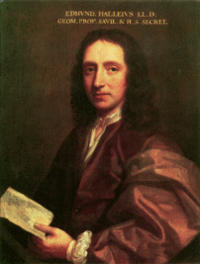
Edmond Halley 1656 - 1742

Slide 6
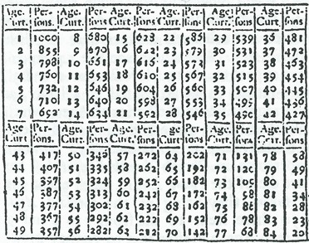
Edmond Halley’s Life Table, 1693

Slide 7
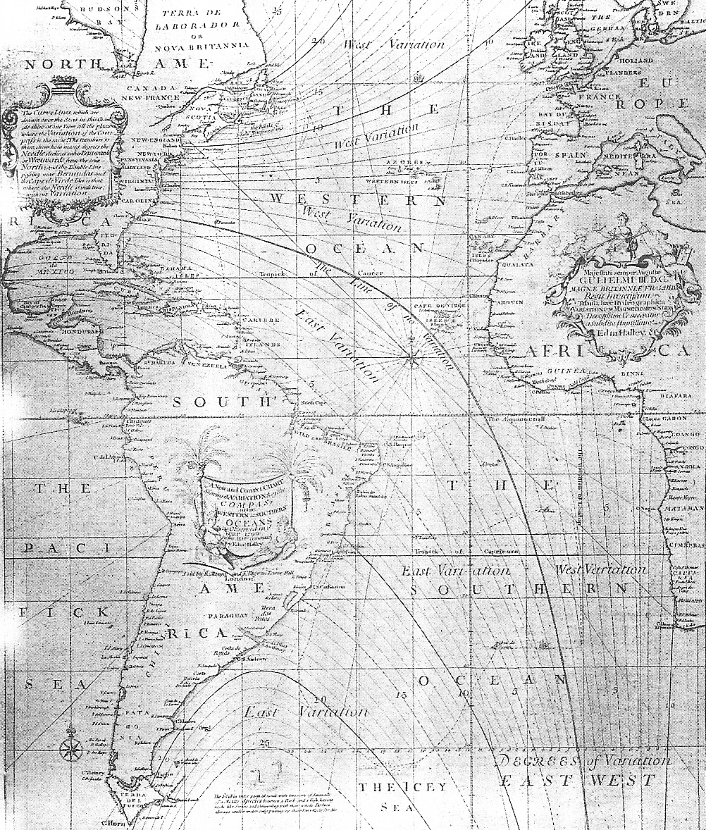
Halley’s chart of magnetic variation over the Atlantic introduced the important technique of using lines to join points of the same value.

Slide 8
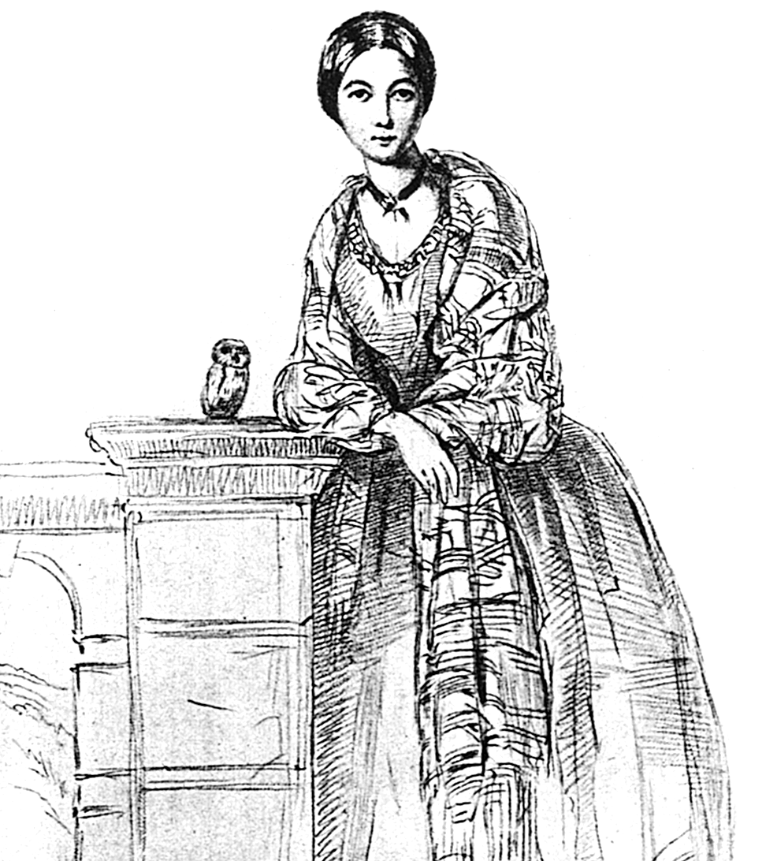
Florence Nightingale 1820 - 1910

Slide 9
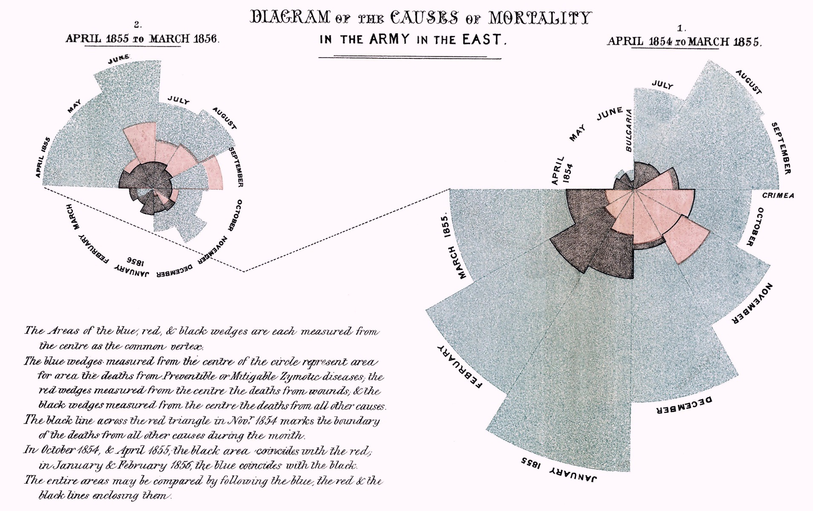

Slide 10
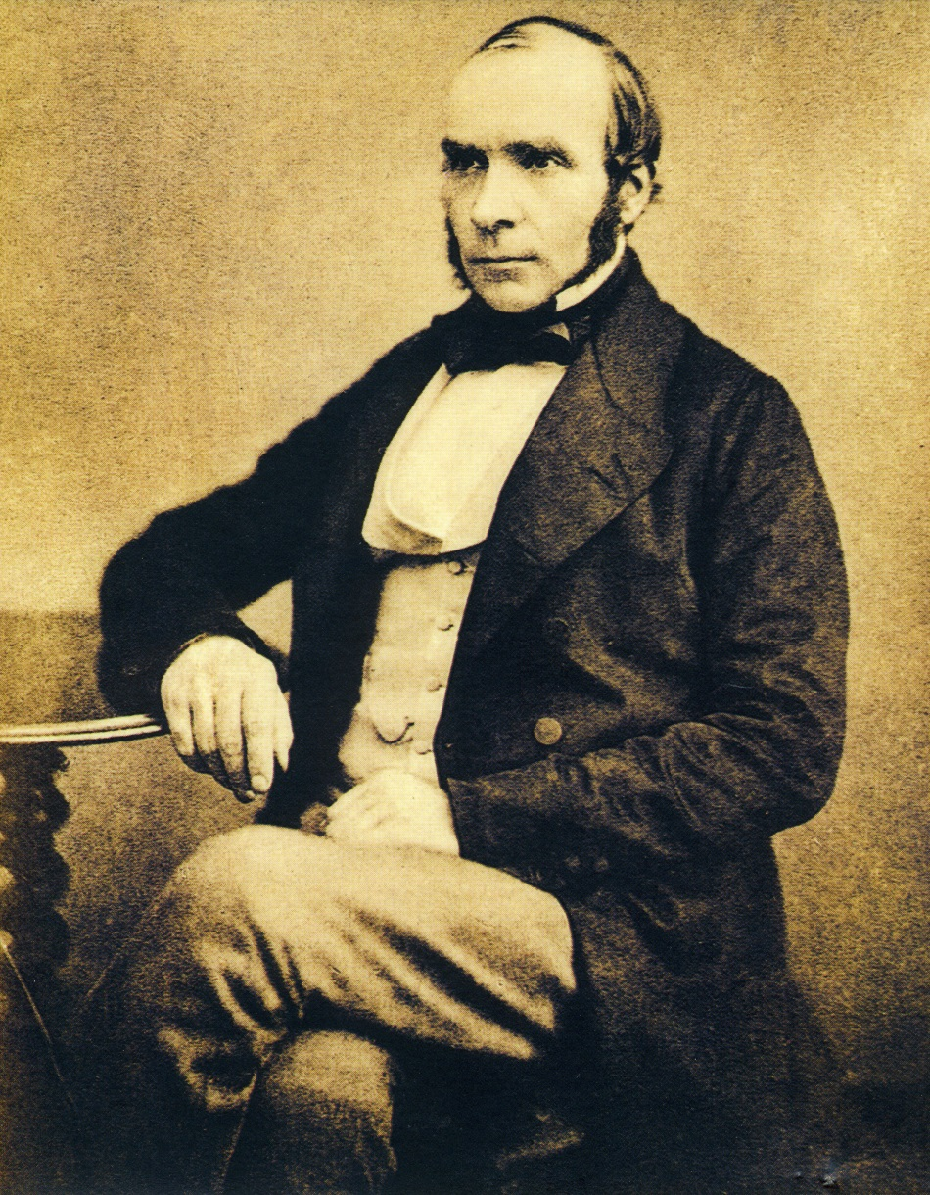
John Snow 1813 – 1858
Father of contemporary epidemiology

Slide 11
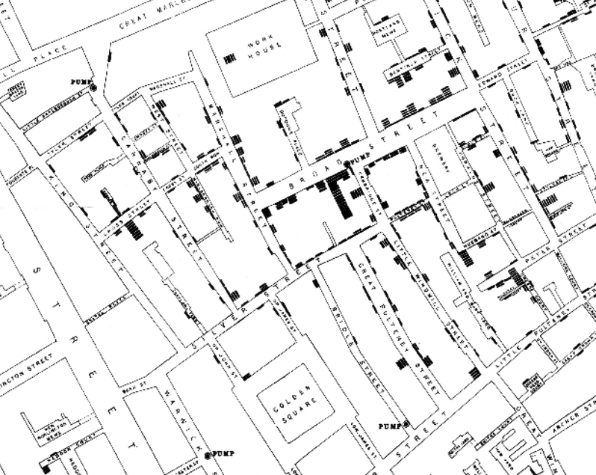
John Snow’s cholera map

Slide 12
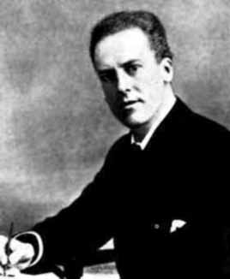
Karl Pearson 1857 - 1936

Slide 13
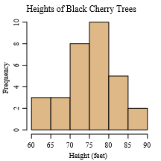
Histograms
Heights of 31 cherry trees
65 63 72 81
83 66 75 80 75 79 76 76 69 75 74 85 86 71 64 78 80 74 72 77
82 80 80 80
87

Slide 14
Age profile attending lectures at Gresham College – Bar Chart

Slide 15
Describing a population – Numerical methods
Measures of location
Mean
Median
Minimum
Maximum
Measures of variation
Range
Percentiles
Variance
Standard deviation

Slide 16
Measures of Location
Mean or average
Mean or Average of n numbers is their sum over n
For 9, 21 and 30 sum is 9 + 21 + 30 = 60 and dividing by 3 gives the average as 20.
For £15K, £20K, £25K, £30K, £35K, £40K and £155K
Sum is £315K giving average of £315K / 7 = £45K

Slide 17
Measures of Location
Median
The Median is that observation with the property that half the remaining observations are smaller than it and half bigger than it.
For the salaries example :
£15K, £20K, £25K, £30K, £35K, £40K and £155K
The median is £30K
Pay rise:
£15K, £20K, £25K, £30K, £135K, £140K and £155K
The median is still £30K

Slide 18
Alan Stewart on Averages
The Times, Monday, January 4, 1954, p7
Sir, In your issue of December 31 you quoted Mr. B.S. Morris as saying that many people are disturbed that about half the children are below the average in reading ability. This is only one of many similarly disturbing facts. About half the church steeples in the country are below average height; about half our coal scuttles below average capacity, and about half our babies below average weight. The only remedy would seem to be to repeal the law of averages.

Slide 19
Measures of variation
Range
Range = maximum value – minimum value
£15K, £20K, £25K, £30K, £35K, £40K, £155K
The range is £140K.
The average is £45K

Slide 20
Measures of variation
Percentiles
The pth percentile in a data set or population is that observation where p% of the population is smaller than or equal to it.
Example: If ‘41’ is the 80th percentile in a set of observations then 80% of the numbers are smaller than or equal to 41.
The median is the 50th percentile
The name given to the 25th percentile it is the first quartile.
The name given to the 75th percentile it is the third quartile.

Slide 21
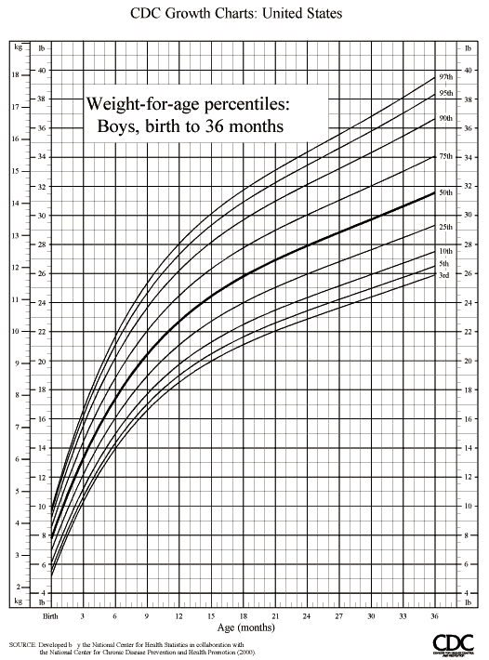
Weight against age Percentile chart

Slide 22
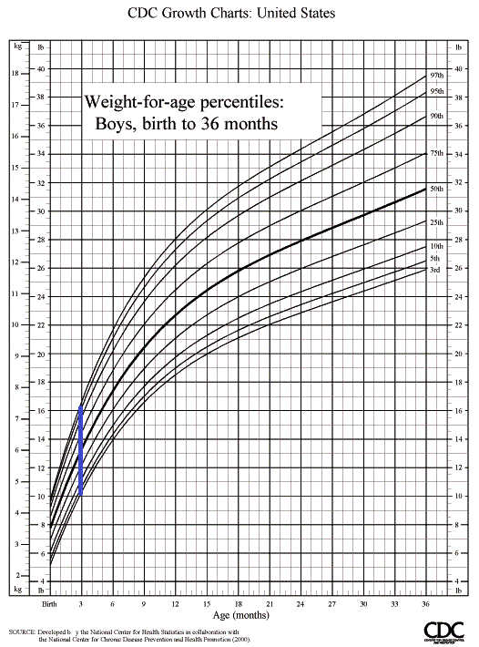
Age 3 months

Slide 23
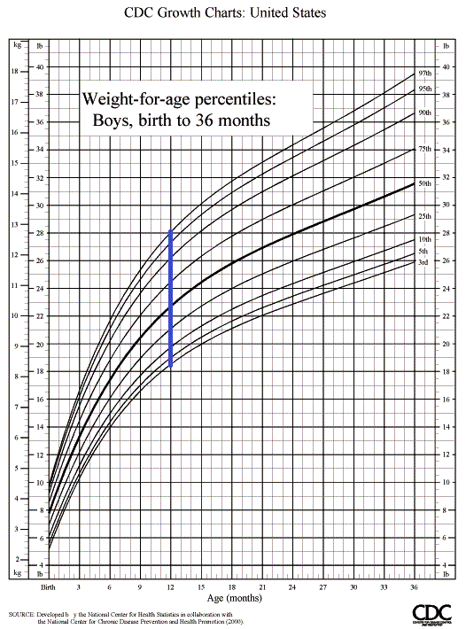
Age 12 months

Slide 24
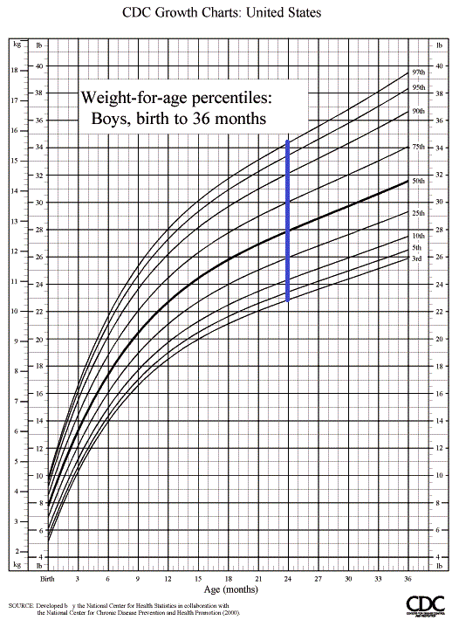
Age 24 months

Slide 25
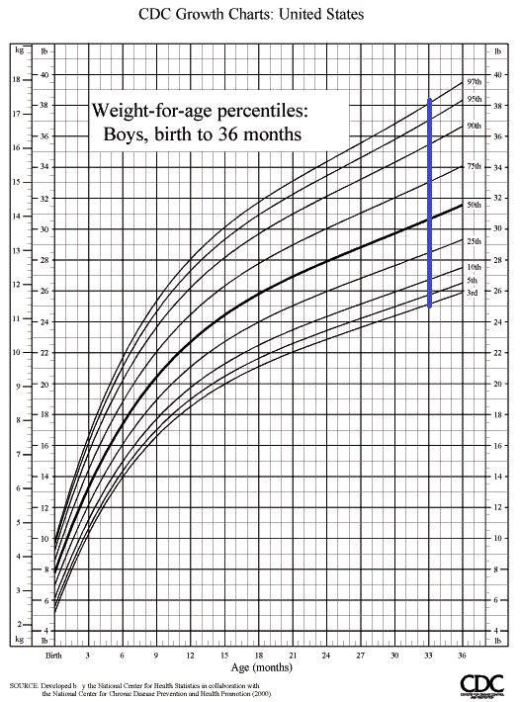
Age 33 months

Slide 26
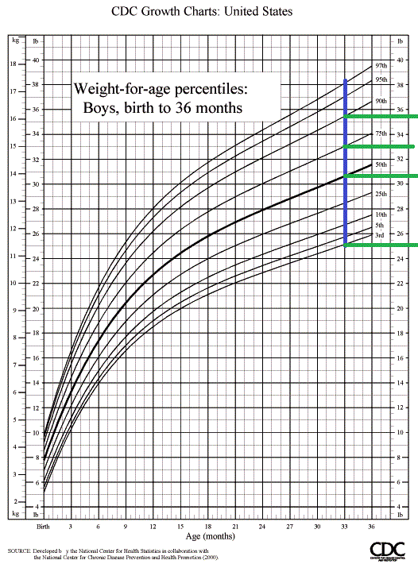
Age 33 months percentiles

Slide 27
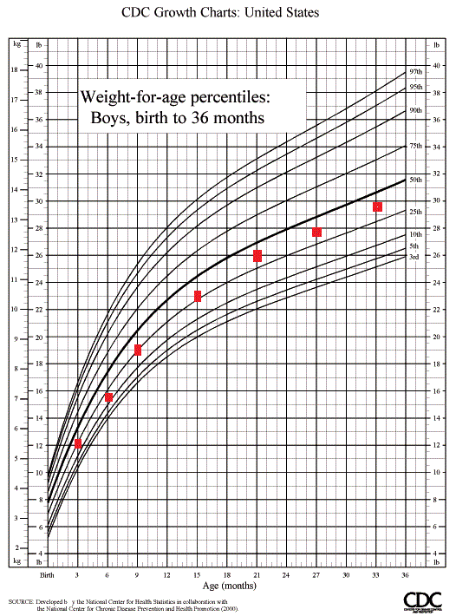
Imaginary child’s history

Slide 28
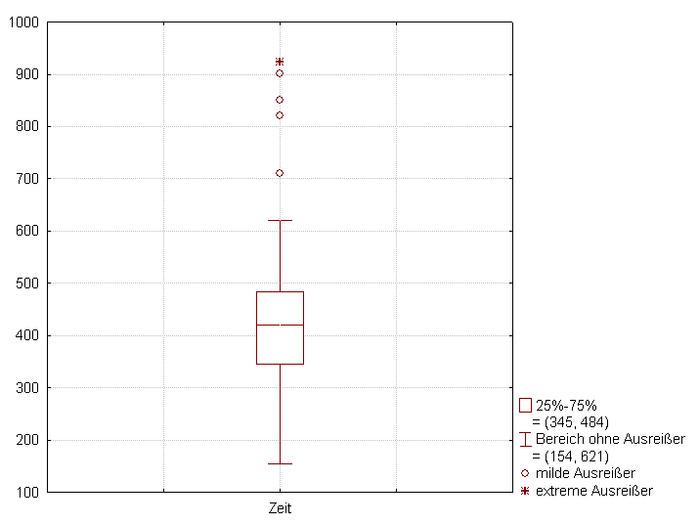
Boxplot

Slide 29
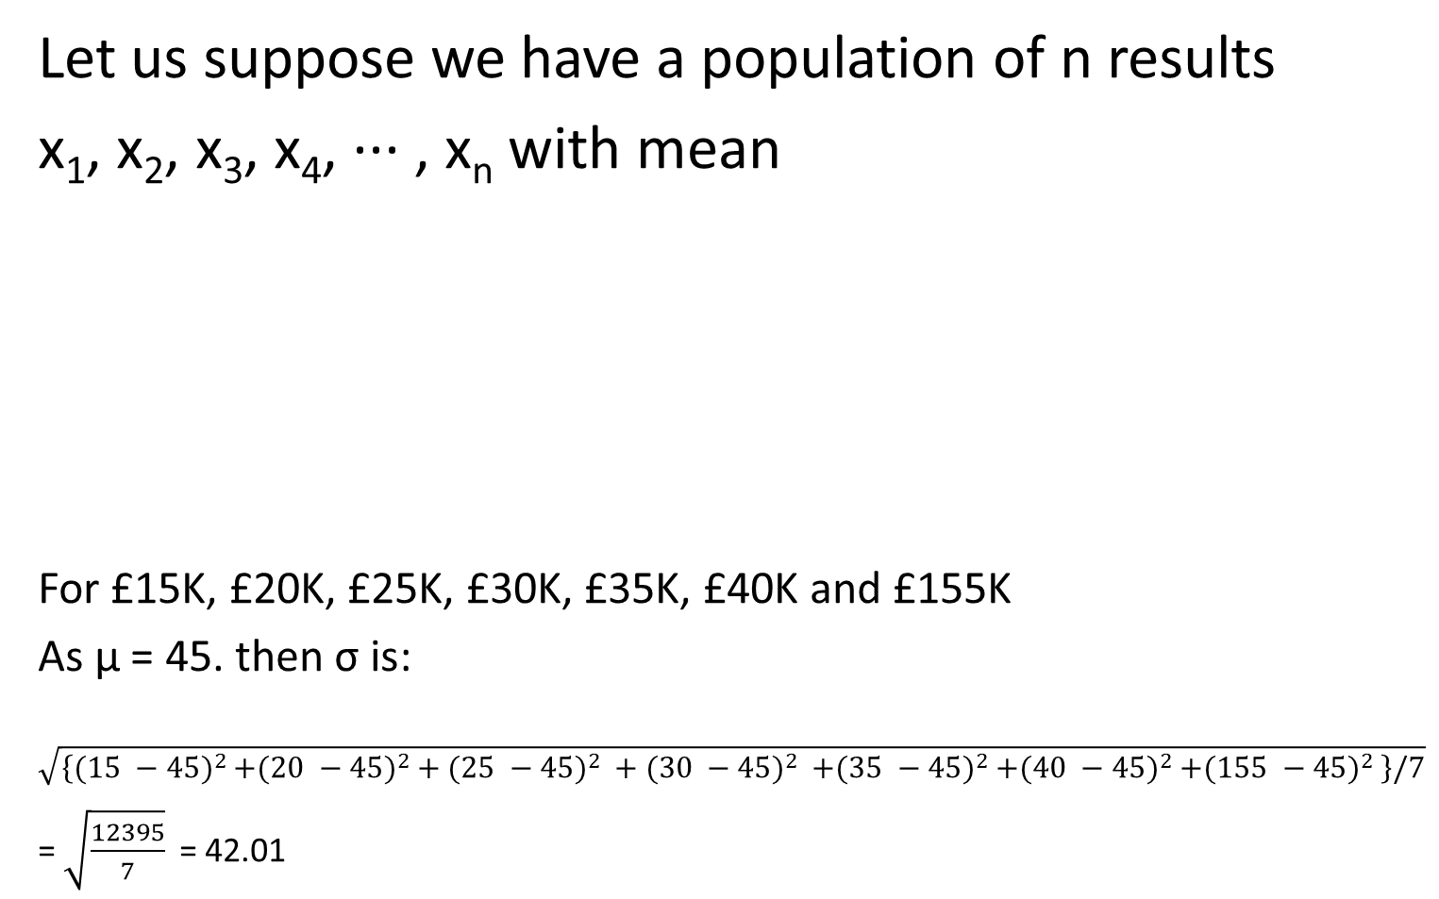
Standard deviation, σ

Slide 30
Quantifying Uncertainty
What is probability?
Examples: coins, lottery, measurements, annuities
Normal curve.

Slide 31
What is Probability theory?
Probability theory is used as a model for situations in which the results occur randomly.
We call such situations experiments.
The set of all possible outcomes is the sample space corresponding to the experiment, which we denote by Ω.

Slide 32
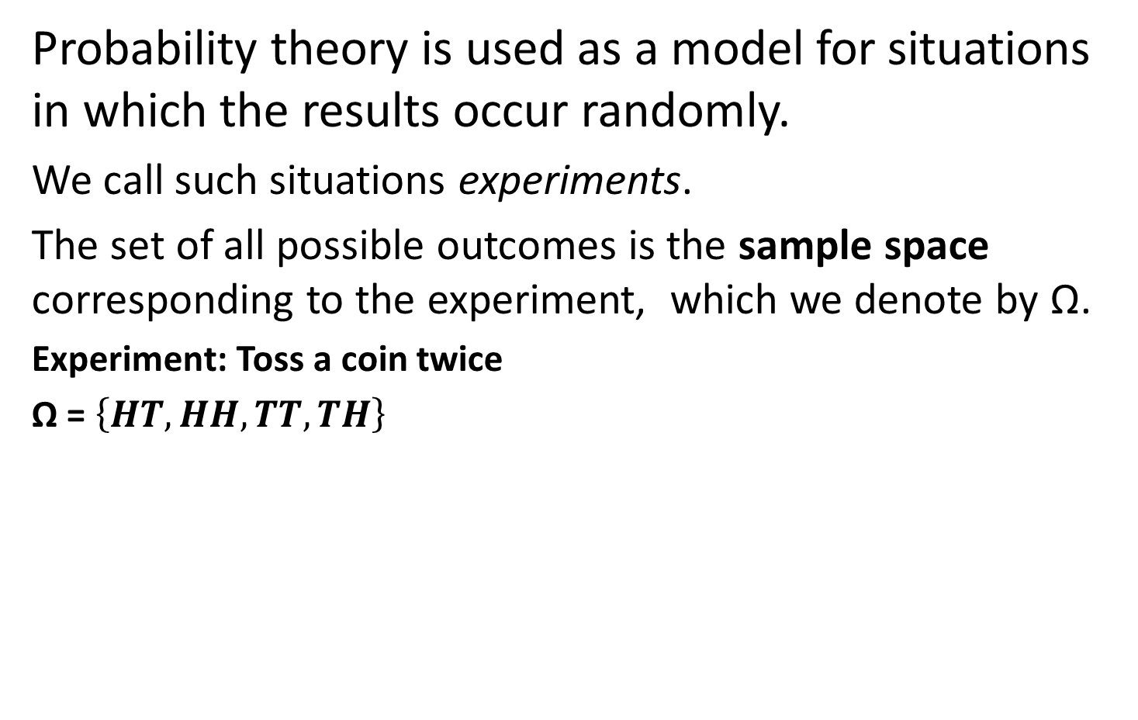
What is Probability theory?

Slide 33
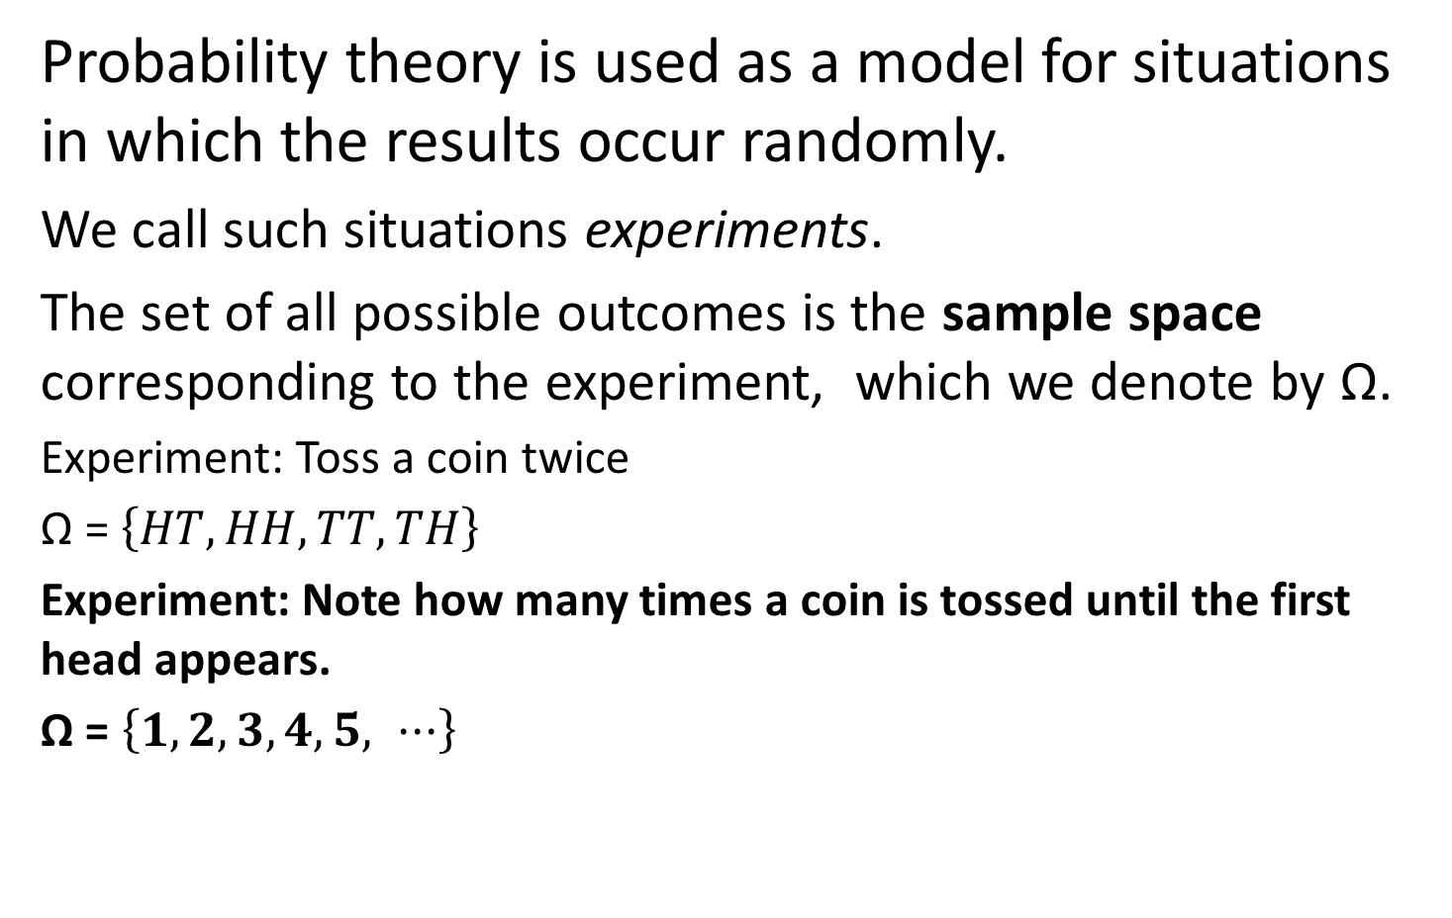
What is Probability theory?

Slide 34
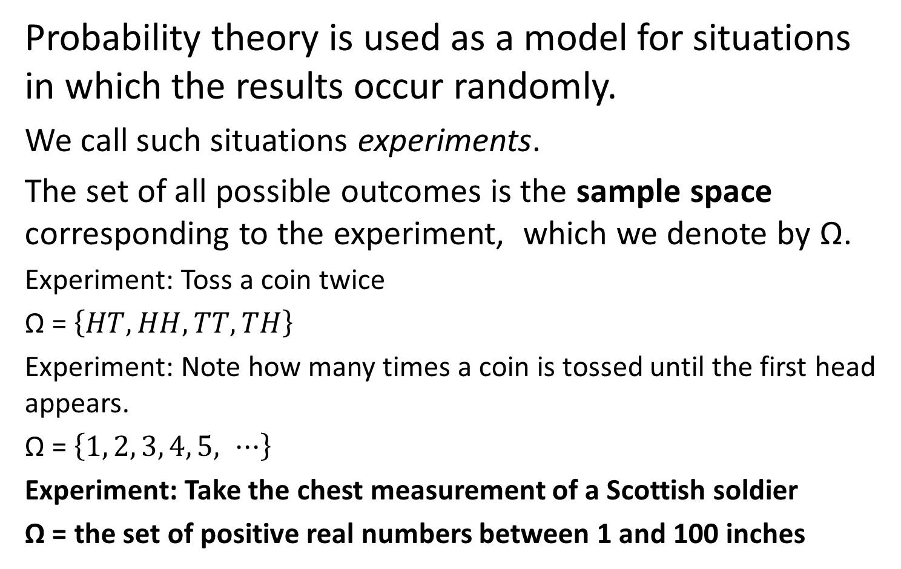
What is Probability theory?

Slide 35
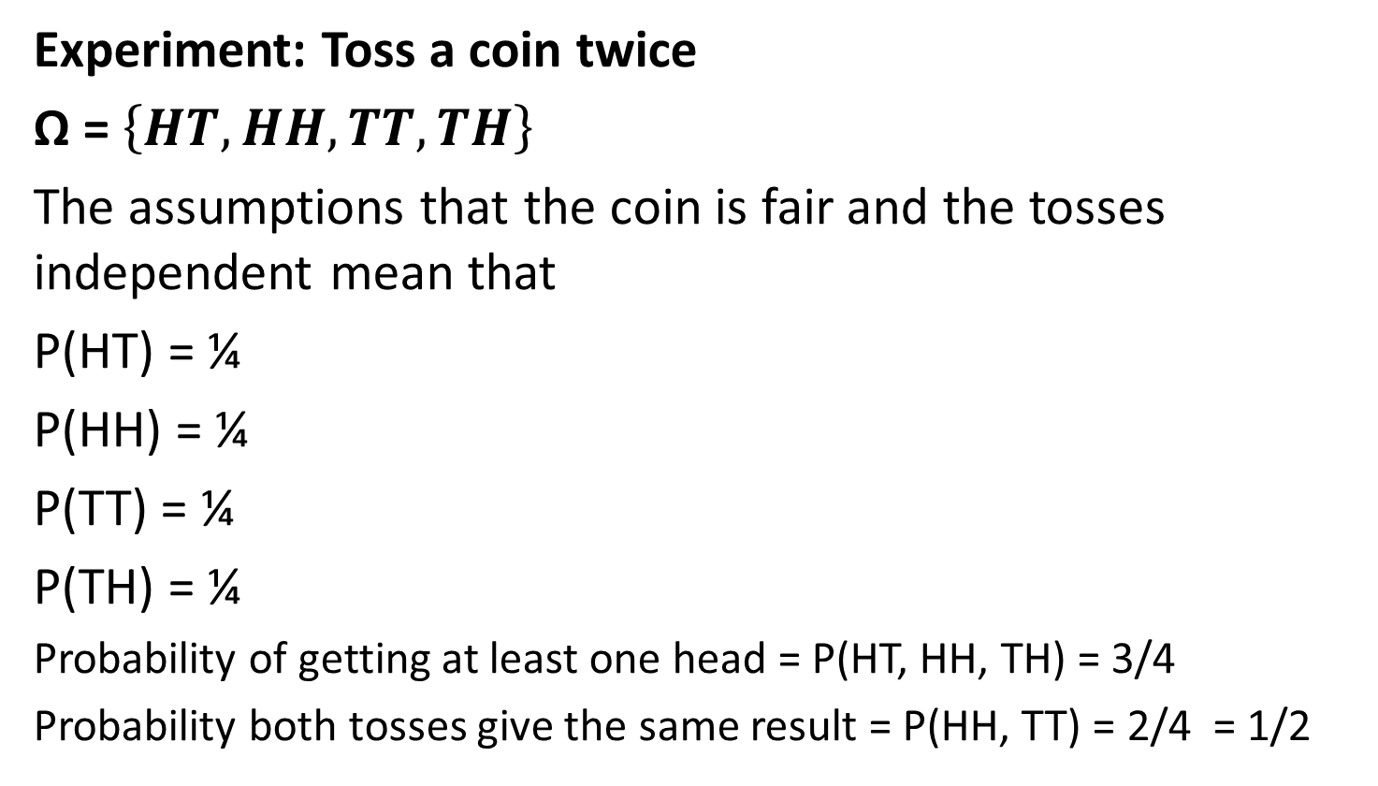
What is a Probability Measure?

Slide 36
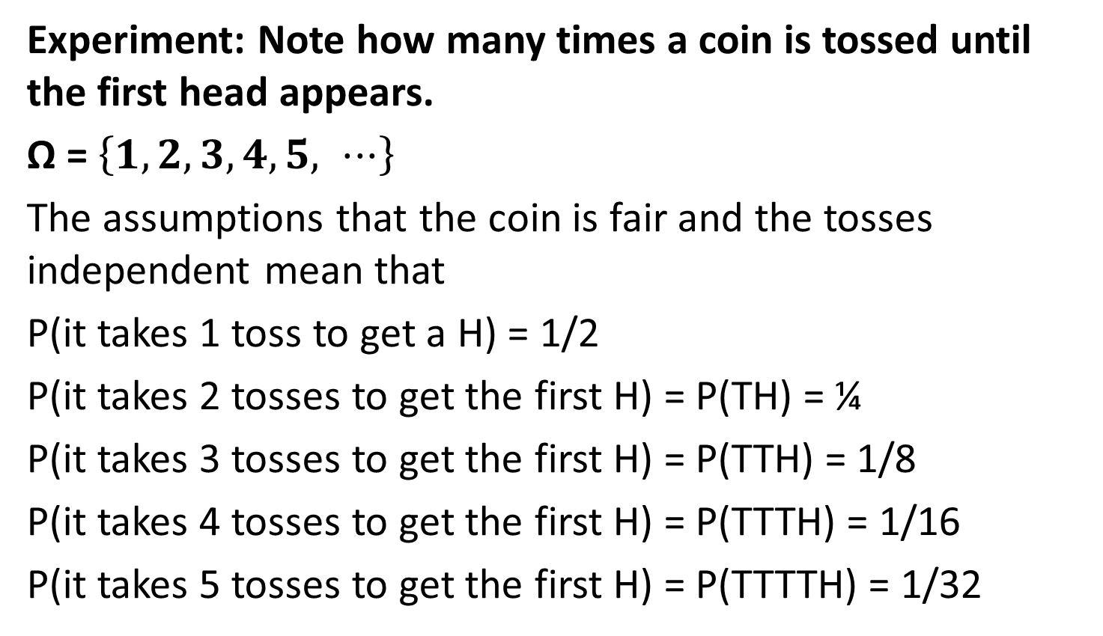
What is a Probability Measure?

Slide 37
Probability of winning the Lottery
49 numbers
49 x 48 x 47 x 46 x 45 x 44
different ways for the six balls to appear in order
One set of numbers might be: 19 17 31 11 41 2
This result is the same as: 17 31 19 41 2 11
which is simply a different arrangement
Number of different arrangements of six numbers is
6 x 5 x 4 x 3 x 2 x 1
Number of different selections of six numbers is
(49 x 48 x 47 x 46 x 45 x 44) / (6 x 5 x 4 x 3 x 2 x 1)
=13,983,816.

Slide 38
UK National Lottery
Numbers Matched | Odds Of Winning
6 main numbers | 1 in 13,983,816
5 main numbers + Bonus Ball | 1 in 2,330,636
5 main numbers | 1 in 55,492
4 main numbers | 1 in 1,033
3 main numbers | 1 in 57

Slide 39
Deming, William Edwards Out of Crisis, p.394
As to the influence and genius of great generals – there is a story that Enrico Fermi once asked General Leslie Groveshow how many generals might be called “great”. Groves said about three out of every 100. Fermi asked how a general qualified for the adjective, and Groves replied that any general who had won five major battles in a row might safely be called great.

Slide 40
Deming, William Edwards Out of Crisis, p.394
This was in the middle of World War II. Well then, said Fermi, considering that the opposing forces in most theatres of operation are roughly equal the odds are one of two that a general will win a battle, one of four that he will win two battles in a row, one in eight for three, one of sixteen for four and one of thirty two for five.
“So you are right, General, about three out of every 100.
Mathematical probability, not genius.”

Slide 41
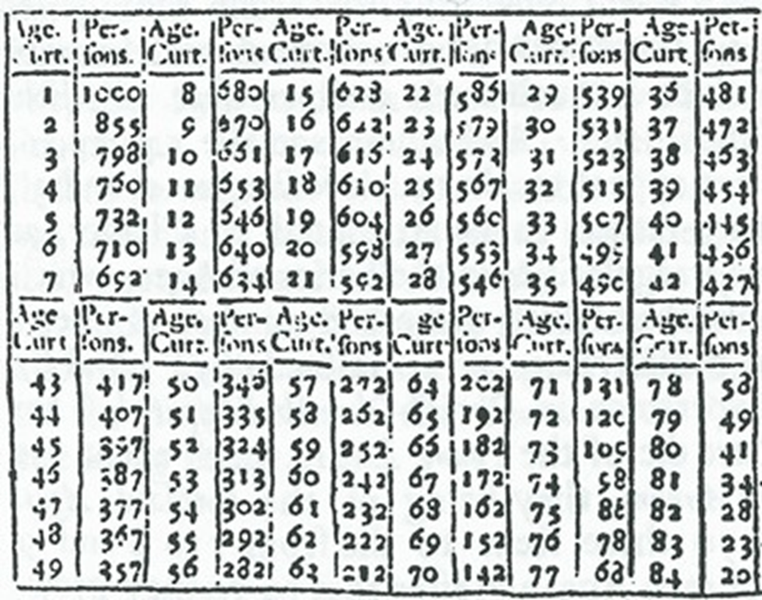
Pricing an Annuity
Probability from data
Price of Annuity bought at age 50 to deliver £1 on each subsequent birthday.
Probability of living to 51 is 335/346
Probability of living to 52 is 324/346
Probability of living to 53 is 313/346
Probability of living to 54 is 302/346
….
Probability of living to 84 is 20/346
The expected price of the annuity at age 50 is
335/346 + 324/346 + 313/346 + 302/346 + … + 20/346
= £16.45
Age 1 it is £33
Age 6 it is £41

Slide 42
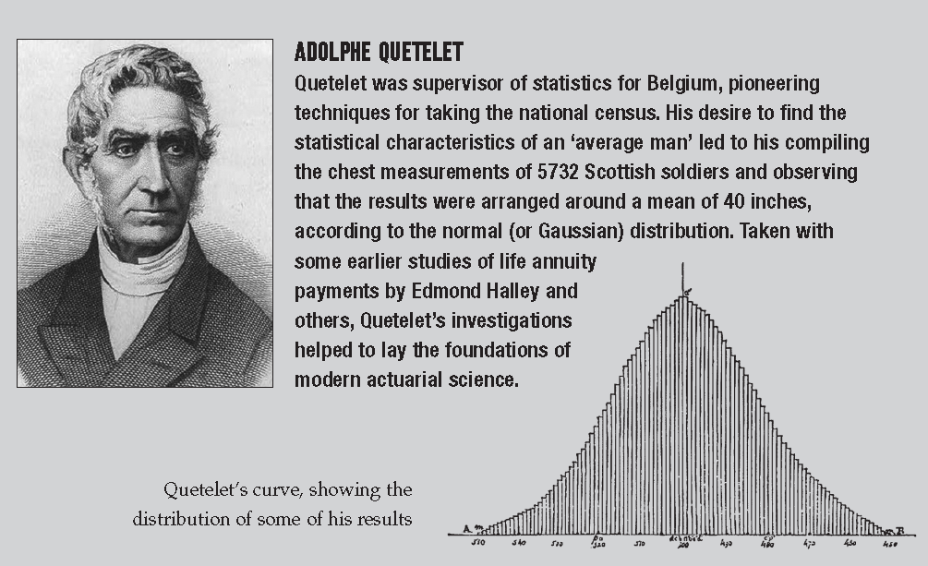
Adolphe Quetelet

Slide 43

Normal Distribution

Slide 44

Normal Distribution

Slide 45
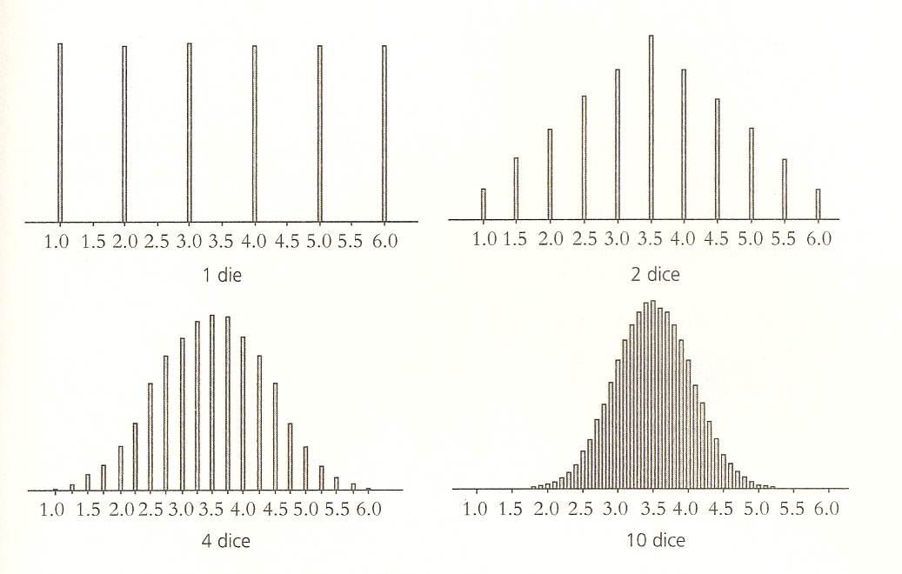
Central Limit Theorem - 1

Slide 46
Central Limit Theorem - 2

Slide 47
Central Limit Theorem - 4

Slide 48
Central Limit Theorem – 10

Slide 49
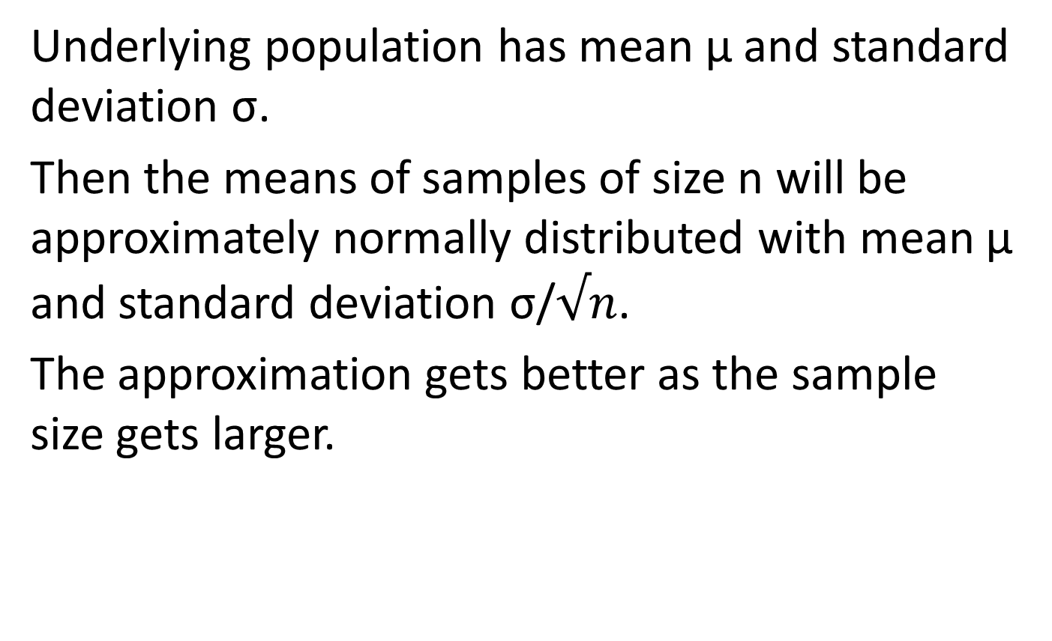
Central Limit Theorem

Slide 50
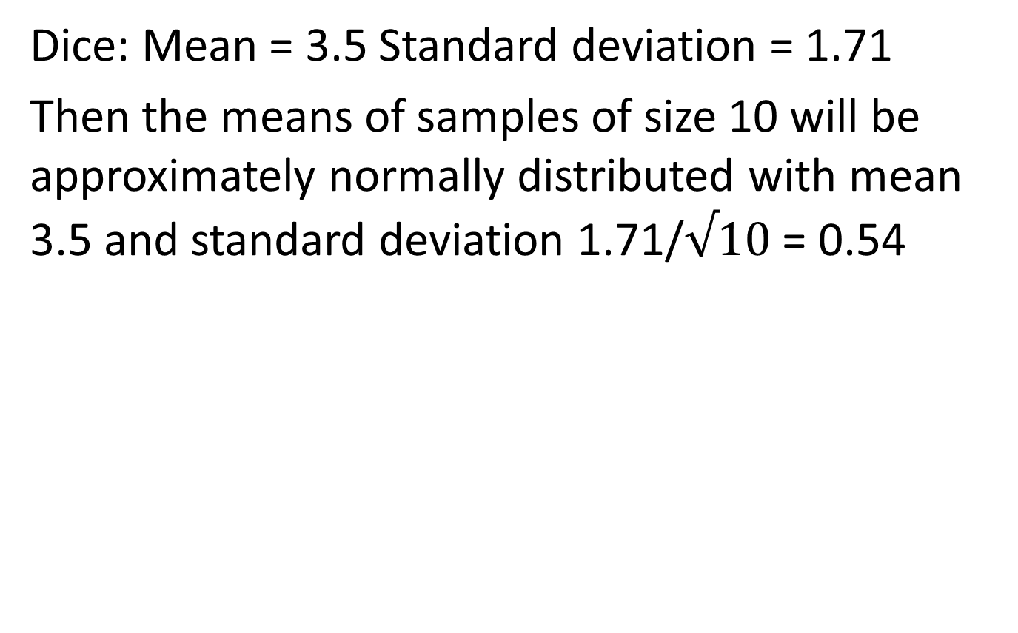
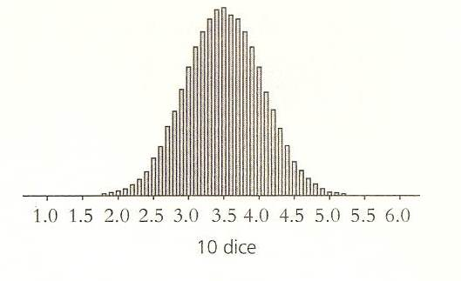
Central Limit Theorem for dice
For the Normal distribution 99.6% lie within 3 standard deviations of the mean, that is between
3.5 – 3 x 0.54 and 3.5 + 3 x 0.54
Which is 1.88 to 5.12

Slide 51
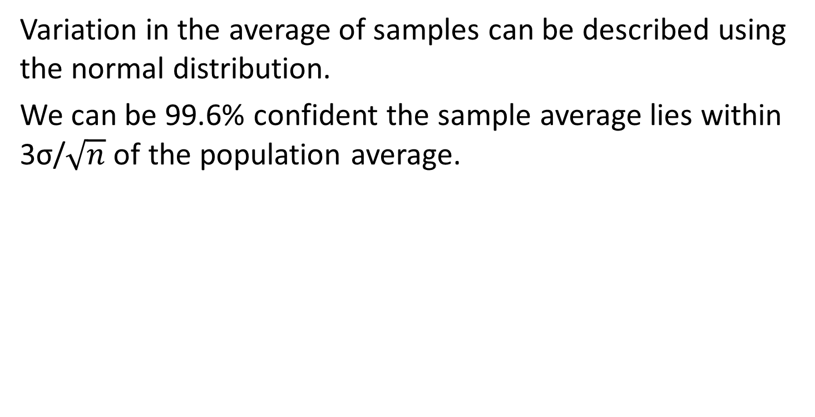
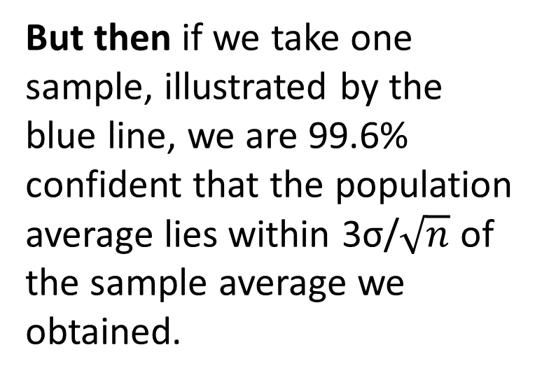
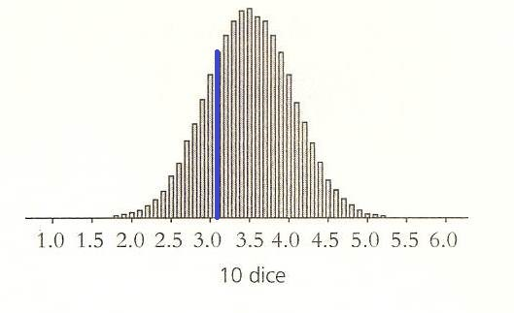
Are Sample Averages Typical?

Slide 52
Example of Opinion polls
Can we apply this to estimating the proportion, p, of people voting for Party A.
With a sample size of about 1050 we can be 95% confident that the answer our poll gives will be within 3% of the underlying proportion p.
With a sample size of 2500 we can be 99.6% confident that the answer our poll gives will be within 3% of the underlying proportion p

Slide 53
Quote from the Introduction to Stephen Stigler’s History of Statistics.
Over the two centuries from 1700 to 1900, statistics underwent what might be described as simultaneous horizontal and vertical development: horizontal in that the methods spread among disciplines from astronomy and geodesy to psychology, to biology, and to the social sciences and was transformed in the process; vertical in that the understanding of the role of probability advanced as the analogy of games of chance gave way to probability models for measurement…

Slide 54
Lectures
At the Museum of London
Ghosts of Departed Quantities: Calculus and its Limits
Tuesday 25 September 2012
Polynomials and their Roots
Tuesday 6 November 2012
From One to Many Geometries
Tuesday 11 December 2012
The Queen of Mathematics
Tuesday 22 January 2013
Are Averages Typical?
Tuesday 19 February 2013
Modelling the World
Tuesday 19 March 2013

Slide 56
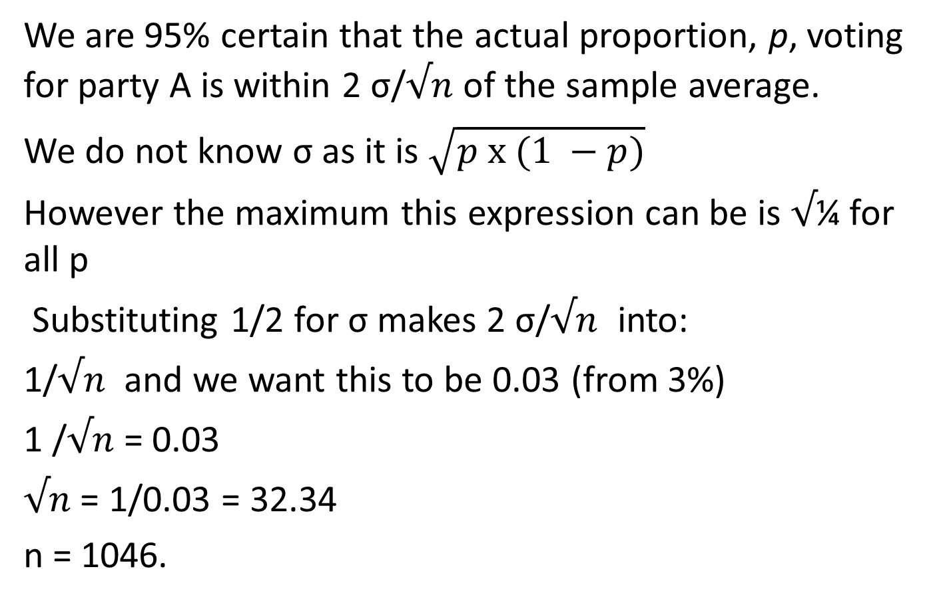
With a sample size of about 1050 we can be 95% confident that the answer our poll gives will be within 3% of the underlying proportion p

Slide 57
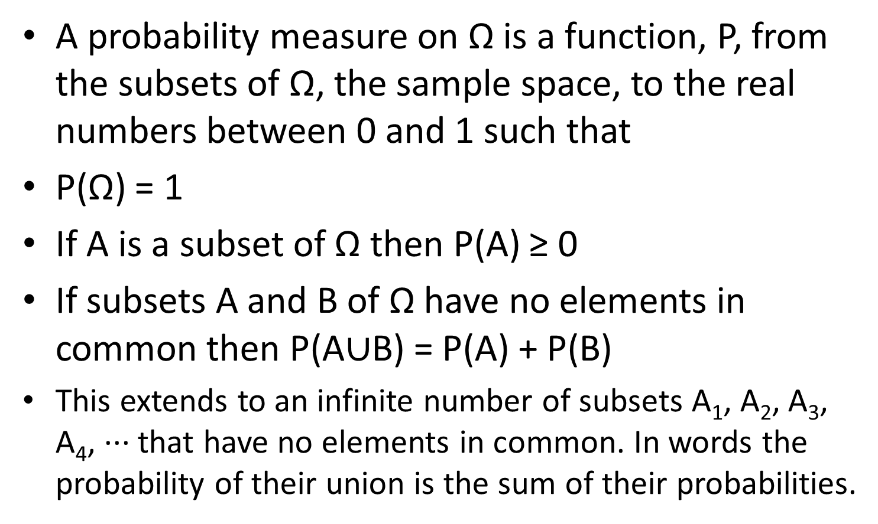
What is a Probability Measure?

