Slide 1
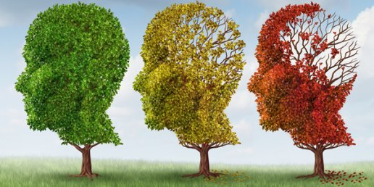
Dementia: in danger of being forgotten?
Christopher Whitty
Gresham College 2016

Slide 2
Dementia: much feared, recently sympathetically portrayed.

Slide 3
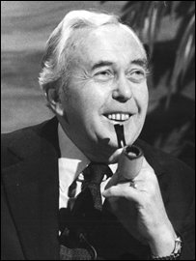
Can happen to people with remarkable memory and mental capacity.

Slide 4
In this lecture we will consider:
The epidemiology of dementia
Some of the dementias where we are winning
How different dementias affect the brain
The major dementias of old age
Living with dementia
Looking to the future

Slide 5
Ten leading causes of death in females, 2003-2013, England & Wales (ONS)

Slide 6
Around 820,000 UK people affected 2016. Current projections. (Prince et al 2015)

Slide 7
Current estimates risk by age. UK data. (Prince et al 2014)
65-69: 1.7% (Female 1.8%)
70-74: 3%
75-79: 6%
80-84: 11%
85-89: 18% (Female 20%, or 1:5)
90-94: 30%
95%+: 41% (Female 44% Male 29%)
Overall 54% mild dementia, 13% severe.

Slide 8
But dementia may be decreasing, or more accurately being delayed: 1990-2011 20% reduction in one UK study.

Slide 9
Difference between men and women with late onset dementia: UK. (MRC CFAS2)

Slide 10
20% reduction over 20 years but not equal between men and women. (Matthews et al Nature Com 2016)
Male
Female

Slide 11
In Sir Thomas Gresham’s time a new cause of dementia was sweeping Europe.
Syphilis arrived in UK around 1497.
Rapidly became very common. Royal Commission 1916 estimated ‘no less than’ 10% of people in London had it.
‘General paralysis of the insane’ a late (10+ years) manifestation- around 7%.
Now virtually unknown thanks to antibiotics.

Slide 12
Within the lifetimes of most of this audience a new viral cause of dementia took off.
HIV-associated neurocognitive disorder.
Before antiretroviral drugs 20-30% of people with advanced HIV developed dementia.
This figure has now decreased to around 2% where treatment is available.

Slide 13
In Africa a major parasitic cause of dementia is down, but not yet out.
Sleeping sickness (human African trypanosomiasis).
Was a major cause of infectious dementia in Africa.
Now down to less than 10,000 reported cases.
May be eliminated in our lifetimes.

Slide 14
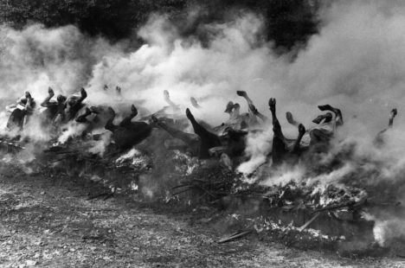
The UK was where the last major new infectious cause of dementia arose.
BSE and vCJD.
Number of cases small, although all tragic.
Demonstrated prions could jump species barrier.
Removing neurological tissue from food chain and culling infected cattle halted epidemic.

Slide 15
Not just infections.
Chemicals used in industry especially heavy metals:
Mercury (Hatters shakes).

Slide 16
Nutritional deficiencies: B vitamins.
Pellagra: Niacin deficiency (Vitamin B3).
Diet largely consisting of maize (corn).
1906-1940 >3 million Americans affected by pellagra, more than 100,000 deaths.
Thiamine (Vitamin B1) in alcohol dependency.
Current controversy about the importance of Vitamin B12 and folate.

Slide 17
Some rare causes of early dementia with strong genetic linkage.
Downs Syndrome.
Huntington's disease.
Familial early onset Alzheimer's (<1000 known families worldwide).

Slide 18
Dementia is not one disease.
Many causes. Only a few are common.
Different from major stroke: insidious, widespread reduction in brain capacity.
Memory affected in most eventually, but not always the main or first symptom.
It is likely major causes such as Alzheimer's will be identified as several diseases.

Slide 19
Different parts of the brain and dementia.
Frontal lobe:
Planning, judgement, attention-span, inhibition.
Parietal lobe:
Speech, visual integration, perception of space, attention.
Temporal lobe:
Auditory processing, facial recognition, language recognition.

Slide 20
Memory: theory.
Various theories of memory.
Most include a working (short) memory, and a long-term memory.
Long-term is explicit and implicit.
Certain specialised memory functions (e.g. faces, music).
Atkinson-Shiffrin model
(diagram Mastin)

Slide 21
Memory: structures.
Many structures of the brain involved in conscious memory, widely dispersed. Include:
Hippocampus. Laying down memories.
Frontal lobe. Includes working memory.
Parietal and temporal lobe have some specialist functions (faces, words, music).

Slide 22
Not all physical: cognitive reserve hypothesis.
Association between less education and dementia.
Scottish Mental Survey of 1947: measured intelligence of children associated with reduced dementia.
Brayne C et al 2006, Murray A et al 2011.

Slide 23
Memory becomes less sharp in old age in those without dementia.
Knowing the temporal order in which we learned information.
Prospective memory tasks; remembering to perform an act at a future time.
Usually relatively simple to work around- eg diary.

Slide 24
Major dementias of old age. (UK data)
Alzheimer’s disease 62%
Vascular dementia 17%
Dementia with Lewy bodies 4% (some series significantly higher- 20%)
Parkinson’s associated dementia 2%.
Mixed dementia 10%
Other 5%

Slide 25
Vascular dementia- what it is.
A mixed group including:
After a major stroke
Small-vessel disease / subcortical
Multi-infarct dementia
Healthtap

Slide 26
Vascular dementia: presentation.
Initial symptoms depend where the strokes or vascular disease are.
Frontal or subcortical: higher functions, planning, behaviour.
Temporal or parietal lobe memory may be affected earlier.

Slide 27
Vascular dementia- prevention.
Evidence much less good than for stroke.
Stop smoking.
Reduce hypertension.
Anticoagulation in atrial fibrillation.
Exercise.
(Reduce cholesterol, alcohol).
Harriette Thompson, 92, marathon runner.
(RunRocknRoll)

Slide 28
Stroke mortality in UK. Age-standardised mortality /100,000 population 1969-2013.
BHF data

Slide 29
Dr. Alois Alzheimer's dementia.
The most common dementia in high-income countries.
First described 1906, including the cell damage.
Around 50M cases worldwide and rising.
Starts with memory impairment.
Progresses to widespread brain damage and dysfunction.
Picture credit Eurostemcell

Slide 30
Progression of Alzheimer's- current understanding.
Alzheimer's generally starts near the hippocampus.
Memory is affected early.
Working and long term memory initially relatively preserved.
As it progresses begins to affect the frontal lobes.
Alzheimer's Association

Slide 31
Cellular basis: current theories
Amyloid-beta (Aß) plaques clumps of protein fragments that accumulate around and damage and kill brain cells.
Neurofibrillary tangles are twisted fibres of tau protein that build up inside the neurons of Alzheimer’s patients.
Both are normally occurring proteins.
Gradual buildup, starting around hippocampus.
Exact mechanism of damage not settled.
National Institute of Ageing / NIH

Slide 32
Amyloid deposited in the brain in Alzheimer's.
There is a clear association between amyloid deposition and Alzheimer’s.
This has become a drug target.
May be helpful in helping identify those who will benefit from certain treatments.
Positive amyloid (11C‐PIB) scan. Courtesy Martin Rossor.

Slide 33
The association of hippocampal plaques and tangles with dementia is strong in the younger old aged, not the very old. (Savva et al NEJM 2009)

Slide 34
Current drugs can slightly improve function in 40-70% for a while but do not halt disease.
Cholinesterase inhibitors:
Donepezil, rivastigmine, galantamine.
In Altzheimers low levels of the neurotransmitter ACh.
NMDA receptor antagonist:
Memantine.
In Altzheimer’s high levels of neurotransmitter glutamate.
D Connelly, Pharmaceutical Journal

Slide 35
Potential future drugs to slow, halt or even reverse Alzheimer's.
Difficult. But achievable.
A less clear start point (diagnosis) and end-point for trials than many other diseases.
Biology much less well understood than many diseases.
Not clear how good mouse model is.
Drug companies deterred by several costly failures.

Slide 36
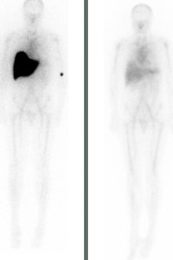
Most promising drugs currently depend on the amyloid plaque theory.
Several drugs could in theory slow or attack amyloid plaques.
Tau tangles another potential target.
Some chemical, some immunological.
IF this is the basis of disease it should slow or halt it.
Trials will test the theory.
Neural stem cells another approach, further behind.
Above. Calcoen et al 2015
L. FT. Pepys M. 2015.

Slide 37
Modifiable risk factors for Alzheimer's.
Associations surprisingly similar to cardiovascular disease.
Obesity.
Exercise.
Smoking.
Diabetes.
Cholesterol.
Excess alcohol.

Slide 38
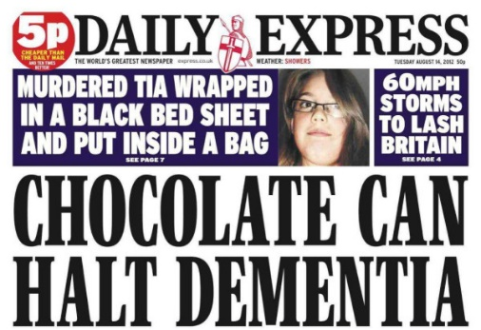
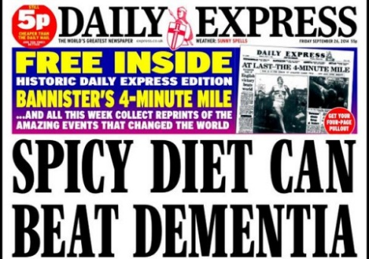
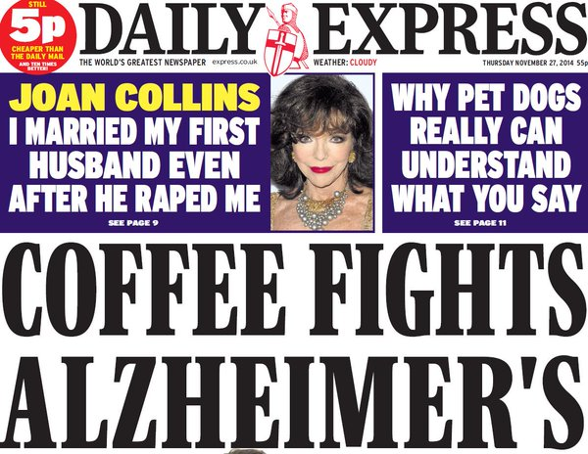
Prevention of Alzheimer's dementia.
For dementia hampered by limited evidence.
Don’t believe everything you read….
Reasonable evidence for:
Exercise, stop smoking, keep mentally active, moderate alcohol, (reduce blood pressure), (statins).

Slide 39
Genes and Alzheimer's.
Other than rare early Alzheimer’s most not inherited in the normally understood sense.
With a close relative, risk roughly doubled from a low base. Many genes associated.
The main one apolipoprotein E (APOE).
APOE ε2 (protective), APOE ε3, APOE ε4 (risk).
In UK around 25% get 1 ε4 gene. Slight increase in risk.
2% get APOE ε4 double gene (homozygous) 10x risk.
Most people with 1 ε4 gene will not get Alzheimer’s in normal current lifespan.
Genetics probably not ‘whether’ but ‘when’.

Slide 40
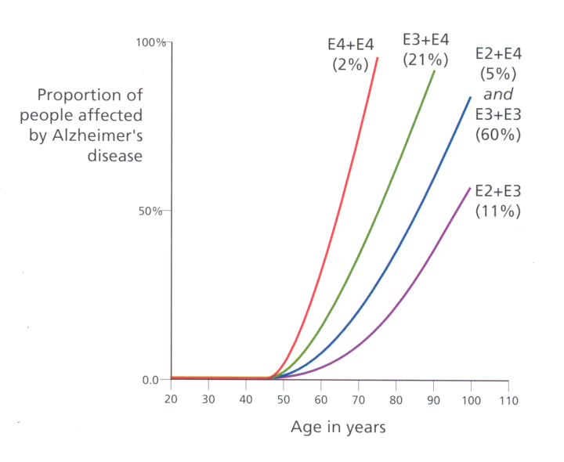
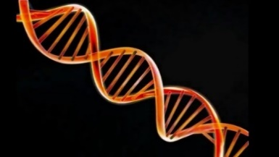
E4+E3
100 %
E4+E4
21 %
E4+E2 5 % & E3+E3 60 %
2 %
E2+E3 11 %
50 %
0.0
30 40 50 60 70 80 90 100 110
Courtesy R McShane
Age in Years

Slide 41
Dementia with Lewy Bodies
Brain pathology similar to Parkinson's disease (PD), probably a spectrum.
Post-mortem, alpha-synuclein and ubiquitin protein clumps in brain.
Base of brain PD. Outer layers Lewy body dementia.
May have motor features.
Analytical function reduced early. Memory may be late.
Fluctuates.
Visual hallucinations relatively common.

Slide 42
Dementia with Lewy bodies (DLB): treatment.
The acetylcholinesterase drugs which work in Alzheimer's to reduce symptoms probably work roughly as well in DLB.
Drugs to prevent or treat are likely to be different.
Less clear genetic components.
Need to treat Parkinson’s symptoms.

Slide 43
Treatment not just (or mainly) about drugs.
Memories, music, dance.
Keeping people stimulated.
Light (enough), mealtimes (uninterrupted).
Cognitive behavioural therapy.
Minimising the gap between realistic expectations and current reality.
Age UK

Slide 44
Depression and dementia.
Dementia can initially be mistaken for depression. Sense of vulnerability.
Depression can look like dementia.
A physiological process due to disease, more common in DLB and vascular.
A reaction to circumstances.
Treatment may help.
Old Man in Sorrow. Van Gogh

Slide 45
Living with mild-moderate dementia.
People living with dementia initially have mild disease.
Their memory and word finding may be impaired and often less confident- otherwise usually as they were.
They (we) may have a good quality of life if life can be structured to accommodate this.
NHS Choices

Slide 46
Living with more severe dementia.
Severe dementia is a minority.
Memory of important people, personality and inhibition may be severely impaired.
Anger, aggression and emotion are communication.
Maintaining dignity, minimising distress and supporting carers and families important.

Slide 47
Have we forgotten dementia research?
Historically it has been substantially under-funded relative to future need.
This is improving, and UK has recently put major public resources behind it.
Has not attracted the same scientific interest.
Scientific, ethical, legal challenges, but not insuperable.
A
L
Anatomical Lab Munich c. 1906

Slide 48
We have covered:
Current epidemiology.
Classical infectious and nutritional causes of dementia.
Memory.
Some rare familial dementias.
Vascular dementia.
Alzheimer's dementia.
Dementia with Lewy bodies.

Slide 49
Dementia prevalence in England: male (L) and female (R). Matthews et al Lancet 2013

Slide 50
Chichester (L), City of London

Slide 51
Population 85 and over: 1992, 2015, 2033 (ONS).

Slide 52
Ethical and legal issues.
Consent to trials. Restrictions gradually increasing. Theory: fine. Practice: may harm those with dementia.
UK law on adult consent: future-proof?
Heavily concentrated in care homes: 58% residential homes, 73% nursing homes.
The ethical issues around repeated curative treatment of people with advanced dementia.

Slide 53
Dementia in older age: our worst times but also our best times are ahead of us.
Classical infectious and nutritional causes of dementia largely gone in high-income countries, falling in lower-income.
Incidence of dementia probably falling in high-income countries, especially in men.
It is likely vascular dementia will retreat as stroke is retreating.
Alzheimer's dementia and dementia with Lewy bodies will increase until science finds ways to prevent, halt and (possibly) reverse them.
A 5 year delay might reduce population prevalence by up to 50%.
This is a matter of when, not if.

