Slide 1
Theatre and Love: Tom Stoppard, ‘The Real Thing’
Belinda Jack
Gresham Professor of Rhetoric

Slide 2
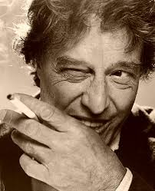

Slide 4
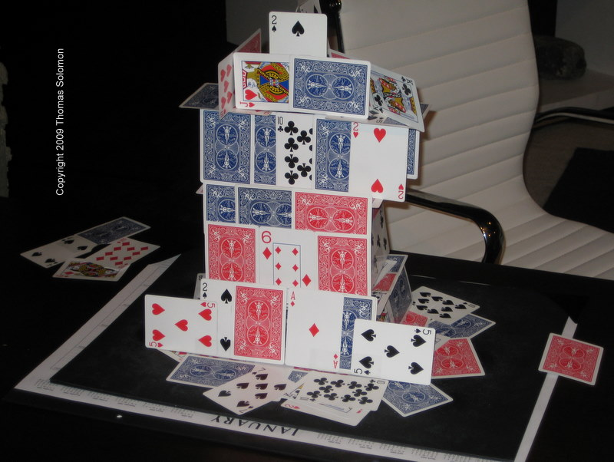

Slide 5
‘The Real Thing’ by Tom Stoppard
2009 at the Belfry

Slide 6
https://www.youtube.com/watch?v=n250Cj97ylY

Slide 7
‘The Real Thing’ by Tom Stoppard
at Writers' Theatre Directed by Artistic Director Michael Halberstam

Slide 8
https://www.youtube.com/watch?v=_BF--ZqDnv8

Slide 9
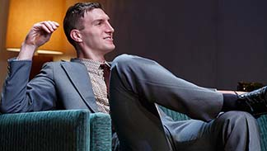
Breau
Notes:
Alex Breaux as Brodie

Slide 10
Tom Stoppard and Charlie Rose

Slide 11
https://www.youtube.com/watch?v=eoSnabj-Cc4

Slide 13
Darkside of the Moon
Pink Floyd

Slide 14
Darkside of the Moon
Pink Floyd

