Slide 1
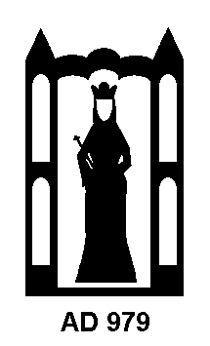
‘The Cradle Of Stonehenge’?
Blick Mead – A Mesolithic Site In The Stonehenge Landscape
David Jacques

Slide 2
Donald Rumsfeld NATO HQ June 6th 2002

Slide 3
Durrington
Walls and
Woodhenge
The Cursus
A two mile long Avenue surrounded by a ditch
The Avenue
King Barrow Ridge
Processional
pathway to the River Avon
Stonehenge
Blick Mead
Coneybury
C. NYT
West Amesbury Henge

Slide 4
Blick Mead c. 7960-4041 cal BC
“The longest proven occupation of a British Mesolithic site”.
Francis Pryor 2016, p42

Slide 5
“ Little can be said about either the
technological or cultural relationships of the
7th to 5th millennium BC material around
Stonehenge as there is simply not enough of
it to judge”. Tim Darvill 2006, 66

Slide 7
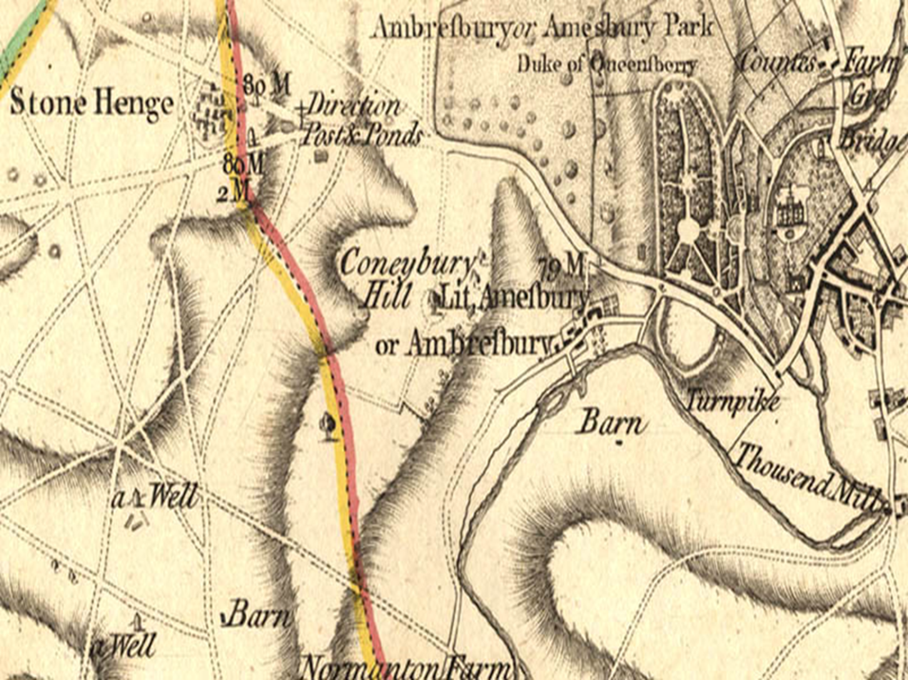
X
Drury and Andrews
map 1773.

Slide 8
Blick Mead 2005

Slide 11
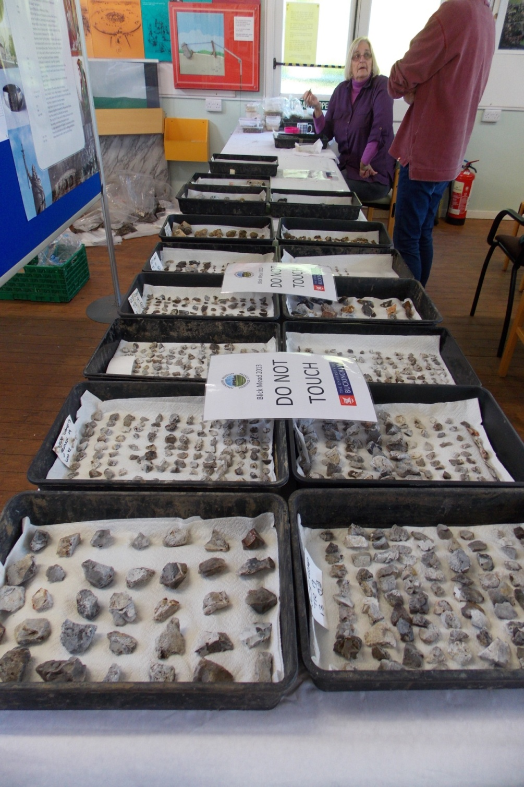

Slide 13
Blick Mead Radio carbon dates
(to 2015):
7596-7542 cal BC (Wild Pig tusk)
* Match with Posts
6698-6590 cal BC (Aurochs)
* Match with Posts.
6360-6080 cal BC (Aurochs) Trench 19
6226-6074 cal BC (Aurochs) Trench 19
5845-5678 cal BC (Aurochs) Trench 19 *
Isotopic analysis
5469-5320 cal BC (Wild Pig) Trench 19
5231-5048 cal BC (Aurochs) Trench 22
5199-4984 cal BC (Aurochs) Trench 19
4998-4835 cal BC (Aurochs) Trench 19
4982-4832 cal BC (Red Deer) Trench 19
4803-4702 cal BC (Aurochs) Trench 19
4896-4695 cal BC (Aurochs) Trench 19
4336-4246 Cal BC (Charcoal) Trench 24

Slide 14
“Despite 50 years of large scale
excavations across western Europe,
the Stonehenge posts are unrivalled
as Mesolithic monuments. They date
to the earliest stages of Blick Mead so
it is likely that people gathering there
were responsible for erecting them”.
Mike Parker Pearson 2015, 4.
First monuments at Stonehenge
c. 8820-6590 cal BC.

Slide 15
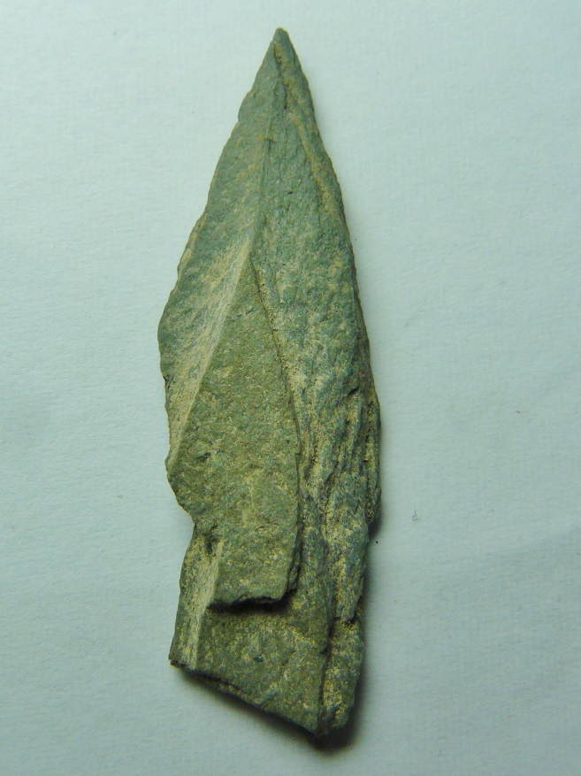
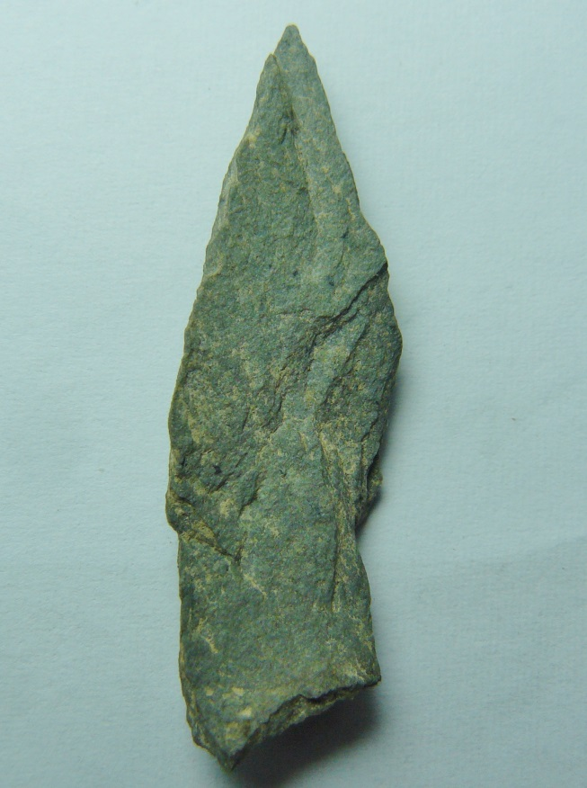
Local people?
The Slate ‘Horsham
Point’ .
Provenance: ‘North Devon/
North Wales’.

Slide 16
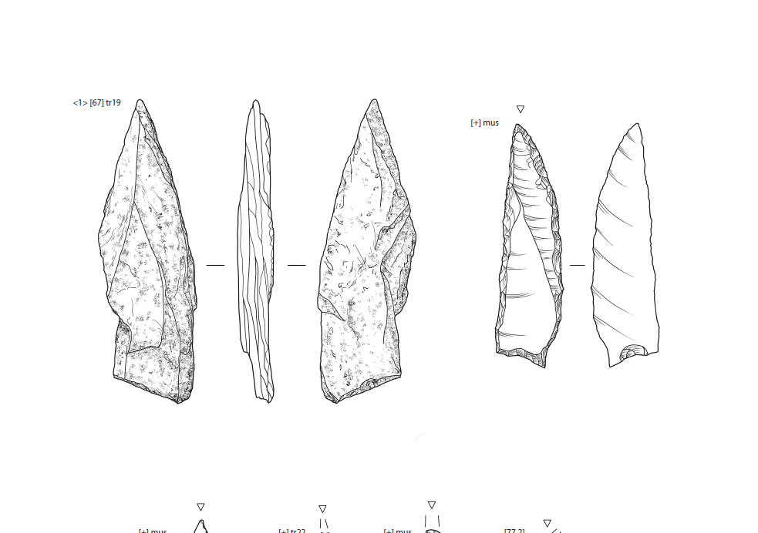
Slate Point
Horsham Point (mid Mesolithic)
c. Cate Davies

Slide 18
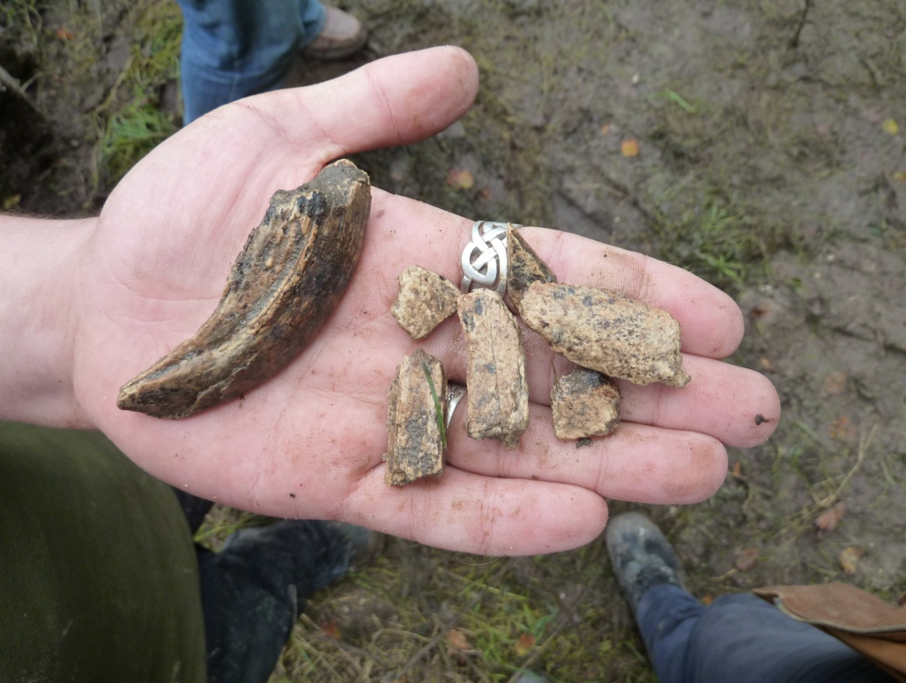
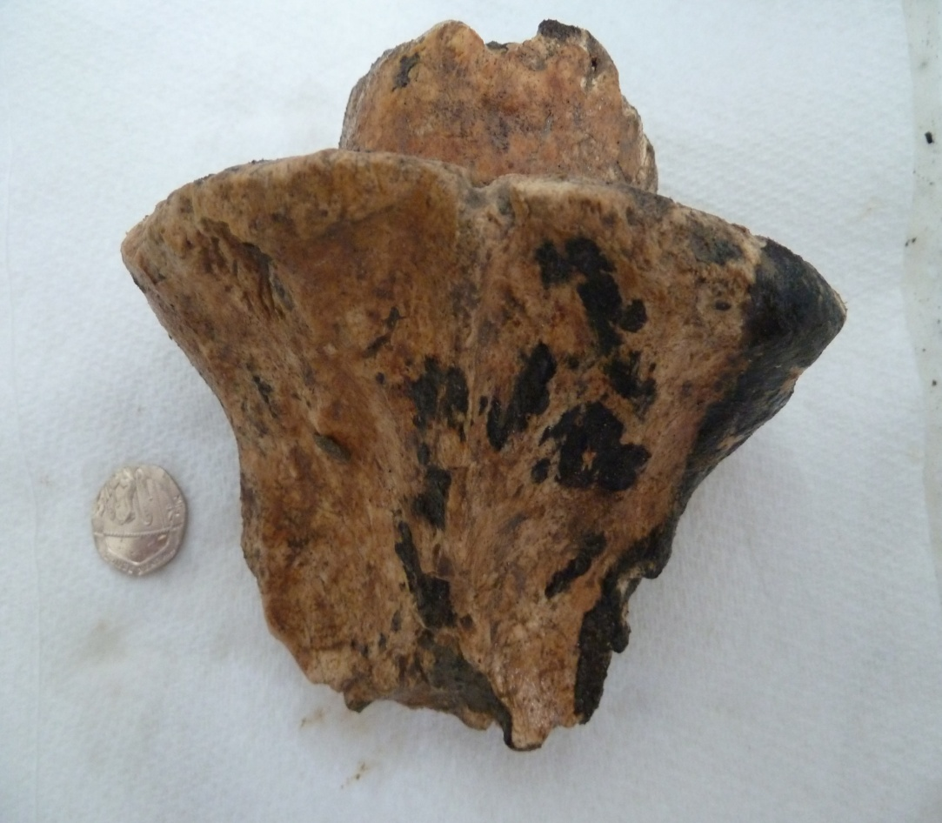
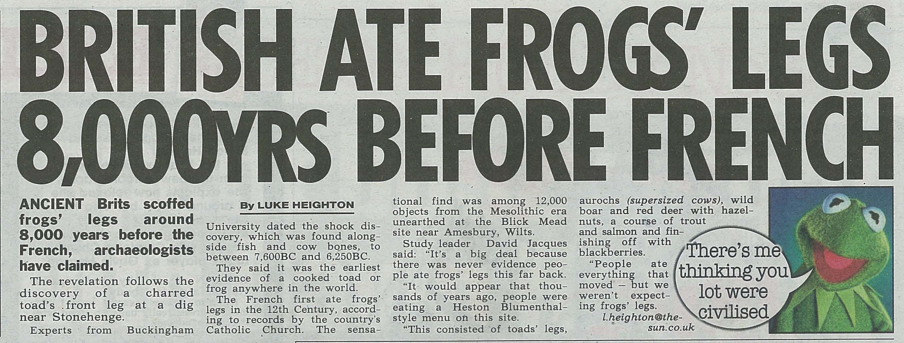

Slide 19
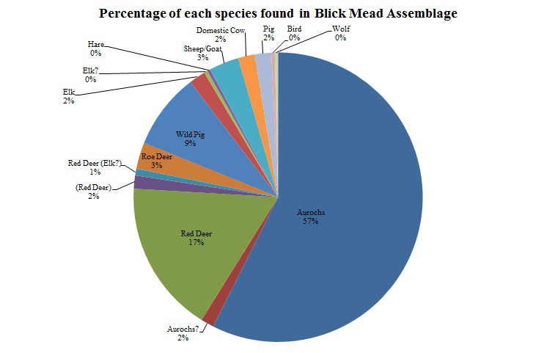
Identifications and analysis:
Bryony Rogers,
Peter Rowley-Conwy
and Kurt Grun
(Durham University)

Slide 20
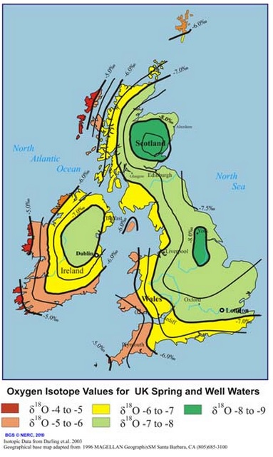
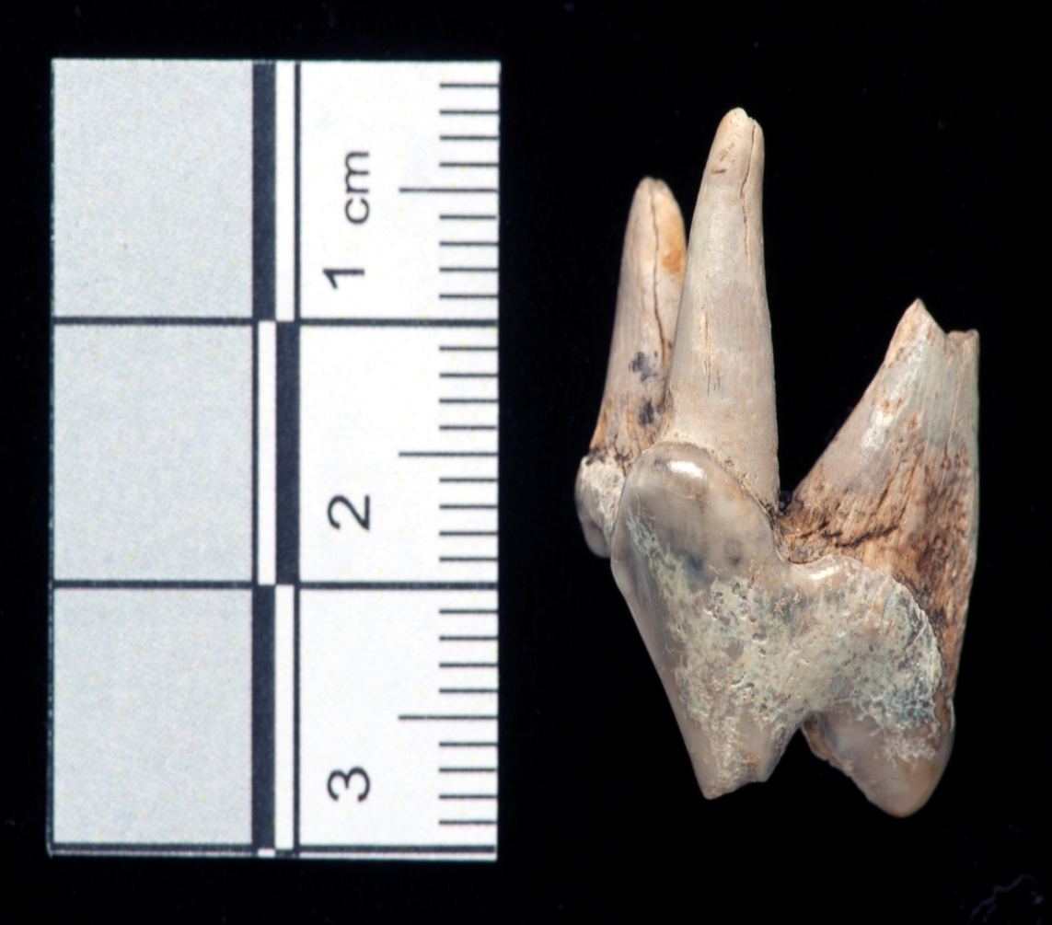
The Blick Mead dog –
c. 4989-4808 Cal BC
Tooth is an upper, left fourth premolar.

Slide 21
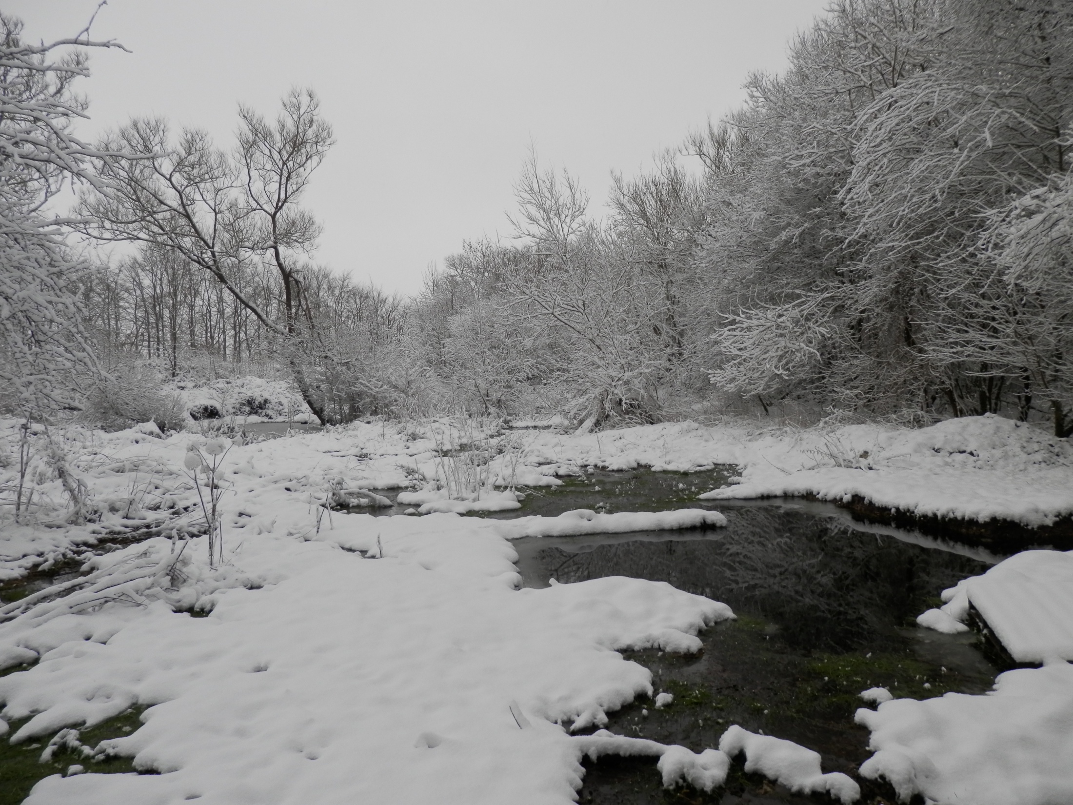
Why Blick Mead?

Slide 22
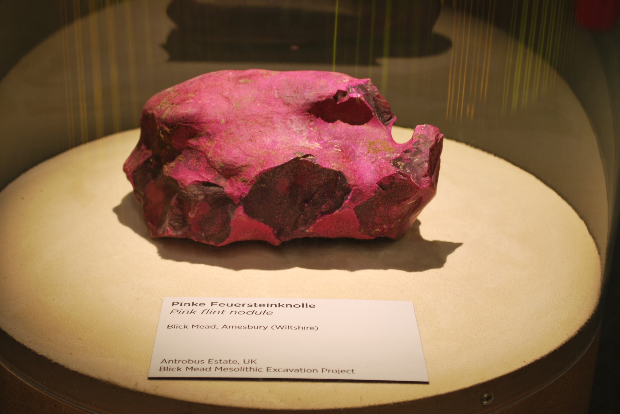
‘Magical magenta stone’
Created by hildenbrandia rivularis algae and particular environmental conditions

Slide 23
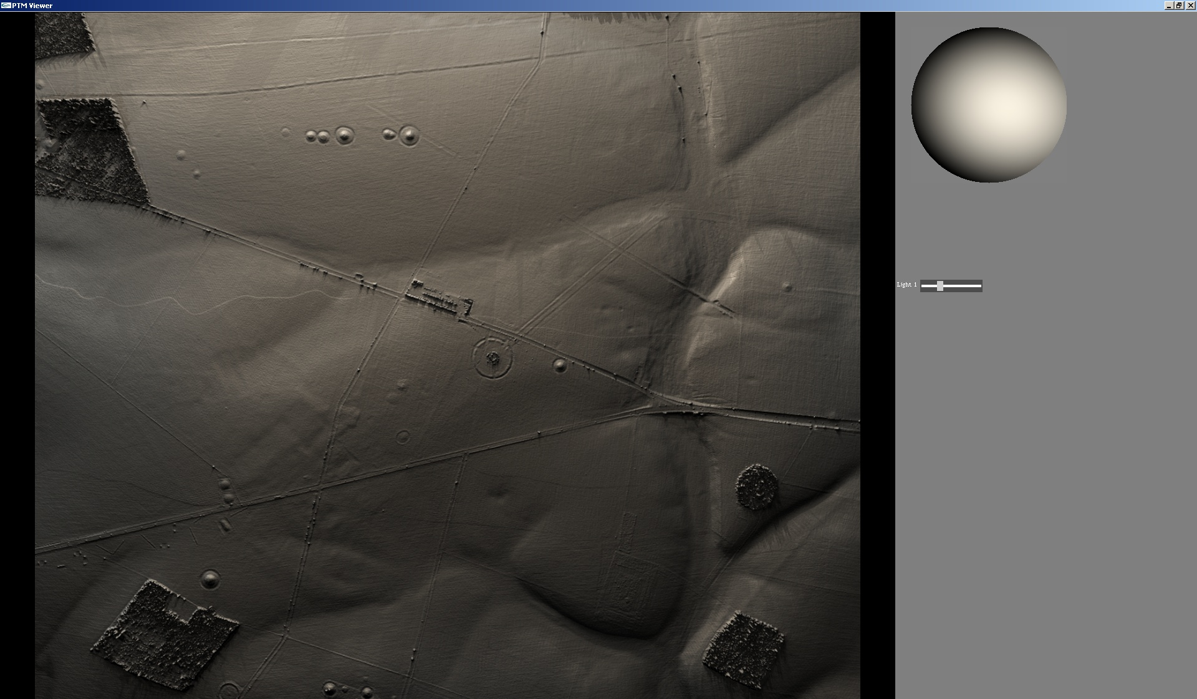
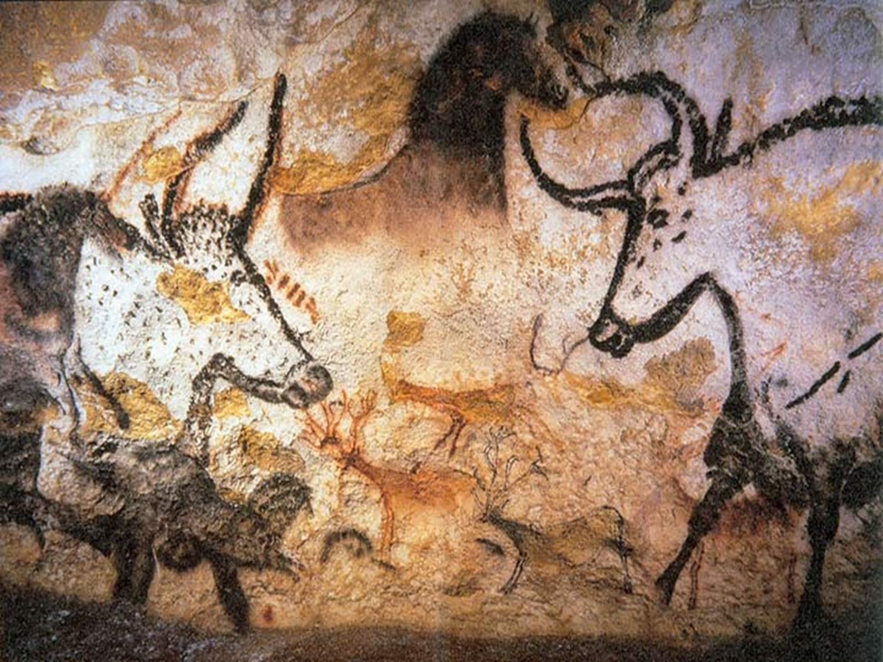
Where did the animals go?
Gt Cursus
Stonehenge Bottom
fording point
Mesolithic posts
Stonehenge

Slide 24
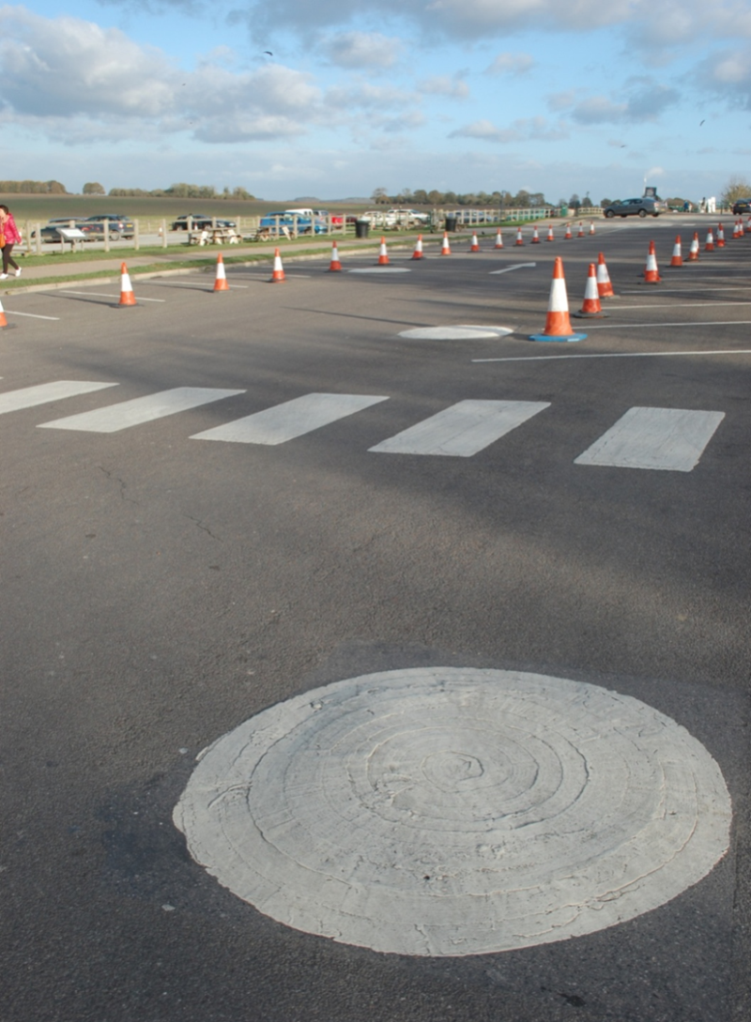

Slide 25
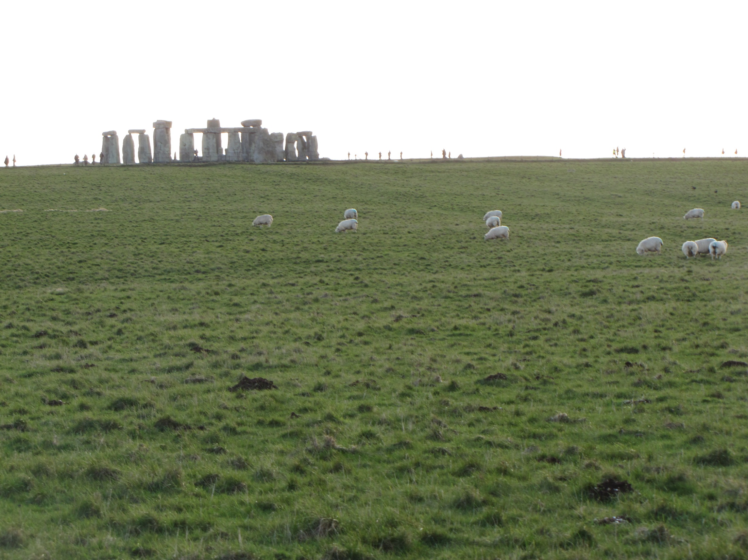

Slide 26
Cursus
<Pine charcoal at western terrninus
Stonehenge Bottom
Funnel
Fording point
Funnel
Funnel
Side Valley/Funnel
Mesolithic Posts
King Barrow
Ridge
Funnel
Coneybury

Slide 27
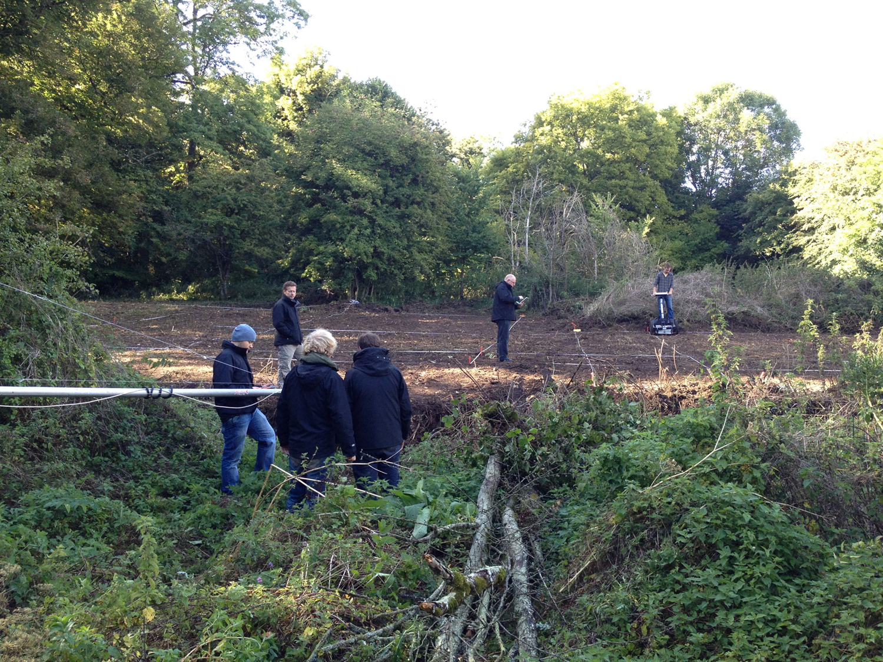
Where did they
live?

Slide 28
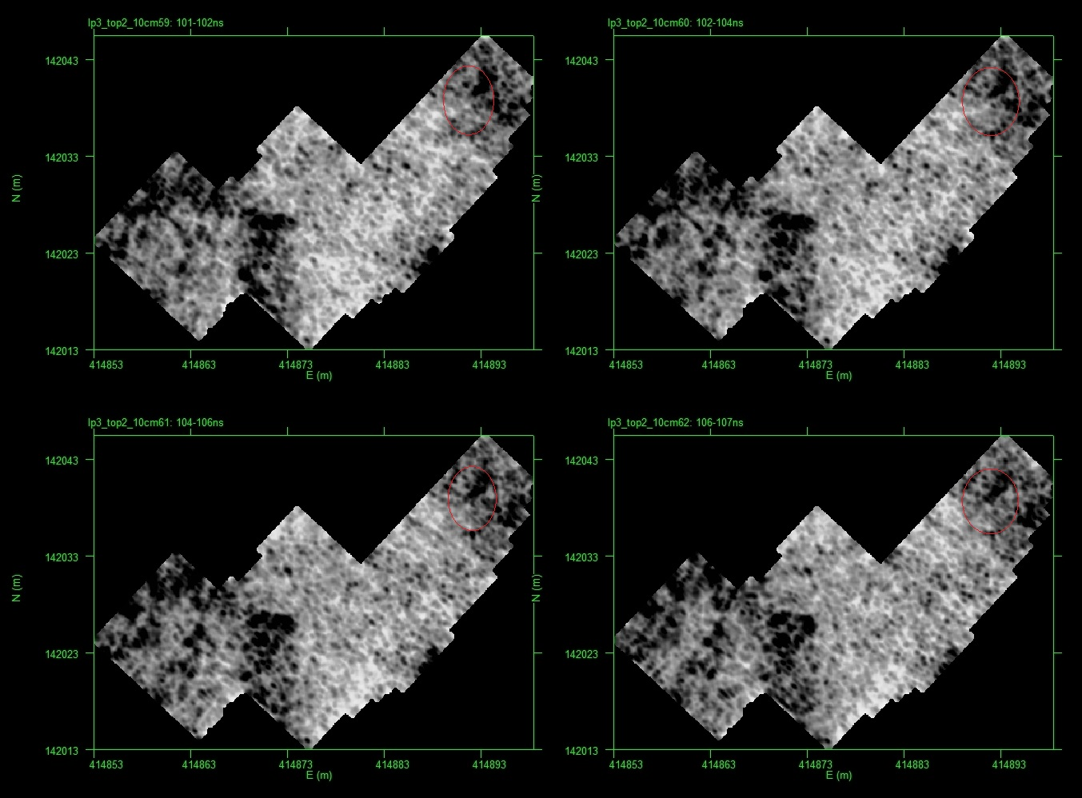

Slide 29
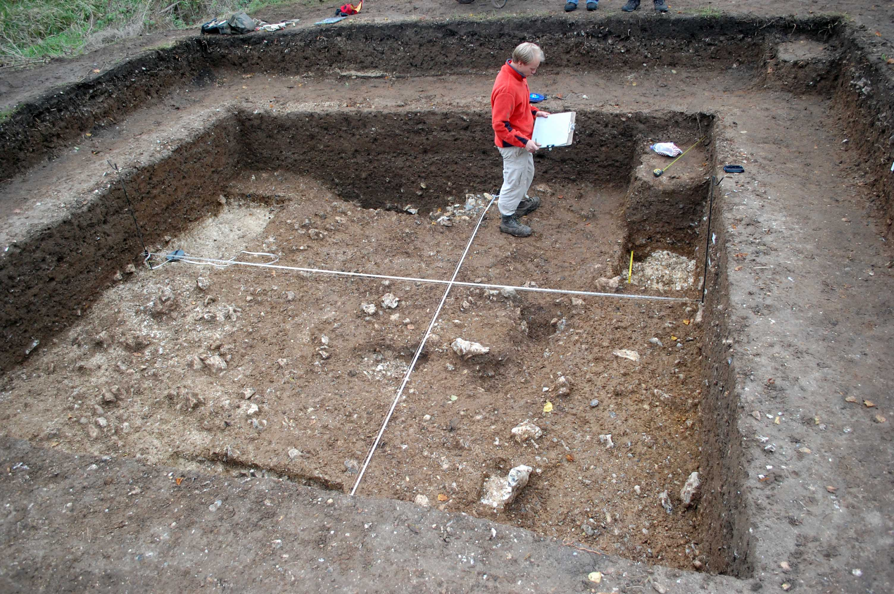
2014
C!4 X

Slide 30
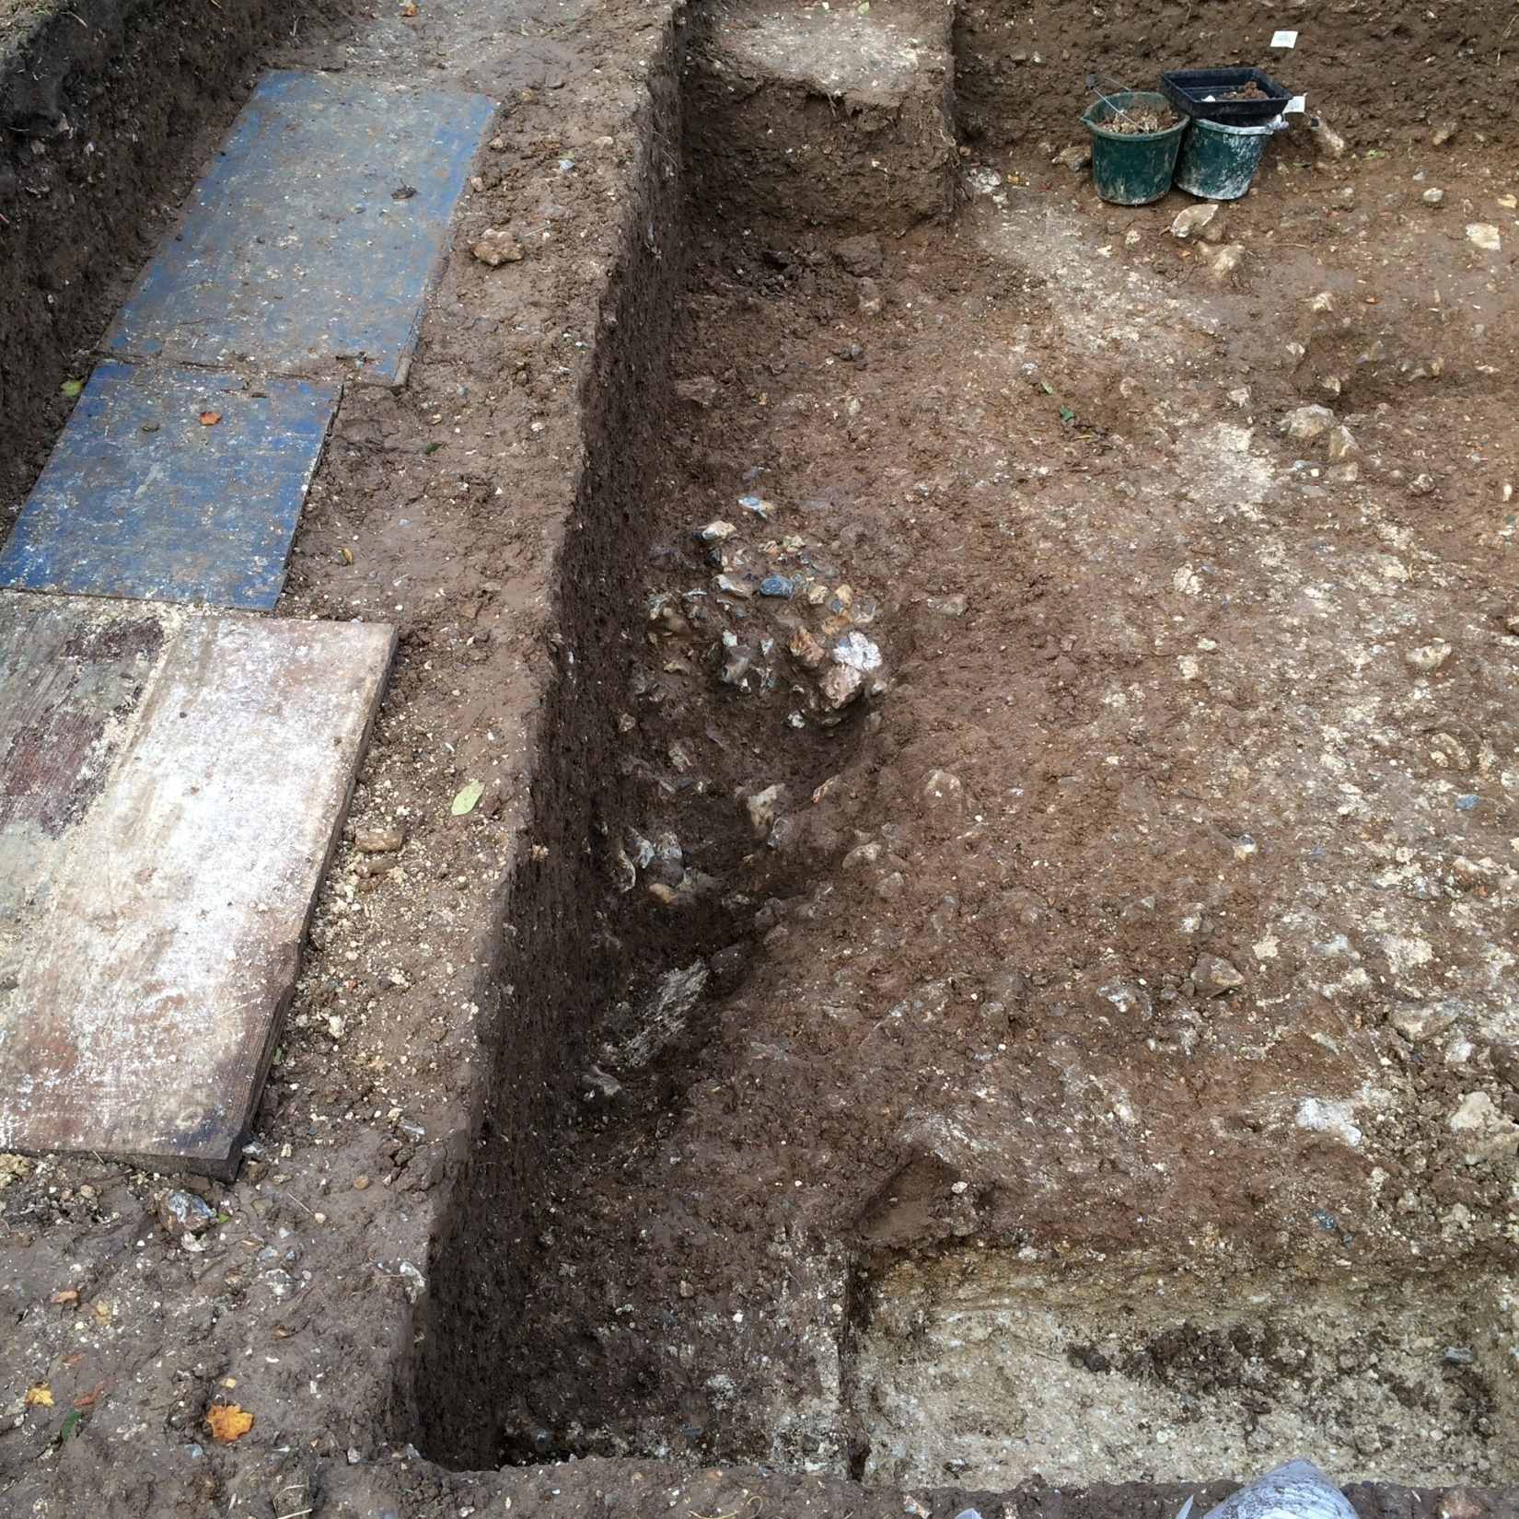

Slide 31
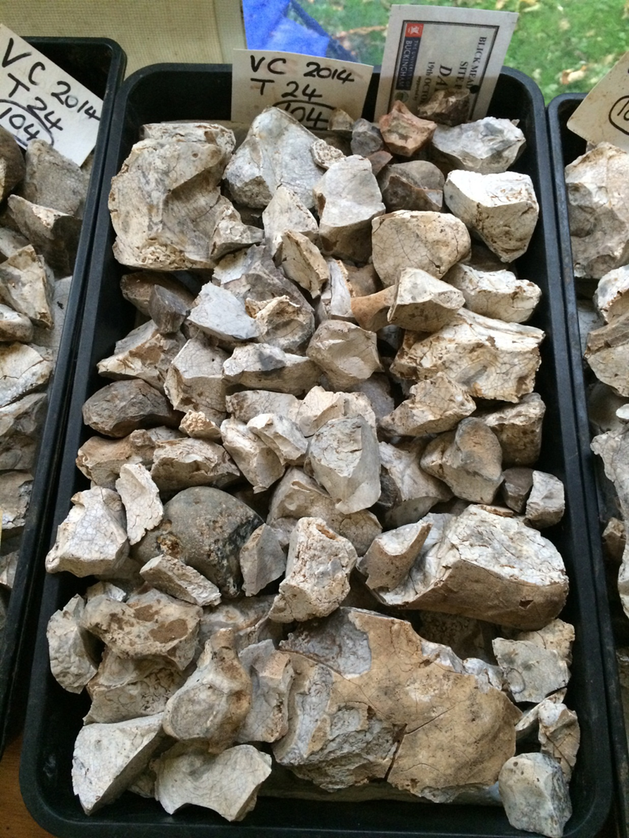

Slide 32
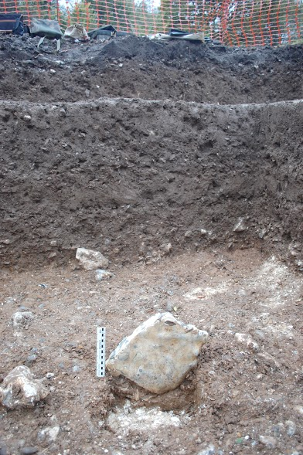

Slide 33
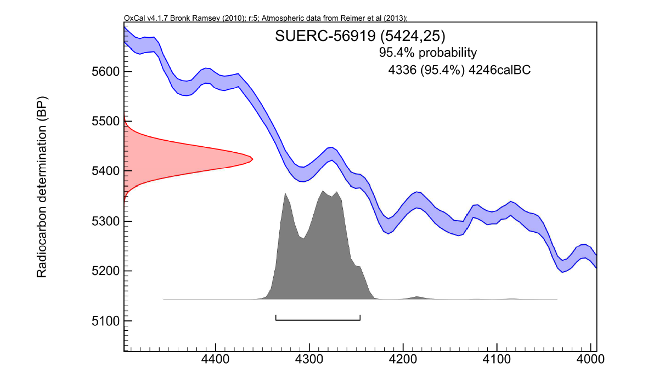

Slide 34
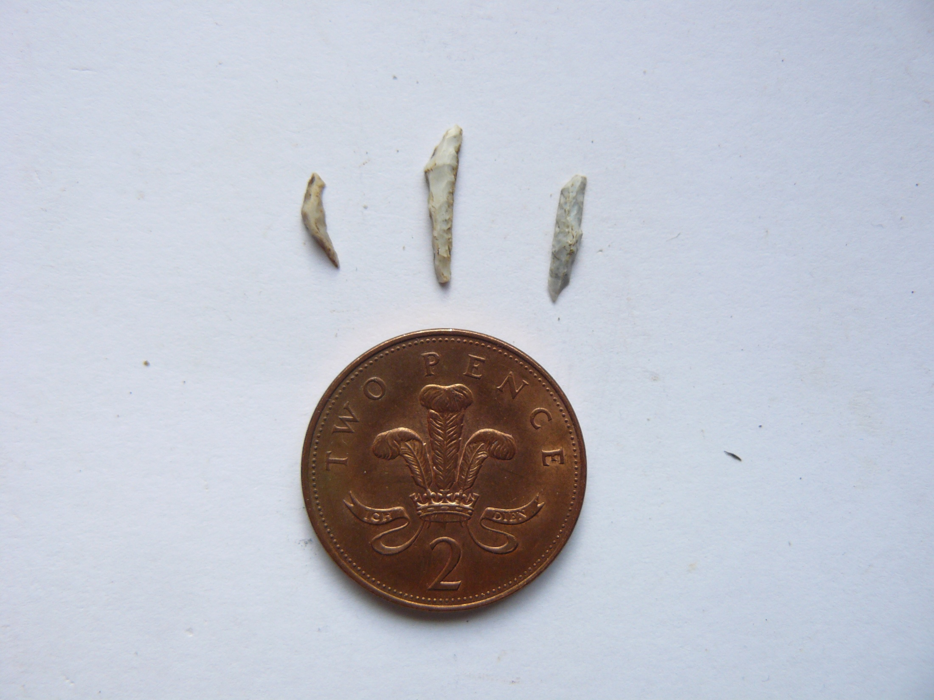
What were people doing?
True Scalene
Rod
Crescent Triangle
Tiny microliths (note detailed retouch around the perimeters).

Slide 35
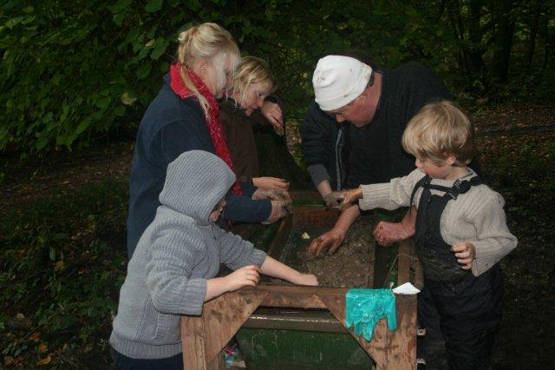

Slide 36
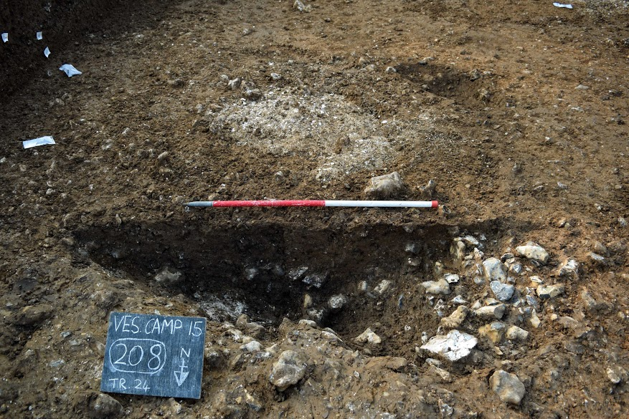
2015

Slide 37
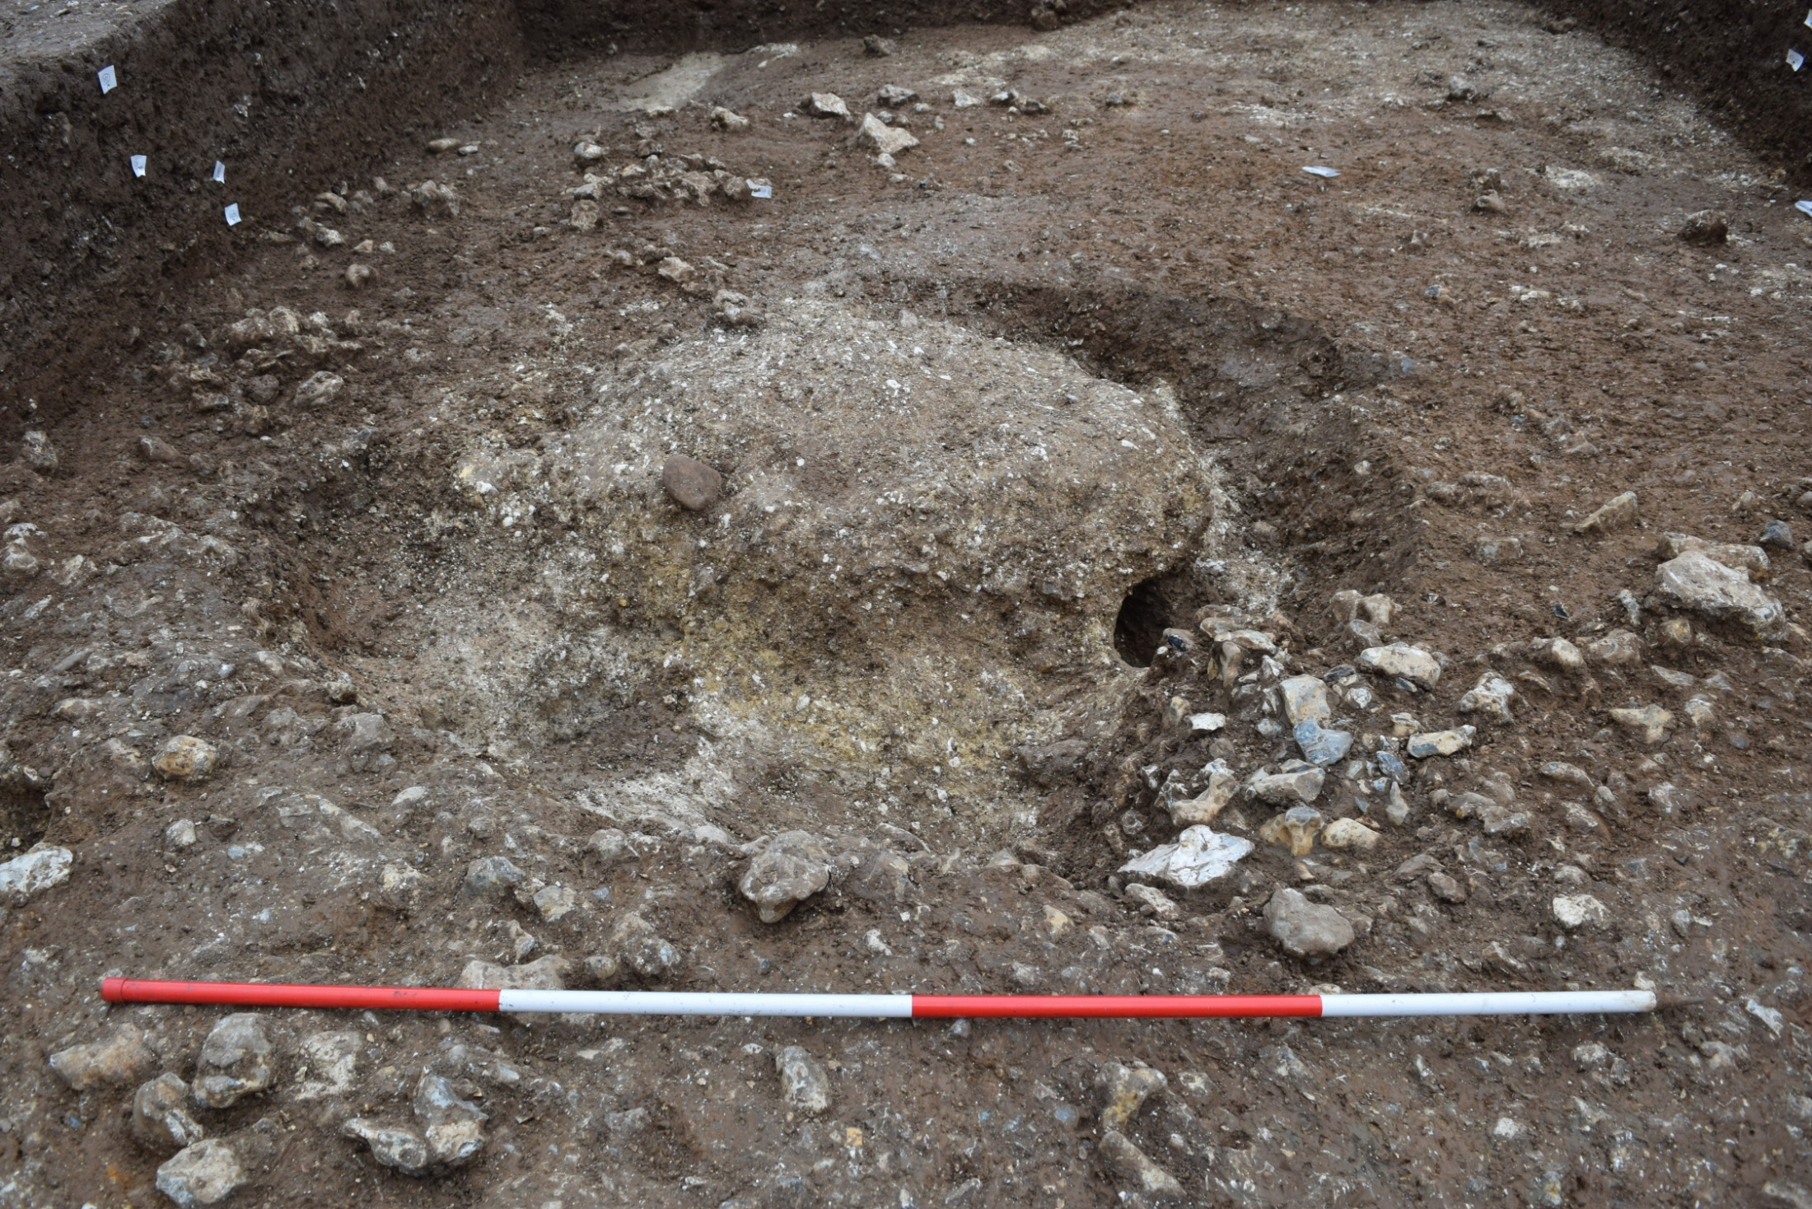

Slide 38
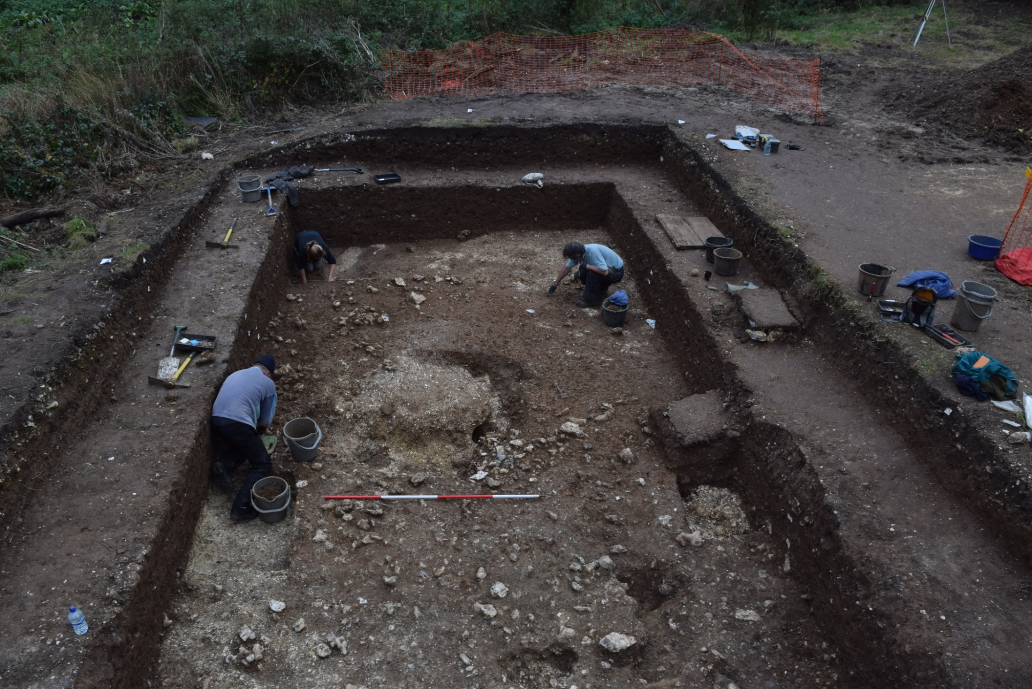
Water channel edge
Large modified tree throw
Burnt flint upper fill
of tree throw
Post hole
Standing stone
Possible post hole 4336-4246 cal BC

Slide 39
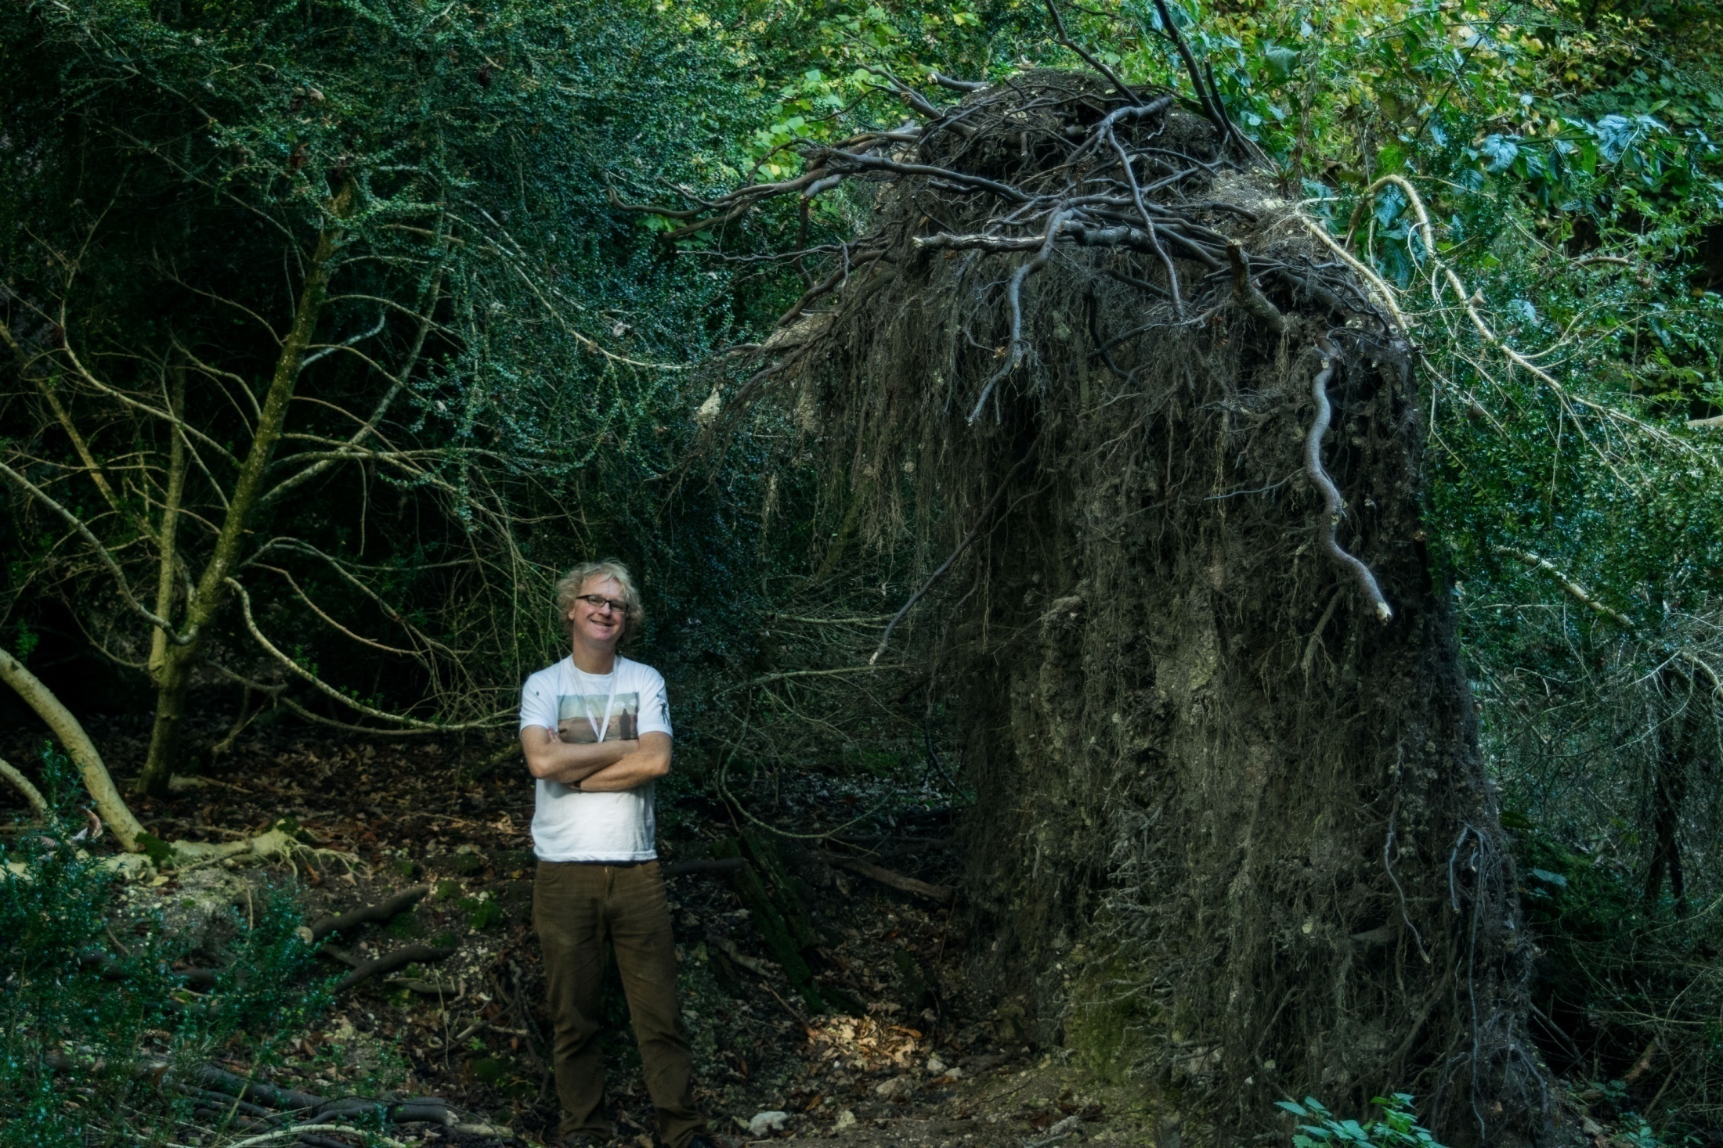

Slide 40
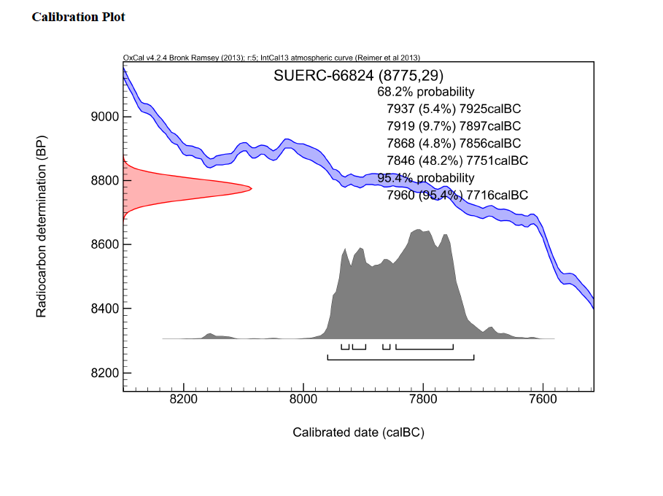
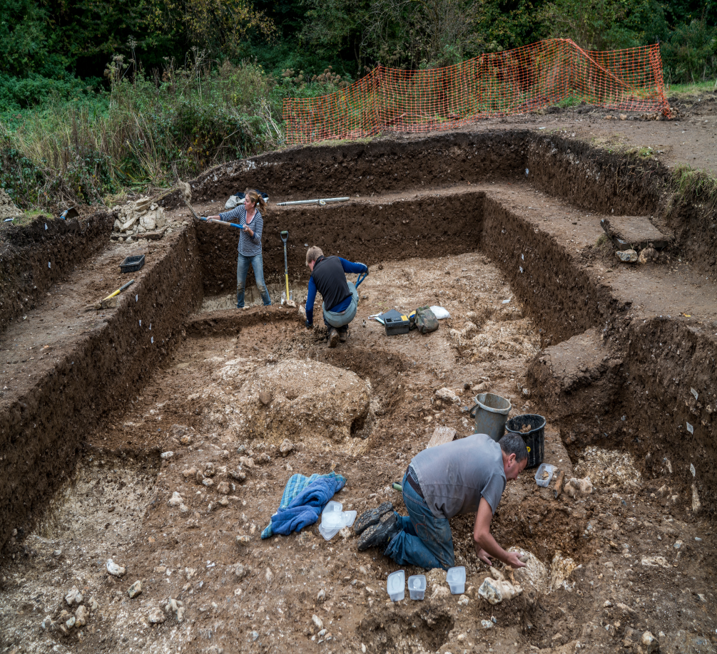
221
221
(115 : 4336-4246 cal BC)

Slide 41
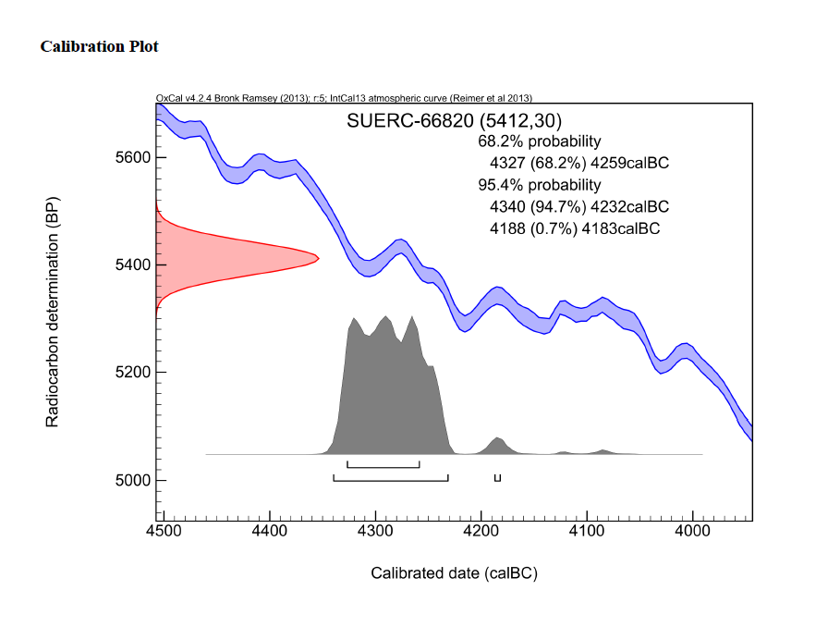
107
107

Slide 42
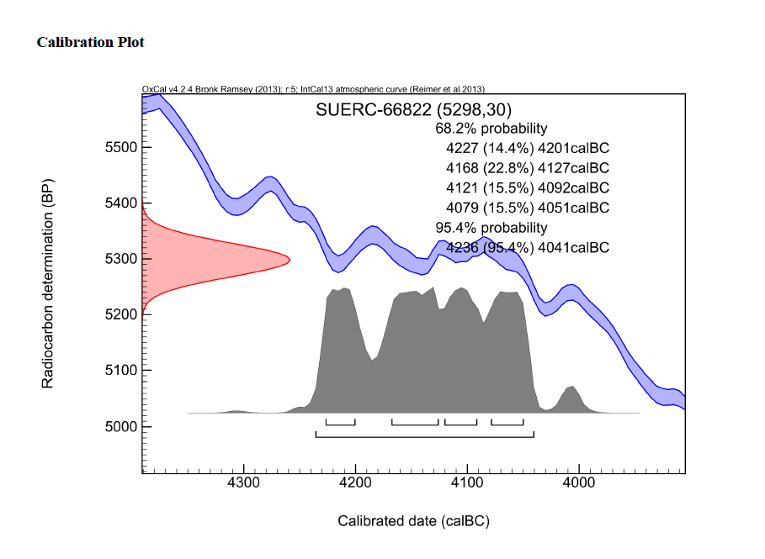
212 w

Slide 43
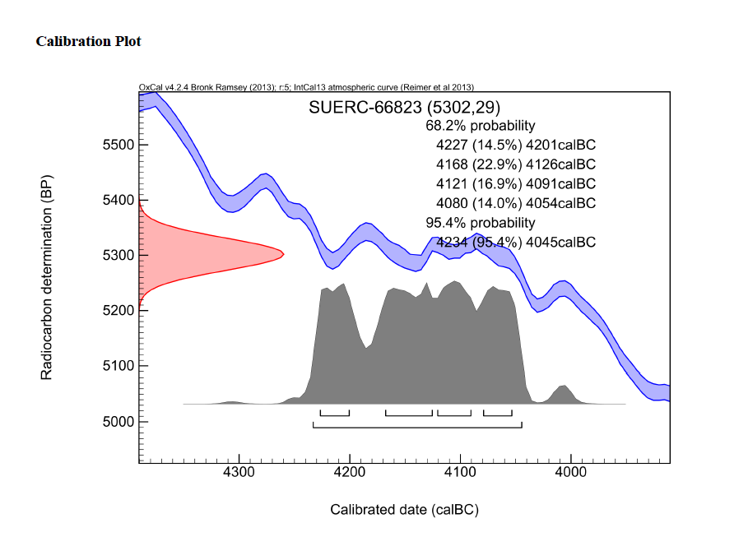
218

Slide 44
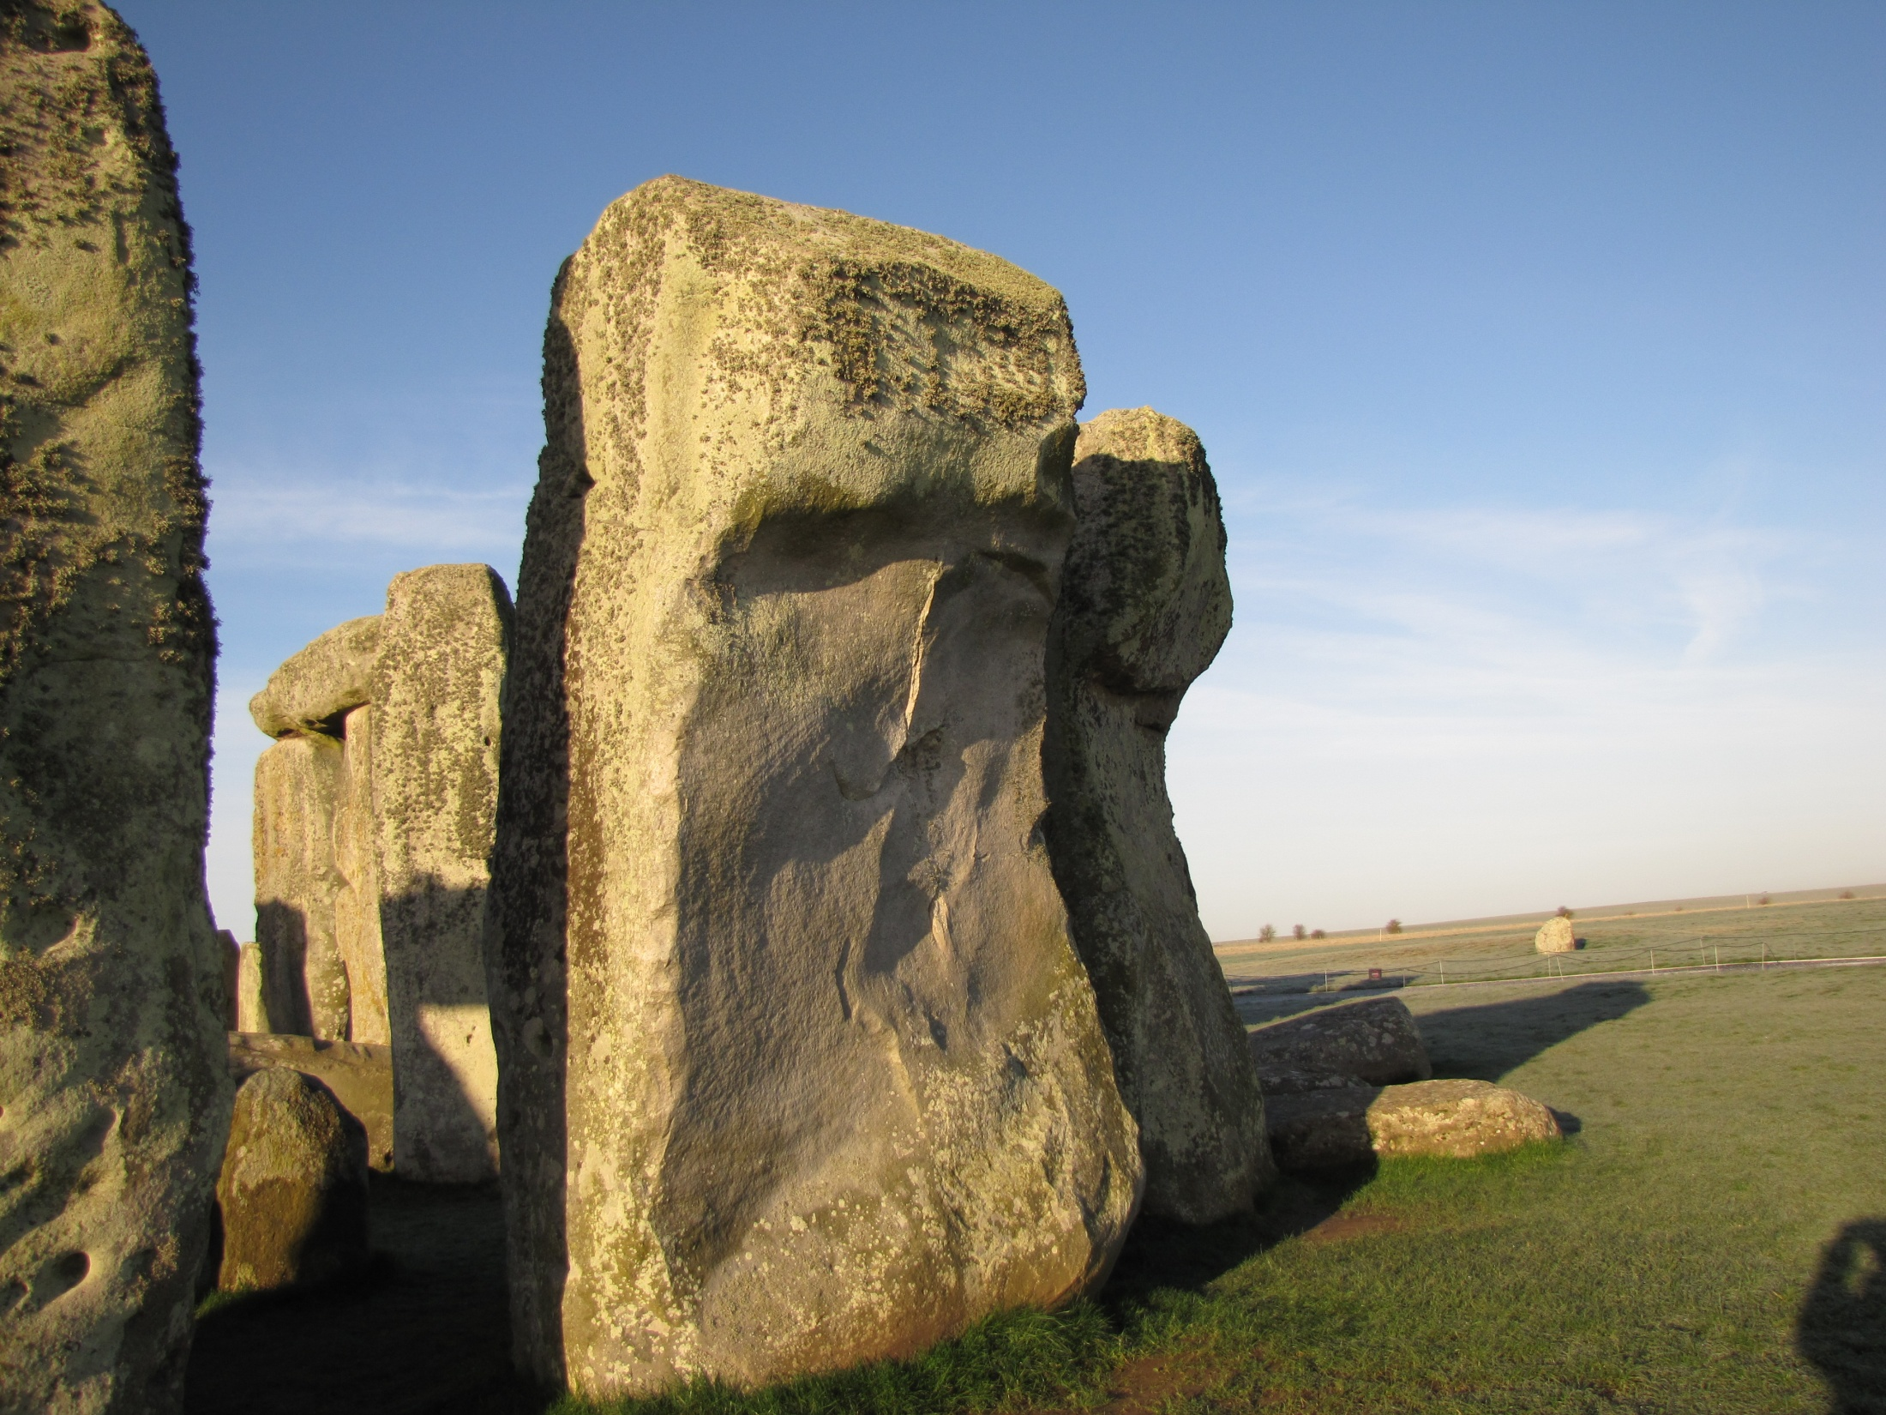
‘Cow’’ bone c. 4340-3980 BC
(“Indicative of pre henge
activity that is otherwise
Invisible”. Darvill 2006, p66)

Slide 45
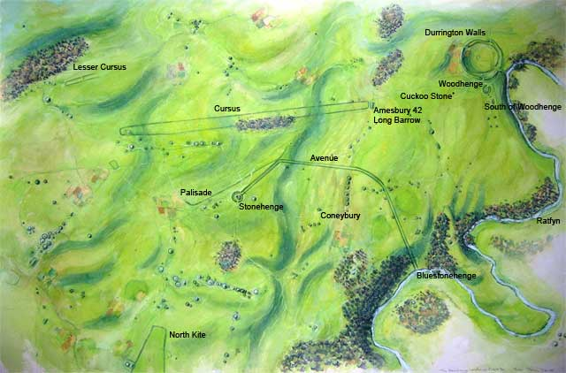
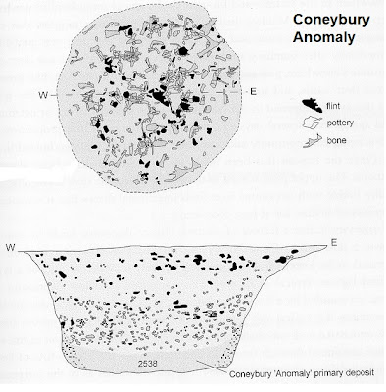
Blick Mead

Slide 46
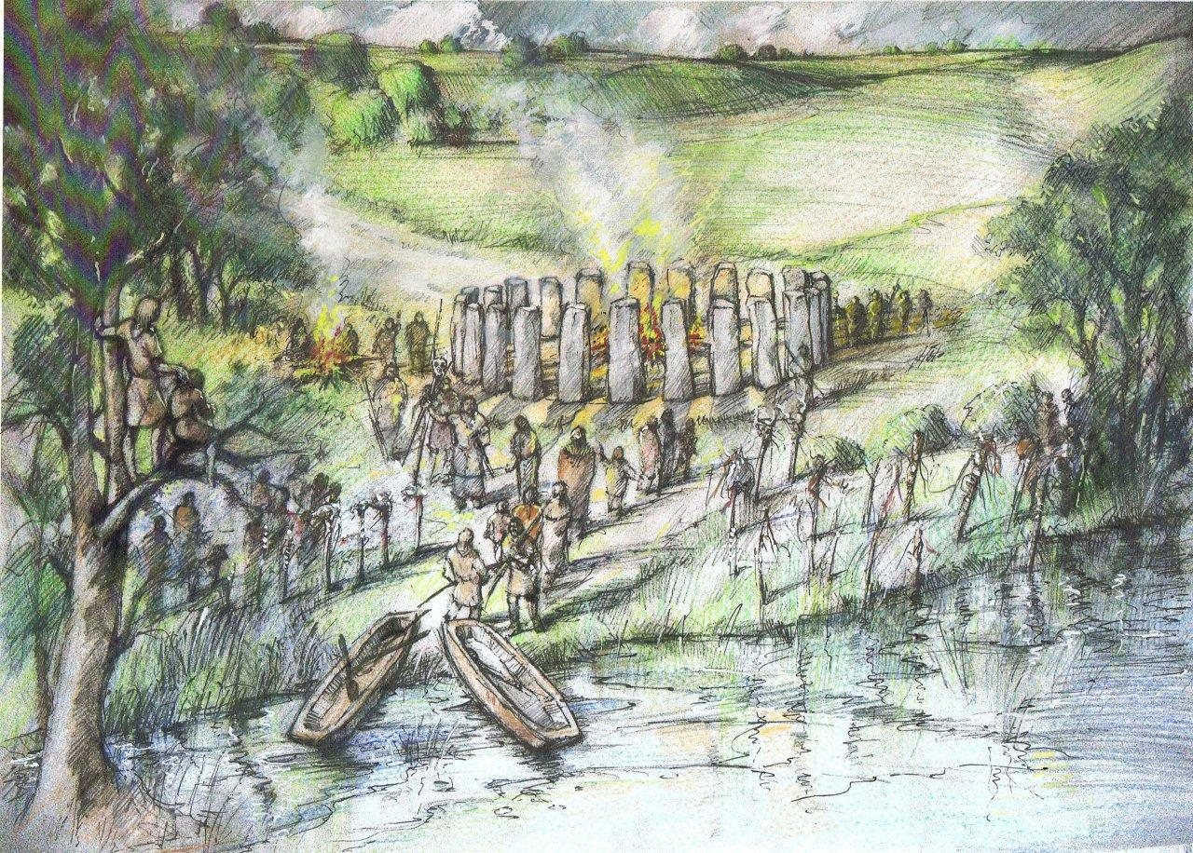
Coneybury
Vespasian’s Camp
West Amesbury
‘Bluestone’Henge –
c. 3400-2600 BC
c. Peter Irons

Slide 47
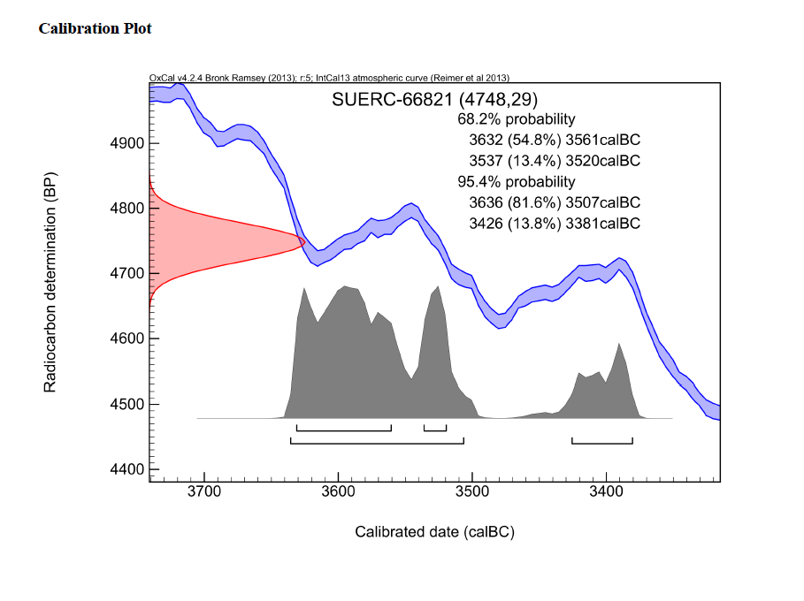
210

Slide 48
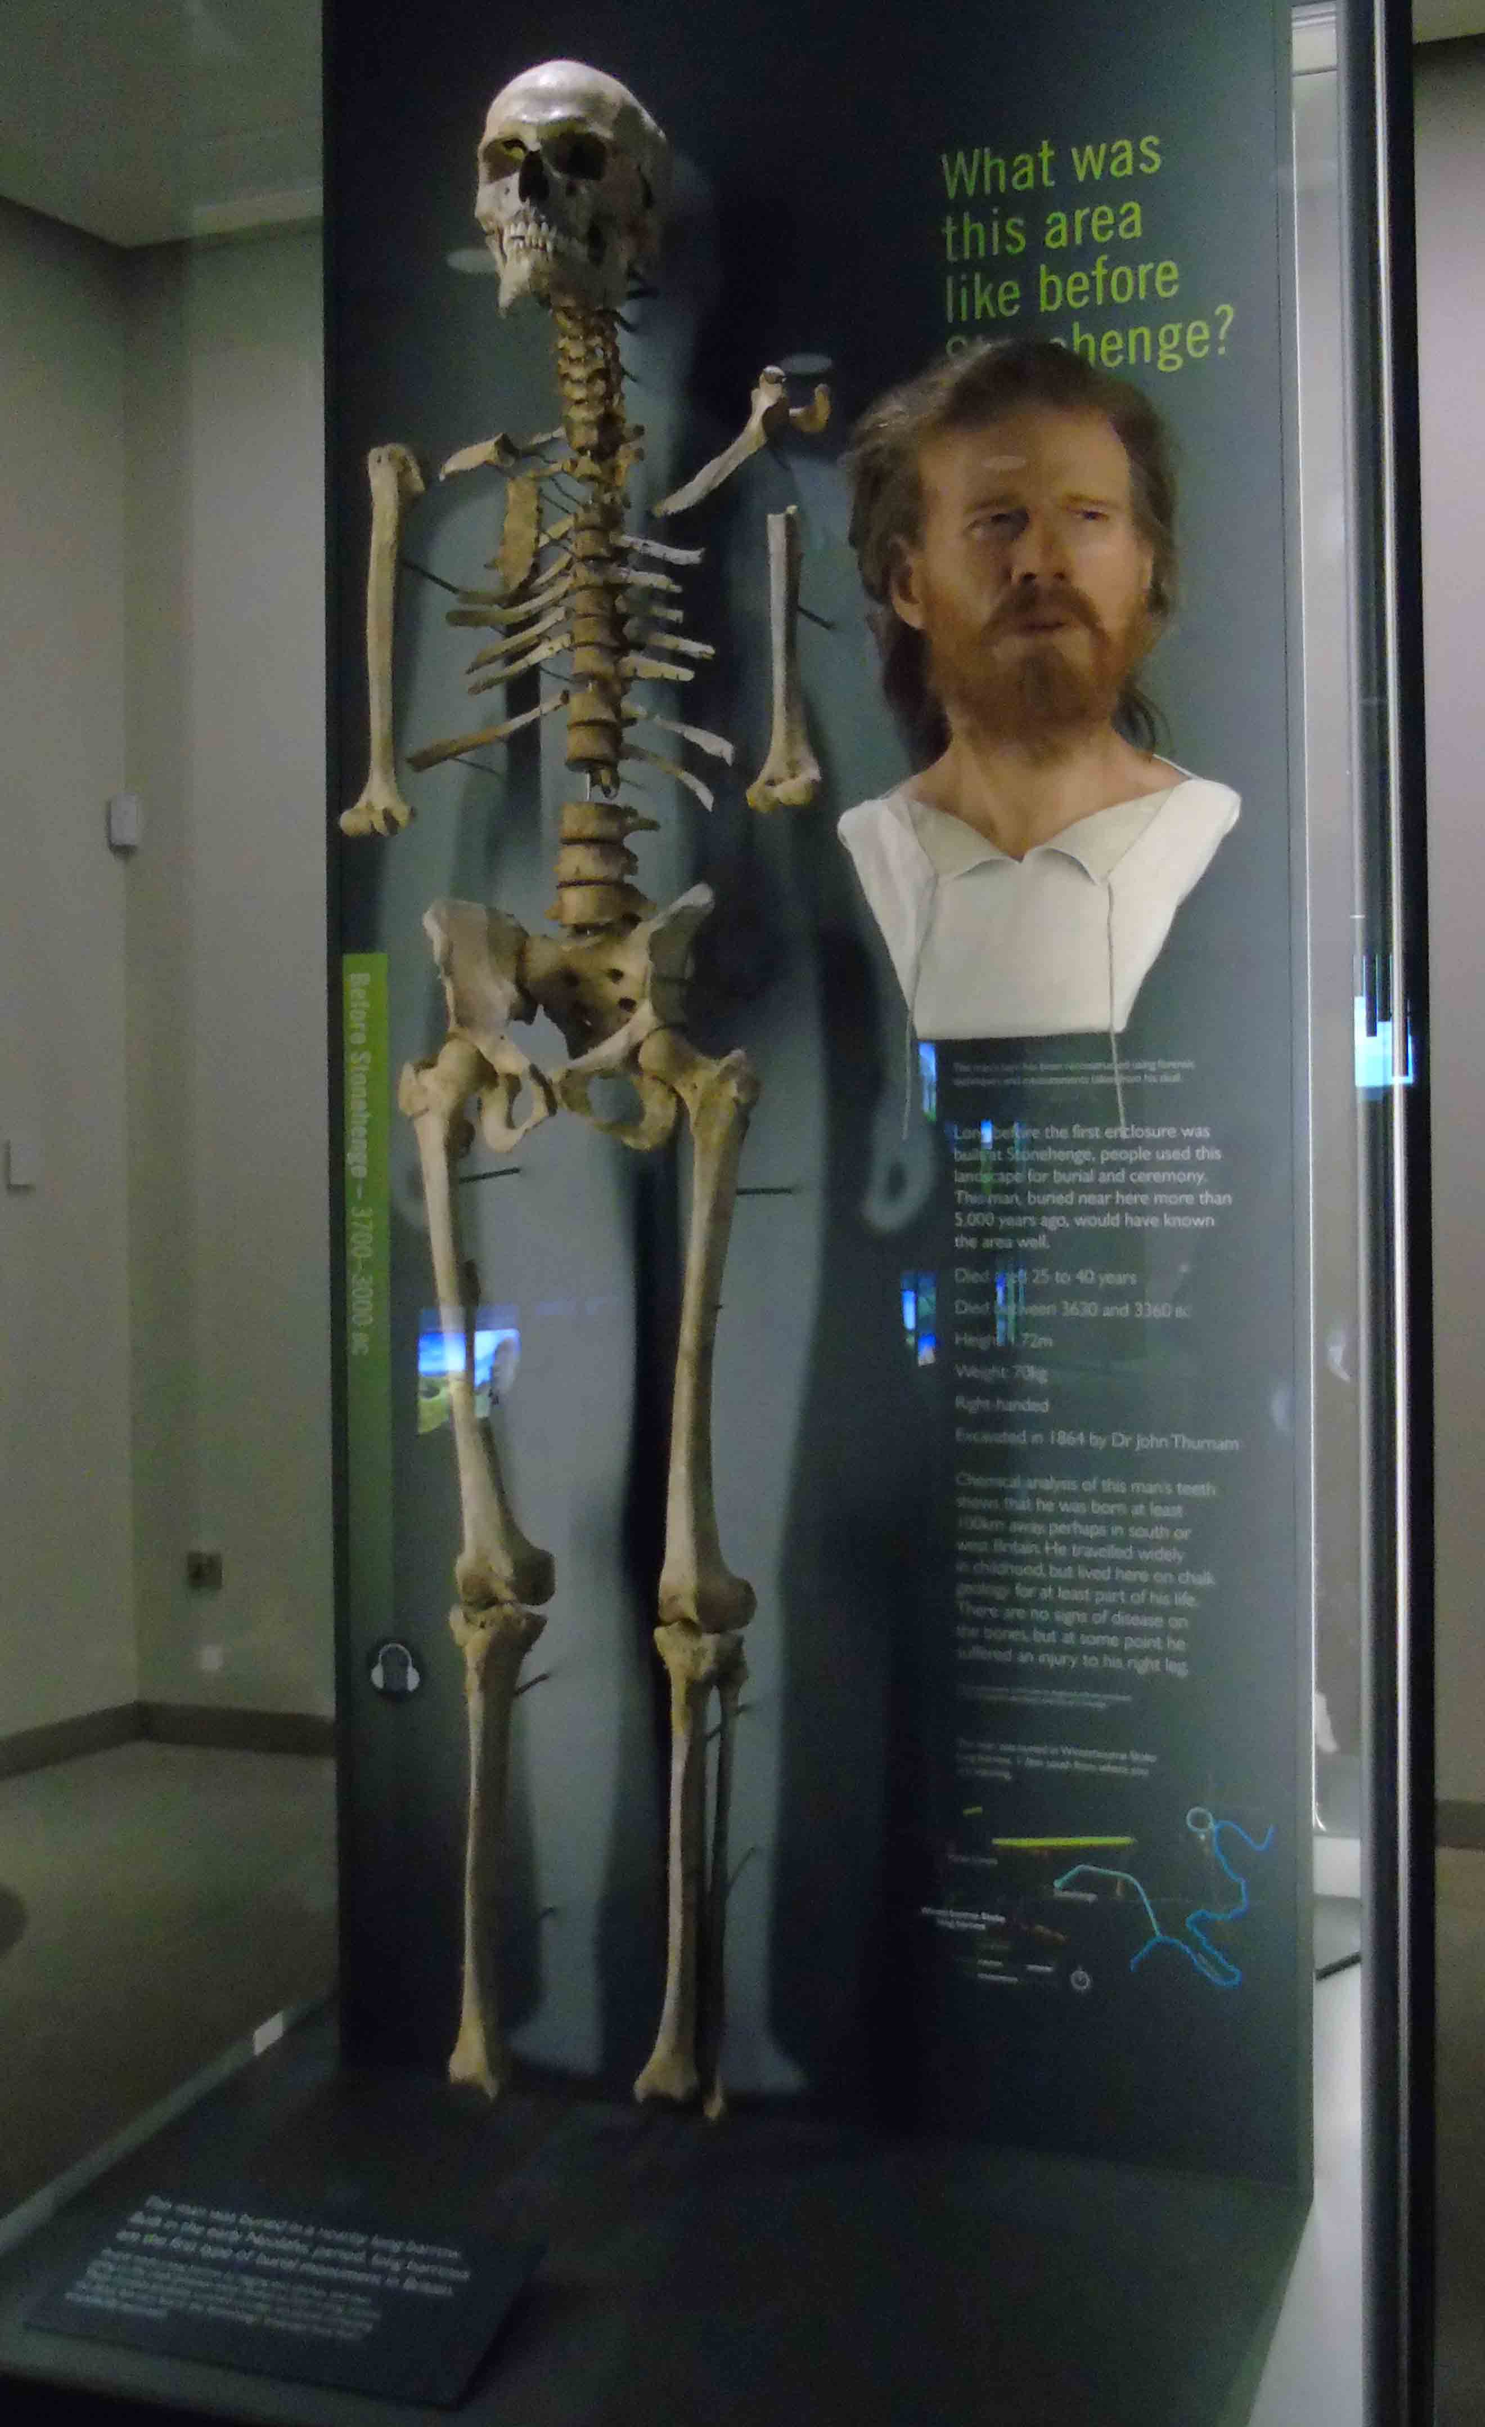
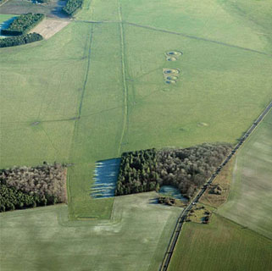

Slide 49
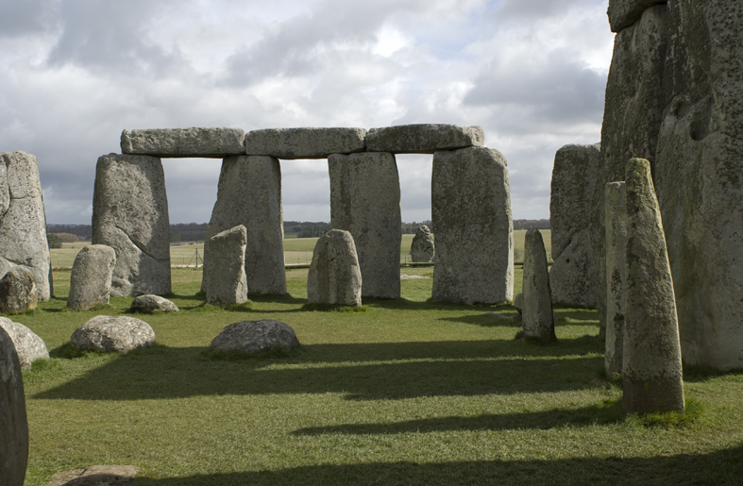

Slide 50
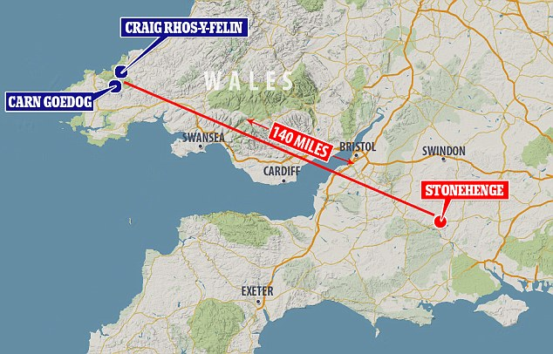
SRP -
8550-8330 cal BC
8220-7790
7490-719
5210-4947
4330-4050
SPACES -
7720-6660 cal BC
6290-5310
5300-3480

Slide 51
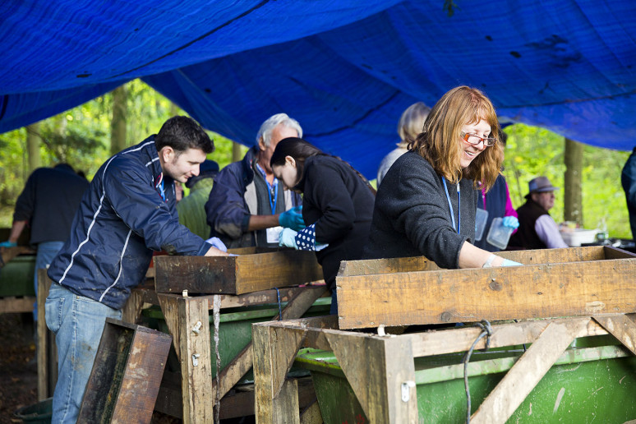
Postscript...

Slide 52
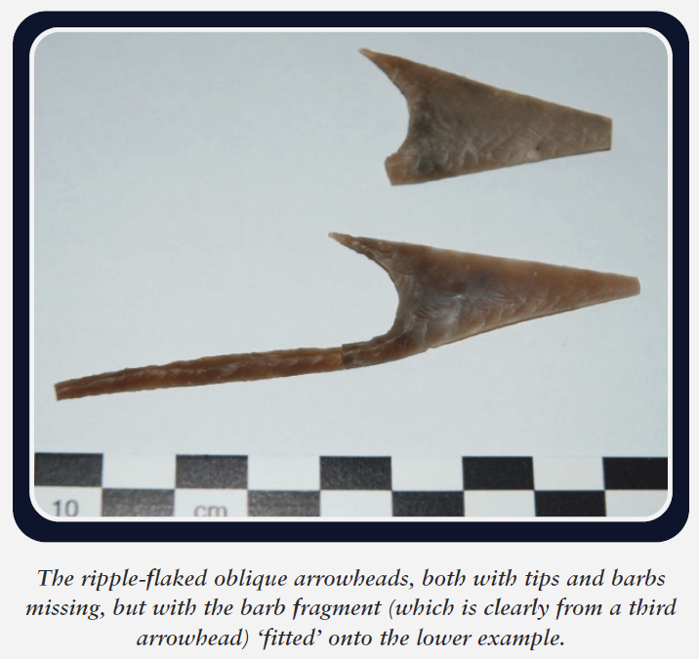

Slide 53
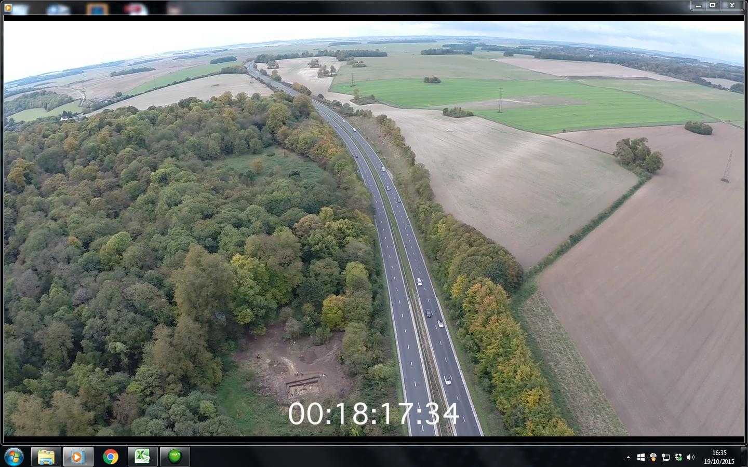
“Blick Mead may have been far more than just a handy place to gather,
but somewhere that people returned to as a place of origin.
Over the centuries and millennia it was used, this place would have
become the centre of a network of paths leading towards it from many
parts of southern Britain. Just as all roads led to Rome, so these paths
led to the future site of Stonehenge”.
Mike Parker Pearson 2015, 43.

Slide 54
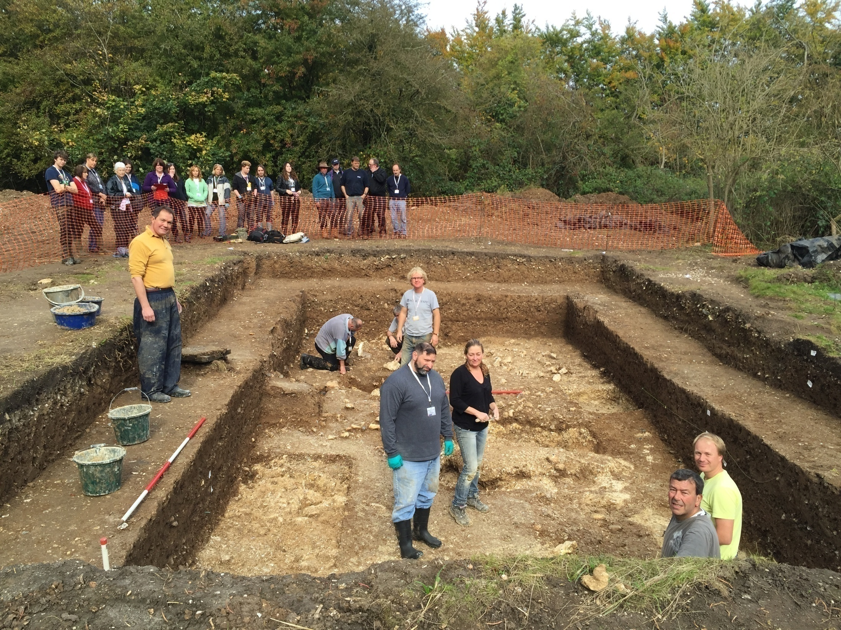
‘There rolls the deep where grew the tree. O earth, what changes hast thou seen! There, where the long street roars, hath been The stillness of the central sea.
The hills are shadows, and they
flow From form to form, and nothing
stands; They melt like mist, the solid
lands, Like clouds they shape
themselves and go.
But in my spirit will I dwell, And dream my dream, and hold
it true; For tho' my lips may breathe adieu, I cannot think the thing farewell.’
Alfred Tennyson, In Memoriam Section CXXIII

