Slide 1
To Die Or Not To Die
Sir Alan Ward
Gresham College
September 2016

Slide 2
To die or not to die
That is the question and it is for the judge to decide.
For generations the real decision was made by the jury by returning a verdict of guilty to murder leaving the judge no discretion but pass the sentence of death.
The mandatory sentence of death for murder having been abolished, judges now frequently have to decide matters of life and death of children and adults lacking legal competence.

Slide 3
Deciding a person shall die.
In re C (A Minor) (Wardship: Medical Treatment) 1990 Fam 26, the case of the brain-damaged baby.
Aintree University Hospitals NHS Foundation Trust v James and others [2013] EWCA Civ 65, a case of a DNR (Do Not Resuscitate) notice.

Slide 4
Deciding the patient is not to die.
Re E (A Minor) (Wardship: Medical Treatment) [1993] 1 FLR 386, the Jehovah’s Witness boy suffering from leukaemia and refusing a blood transfusion

Slide 5
Deciding whether one must die so that another may live.
Mary and Jodie born in August 2000. Their parents were Roman Catholics living in Gozo.
In re A (Children) (Conjoined Twins: Surgical Separation) 2001 Fam. 147.
The girls were ischiopagus (joined at the pelvis), tetrapus (with four legs) conjoined twins. Their spinal cords were fused as were their bodies from umbilicus to the scrum.
Each had her own brain, heart, lungs and other vital organs.
They shared a bladder.
Legs and perineum were rotated 45 degrees producing grossly abnormal laterally placed vulval configuration.

Slide 6
Jodie and Mary: Unique features
Mary’s brain, heart and lungs were defective. She was not capable of separate survival.
The twins shared a common aorta and the arterial circulation ran from Jodie to Mary.
Mary was not capable of separate survival because of grossly impaired cardiac performance and no useful lung function.
There was no prospect of recovery.

Slide 7
The dilemma
Both girls would die within months from a failure of Jodie’s heart to maintain circulation.
If surgically separated, Jodie would live but Mary would die.
The cruel decision: should one die in order to give life to the other?

Slide 8
The nature of the proceedings
The hospital sought a declaration that it would be lawful to carry out the operative procedures necessary for the separation of Jodie and Mary.
Jodie’s guardian ad litem supported the hospital.
The parents and Mary’s guardian resisted the application.
Archbishop Cormac Murphy O’Connor put in written submissions in opposition to their separation.

Slide 9
The issues arising
Medical law
Family law
Criminal law

Slide 10
Medical law
The libertarian principle of autonomy: “Every human being of adult years and sound mind has a right to determine what shall be done to his own body”, per Cardozo J. in Schloendorf v Society of New York Hospital (1914) 105 NE 92.
“It is well established that, as a general rule, the performance of a medical operation on a person without his or her consent is unlawful, as constituting both the crime of battery and the tort of trespass to the person” per Lord Goff in In re F [1990] 2 AC 1, 71

Slide 11
The power to give proxy consent for a young child
“It is abundantly plain that the law recognises that there is a right and a duty of parents to determine whether or not to seek advice in respect of their child, and, having received advice, to give or withhold consent to medical treatment”, per Lord Scarman in Gillick v West Norfolk and Wisbech Area Health Authority [1986] AC 112, 184.
The parental rights must be exercised in the best interests of the child and are not sovereign or beyond review by the court.
Here the parents refused to give consent for the separation of the twins.

Slide 12
The doctors’ dilemma
They would either
fail in their duty of care for Jodie by letting her die when they could save her by separating her from her sister
or
fail in their duty to Mary by undertaking a procedure they knew would kill her.

Slide 13
The point of controversy
Should the doctors have the right to apply to the court, or
Should they instead accept and abide by the parental decision?

Slide 14
The Family Law considerations
The fundamental principle is that in making the decision the first and paramount consideration is the welfare of the child.
“There is no doubt that, in the exercise of its wardship jurisdiction the first and paramount consideration is the well being, welfare, or interests (each expression occasionally used, but each, for this purpose, synonymous) of the human being concerned”, per Lord Hailsham, Lord Chancellor, in In re B 1988 AC 199, 202.

Slide 15
Giving due weight to the parent’s wishes.
“Parenthood, in most civilised societies, is generally conceived of conferring upon parents the exclusive privilege of ordering within the family the upbringing of children of tender age, with all that that entails. … When the jurisdiction of the court is invoked for the protection of the child the parental privileges do not terminate. They do, however, become immediately subservient to the paramount consideration which the court always has in mind, that is to say, the welfare of the child”, per Lord Oliver in In re KD [1988] AC 806

Slide 16
Overriding the parents’ refusal
“ … although due weight must be given to the decision of the parents which everyone accepts was an entirely responsible one, doing what they considered best, the fact of the matter is that this court now has to make the decision. It cannot hide behind the decision of the parents or the decision of the doctors …” per Dunn LJ in In re B [1981] WLR 1421, 1424.

Slide 17
Should the court override the parental decision – a controversial question.
“While there is now no rule that the rights and wishes of the unimpeachable parents must prevail over other considerations, such rights and wishes, recognised as they are by nature and society, can be capable of ministering to the total welfare of the child in a special way, and must preponderate in many cases. The parental rights remain qualified and not absolute … per Lord MacDermott in J v C [1970] AC 668, 715.
“In exercising the jurisdiction to control or ignore the parental right the court must act cautiously, not as if it were a private person acting with regard to his own child, and acting in opposition to the parent only when judicially satisfied that the welfare of the child requires that the parental right should be suspended or superseded,” per FitzGibbon in In re O’Hara [1900] IR 232, 240.

Slide 18
The test to apply
“[Counsel’s] suggestion that the decision of this mother [to refuse consent to a liver transplant] came within a band of reasonable decisions within which a court would not interfere would import into this jurisdiction the test applied in adoption to refusal of consent to adoption. It is wholly inappropriate to the welfare test”, per Butler-Sloss LJ in In re T [1997] 1WLR 242, 250.
The crucial question: what does the welfare of the twins dictate?

Slide 19
The test for balancing the gains and losses from medical intervention
“The operation or other treatment will be in their best interests if, but only if, it is carried out in order to save their lives, or ensure improvement or prevent deterioration in their physical or mental health”, per Lord Brandon in In re F at p.55.

Slide 20
Jodie’s best interests
Jodie was “very sparkling, very alert, very much a with-it sort of baby”.
The proposed operation carried negligible risk of harm and every prospect of success for her.
Jodie’s best interests would be served by acceding to the hospital’s application.

Slide 21
But Mary’s welfare? The trial judge’s view
Johnson J held that
Mary’s “pitiable “ state would not improve;
Jodie’s wish to move “pulling Mary with her” would hurt Mary and was an “horrendous scenario”;
The remaining few months of her life if not separated “would simply be worth nothing – they would be hurtful”;
“To prolong her life for those few months would be very seriously to her disadvantage”.

Slide 22
Is Mary’s life worth nothing?
There was an intervention by the Pro-Life Alliance and the Archbishop of Westminster, Cardinal Cormac Murphy O’Connor.
In the Roman Catholic Church’s submission, “the overarching moral consideration “ is that “human life is sacred, that is inviolable, so that one should never aim to cause an innocent person’s death by act or omission.”
“Because human life is a gift from God to be preserved and cherished, the deliberate taking of life is prohibited except in self defence or the defence of others.”

Slide 23
The worth of Mary’s life.
Every life has an equal inherent value. To accede to the proposition that ”because of incapacity or infirmity one life is intrinsically worth less than another … is the first step on a very dangerous road indeed”, per Lord Mustill in Bland’s Case [1993] AC 789, 894
Life is worthwhile in itself whatever the diminution in one’s capacity to enjoy it and however gravely impaired some of one’s vital functions of speech, deliberation and choice may be.

Slide 24
Conclusion as to Mary’s best interests.
Separation will bring her life to an end before it has run its natural span.
It denies her inherent right to life.
Although it meets her natural right to bodily integrity and autonomy and gives her the dignity of independent existence, given the short period of enjoyment of these benefits and her inevitable consequential death, there is no sufficient countervailing advantage to Mary in having to undergo the operation.
But note Robert Walker LJ’s view that the operation would give her, even in death, bodily integrity as a human being.

Slide 25
The sharpest horns of dilemma
Can one child’s right to life be traded against another’s?
“You start with an evenly balanced pair of scales. Of course, when you start to put in the scales the matters relevant to each child … the result may come down in favour of one rather than the other, but that is a balancing exercise which the court is well used to conducting in cases concerning children”, per Balcombe LJ in Birmingham C.C. v H [1993] 1 FLR 883, 890.
Declining to decide would be an abdication of the duty imposed on the court. There is no other way of dealing with the problem than choosing the lesser of the two evils and so finding the least detrimental alternative.

Slide 26
Giving weight to the parental wishes
The parents devoutly believed the children, born as they were, were nonetheless a gift from God. If they were soon to die that was God’s will and God’s will must be done.
They could not countenance killing Mary even to save Jodie. If, however, Mary had been stillborn, they would have consented to the separation.
They did not accept the prognosis that Jodie had every prospect of a reasonably normal life.

Slide 27
How to strike the balance.
There is an equal right to life.
But the court must take account of the actual condition of the girls to judge the worthwhileness of treatment, not the worth of one life compared to the other.
The operation will give Jodie the prospects of a relatively normal expectation of ordinary life.
The operation will shorten Mary’s life but she remains doomed for death or “designated for death” per George Annas J in Philidelphia (1987) 17 Hastings Center Reports 27.
Mary may have a right to life but she has very little right to be alive. She was beyond help.
Therefore help the child who will take advantage of the help the doctors offer.

Slide 28
The criminal law aspect.
Would the doctors be guilty of he crime of murder were they to separate the twins and in so doing cause Mary’s death?
The crime of murder is committed where a person of sound mind and discretion unlawfully kills any reasonable creature in being and under the Queen’s peace with intent to kill or cause grievous bodily harm.

Slide 29
Is Mary a reasonable creature?
Old notions of “monstrous birth” are to be deprecated in the 21st century.

Slide 30
Mens rea for murder
The jury would be instructed by the judge that they must be satisfied that the doctors recognise that death or serious harm will be virtually certain, barring some unforeseen intervention, to result from carrying out this operation, however little they may have desired or wished it to happen: see R v Woollin [1999] 1 AC 82
The doctrine of double effect: an act which produces a bad effect is nonetheless morally permissible if the action is good in itself, the intention is solely to produce the good effect, the good effect is not produced by the bad effect and there is sufficient reason to permit the bad effect.
This may justify the administering pain-killing drugs but here the good end (saving Jodie) did not justify the means (killing Mary).

Slide 31
Medical immunity
On the one hand, “The bona fide exercise by a doctor of his clinical judgement must be a complete negation of the guilty mind which is an essential ingredient of the criminal offence of aiding and abetting the commission of unlawful intercourse”, per Lord Scarman in Gillick at p.190.
On the other hand, “… it is not lawful for a doctor to administer a drug to his patient to bring about his death, even though that course is prompted by a humanitarian desire to end his suffering … So to act is to cross the Rubicon which runs between one the one hand the care of the living patient and on the other hand euthanasia - actively causing his death to end his suffering,” per Lord Goff in Bland at p.865.

Slide 32
Causation
“Mary’s death would not be the purpose or intention of the surgery, and she would die because tragically her body, on its own, is not and never has been viable” per Robert Walker LJ.

Slide 33
Necessity
“It is not needful to point out the awful danger of admitting the principle [of necessity] which has been contended for. Who is to be the judge of this sort of necessity? By what measure is the comparative value of lives to be measured? Is it to be strength, or intellect, or what? It is plain that the principle leaves to him who is to profit by it to determine the necessity which will justify him in deliberately taking another’s life to save his own. In this case the weakest, the youngest, the most unresisting, was chosen. Was it more necessary to kill him than one of the grown men? The answer must be ‘No’”, per Lord Coleridge CJ in R v Dudley and Stephens 14 QBD 273.

Slide 34
Duress
“It seems to me to be plain that the reason that it was for so long stated by writers of authority that the defence of duress was not available in a charge of murder was because of the supreme importance the law afforded to the protection of human life and that it seemed repugnant that the law should recognise in any individual in any circumstances, however extreme, the right to choose that one innocent person should be killed rather than another, “ per Lord Mackay of Clashfern in R v Howe [1987] AC 417, 456.

Slide 35
Brooke LJ’s conclusion
The choice had been made – Mary was designated for death.
This was not the clear-cut moral situation of concern to the court in 1884.
The act was needed to avoid inevitable and irreparable evil. No more should be done than was reasonably necessary for the purpose to be achieved. The evil inflicted must not be disproportionate to the evil avoided.

Slide 36
Self-defence
Human life is sacred and the deliberate taking of human life is prohibited except in self-defence or the legitimate defence of others.
No need to label Mary with the American terminology of being “an unjust aggressor”.
Using Jodie’s heart and lungs for her essential supply of oxygenated blood will cause Jodie’s heart to fail and will kill her.
The doctors are therefore entitled too come o Jodie’s defence by removing the threat of fatal harm from Mary’s draining away Jodie’s lifeblood.
To operate would be to act lawfully.

Slide 37
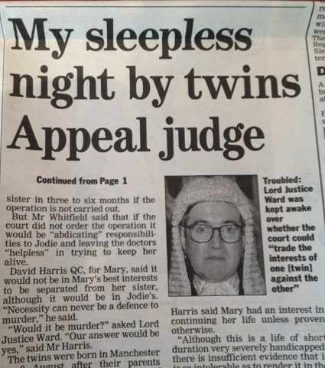
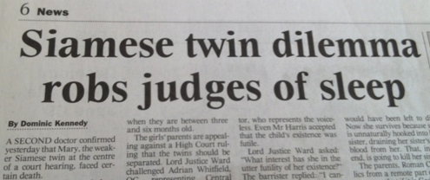

Slide 38
The Daily Mail’s reaction

Slide 39
Media response.

Slide 40
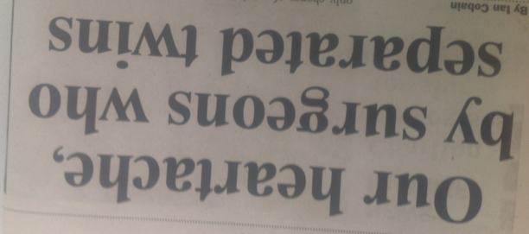
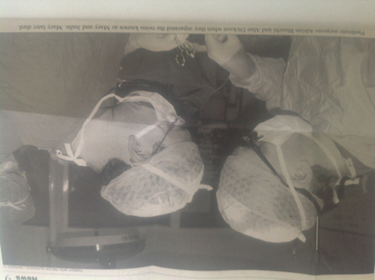
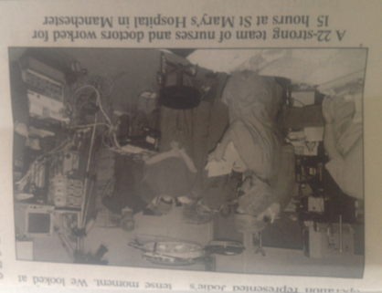

Slide 41
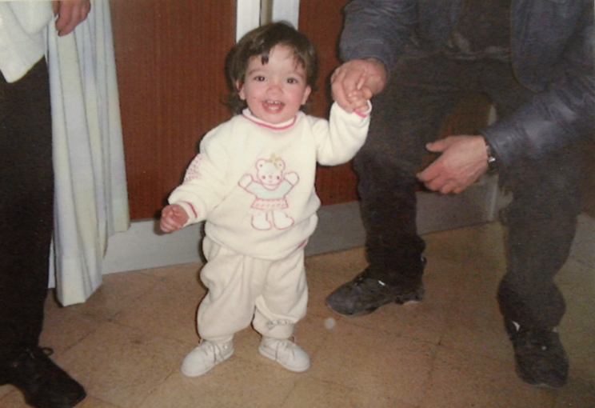

Slide 42
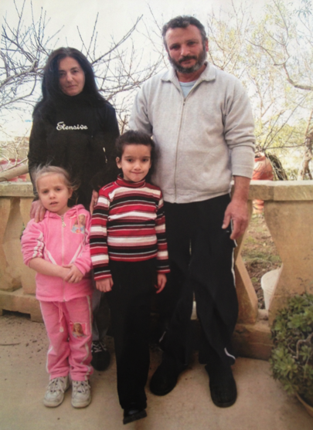

Slide 43
Jodie aged 14

Slide 44
The ICLR’s verdict
“It is rare to find a judgment which can so readily be recommended, despite its length, for reading by those outside the discipline of law, but the case is one which captures the imagination of lay readers in a way not matched by most of the daily business of the courts.”
“[Ian McEwan’s book] can at least claim to have drawn wider attention to an aspect of judicial law-making about which a lay readership (especially one now fed a constant diet of complain about “unelected judges” and their preference for human rights over good old-fashioned common sense) could feel something not only positive, but perhaps even morally reassuring.”

Slide 45
Good or bad decision?
Now you be the judge and decide was Mary to die or not to die.

