Slide 1
BLACK HOLES
Joseph Silk
IAP/JHU/Oxford

Slide 2
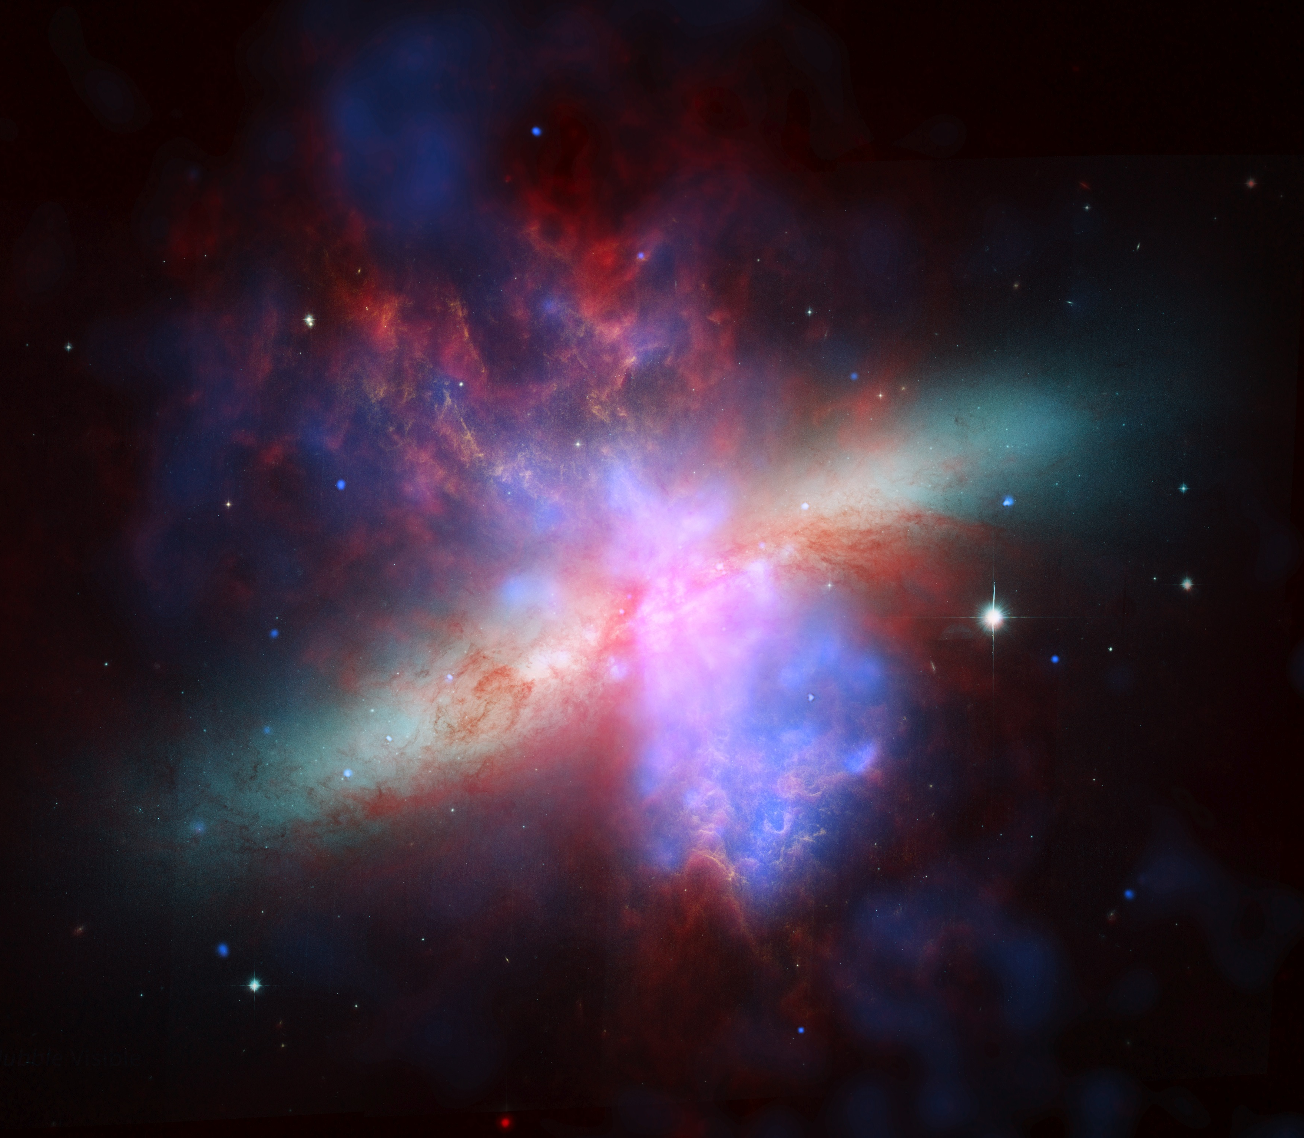
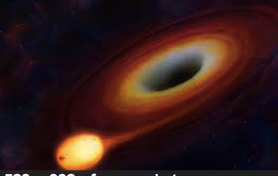

Slide 3
The black hole is a completely collapsed object. It is mass without matter. The Cheshire cat in Alice in Wonderland faded away leaving behind only its grin. A star that collapses to make a black hole fades away. There remains behind only gravitational attraction, the attraction of disembodied mass. John Wheeler 1981

Slide 4
Discovering black holes
Predictions
Black holes in astronomy
Observing black holes at last
Searching for monster black holes
Quasars

Slide 5
The amazing force of gravity
Compress sun into a sphere 4 miles in diameter
Gravity on surface is strong, mass collapses to a point
Event horizon is the ghost of the surface
Even light cannot escape
Further away, its just gravity falling off as 1/r²
Space-time moves matter, matter curves space-time
If a black hole is disturbed or collides, it vibrates
Produces ripples in space-time: gravitational waves
Energy is carried away, orbiting black holes merge

Slide 6
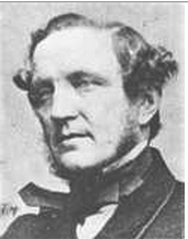
PREDICTION
If the semi-diameter of a sphere of the same density as the Sun were to exceed that of the Sun in the proportion of 500 to 1, a body falling from an infinite height towards it would have acquired at its surface greater velocity than that of light, and consequently supposing light to be attracted by the same force in proportion to its vis inertiae, with other bodies, all light emitted from such a body would be made to return towards it by its own proper gravity.
John Michell 1783
Professor of Geology at Cambridge, then a Yorkshire vicar
Invented artificial magnets & father of seismology &
“Cavendish” torsion balance for measuring mass of Earth
Proposed black holes “dark stars” and how to measure
their mass in a binary system
John Michell 1724-1793
½ v² =GM/r
v < speed of light c
Escape velocity from star satisfies
If a star is too compact, light cannot escape!
The critical size is r=2GM/c²
v

Slide 7
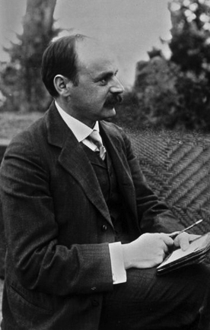
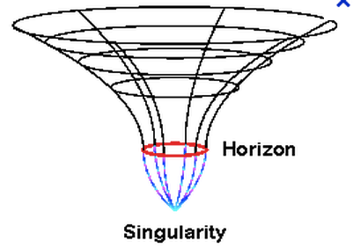
Karl Schwarzschild 1873-1916
A year before he died on the Russian front,
he read: Einstein 1915: “Gravity curves space”
and calculated the horizon size of a black hole
Schwarzchild radius r=2GM/c²

Slide 8
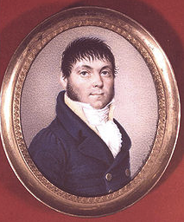
Georg von Soldner 1776-1833
In 1804 he predicted deflection 0.84” by sun.
Used Newton’s theory: light consists of particles.
We now know it’s a wave! But thanks to Einstein: quantum of light E=mc².
θ=2Gm/rc²

Slide 9
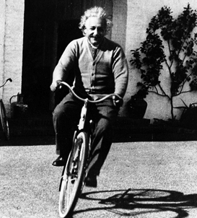
Albert Einstein 1879-1955
In 1911 used special relativity (time dilation) to confirm Newtonian deflection, without citingSoldner!
In 1916 used general relativity to get the correct result of 4GM/rc² (time dilation + space curvature)

Slide 10
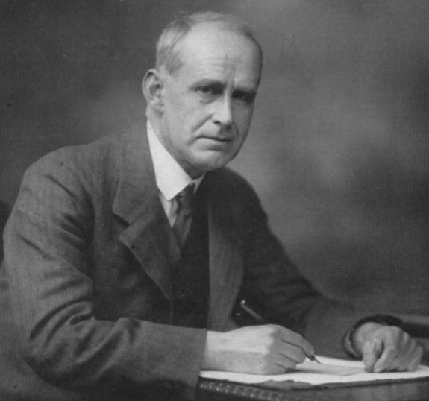
Arthur Eddington 1882-1946
imagine a physicist calculating
on a cloud-bound planet and ending with the
dramatic conclusion, "What 'happens' is the stars."
In 1913, Einstein wrote to many astronomers
urging them tosearch for his predicted shift of 0.87”
In 1916, he changed his mind: 0.87” was the newtonian
prediction, his was double this!
Eddington avoided conscription as a conscientious objector by agreeing to lead an expedition to Principe, West Africa in 1919 to measure the deflection of light during a total eclipse. Another expedition went to Sobral, Brazil.
The results:
Einstein’s prediction: 1.74”, Newton’s theory: 0.87”
Sobral: 1.98+-0.16”; Principe: 1.61+-0.40”

Slide 11
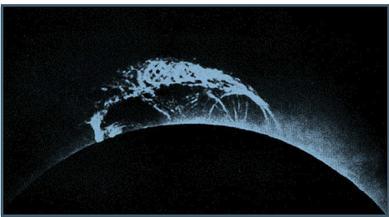

Slide 13
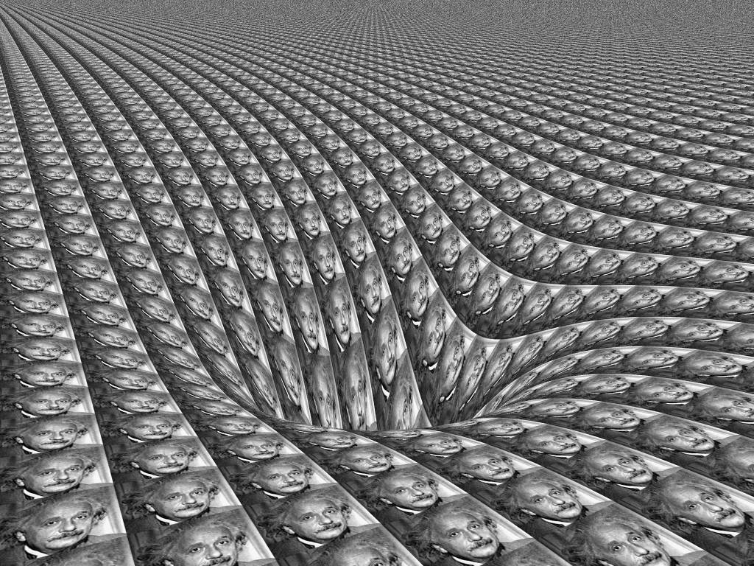
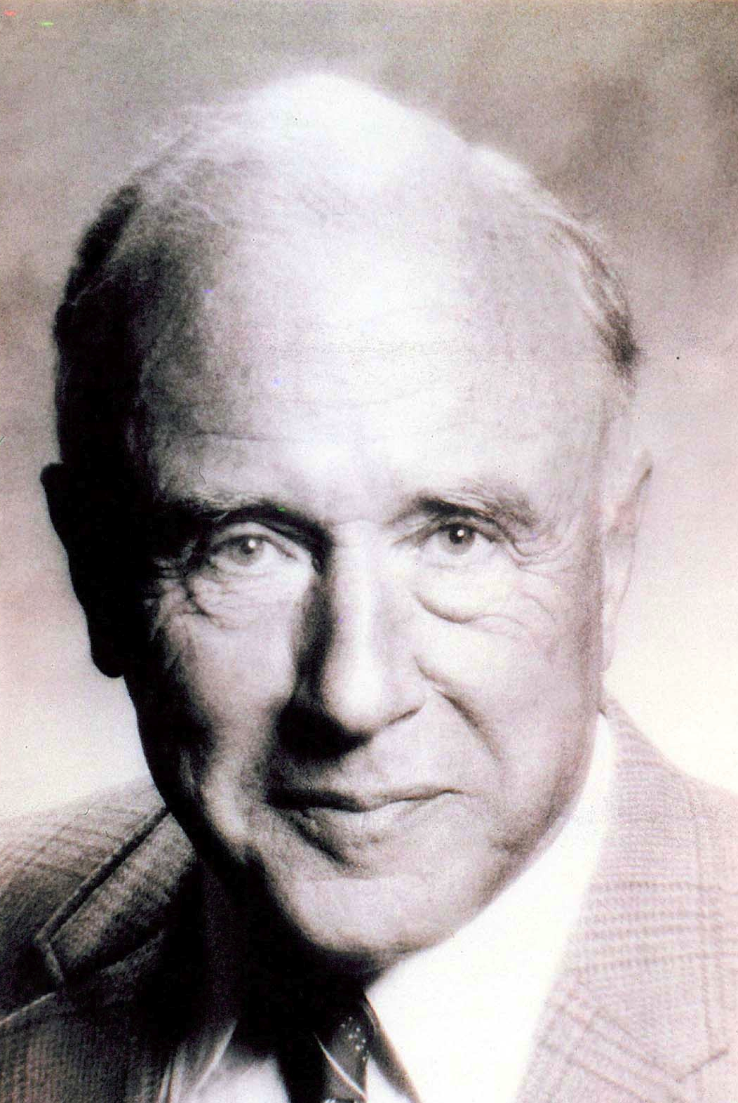
John Archibald Wheeler
1911-2008

Slide 14
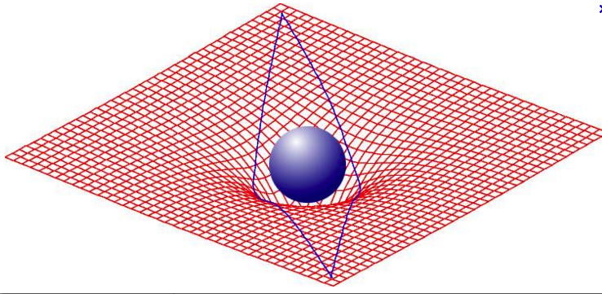
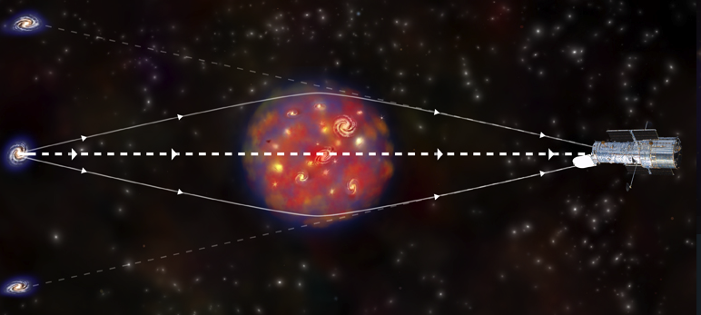
According to Einstein, matter curves space, and space moves matter
Gravitational lensing predicted by Einstein in 1916

Slide 15
Gravitational lens observed!

Slide 16
two types of astrophysical black holes
stellar
Tens of solar masses
supermassive
Millions of solar masses

Slide 17
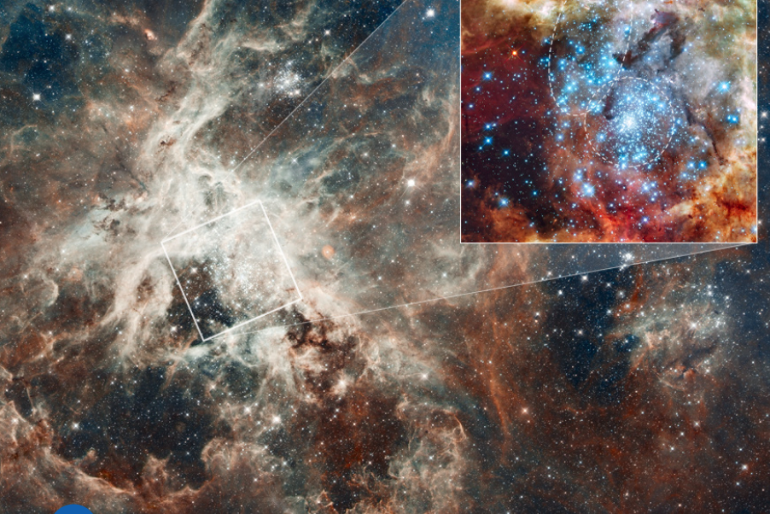
These stars will form black holes
30 Doradus
Eta carina

Slide 18
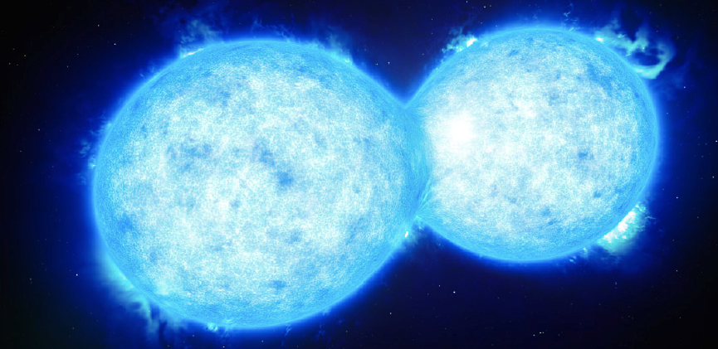
En route to a black hole
X-ray binary stars
Calcada 2015
Contact binary stars
Almeida 2015

Slide 19
Feeding the black hole
Observe as a luminous x-ray source
Ruiz 2014

Slide 20
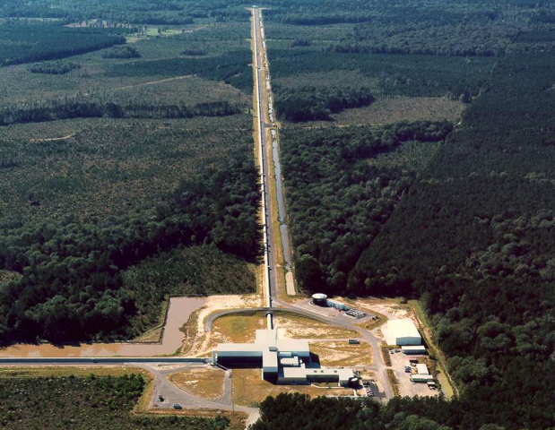
Observing black holes in Hanford, Washington
and in Louisiana

Slide 21
How an interferometer works

Slide 22
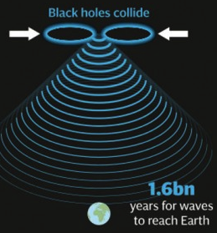
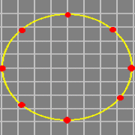

Slide 23
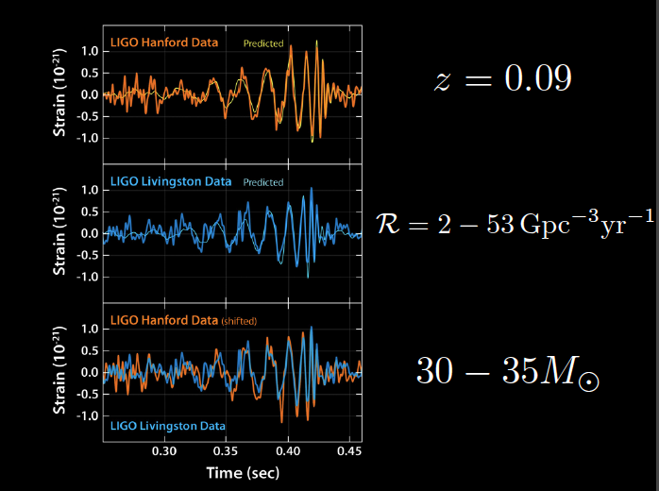
Observing black holes, at last!
Distance
Rate
Mass

Slide 24
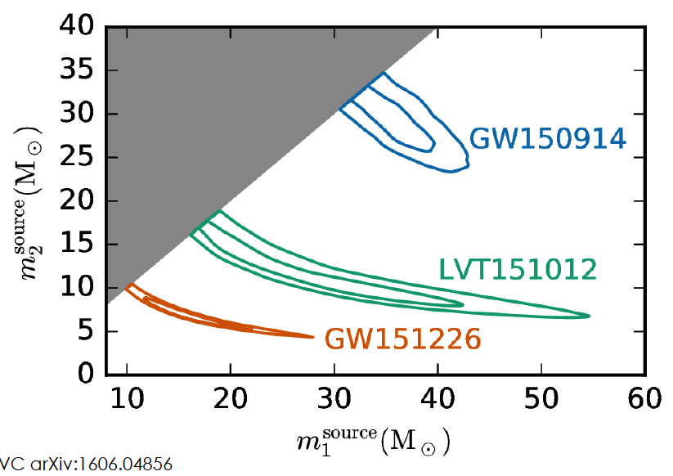

Slide 25
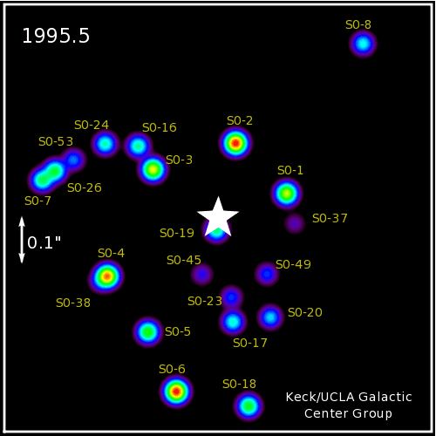
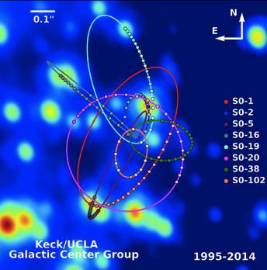
Orbits of stars tell us black hole mass
Centre of our galaxy

Slide 26
Supermassive black holes lurk in the centers of galaxies

Slide 27
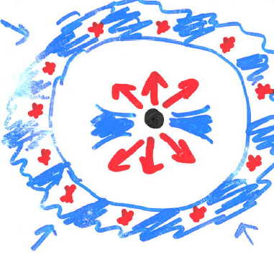

Slide 28
Gabor & Bourneaud 2014

Slide 29
The Milky way, in gamma rays
A giant explosion occurred 10 million years ago in our galactic center

Slide 30
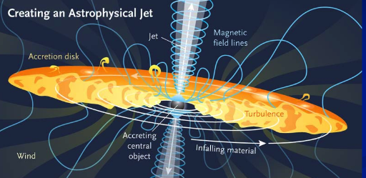
Winding up magnetic fields is explosive
McKinney 2010

Slide 31
Gaibler 2013

Slide 32
radio galaxy Hercules A

Slide 33
Black holes are likely to be kicked out
They could be lurking nearby!
Moore 2016

Slide 34
Gravitational waves, the only way to see a supermassive black hole
It takes a millisecond for stellar mass black holes to merge..
Need a kilometer scale laser base line
For a million solar mass BH its 1000 seconds
Need a million kilometer baseline
Only in space

Slide 35
eLISA launch in 2034

Slide 36
Far away from the black hole

Slide 37
Near the black hole
Generated by Alain Riazelou for the film INTERSTELLAR

Slide 38
and what may lie inside the black hole
black hole
A wormhole
Tunneling through
space and time
wormhole

Slide 39
MULTIVERSE

Slide 40
We live on an island surrounded by a sea of ignorance. As our island of knowledge grows, so does the shore of our ignorance
John Wheeler 1992

