Slide 1
2016-7 Lecture Series:
Where are we after the Storm? The UK Economy in the Aftermath of Financial Crisis:
Recession and Recovery
Professor Jagjit S. Chadha
Mercers’ School Memorial Professor of Commerce
© Jagjit S. Chadha 2016-7

Slide 2
Recessions and Recoveries
“A person's life consists of a collection of events, the last of which could also change the meaning of the whole, not because it counts more than the previous ones but because once they are included in a life, events are arranged in an order that is not chronological but, rather, corresponds to an inner architecture.”
Italo Calvino, Mr Palomar.

Slide 3
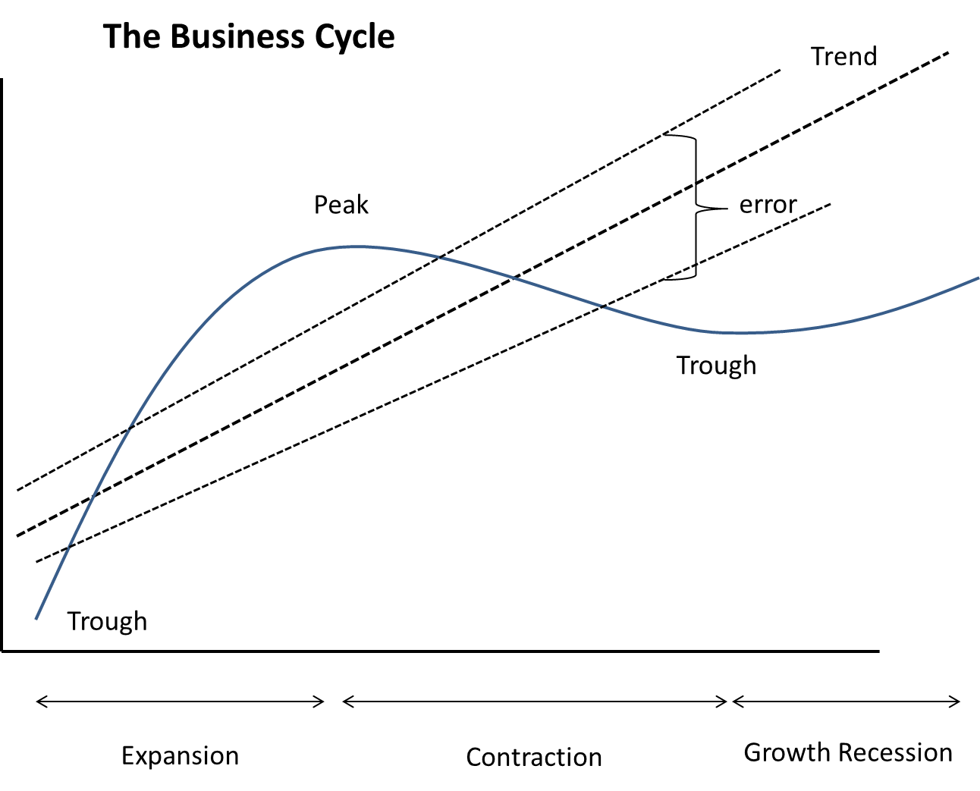

Slide 4
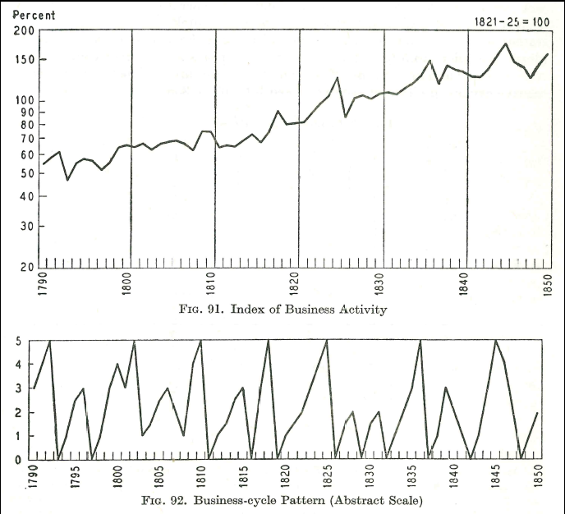

Slide 5
Business Cycles 1790-1850
Constructed Business Cycle Activity Index
Shows trend – during canal mania, war, deflation, post-war deflation and return to peacetime stability
Cycle is deviation from trend
Abstract index has 0 as depression and 5 as boom
7 peaks and 11 troughs so 6-8 business cycles of 6-10 years duration.

Slide 6
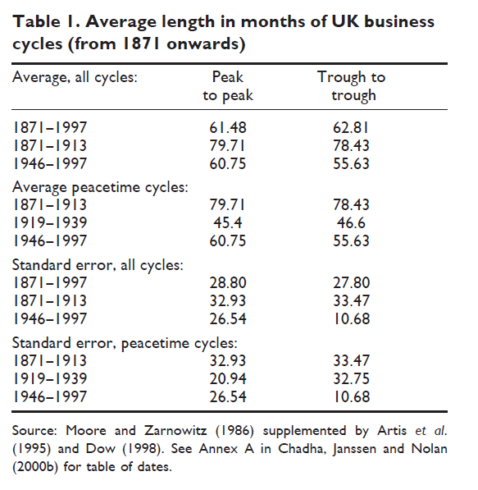

Slide 7
Business Cycles 1870-1992
Five-six years from peak to peak or trough to trough
Pre-1913 cycles seemed around seven years
Post-WWII cycles were around five years
The standard error was around 2-2.5 years
We could therefore expect cycles to operate in the range of 2-8 years
Many statistical filters therefore try to identify the frequency of range of 8-32 quarters

Slide 8
Demand-led Cycles
AS
P
SRAS
P
T
AD^{P}
AD¹
AD^{T}
Q

Slide 9
Depressions
AS
P
SRAS
AD^{P}
T
AD¹(Debt)
D
AD^{T}(Debt)
AD^{D}(Debt)
Q

Slide 10
The Long Expansion (growth)
q/q %
Peak
Trough
Trough

Slide 11
The Long Expansion (levels)
£mn 2013
Trend is your friend!

Slide 12
Was this Time Different?
18 year trough to trough cycle (1990-2008)
Arguably 18 year peak to peak (1987-2005)
Different economic process? Or juxtaposition of many factors? E.g. policy, globalisation, change in economic structure (inventories or digital)
Difficult to know in real time what is a peak
View of trend determines policy (monetary and fiscal) space
Private and Public debt hangover prompts careful judgement of recovery

Slide 13
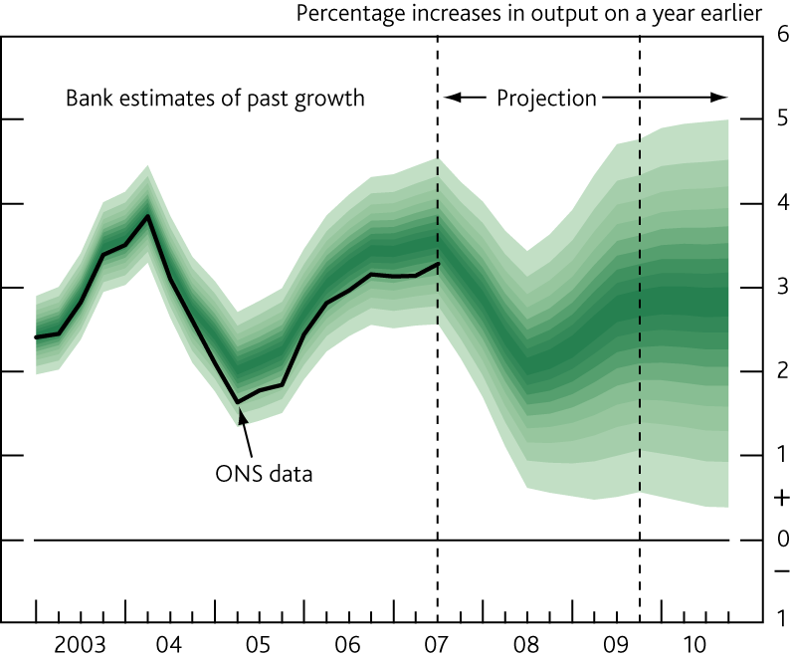
Nov 2007: BoE GDP projection (market interest rate expectations)

Slide 14
Recessions are Surprises
y/y growth

Slide 15
Freq.
UK annual GDP Growth in ranges and by frequency
Growth

Slide 16
Freq.
UK Annual postwar GDP Growth in ranges and by frequency
Blue bars actual
Red bars expected under normal dist.
Growth

Slide 17
Recession probabilities
1955q1 to 2016q1 gives 245 quarters and 244 quarterly growth rates
198 quarters were expansionary and 46 were contractionary
The unconditional sample probability of a contractionary quarter is 18.9%
The probability of a technical recession arising from two independent contractionary quarters is thus 3.6% (0.189*0.189)
But there have been 20 two quarter events involving contractions implying a sample probability of 8.9% (0.189*0.47=0.089)
This means the conditional probability of a contractionary quarter after a single random contractionary quarter is 47%
Recessions may signal some fundamental period of change

Slide 18
Post war recoveries in growth rates

Slide 19
Post war recoveries in levels

Slide 20
Remarks
Recessions are shocks, surprises and unanticipated
Might be Demand, Supply or Policy-induced but difficult to explain
Do not conform to deterministic periodicity
May represent paradigm or regime shift
Imbue or even scar the collective memory
May have important distributional effects

Slide 21
Concluding Remarks
Recessions are rare but important events
Recovery can be rapid but equally can be quite elusive
To what extent are recessions:
Just a negative draw?
A signal for reform?
To what extent is recovery the responsibility of government and stabilisation policy or something for which we simply wait?

