Slide 1
Gresham Lectures 2016-17
Divinity Lecture 1
Does science rob nature of its mystery and beauty? And can theology restore this?
John Ruskin on science, religion, and the arts
Alister McGrath
Gresham Professor of Divinity

Slide 2
Bonaventure
“All the creatures of this sensible world lead the soul of a wise and contemplative person to the eternal God, since they are the shadows, echoes, pictures, vestiges, images and visible manifestation of their eternal origin . . . They are put before us for the sake of our knowing God.”

Slide 3
William Wordsworth
One impulse from a vernal wood
May teach you more of man,
Of moral evil and of good,
Than all the sages can.
Sweet is the lore which Nature brings;
Our meddling intellect
Mis-shapes the beauteous forms of things:
We murder to dissect.

Slide 4
John Keats
Do not all charms fly
At the mere touch of cold philosophy?
There was an awful rainbow once in heaven:
We know her woof, her texture; she is given
In the dull catalogue of common things.
Philosophy will clip an Angel’s wings.

Slide 5
G. K. Chesterton
“Every true artist feels that he is touching transcendental truths; that his images are shadows of things seen through the veil.”

Slide 6
Mark Twain
Life on the Mississippi (1883)
“The face of the water, in time, became a wonderful book – a book that was a dead language to the uneducated passenger, but which told its mind to me without reserve, delivering its most cherished secrets as clearly as if it uttered them with a voice.”

Slide 7
Mark Twain
“There never was so wonderful a book written by man; never one whose interest was so absorbing, so unflagging, so sparkingly renewed with every re-perusal.”

Slide 8
Mark Twain
“All the grace, the beauty, the poetry had gone out of the majestic river!”
“I had lost something which could never be restored to me while I lived.”

Slide 9
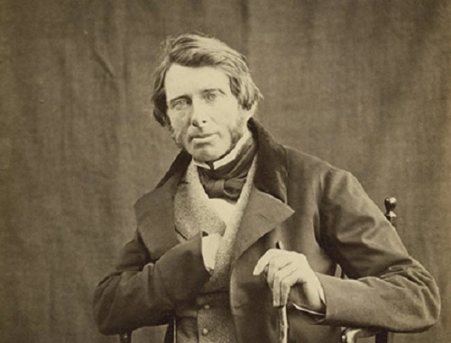
John Ruskin

Slide 10
John Ruskin
“We want, in this sad world of ours, very often to see in the dark – that’s the greatest gift of all – but at any rate to see; no matter by what light, so only we can see things as they are.”

Slide 11
John Ruskin
“It is necessary to the existence of an idea of beauty, that the sensual pleasure which may be its basis should be accompanied first with joy, then with love of the object, then with the perception of kindness in a superior intelligence, finally, with thankfulness and veneration towards that intelligence itself.”

Slide 12
John Ruskin
“The mere animal consciousness of the pleasantness I call Aesthesis; but the exulting, reverent, and grateful perception of it I call Theoria. For this, and this only, is the full comprehension and contemplation of the Beautiful as a Gift of God.”

Slide 13
William Wordsworth
The Tables Turned:
Sweet is the lore which Nature brings;
Our meddling intellect
Mis-shapes the beauteous forms of things:
We murder to dissect.

Slide 14
John Ruskin
Wordsworth “could not understand that to break a rock with a hammer in search of crystal may sometimes be an act not disgraceful to human nature, and that to dissect a flower may sometimes be as proper as to dream over it.”

Slide 15
John Ruskin
“It gilded all the dead walls, and I felt a charm in every vine tendril that hung over them. It required an effort to maintain the feeling: it was poetry while it lasted, and I felt that it was only while under it that one could draw, or invent, or give glory to, any part of such a landscape.”

Slide 16
John Ruskin
“I had a hot march among the vines, and between their dead stone walls; once or twice I flagged a little, and began to think it tiresome; then I put my mind into the scene, instead of suffering the body only to make report of it; and looked at it with the possession-taking grasp of the imagination – the true one.”

Slide 17
Arthur Koestler
“In my youth, I regarded the universe as an open book, printed in the language of physical equations and social determinants, whereas it now appears to me as a text written in invisible ink, of which, in our rare moments of grace, we are able to decipher a small fragment.”

Slide 18
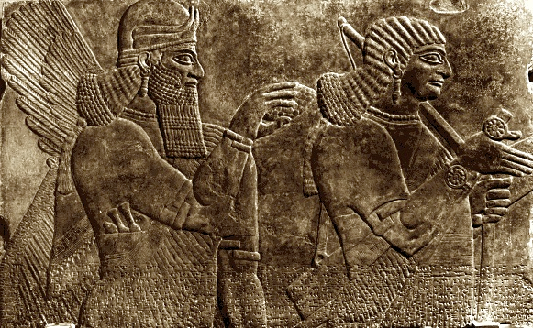
Canford School: The Stone

Slide 19
William James
“At a single stroke, [theism] changes the dead blank it of the world into a living thou, with whom the whole man may have dealings.”

Slide 20
Jonathan Edwards
“When we are delighted with flowery meadows and gentle breezes of wind, we may consider that we only see the emanations of the sweet benevolence of Jesus Christ; when we behold the fragrant rose and lily, we see his love and purity.”

Slide 21
Jonathan Edwards
“So the green trees and fields, and singing of birds, are emanations of his infinite joy and benignity; the easiness and naturalness of trees and vines [are] shadows of his infinite beauty and loveliness; the crystal rivers and murmuring streams have the footsteps of his sweet grace and bounty.”

Slide 22
Anna King on Spirituality
“The term spirituality as currently used, indicates both the unity at the heart of religious traditions and the transformative inner depth or meaning of those traditions. . . . It supplies a term which transcends particular religions and it suggests a non-reductionist understanding of human life. It is more firmly associated than religion with creativity and imagination, with change, and with relationship.”

Slide 23
Gregorii Petrov
“O Lord, how lovely it is to be your guest.
Breezes full of scents; mountains reaching to the skies;
Waters like boundless mirrors, reflecting the sun’s golden rays and the scudding clouds.
All nature murmurs mysteriously, breathing the depth of tenderness.”

Slide 24
Gregorii Petrov
“Birds and beasts of the forest bear the imprint of your love.
Blessed is mother earth, in your passing loveliness, which awakens our yearning for the happiness that will last for ever,
In the eternal native land where, amid beauty that will never grow old, the cry rings out: Alleluia!”

Slide 25
[End]

