Slide 1
Sex, death & witchcraft
- what goes on in the family court?
Johanne Delahunty qc

Slide 2
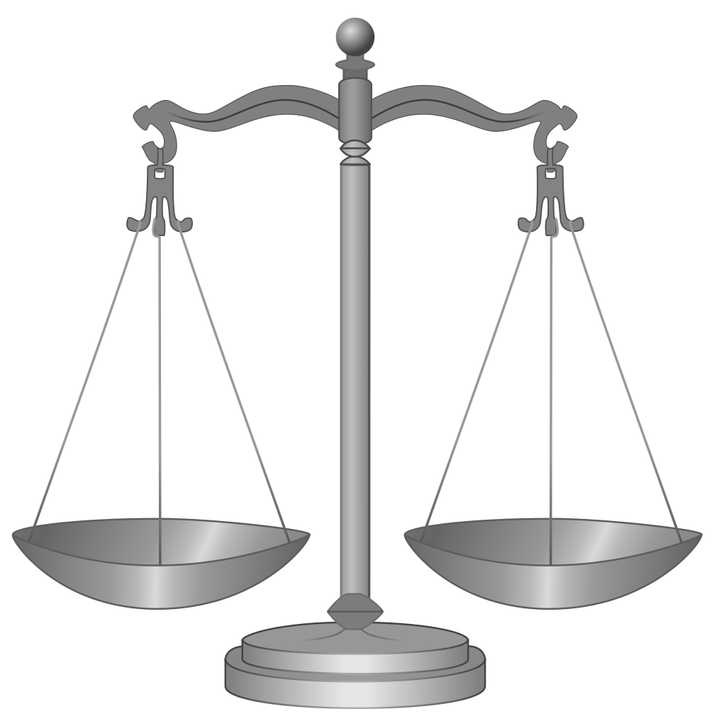
Introduction
Sex, death & witchcraft
Seminar Programme
Today's Lecture
My Background
A Warning!
Aren't you all just lawyers?

Slide 3
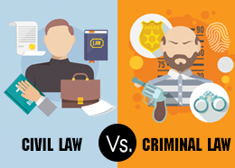
Criminal law vs civil law
Sex, death & witchcraft
Standard of proof
Criminal: beyond reasonable doubt
Civil: balance of probabilities
Family Law
Branch of Civil Law
Private vs Public
http://www.buzzle.com/articles/difference-between-civil-and-criminal-law.html

Slide 4
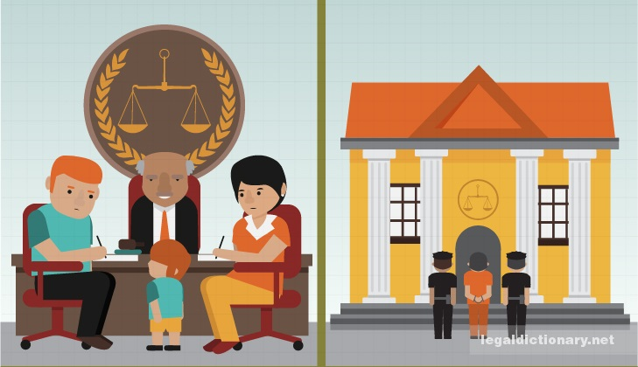
Crime vs care
Sex, death & witchcraft
Example
Death of Kye Kerr
Same event - different verdicts
Different rules of evidence
Press
Wigs & Gowns
Jury decides / Judge decides
Standard of proof
http://legaldictionary.net/civil-law/

Slide 5
Kye Kerr - background
Sex, death & witchcraft
11th July 2011 - 6 week old Kye Kerr died
Catastrophic head injury
Sibling (A) temporarily removed
Cause of death unascertained
No proceedings; A returned to parents
2013 - conclusions reviewed; parents arrested
A taken into foster care

Slide 6
Kye kerr - liverpool crown court
Sex, death & witchcraft
Regina v D - Mr Beattie charged with murder
Different rules of evidence
Press & public allowed in
Barristers wear wigs & gowns
Jury returns verdict
Beyond reasonable doubt
Guilty or Not Guilty
Judge determines sentence if Guilty verdict

Slide 7
Kye kerr - family division
Sex, death & witchcraft
Cumbria County Council v M & Others
Mr Beattie, Kye's mother and sibling A respondents
Evidence in care case wider
Public not admitted; restrictions on press
No wigs & gowns
No jury; judge decides
Balance of probabilities
Child's welfare paramount
Judge makes order - contact, adoption, fostering etc

Slide 8
Private law vs public law
Sex, death & witchcraft
Private Family Law
between parents
Public Family Law
between The State and the family
Burden of proof
Standard of proof
Removal of a child
https://www.roberthalf.com/accountemps/blog/public-accounting-vs-private-accounting-whats-right-for-you

Slide 9
Private law vs public law
Sex, death & witchcraft
Private Law: Parent A v Parent B
Public Law: Local Authority X v A, B and C (the child)
Public Law: professional concern of actual or potential harm
Harm - emotional, physical, sexual, etc
Threshold Criteria

Slide 10
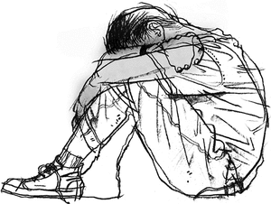
Public family law - care & wardship
Sex, death & witchcraft
What constitutes child abuse?
What is "significant harm?"
What factors are considered?
"The most drastic decision....any judge is empowered to make"
https://www.emaze.com/@AZRWCTFZ/Presentation-Name

Slide 11
Changing definition of harm
Sex, death & witchcraft
'The family court system, particularly the Family Division, is, and always has been, in my view, in the vanguard of change in life and society. Where there are changes in medicine or in technology or cultural change, so often they resonate first within the family. Here, the type of harm I have been asked to evaluate is a different facet of vulnerability for children than that which the courts have had to deal with in the past.’
Per Hayden J

Slide 12
Impact of public law decisions
Sex, death & witchcraft
‘with the state’s abandonment of the right to impose capital sentences, orders of the kind which family judges are typically invited to make in public law proceedings are amongst the most drastic that any judge in any jurisdiction is ever empowered to make. When a judge makes placement order or an adoption order in relation to a twenty year old mother’s baby, the mother will have to live with the consequences of that decision for what may be upwards of 60 or even 70 years, and the baby may be upwards of 80 or even 90 years’
Re J (A Child) [2013] EWHC 2894 (Fam)

Slide 13
Issues impacting the family court
Sex, death & witchcraft
Geographical
Cultural
Sexual
Political
Religious
Scientific
Medical
www.emaze.com

Slide 14
Geographical
Sex, death & witchcraft
Unaccompanied minors
Child slavery
"Miracle babies"
Removal - in UK or abroad?
Jurisdiction
http://www.123rf.com/photo_19121122_world-globe-travel-map-with-airplanes-boat-balloon.html

Slide 15
Cultural
Sex, death & witchcraft
Forced marriage vs arranged marriage
Female Genital Mutilation vs Male Circumcision
Kindoki
https://openclipart.org/detail/233143/united-globe

Slide 16
Sexual
Sex, death & witchcraft
Stranger danger?
Intra family abuse
Abused or abuser?
http://www.internationalchildsafety.org/

Slide 17
Political
Sex, death & witchcraft
Courts are not "Guardians of Morality"
When to intervene?
https://stefaniefix.wordpress.com/tag/culture

Slide 18
Religious
Sex, death & witchcraft
Radicalisation
Human Rights Act 1998
Often no physical harm
Consequences of removal
Blood transfusions
http://www.123rf.com/clipart-vector/world_religion.html

Slide 19
Scientific
Sex, death & witchcraft
Benign causes mimicking abuse
The Triad
Vitamin D deficiency
http://www.oxfordhomeschooling.co.uk/subject/science-igcse/

Slide 20
Medical
Sex, death & witchcraft
Coventional vs alternative medicine
Professional vs parental view
When does a court intervene?
Child's welfare paramount
Parents' wishes?
https://www.quora.com/What-is-the-history-behind-the-symbol-of-medicine

Slide 21
Closing remarks
Sex, death & witchcraft
Welfare of the child
Rights of the child
What was once acceptable is no longer
The lawyer's role
what we are
what we are not
Future lectures
Questions
http://www.stockunlimited.com/vector/thank-you-for-coming-label_1708127.html

Slide 22
future lectures
Sex, death & witchcraft
Is One Individual's Radicalism Another's Right To Free Speech?
Thursday 24th November 2016
When Legal Worlds Collide
Thursday 26th January 2017
Guilty Until Proven Innocent
Thursday 2nd March 2017

