Slide 1
Customer or Product?
ownership and control of personal data
Martyn Thomas CBE FREng
Livery Company Professor of Information Technology

Slide 2
Twitter and Facebook
Why are Twitter and Facebook worth so much?
How do free services maximise their profits?
What exactly are they selling?
See the lecture transcript for all references

Slide 3
Facebook
reported figures for the 3 months to June 30 2016
Revenue: $6.347 billion
Profit (before tax, after $1.462B R&D): $2.766 billion
1.71 billion monthly active users
Market value: > $350 billion
each user is worth more than $200 to shareholders and generates $1.62 profit every 3 months

Slide 4
Twitter
reported figures for the 3 months to June 30 2016
Revenue: $602 million
Loss (before tax, after $178 million R&D): $104 million
313 million monthly active users
Market value: > $12 billion
each user is worth around $38 to shareholders and costs $0.33 every 3 months

Slide 5
Take-over values
Facebook bought WhatsApp for $16 billion - £19 billion in 2014, when WhatsApp had 450m active users (it is now said to have over 1 billion active users)
Google bought YouTube for $1.6 billion in 2006 when YouTube had some 12 million active users
The number of active users is an important factor explaining the difference between the value of these companies and the value of their staff, technology, and other tangible and intangible assets

Slide 6
Monetisation
turning users into revenue
Advertisers will pay for access to users, but usually only if their adverts create some desired user action
  random advertising would be ineffective - they want to target particular groups of users
  the more effective their advertising is, the more they are willing to pay
  showing the most profitable adverts to the best targeted users will maximise profits for advertisers and for the company selling the access to their users

Slide 7
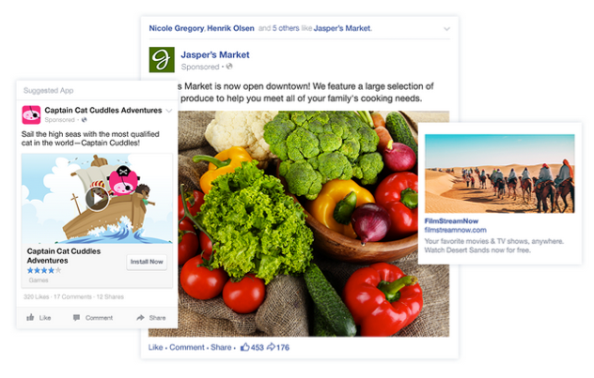
Successful Monetisation
#1: Facebook advertising

Slide 8
Facebook advert targeting
Facebook offers targeting by ….
Location Reach your customers in the areas where they live or where they do business with you. Target adverts by country, county/region, postcode or even the area around your business.
Demographics Choose the audiences that should see your adverts by age, gender, interests and even the languages they speak.
Interests Choose from hundreds of categories such as music, films, sport, games, shopping and so much more to help you find just the right people.

Slide 9
Behaviours You know your customers best, and you can find them based on the things they do – such as shopping behaviour, the type of phone they use or if they're looking to buy a car or house.
Connections Reach the people who like your Page or your app – and reach their friends, too. It's an easy way to find even more people who may be interested in your business.
Partner categories These are targeting options provided by third-party data partners. With Partner Categories, you can reach people based on offline behaviours people take outside Facebook, such as owning a home, being in the market for a new van or being a loyal purchaser of a specific brand or product. Facebook has partnered with Acxiom, Epsilon, Experian Marketing Services, Oracle Data Cloud (formerly Datalogix), and Quantium to activate Partner Categories in specific markets. These third-party partners collect and model data from a variety of sources, like public records, loyalty card programs, surveys and independent data providers.
These descriptions were taken from https://en-gb.facebook.com/business/products/ads/ad-targeting/ (on 23/8/2016)

Slide 10
Facebook charging
Facebook charges by results – an agreed fee for:
    likes
    click-throughs to web pages
    video views
    joining an event
    downloading an advertised app
    … or any other action that Facebook makes available to advertisers
So Facebook’s income depends on showing the right adverts to targeted users

Slide 11
What adverts will you see?
The ones that maximise the advertiser’s hits and Facebook’s income
Facebook helps the advertiser to target their audience and to calculate what it is worth offering for each action by a user.
Facebook algorithms calculate a Facebook’s value for each advert, by combining their assessment of the likelihood that the user will respond, with the fee that the advertiser has bid for their advert to be displayed
When a page is accessed, the adverts are then compared in an auction to determine which adverts are shown on that page
There is a strong incentive for Facebook to keep users online and responding to advertisements that are well targeted

Slide 12
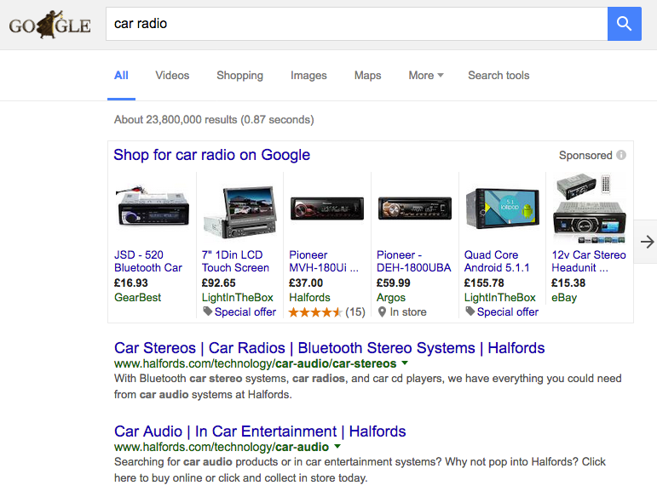
Successful Monetisation
#2: Google AdWords

Slide 13
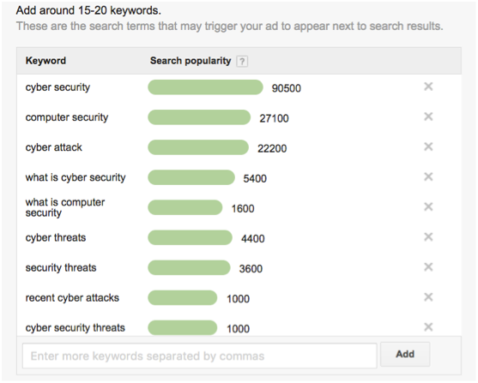
Google AdWords
Google AdWords are a mechanism to target advertisements to people who are searching for what the advertiser is offering
When a Google search matches the AdWords the advertiser has purchased, the advertisement has the chance of being shown near the search results.

Slide 14
Google AdWords
The advertiser sets the fee they are willing to pay for each click on their advert (and a daily budget to control their financial exposure).
A real time ad auction happens with each Google search to decide which ads will appear for that specific search and in which order those ads will show on the page.
Each time an Ad Words ad is eligible to appear for a search, it goes through the ad auction.
The auction determines whether or not the ad actually shows and in which ad position it will show on the page.

Slide 15
Google AdWords
Google explains the auction:
When someone searches, the Ad Words system finds all ads whose keywords match that search.
From those ads, the system ignores any that aren't eligible, like ads that target a different country or that are disapproved.
Of the remaining ads, only those with a sufficiently high Ad Rank may show. Ad Rank is a combination of your bid, ad quality and the expected impact of extensions and other ad formats.

Slide 16
Google uses personal data to target adverts, including …
• Things that you search for (remember how revealing the AOL search histories were that we looked at in my Big Data lecture)
• Websites that you visit
• Videos that you watch
• Ads that you click on or tap
• Your location
• Device information
• IP address and cookie data

Slide 17
… and other data you have provided
Your address, date of birth and gender
Emails that you send and receive on Gmail
Contacts that you add
Calendar events
Photos and videos that you upload
Docs, Sheets and Slides on Google Drive

Slide 18
Google tells users that it analyses emails and other uploaded content
Our automated systems analyze your content (including emails) to provide you personally relevant product features, such as customized search results, tailored advertising, and spam and malware detection. This analysis occurs as the content is sent, received, and when it is stored.

Slide 19
… and uses the data to target advertisements
We try to show you useful ads by using data collected from your devices, including your searches and location, websites and apps that you have used, videos and ads that you have seen and personal information that you have given us, such as your age range, gender and topics of interest.
If you are signed in, and depending on your Ads Settings, this data informs the ads that you see across your devices. So if you visit a travel website on your computer at work, you might see ads about airfares to Paris on your phone later that night.

Slide 20
How much personal data?
“In 2011, Max Schrems used European data privacy laws to file a request for his personal data from Facebook. Facebook provided him with a CD that had 1,222 pages of data chronicling about 3 years of his use of the service. After reviewing the data, Schrems discovered that Facebook had retained deleted chat conversations, event invitations he did not respond to, pokes, and details on his physical location identified by IP addresses, among other data which he never agreed to share. And the 1,222 pages only contained data from 23 out of the 84 categories Facebook has"
From https://informationactivism.org/en/europe-vs-facebook
Further lawsuit details on http://europe-v-facebook.org/EN/en.html

Slide 21
Who owns your personal data?
Many sites’ Terms and Conditions say that they can use your personal data in a wide variety of ways
Getting access to a relative’s data (their documents and photo library for example) may difficult after their death, even for executors.
See: What Happens to My Facebook Profile When I Die? Legal Issues Around Transmission of Digital Assets on Death, by Lilian Edwards (University of Strathclyde Law School) and Edina Harbinja (University of Strathclyde Law School; University of Hertfordshire).

Slide 22
Some of the data used to target your ads on Facebook can be seen at facebook.com/ads/preferences
Categories include:
Lifestyle/Culture, News/entertainment, Business/industry, People, Hobbies/activities, Travel/Places/events, Technology, Education, Shopping/Fashion, Food/Drink, Sports/Outdoors, Fitness/Wellness.
Lifestyle/Culture category has many subcategories: Judaism, Rhombus, Soho, Citrus, Portuguese language, Nobility, Piccadilly, Asia, Society, Prophets and messengers in Islam, Instant messaging, Universe, Mezzo-Soprano and many more
Facebook explains (in outline) why it has decided that each category is one of your interests
This may be a very tiny fraction of the data held by Facebook about each user.

Slide 23
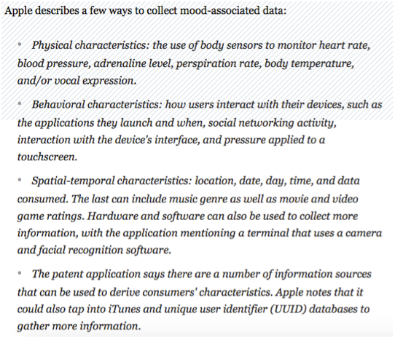
Targeting adverts by your Mood
This is apparently from an Apple patent application

Slide 24
Google’s patent application to track what advertisements you look at
– perhaps using Google Glass or a similar device?
Pay per gaze advertising need not be limited to on-line advertisements, but rather can be extended to conventional advertisement media including billboards, magazines, newspapers, and other forms of conventional print media. Thus, the gaze tracking system described herein offers a mechanism to track and bill offline advertisements in the manner similar to popular online advertisement schemes.
Furthermore, the inferred emotional state information can be provided to an advertiser (perhaps for a premium fee) so that the advertiser can gauge the success of their advertising campaign. For example, if the advertiser desires to generate a shocking advertisement to get noticed or a thought provoking advertisement, then the inferred emotional state information and/or the gazing duration may be valuable metrics to determine the success of the campaign with real-world consumers.

Slide 25
If mood is important to advertisers, might you be manipulated?
According to the Washington Post, Facebook
“tweaked the newsfeed algorithms of roughly 0.04 percent of Facebook users, or 698,003 people, for one week in January 2012. During the experiment, half of those subjects saw fewer positive posts than usual, while half of them saw fewer negative ones. To evaluate how that change affected mood, researchers also tracked the number of positive and negative words in subjects’ status updates during that week-long period. Put it all together, and you have a pretty clear causal relationship.”
See: Proceedings of the National Academy of Sciences of the United States of America Experimental evidence of massive-scale emotional contagion through social networks

Slide 26
Your Facebook News Feed
According to a Washington Post experiment, “as much as 72 percent of the new material your friends and subscribed pages post never actually shows up in your News Feed.”
In a recent study from the University of Illinois, 62.5 percent of participants had no idea Facebook screened out any posts.

Slide 27
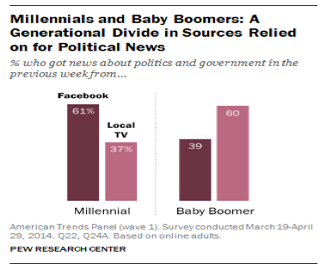
Where do Americans get their news?

Slide 28
The Filter Bubble
Social media sites want users to be happy and to stay online …
… so they tailor what you see, to give you more of what you like and read at length, and less of what you don’t
Over time, this shapes what you see, to reflect and reinforce your views and prejudices

Slide 29
Does this matter?
“Eli Pariser used the example of two people who googled the term “BP”. One received links to investment news about BP while the other received links to the Deepwater Horizon oil spill, presumably as a result of some recommendation algorithm.
This is an insidious problem. Much social research shows that people prefer to receive information that they agree with instead of information that challenges their beliefs. This problem is compounded when social networks recommend content based on what users already like and on what people similar to them also like.
This is the filter bubble—being surrounded only by people you like and content that you agree with.
And the danger is that it can polarise populations creating potentially harmful divisions in society.” (from MIT Technology Review)

Slide 30
How much control can you have?
Some… with a bit of inconvenience. This is what I do:
All searches use startpage.com which uses Google through a proxy and offers a proxy link to the resulting websites, so Google cannot easily link searches to me.
Firefox browser, set to private browsing (no history is kept and all cookies cleared after each session) with Ad Blockers Ghostery and Privacy Badger.
I disable Javascript using the NoScript plugin and only run scripts if I trust the website.
Does this seem paranoid? I’m not alone …

Slide 31
Most US aged18-24 use an ad blocker

Slide 32
Browsing without Ad Blockers can be dangerous
“This morning, we encountered a gratuitous act of violence against Android users. By simply viewing their favorite news sites over their morning coffee users can end up downloading a banking Trojan (detected by Kaspersky Lab solutions as Trojan-Banker.AndroidOS.Svpeng.q). There you are, minding your own business, reading the news and BOOM! – no additional clicks or following links required. And be careful – it’s still out there.
It turns out the malicious program is downloaded via the Google AdSense advertising network. Be warned, lots of sites use this network – not just news sites – to display targeted advertising to users. Site owners are happy to place advertising like this because they earn money every time a user clicks on it. But anyone can register their ad on this network – they just need to pay a fee. And it seems that didn’t deter the authors of the Svpeng Trojan from pushing their creation via AdSense. The Trojan is downloaded as soon as a page with the advert is visited.” Kaspersky 15 Aug 2016
Just going to a website with a malicious advert can infect your phone or computer.

Slide 33
Differential Pricing and Discrimination
Do websites offer everyone the same prices?
  Increasingly not. Their algorithms try to assess the maximum you are willing to pay.
When you compare prices and go back to the cheapest, why has that cheap fight or hotel room gone?
  It might have been sold but it’s possible that the website calculated that you would pay more now.
Many algorithms are confidential: they may be discriminating unlawfully, by accident or by design.

Slide 34
How Much is your Data Worth?
Here is what IT security company Avast Software, says that data sellers are charging for the following:
Credit cards without a balance guarantee: $8 per card (number and CVV
$2,000 balance guarantee: $20 per card (number and CVV)
Driver's license scans: $20
Email addresses and passwords: $0.70–$2.30
Social Security numbers: $1 ($1.25 for state selection)
PayPal credentials/access: $1.50

Slide 35
Conclusions
Your time and your personal data are valuable to commercial companies and to criminals and that value is increasing.
The amount of data they collect and store gives them increasing power: power to make money, but also power that could be used for other purposes. Power greater than other media, because of targeting
Big data analysis provides unprecedented power to address people individually and personally or as highly selected groups, and to influence or to discriminate against individuals or groups with impunity, because the algorithms for big data analysis are usually commercial secrets.
Free services have to be paid for somehow but, if we are the product being traded, are free services already too expensive?

Slide 36

Next Cyberliving Lecture
Safety-Critical Systems
Is what the standards and regulators require based on sound computer science?
Tuesday 10 January Museum of London
For the discussion forum for all lectures, visit www.cyberliving.uk

