Slide 1
THE EXPANDING UNIVERSE
Joseph Silk
Gresham Lecture 26 October 2016
IAP/JHU/Oxford

Slide 2
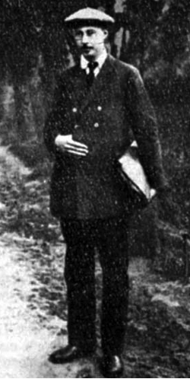
Alexander Friedmann
1888-1925

Slide 3
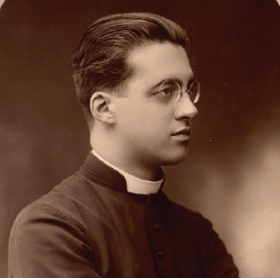
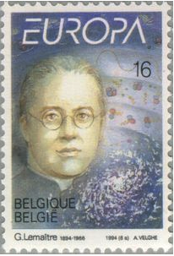
The evolution of the world can be compared to a display of fireworks that has just ended:
some few red wisps, ashes, and smoke. Standing on a cooled cinder, we see the slow fading
of the suns, and we try to recall the vanished brilliance of the origin of the world.
G. Lemasitre, The Primeval Atom, 1950
Georges Lemaitre
1894-1966

Slide 4
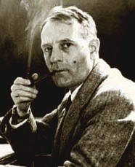
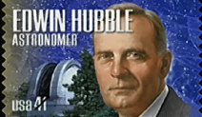
the observations as they stand
lead to the anomaly of a closed
universe, curiously small and dense,
and...suspiciously young. On the
other hand, if redshifts are not
Doppler effects, these anomalies
disappear and the region observed
appears as a small, homogeneous,
but insignificant portion of a
Universe extended indefinitely
both in space and time.
E. Hubble, MNRAS, 97, 506, 1937
1889-1953
Edwin Hubble

Slide 5
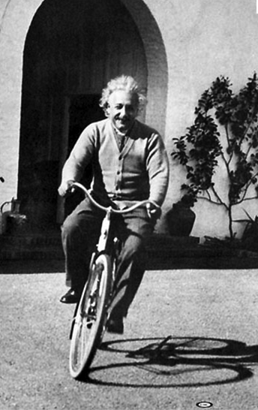
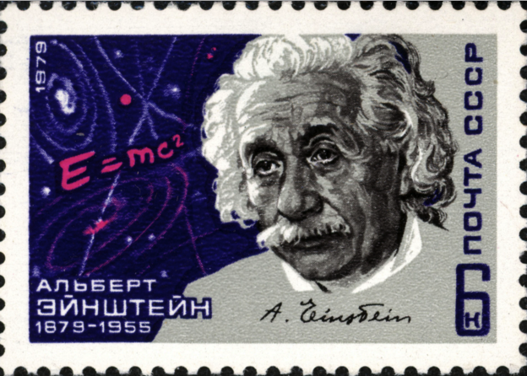
Albert Einstein
1879-1955

Slide 6
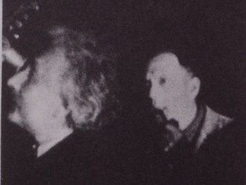
1930
Einstein
Hubble

Slide 7
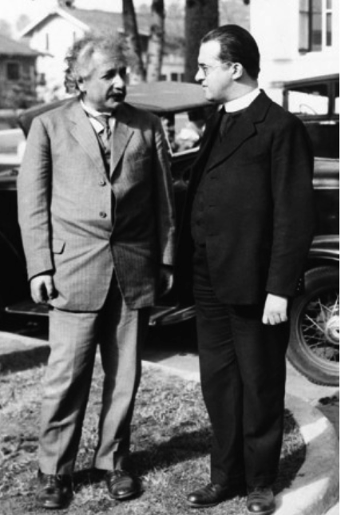
Albert Einstein
Georges Lemaitre

Slide 8
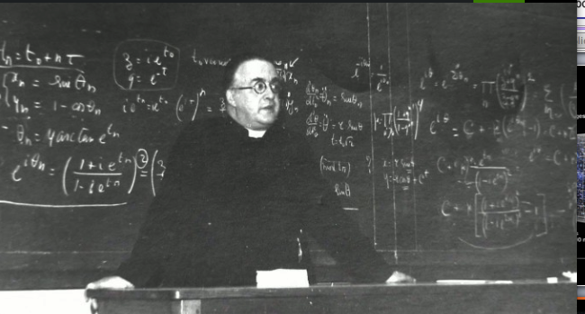
Georges Lemaitre

Slide 9
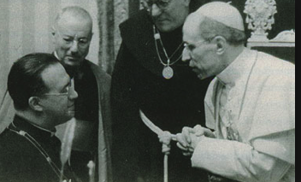
Georges Lemaitre
Pius XII

Slide 10
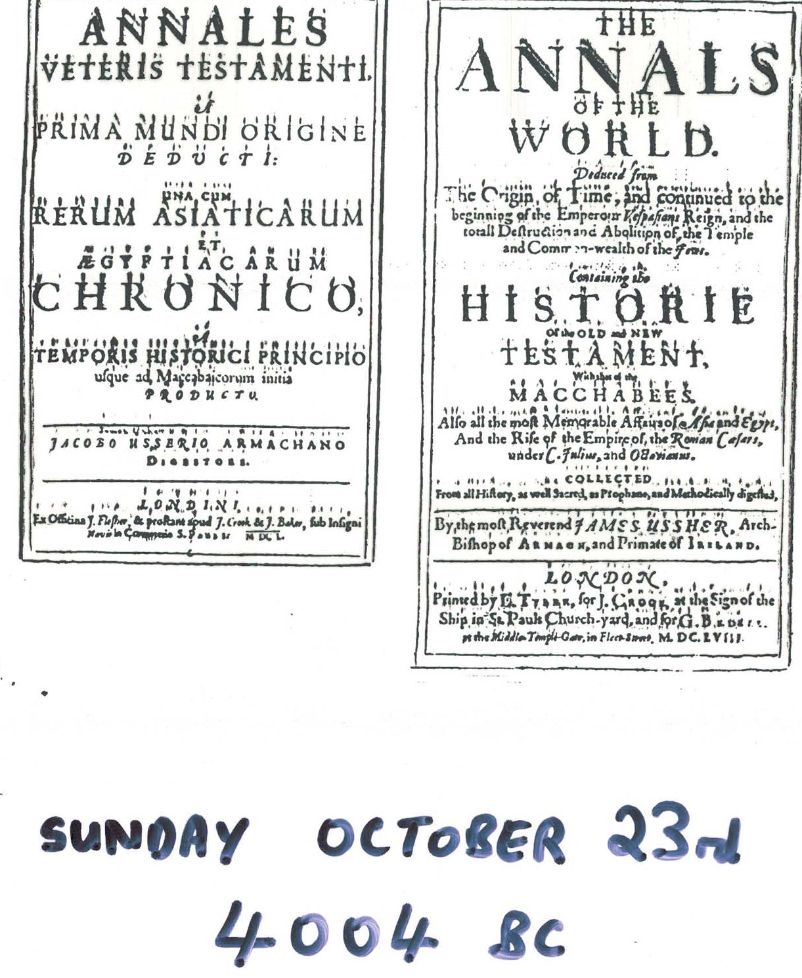
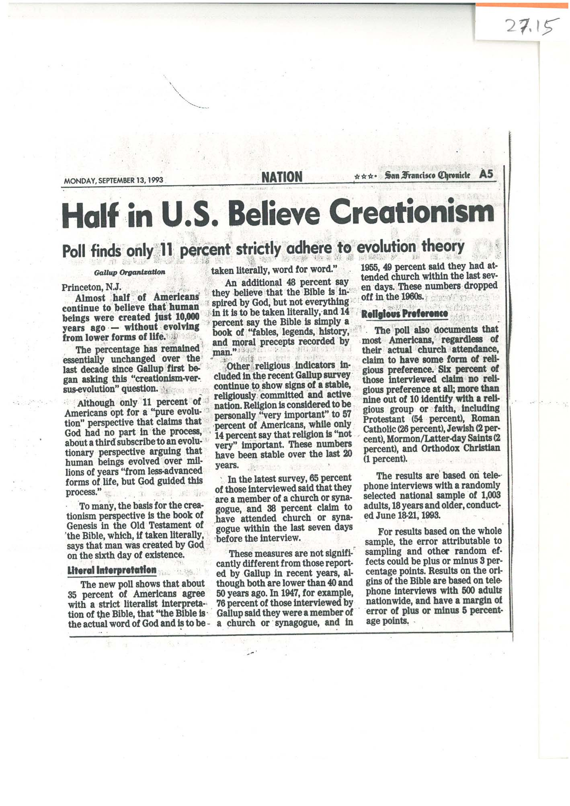
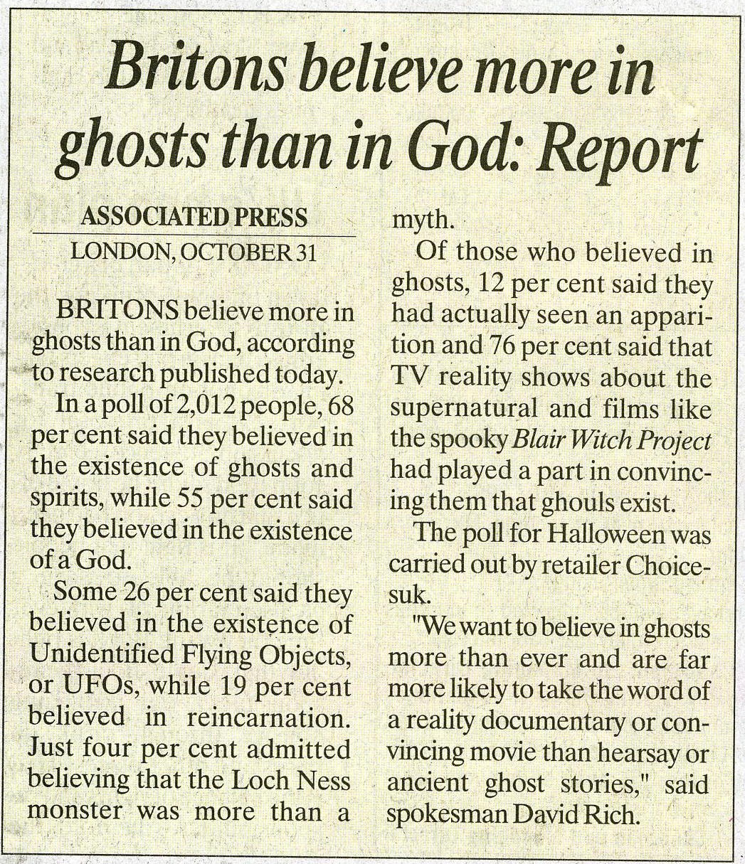

Slide 11

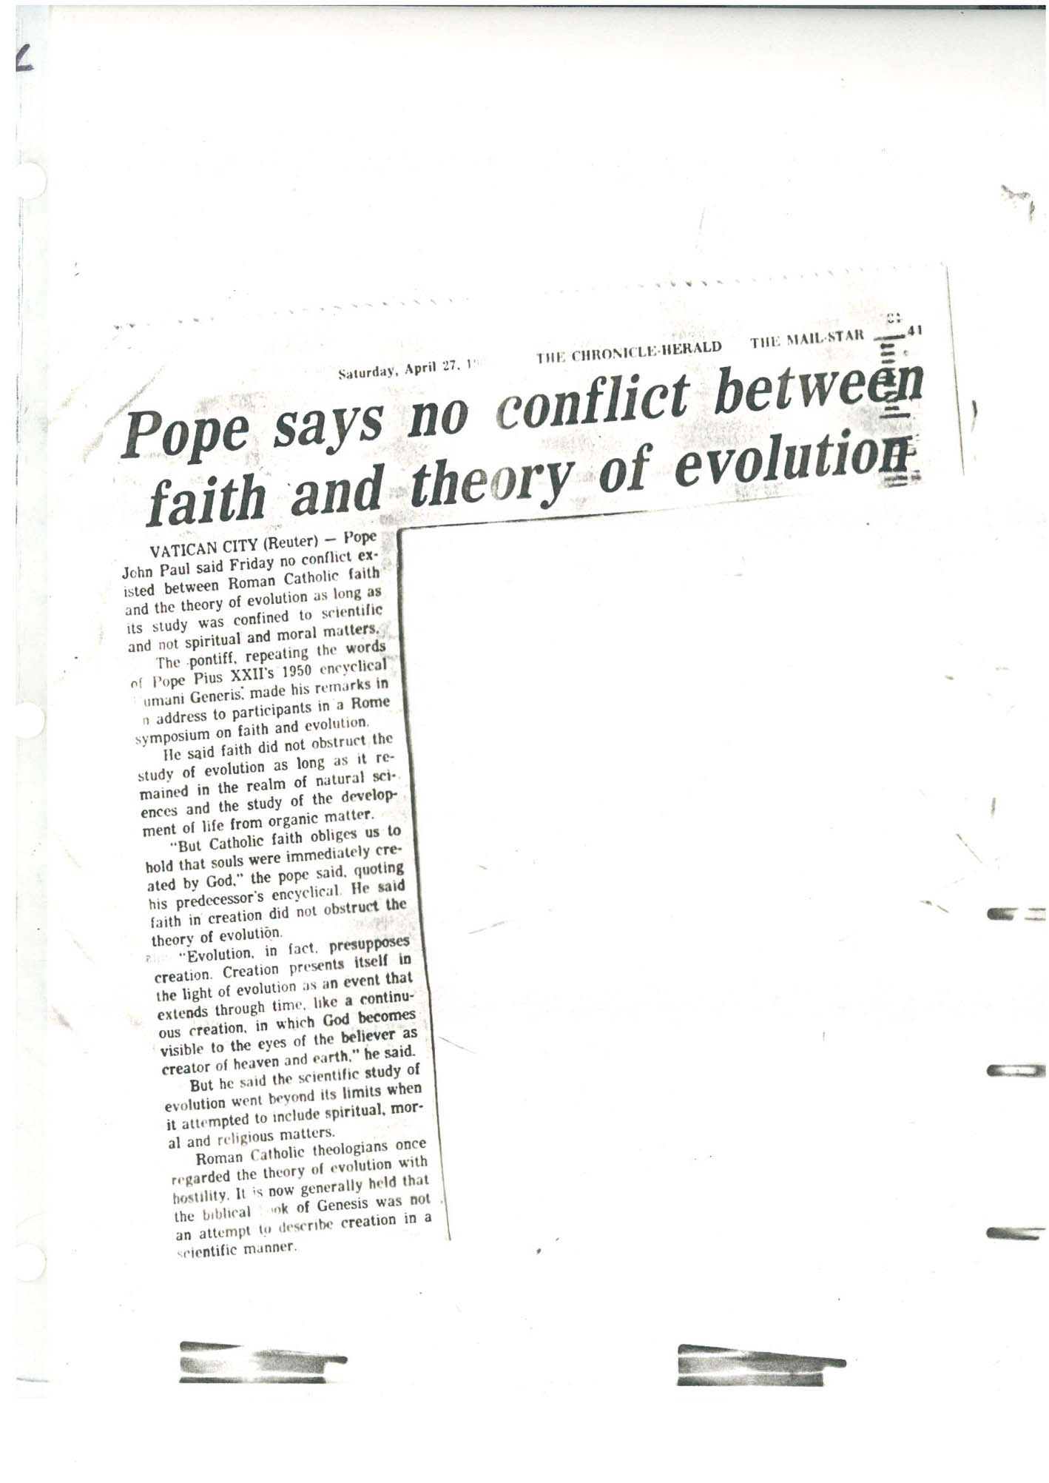
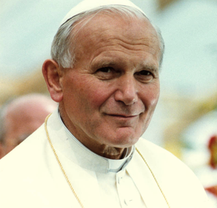
Tuesday, 28 October 2014 (from The Independent, London)
The theories of evolution and the Big Bang are real and God is not “a magician with a magic wand”, Pope Francis has declared. Speaking at the Pontifical Academy of Sciences, the Pope made comments which experts said put an end to the “pseudo theories” of creationism and intelligent design
1996

Slide 12
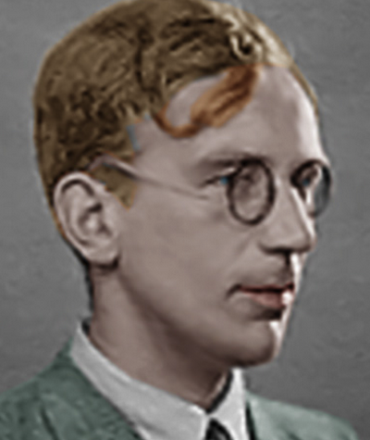
George Gamow
1904-1968
1949
nuclear physicists plunge in
Notes:
12

Slide 13
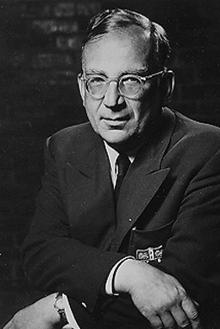
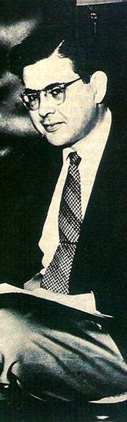
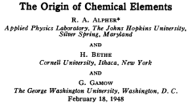

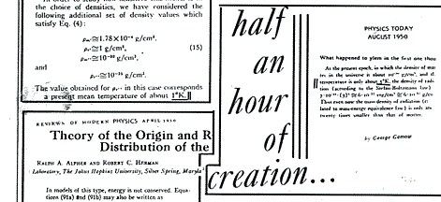
RALPH ALPHER
GEORGE GAMOW
ROBERT HERMANN
predicted origin of light elements
& fossil radiation
Notes:
Which accounted for one Nobel prize,
but not to Gamow

Slide 14
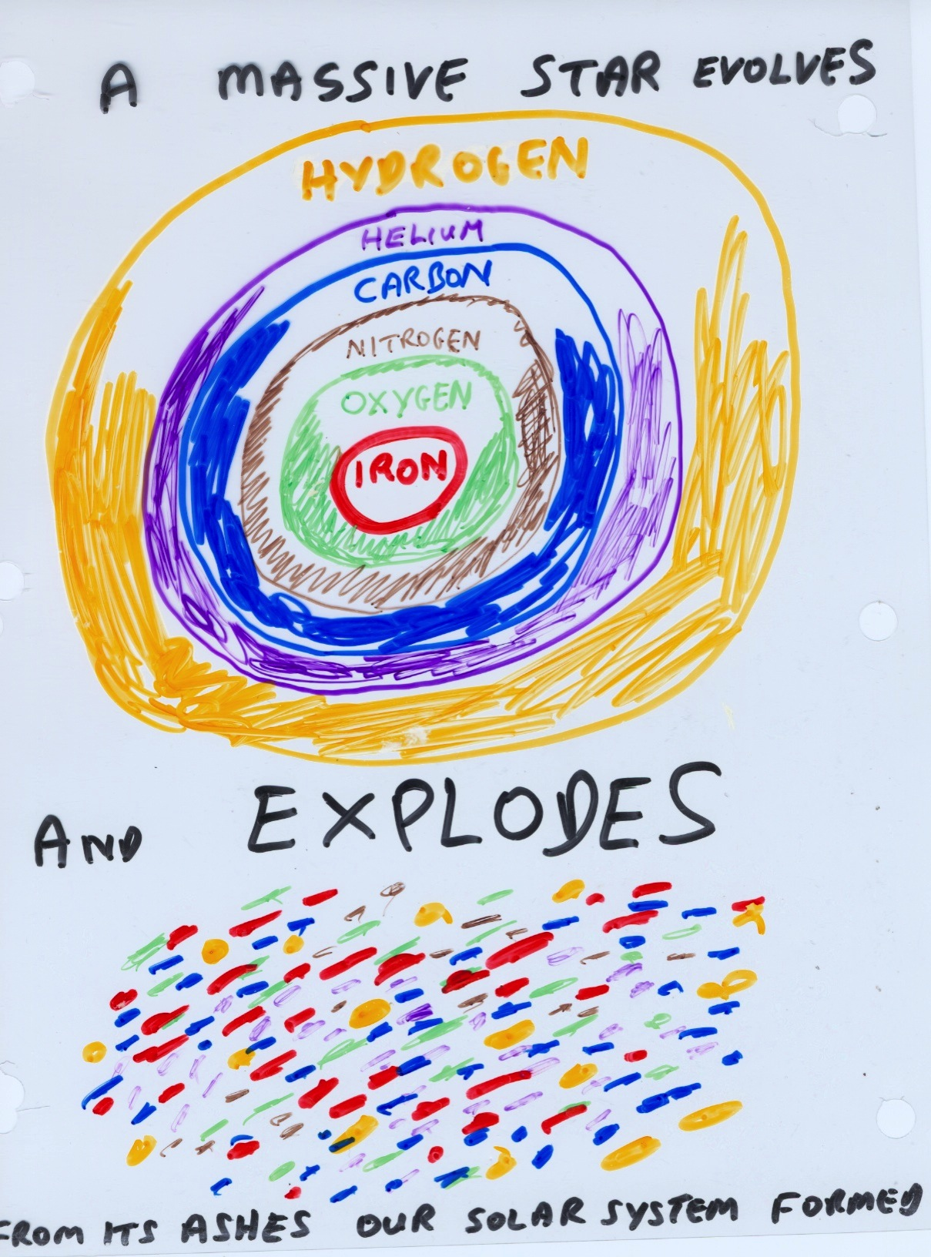
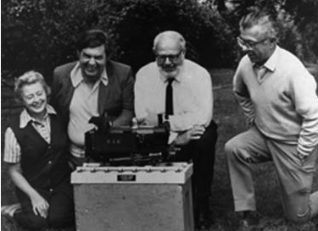
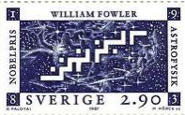
Burbidge, Burbidge, Fowler, Hoyle: 1957
Notes:
Add Fowler Nobel picture
Burbidge, hoyle photos

Slide 15
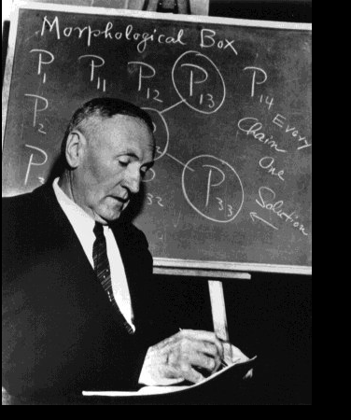

Fritz Zwicky
1898-1974
1960s
Astronomers “see” dark matter
Notes:
15

Slide 16
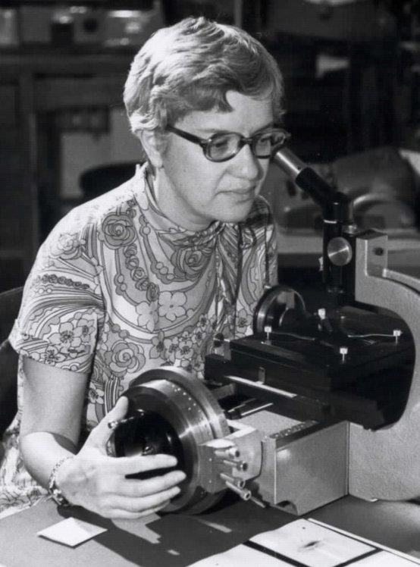
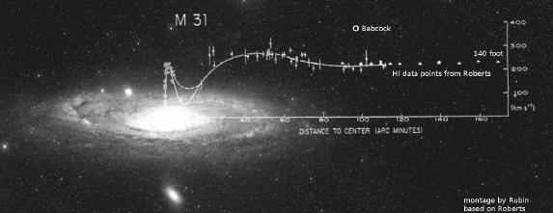
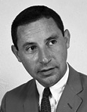
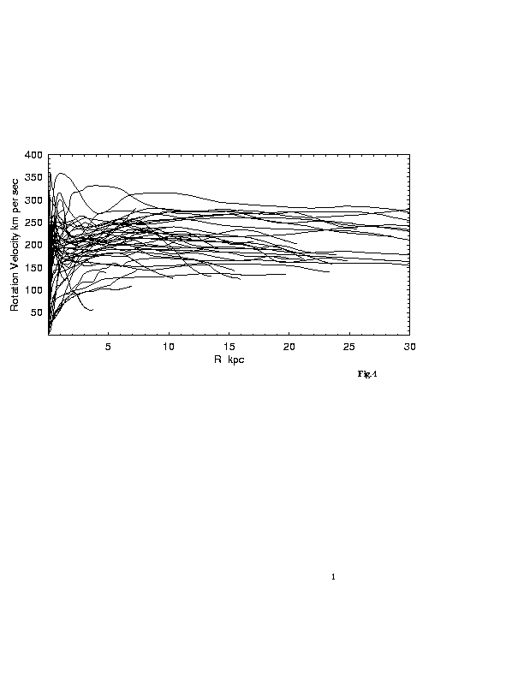
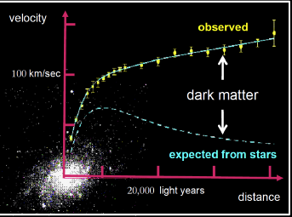
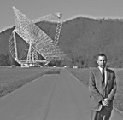
Vera Rubin
Mort Roberts
Sofue + 1999

Slide 17
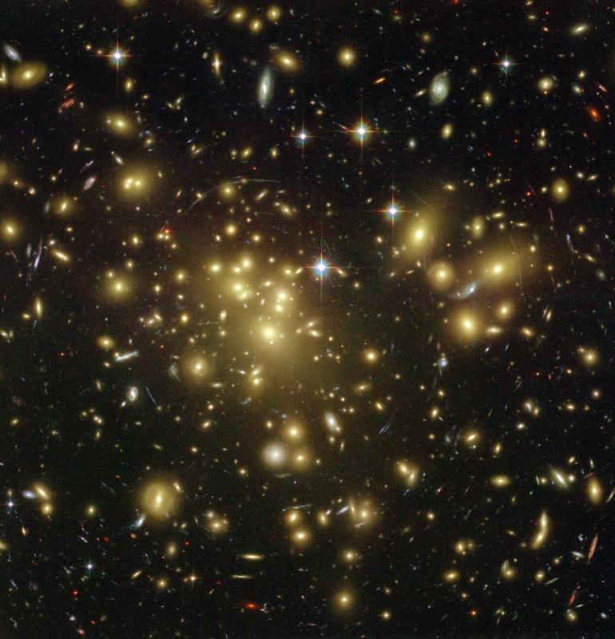
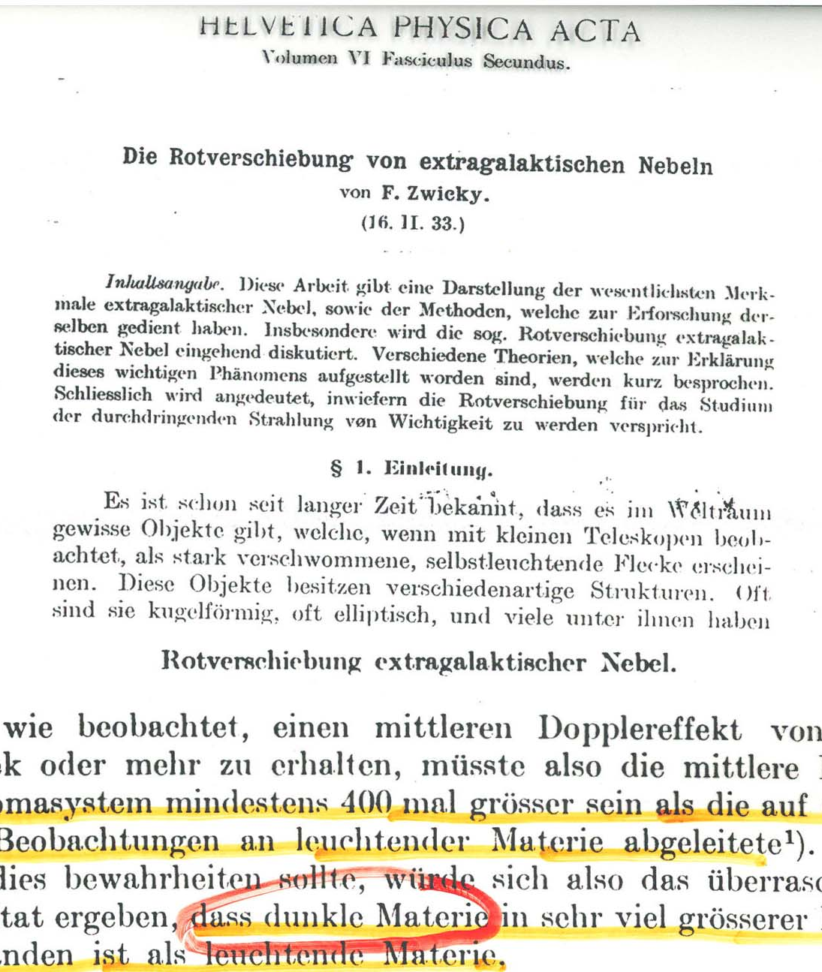
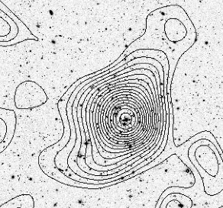
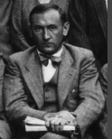
Clusters of galaxies are mosly dark matter
otherwise they’d fly apart

Slide 18
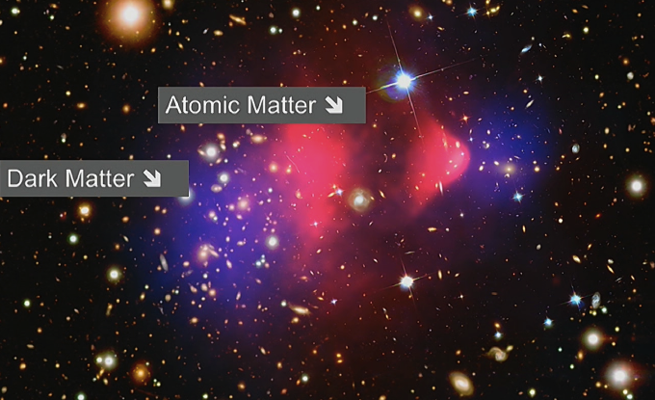
The Bullet cluster of galaxies
Dark matter is weakly interacting

Slide 19
1960s
…and the Big Bang
Notes:
19

Slide 20
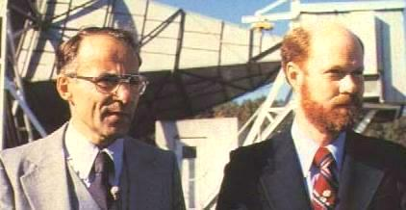
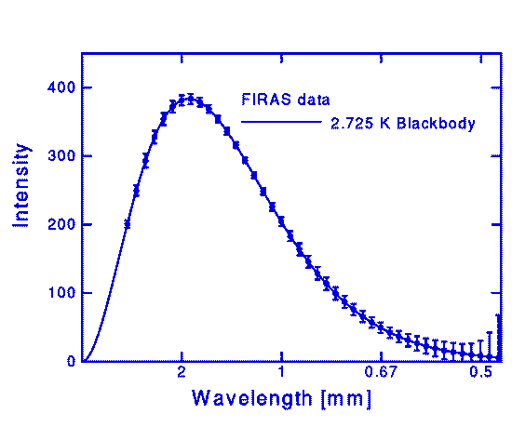
1964
RELIC RADIATION DISCOVERED
BY PENZIAS AND WILSON
1990: COBE satellite

Slide 21
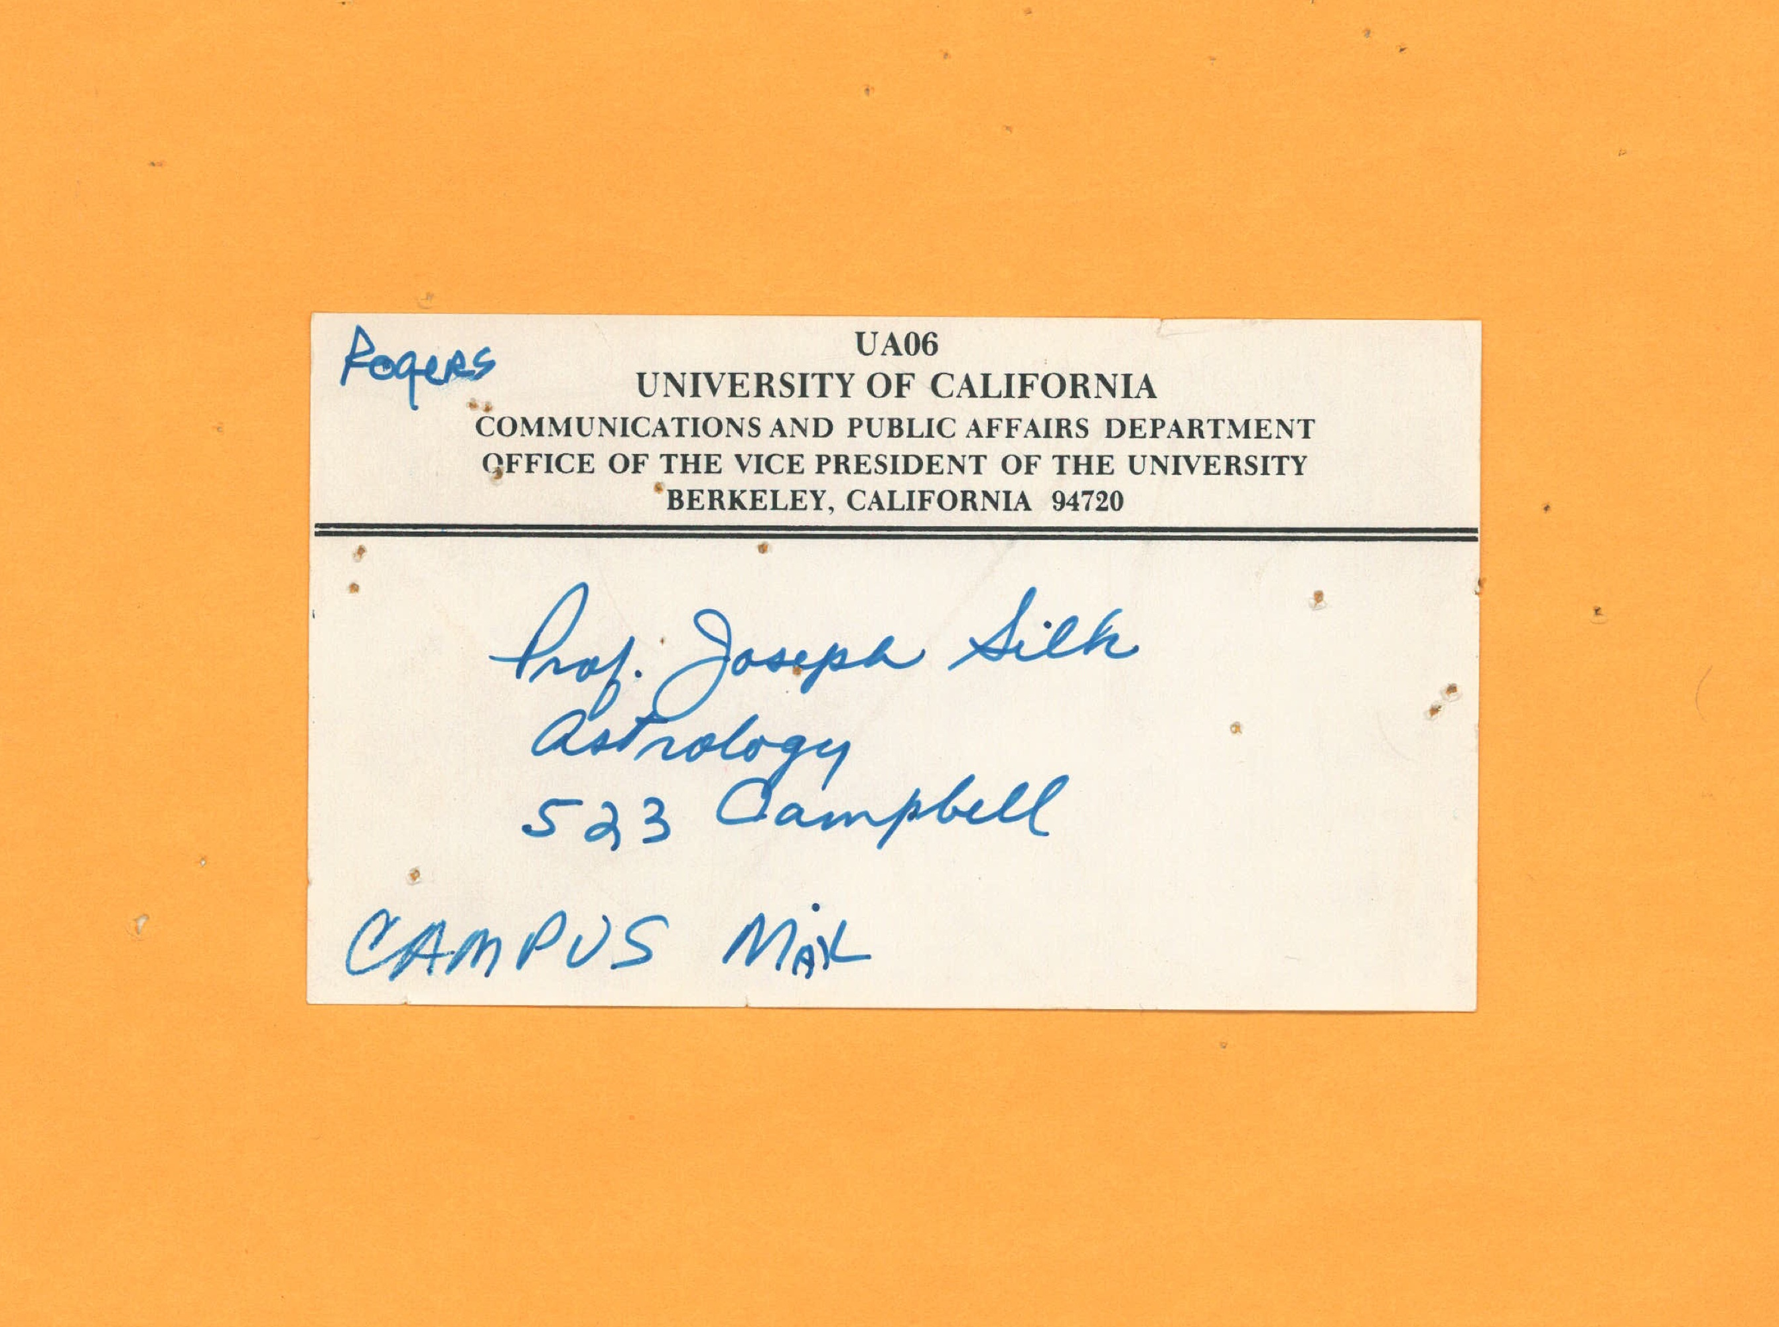

Slide 22
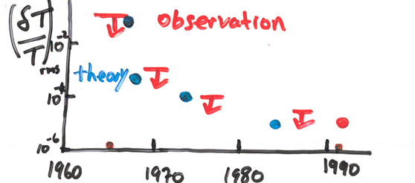
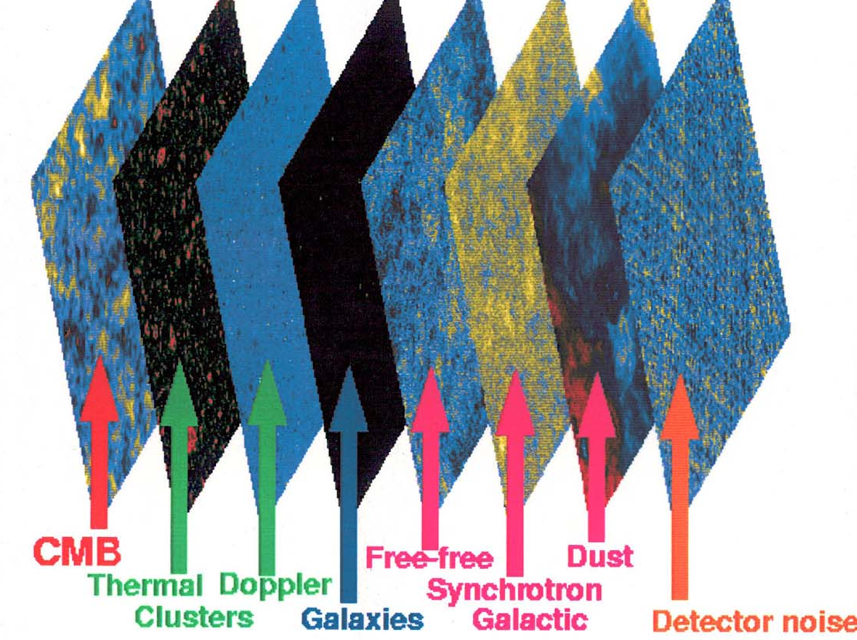

Slide 23
1992
Discovery of the seeds of creation
temperature fluctuations in the relic radiation
Notes:
23

Slide 24
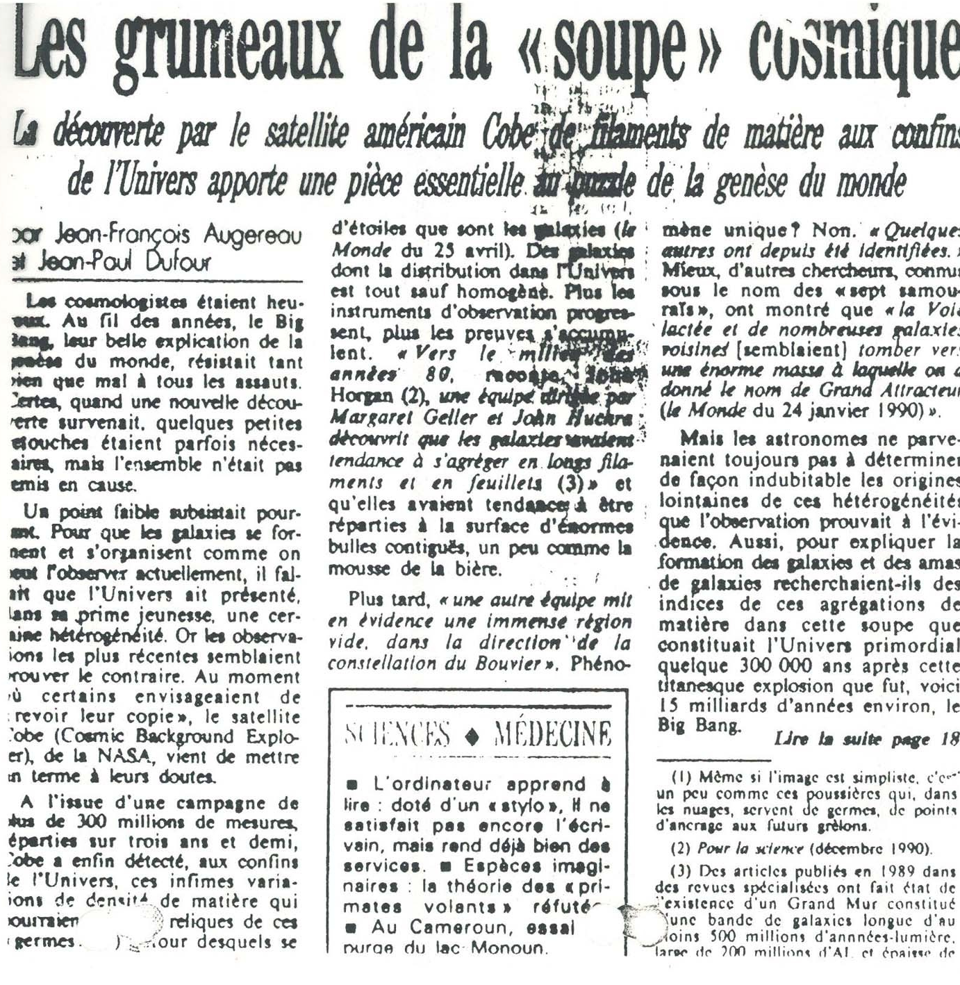
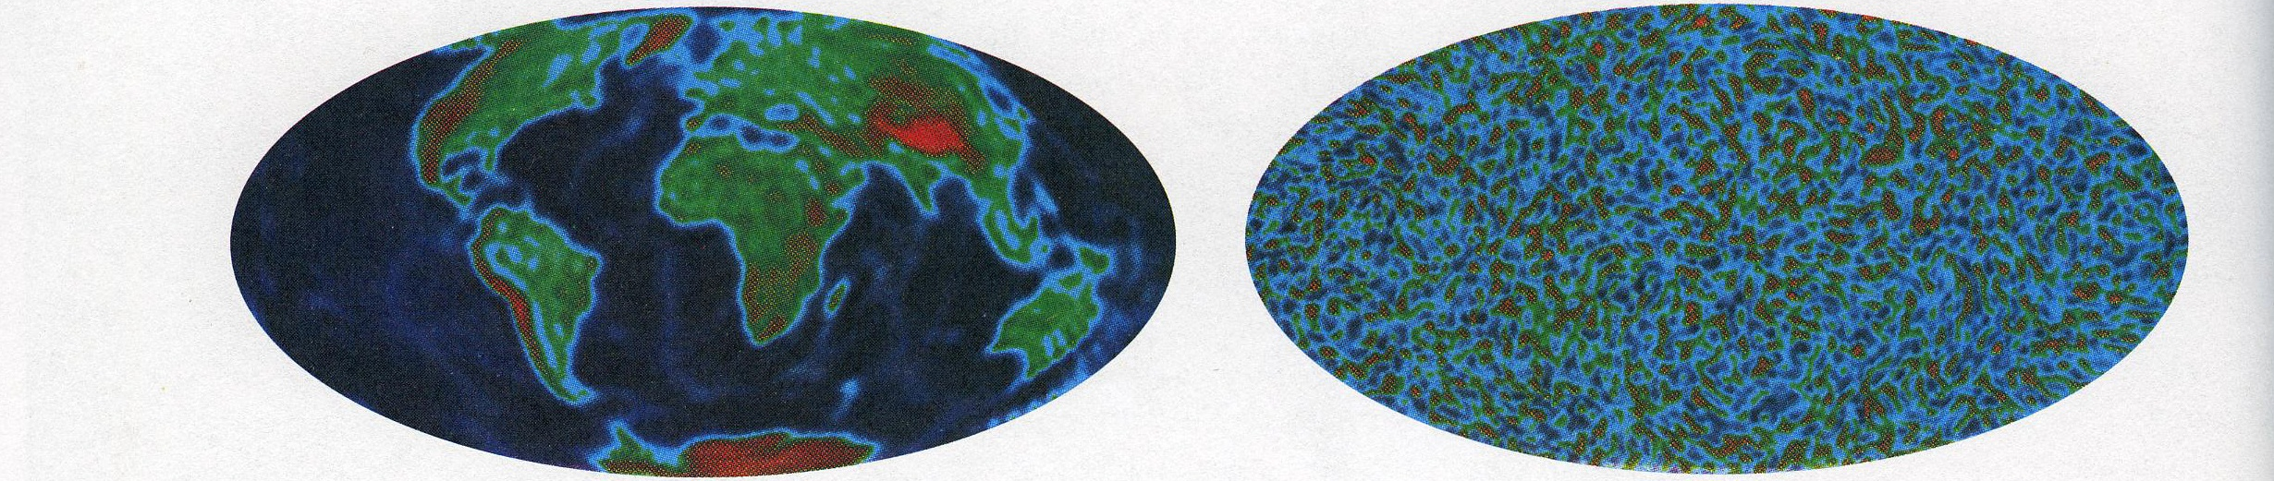
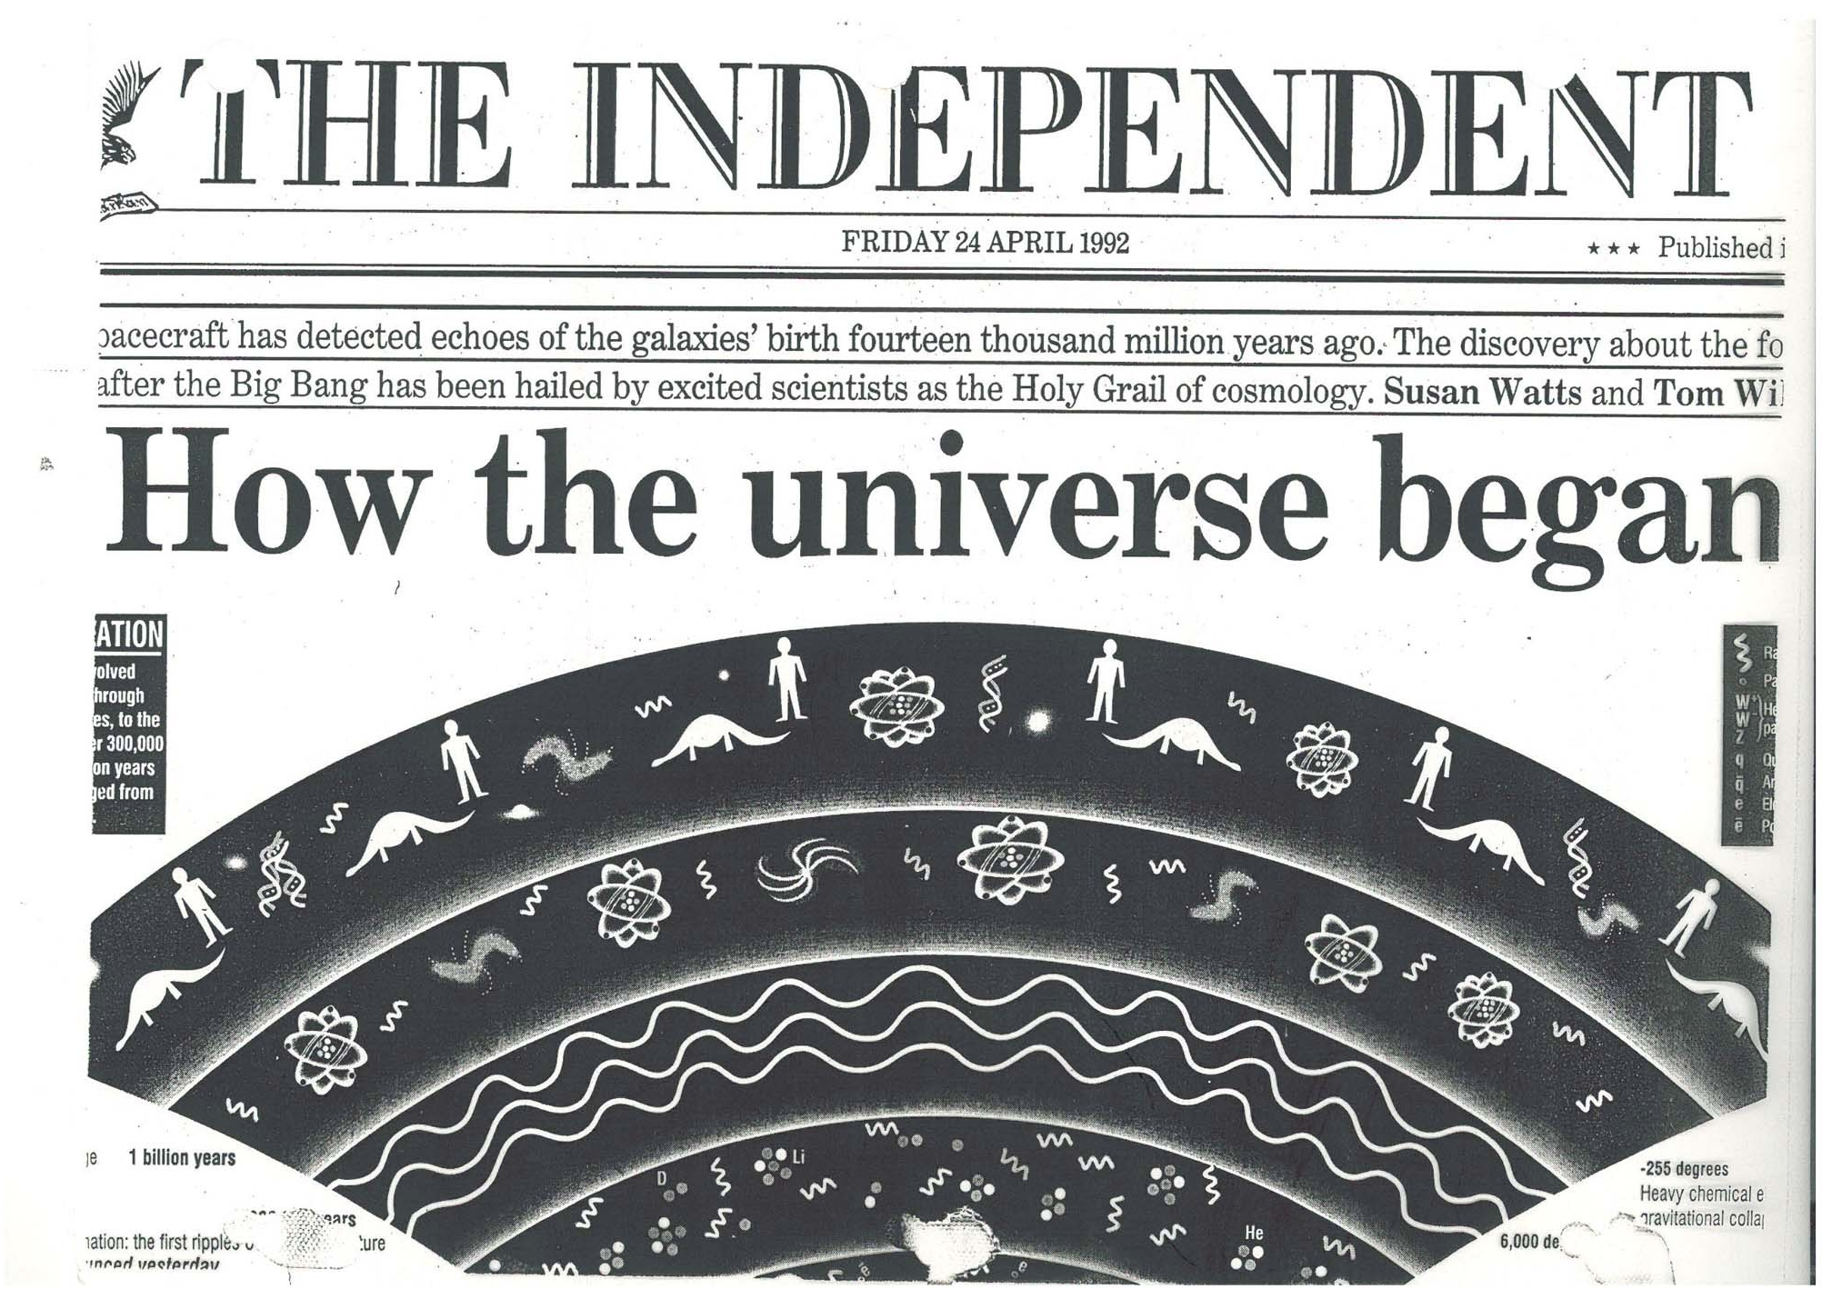
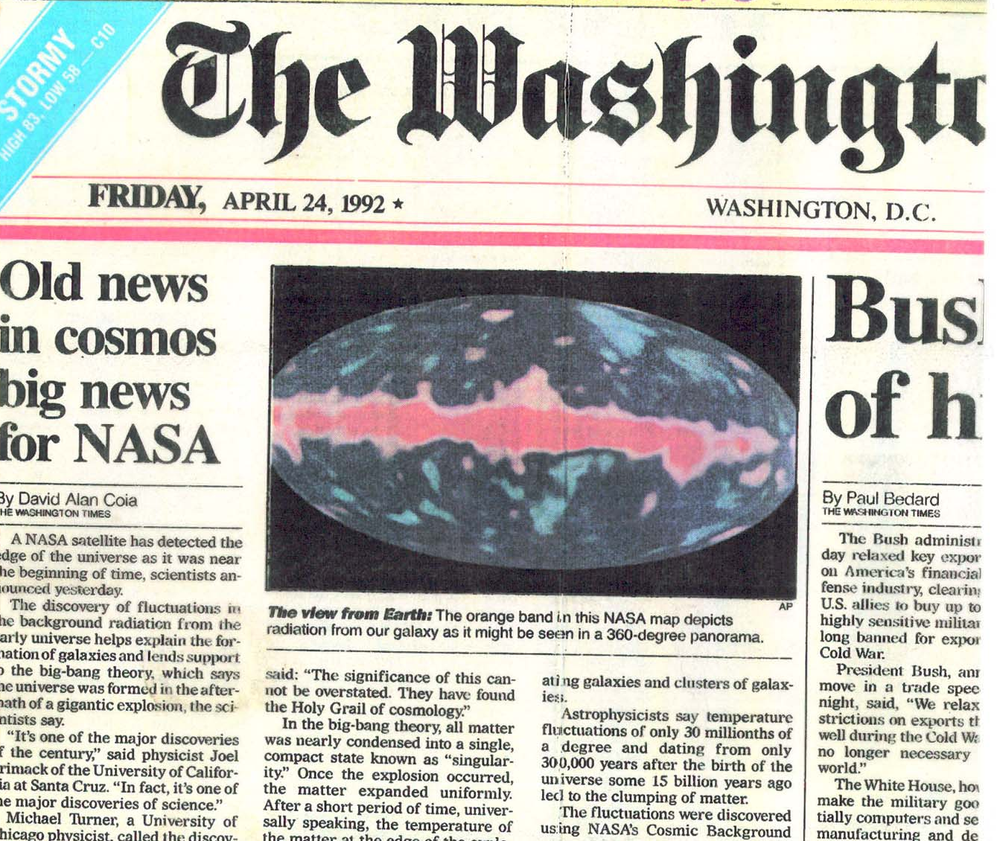
A VIEW OF THE EARTH AT COBE RESOLUTION

Slide 25
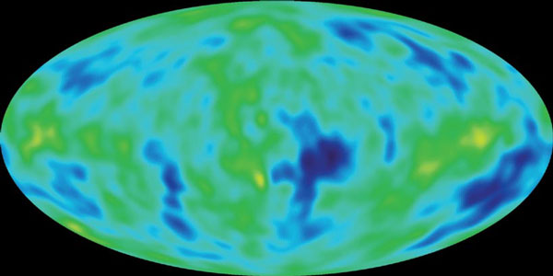
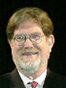
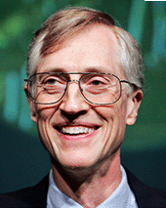
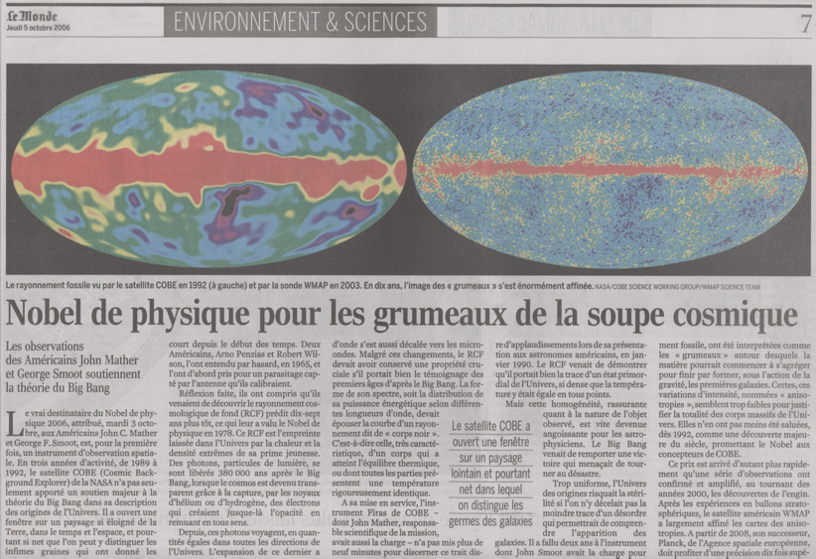
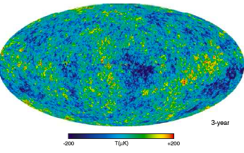
ALL-SKY MAPS OF THE CMB
1992
FROM COBE
TO WMAP
George Smoot
John Mather
2006
COBE 1992
WMAP 2006

Slide 26

The steady state universe

Slide 27


Slide 28


Slide 29


Slide 30


Slide 31


Slide 32


Slide 33

Lemaitre’s first sketch of cosmological models from 1928

Slide 34





Alexander Friedmann: 1924
prediction of expansion
1927: Georges Lemaitre independently predicted expansion, obtained H=625 km/sec/Mpc but published in French
1929: Hubble obtained
slope H=530 km/sec/Mpc
velocity
distance

Slide 35
Log(distance)
80 years progress
Hubble
Lemaitre
redshift
35
Betoule + 2014
Notes:
35

Slide 36
1980
particle physicists plunge in
Notes:
36

Slide 37

THE BEGINNING
LHC
HERE WE ARE
Notes:
37

Slide 38




FROM EXPANSION TO INFLATION (1980)
Alan Guth
Andrei Linde
“The Big Bang? Believe me, it was
very, very, very, very, very, very big”

Slide 39


Slide 40

Predicts flatness,
size,
density fluctuations

Slide 41

Einstein: gravity curves space
Euclidean geometry
Spherical
Hyperbolic
INFINITE
FINITE
INFINITE

Slide 42

M.C. Escher
spherical geometry

Slide 43

M.C. Escher
Angels and demons
hyperbolic
geometry

Slide 44


Slide 45




2013
Planck satellite
Jean-Loup Puget
Reno Mandalese

Slide 46


EUCLIDEAN or flat space FITS TO HIGH PRECISION! to 0.01%!
Temperature fluctuations
WMAP7
curved
flat
INFER SPACE IS NEARLY EUCLIDEAN
The universe is very, very large!

Slide 47

THE OLD BIG BANG

Slide 48

THE INFLATIONARY UNIVERSE

Slide 49
“Nature is an infinite sphere, whose center is everywhere and whose circumference is nowhere.”
Blaise Pascal (Pensees, 1669)

Slide 50




