Slide 1
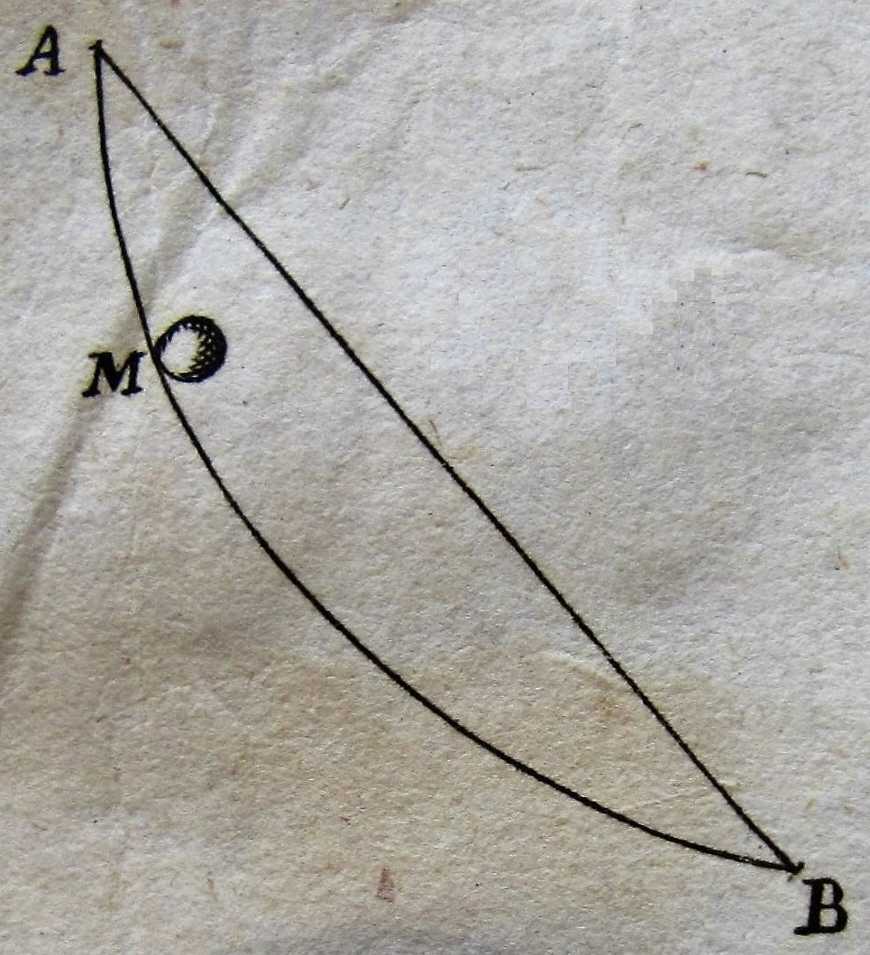
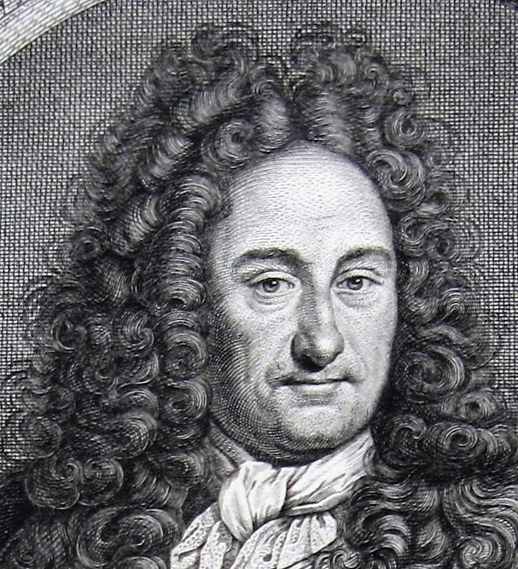
Mathematics
and
diplomacy

Slide 2
Leibniz
born in Leipzig 1646, dies 14th November 1716 in Hanover
begins his law studies in Leipzig, but in 1666 changes to Altdorf near Nuremberg

Slide 3
Leibniz speaking:
“ When I noticed [in Leipzig] the intrigue of my opponents I changed my plans and decided to travel around and to study mathematics. For in my opinion a young man should not, as if nailed down, stay at one and the same place, and for a long time already it was my burning desire to increase my reputation in the sciences and to get to know the world better. “

Slide 4
Leibniz
doctorate “utriusque iuris” (in both laws), Altdorf 1667
first job in Nuremberg unsatisfactory
By the end of 1667 he passes through Mainz on his way to Holland and is ‘discovered’ and offered a juridical position by the Prince-bishop of Mainz
1671: year of tension in Europe, year of internal tension in Leibniz

Slide 5
Leibniz, writing to the Duke of Hanover
October 1671, letter to Duke Johann Friedrich (uncle of the later King George I) saying: ‘keep an eye on the French’
“ It is clear that such big French army units must eventually break out, and that, when they break out in Europe, they will be responsible for a long and universal war and will woefully ruin many 100000 people. Also clear that not only the Catholics but all Christians would like to see the French efforts directed against our traditional enemy in the Levant. “

Slide 6
Leibniz in Paris
end of March 1672: arrival in Paris
too late with his plan for a French expedition to Egypt, since the French and English had already started war against the Dutch

Slide 7
Leibniz, writing to the Duke of Hanover (2)
(We return for a while to October 1671.)
“ My highest wish is how I may obtain such peaceful circumstances that I may employ the little talent that God has bestowed on me for the perfection of the sciences, and for that, I do not see better conditions than there are now in France. [...] I am confident of those results that I can easily present, such as: my calculating machine, my optical inventions, my justification of the possible mysteries of the Eucharist, and finally my new counsel for a Holy War. ”

Slide 8
A stunning letter
For me, as a mathematician, this is a stunning letter. I knew, he was also a philosopher, but for me Leibniz was mainly a mathematician.
As a freshman in mathematics I was amazed by ‘his’ infinite series $\frac{π}{4}=1−\frac{1}{3}+\frac{1}{5}−\frac{1}{7}+\frac{1}{9}+…$
You divide one by the successive odd numbers, subtract and add them alternately, you do this to infinity, and the sum is a quarter of the magic number $π$. Unbelievable.
In his letter of October 1671, Leibniz is not only a scientist, but also a diplomat and apparently he has theological interests.

Slide 9
Leibniz in Paris (1672-1676)
Why is Paris inportant for Leibniz?
‒ Paris is a real centre of politics, culture and science
‒ Paris has the new Académie Royale des Sciences (with Huygens, Carcavy, L’Hospital, Varignon)
‒ Paris is a stepping stone towards England

Slide 10
Leibniz in London (first visit February 1673)
1673: assistant on a diplomatic mission from Mainz to the English court
For Leibniz science was more important, especially the Royal Society. Since 1670 he corresponds with Henry Oldenburg.
Leibniz attends several meetings of the Royal Society. He is appointed FRS on April 19th, by which time he was already back in Paris.
The Royal Society owns a portrait of Leibniz, c. 1695, by an unknown artist.

Slide 12
Leibniz in London (second visit Oct. 1676)
In the autmn of 1676 Leibniz returns from Paris to Hanover via London and Holland.
In London he visits Oldenburg and meets with Collins, who gives him access to papers by Newton and Gregory.
The boat trip from Londen to Rotterdam takes him two weeks. He tours Holland and meets scientists and philosophers (mathematician Hudde, microscopist Van Leeuwenhoek, philosopher Spinoza and others)
c. 15 December 1676 arrival in Hanover, where Leibniz enters the service of Duke Johann Friedrich.

Slide 13
Leibniz in Paris, a review
Leibniz wanted “peace and quiet”. That worked out very well: during his four years in Paris he made considerable progress, especially in the mathematical domain. One example:
Christiaan Huygens proposed this question to Leibniz. Determine the sum $\frac{1}{2}$ $+$ $\frac{1}{6}$ $+\frac{1}{12}+ \frac{1}{20}+$ and so on to infinity.
Leibniz realised that he could make the addition with the help of subtractions:
$\frac{1}{2}= 1−\frac{1}{2}$ $\frac{1}{6}=\frac{ 1}{2}−\frac{1}{3}$ $\frac{1}{12}=\frac{1}{3}−\frac{1}{4}$ $\frac{1}{20}=\frac{1}{4}−\frac{1}{5}$ etc.
Look at the right sides: all terms cancel each other, except for the first 1.

Slide 14
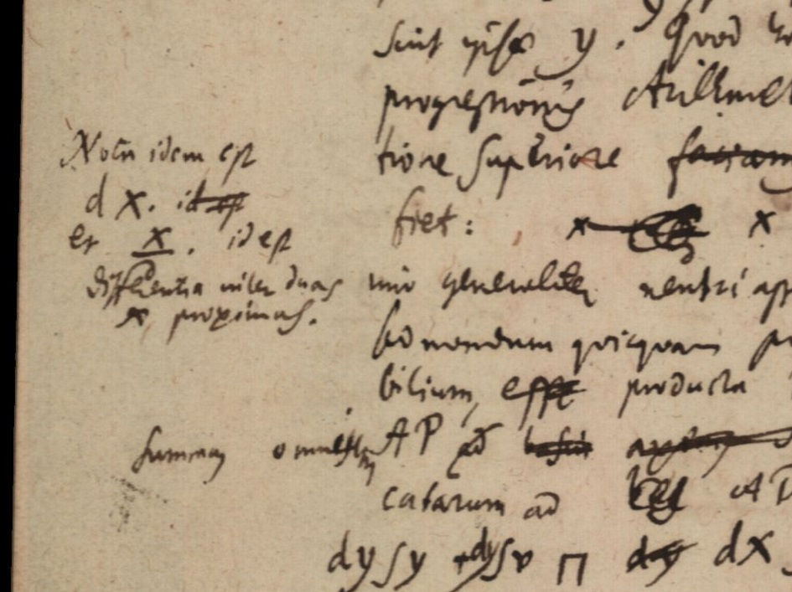
Notations and $\text{d}x$date from Paris autumn 1675
Hanover, GWLB, Leibniz Manuscripts LH 35,5,9,p.2 and LH 35,8,18,p.4

Slide 15
Leibniz in Paris, a review (2)
Leibniz goes through major developments in his Paris years. He grows as a diplomat, which is also noticed by the European sovereigns. He receives invitations from several courts to come and work for them. In 1675 he accepts the offer of the Duke of Hanover.
Leibniz extends his network widely, thanks to the many visitors to Paris and his own travels. His main development is in mathematics and philosophy. Stimulated by the discussions with French and foreign scientists and supported by the resources in Paris, he makes substantial progress, especially in conceiving his differential and integral calculus.

Slide 16
Jacob Bernoulli (Basel, 1654–1705)
best known for his work in probability theory (Ars conjectandi, Basel 1713)
professor of mathematics at the University of Basel as of 1687

Slide 17
Jacob Bernoulli writes to Leibniz (Dec. 1687):
“ Most famous and worthy Sir,
My mind stimulates me already for a longer while to address your Muses. But the multitude of most important occupations, which I knew were pressing on you, and my own consciousness of my limited ability, and the reputation of your name have until now blocked my pen. For not without reason I feared that you would count me among the number of those who try –because they have no other means—to raise their fame by approaching great men. [...] I want you to be convinced, Worthy Sir, that nothing else has driven me to write to you than the ardour by which I glow for matters mathematical, and an insatiable desire to make progress in these. “

Slide 18
Leibniz tours to Italy (Nov. 1687 – June 1690)
He travels with his own coach and by boat to
Vienna (May 1688 – 10 February 1689)
from there with regular post-coaches via Graz to Venice (4 March 1689)
and finally to Rome.

Slide 19
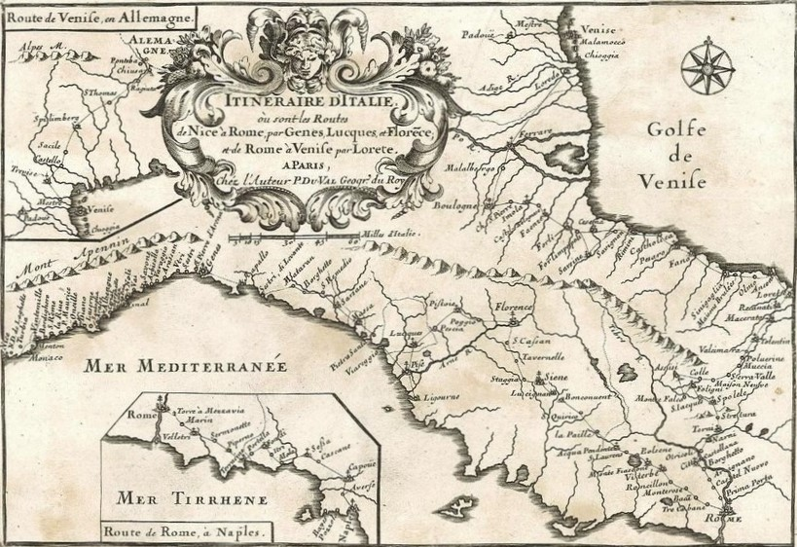

Slide 20
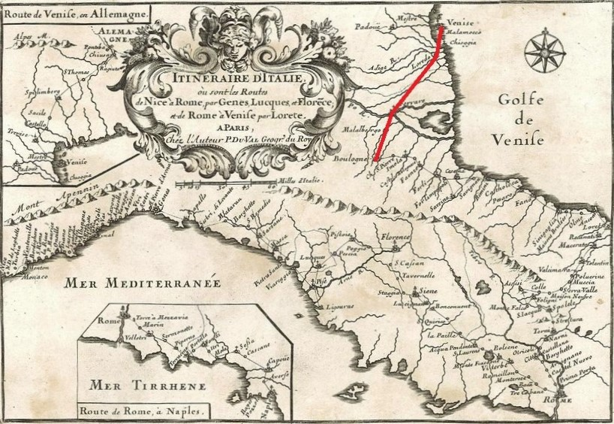

Slide 21
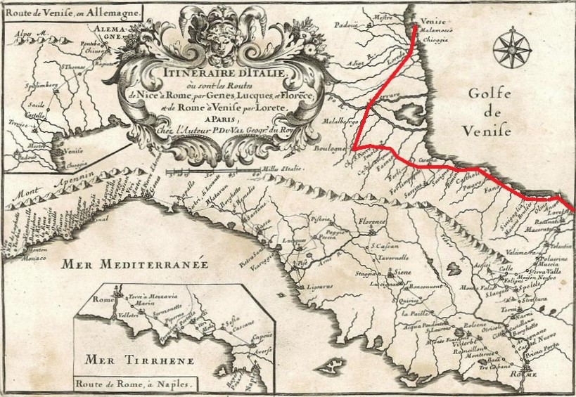

Slide 22
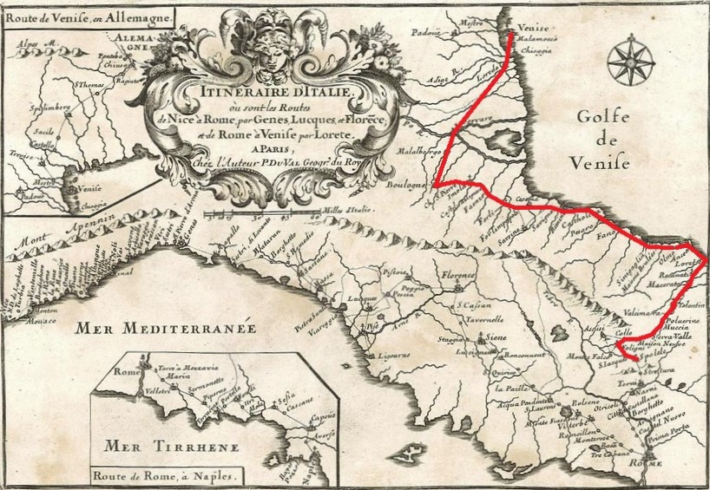

Slide 23
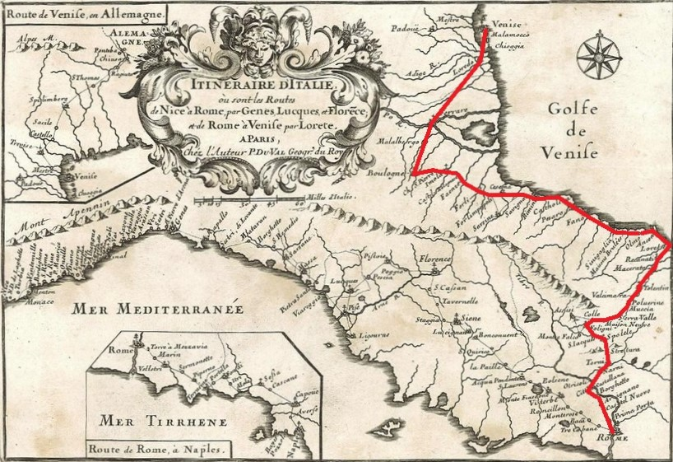

Slide 24
Why this long journey?
Work:
collecting sources for the history of the Guelf house, the oldest predecessors of the Duke’s family
investigating a possible reunion of the Roman catholic and the protestant churches
various: studying mining technique, visiting libraries, and much more
Personal:
job hunting, lobbying for Copernicanism, visiting scientists
tourist (Naples, Mount Vesuvius)

Slide 25
Back to mathematics
October 1684: Leibniz publishes Nova methodus pro maximis et minimis, itemque tangentibus, nine pages in the scientific journal Acta Eruditorum

Slide 26
Leibniz’s New method (1684)
The New method was a summary, rather than an introduction to the new subject of differentiation. Rules are given, but there are no explanations, nor are there proofs.

Slide 27
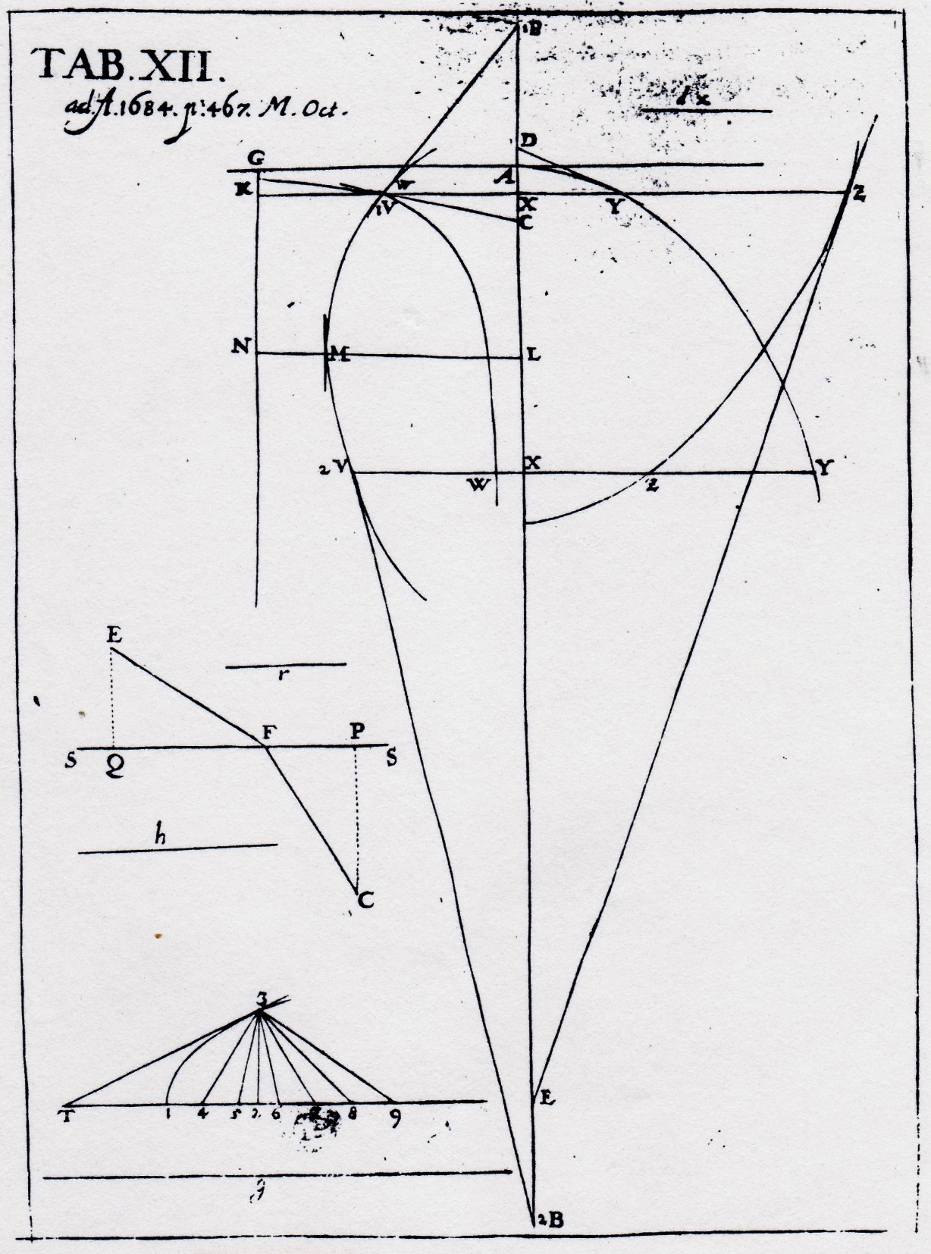
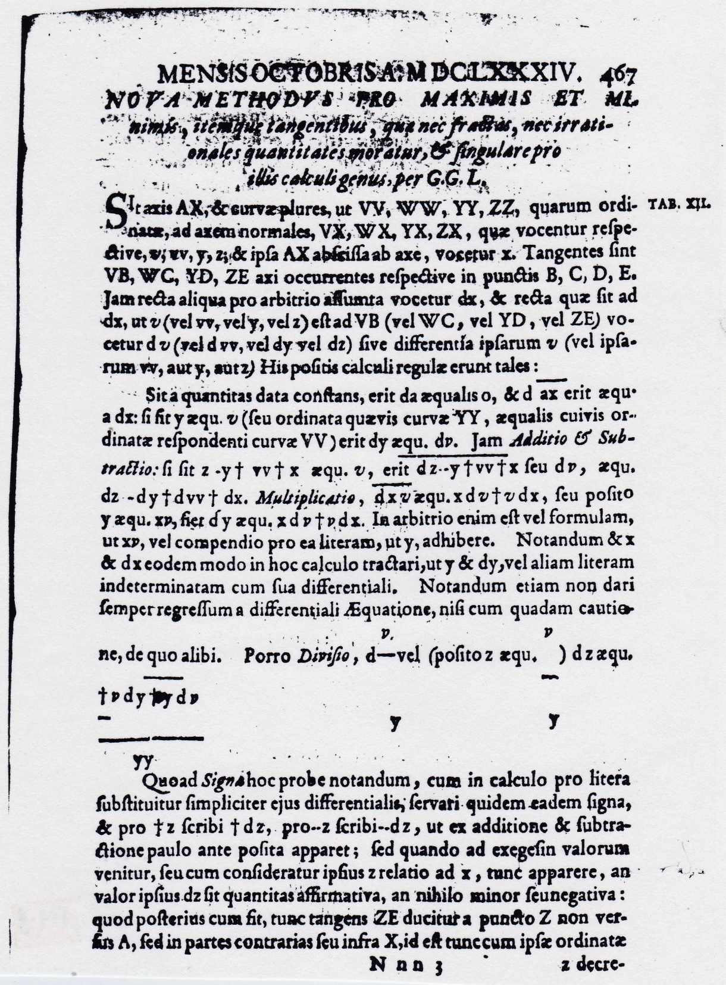

Slide 28
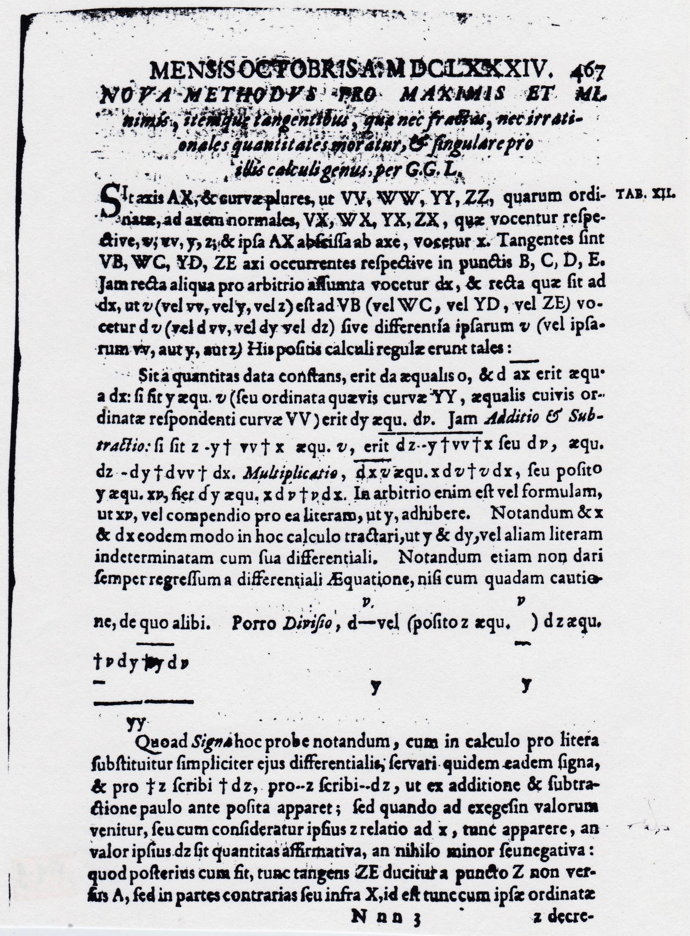

Slide 29
Leibniz’s New method (1684)
The New method was a summary, rather than an introduction to the new subject of differentiation. Rules are given, but there are no explanations, nor are there proofs.
The New method had convincing applications, for example the derivation of Snell’s law (about the refraction of light).
The New method enabled mathematicians to also study non-algebraic curves, and to study inverse tangent problems (nowadays called differential equations).

Slide 30
The brothers Bernoulli study the New Method
“ In the year 1684 geometry at once changed its face. The famous Mr Leibnitz published in the Leipziger Journal solutions to problems, which he had obtained with a completely new method, the secret of which he however hid. This amazed both gentlemen Bernoulli to such an extent that they worked jointly to reveal the secret of this new geometry. This secret seemed to them to lie far away from ordinary geometry. They managed in such an excellent way, that Mr Leibnitz has declared that this new art comes on their account no less than on his own. ”
(from a French eulogy of Jacob Bernoulli, 1706)

Slide 31
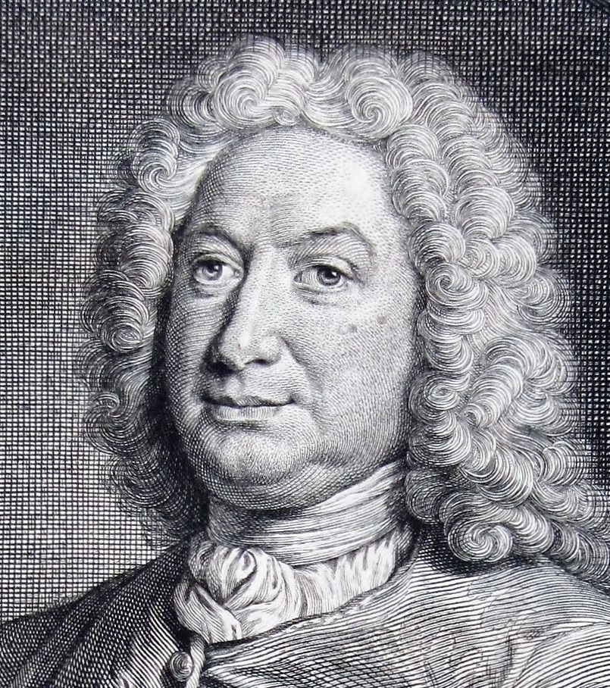
Johann Bernoulli (Basel, 1667–1748)
At the university Johann follows the lectures of his brother Jacob.
As a team Jacob and Johann explore Leibniz’s New Method.
private teacher of the calculus (Geneva 1691 and Paris 1692 where L’Hospital is his student)

Slide 32
Johann is back in Basel, by the end of 1692
Johann Bernoulli is in an awkward situation.
He is highly qualified in the new mathematical developments but cannot find a proper job.
In 1694 he completes his medical studies with a doctorate, his application for the university’s chair of logic fails, he decides to take the job of municipal engineer. With his boots in the mud.
April 1694 he marries Dorothea Falkner and in February 1695 their first child Nikolaus is born. Johann needs to improve his position.
In September 1695 Johann and Dorothea move to Groningen (NL), where Johann has accepted the university’s chair of mathematics.

Slide 33
1690–1695: interaction Leibniz↔Bernoullis
Before answering Jacob’s letter of Dec. 1687 Leibniz had already reacted in a journal article to two publications by Jacob.
Leibniz praises in the Acta Eruditorum Jacob’s solution of a challenge that Leibniz had proposed about the isochronous curve:
Mr Bernoulli “presents his analysis according to the rules of my new calculus, which I call differential or incremental, published by me in these Acta. To elaborate this analysis of my problem was totally not everybody’s business, because the art of this calculus is until now known to very few people, and I know no one who has better penetrated my thoughts than Mr. B.”

Slide 34
Now it is Jacob Bernoulli’s turn
Jacob Bernoulli challenges Leibniz personally with a new problem: to determine the shape of a hanging chain (the so-called catenary problem, already posed by Galileo).
Leibniz reacts in his answer to Jacob Bernoulli, in the Acta Eruditorum of July 1690, in an interesting way. He says that Jacob Bernoulli’s problem is more intricate than his (Leibniz’s) earlier one, and that it will need an extraordinary use of the New Method.
Leibniz: “I will give time to others before I publish my own solution.“
And he sets a deadline: if no one before the end of the year indicates to have found a solution, he will publish his own result.

Slide 35
Yet another challenge: the curve of a sail
Three solutions of the catenary problem were published (Jacob Bernoulli, Johann Bernoulli and Christiaan Huygens), and Jacob Bernoulli immediately proposed a new challenge.
The title of Johann Bernoulli’s solution (April 1692, Journal des sçavans) tells what Jacob had asked: “Solution of the problem of the curvature that a sail makes when the wind blows into it.”
Jacob was not amused about Johann’s solution. In December 1695 he gives his version: he, Jacob was the first to understand that the sail is curved in the same manner as the hanging chain. He, Jacob, sent to Johann the differential equation of the curve. So, Johann received the solution from him, and not the other way round as Johann had presented it in 1692.

Slide 36
Johann Bernoulli is furious
Johann is furious that Jacob publicly calls him a liar. He unburdens his heart in a letter to Leibniz (15/25 May 1696). Some fragments:
[...] “I cannot be very much surprised that the mood of my Brother is still occupied by too malicious envy; [...] probably you have not yet seen in this month’s issue how viciously he has written against me, driven by I don’t know what jealousy or animosity, and how low he speaks about me. [...] is it likely that my brother precisely in that period in which my letter was under way from here to there, achieves what he could not achieve during the whole year before? And rather, if it is not probable that he plagiarized by claiming my solution for himself. “

Slide 37
Leibniz moderates (15/25 May 1696):
In a letter to Johann Leibniz makes clear that he values both brothers:
“ You act in a praiseworthy manner, that you have chosen to stay moderate towards your brother. I will be glad, if an occasion arises, to give a testimony (that you do not need) according to my opinion about Your candour and about the merits that are the subject of the quarrel between the two of you. Why can You not be praised for your merit? It has no damage for him, it goes rather with honour for him, since he was the first to educate you towards these studies. “

Slide 38
Johann’s turn (June 1696)
Johann reacts in two ways:
in a letter to Leibniz (9/19 June 1696)
with a public challenge in the Acta Eruditorum (June 1696 issue)
Summary of the letter: of course I need your testimony. I am much distressed, it is about my honour, even more because my honour is attacked by my own brother. In the letter Johann also announces that he will publish a new challenge in the Acta Eruditorum.
The new challenge, in the Acta, is the brachystochrone problem, although it receives its name only six weeks later.

Slide 39
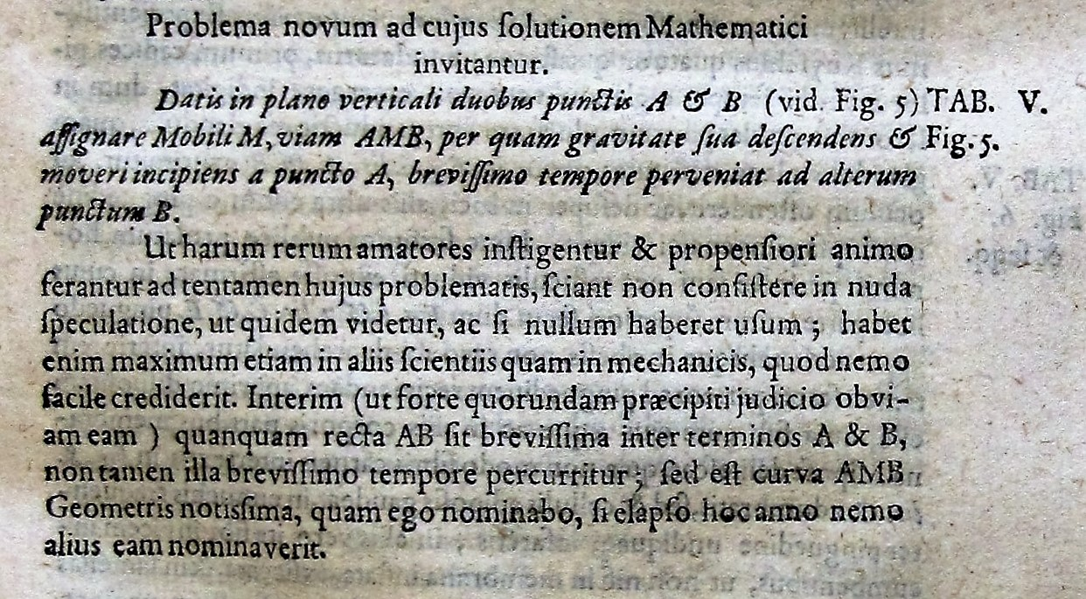

Slide 40
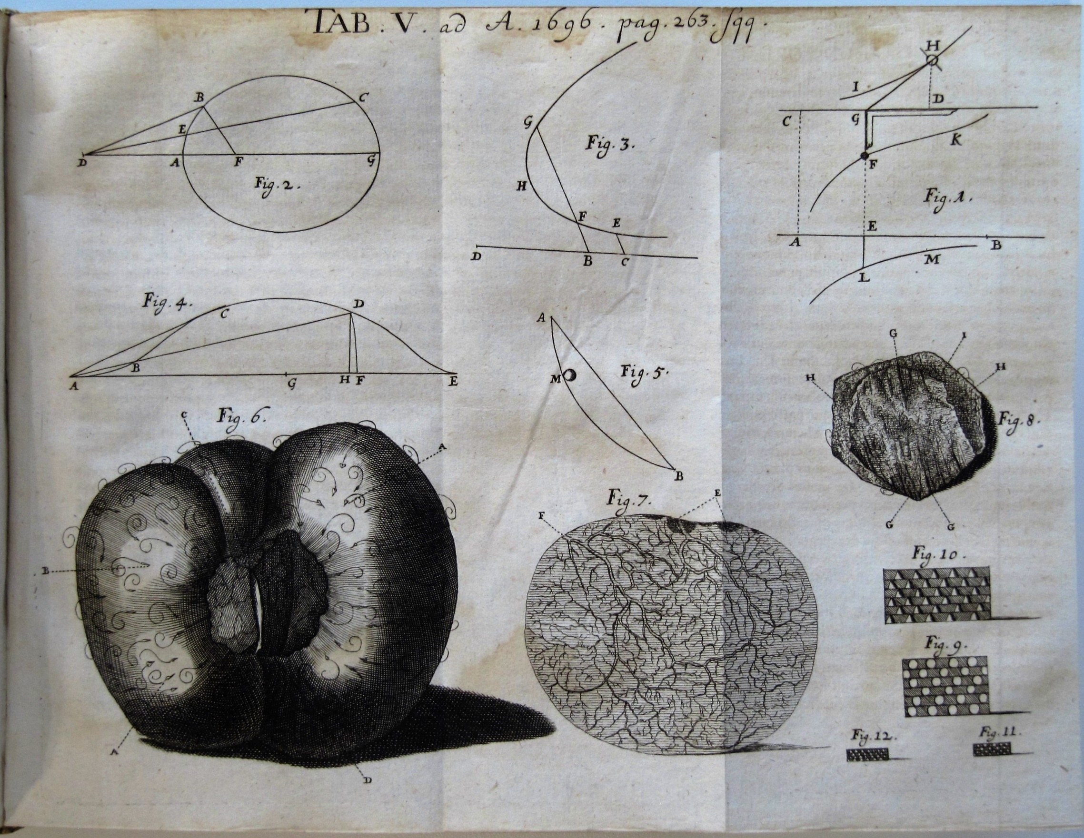

Slide 41
The problem, as Johann phrases it his letter to Leibniz: Given two points A and B in a vertical plane, to determine the path AMB, along which the movable point M, starting to move from point A and descending because of its own weight, reaches point B in the shortest time.

Slide 42
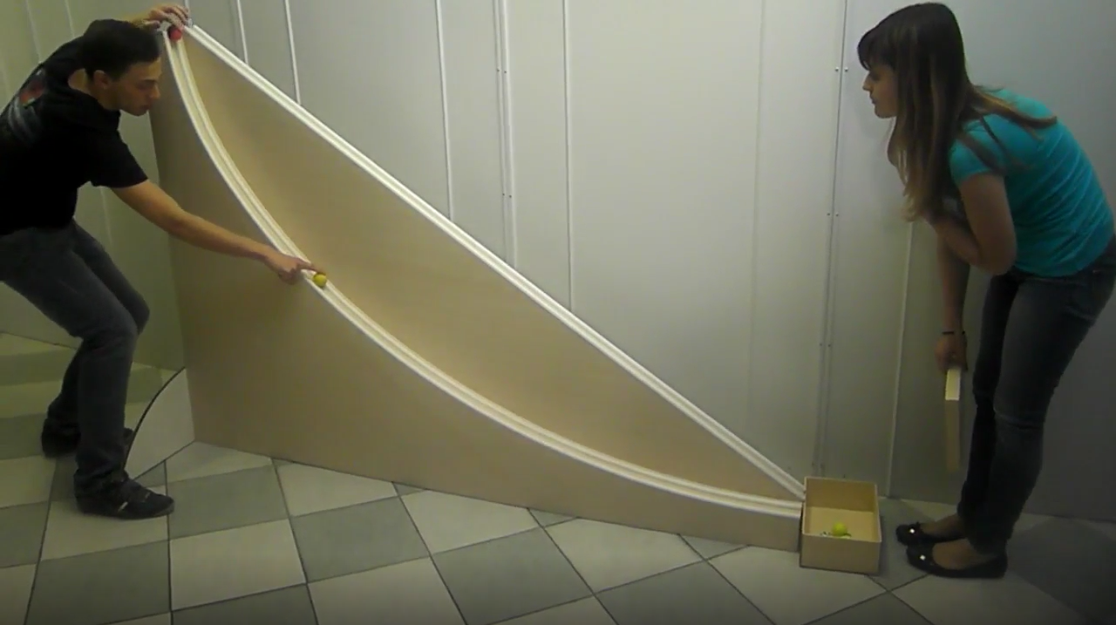
Would the straight line that connects A and B be the solution?
Time for a physical experiment.
We see two students of
the Liceo Ancina
in Fossano, Italy.

Slide 44
Would the straight line that connects A and B be the solution?
Time for a physical experiment.
We see two students of
the Liceo Ancina
in Fossano, Italy.

Slide 46
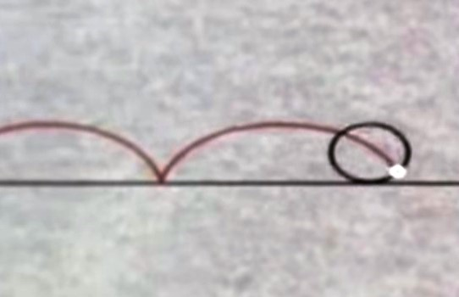
The cycloid
Johann Bernoulli, Jacob Bernoulli, Leibniz and some other colleagues prove in 1696 and 1697 that the cycloid is the best possible path. Along the cycloid the movable point M reaches B from A in the shortest time.
What is a cycloid.
Look at the Open University
video about Mersenne (from
the course MA 290).

Slide 48
The name Brachystochrone
When Johann proposed the problem it did not have a name.
Leibniz answers within one week. He transforms the problem into the correct differential equation, but does not yet recognize that this equation represents the cycloid. In the same letter to Johann he proposes a name for the curve: tachystoptote (from the Greek words for quickest and fall).
Five weeks later Johann suggests the name: brachystochrone. When he realized that the solution to his problem was the cycloid, he immediately thought about Huygens, who found the tautochronism of the cycloid, or isochronism as Johann prefers to call it. And for the new curve he wanted a name that associates with isochrone, and chose brachystochrone, the curve of shortest time.

Slide 49
The distribution of the problem
By the end of July 1696 the problem has reached the readership of the Acta Eruditorum.
Johann Bernoulli and Leibniz also spread the word to their correspondents.
Then Johann decides to include the problem in a pamphlet, which he uses as a seasonal greeting for New Year 1697. On the pamphlet he extends the deadline until Easter 1697.

Slide 50
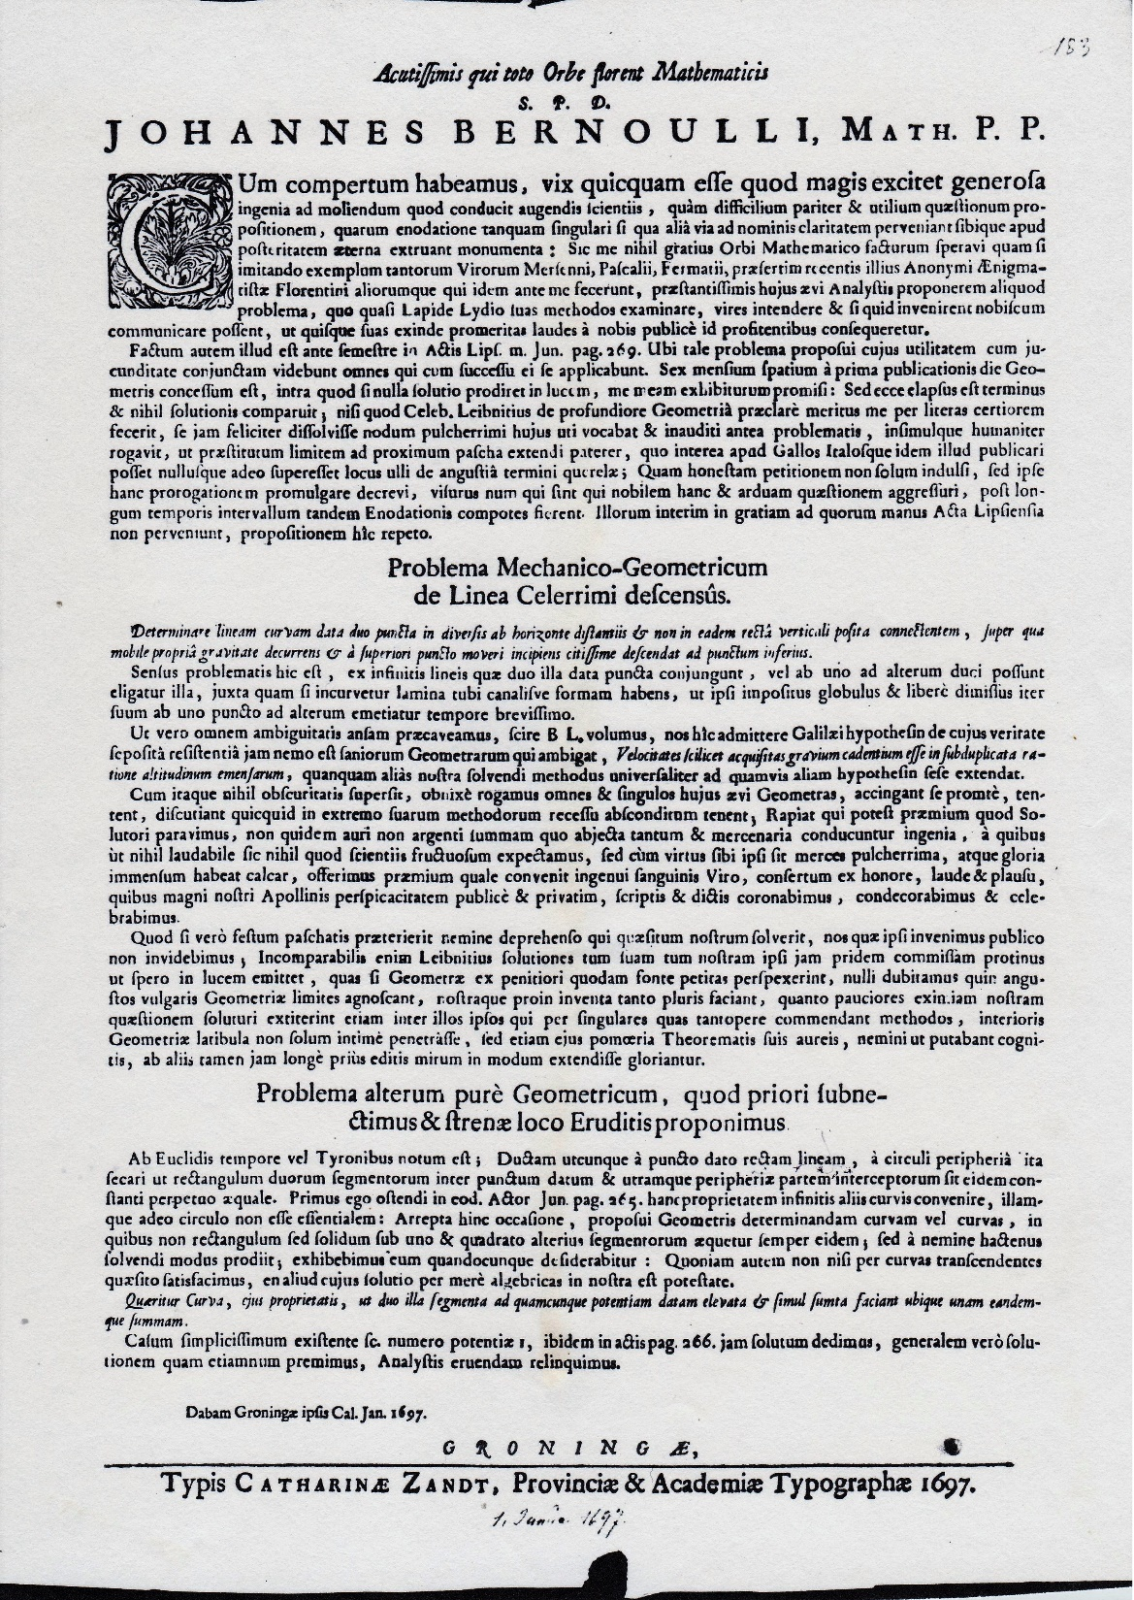

Slide 51
Who solved the brachystochrone problem?
Newton, who received the New Year card, needed one day. His solution appeared anonymously in the Philosphical Transactions of January 1697.
Jacob Bernoulli also solves the problem, but only with much anger towards Johann. He writes to Leibniz 6 February 1697:
“ I know my limitations and I do not believe that I have solved it, but rather that God solved it through me in order to calm down my brother’s excessive haughtiness. Yet I bitterly regret that this man has forgotten himself to such extent that he does not remember any more by what instrument the grace of God has worked in him long ago.”

Slide 52
Leibniz tries to calm down the brothers
He has three ways to intervene:
via direct correspondence with Jacob and Johann

Slide 53
From Leibniz’s letters to Jacob and Johann
To Jacob (April 1697):
“ I, who have the highest esteem for both of you, would like that you are the best friends, and not that you are ill-disposed towards each other. There is no doubt, I think, that your brother owes to you at any rate the basics of his studies and for the greatest part its increase too. After all he is introduced into these mysteries by his elder brother. “
To Johann (24 June 1701):
“both of you have to be careful, for your own prudence, that no one can blame you for it. And this warning was absolutely necessary, in order to not make the impression that I want to keep the brotherly quarrel going (it cannot be said enough how much everybody is displeased at it). “

Slide 54
Leibniz tries to calm down the brothers
He has three ways to intervene:
via direct correspondence with Jacob and Johann
he offers them a carrot, provided that they would behave properly

Slide 55
The carrot: an academy membership
First Leibniz promoted the idea that Jacob and Johann should be appointed members of the grand old Paris Academy of Sciences.
Varignon writes to Johann the news (19 February 1699)
“ You were both received by the Academy last Saturday; but on the condition that you would cease to fight each other, that you would both drop your objections, and that you together would never have these again. “
In the new Berlin Sozietät der Wissenschaften (Society of Sciences), founded 1700 with Leibniz as its first president, memberships for Jacob and Johann Bernoulli were even easier to settle.

Slide 56
Conclusions, before Leibniz has the last word
Leibniz appeared to be so much more than the mathematician who in 1684 published the crucial Nova Methodus.
His diplomacy was often explicit. More often his diplomacy was informal. And Leibniz certainly did not forget his own interests.
This talk could have given more esteem to Jacob Bernoulli, certainly if it had contained more ‘hard’ mathematics. Among mathematicians he is the better known of the two brothers.

Slide 57
Conclusions, before Leibniz has the last word
Leibniz appeared to be so much more than the mathematician who in 1684 published the crucial Nova Methodus.
His diplomacy was often explicit. More often his diplomacy was informal. And Leibniz certainly did not forget his own interests.
This talk could have given more esteem to Jacob Bernoulli, certainly if it had contained more ‘hard’ mathematics. Among mathematicians he is the better known of the two brothers. Proof by stamps:

Slide 58
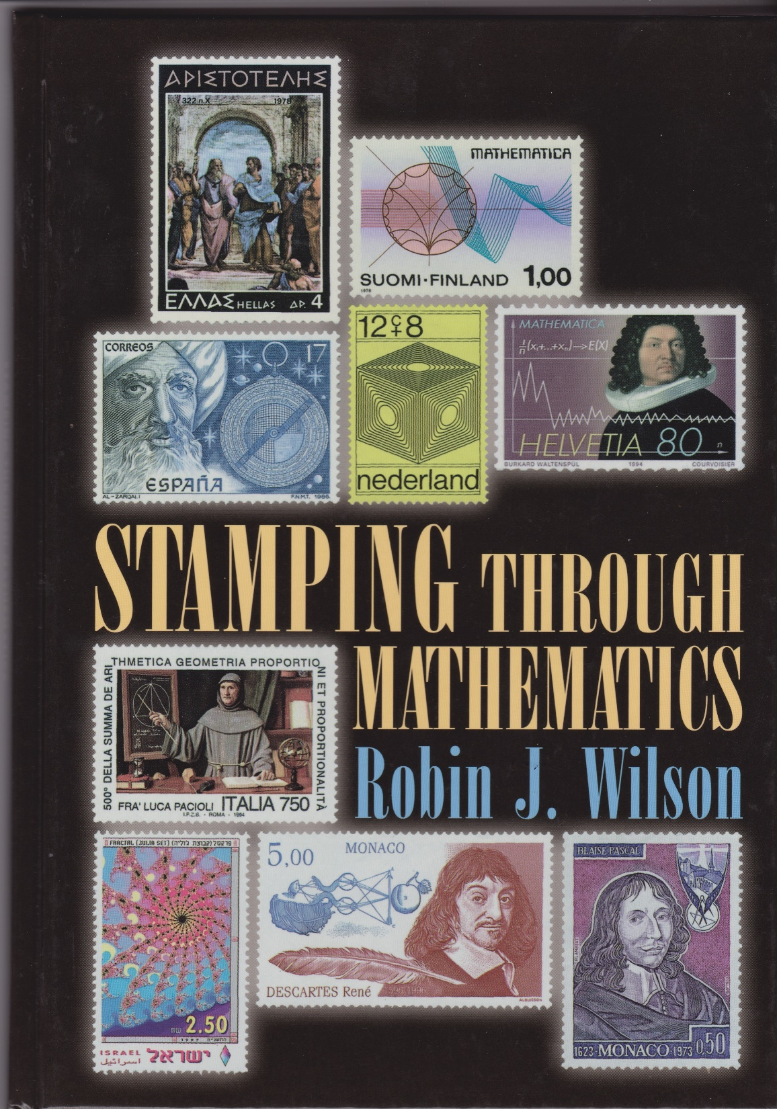
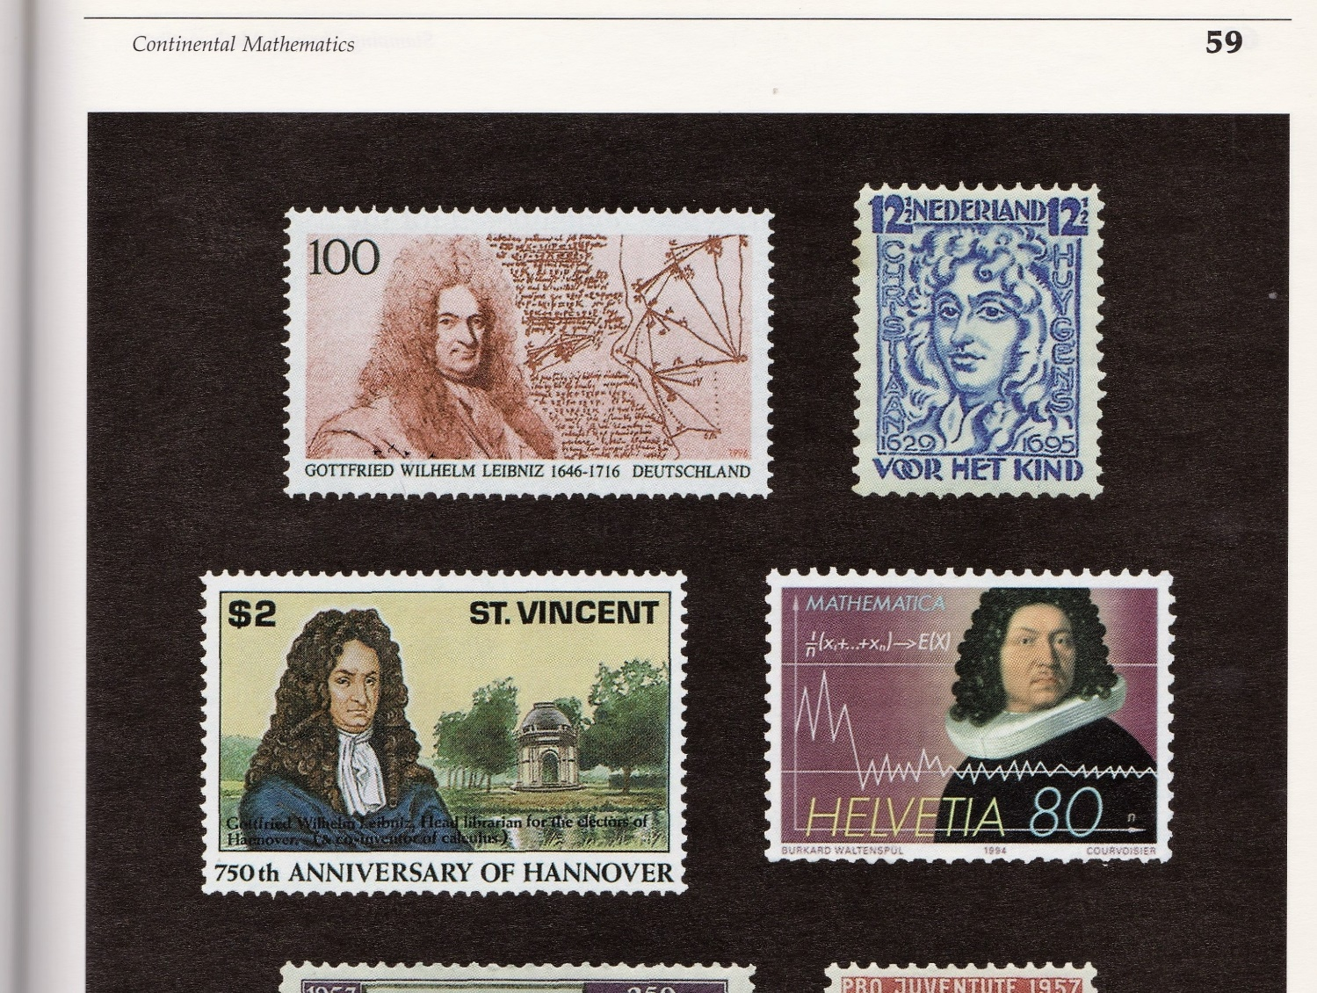
Leibniz and Jacob Bernoulli on stamps

Slide 59
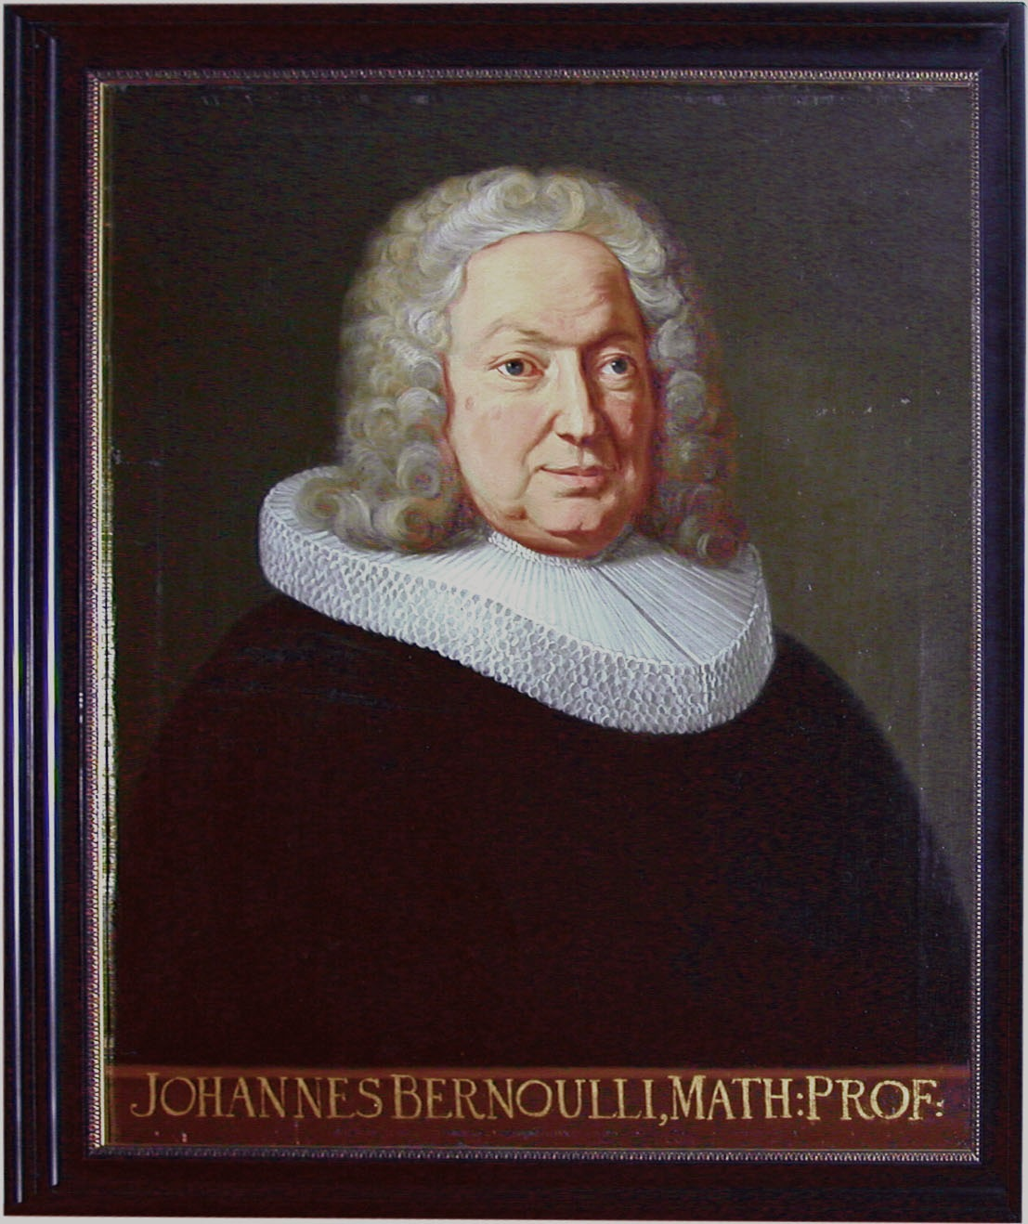
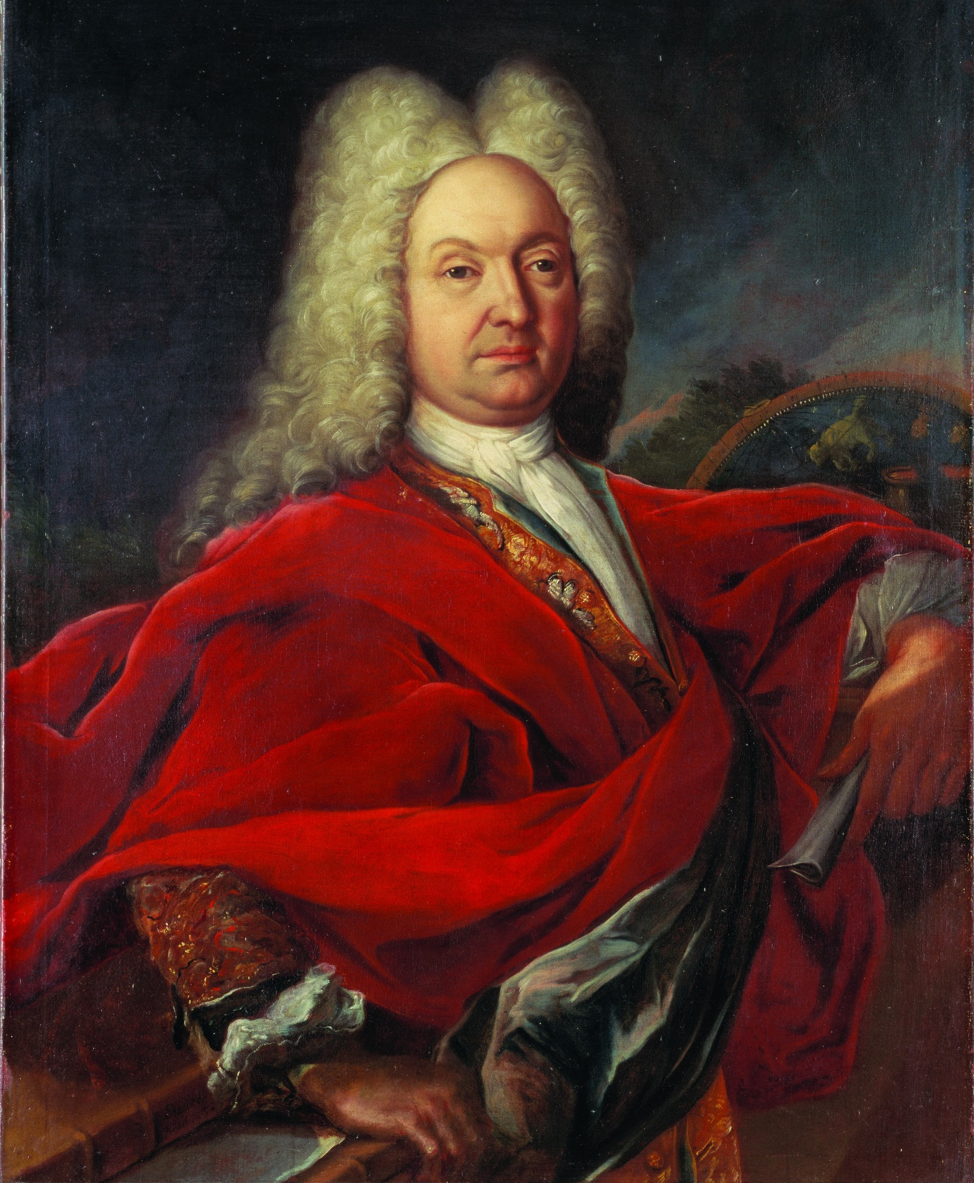

Slide 60
Conclusions, before Leibniz has the last word
Leibniz appeared to be so much more than the mathematician who in 1684 published the crucial Nova Methodus.
His diplomacy was often explicit. More often his diplomacy was informal. And Leibniz certainly did not forget his own interests.
This talk could have given more esteem to Jacob Bernoulli, certainly if it had contained more ‘hard’ mathematics. Among mathematicians he is the better known of the two brothers. Proof by stamps.
My sympathy goes to the younger brother, who for ten years left his country and went as a foreign worker to the Netherlands, to Groningen.

Slide 62
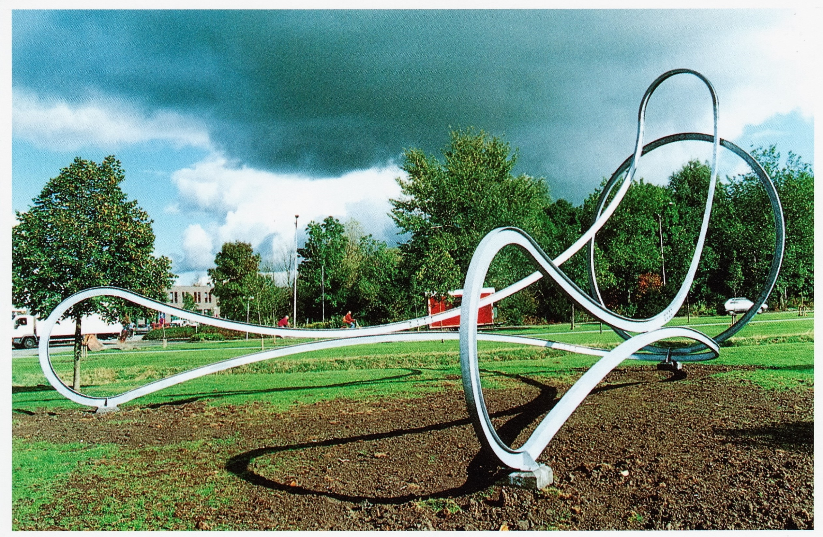

Slide 63
Leibniz tries to calm down the brothers
He has three ways to intervene:
via direct correspondence with Jacob and Johann
he offers them a carrot, provided that they would behave properly
he acts in public, via his publications

Slide 64
Leibniz about the affair in the Acta (1701)
“ Professor Jacob Bernoulli from Basel has sent me his open letter to the Groningen professor Johann Bernoulli, from which it is only too clear that his intention is to invite me in a certain way to take a particular position. I, for my part, hold both brothers in so great esteem as one can only esteem a mind that has penetrated into mathematics very deeply. And I owe both my sincerest respect, and the scientific community does so even more, that mainly the seeds they spread, partly indirectly and partly by their own inventions, resulted for my method in such a rich harvest. … “

Slide 65
Leibniz about the affair in the Acta (2)
“... For the rest I wish very much, yes I ask for it, that a noble pair of brothers may temper its rivalry, though most useful for the study of higher mathematics, so that people do not think worse about the sciences, when they must see that men of so big and immeasurable mental gifts, yes what is the summit, brothers, in a minor case have not been able to control their emotions. ”

