Slide 1
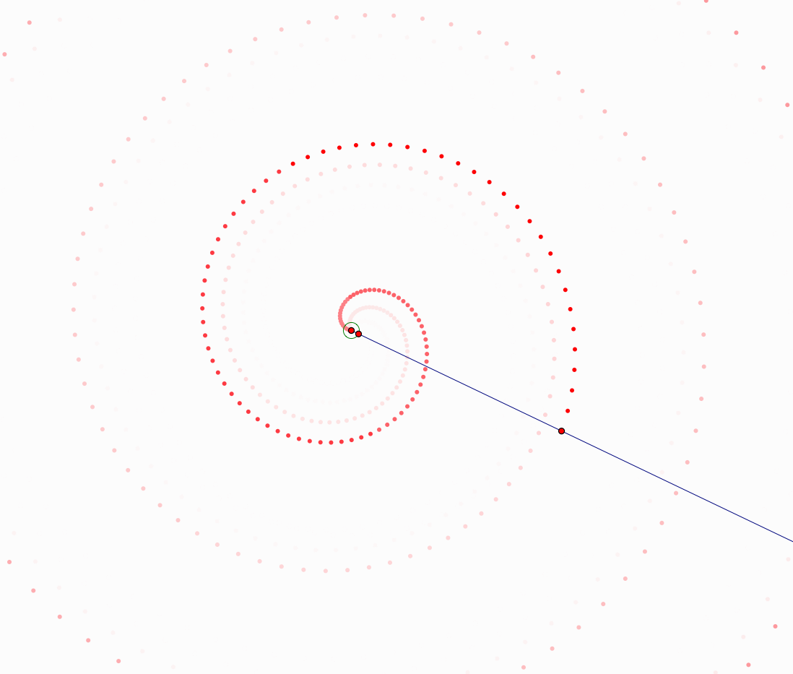
Hold on to your chairs!
Archimedes and the mathematics of spirals
Dr Snezana Lawrence

Slide 2
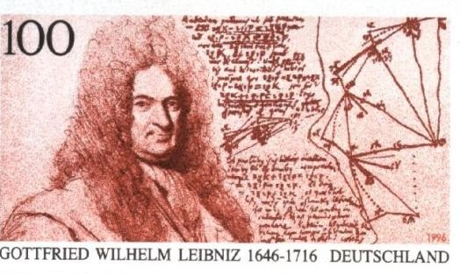
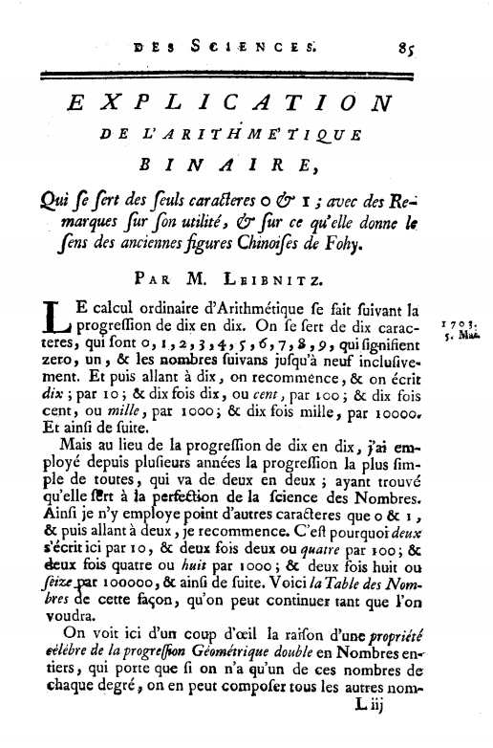
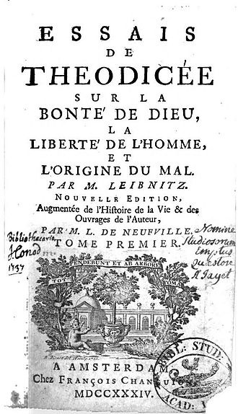
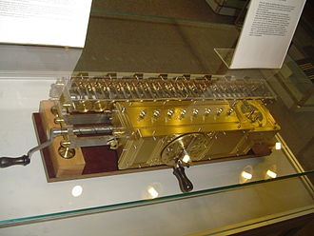
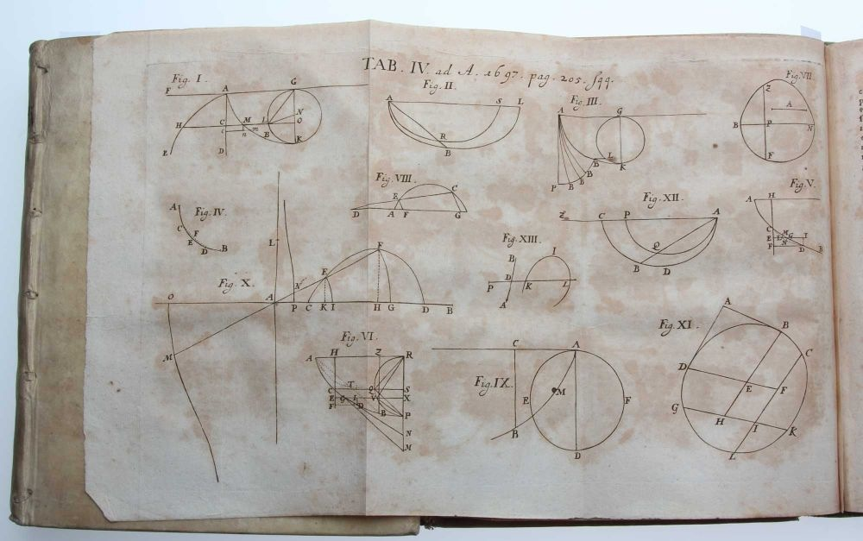
Leibniz (1646-1716)
The journey which, in an evening dedicated to Leibniz, leads us all the way back to Archimedes

Slide 3
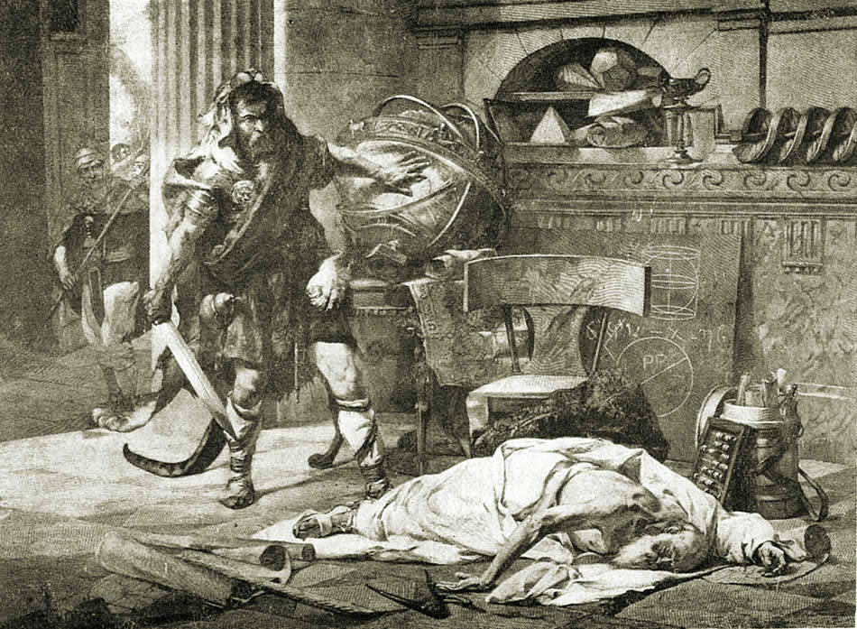
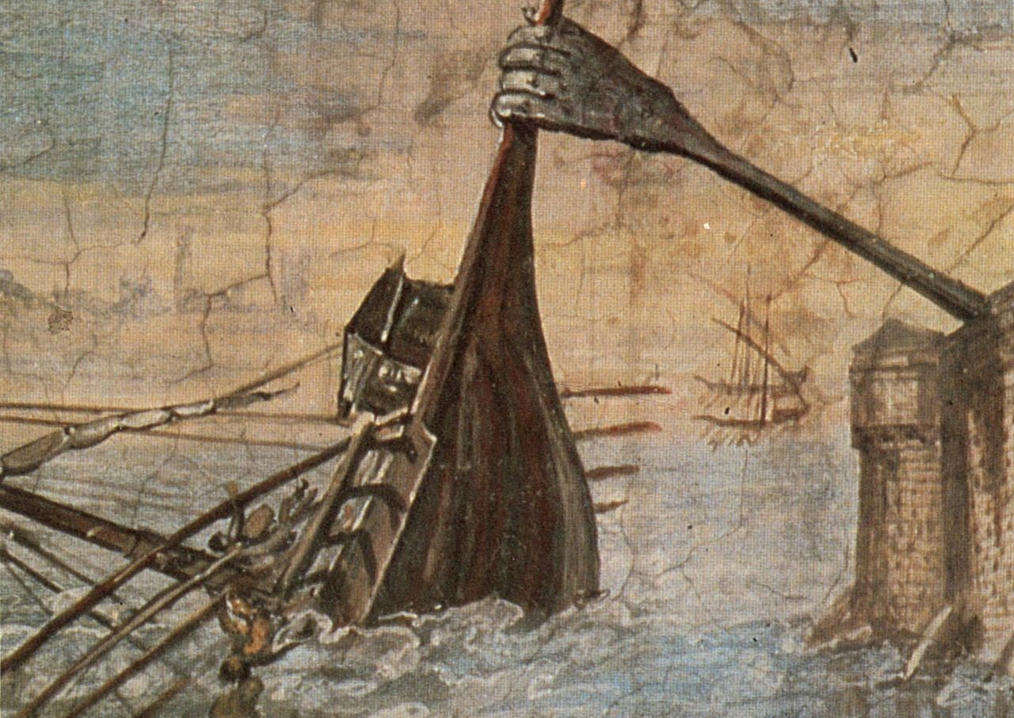
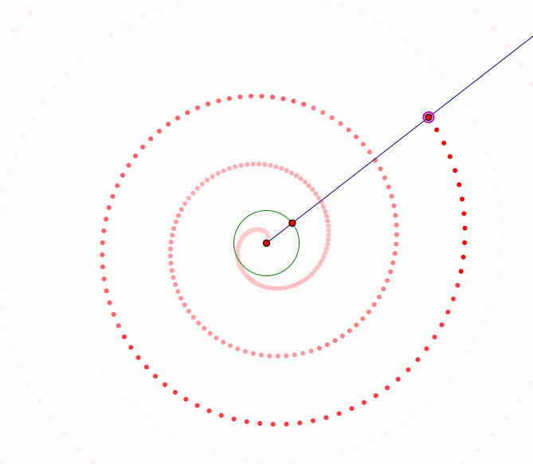

Slide 4
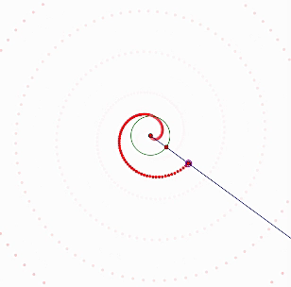
The spiral
If a straight line of which one extremity remains fixed be made to revolve at a uniform rate in a plane until it returns to the position from which it started, and if, at the same time as the straight line revolves, a point move at a uniform rate along the straight line, starting from the fixed extremity, the point will describe a spiral in the plane.

Slide 5
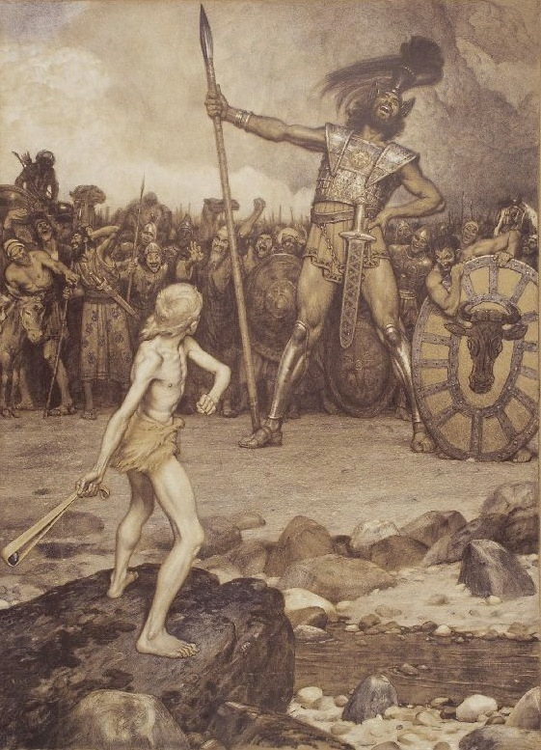
But even before…
The story of David and Goliath - referring to the period between c.1010-970 BCE
How did he succeed?
by a falcon which circles over an extended arm that feeds it
a point on a ferris wheel which rolls on the floor as the mouse keeps turning it
by a human projectile

Slide 6
Three problems…
The most famous problems of the ancient mathematics
  Squaring the circle
  Doubling the cube
  Trisecting the angle

Slide 7
Doubling the cube

Slide 8
Squaring the circle & trisecting an angle

Slide 9
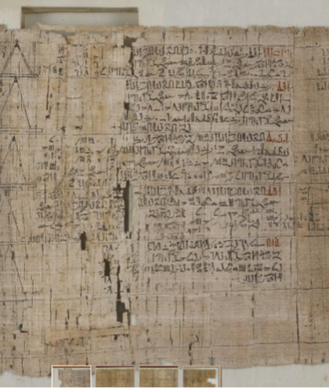
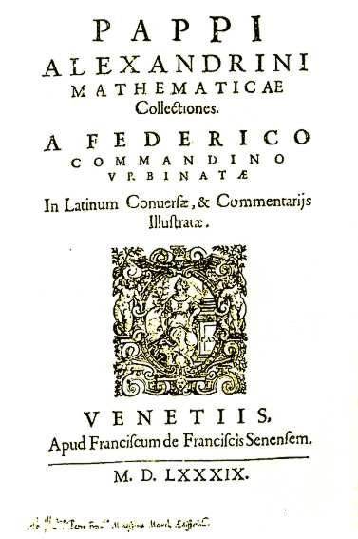
The tree types of problems…
There are, we say, three types of problems in geometry, the so called ‘plane’, ‘solid’, and ‘linear’ problems. Those that can be solved with straight line and circle are properly called ‘plane’ problems, for the lines by which such problems are solved have their origin in a plane. Those problems that are solved by the use of one or more sections of the cone are called ‘solid’ problems. For it is necessary in the construction to use surfaces of solid figures, that is to say, cones. There remain the third type, the so-called ‘linear’ problem. For the construction in these cases curves other than those already mentioned are required, curves having a more varied and forced origin and arising from more irregular surfaces and from complex motions.

Slide 10
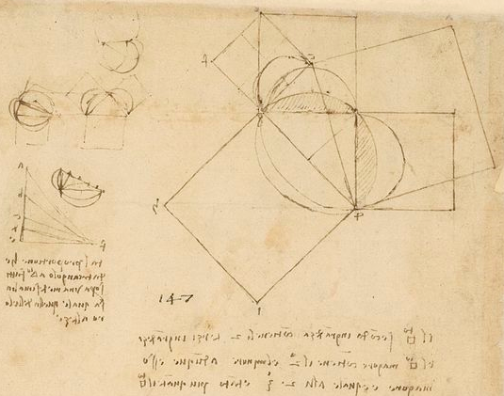
Hippocrates of Chios
(c 470BC – 410BC)
The centre of circle AEB is in D, the midpoint of AB
AOB is isosceles triangle with right angle at AOB
If AE=1
AB=√2
Smaller circle has ½ area of the larger
¼ of larger circle = ½ area of smaller
subracting the segment ABF from ABC (semi-circle) = subtracting the segment from ¼ larger circle = luna

Slide 11
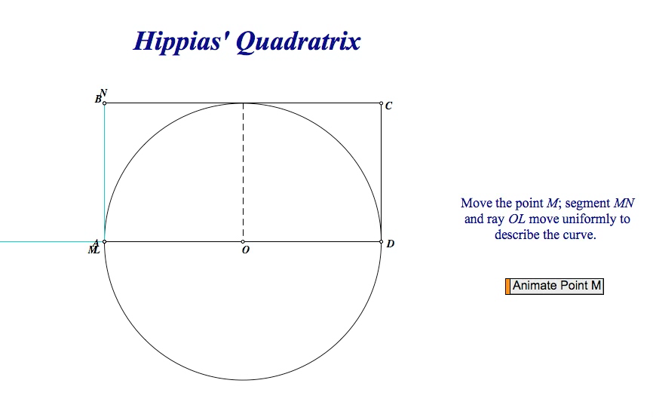
Hippias’ Quadratrix
Hippias of Elis (c 460BC-c400BC)
Invented for trisecting the angle, although some reports suggest that it was used to square the circle.
Kinematic curve – created and described by motion
The quadratix is a locus of the intersection of the parallel MN to the half-side of square and the radius OP which moves from OA to OB. Both movements are done with constant and equal rate.

Slide 12
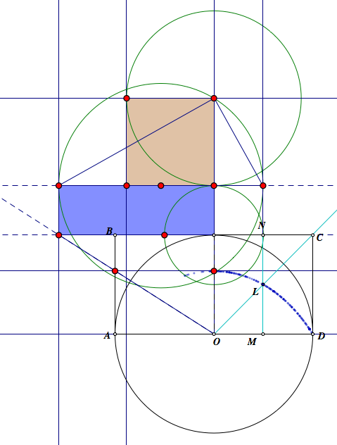

Slide 13
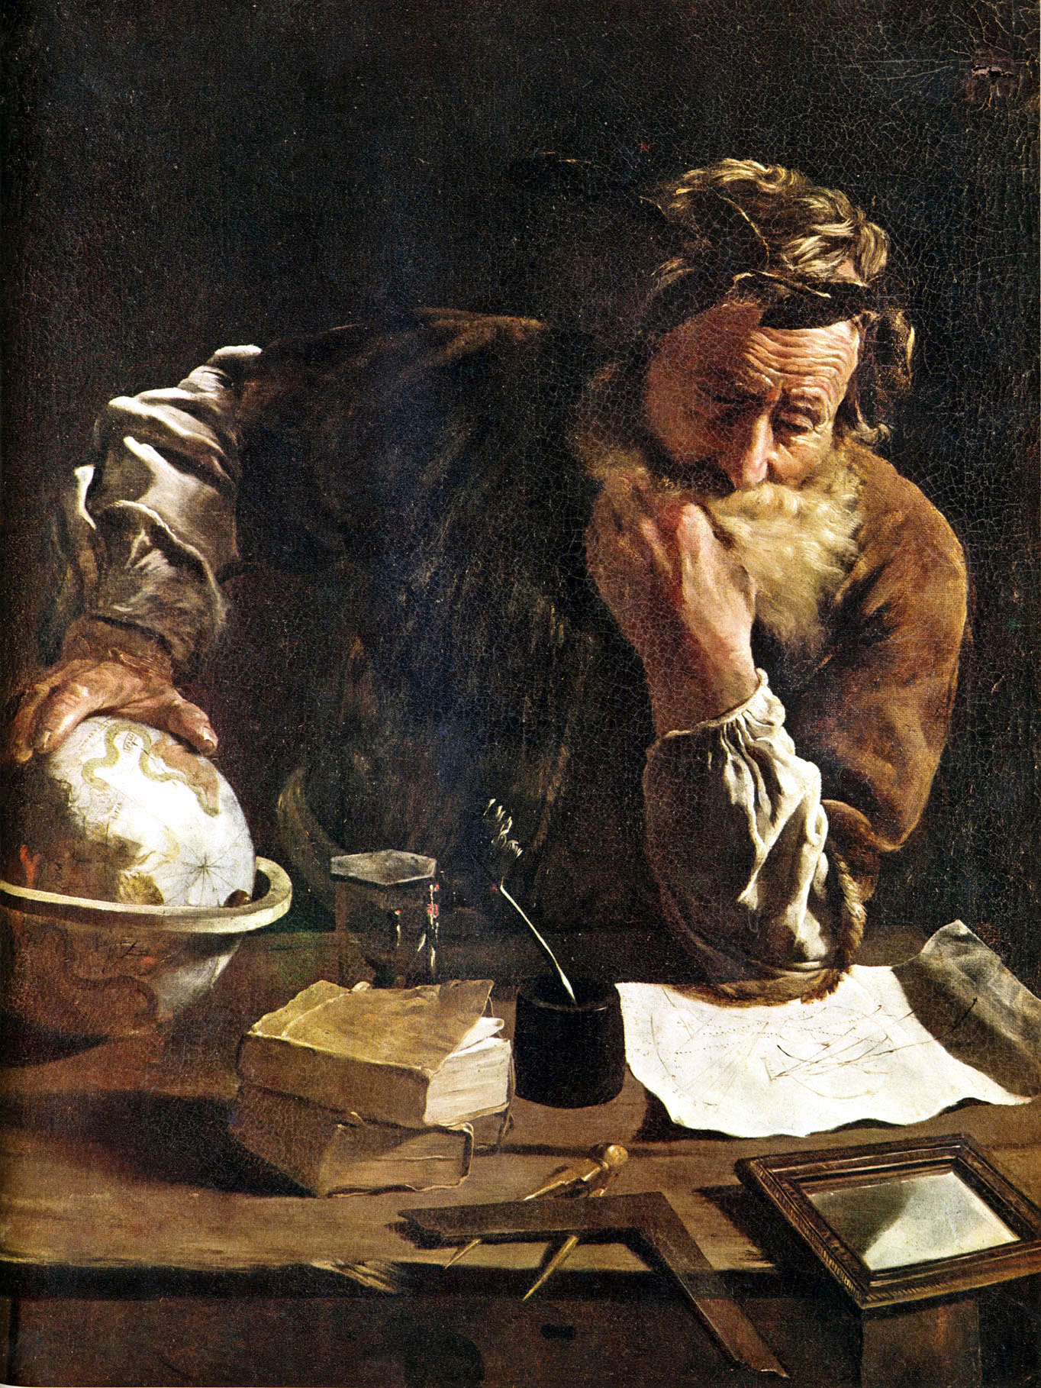

Archimedes’ spirals
Created by locus of points that is rotated around a circular and when it rotates the each point has constant rate of growth out from the center
Archimedes description from his work On Spirals
(Archimedes to Dositheus greeting)
On most of the theorems which I sent to Conon, and of which you ask me from time to time to send you the proofs, the demonstrations are already before you in the books brought to you be Heracleides; and some more are also contained in that which I now send you.

Slide 14
The spiral
If a straight line of which one extremity remains fixed be made to revolve at a uniform rate in a plane until it returns to the position from which it started, and if, at the same time as the straight line revolves, a point move at a uniform rate along the straight line, starting from the fixed extremity, the point will describe a spiral in the plane.

Slide 15
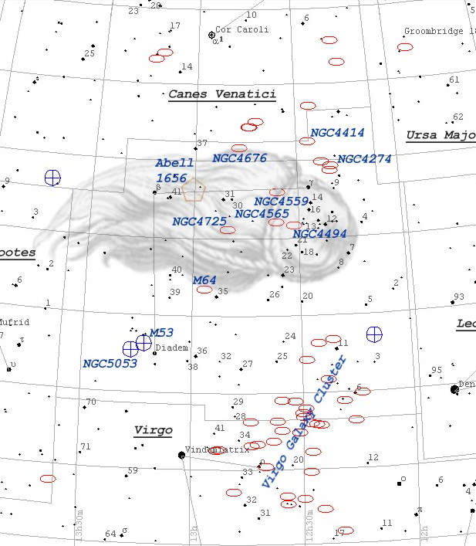
Conon and the Coma Berenices
Conon of Samos (c280BC-c220BC) lived at the court of Ptolemy III who was warring with Syrians
The origin of the Coma Berenices
Archimedes states he would not have been able to prove the spiral had Canon not lived – it may be he would not have known about it or thought about it

Slide 16
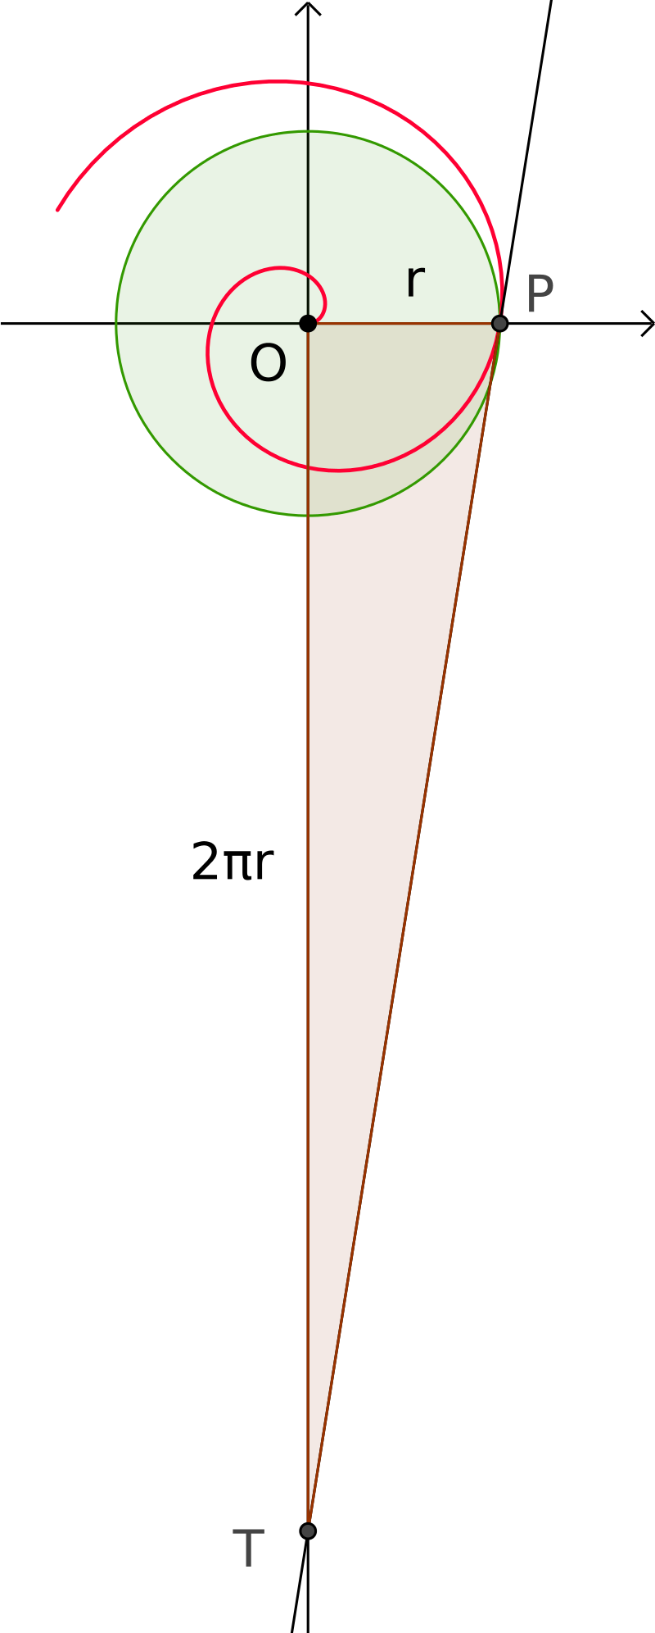
Archimedes’ spiral and squaring of the circle
I say then that the area bounded by the piral and the straight line which has returned to the position from which it started is a third part of the circle described with the fixed point as centre and with radius the length traversed by the point along the straight line during one revolution.
And, if a straight line touch the spiral at the extreme end of the spiral, and another straight line be drawn at right angles to the line which has revolved and resumed its position from the fixed extremity of it, so as to meet the tangent, I say that the straight line so drawn to meet it is equal to the circumference of the circle.

Slide 17
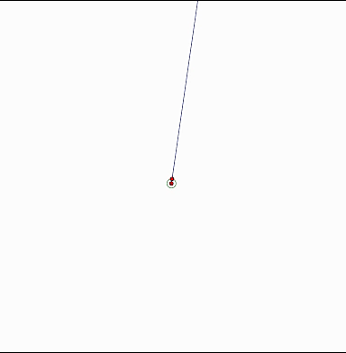


The spiral some time later
The Archimedean spiral is also sometimes called the ‘linear’ spiral. The spacing between intersections along a ray that generates it from the origin remain constant.
The equation of this spiral is
But what if the rate changes?
Equiangular (Descartes 1638) or logarithmic or ‘Spira Mirabilis’ (Jacob Bernoulli – proponent of Leibniz’s calculus)

Slide 18
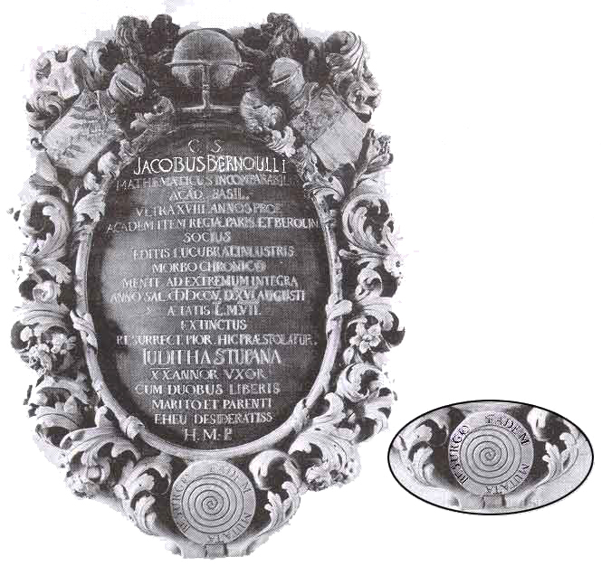

Slide 19
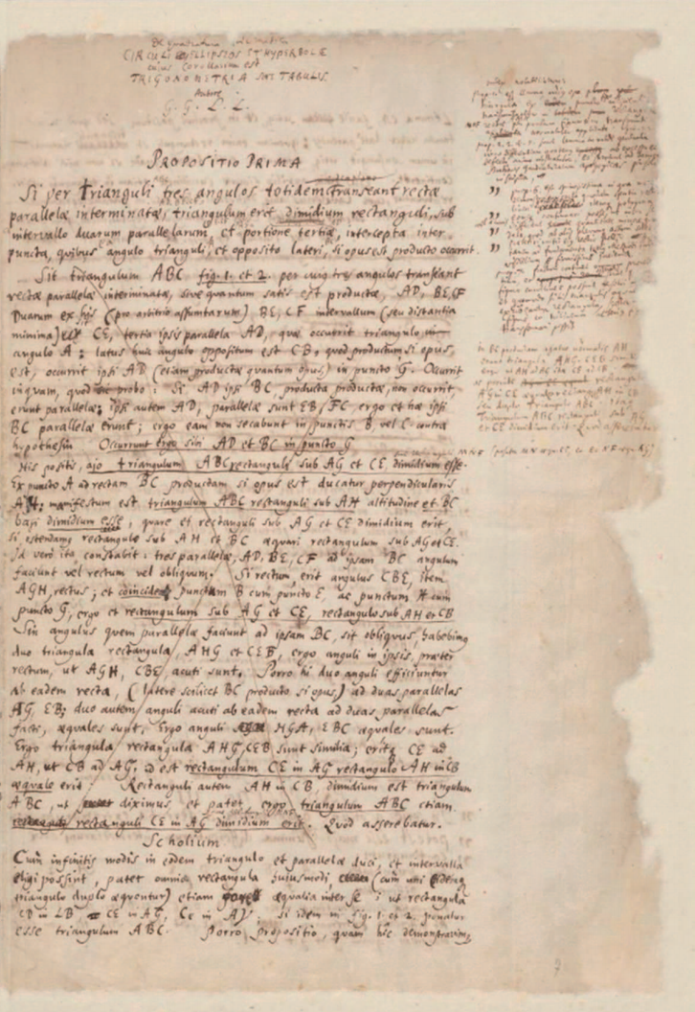
Back to Leibniz
The well known dispute between Newton and Leibniz
Leibniz has been accused of neglecting mathematical rigour
Arithmetical quadrature of the circle, of the ellipse, and of the hyperbola – not published in his lifetime (written 1675-6).
In 1993 first printed version in Göttingen.
Refers to Archimedes as the model of mathematical rigour: ‘Hence the method of indivisibles which finds the areas of spaces by means of sums of lines can be regarded as proven’.

Slide 20
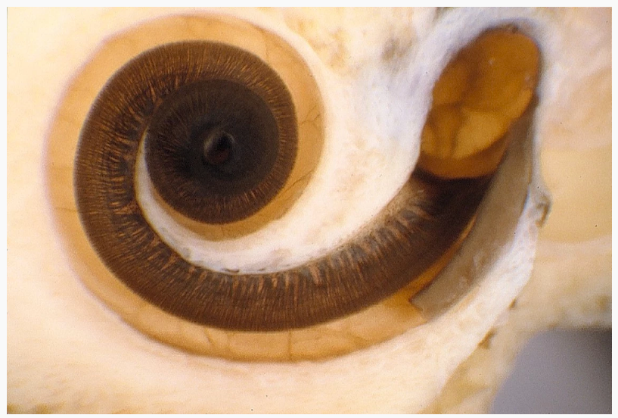
Curves of life

