Slide 1


H
Hotting Up: Meeting the challenges of climate change in the 21st Century
Carolyn Roberts
Frank Jackson Professor of Environment
Gresham College, London
Water and Environment Consultant

Slide 2
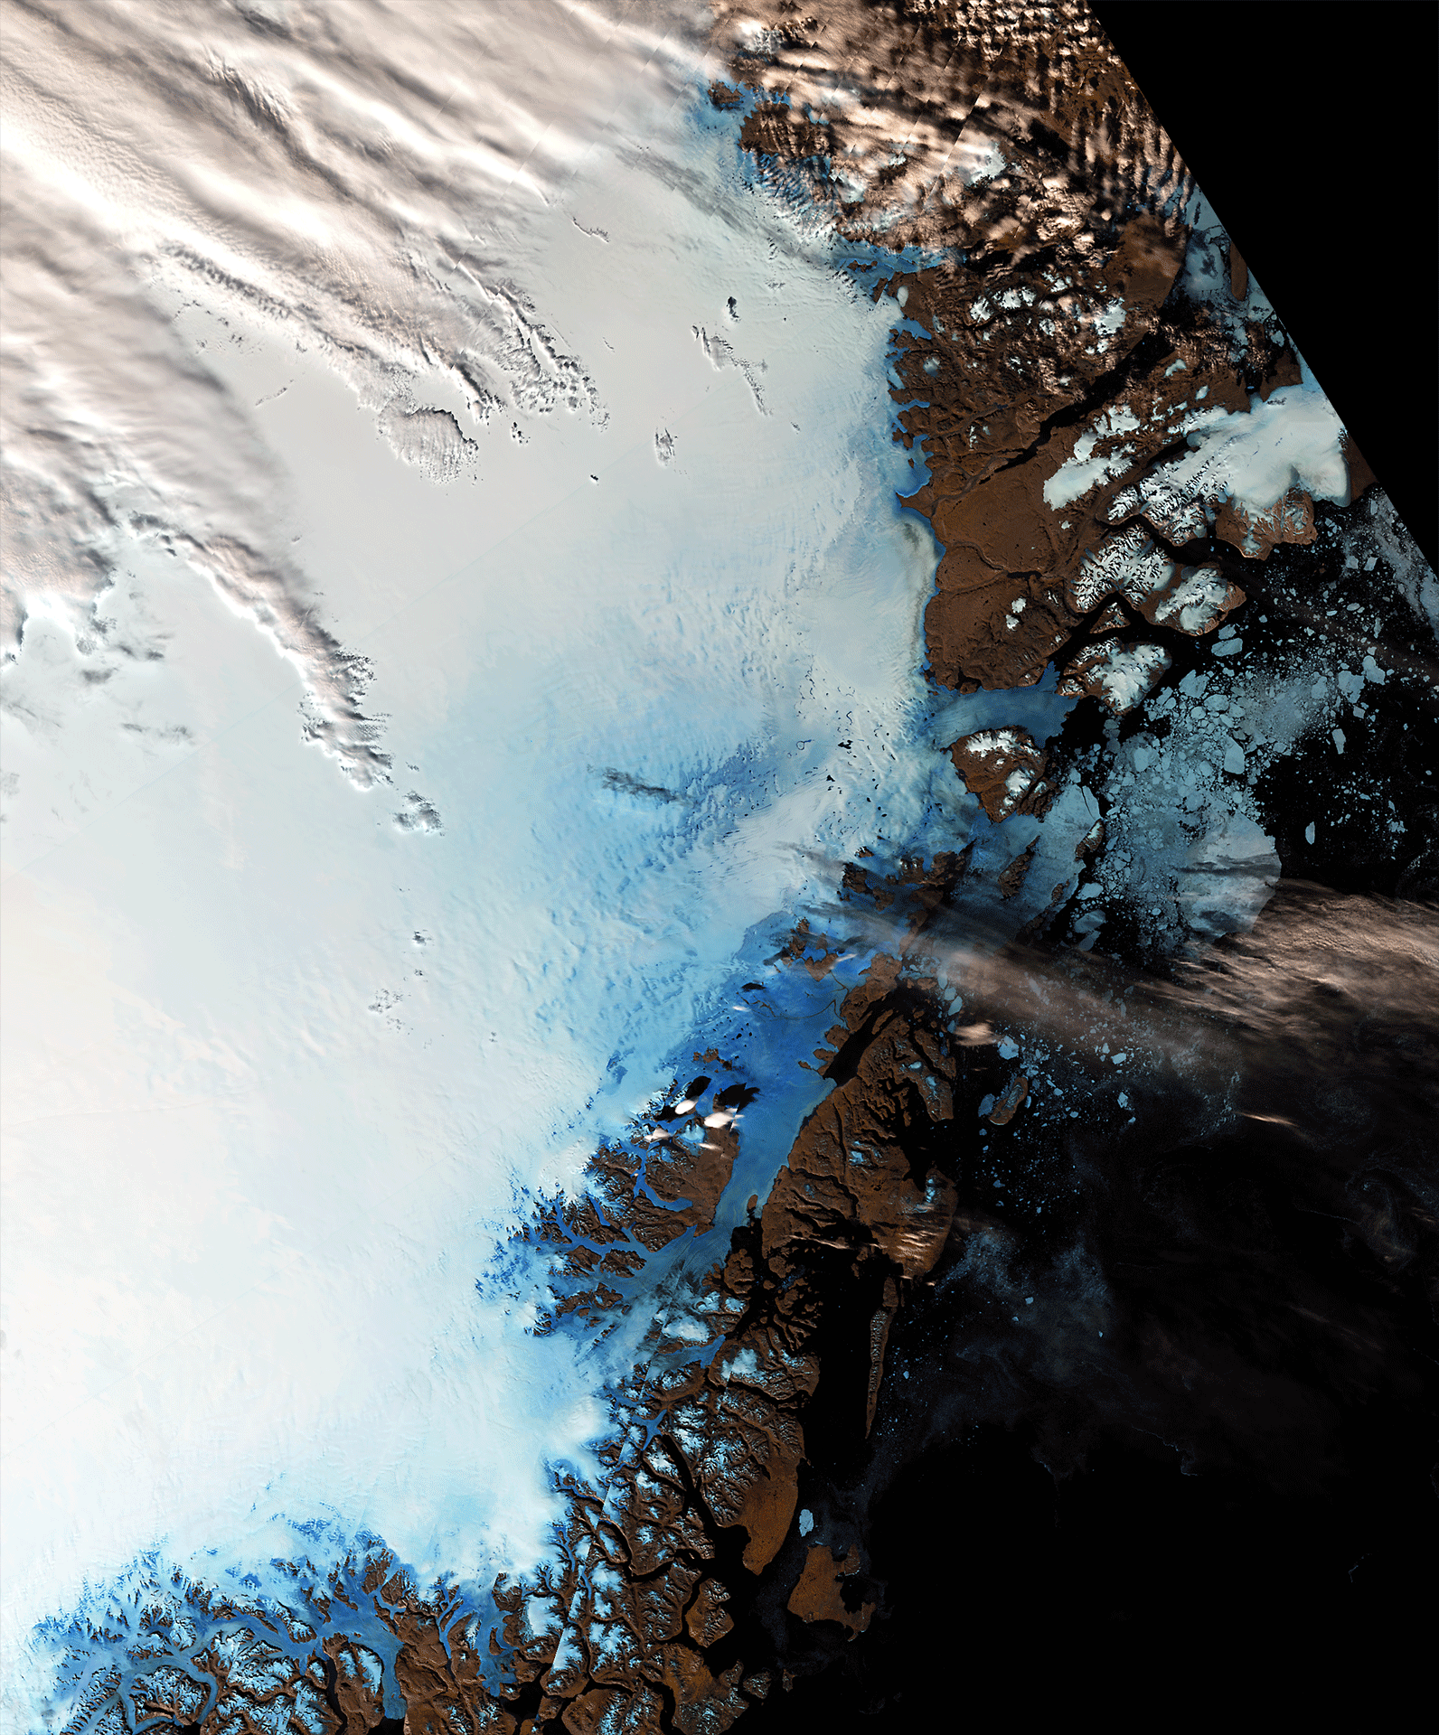
These two images, taken on 13 June 2016 and 22 August, by Sentinel-3A’s Ocean and Land Colour Instrument show differences in ice cover in northeast Greenland. Differences in coastal sea ice are clear.
Photo: ESA

Slide 3
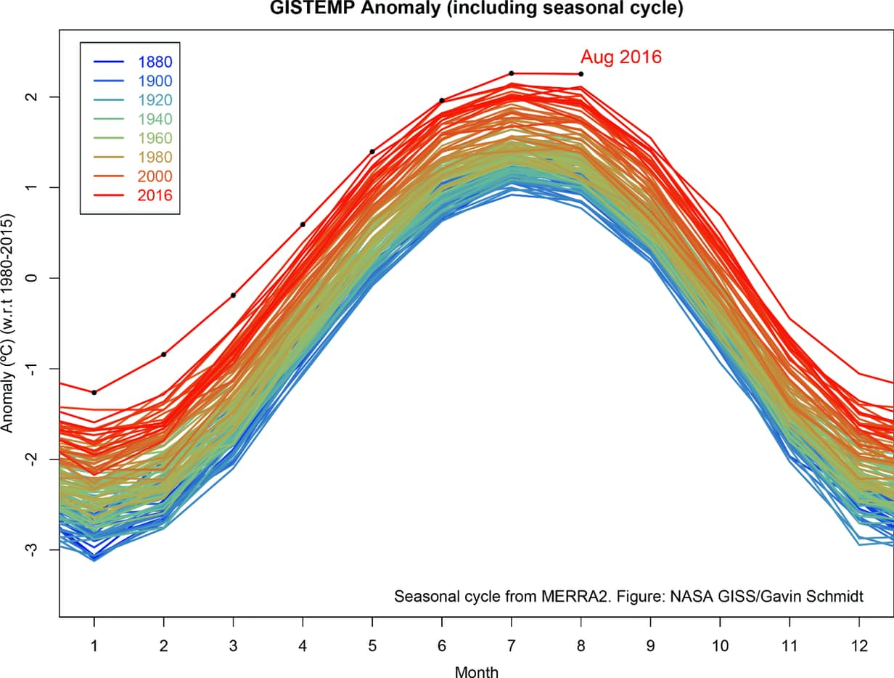

Slide 4
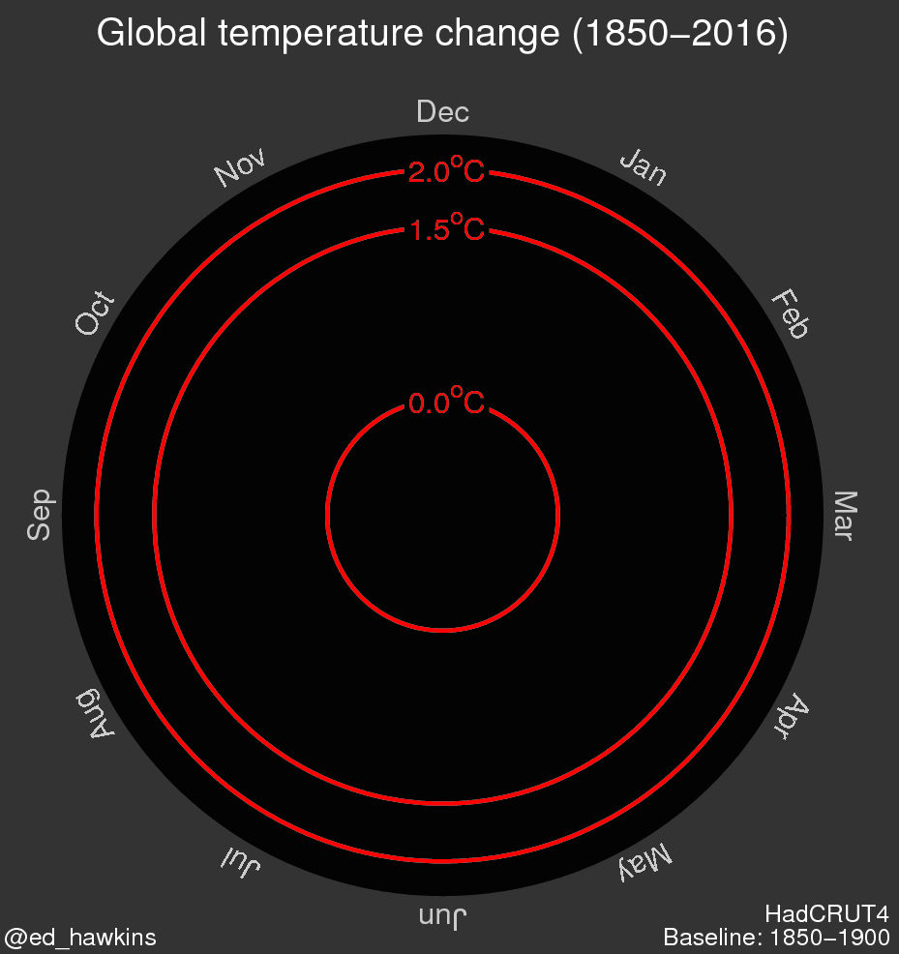

Slide 5
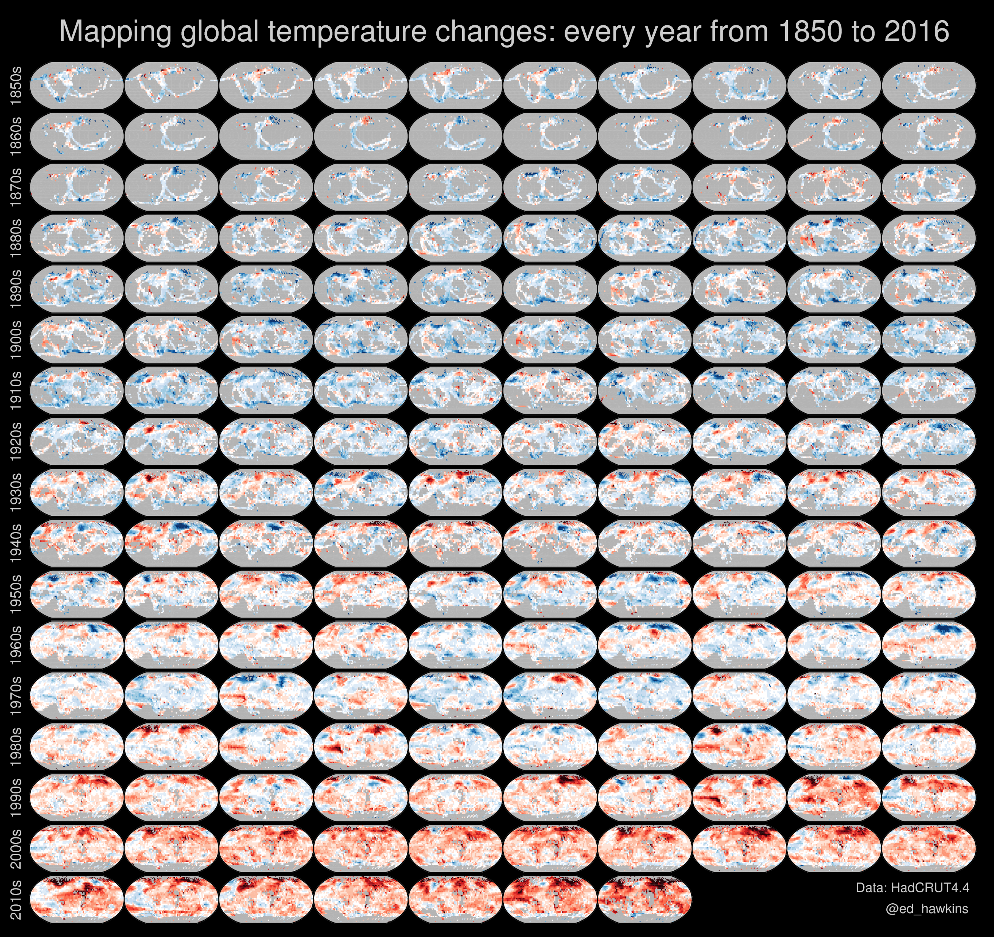


Slide 6
Multiple stakeholders – one of the characteristics of a ‘wicked problem’
Atmospheric scientists
Hydrologists
Oceanographers
Ecologists
Economists
Policy analysts

Slide 7

Lies, damned lies and climate change…
DavidOldham, November 5th, 2016
The US which did not ratify it is the only major industrial country to meet the goals of the Kyoto Treaty. That was supposed to be the end all to the climate change melodrama. Fast forward to the latest statists' attempt to control the human condition, it's all a farce about control, nothing more nothing less. They are coming for your heating and air conditioning. …..The biggest factors in our climate are the sun and water vapor and the rest is scientific fantasy. Yes we are all going to die fortunately climate change will have nothing to do with it.
Republican candidate Donald Trump vowed to end both international and domestic climate spending, as Hillary Clinton mocked Trump's claim he is an environmentalist… Trump used the last few days of the US election campaign to underline his opposition to global and domestic climate policies, vowing to "cancel billions in global warming payments to the EPA...”
Aristotle, November 4th, 2016
Total UN b.s., just another way to redistribute wealth from the developed world to the undeveloped world. There has been no documented global warming for approximately 15 years. Of course as we came out of the last mini-Ice age period, the globe has warmed (thankfully). Refugees fleeing flooding, fire, famine and war has occurred through all of history.

Slide 8


Slide 9


Slide 10
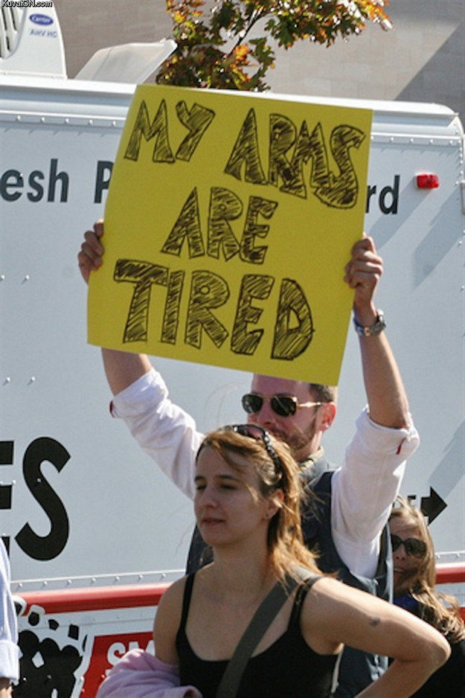

Slide 11
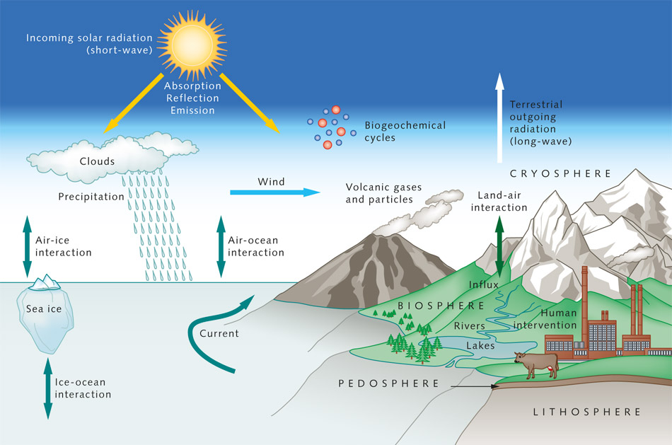
Key ideas, diagram
Influences on climate and radiation

Slide 12
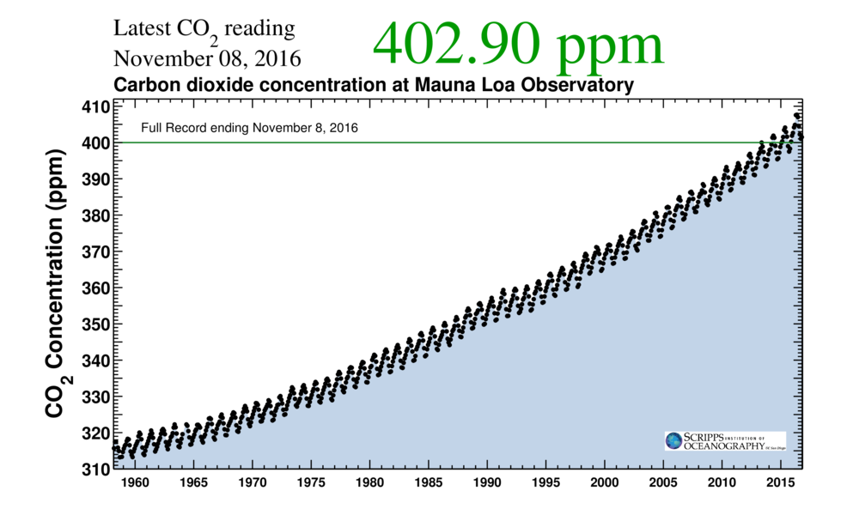
When available, daily average values for CO2 in the atmosphere are posted here.
Measurements are made by two independent CO₂ monitoring programs (NOAA and Scripps) at the Mauna Loa Observatory in Hawaii, about 3400 metres above sea level.
https://www.co2.earth/daily-co2

Slide 13
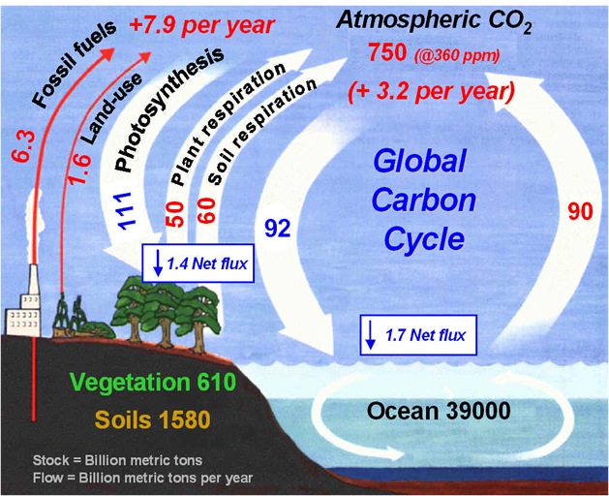
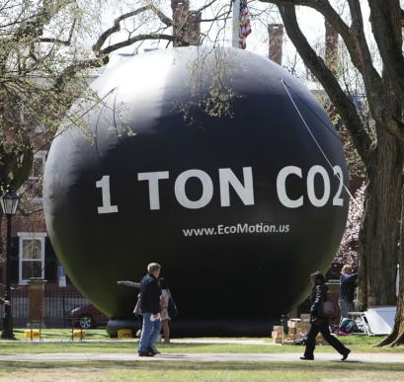
Carbon cycles, approximate figures for flows and stores
University of Michigan

Slide 14
What we knew and what we didn’t know about the science five years ago….
Habitats will shift
Greenhouse gases are warming the earth
The Earth will get hotter
How far will greenhouse gases rise?
How large are our cooling effects?
Exactly how much hotter will it get, and where?
How quickly will sea level rise?
There will be more floods and droughts
Are there any tipping points?
Sea level will rise by metres
Can habitats and organisms maintain biodiversity?
Where does the heat go?
Other pollutants are cooling the Earth
KNOWN
UNKNOWN

Slide 15
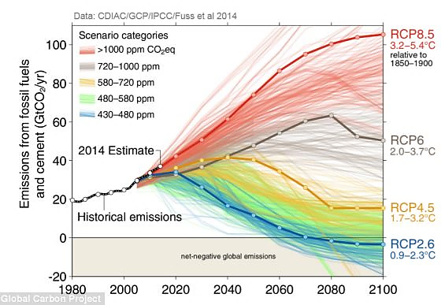
Far more carbon was emitted into the air in 2014 than ever before, largely by China, the United States and India burning coal, oil and gas, according to a recent report that estimated 36.1 billion metric tons of carbon dioxide last year. That is 706 metric tons or 2.3 per cent more than the previous year, despite increasingly urgent warnings over the need to curb greenhouse gases.

Slide 16
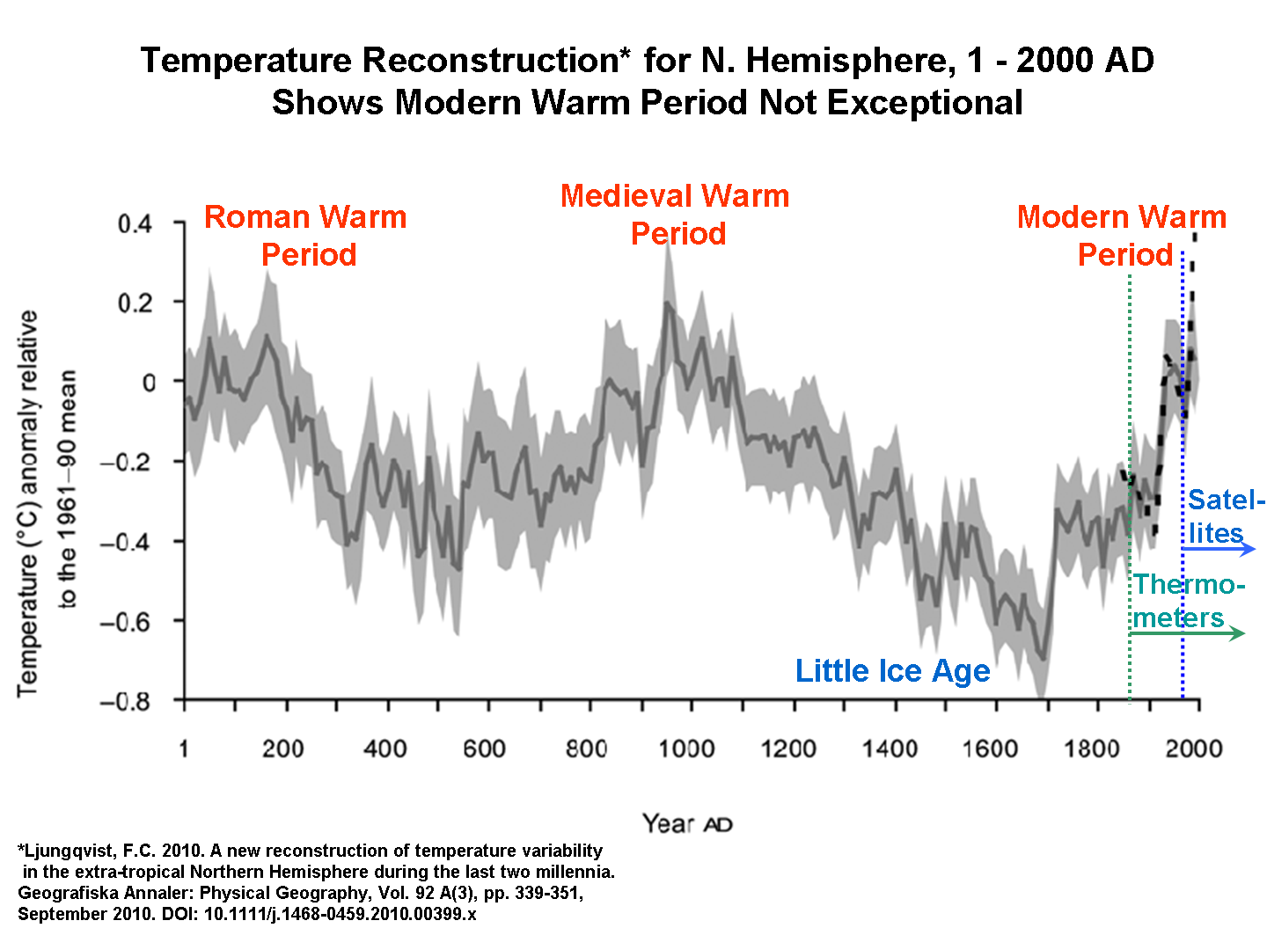
‘Roy Spencer, a climate expert at the University of Alabama testified before a US Senate committee on the issue of global warming. Spencer said the current worldwide warming trend has happened before..’
July 2013

Slide 17
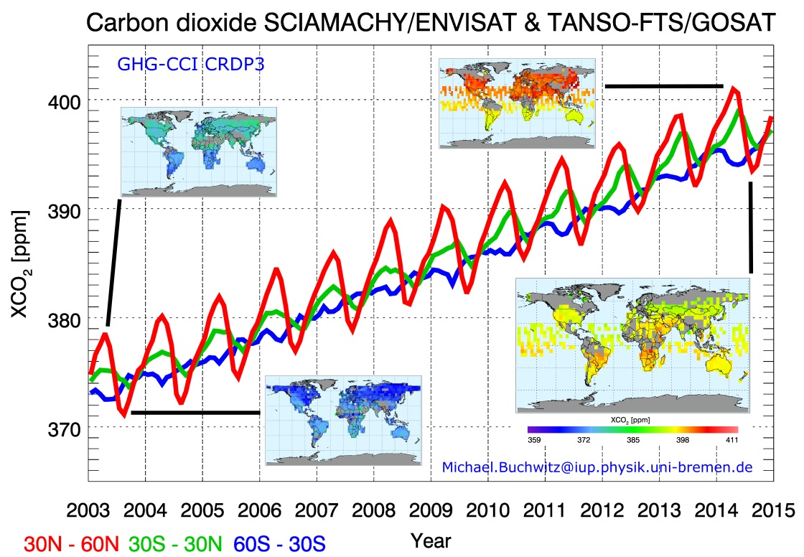
Carbon dioxide levels 2003 to 2015. Coloured lines show average amount in different latitudes, eg red line shows the carbon dioxide over northern hemisphere mid-latitudes 30º to 60º north. Atmospheric carbon dioxide is increasing despite effort to reduce emissions primarily caused by burning fossil fuel.
IUP, Univ. Bremen/SRON/Univ. Leicester/ESA/DLR/JAXA/NIES

Slide 18
http://www.esa.int/spaceinimages/Images/2013/08/Carbon_dioxide_on_the_rise

Slide 19
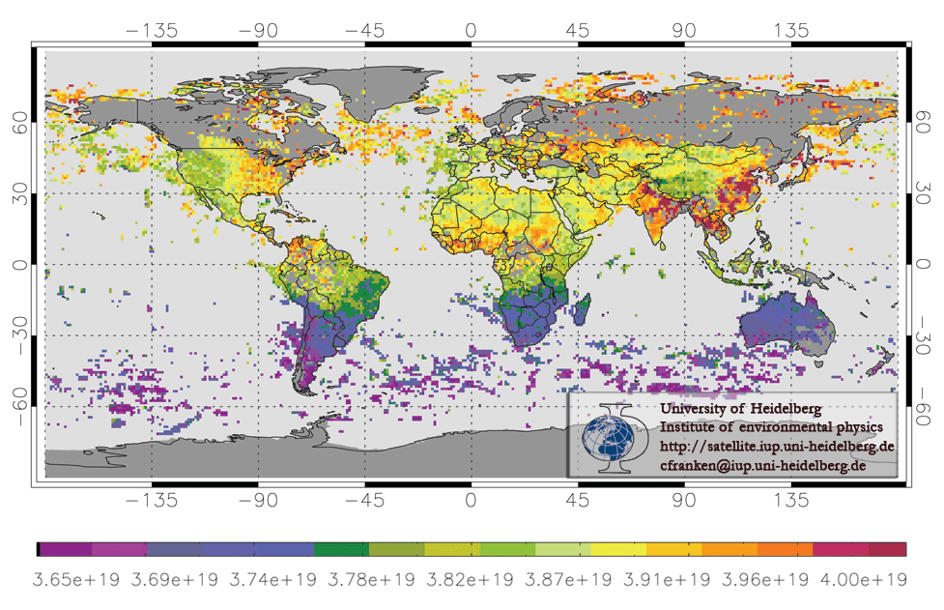
Atmospheric data acquired between August and September 2003 by Envisat. It shows the density of methane measured in molecules per square centimetre. Note the methane over the Indian subcontinent from rice cultivation in the Ganges valley.

Slide 20
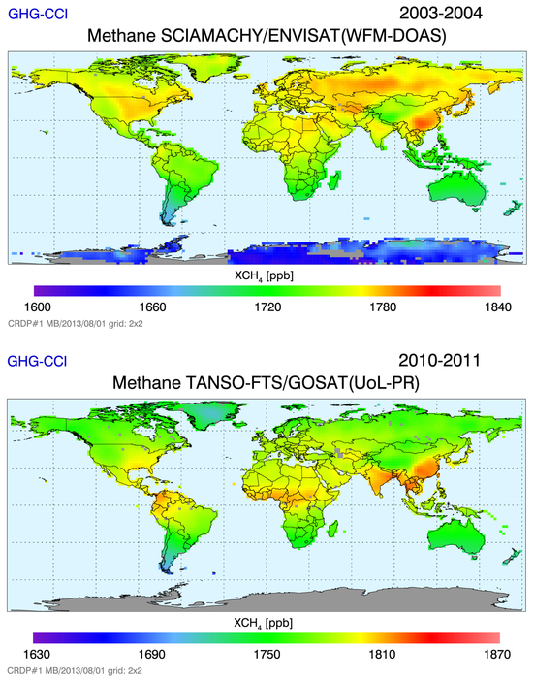
Atmospheric methane as retrieved from Envisat covering 2003–04 (top) and Japan’s GOSAT from 2010–11 (bottom). High values (yellow to red) correspond to major sources such as China (e.g., rice cultivation), Siberia (wetlands) and parts of the US (e.g., gas and coal mining, wetlands).
During 2010–11 (bottom) the average global methane is approximately 30 parts per billion higher than in 2003–04 (top).
Note: the colour scale changes
between the two images.
University Bremen/ESA

Slide 21
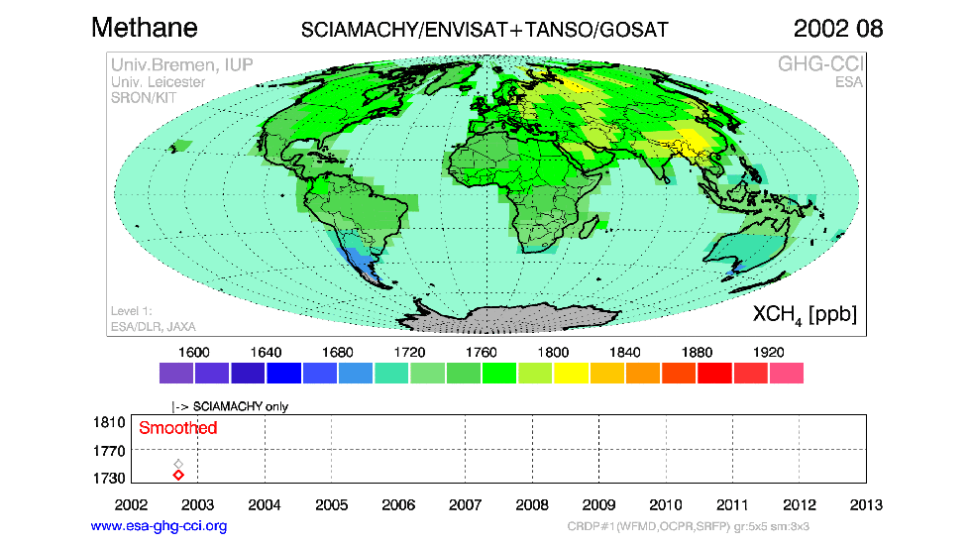
Animation of atmospheric methane from Envisat (2002–12) and Japan’s GOSAT (2009–12). Over time, methane levels gradually increase from shades of blue and green (representing lower levels) to shades of yellow and red (higher levels). Methane is expressed in parts per billion (ppb). University Bremen/ESA

Slide 22

Methane? Not me, surely?

Slide 23

Nor me?

Slide 24
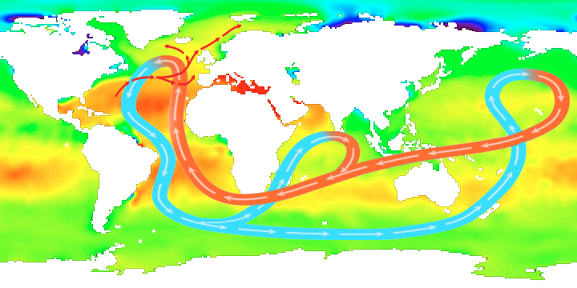
The role of the oceans in circulating heat and carbon- ocean circulation patterns
Average sea-surface salinity
Areas of red indicate regions of high salinity and areas of green indicate low salinity. The map is overlaid with a simplified global ocean circulation pattern called the 'thermohaline circulation'. Temperature (thermal) and salinity (haline) variations are key variables affecting ocean circulation. ESA, 03/09/2010

Slide 25
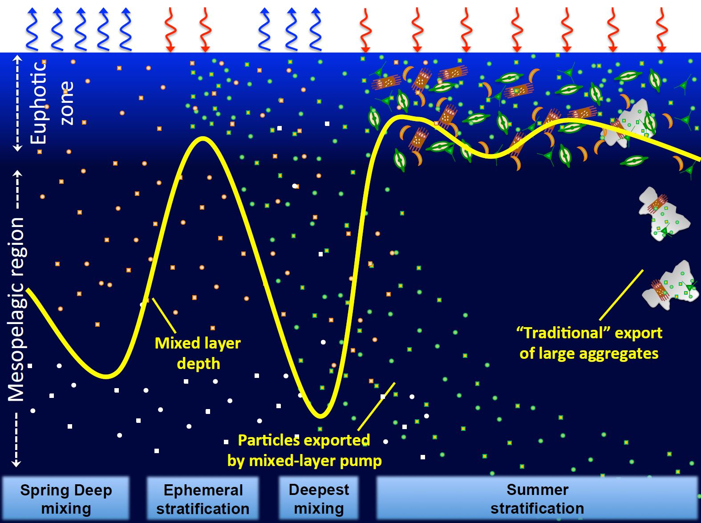
Scientists at Plymouth Marine Laboratory in the UK, working with colleagues from France, combined ocean-colour satellite data with in situ measurements from floats, to work out how much energy is transported from the ocean’s surface down to the mesopelagic layer. They estimate that seasonal mixed layer pump moves around 300 million tonnes of carbon each year, which is a vital energy source for organisms living in the deep dark part of the ocean.
PML, September 2016

Slide 26
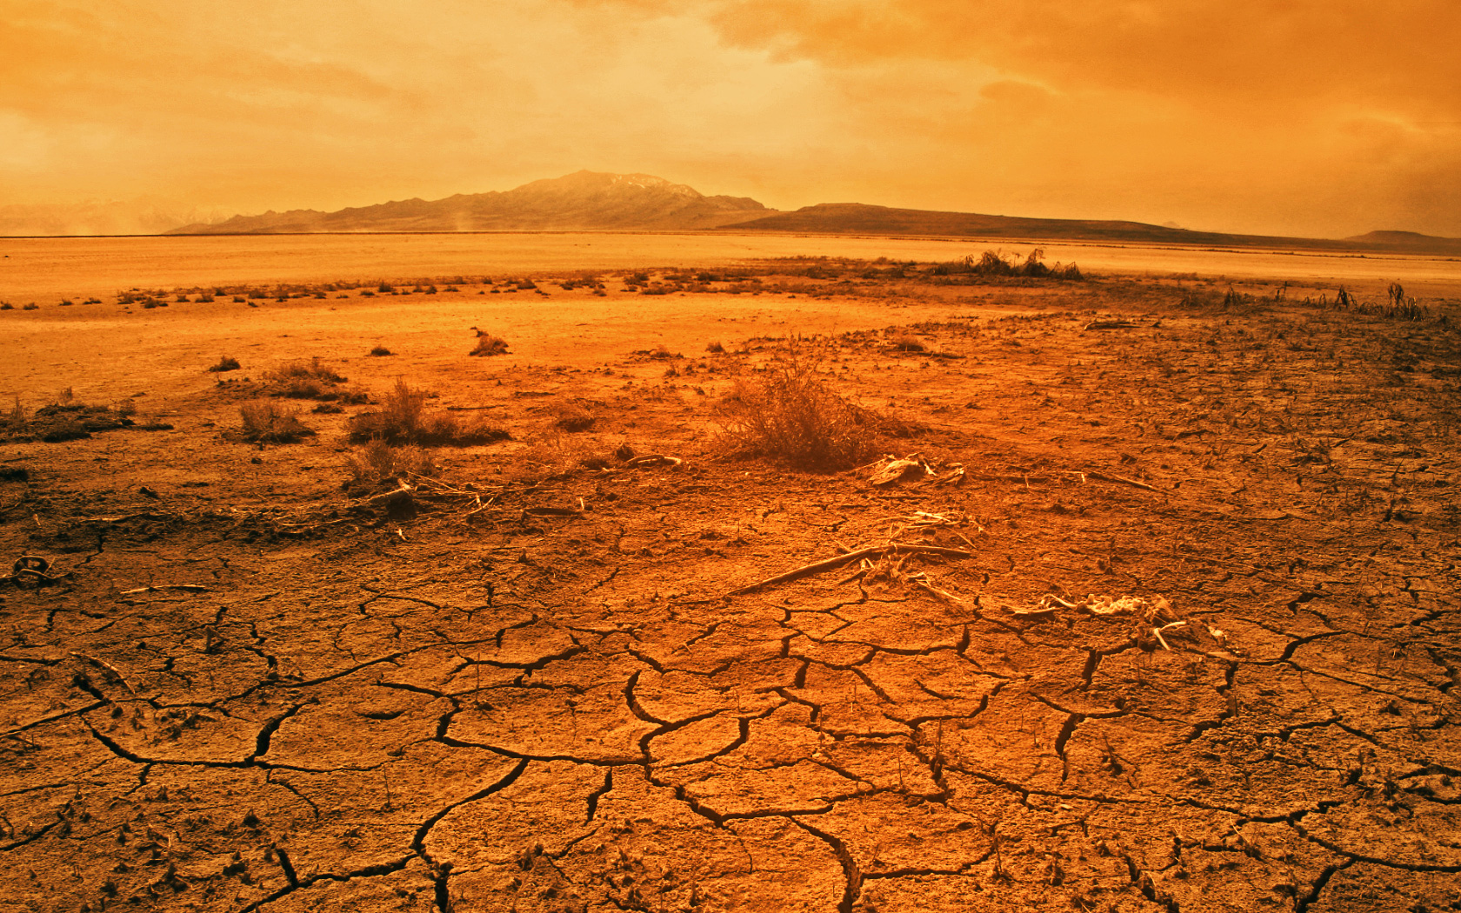
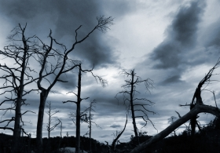
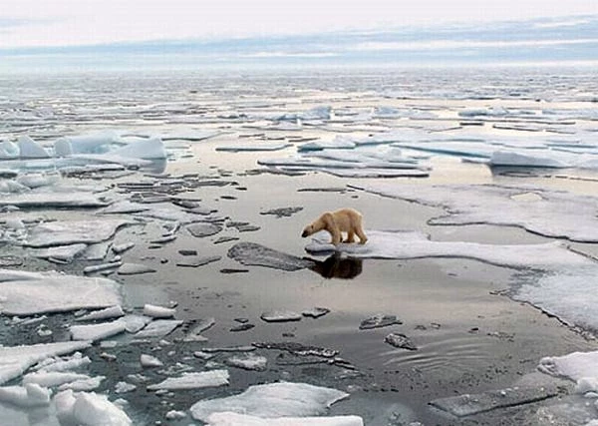
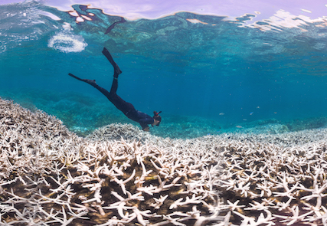
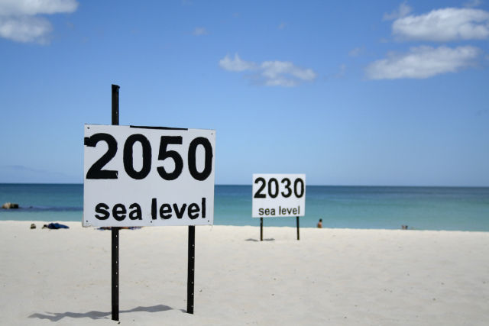
Climate change implications, and the consequences for human life?

Slide 27
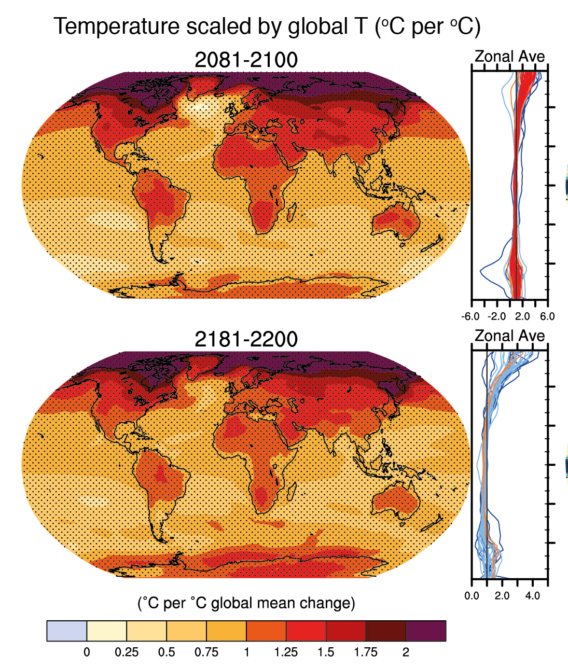
Inter-Governmental Panel on Climate Change Long Term Climate Change Projections, 2014

Slide 28
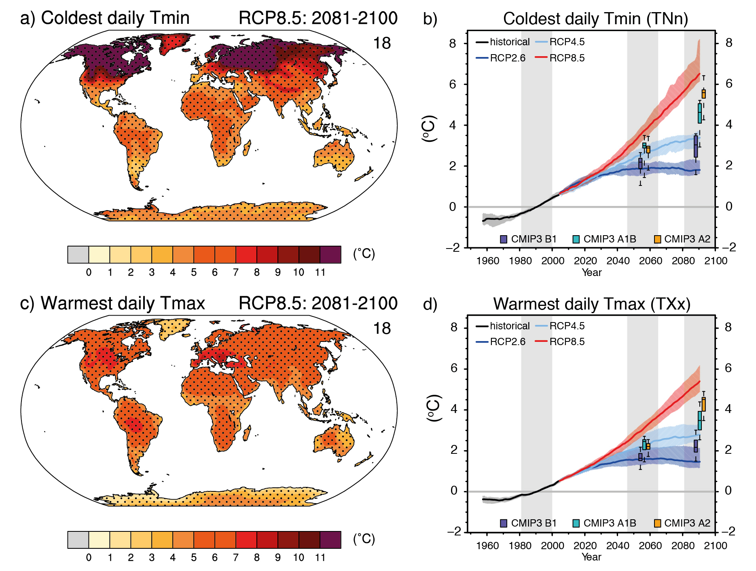

IPCC Long Term Climate Change Projections, 2014

Slide 29
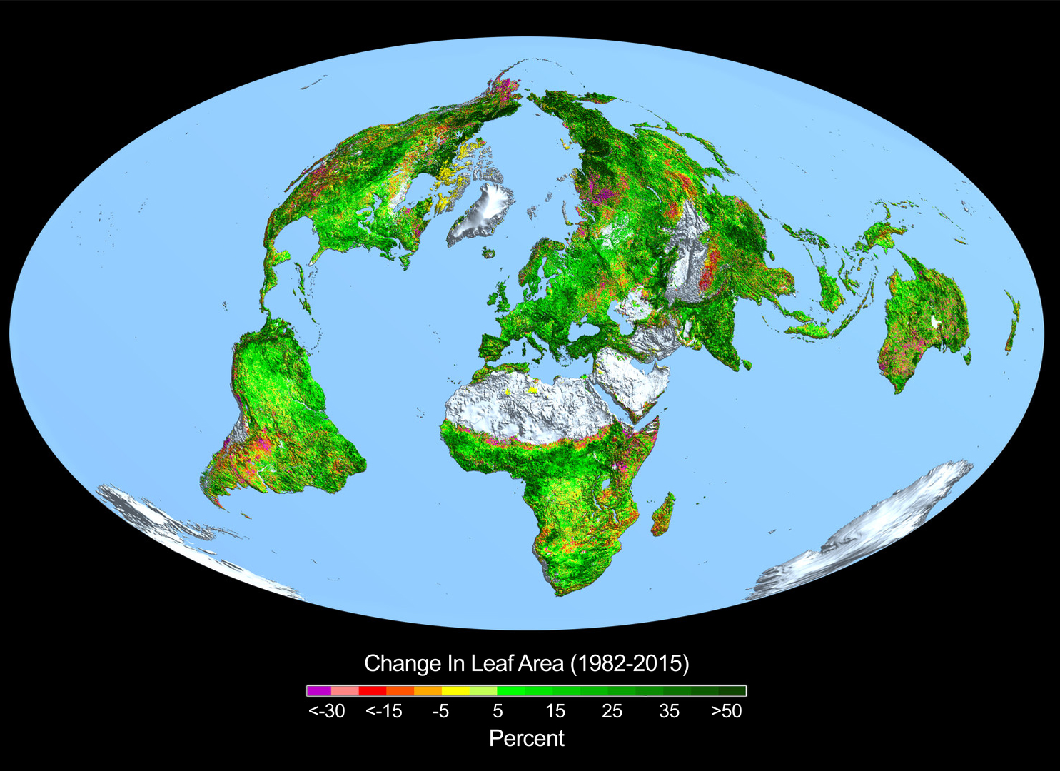
From a quarter to half of Earth’s vegetated land has shown significant greening over the last 35 years, largely due to rising levels of carbon dioxide. Satellite data from NASA’s Moderate Resolution Imaging Spectrometer and the NOAA Advanced Very High Resolution Radiometer were used to determine the amount of leaf cover. Carbon dioxide fertilization explains 70% of the greening effect, with nitrogen at 9 %..
Every year, about half of the 10 Bn tons of carbon emitted into the atmosphere from human activities remains temporarily stored, in about equal parts, in the oceans and plants. “While our study did not address the connection between greening and carbon storage in plants, other studies have reported an increasing carbon sink on land since the 1980s, which is entirely consistent with the idea of a greening Earth,”

Slide 30
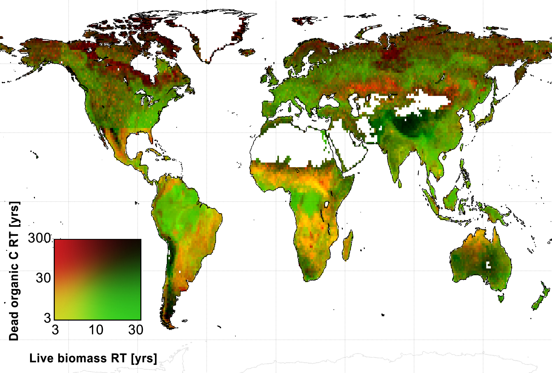
Carbon is stored in trees, other plants and soils for different periods of time. Areas in red and blueish tones hold a lot of sequestered carbon. In warm wet climates, carbon is stored longer in vegetation than in soils.
Research by the University of Edinburgh, United Kingdom; NASA’s Jet Propulsion Laboratory, California; and Wageningen University, Netherlands, analyzed satellite and field study data from 2001 to 2010. The existing global maps of vegetation and fire activity they studied were produced from data from NASA’s Terra, Aqua and ICESat spacecraft

Slide 31
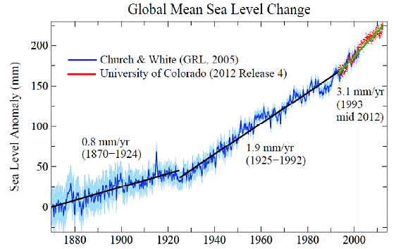
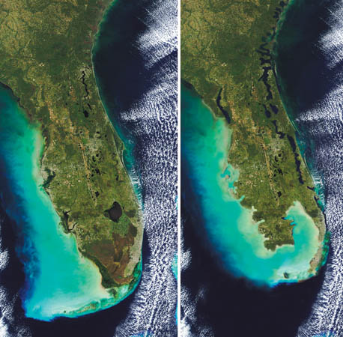
Ocean warming experienced at depth
Glacial melt starting
South Florida before and after 6 m of sea level rise.
Note second image is an artist’s impression. Image source: Tropical Audubon Society
Global sea level rise since 1870
Source: Dr James Hanson
A further surge in levels is apparent after 2014-15, according to Shuang Yi, April 2016, Geophysical Research Letters. Average rate of sea level rise of 4.4 mm per year, or 30% faster than the annual rate from 1992 to 2009, during the period 2010 to 2013, and faster again in 2014 to 2015

Slide 32
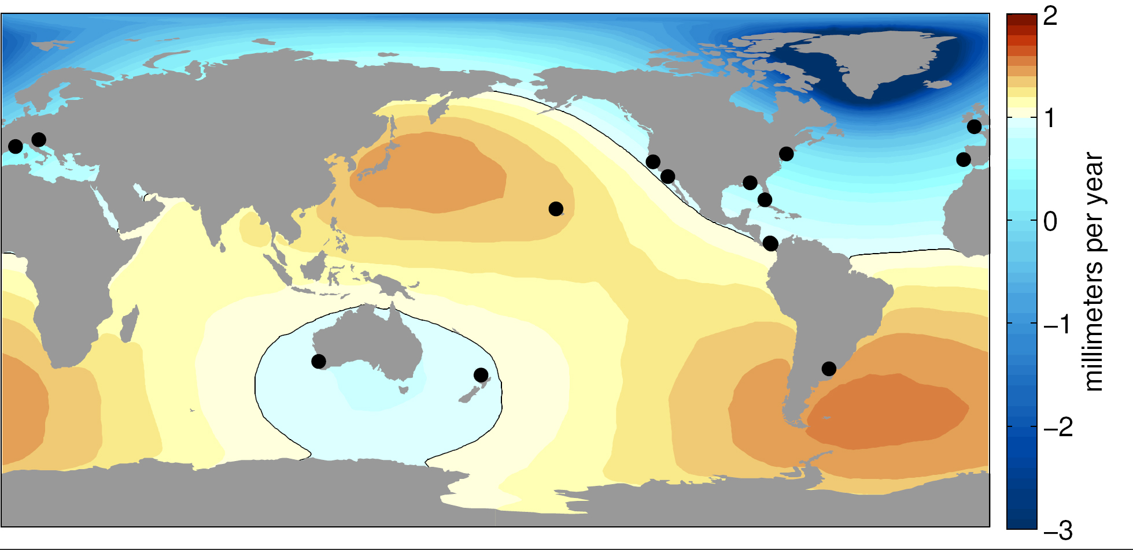
Historical Records May Underestimate Sea Level Rise
Sea level change resulting from Greenland ice melt, derived from NASA GRACE measurements. Black circles show locations of the best historical water level records, which underestimate global average sea level rise due to Greenland melt by about 25 percent.
Credits: University of Hawaii/NASA-JPL/Caltech, October 18, 2016

Slide 33
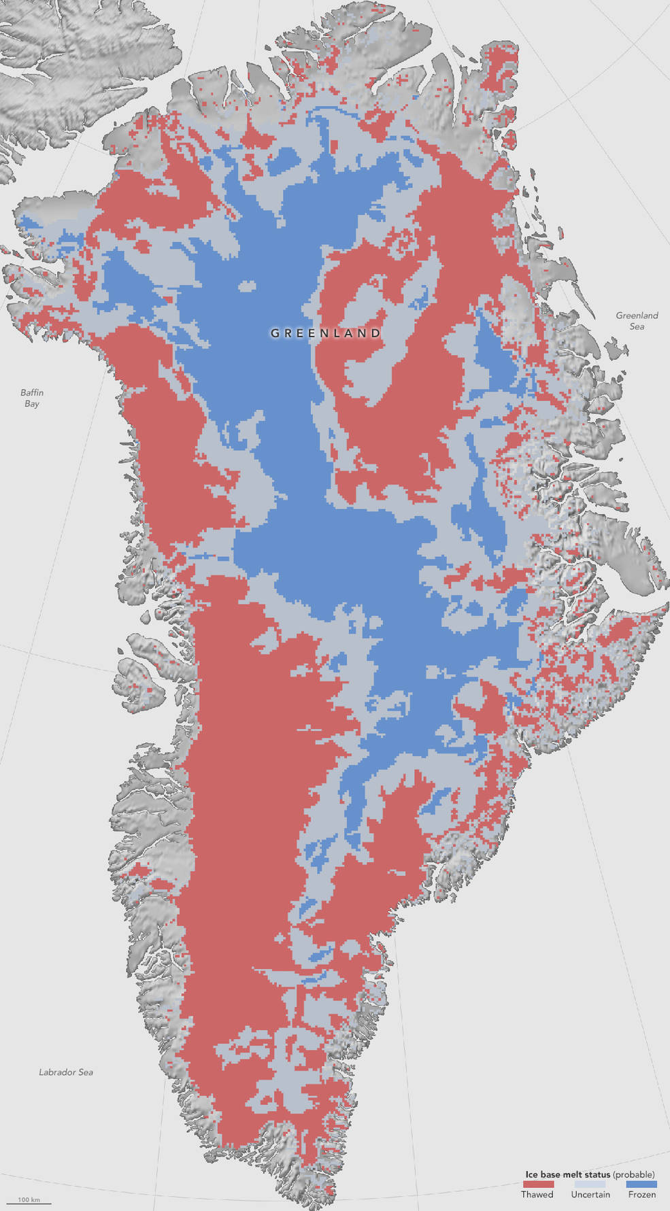
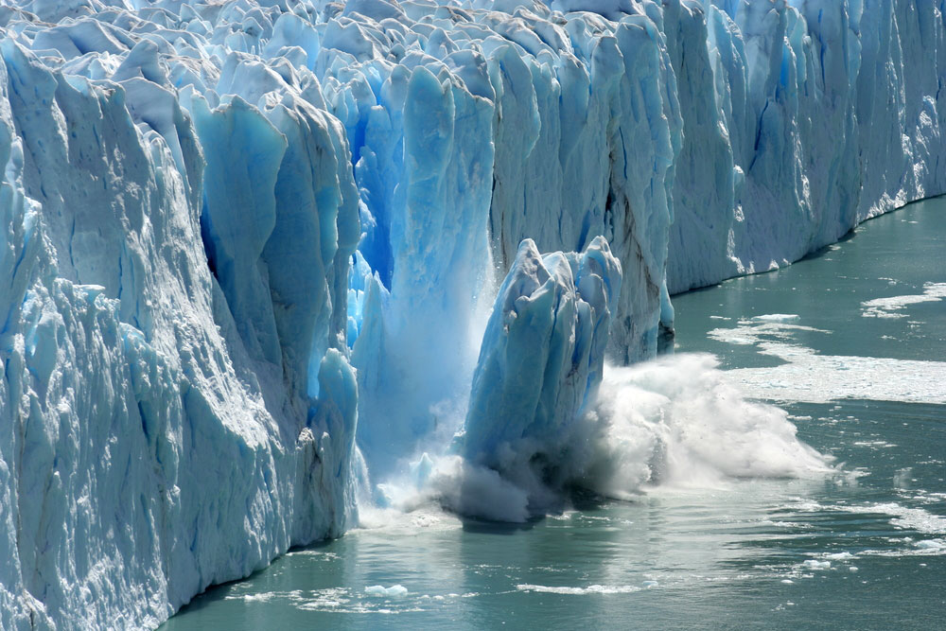
New map (October 2016), showing which parts of the bottom of the Greenland Ice Sheet are likely to have thawed (red), be frozen to the bedrock (blue) or still uncertain (grey), will help better predict how the ice will flow in a warming climate. Data is from merged radar satellite imagery and computer models.
Credits: NASA Earth Observatory/Jesse Allen

Slide 34
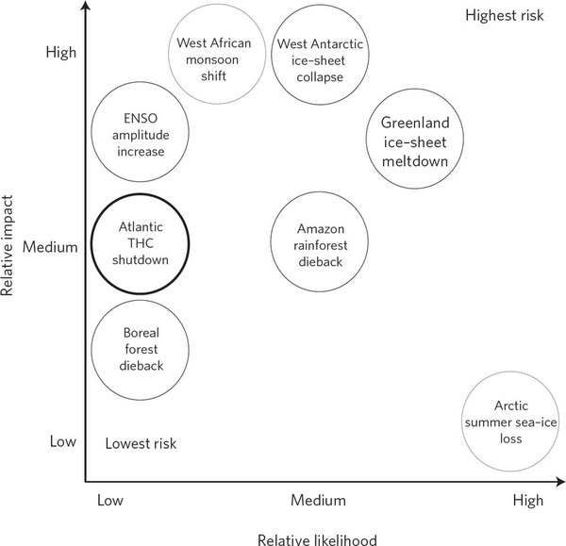
Sudden changes in climate

Slide 35

Impacts on ecological zones – new research ideas
Climate change has already resulted in extinction of many species of amphibians in Central America
Climate change is expected to result in changes in species and ecosystem structure in the Amazon forest
Warming in the boreal-tundra system will transform the speciesd composition, land cover, drainage and permafrost extent
IPCC, and
Convention on Biological Diversity
The Cuban Tree Frog is affected by the fungal disease chytridiomycosis, and mortality increases when temperatures fluctuate more

Slide 36
Time series of annual rainfall totals for England and Wales showing long term rainfall patterns, from the National Flood Resilience Review, September 2016
‘The UK’s weather is notoriously variable and so detection of any change in the behaviour of the meteorology (e.g. storminess) is particularly challenging. Severe storms have always affected the UK and are documented in many historical records. The intensity of recent storms is unusual, but not necessarily unprecedented.’

Slide 37
Maximum flow rates for the Severn at Bewdley, from the from the National Flood Resilience Review, September 2016
‘Flood-rich and flood-poor periods in the hydrological record…and the recent decade is not very different from the early part of the twentieth century. Reconstruction of floods from sediment records suggests some very large floods in the 18th and 19th centuries.’

Slide 38
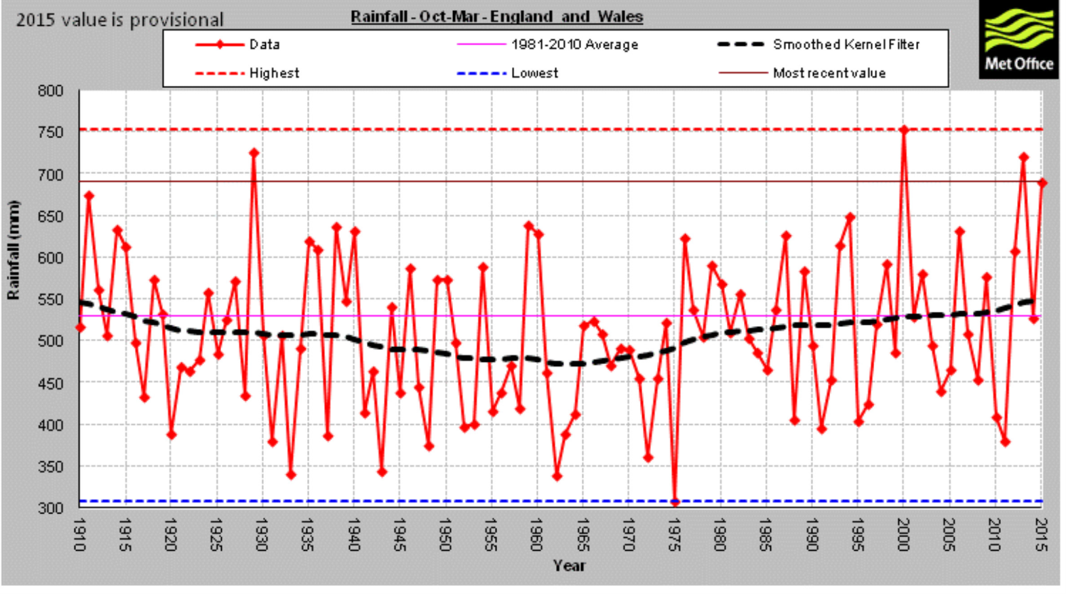
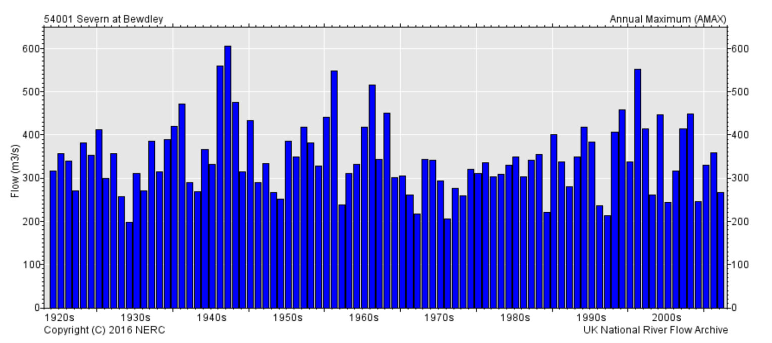
Long term trends?
National Flood Resilience Review, September 2016

Slide 39
Projections for winter rainfall in response to historical forcings, followed by the A1B scenario from the UKCP09 regional model simulations.
Grey shading and lines show percentiles of anomalies in the variables relative to 1961–1990, calculated from 1-year mean probability distribution functions for every year between 1860 and 2100. Coloured lines show three individual realisations of year-to-year variation. Thick black lines show observed annual global and England/Wales precipitation time series up to winter 2014/15. (Taken from Sexton and Harris (2015).
Projected natural variability and climate change in UK rainfall,
National Flood Resilience Review, September 2016

Slide 40
National Flood Resilience Review, September 2016
…finding evidence for increased storminess over the UK, in terms of frequency or intensity, is currently very challenging and is a topic of active research.
Most of the reliable high flow records in the UK start in the 1960s. In line with changes in rainfall over the same period, annual average flow has increased over the last 50 years in Scotland, Wales and parts of Northern and Western England; in contrast, no pronounced changes have occurred in the lowlands of South East England. Over the same period, winter flows have increased in upland, western catchments. Autumn flows have increased in Central England and parts of Eastern Scotland. There is no apparent pattern of change in summer flows across the UK.’
‘…the current capabilities of meteorological and hydrological models are
not robust enough to attribute recent flooding events to climate change.’

Slide 41
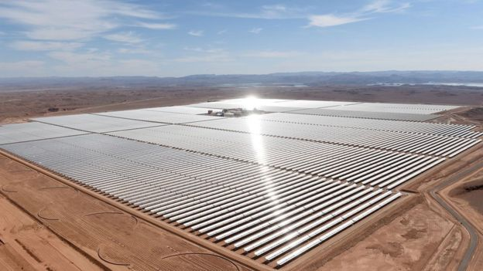
Reducing dependence on fossil fuels: the giant solar array at Noor, Morocco, close to Marrakech where the current Conference of the Parties (COP22) is taking place

Slide 42
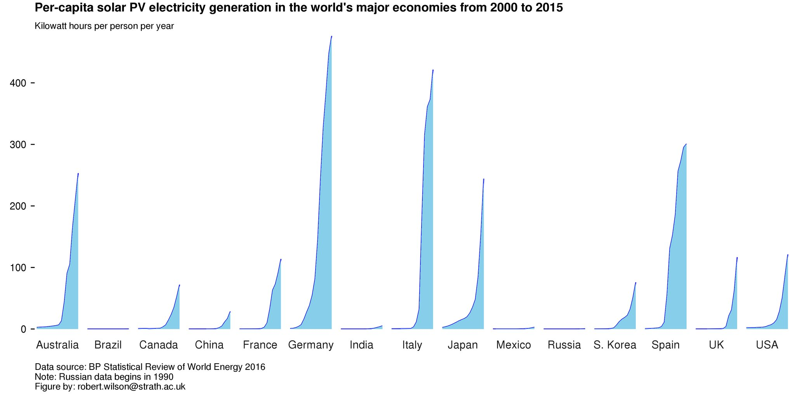
Per-capita solar PV electricity generation in the world’s major economies, 2000-2015

Slide 43
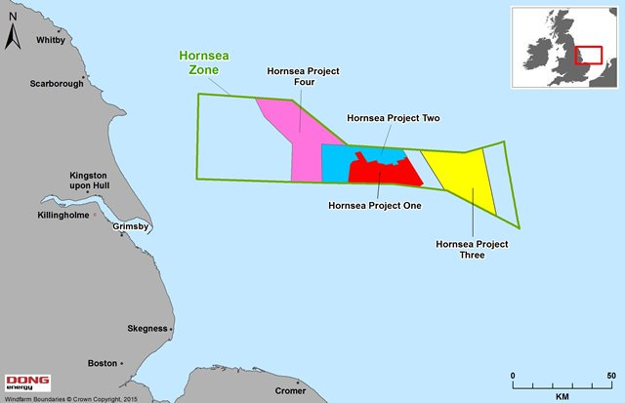
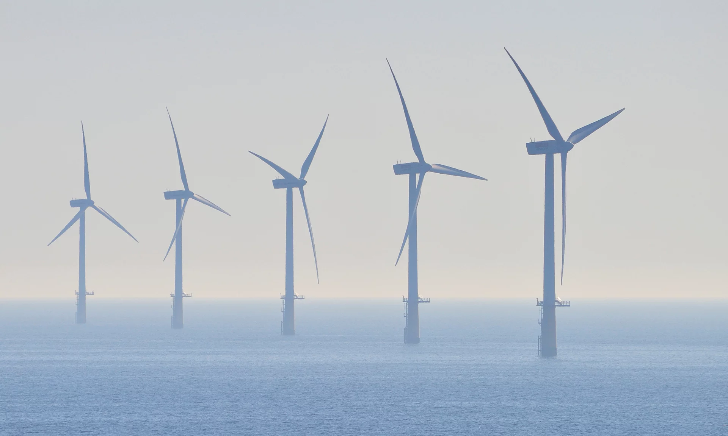
Biggest wind farm in the world approved in August 2016 for the area off Grimsby – 480 square miles
Hornsea Project 2 with 300 turbines, each taller than the Gherkin building

Slide 44
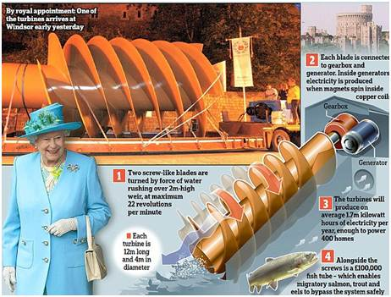
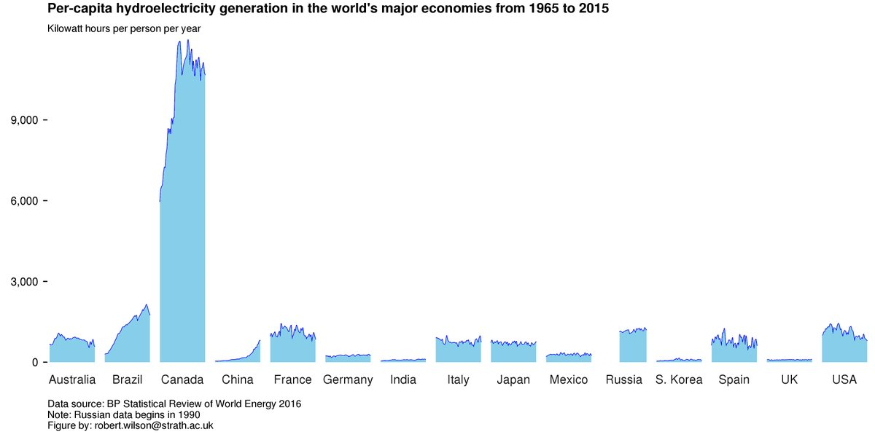
Per-capita hydroelectricity generation in the world’s major economies,1965-2015

Slide 45
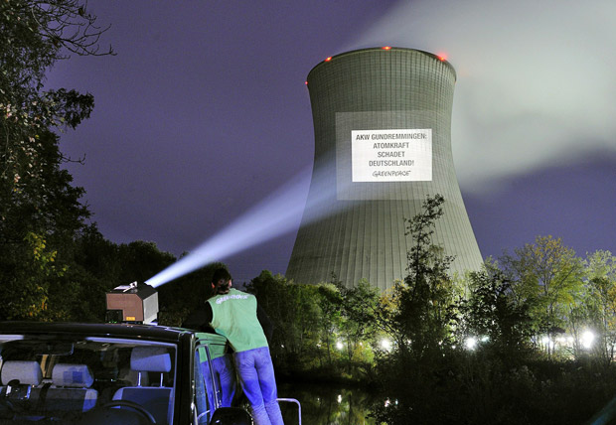
The nuclear option – carbon-free?
A Greenpeace activist projects the slogan 'Nuclear power station Grundremmingen: nuclear power harms Germany’.
Picture: THOMAS EINBERGER/AFP/Getty Images, in the Telegraph

Slide 46
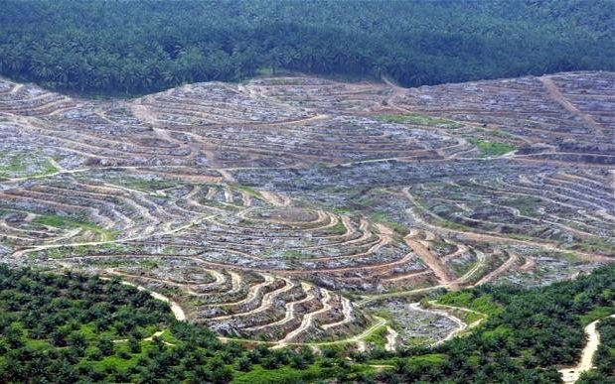
First generation biofuels
Biofuels such as ethanol and biodiesel are worse for the environment that petrol, 2016 research from the University of Michigan has stated. The alternative energy source represents an attempt to be carbon-neutral because the plants from which it is made absorb carbon dioxide from the atmosphere while they are growing. However, the scientists analysed real data on crop production, biofuel production, fossil fuel production and vehicle emissions finding that these crops absorb only 37% of the CO2 that is later released into the atmosphere when they are burnt, meaning the process actually increases the amount of greenhouse gas in the air.
In the UK, the Renewable Transport Fuel Obligation now means that 4.75% of any suppliers’ fuel must come from renewables, usually ethanol derived from crops.
Indonesian biofuel plantation.
Second generation biofuels use crop residues and waste.

Slide 47
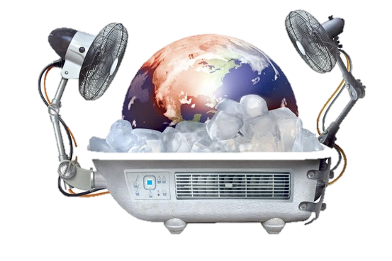
Geoengineering: dealing with the trouble in new ways
Checklist for funding research:
Value – social and scientific benefit, and new understandings
Risk – known, predicted or perceived downsides
Transparency – open experiments with public information
Vested interests – no conflicts of interest, and IP caution
Legal considerations – international regulatory review

Slide 48
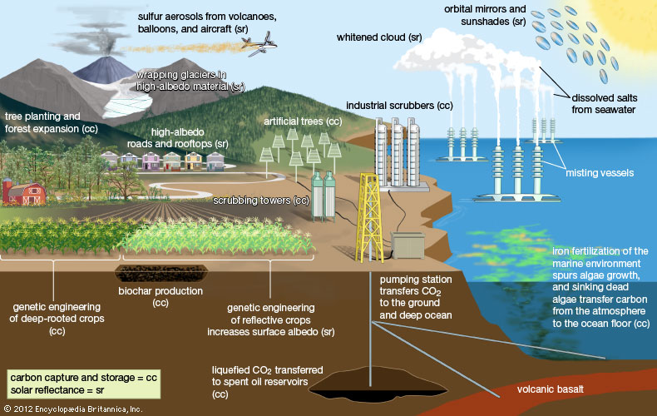

Slide 49
Altering the reflectivity of the earth to reradiate solar energy
‘Climate engineering experiments should commence now…Small-scale outdoor experiments in particular are needed to provide real-world answers to questions about the efficacy and advisability of climate engineering….. Experiments that extend up to kilometres in altitude and last days to weeks would leave the global climate unchanged but would increase scientific understanding substantially’
Long et al, Nature, 5th February 2015
Ship trails (clouds seeded by particles in ship exhaust) off North America on 20 January 2013.

Slide 50
Dealing with the trouble- CO₂ removal (CDR)
Technologies which reduce the levels of C0₂ in the atmosphere, including
bioenergy with carbon capture and storage
biochar
direct air capture
ocean fertilisation
enhanced weathering
CDR is a different approach than removing CO₂ from the stack emissions of large fossil fuel point sources, such as power stations. The latter reduces emissions but cannot reduce the amount of carbon dioxide already in the atmosphere. As CDR removes carbon dioxide from the atmosphere, it creates negative emissions, offsetting those from dispersed point sources such as domestic heating systems, airplanes and vehicle exhausts.

Slide 51
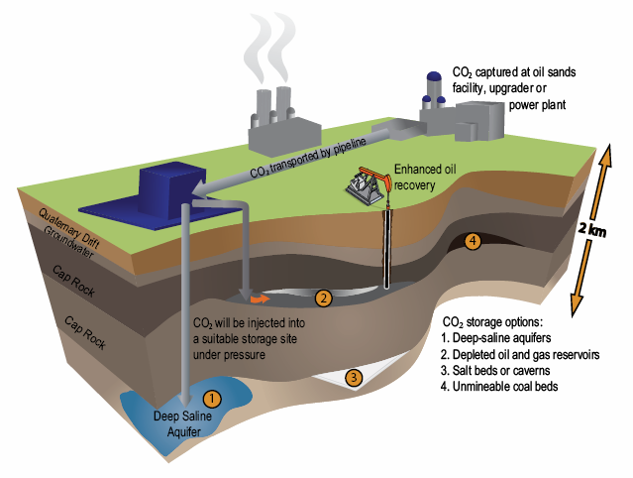
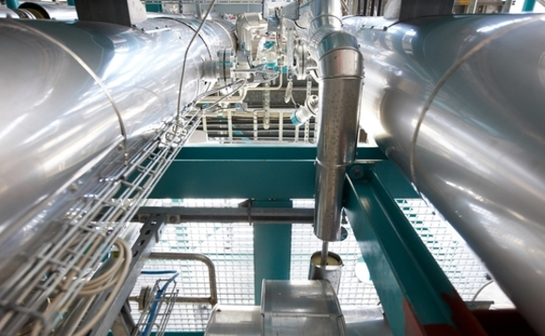
Taking carbon dioxide out of short term circulation: Carbon Capture and Storage
Siemens’ CCS plant

Slide 52
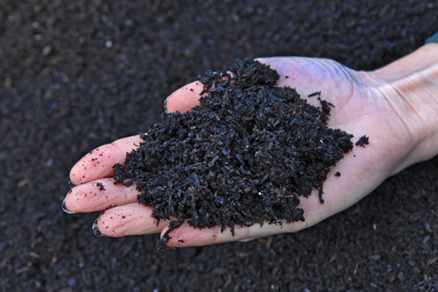
Dealing with the trouble - Biochar
Biochar is created by the pyrolysis of biomass, and is under investigation as a method of carbon sequestration.
Made by high temperature heating of organic matter such as plants or organic waste in a low oxygen environment, it is used for agricultural purposes and also captures and holds carbon. . What remains is a material like charcoal but made sustainably. The offset of GHG emissions if biochar were to be implemented, would be a maximum of 12%. This equates to about 106 tonnes of CO₂ equivalent. On a medium conservative level, it would be less than that, at 82 tonnes.
The UK Biochar Research Center has stated that, conservatively, biochar could store 1 gigaton of carbon per year. With greater marketing and acceptance, 5-9 gigatons per year could be stored in biochar soils.

Slide 53
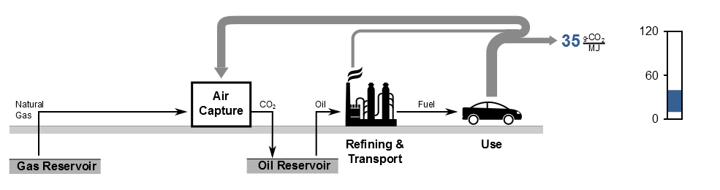
Dealing with the trouble – Direct Air Capture of C0₂
DAC captures CO₂ from the air, which compensates for the CO₂ released in fuel use, and in effect recycles the emissions for reuse in fuel production. Fossil fuel is used to power DAC and both the combustion CO₂ and atmospheric CO₂ are captured and used to force out more oil. The CO₂ delivered to the oil reservoir is permanently sequestered, resulting in a low carbon fuel, roughly 35g-CO₂/MJ or lower (depending on the oil to CO₂ “lift ratio”). It complements carbon capture and storage, rather than replacing it.

Slide 54
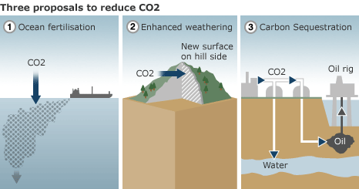
Enhanced weathering
A chemical approach to remove carbon dioxide involving land or ocean based techniques.
Examples of land based techniques are in-situ carbonation of silicates. Ultramafic rock for example, has the potential to store thousands of years worth of CO₂emissions according to one estimate. Ocean based techniques involve alkalinity enhancement, such as grinding, dispersing and dissolving olivine, limestone, silicates, or calcium hydroxide to address ocean acidification and CO₂ sequestration.
Enhanced weathering is considered as one of the least expensive of geoengineering options.
One example of a research project on the feasibility of enhanced weathering is the Carbfix project in Iceland.

Slide 55
CO₂ scrubbing chemistry
Calcium oxide - Quicklime will absorb CO₂ from air mixed with steam at 400 °C (forming calcium carbonate) and release it at 1,000 °C. This process can be done using renewable energy from thermal concentrated solar power. Quicklime is made by heating limestone to release the CO₂ within it. Quicklime is mixed with sand for brick building as mortar, where it hardens by absorption of CO₂.
Potassium Hydroxide - Zeman and Lackner outlined a method of air capture using sodium hydroxide. Carbon Engineering, a Canadian firm partially funded by Bill Gates, is developing a process using a solution of potassium hydroxide mixed with water at their pilot plant. They hope to create and sell synthetic fuels at a cost of $100 a ton.
Cost varies for different technologies: some of these are not sufficiently developed to price. The American Physical Society estimates the costs for direct air capture to be $600/tonne with optimistic assumptions. The IEA Greenhouse Gas R&D Programme and Ecofys provides an estimate that 3.5 billion tonnes could be removed annually from the atmosphere with Bio-Energy with Carbon Capture and Storage at carbon prices as low as €50, whereas a report from Biorecro and the Global Carbon Capture and Storage Institute estimates costs "below €100" per tonne for large scale BECCS deployment.

Slide 56
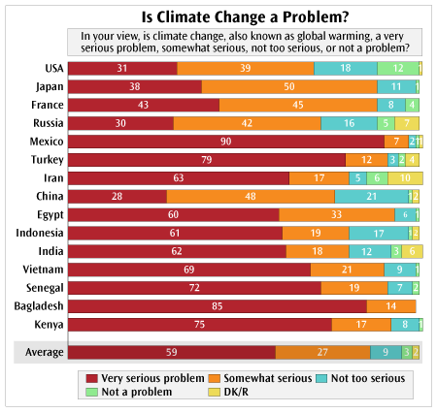
2009 World Bank survey
More than 13,000 people in 15 nations (most of which are developing countries) were asked questions, including whether climate change should be a concern, its urgency and what their governments should do about it. The poll also shows what people in some East Asian countries – including Vietnam, China and Indonesia – think about climate change.
Most people polled said they want their government to take steps to fight climate change – even if that means an economic cost to their country. Some of the largest majorities of people who answered this way were in low-income countries, including Vietnam.

Slide 57

What was agreed in Paris, 2015?
The Paris Agreement commits governments to moving away from fossil fuels
To peak greenhouse gas emissions as soon as possible and achieve a balance between sources and sinks of greenhouse gases in the second half of this century
To keep global temperature increase "well below" 2ºC and to try to limit to 1.5ºC
To review progress every five years
$100 billion a year in climate finance for developing countries by 2020, with a commitment to further finance in the future
A UN review of national pledges to cut emissions said they fall short of the levels needed to keep the rise in global temperatures under 2ºC. The report found pledges from governments that have ratified the accord would see a rise in temperatures by the end of this century of between 2.9 and 3.4 ºC.

Slide 58
Cognitive dissonance?
Bushell et al, Grantham Institute, Imperial College London, April 2016

Slide 59


6 metres of sea level rise on South Florida
NB Trump won Florida’s 29 electoral votes

