Slide 1
rhetoric
ˈrɛtərɪk/
noun
the art of effective or persuasive speaking or writing, especially the exploitation of figures of speech and other compositional techniques.
"he is using a common figure of rhetoric, hyperbole"

Slide 2
hyperbole
hʌɪˈpəːbəli/
noun
exaggerated statements or claims not meant to be taken literally.

Slide 3
caricature
ˈkarɪkətjʊə,ˈkarɪkətʃɔː/
noun
1.
a picture, descriptin, or imitation of a person
in which certain striking characteristics are
exaggerated in order to create a comic or
Grotesque effect.
synonyms: | cartoon, distorted/exaggerated drawing, distortion

Slide 4
Mr ‘Murd-stone’

Slide 5
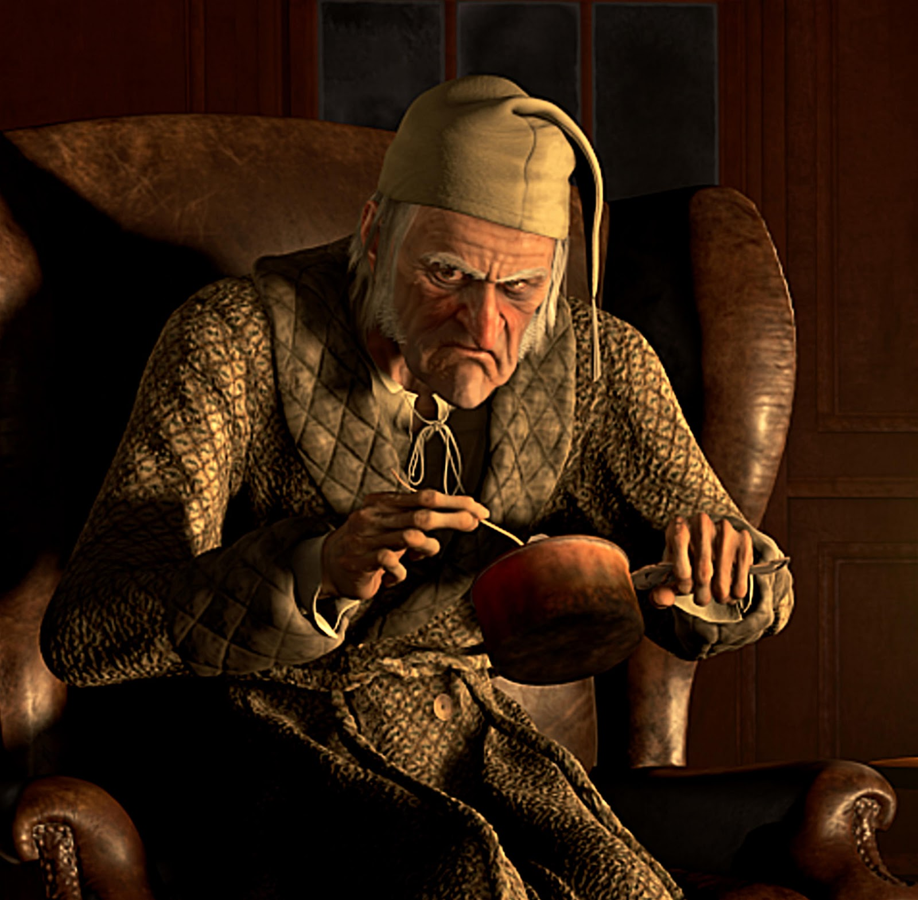

Slide 6
‘…a squeezing, wrenching, grasping, scraping, clutching, covetous, old sinner! Hard and sharp as flint…solitary as an oyster. The cold within him froze his old features…. He carried his own low temperature always about with him; he iced his office in the dog-days; and didn’t thaw it one degree at Christmas.
‘…No warmth could warm, no wintry weather chill him. No wind that blew was bitterer than he, not falling snow was more intent upon its purpose, no pelting rain less open to entreaty.’

Slide 7
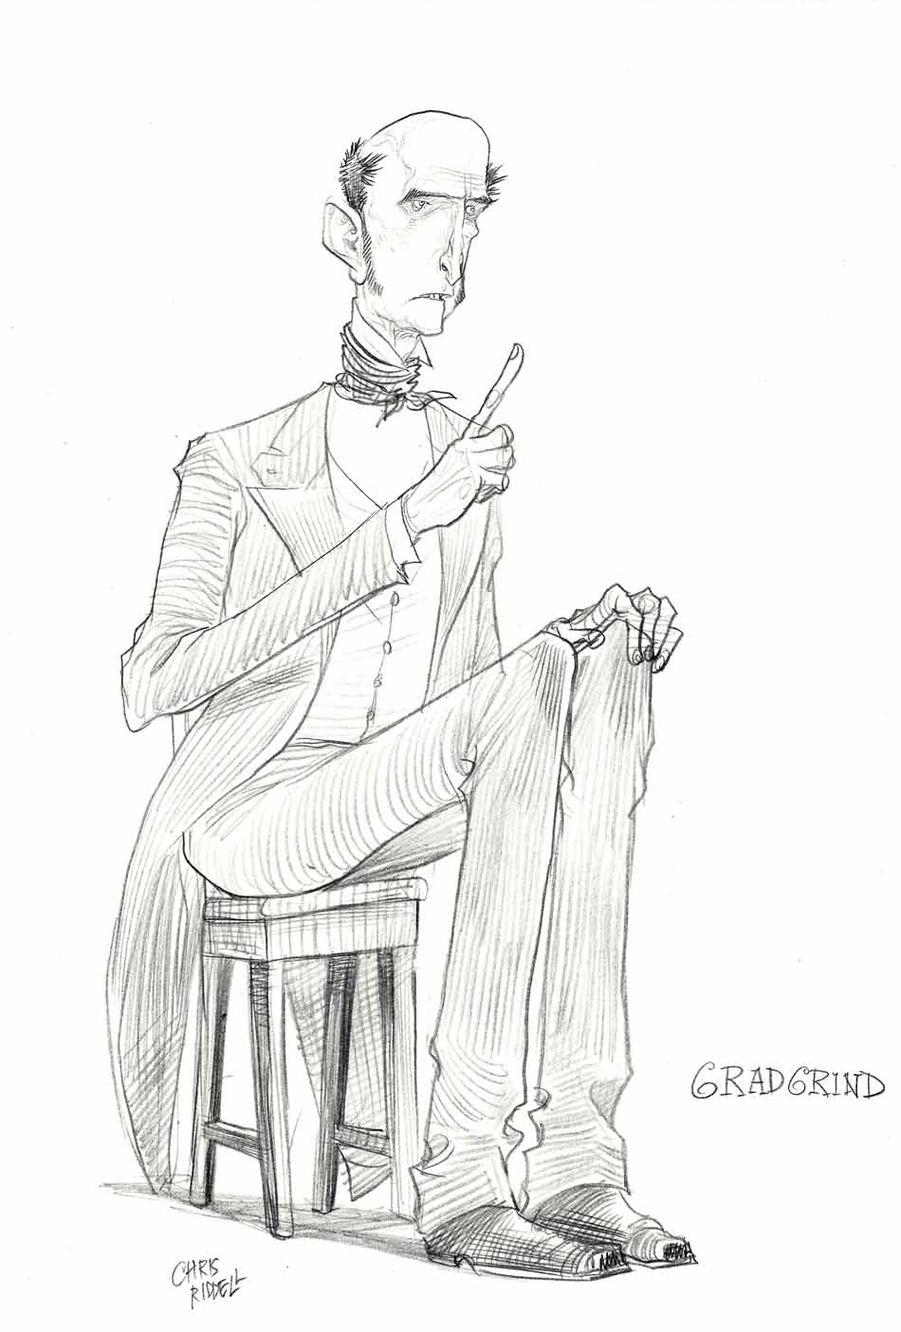

Slide 8
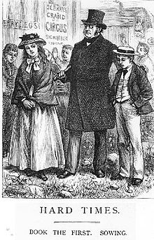
G

Slide 9
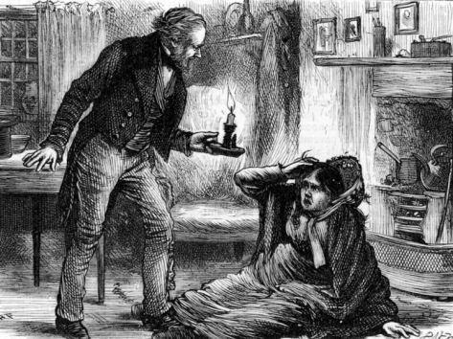

Slide 10
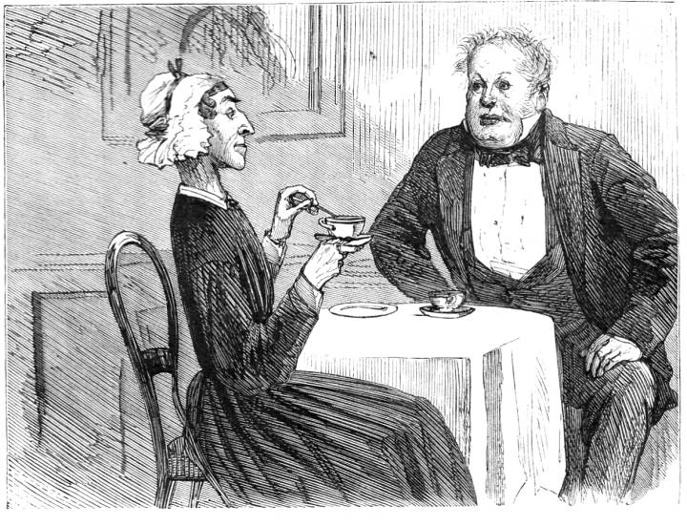

Slide 11
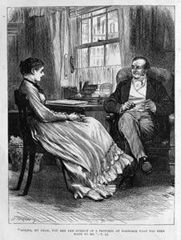

Slide 12
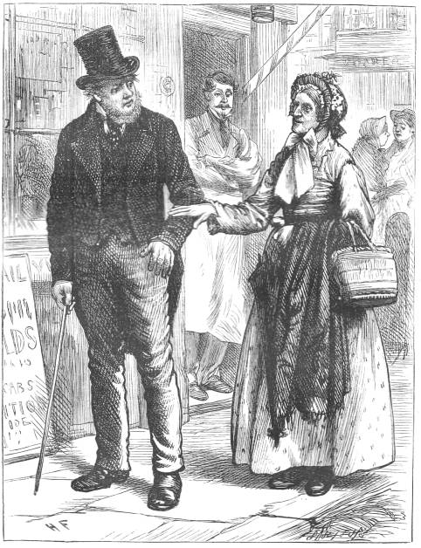
Notes:
Mrs Pegler and Stephen Blackpool

Slide 13
‘Now, what I want is, Facts. Teach these boys and girls nothing but Facts. Facts alone are wanted in life. Plant nothing else, and root out everything else. You can only form the minds of reasoning animals upon Facts: nothing else will ever be of any service to them. This is the principle on which I bring up my own children, and this is the principle on which I bring up these children. Stick to Facts, sir!’

Slide 14
The scene was a plain, bare, monotonous vault of a school-room, and the speaker’s square forefinger emphasized his observations by underscoring every sentence with a line on the schoolmaster’s sleeve. The emphasis was helped by the speaker’s square wall of a forehead, which had his eyebrows for its base, while his eyes found commodious cellarage in two dark caves, overshadowed by the wall. The emphasis was helped by the speaker’s mouth, which was wide, thin, and hard set. The emphasis was helped by the speaker’s voice, which was inflexible, dry, and dictatorial. The emphasis was helped by the speaker’s hair, which bristled on the skirts of his bald head, a plantation of firs to keep the wind from its shining surface, all covered with knobs, like the crust of a plum pie, as if the head had scarcely warehouse-room for the hard facts stored inside. The speaker’s obstinate carriage, square coat, square legs, square shoulders,—nay, his very neckcloth, trained to take him by the throat with an unaccommodating grasp, like a stubborn fact, as it was,—all helped the emphasis.
‘In this life, we want nothing but Facts, sir; nothing but Facts!’

Slide 15
The speaker, and the schoolmaster, and the third grown person present, all backed a little, and swept with their eyes the inclined plane of little vessels then and there arranged in order, ready to have imperial gallons of facts poured into them until they were full to the brim.

Slide 16
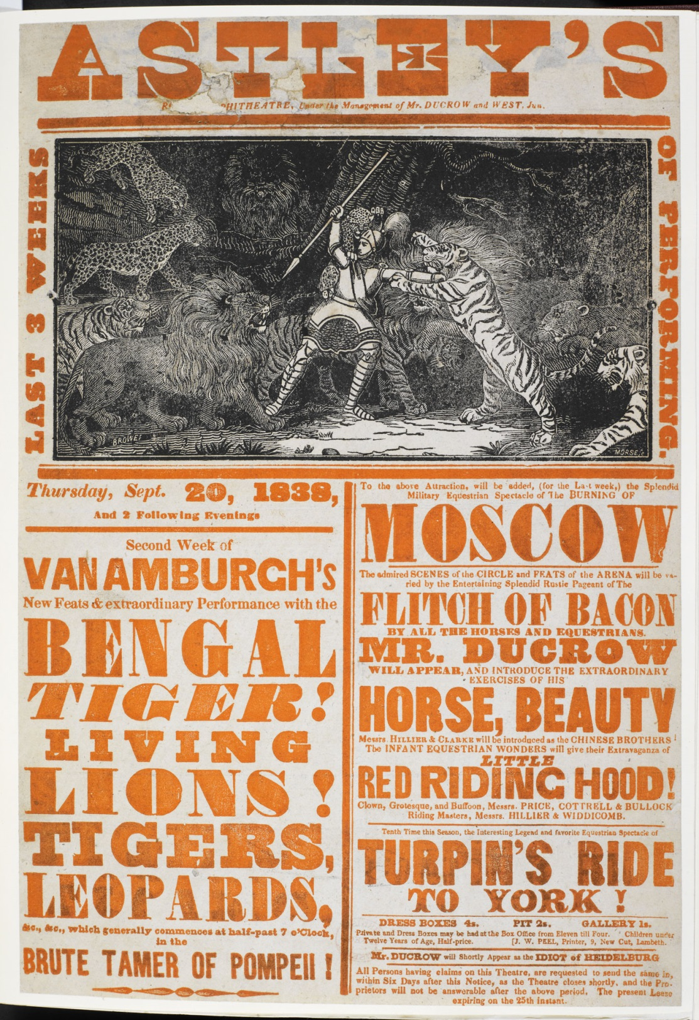

Slide 17
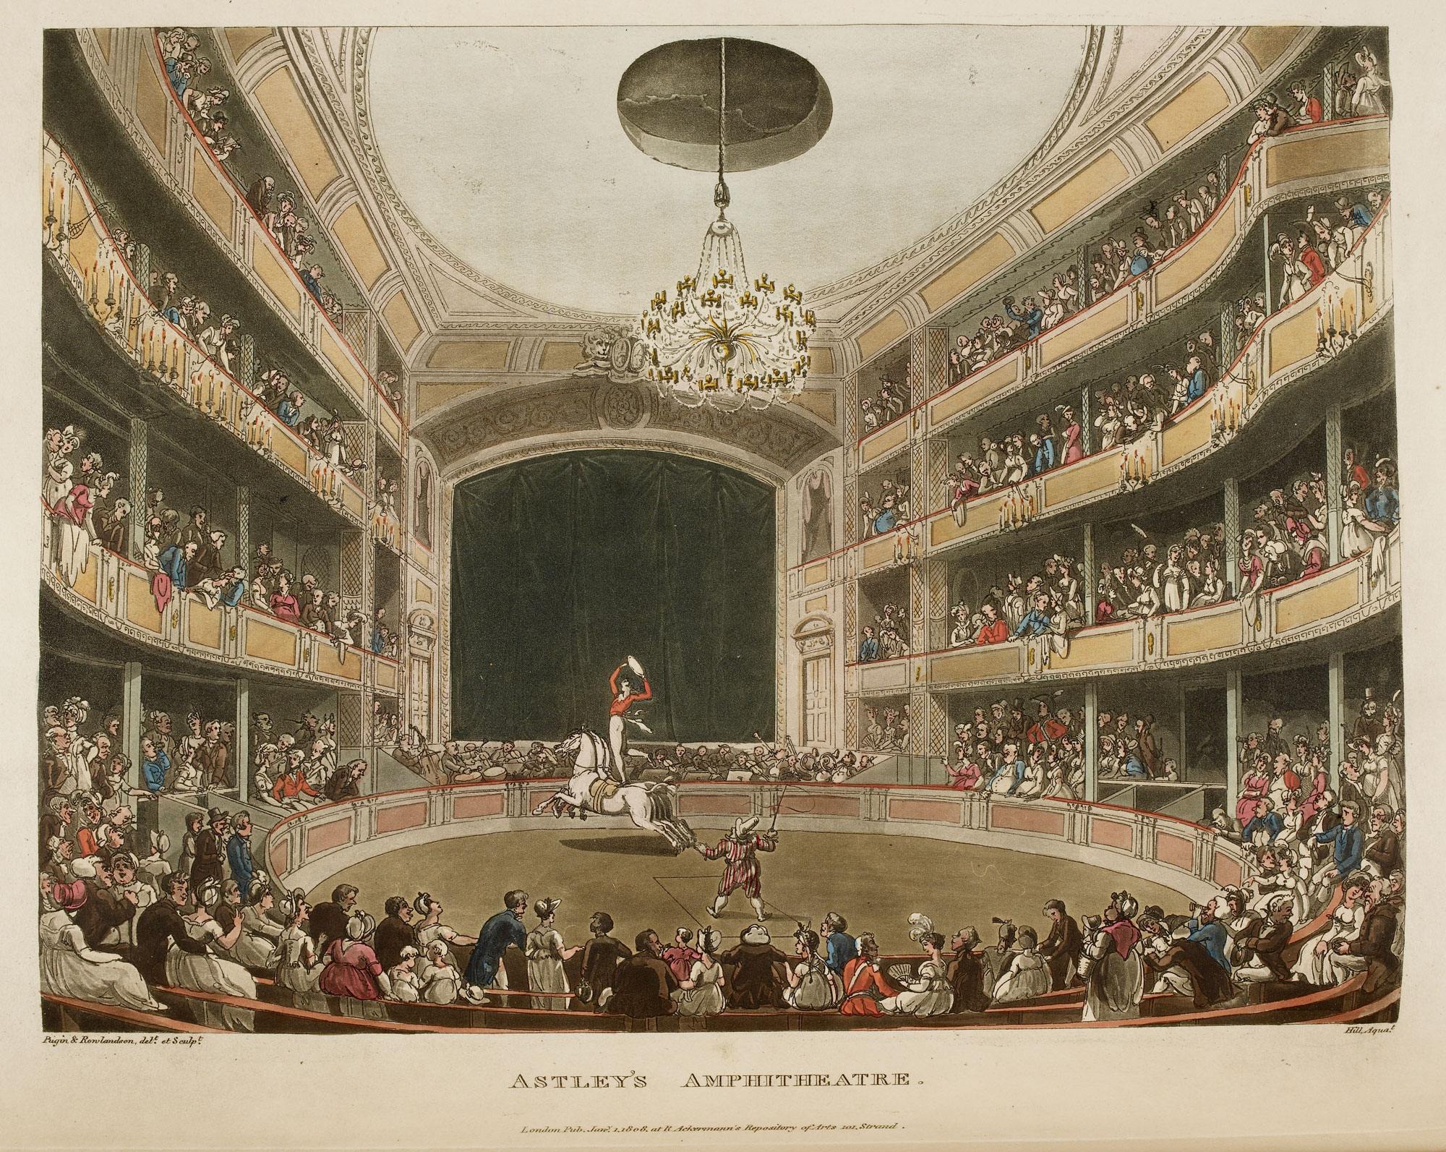

Slide 18
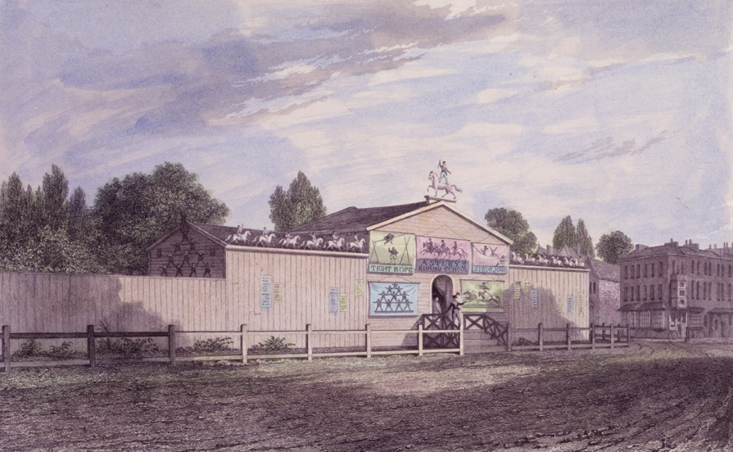

Slide 19
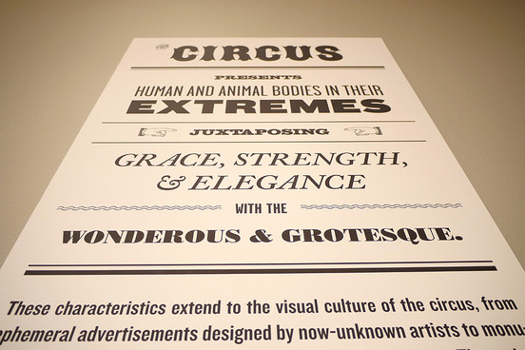

Slide 20
“dance upon rolling caskets, stand upon bottles, catch knives and balls, twirl hand-basins, ride upon anything, jump over everything, and stick at nothing”? (Dickens 31)

Slide 21
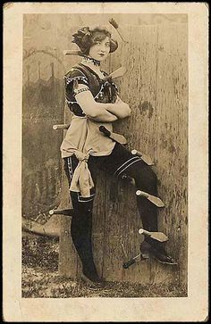

Slide 22
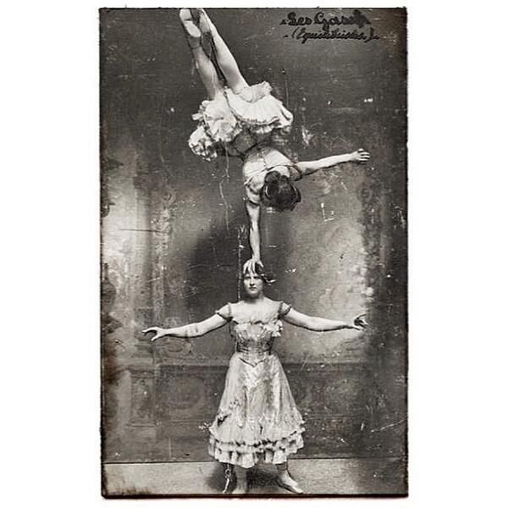

Slide 23
As circus Emcee, you entertain and excite audiences by introducing and narrating each of the show’s acts, from the Acrobats and Aerialists to the Clowns and Jugglers. Known for your hyperbole, you have a vocabulary that’s littered with words like “spectacular,” “amazing,” “astonishing,” and “sensational.”

Slide 24
http://www.insidejobs.com/careers/circus-ringmaster

Slide 25
‘Where the piston of the steam-engine worked monotonously up and down, like the head of an elephant in a state of melancholy madness.’

Slide 26
