Slide 1
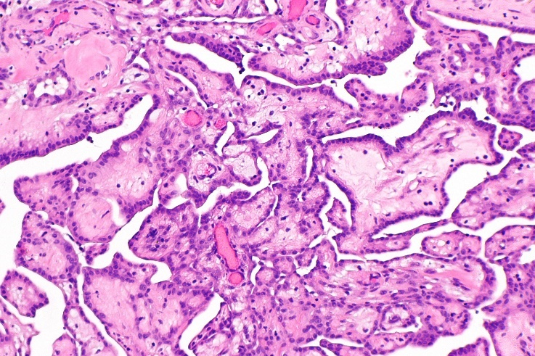
Cancer prevention.
Christopher Whitty
Gresham College 2016

Slide 2
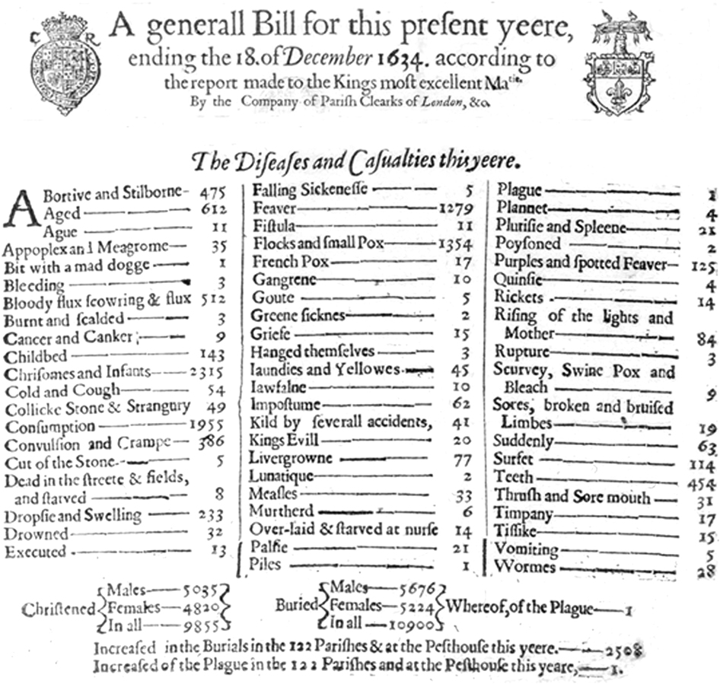
When Gresham College was founded cancer was rare, and even more rarely diagnosed.
Deaths in London 1634 (not a plague year).
Deaths reported 10,900
Cancer and canker 9 (<1%)
Fever 1279
Smallpox 1354
Consumption 1955
Now cancer causes 29% of all UK deaths.

Slide 3
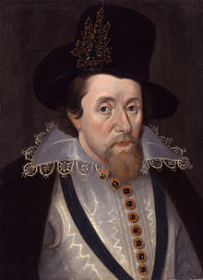
Many of the debates would however have been familiar including on tobacco, diet.
The first Gresham Professor of Physic Matthew Gwinne got his MD in part on the question 'whether the frequent use of tobacco was beneficial’.
Disputed it in front of James VI & I, author of A Counterblaste to Tobacco.
Dr. Gwinne later became commissioner for inspecting tobacco.
“A custome lothsome to the eye, hatefull to the Nose, harmefull to the braine, dangerous to the Lungs” King James VI & I 1604

Slide 4
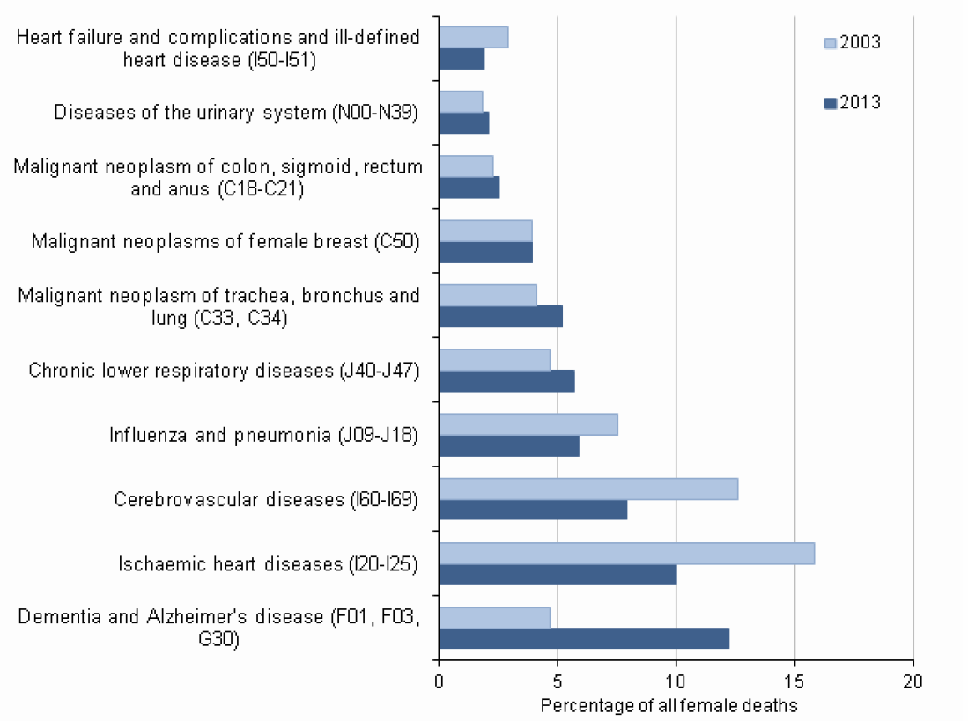

Ten leading causes of death in females, 2003-2013, England & Wales (ONS)

Slide 5
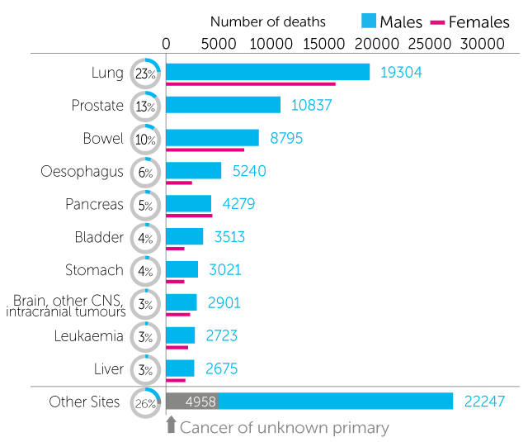
Cancers: UK mortality
(CRUK 2014: males)
Overall mortality a combination of incidence (how common) and survival.
This talk will consider how to reduce incidence.
Prevention is better than cure.
CRUK estimates 42% of cancer in the UK is preventable.

Slide 6
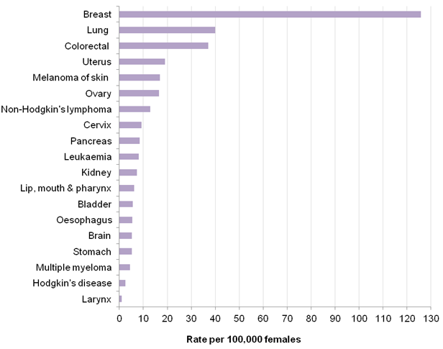
Age-standardised incidence rates for common cancers in females, UK. 2008−2010 data.

Slide 7
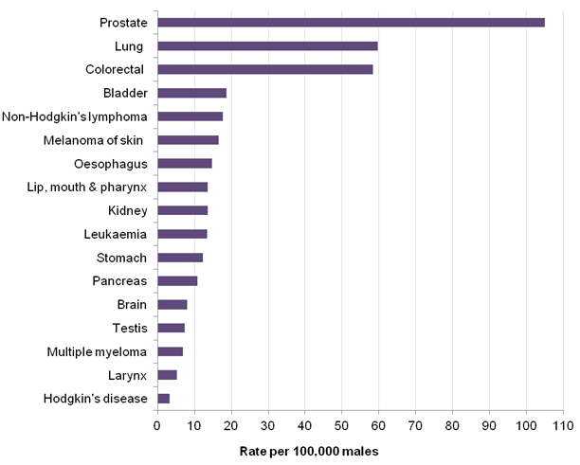
Age-standardised incidence rates for common cancers in males, UK. 2008−2010 data.

Slide 8
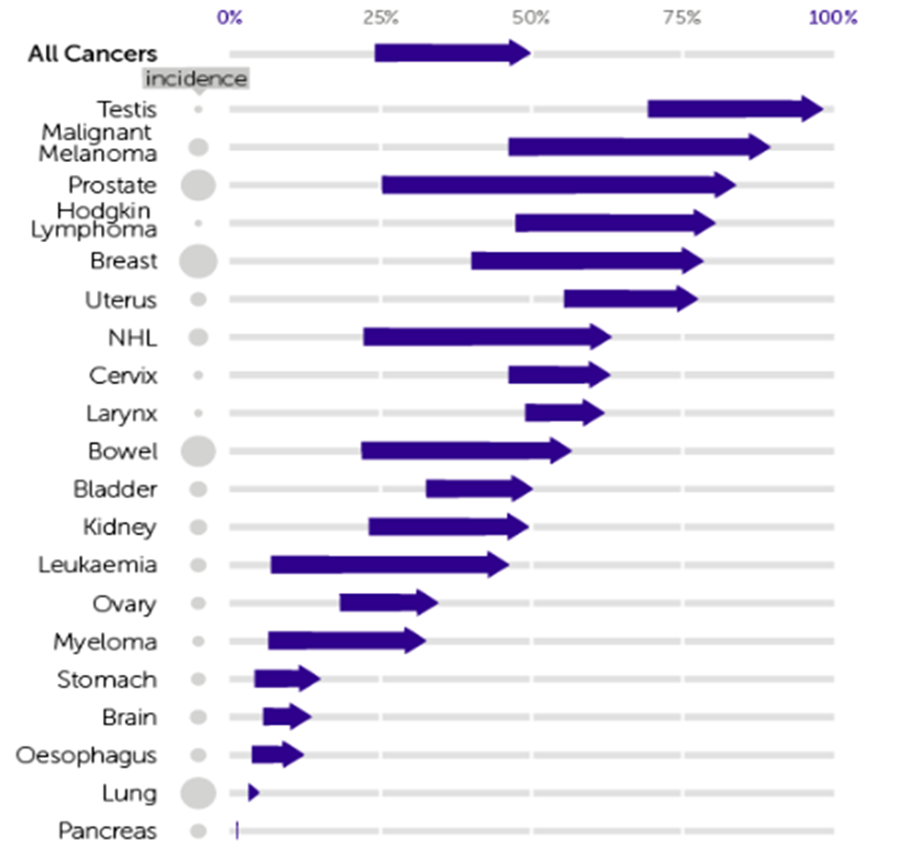
Many of the least treatable are most preventable.
Changes in 10 year survival 1971-2011, CRUK

Slide 9
Age-standardised UK cancer incidence, all cancers.
Source: cruk.org/cancerstats
Notes:
Overall rates of cancer are predicted to remain stable over the next 20 years but this masks individual changes
Stability in incidence means the number of cancer cases in the UK will increase reflecting growing and aging population

Slide 10
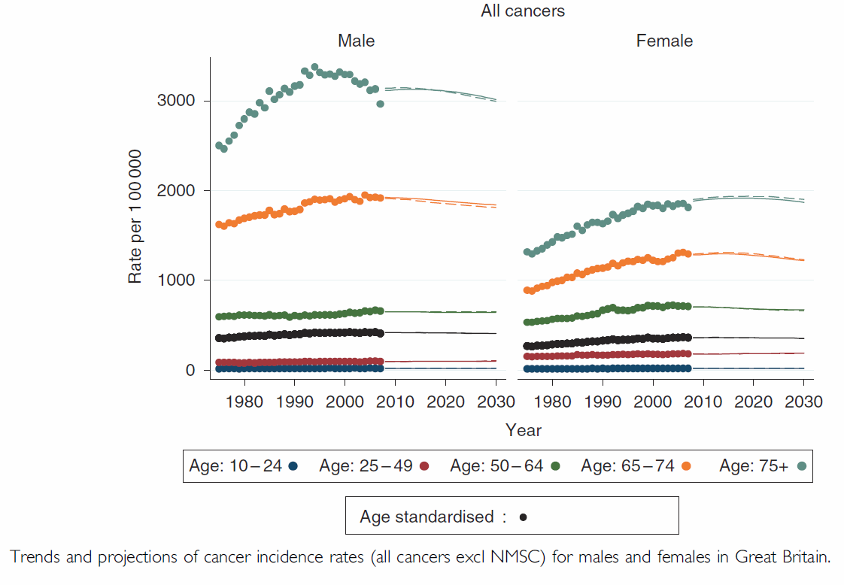
Overall cancer incidence. (Mistry et al 2011).

Slide 11
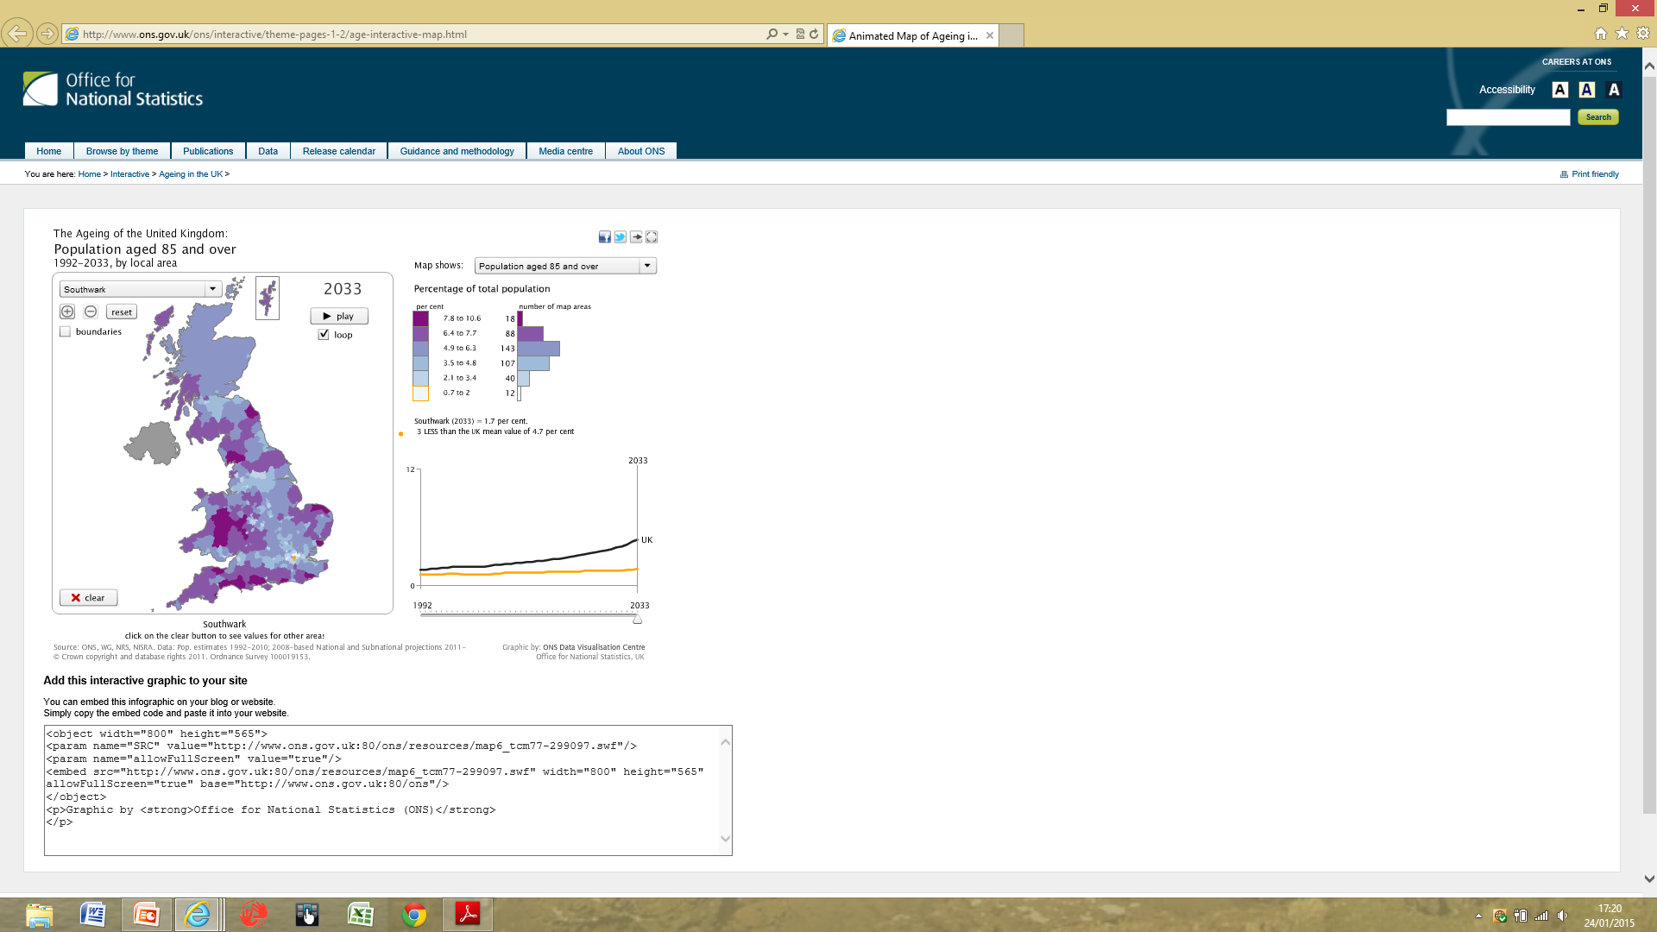
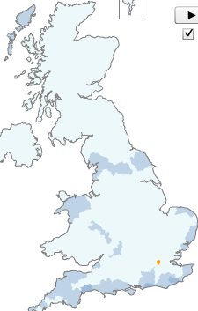
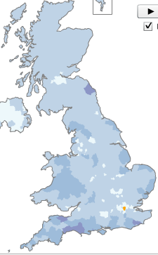
Population 85 and over: 1992, 2015, 2033 (ONS).

Slide 12
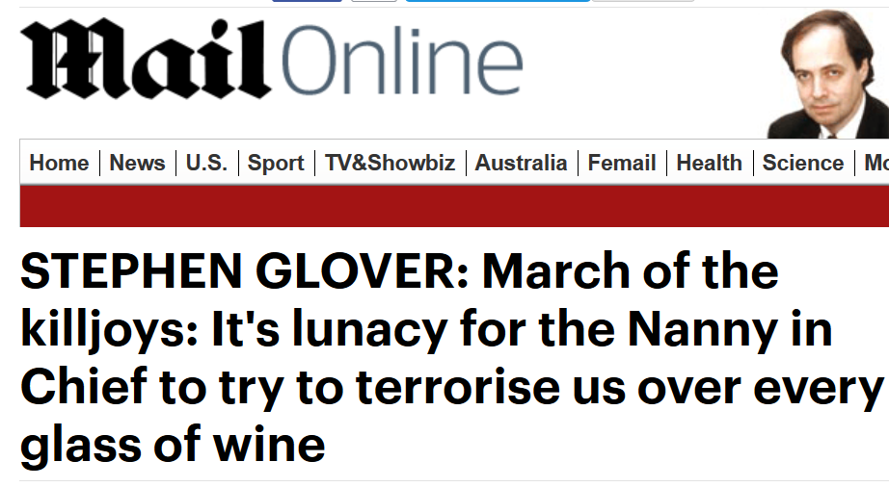

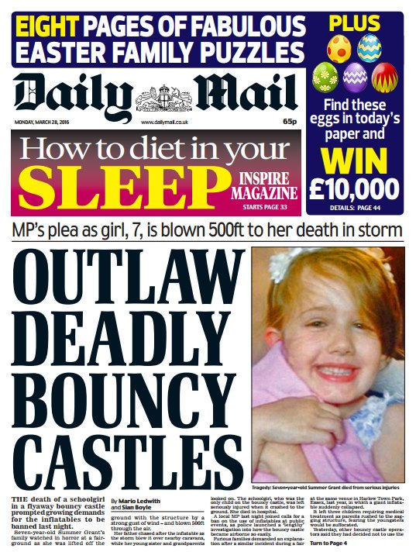
What is the role of the individual, the medical professions and the state?
The political tradition that the state should not interfere in people’s lives is a long and honourable one.
On both the left and the right. Generational differences.
Presents a challenge to cancer prevention and public health.
Some of the press claim this tradition, not always consistently.
Public health must respect it but not be cowed by it.

Slide 13
For those sceptical of the state’s right to intervene for pubic health:
Pro:
Very strong evidence.
Very strong effect.
Infections, where protect one protect all.
The vulnerable (children).
Cost-effective.
Healthy working age population.
Con
Removing existing rights.
Removing pleasures.
Exposes the citizen to the law.
Barrier to trade.
Expands government.
Unintended consequences.

Slide 14
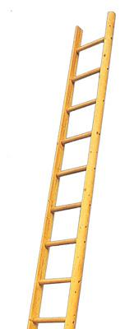
Ladder of state intervention.
Ban.
Tax heavily.
Regulate.
‘Nudge’ tax or intervention.
Mass voluntary programme (eg vaccination, screening).
Engage with industry.
Inform.
Leave up to individuals.

Slide 15
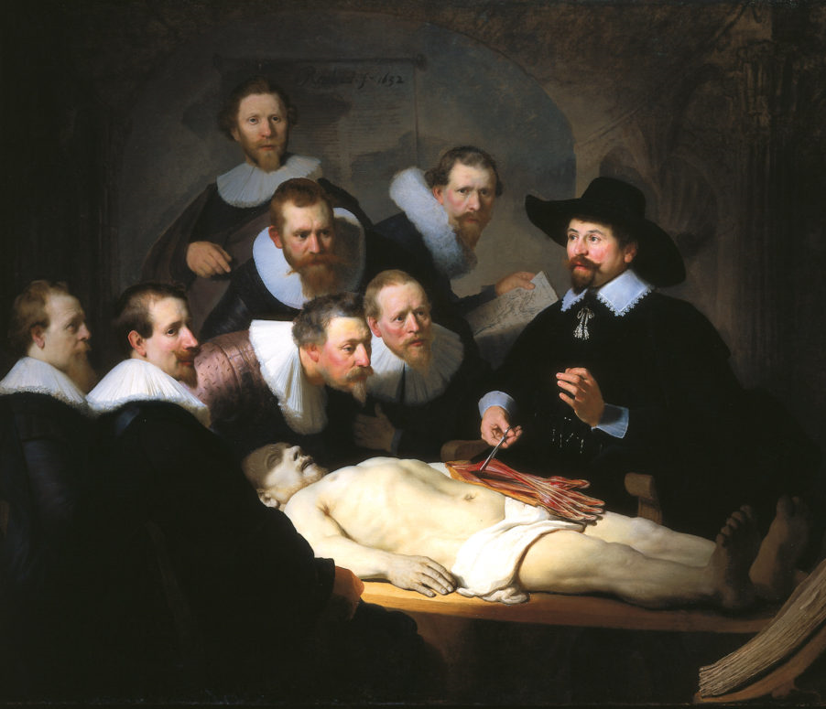
Preventing or treating infectious causes of cancer.
When Dr. Tulp said cancer is contagious, he was partially right.
Some cancers have a strong infectious driver.
If these can be identified, and then either prevented or treated cancer may not occur.
Most consider this the role of the state or medicine.
Rembrandt. The Anatomy lesson of Dr. Nicolaes Tulp. 1632.

Slide 16

Cancers with strong infectious drivers include:
Cervical cancer – human papilloma virus.
Liver- Hepatitis B and C.
Some stomach and duodenal cancer- H. pylori.
Lymphoma- HIV, EBV.
Kaposi’s sarcoma HHV8 with HIV.

Slide 17
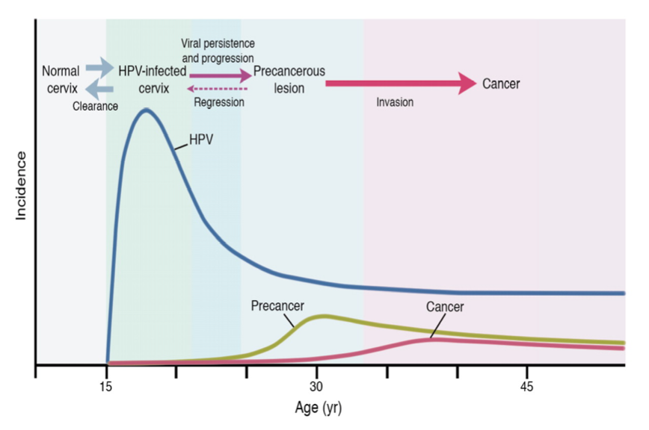
Almost all cervical cancer is caused by papillomaviruses (wart viruses).
Around 2500 cervical cancer a year in UK. Commonest cancer of young women.
HPV16 and 18 responsible for 50-70%.
Vaccines are over 95% effective against these if before sexually active.
UK coverage of girls 89%. Likely to reduce cervical cancer by around 50%.
New vaccine covering HPV 31, 33 and 45 may extend protection.
Schematic of HPV and cervical cancer.
U. Wisconsin.

Slide 18
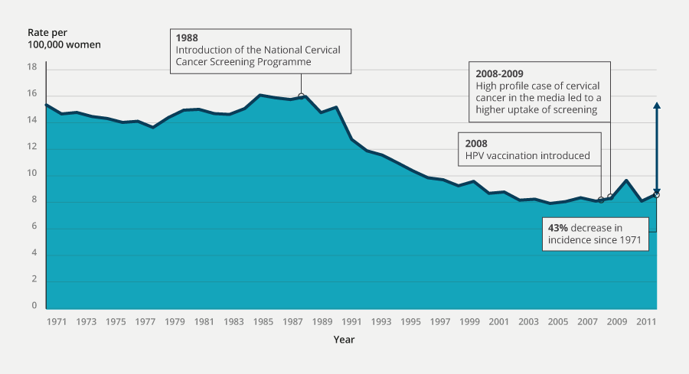
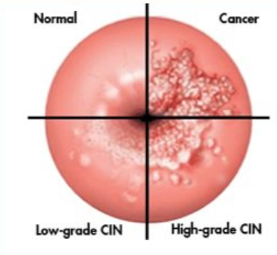
Screening of women 25-64 for pre-cancerous cells (‘smear’ or PAP test).
Has led to a substantial reduction in cervical cancer.
At the cost of some overtreatment.
New HPV DNA tests may help improve accuracy.
Over 40% reduction in cervical cancer since screening started. ONS

Slide 19
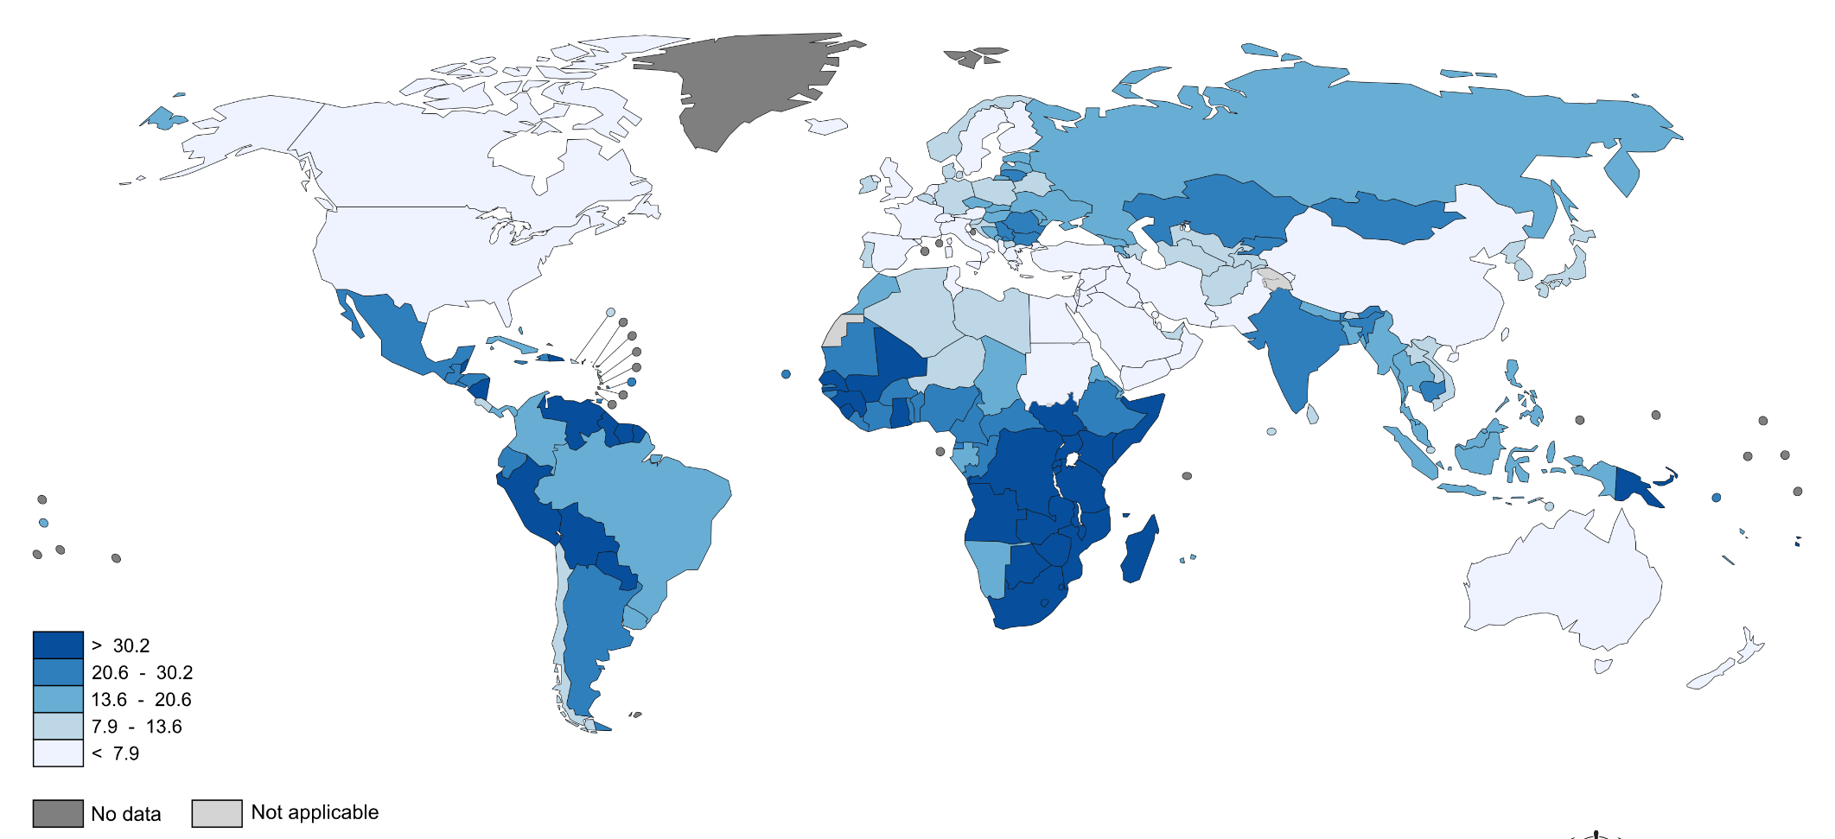
Cervical cancer incidence is much higher in many developing countries. Vaccination will lead to a substantial global reduction. WHO 2015.

Slide 20
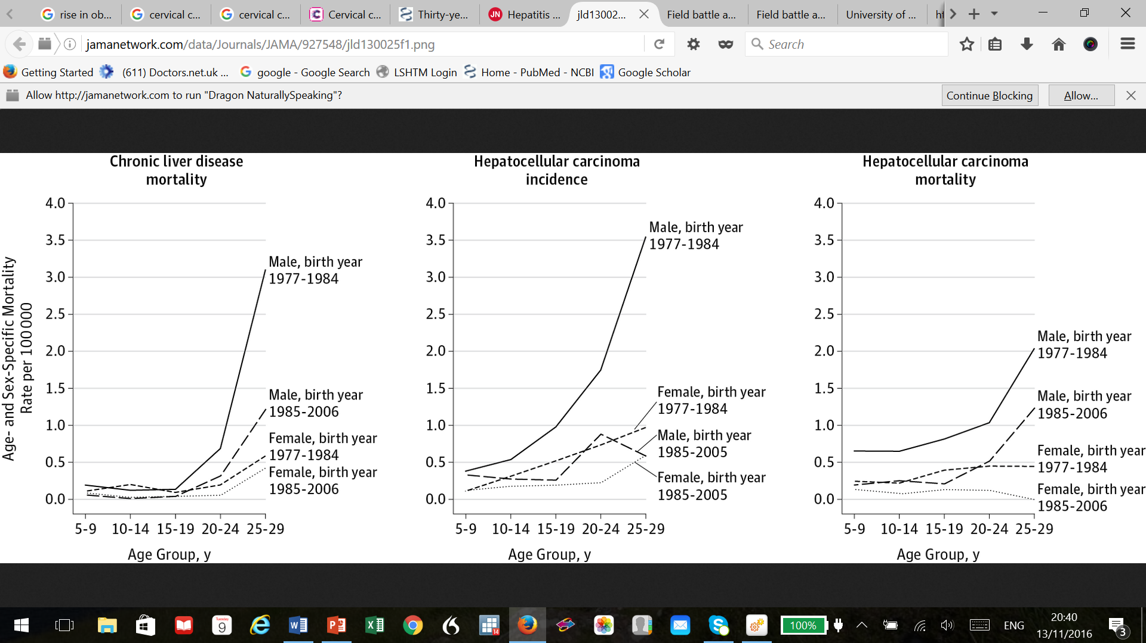
Prevention by vaccination: Hepatitis B and hepatocellular carcinoma (liver cancer, HCC).
Hepatitis B a rare cause of liver cancer in the UK but a major one in Asia and Africa. Hepatitis B and C account for around 80% HCC worldwide.
Taiwan Hep B vaccination programme for infants 1984. Reduced cancer incidence by 80%, mortality by over 90%.
In Africa potentiated by a fungal toxin of peanuts (aflatoxin).
C. Chaing et al JAMA 2013

Slide 21
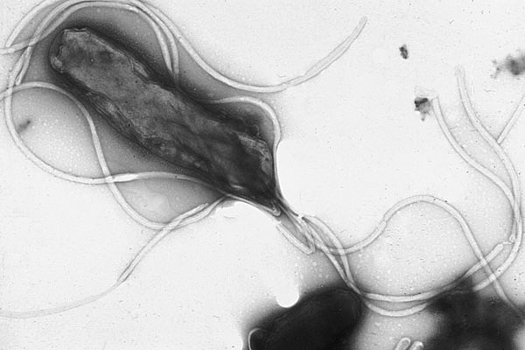
H. pylori and gastric cancer.
Best known as the major cause of peptic ulcer disease.
Increases risk around 6-8x for non-cardia gastric cancer (the main type).
May reduce cardia gastric cancer (not yet clear).
A major risk for a rare gut lymphoma (MALToma).
Reduced risk of oesophageal adenocarcinoma, maybe by reducing stomach acidity.
Electron micrograph H. pylori. Dr. Y. Tsutsumi

Slide 22
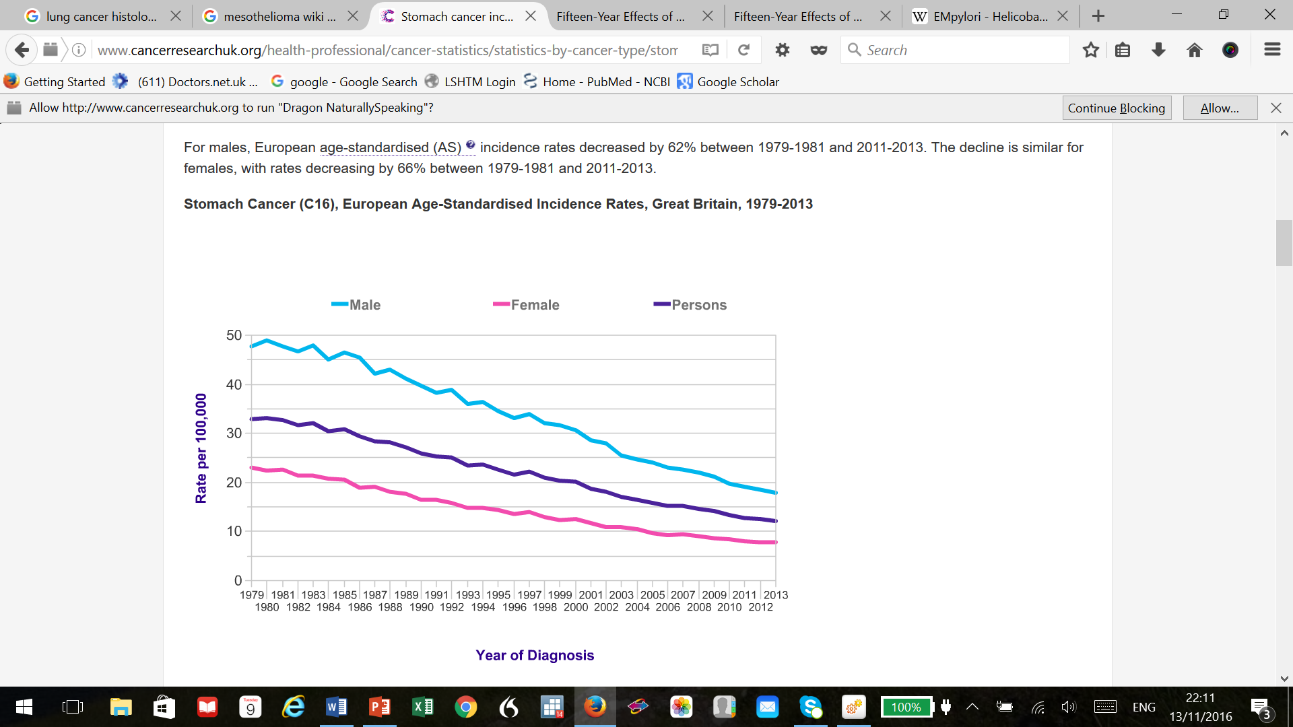
Does treating H. pylori prevent gastric cancer?
Almost certainly yes, RR around 0.65 in meta-analyses in trials of around 8000 patients. Most from China.
May not once pre-cancerous cells identified.
Around 32% of UK stomach cancer H. pylori related. Often treated for ulcers.
Smoking, diet also important.
Combined 75% stomach cancer probably preventable.
Stomach cancer incidence decreased 62% in UK since 1970s. Projected to fall 17% more by 2035 (CRUK)

Slide 23
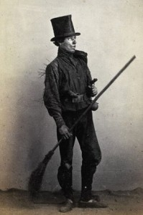
There is generally support for state action against occupational causes of cancer.
Occupational cancers have varied through history as industries rise and fall.
One of the earliest recognised examples Potts’ scrotal cancer in chimney-sweeps.
Around 4% of UK cancers currently attributable to occupation (HSE).
Maybe only 1% avoidable in practicable ways (Doll & Peto).
Wellers chimney sweeps

Slide 24
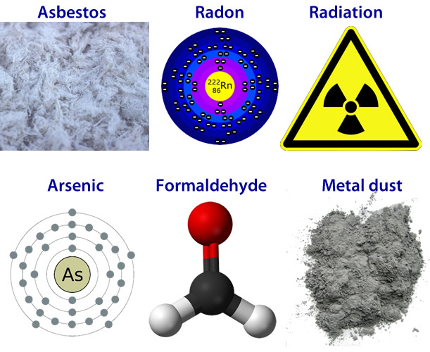
Important occupationally related cancers UK. HSE annual estimates of strong IARC evidence.
Lung, 12% (4500 cases)
Non-melanoma skin cancer 4.6% (3000 cases)
Sinonasal 17% (70 cases)
Bladder 1% (70 cases)
Larynx 2% (50 cases)
Rahma

Slide 25
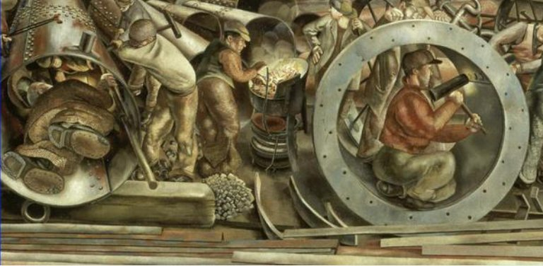
Put a different way, what are the occupational exposures that cause most cancer (UK)?
Asbestos: 4000 pa.
Silica 800.
Diesel exhaust 650.
Mineral oils 550.
Paint 350.
TCCD 230
Radon 180.
Stanley Spencer. Shipbuilders on the Clyde (detail, 1946). IWM

Slide 26
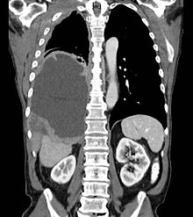
Mesothelioma.
An almost entirely preventable cancer.
94% of risk related to exposure to asbestos, almost all occupational.
“It would be ludicrous to outlaw this valuable and often irreplaceable material in all circumstances (as) asbestos can save more lives than it can possibly endanger.” The Lancet 1967
First major UK limitations mid 1980s, banned late 1990s.
Mesothelioma pleural effusion. Wiki Commons.

Slide 27
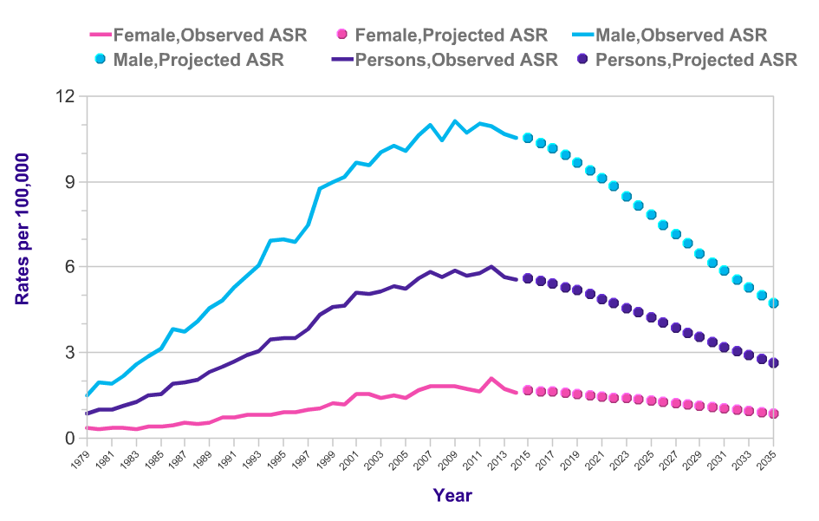
Observed and projected mesothelioma incidence, UK. Rose rapidly, now peaked, projected to fall by over 50% by 2035. (CRUK)

Slide 28
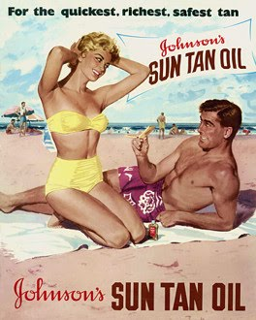
Melanoma and ultraviolet light.
Melanoma is a very common cancer, incidence is rising.
Used to be occupational, now more recreational.
Extended exposure to sunlight, sunburn.
Sunbed risk RR 1.3, 1.9 in those using before 35 years old. (Boniel et al)

Slide 29

Genetic screening and other stratification to identify those most at risk of cancer
Some high-risk individuals for prophylactic treatment, eg BRCA1, 2, TP53.
Surgery the most invasive manifestation.
Drug treatment as prophylaxis already recommended by NICE; tamoxifen or raloxifene.
Likely to become more common, like statins for high-risk heart disease patients.

Slide 30
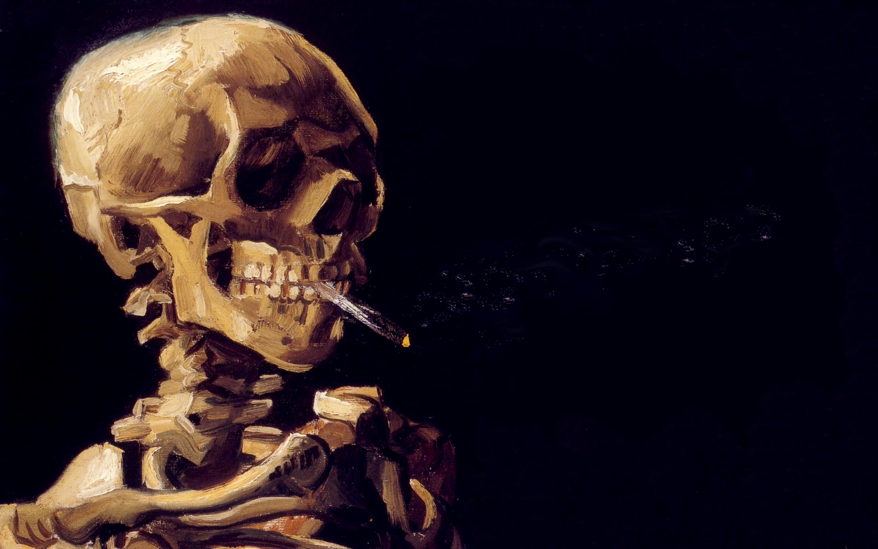
Smoking: the front line in the battle against cancer.
Around 28% of cancer deaths in the UK are smoking related.
4 in 5 lung cancer deaths are caused by smoking. Lung cancer causes the most deaths.
It contributes to many others including larynx*, oesophagus*, mouth, bladder, pancreas, kidney, liver, stomach, bowel, cervix, ovary, nose. *=by 5x or more.
Vincent Van Gogh

Slide 31
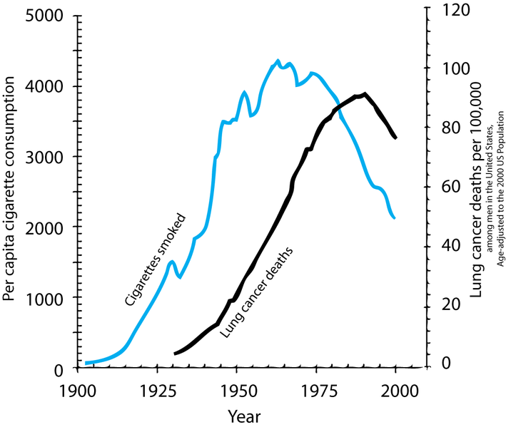
The epidemiological evidence.
Simplest data correlated smoking and cancer rates in the population.
Case-control studies from the 1930s onward compared patients suffering from lung cancer (case) with those without (control).
Much higher rates of smoking in the cancer cases.

Slide 32
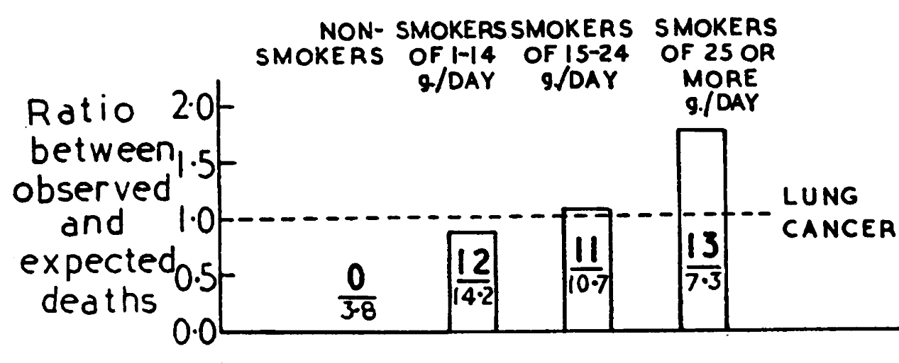
Cohort studies.
The most convincing evidence was from cohort studies.
The British doctors study followed 34, 439 male doctors from 1951.
Within 4 years lung cancer rates much higher in heavier smokers.
Doll & Bradford Hill BMJ 1954

Slide 33
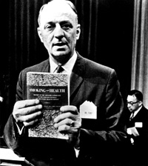
It took a long time to convince the medical profession, let alone the public.
A 1960 poll organised by the American Cancer Society: only 1/3rd of US doctors agreed cigarette smoking should be considered ‘a major cause of lung cancer’.
Most of the tobacco industry tried to make sure the science was labelled ‘speculative’ long after its own scientists privately agreed the link was causal.
Dr. Luther Terry, US Surgeon-General and his Report ‘Smoking and Health’ 1964

Slide 34
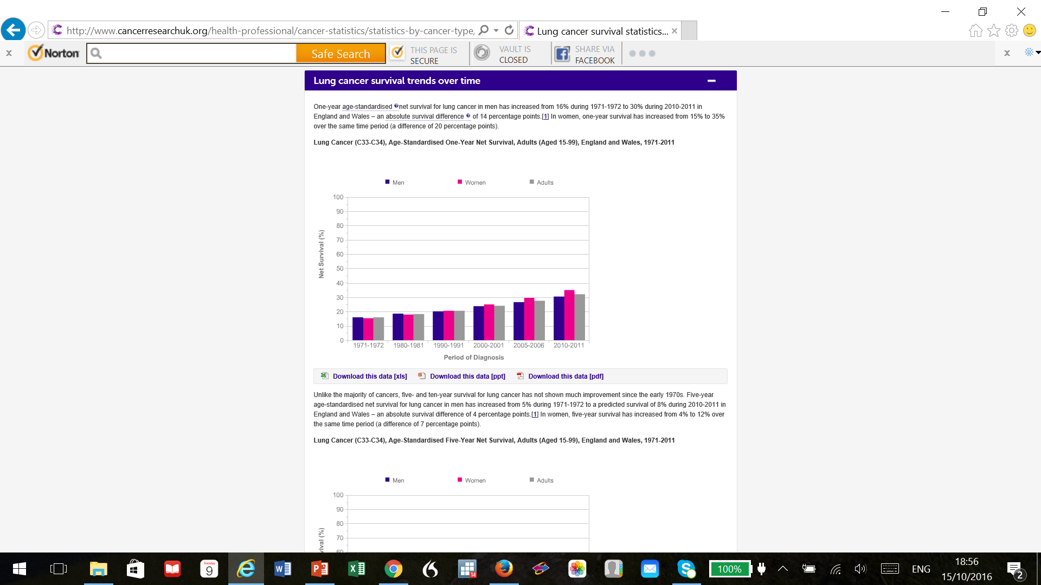
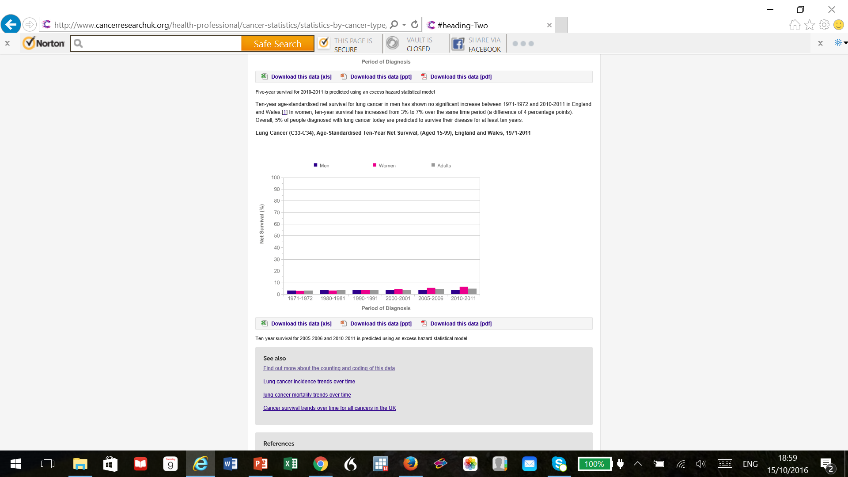
Lung cancer, 1 year (L, 32%) and 10 year (5%) survival. Almost 90% preventable. CRUK

Slide 35
Estimates of the effect of smoking on some other cancers (not exhaustive).
 | Risk ratio RR (pooled)
Lung cancer | 9
Larynx | 7
Upper digestive tract | 3.6
Bladder | 2.8
Pancreas | 2.5
S. Gandini et al 2007

Slide 36
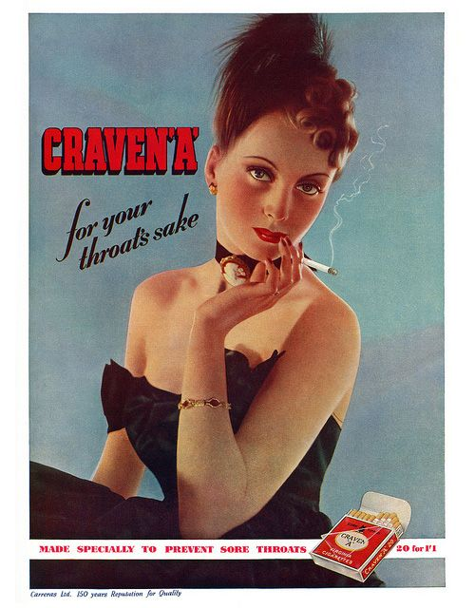

Unsurprisingly heavier smoking= more cancer.
For example for lung cancer in women, one meta-analysis estimates:
1-9 cig/day RR 1.4
10-19 cig/day RR 3.3
20+ cig/day RR 24

Slide 37
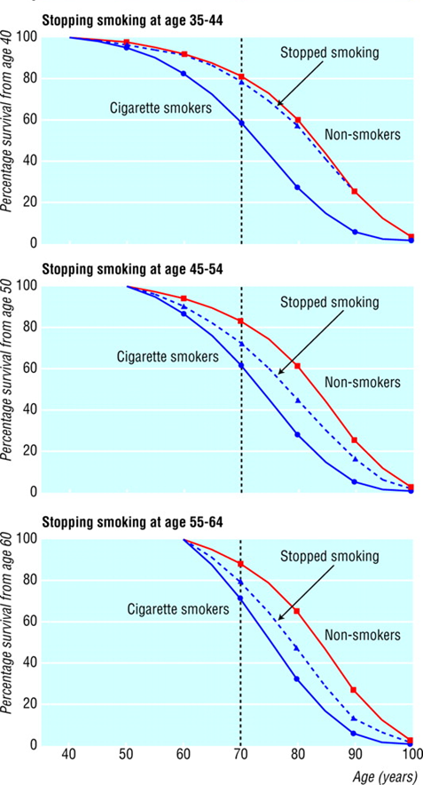
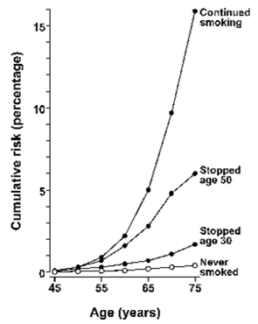
Stopping smoking reduces risk. Data from Peto et al.
Lung cancer
Overall mortality

Slide 38
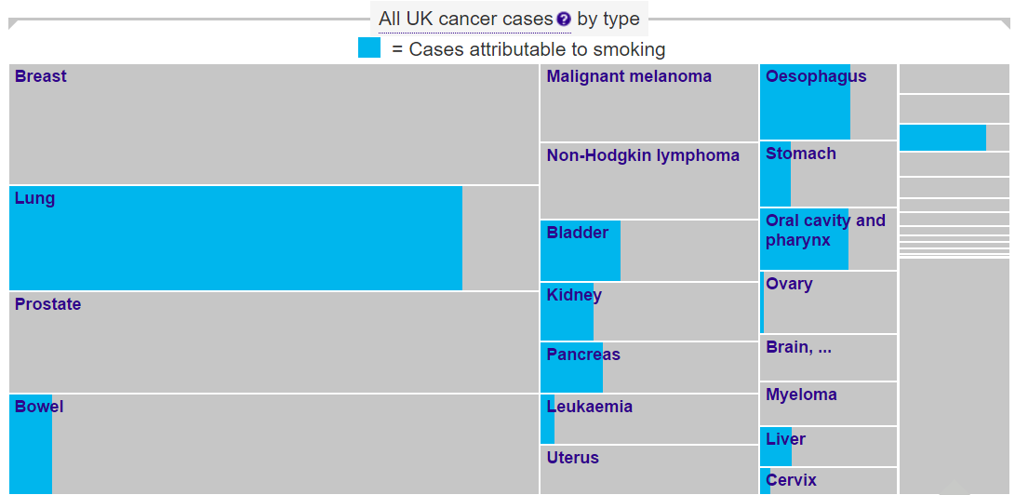
Around 19% of cancer in the UK is attributable to smoking (23% men, 16% women). (Parkin et al)
Proportion of deaths higher (28%) because high-mortality cancers.
CRUK

Slide 39
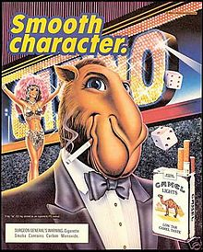
Very strong evidence of cause and effect.
A very unpleasant, common, fatal disease.
What do the public see as the role of the state?
Criminal offence?
A ban on harming yourself when its highly addictive?
Helping stop the addiction?
A ban on harming others? Especially children?
74% of smokers think smoking should be banned in cars with children. (YouGov)
Heavy taxation?
Stopping advertising for smoking?
Advertising against smoking?
Was the Joe Camel ad aimed at children? Moved from 1% to 32.8% of underage market. Started 1988, stopped 1997.

Slide 40
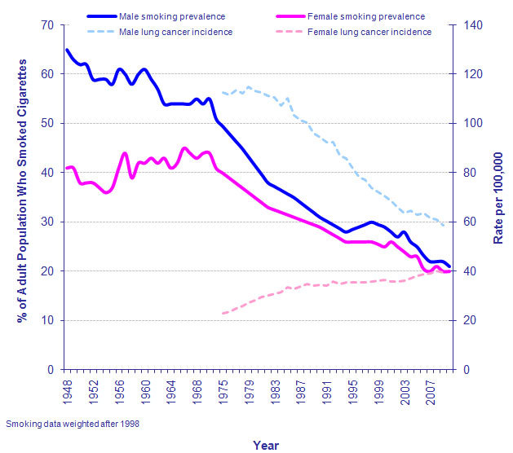
UK smoking and lung cancer rates.
There will be a roughly 20 year lag.

Slide 41
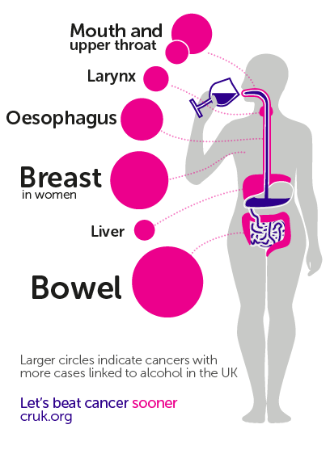
Alcohol is more difficult both scientifically and politically than smoking.
Lung cancer is common, almost always fatal, the link with smoking is extremely strong.
A strong causal relationship with some relatively rare cancers.
A smaller but still significant relationship with common cancers.
Less than 19% of UK adult population smoke (from 46% in 1974). Passive smoking causes cancer.
Only 21% do not drink (ONS).
CRUK

Slide 42

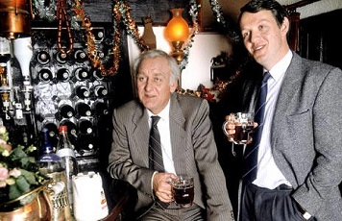
Scientifically assessing lifetime alcohol harder than cigarettes.
Drinking patterns vary during the week, and over the life course.
People misremember (and seldom overestimate…).
Recall bias.
The effects of alcohol are likely to be lifetime risk.

Slide 43
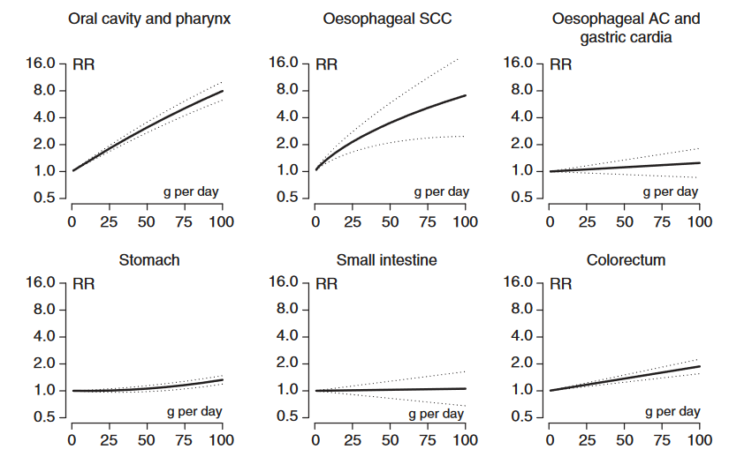
Alcohol and the gastrointestinal tract.
Colorectal cancer RR 1.4 for heavy drinking.
V Bagnardi et al. BJC 2015
Meta-analysis of 572 studies with 486,538 patients with cancer.

Slide 44
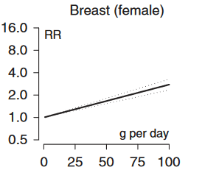
There is now solid evidence of a link between alcohol intake and breast cancer.
A UK ‘unit’ is around 8g alcohol. A large glass of wine might be 25g.
Arbitrarily light<12.5g/day
Moderate <50g/day
Heavy >50g/day
RR 1.04 for light
1.2 for moderate
1.6 for heavy alcohol
Bagnardi et al 2015

Slide 45
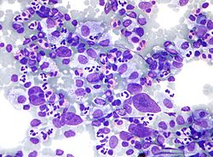
Minimal or no link between alcohol and many other cancers.
These include bladder, ovarian, cervical, prostate cancer.
An inverse relationship with Hodgkin and non-Hodgkin lymphoma, possibly renal and thyroid cancer.
Hodgkin lymphoma

Slide 46
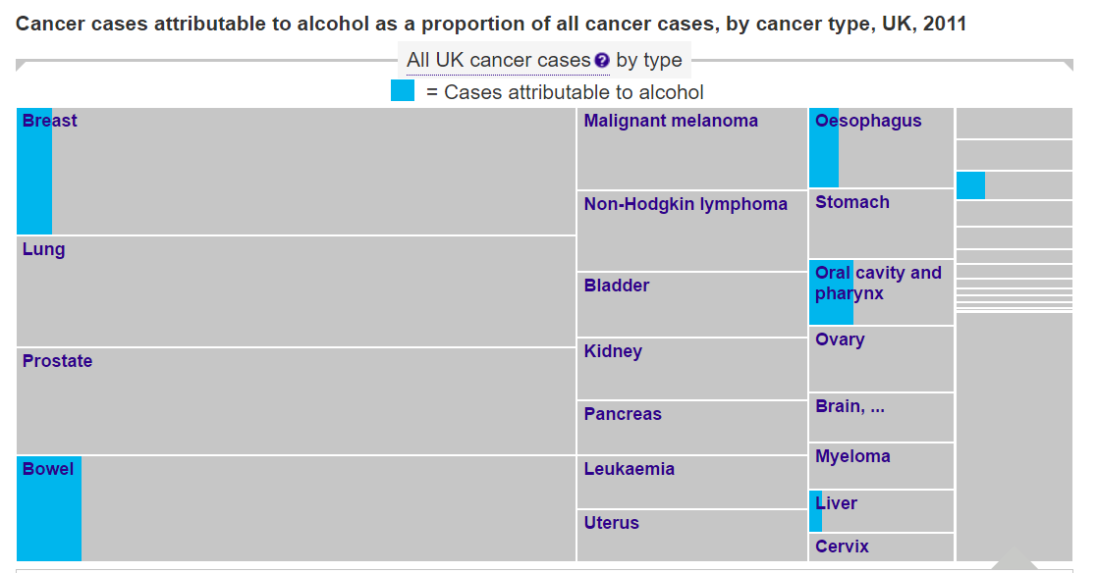
Around 4% of cancers in UK attributable to alcohol. (Parkin 2011)
CRUK

Slide 47
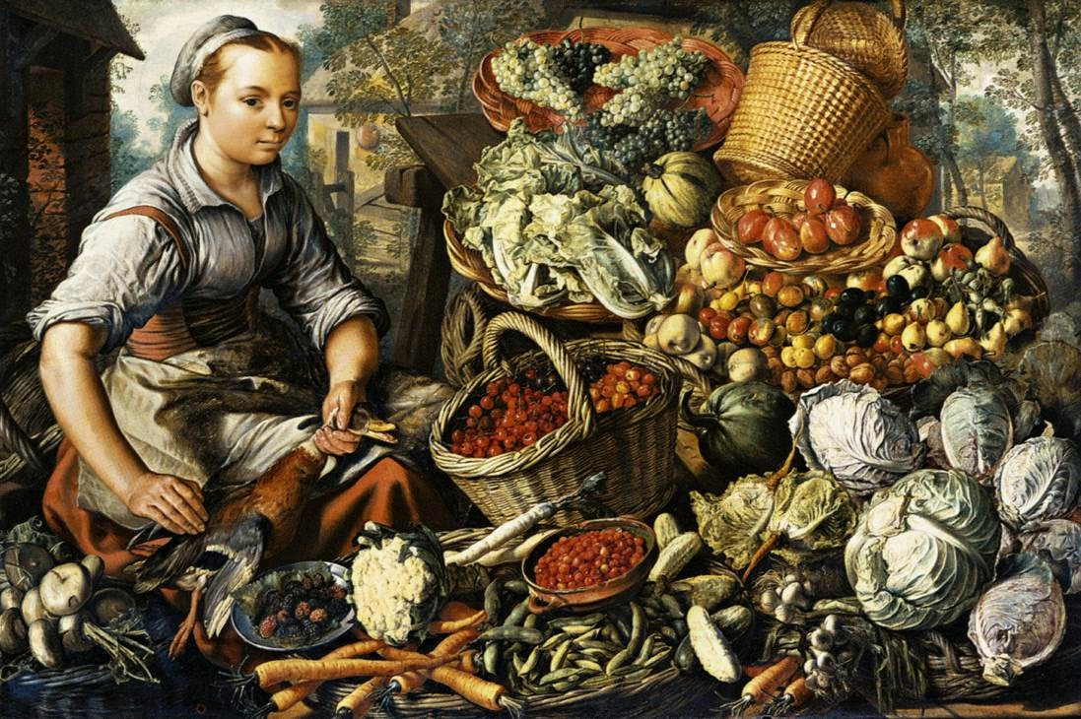
Dietary mix.
There is clear evidence a diet higher in vegetables, fruit, fibre, and lower in red and processed meat is associated with lower colon and other cancers.
It is not as clear what the most important factors are.
Pieter Aertsen 1564

Slide 48
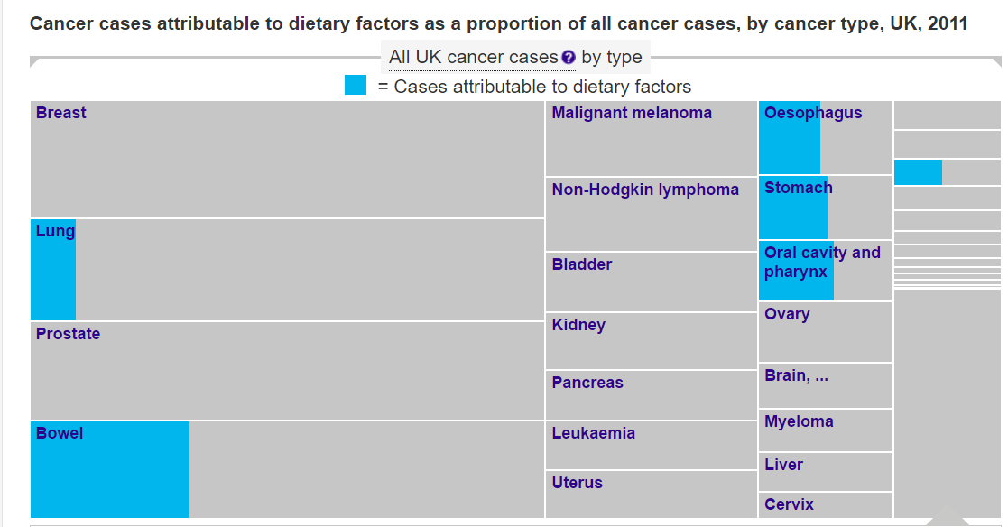
9% of UK cancers estimated to be diet related.
CRUK, Parkin et al.

Slide 49
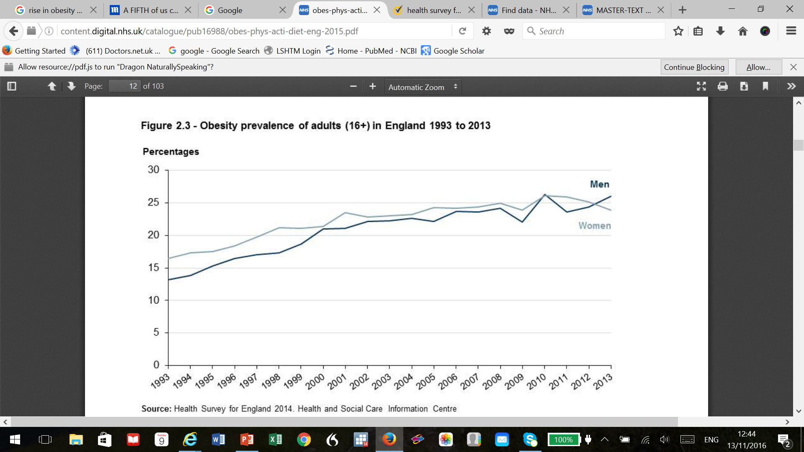
Obesity- gradually increasing.
And a tough policy challenge.
UK is very typical of industrialised countries.
Over 2 decades obesity has gone from 13% to 26% in men and from 16% to 24% in women.
Percentage obese (BMI>30) by year.
Health Survey for England 2014.

Slide 50

In men:
5 kg/m² increase in BMI associated with:
oesophageal adenocarcinoma RR 1·5
thyroid 1·3
colon 1·2
renal 1·2.
Inverse association lung and oesophageal (prob due to smoking)
A. Renehan et al Lancet 2008

Slide 51

In women:
Associations between 5 kg/m² increase in BMI and:
endometrial RR 1·6
gallbladder 1·6
oesophageal adenocarcinoma 1·5
renal 1·3
Same inverse relationship with lung and oesophageal squamous
Renehan et al 2008

Slide 52

Obesity and cancer- a growing future problem.
In high-income countries a recent estimate around 5% of cancers related to high BMI
(M Arnold et al Lancet Oncology 2015)
A quarter of these are attributable to the increase in BMI since 1982.
Postmenopausal breast cancer, uterine cancer and colon cancer contribute over half this risk.
Population attributable fraction of cancers due to high BMI, 2012 data

Slide 53








It’s not easy to boil prevention of cancers down to a headline, but we can reduce them substantially.

Slide 54

This CRUK infographic on lifestyle is only indicative but indicates the relative contributions.
What is the role of the state?

Slide 55
Ladder of state intervention. Remembering that around 40% of cancer is preventable.
Ban
Tax heavily.
Regulate.
‘Nudge’ tax or intervention.
Mass voluntary programme.
Engage with industry.
Inform.
Leave up to individuals.

