Slide 1
2016-7 Lecture Series:
Where are we after the Storm? The UK Economy in the Aftermath of Financial Crisis:
Unemployment and Employment
Professor Jagjit S. Chadha
Mercers’ School Memorial Professor of Commerce
© Jagjit S. Chadha 2016-7

Slide 2
The Road to Wigan Pier, George Orwell (1937)
When you see the unemployment figures quoted at two millions, it is fatally easy to take this as meaning that two million people are out of work and the rest of the population is comparatively comfortable. I admit that till recently I was in the habit of doing so myself. I used to calculate that if you put the registered unemployed at round about two millions and threw in the destitute and those who for one reason and another were not registered, you might take the number of underfed people in England (for everyone on the dole or thereabouts is underfed) as being, at the very most, five millions.
This is an enormous under-estimate, because, in the first place, the only people shown on unemployment figures are those actually drawing the dole — that is, in general, heads of families. An unemployed man’s dependants do not figure on the list unless they too are drawing a separate allowance. A Labour Exchange officer told me that to get at the real number of people living on (not drawing) the dole, you have got to multiply the official figures by something over three. This alone brings the number of unemployed to round about six millions.
But in addition there are great numbers of people who are in work but who, from a financial point of view, might equally well be unemployed, because they are not drawing anything that can be described as a living wage.

Slide 3
Real Wages and Unemployment do not always move together

Slide 4
Stylised Facts: Unemployment Fluctuations
Total hours worked has about the same variance as output,
Employment (extensive margin) has a similar variance as output,
But hours per worker (intensive margin) has less variance than output implying that the cyclical variation in total hours worked stems from changes in employment,
Labour productivity has less variance than output,
Real wages are more stable than output but are broadly acyclical,
Labour share of income, compared to capital or land is around 60% and relatively stable

Slide 5
Labour Market Clearing
W/P
N^{S}
LF
(W/P)*
U
N^{D}
N¹
N
The basic model with derived demand and household labour supply

Slide 6
Labour Market Clearing
W/P
N^{S}
LF
U
(W/P)*
N^{D}
N²
N
Shocks to demand and supply can affect employment and unemployment

Slide 7
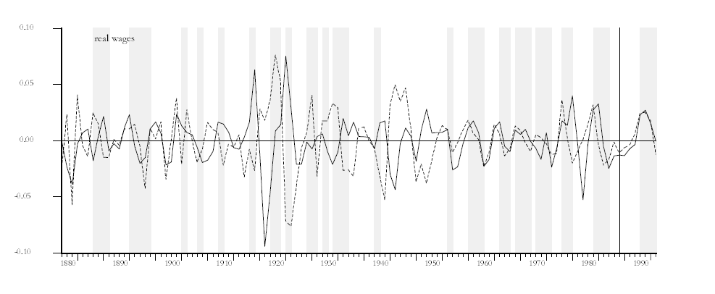
Real Wages and the Business Cycle (1871-1996)
At annual long run frequency not clear which dominates
Output (dotted) and real wages (solid)

Slide 8
Labour Market Clearing
W/P
N^{S}
LF
U²
(W/P)*
U¹
(W/P)**
N^{D}
N³
N⁴
N¹
N

Slide 9
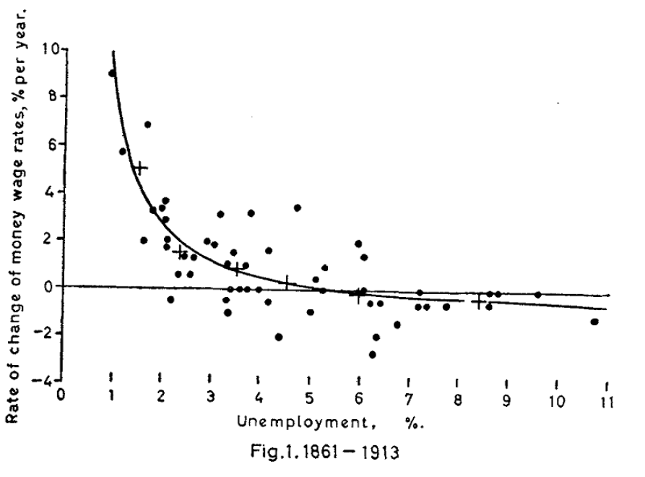
Phillips Curve
Unemployment was thought to be demand-determined and placed pressure on costs

Slide 10
The National Minimum Wage
Minimum wage introduced in 1999 helped equity (distribution) and efficiency (offset labour market frictions)
Raised real and relative wages
But with no significant effects on employment
Labour may have used jobs as a stepping stone to the labour market entry
And firms intensified effort, altered work organisation and raised human capital investment

Slide 11
Minimum Wages (standard)
W/P
N^{S}
LF
(W/P)^{min}
(W/P)*
U
N^{D}
N^{min}
N¹
N
Minimum wages must reduce employment and increase unemployment!

Slide 12
Minimum Wages (labour market frictions)
W/P
N^{S (MC)}
N^{S}
LF
VF
U
(W/P)**
N^{D}
N²
N
Not so clear when there are labour market frictions

Slide 13
Minimum Wages
W/P
N^{S (MC)}
N^{S}
LF
VF
U
(W/P)^{min}
(W/P)**
N^{D}
N²
N¹
N
Might raise employment and lower unemployment!

Slide 14
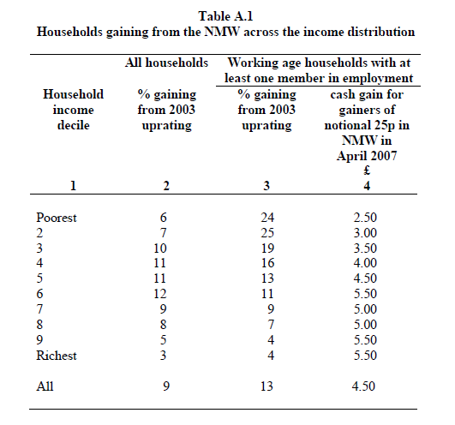
Minimum Wage: Impact on Income Distribution

Slide 15
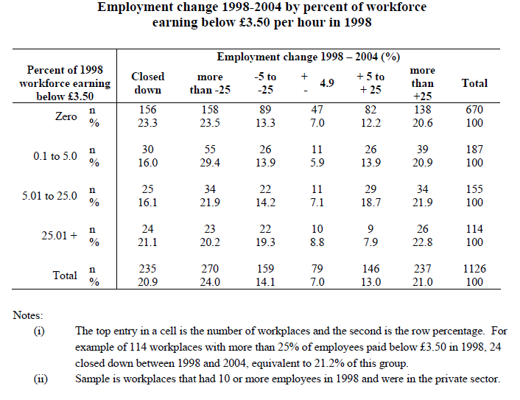
Minimum Wage: Impact on Employment

Slide 16
Low Pay Commission work: Metcalf (2007)
The relative price of minimum wage-produced consumer services rose relative to the RPI
Profits in firms employing low wage workers fell relative to other firms
Overall share of profit in national income has been lower
Firms adjusted hours rather than workers.
Labour market frictions – imperfect information, mobility costs and tastes – give the employer some market power

Slide 17
Recessions are Surprises
y/y growth
Pushes up Unemployment
Should have expected a large increase in unemployment

Slide 18
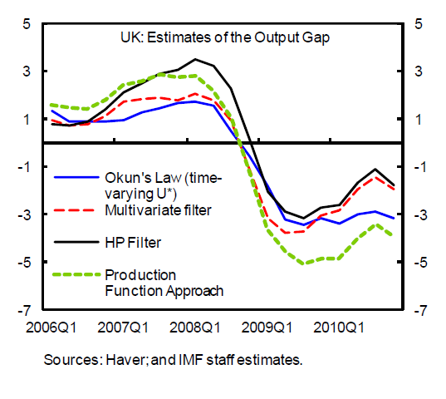
Okun’s ‘Law’
Stable relationship between unemployment and the output gap
Thus use deviations in unemployment to evaluate the output gap
6% movement the output is inferred from a 3% increase in unemployment from 2008-2011
But what if shocks are different?
Or labour market is changing?

Slide 19
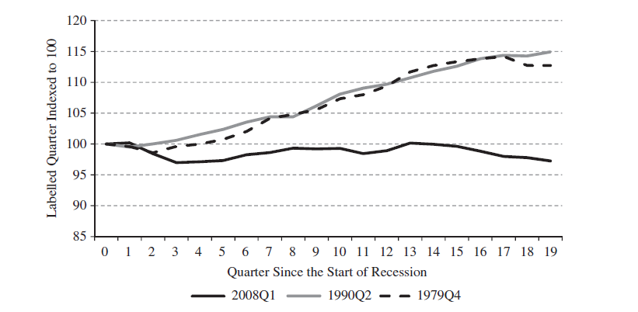
Great Recession: Real Output per Hour
Lack of recovery in productivity the real problem

Slide 20
Great Recession: Unemployment
%
Recession
NRU

Slide 21
Great Recession: Employment and Labour Income
Recession
%
Recovery and Stabilisation in Labour Income after mid-1990s

Slide 22
Great Recession: Real Wages
£
Recession
Sustained growth in wages has had a substantive hiatus after the financial crisis

Slide 23
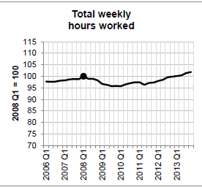
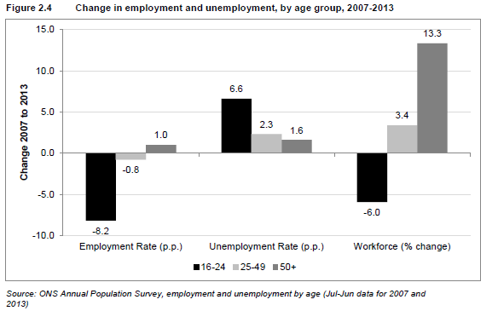
Great Recession: Hours Worked and Age Decomposition
Intensive margin response showed flexibility with tail end responses in employment, unemployment and workforce

Slide 24
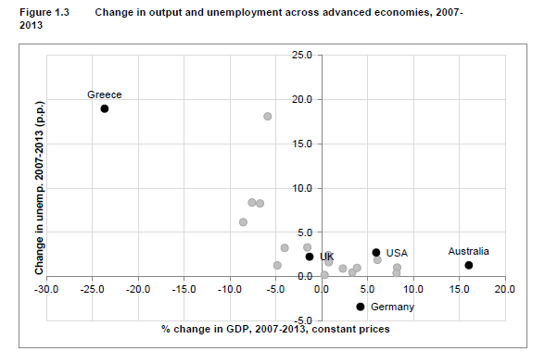
Great Recession: Output and Unemployment
Back to the natural rate for the UK

Slide 25
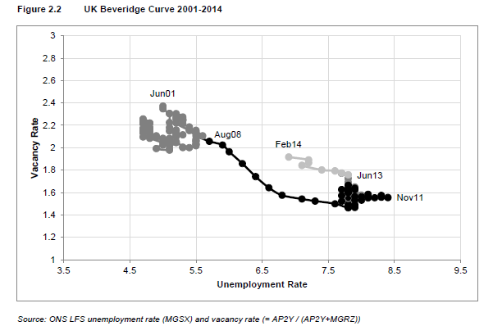
Great Recession: Beveridge Curve
Efficient response to financial shock

Slide 26
Employment after the Recession
Simple labour market models look flawed
Macroeconomic picture cannot do well at explaining the split between hours, employment and unemployment
Minimum wage experience tells us about the importance of labour market frictions
Post-recession fall in real wages suggests increases in supply and a fall in capital-output ratio (see Blundell et al (2014) and Pissarides (2013))

