Slide 1
THE FIRST THREE MINUTES OF CREATION
Joseph Silk (IAP/JHU/Oxford)
Gresham Lecture, 7 December 2016

Slide 2
L'Hypothèse de l'Atome Primitif, Georges Lemaitre (1946)
Lemaitre’s pyrotechnics
The evolution of the world can be compared to a display of fireworks that has just ended: some few red wisps, ashes, and smoke. Standing on a cooled cinder, we see the slow fading of the suns, and we try to recall the vanished brilliance of the origin of the world.
L’evolution de l’univers peut être comparee a un feu d’artifice qui vient de se terminer: quelques cendres et fumées . Debout sur une escarbillemieux refroidie, nous voyons doucement s’éteindre les soleils reconstituer de la formation des mondes

Slide 3
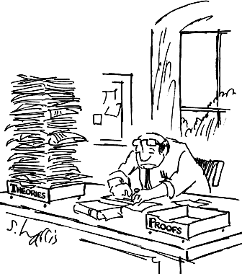
We can’t prove the Big Bang occurred, there is just a theory
with lots of circumstantial evidence
There is a high probability
that it happened
after all who has seen an
electron…or a quark?

Slide 4
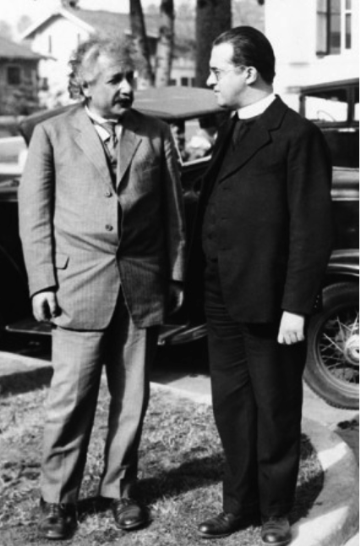
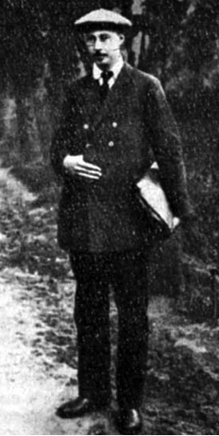
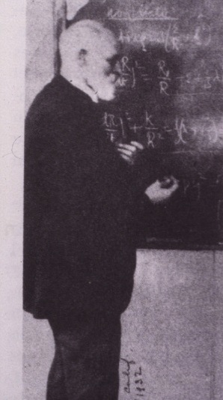
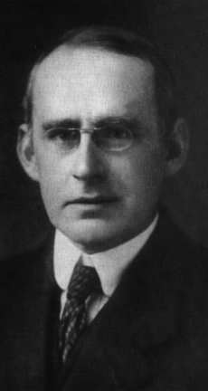
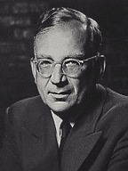
Einstein and Lemaitre
Edwin Hubble
Alexandre Friedmann
Arthur Eddington
George Gamow
Willem de Sitter
An international effort
Robert Wilson
Arno Penzias

Slide 5
Who was Georges Lemaitre?
Born 1894 in Charleroi, Belgium. Trained in engineering and mathematics
Volunteered as artillery engineer in WW1.
Remained NCO because he was critical of range-finding calculations
Delayed vocation at his father’s insistence, entered seminary 1919/23
Seminary head (Cardinal Mercier) allowed him to study Einstein’s theory of gravity
Ordained in 1923
Obtained bursary to spend 1923/24 with Arthur Eddington in Cambridge
Obtained grant to spend 1924/25 with Harlow Shapley at Harvard.
PhD at MIT in general relativity
Visited Pasadena in 1925 & met Richard Tolman, Edwin Hubble.
Visied Lowell Obsevatory, Arizona, & met Vesto Slipher, who first measured the galaxy redshifts
Joined Louvain faculty in 1925
Published paper on expanding universe in 1927, including distance-redshift relation
Hubble published distance-redshift relation in 1929..no mention of expanding space or Lemaitre
In 1930, Eddington had Hubble’s 1927 paper translated into English, omitting expansion law
Lecture tour of California with Einstein in 1931 propelled him to fame
Science advisor to Pius XII, president of the Pontifical Academy of Sciences

Slide 6
Einstein changed his mind
1927: Your calculations are correct, but your physics is atrocious.
Vos calculs sont corrects, mais votre physique est abominable
1931: This is the most beautiful and satisfactory explanation of creation to which I have ever listened.

Slide 7
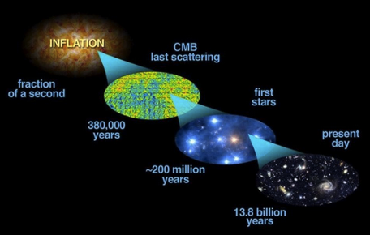
Courtesy J. Bock, E. Siegel

Slide 8
Fossils of the past
The cosmic helium abundance
The cosmic microwave background radiation
Baryons
The oldest stars

Slide 9
Measuring the abundance of helium
2nd most abundant element in the universe
Discovered first in the sun, 30 years later on earth

Slide 10
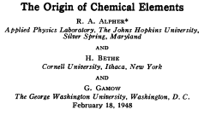
RALPH ALPHER
GEORGE GAMOW
predicted origin of light elements
Notes:
Which accounted for one Nobel prize,
but not to Gamow

Slide 11
The helium story
Fusion of 4 protons to 1 helium nucleus,
releases mass difference in energy 0.07mc²
Makes helium, powers the sun, makes H bombs and someday clean energy
A. Weiss

Slide 12
Helium is evidence for the Big Bang
The nuclear fusion ladder
Stops at beryllium
no stable elent of mass 8

Slide 13
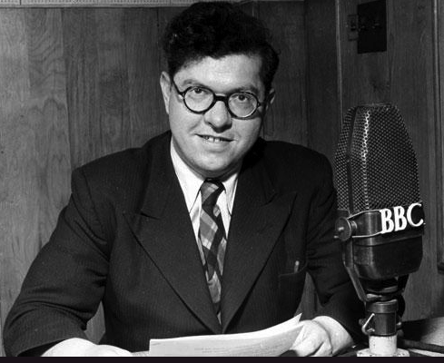
Fred Hoyle derided the “Big Bang” theory in 1951
Steady state universe disfavoured by
steep rise in faint radio source counts

Slide 14
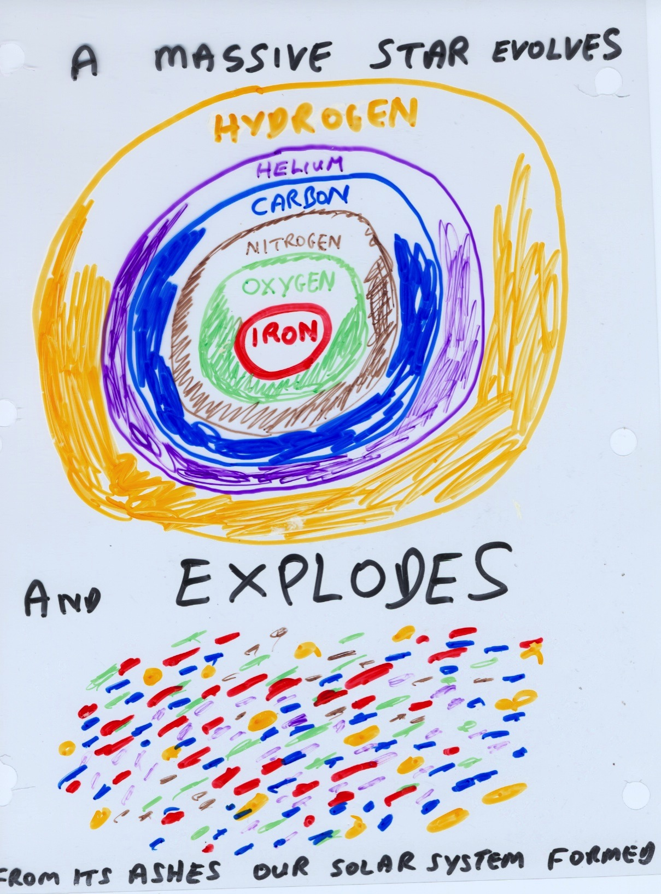
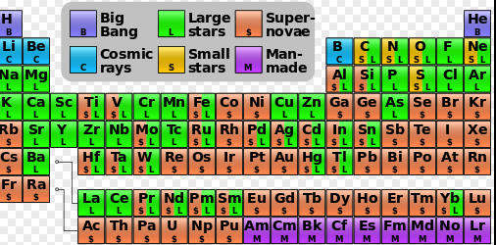
Elements heavier than helium are synthesized in stars
Burbidge, Burbidge, Fowler, Hoyle: 1957
Notes:
Add Fowler Nobel picture
Burbidge, hoyle photos

Slide 15
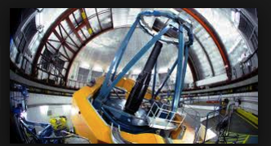
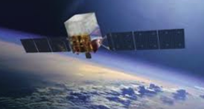
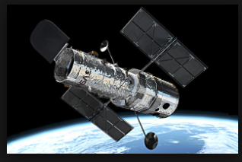
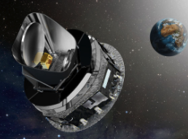
TELESCOPES as time machines
Infrared 2MASS telescope
gamma rays Fermi satellite
Optical Hubble Space Telescope
Microwaves Planck satellite

Slide 16
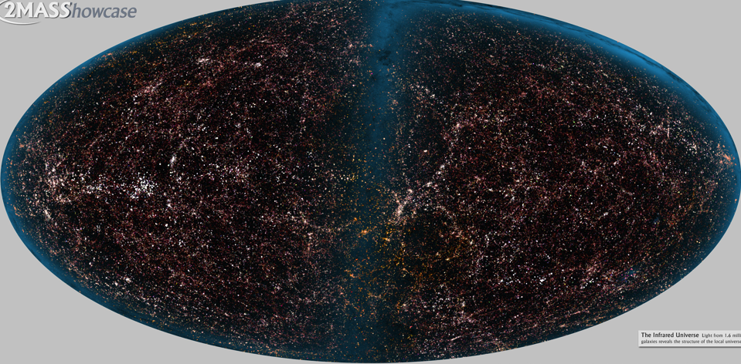
The local universe in the infrared
Predict what’s not observed………..and don’t observe what’s predicted

Slide 17
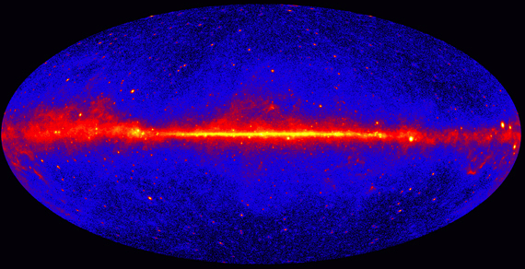
The high energy universe

Slide 18
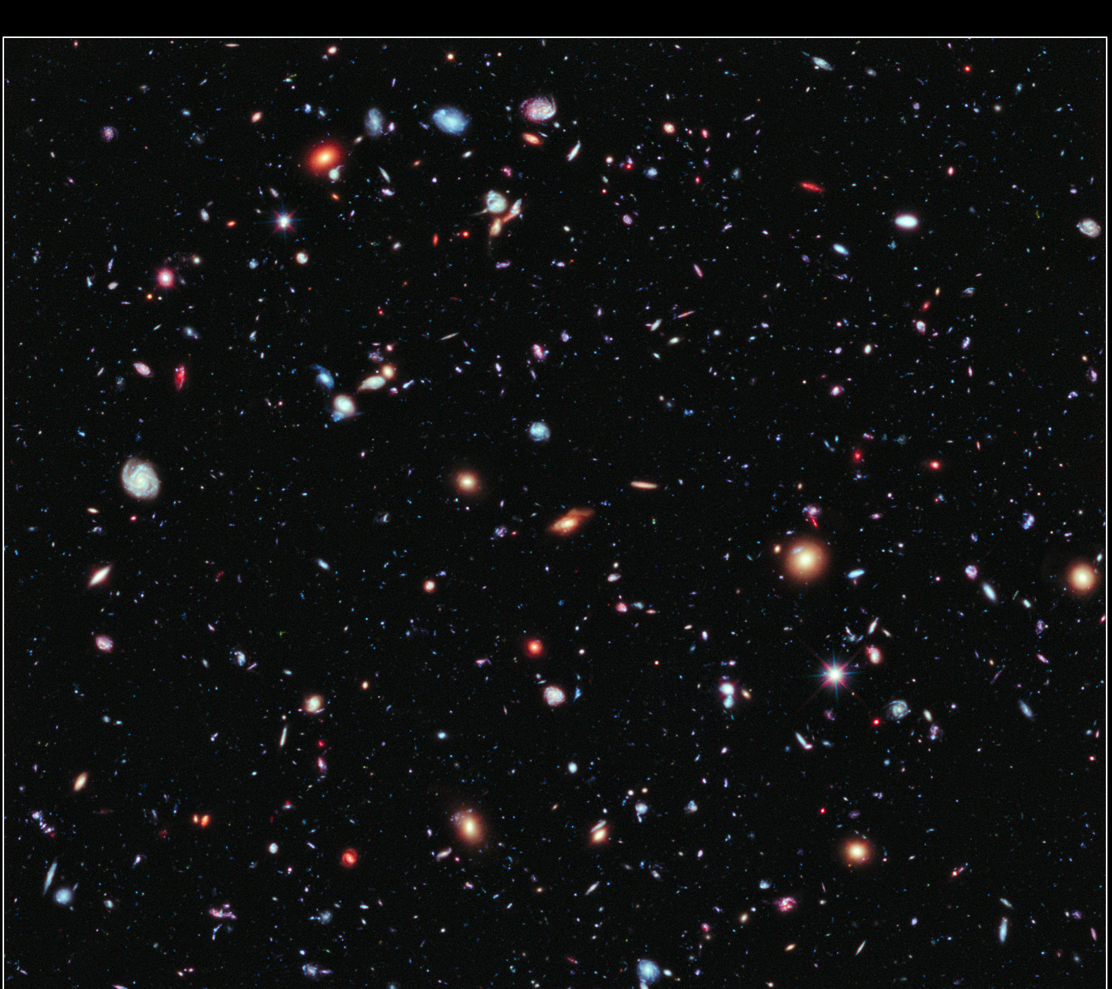
The distant universe

Slide 19
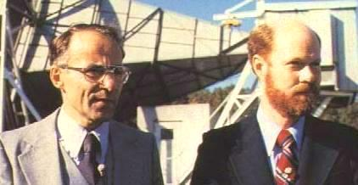
1964
RELIC RADIATION DISCOVERED
BY PENZIAS AND WILSON

Slide 20
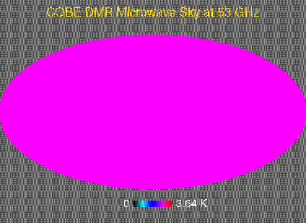
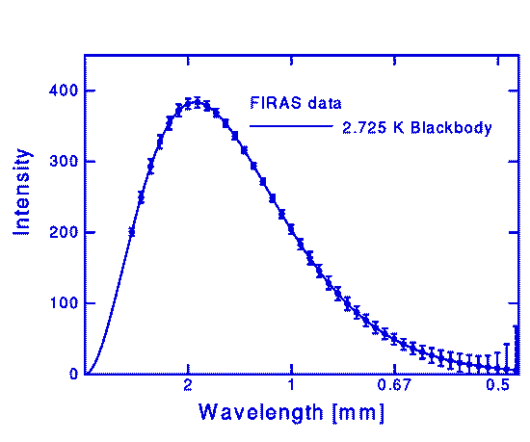
The very distant universe
seen 380000 years after the Big Bang
It is perfect blackbody radiation made 1 month after the Big Bang
measured by COBE satellie in 1980

Slide 21
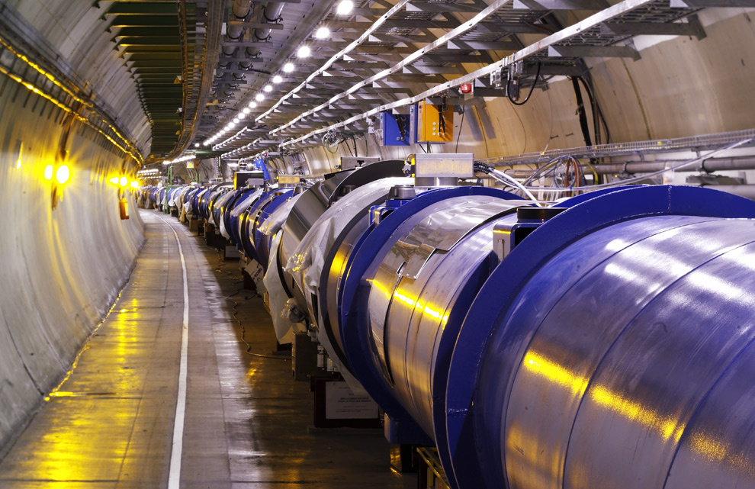
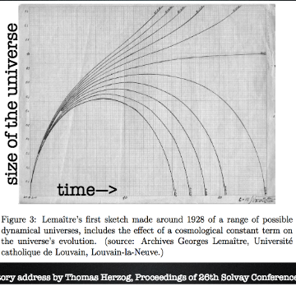
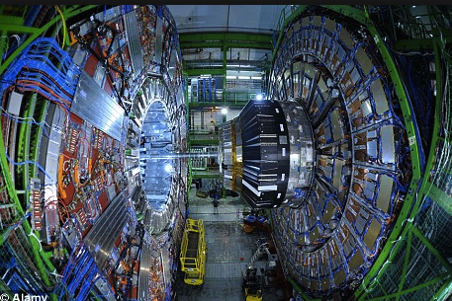
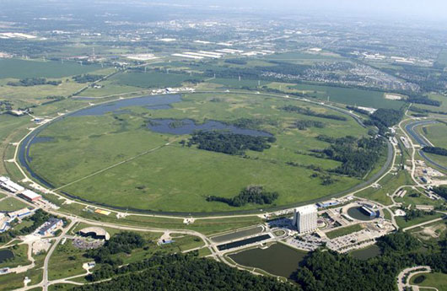
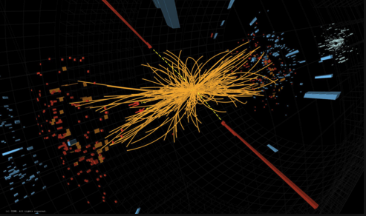
in the beginning
We can’t see back any further…
But we can use the Big Bang as a giant accelerator
From Georges Lemaitre’s notebook in 1927
LHC
here and now
Notes:
21

Slide 22
What we have learnt
There is a desert with no new particles…yet
Force couplings run, leading to unification
Grand unification was a phase transition
that may have triggered inflation

Slide 23
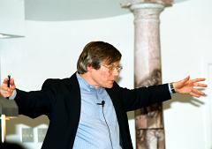
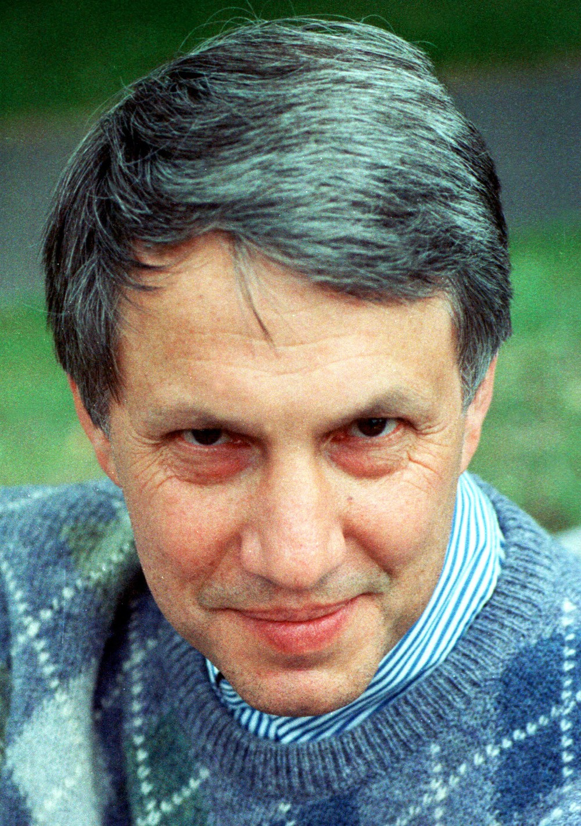
INFLATION explains size of the universe, Euclidean geometry, and seed fluctuations
Alan Guth
1980
Andrei Linde

Slide 24
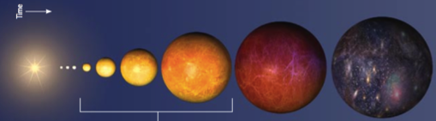
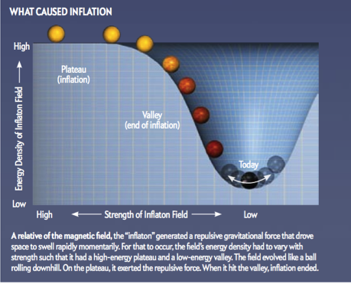
Our universe, full of matter
Steinhard 2011

Slide 25
The old universe

Slide 26
the new universe

Slide 27
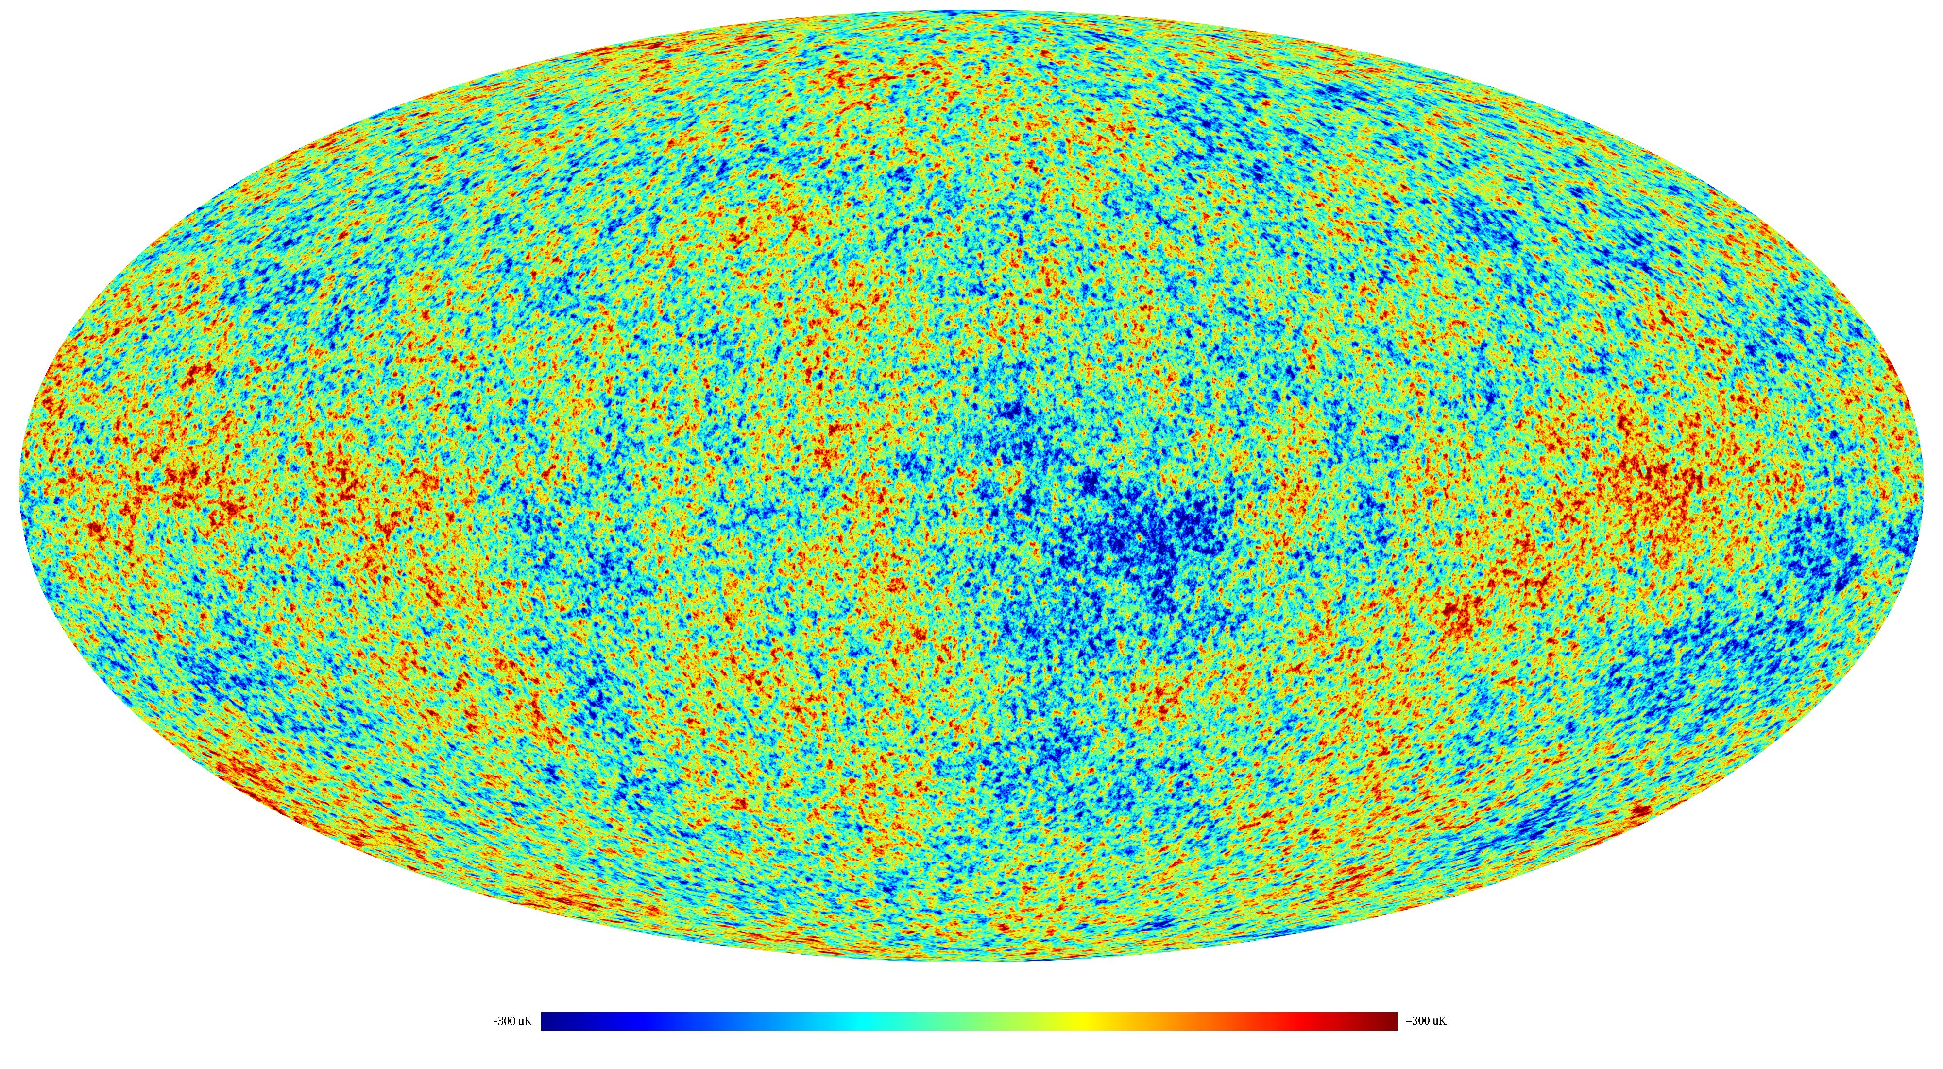
We observe the initial conditions for forming galaxies in the microwave sky
Planck satellite data

Slide 28
The fluctuations emerged from nothing
Predicted by Heisenberg’s uncertainty principle:
weird things can exist if sufficiently short-lived
Such as Higgs bosons that are everywhere
They come and go so rapidly that we cannot detect them.
Produce fluctuations in energy of the vacuum, ie in nothing
these quantum effects
are macroscopically
infinitesimal…..
but inflation boosts
them in size
Notes:
Add higgs boson

Slide 29
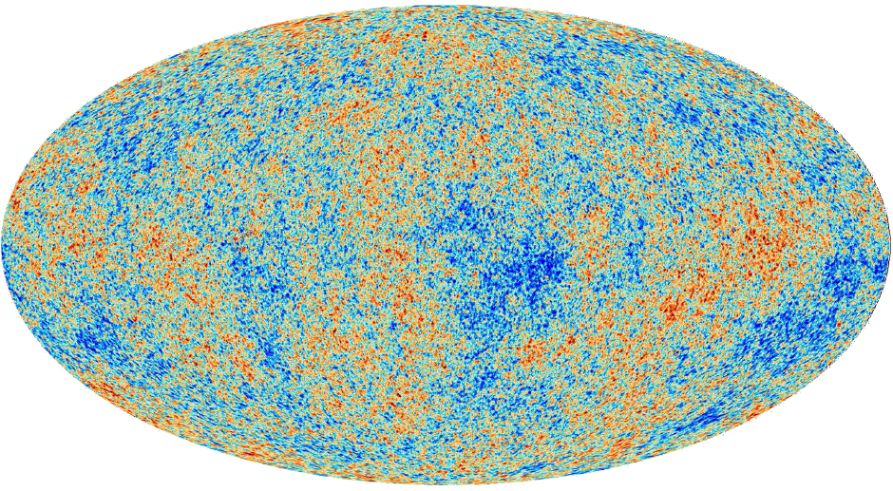
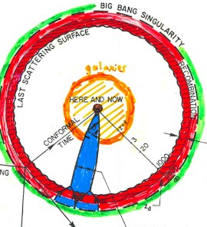
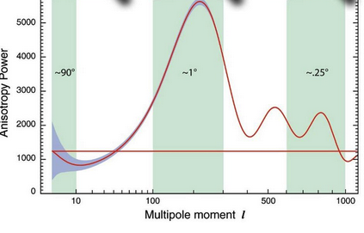
Quantum fluctuations, observed on > degree angular scales
THE DARK AGES
STRENGTH OF TEMPERATURE FLUCTUATIONS

Slide 30
+ gravitational instability
How galaxies form from tiny density fluctuations
Poor get poorer >>>>>>>> voids
Rich get richer >>>>>>>>> galaxies

Slide 31
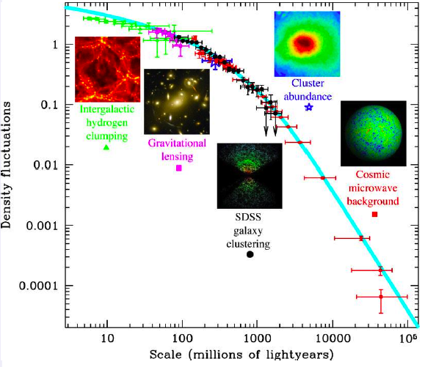
FROM DENSITY FLUCTUATIONS TO GALAXIES
Cosmic microwave background and large-scale structure constraints overlap
inflation prediction
Tegmark 2004

Slide 32
TESTING THIS INCREDIBLE STORY
Can only see directly to 380000 years
Blacbody radiation is produced before 1 month
Helium is synthesised within 3 minutes
Need to probe to much less than 1 sec after the Big Bang
Can do this with most penetrating probe of all: gravity waves
They come from 10⁻³⁶ sec after the Bang

Slide 33
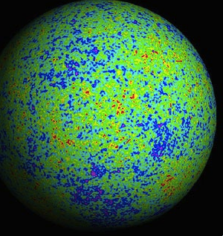
1. Searching for gravity waves
from the beginning of the universe
Gravity waves give a slight twist ti the fossil radiation temperature fluctuations
Look for a nanoK signal, need improvement by 100 on present sensitivity!

Slide 34
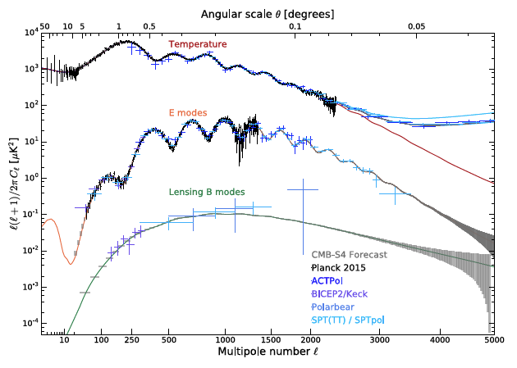
Where we are or soon will be
The challenge

Slide 35
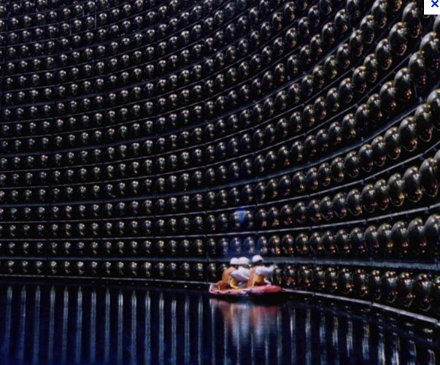
2. Searching for proton decay: a prediction
of grand unification at 10⁻³⁶ second after the beginning
Protons should be decaying slowly today
Live 10³⁴ years or longer, so look for rare events in a huge detector mass
Super-Kamiokande 60000 tons of purified water
1 km underground in mine in Japan
Hyper-Kamiokande. One million tons 2026
Notes:
Super K 1 km underground in Mozumi mine. 60ktons of purified water
40m cube tank.
11000 photubes 50 cm diameter

Slide 36
What happened before the Big Bang?
What did God do before he created the universe?
St Augustine did not reply: He was preparing Hell for people who asked such questions.
He wrote:
there can be no doubt that the world was not created in time but with time. An event in time happens after one time and before another, after the past and before the future. But at the time of creation there could have been no past, because there was nothing created to provide the change and movement which is the condition of time.
— Saint Aurelius Augustinus Augustine (AD 354-430)
De Civitate Dei (The City of God) [413-426], Book XI, chapter 6

Slide 37
the day without yesterday
the first instant at the bottom of space-time, the now which has no yesterday because, yesterday, there was no space
Georges Lemaitre in The Primeval Atom

Slide 38
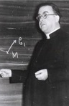
There is no creation in the Big Bang,
just a beginning
We may speak of this event as of a beginning… it is a beginning in the sense that if something happened before, it has no observable influence on the behavior of our universe... everything happens as if the theoretical zero was really a beginning. The question if it was really a beginning or rather a creation, something started from nothing, is a philosophical question which cannot be settled by physical or astronomical considerations.
Georges Lemaitre

Slide 39
It appeared to me that there were two paths to truth, and I decided to follow both of them.
Georges Lemaitre

Slide 40
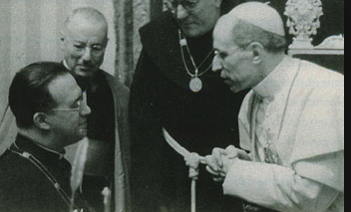
The first word of the bible: fiat lux
Georges Lemaitre
Pius XII

Slide 41
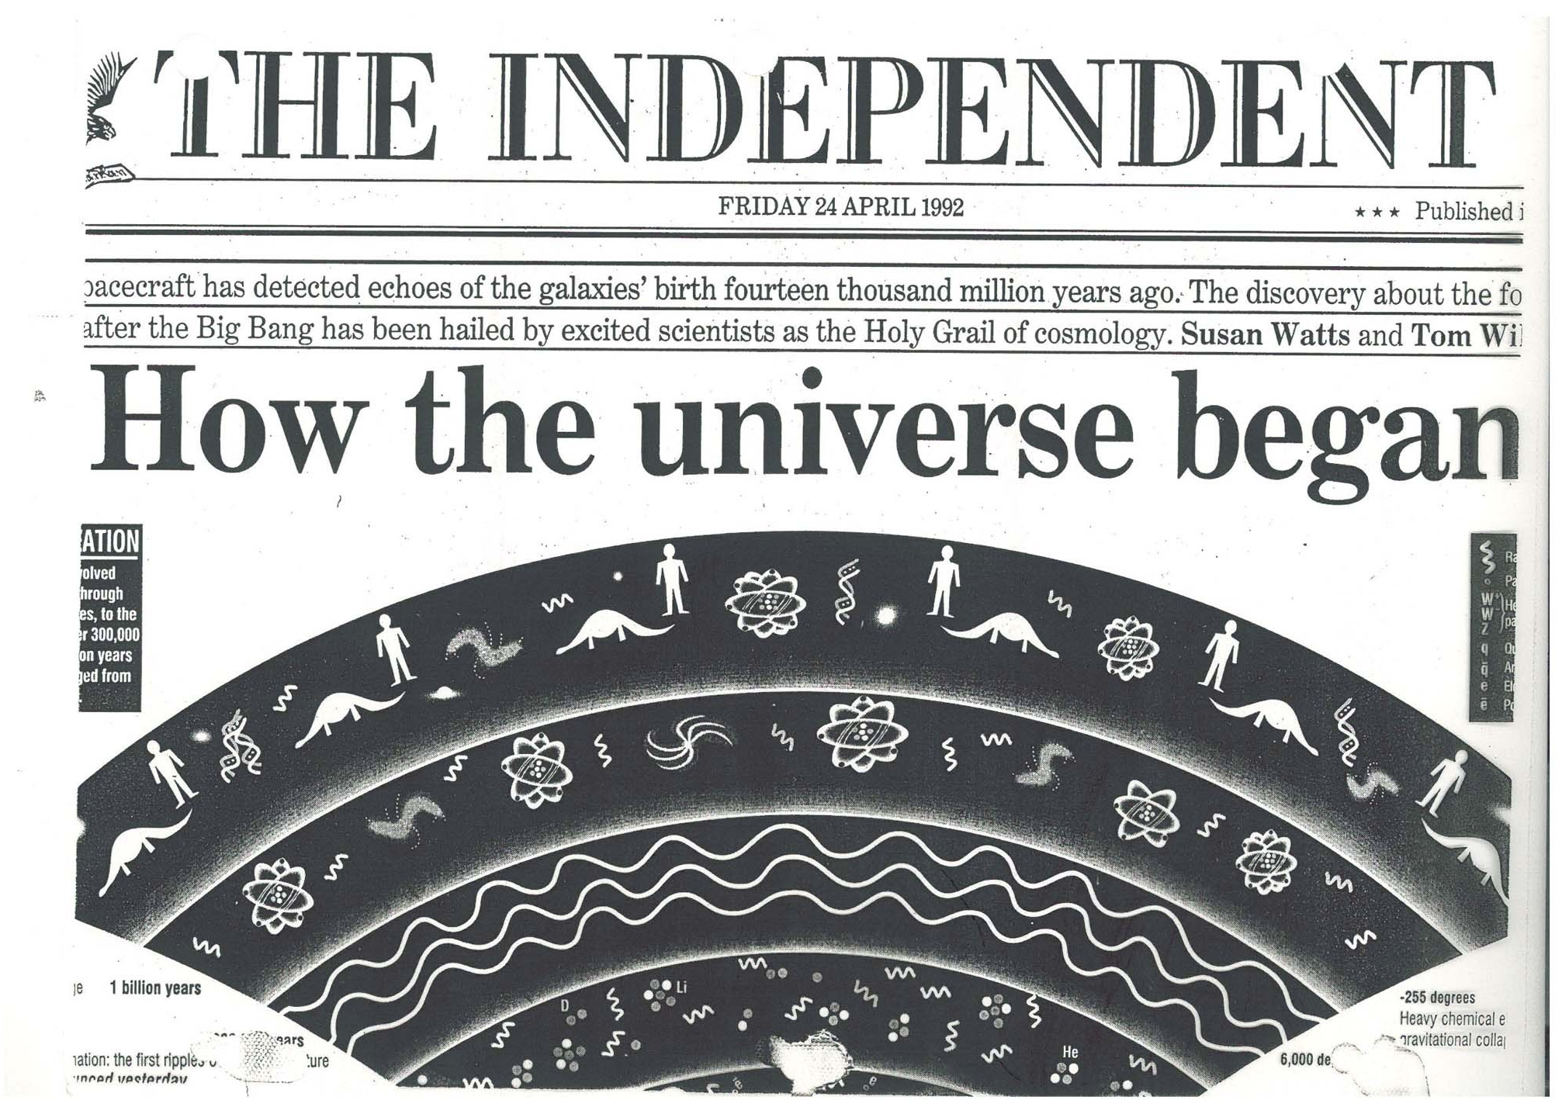

Slide 42
To understand the first three minutes…
no theory can ever be verified, rather we can hope to show
that it passes all challenges….and makes verifiable predictions
What we have so far
beginning of universe, its size, flatness of space, fluctuations…
What next
dark matter? Dark energy? fine-tuning? multiverse?
New data could be transformational
e.g. gravity waves, proton decay, primordial black holes….
maybe there’ll be a new theory some day

