Slide 1
medieval carols
Jeremy Summerly

Slide 2
Crystmas:
‘Here have I dwellyd with more and lasse
From Hallowtyde till Candylmas’.
Christmas stretched from
All Hallows (1 Nov)
to Candlemas (2 Feb)
26 December St Stephen
27 December St John the Evangelist
28 December Holy Innocents
29 December St Thomas of Canterbury
1 January Holy Name of Jesus
6 January Epiphany

Slide 3
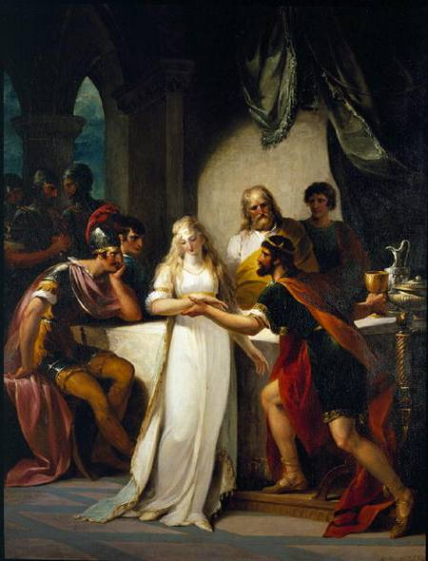
Saxon maiden Ronwein
successfully seduces
British warlord Vortigern
‘Waesheil / Drincheil’
Historia Regum Britanniae
(History of Kings of Britain)
Geoffrey of Monmouth c1136

Slide 4
Carolisation
Recognition
Modernisation
Relocation

Slide 5
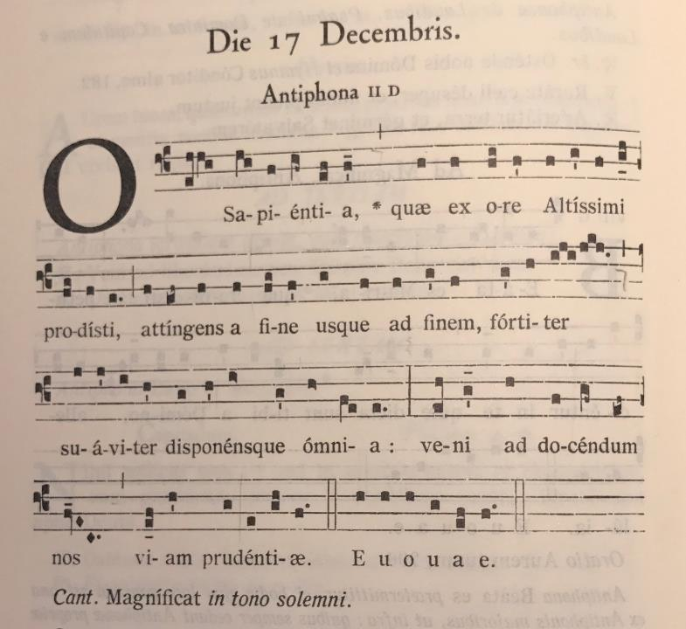

Slide 6
Great ‘O’ Antiphons
O Sapientia – wisdom
O Adonai – Hebrew name for God
O Radix Jesse – root of Jesse (father of King David)
O Clavis David – key of David
O Oriens – morning star
O Rex gentium – King of nations
O Emmanuel – God with us
ERO CRAS – I will be present tomorrow

Slide 7
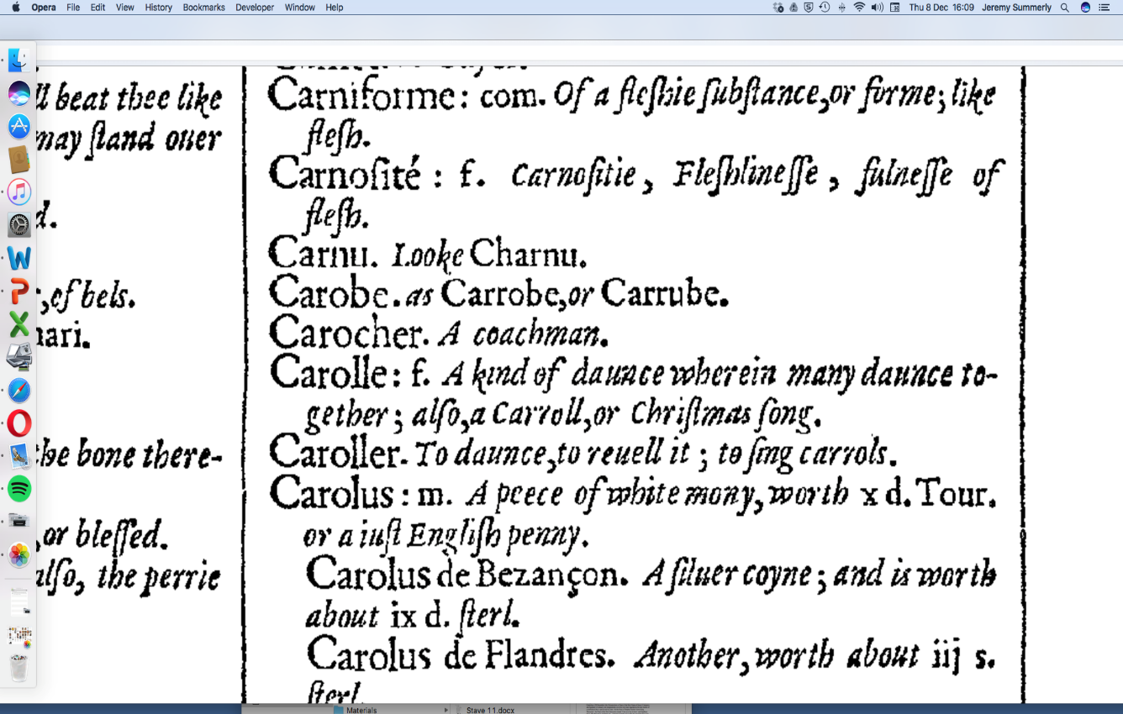

Slide 8
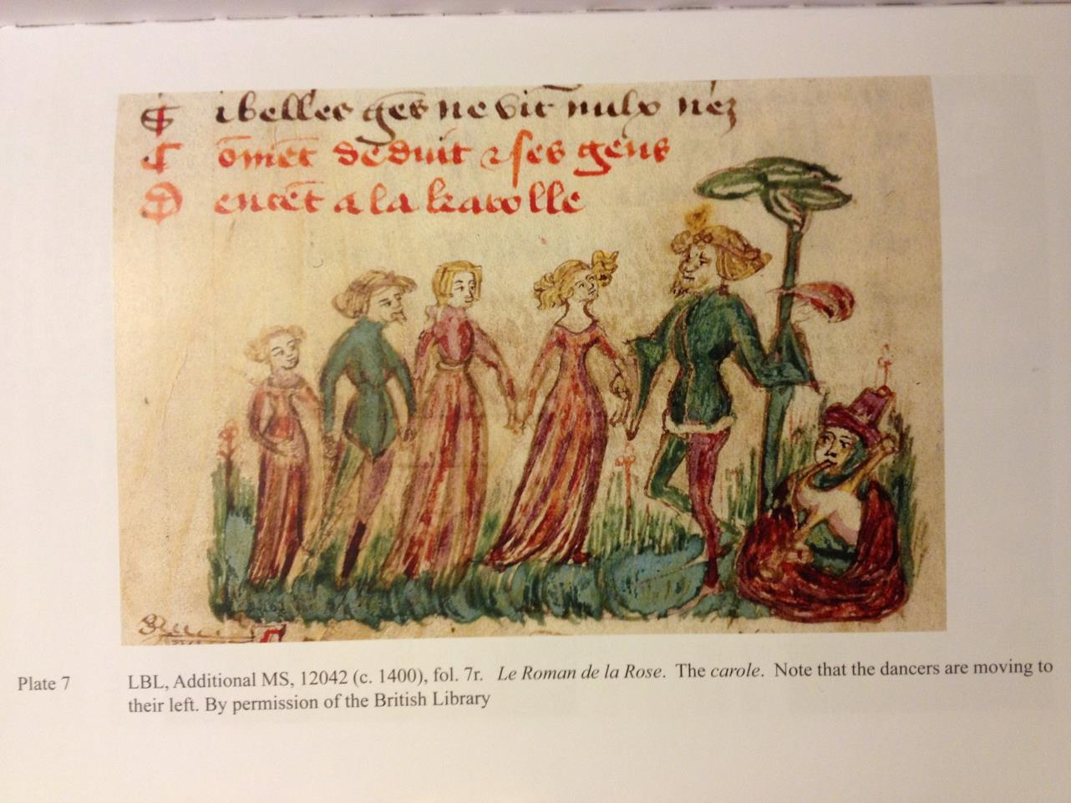
Notes:
Dancers moving to their left

Slide 9
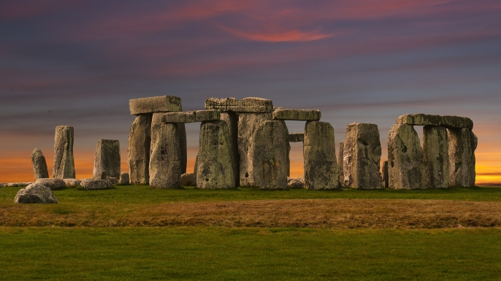

Slide 11
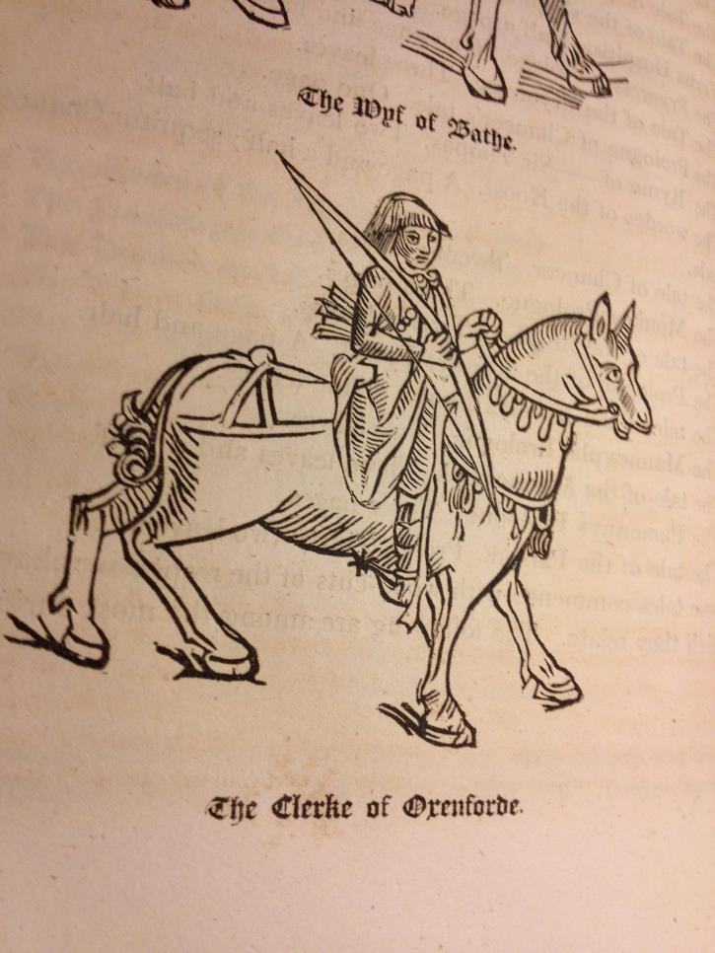

Slide 12
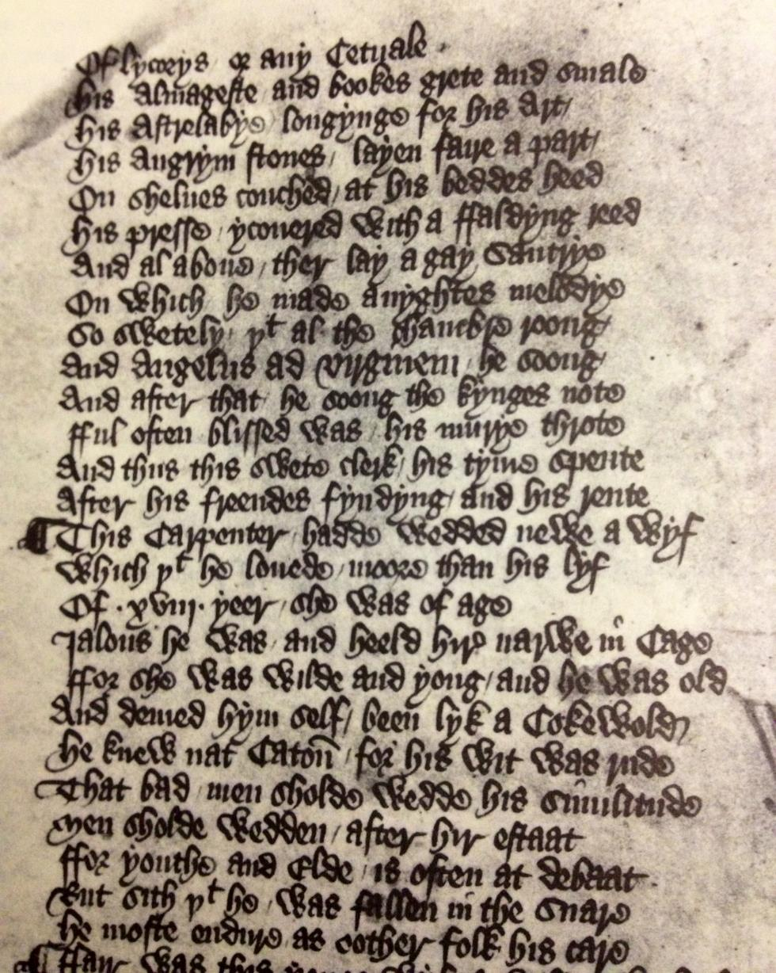

Slide 13
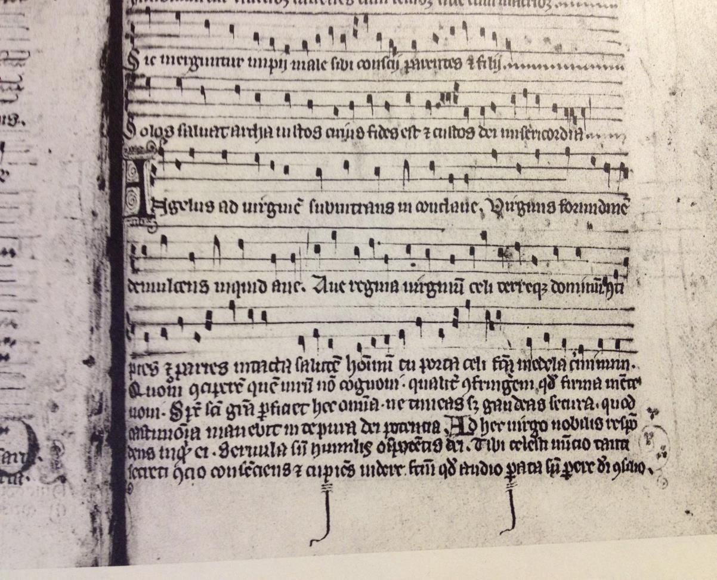

Slide 14
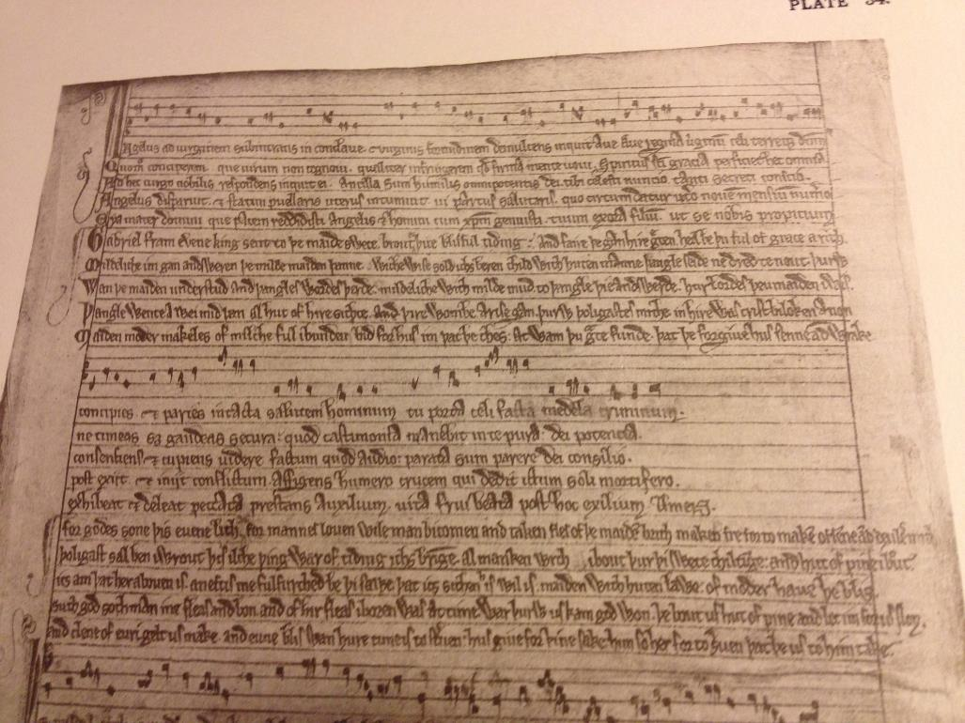
Notes:
GB-Lbl Arundel 248

Slide 15
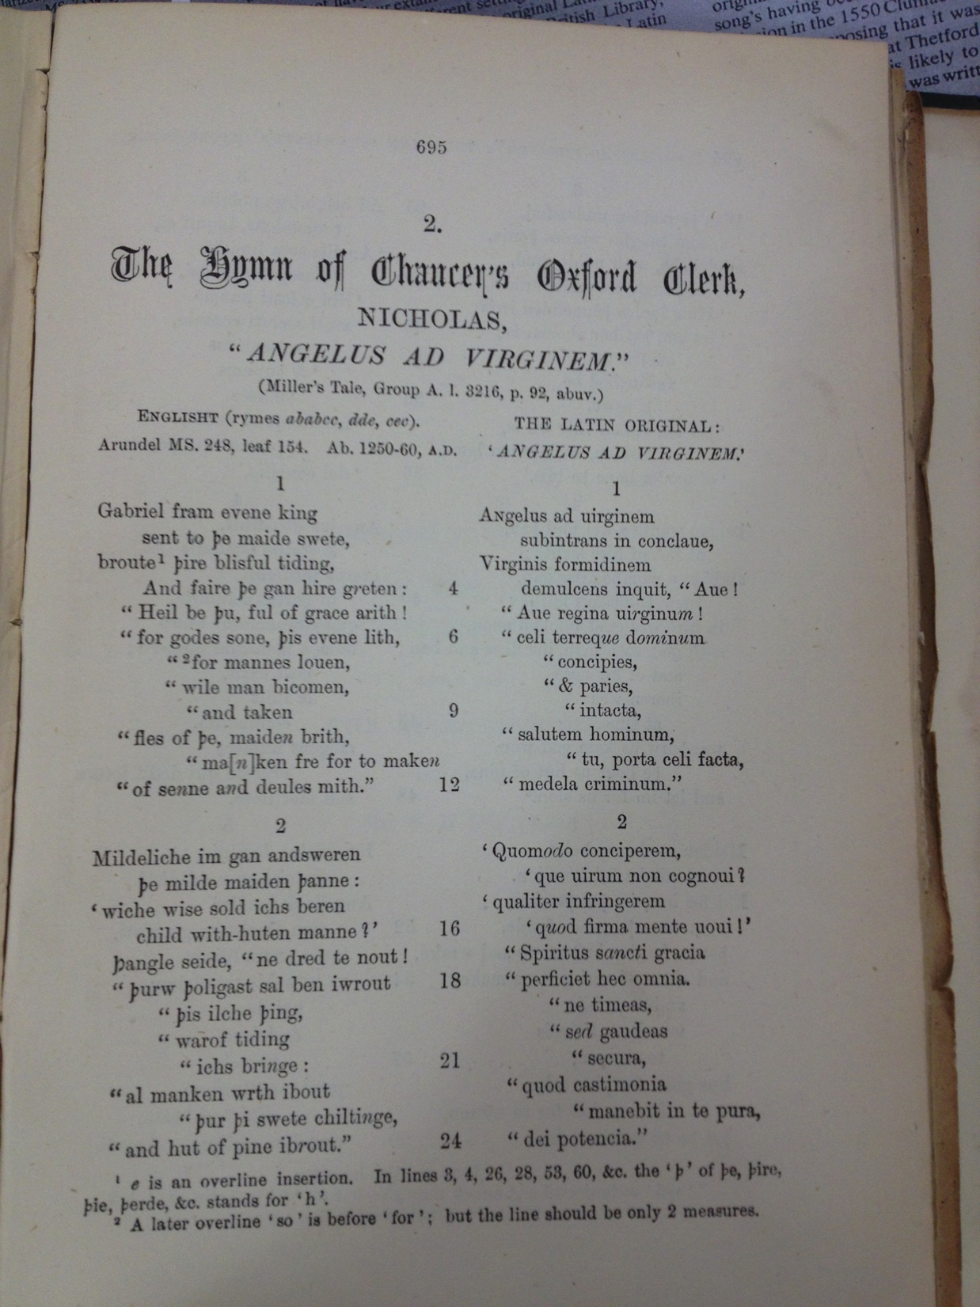

Slide 16
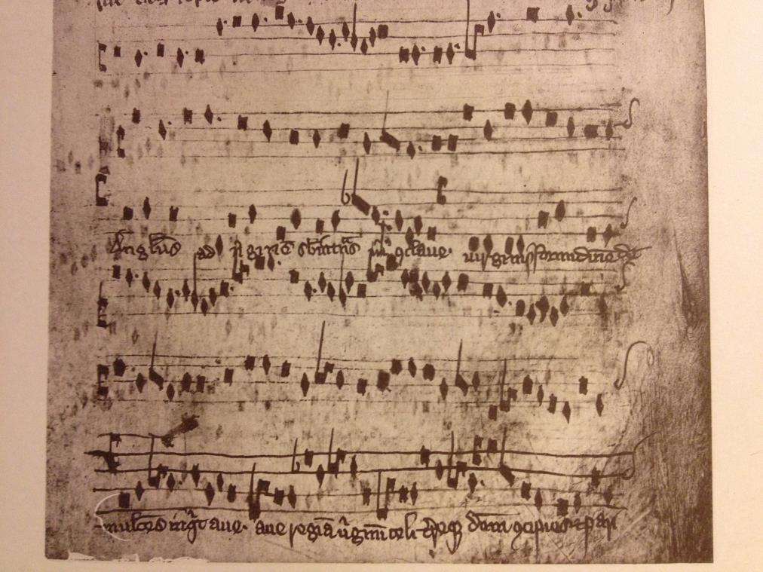

Slide 17
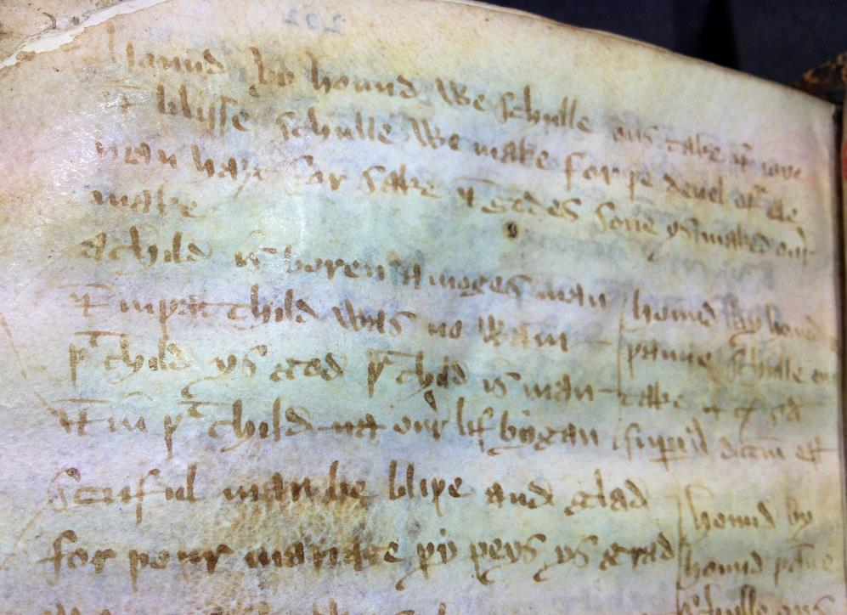
Notes:
GB-Ob Bodley 26

Slide 18
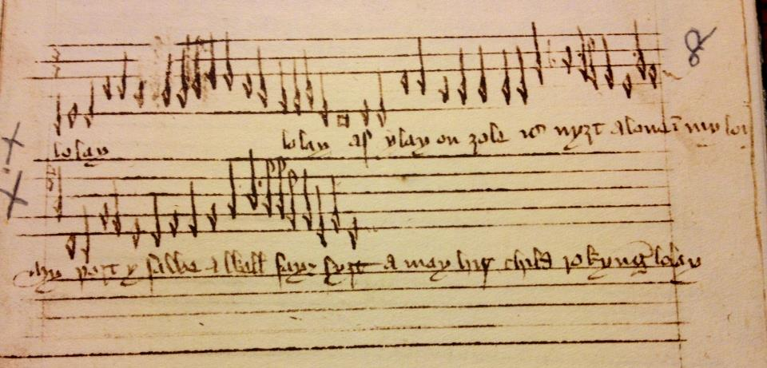

Slide 19
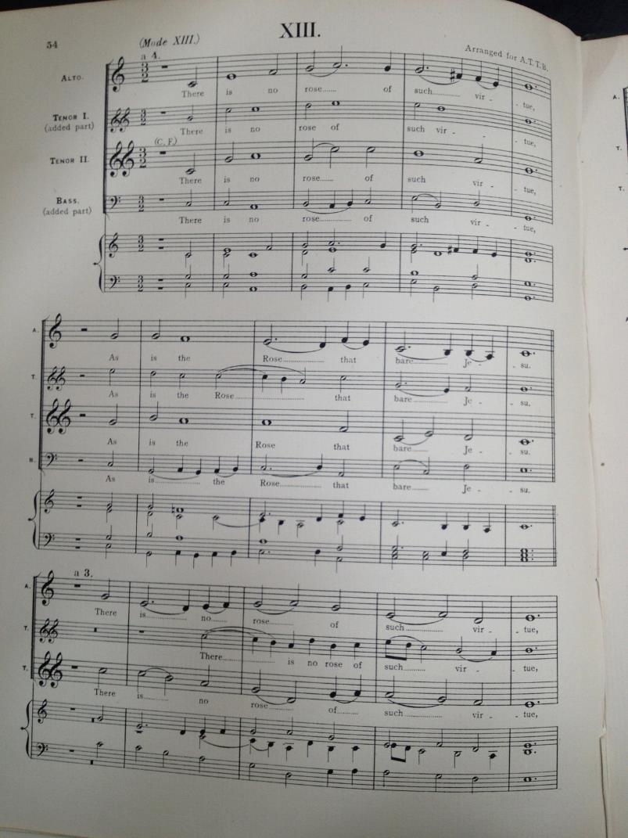

Slide 20
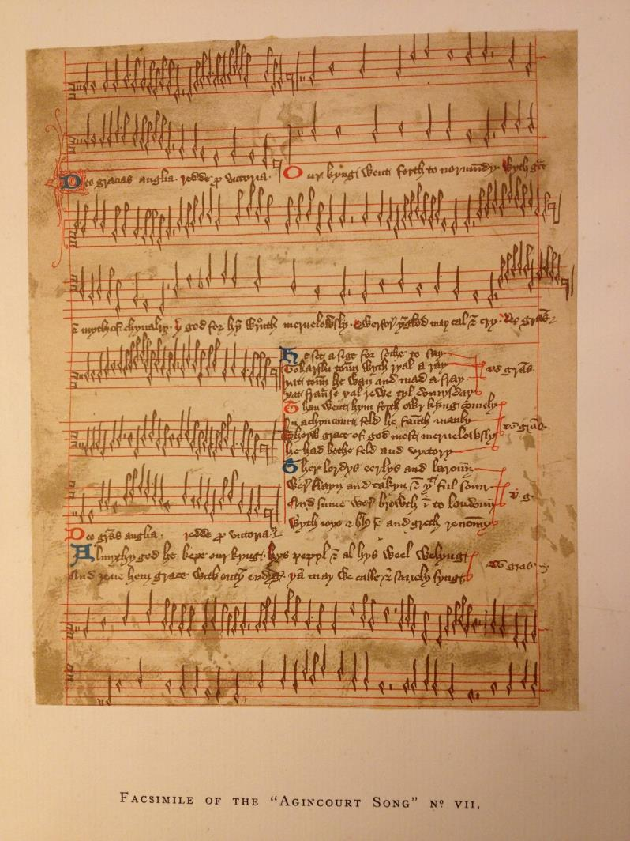

Slide 21
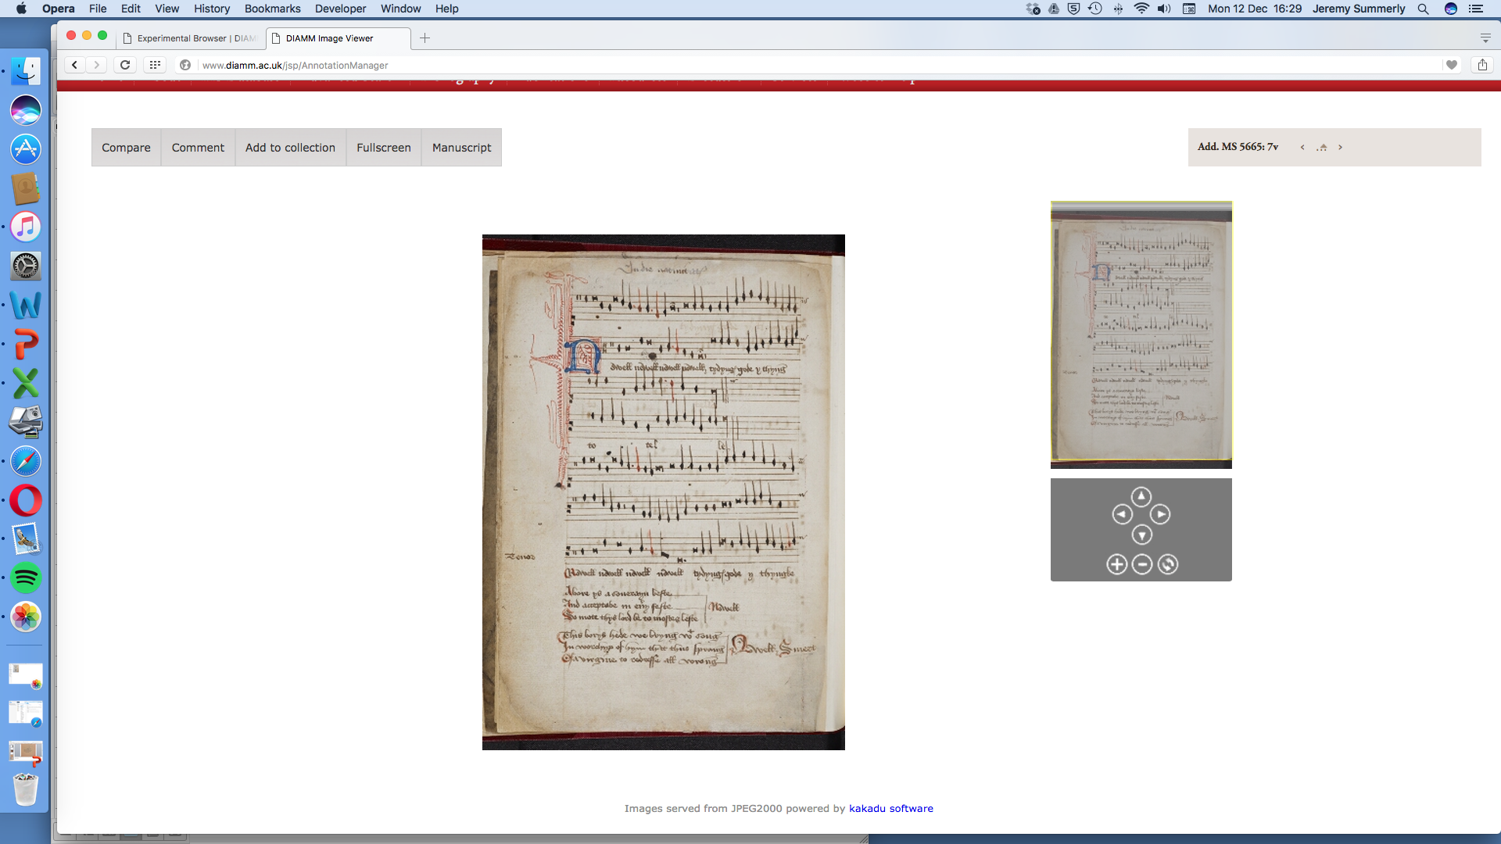

Slide 22
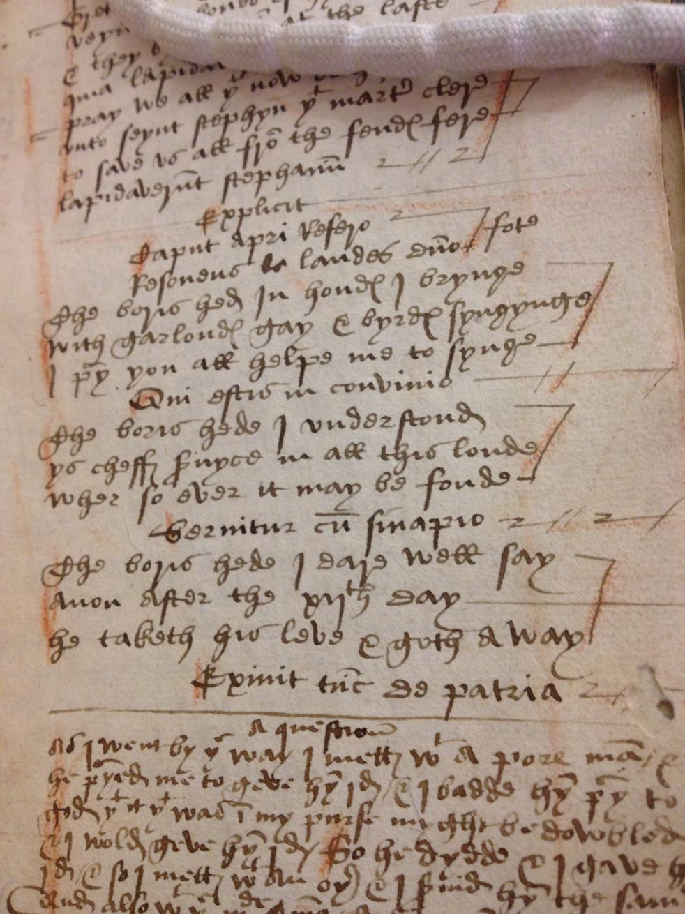

Slide 23
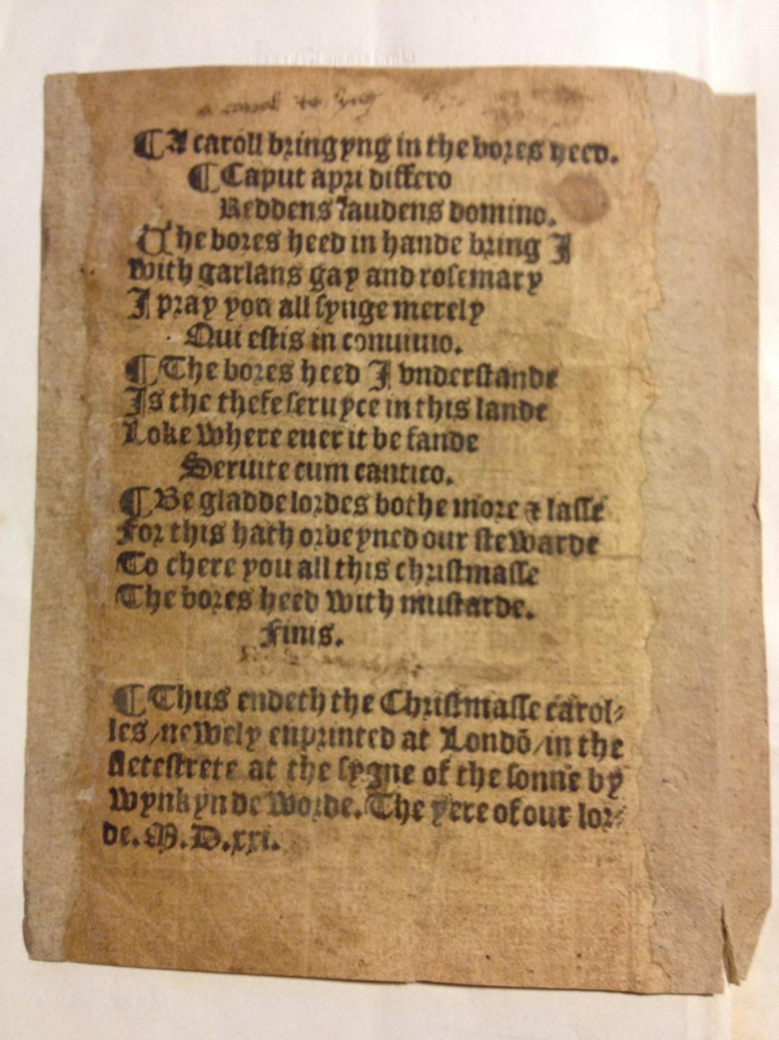

Slide 24
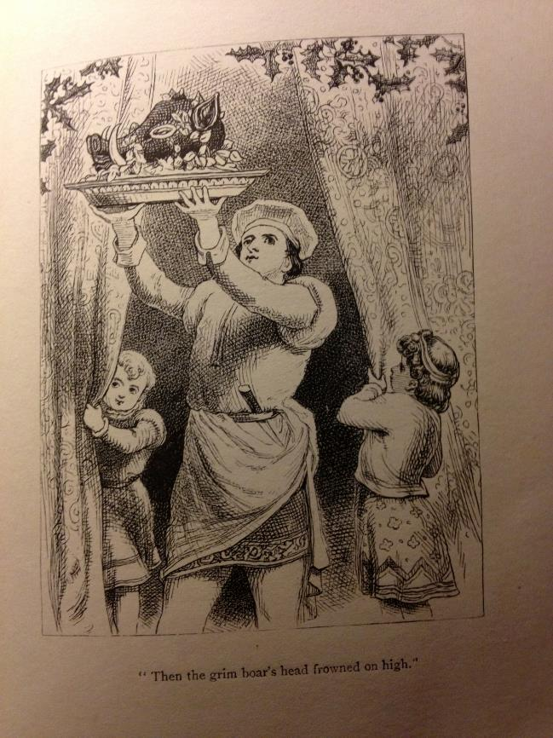
Notes:
A. H. Bullen – A Christmas Garland

Slide 25
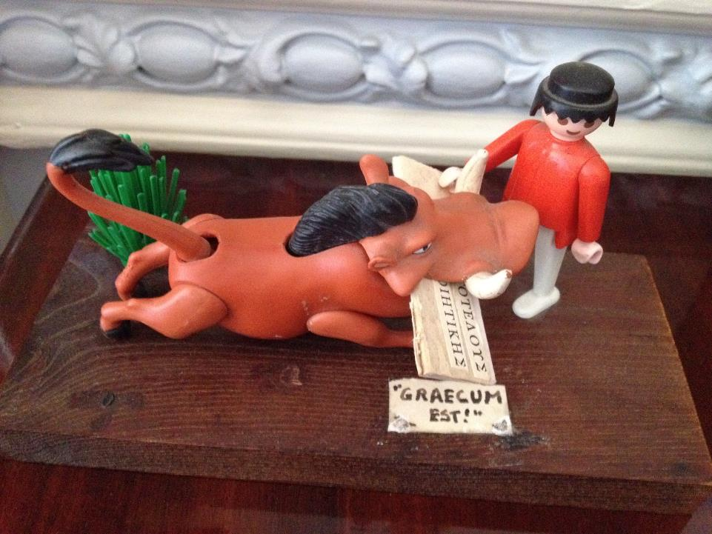

Slide 26
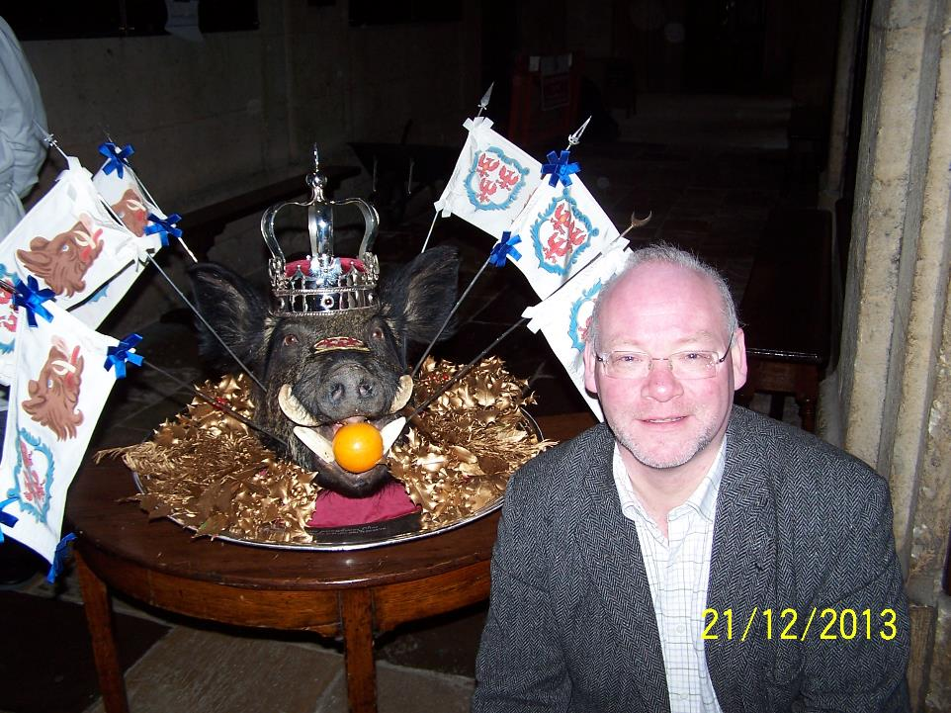

Slide 27
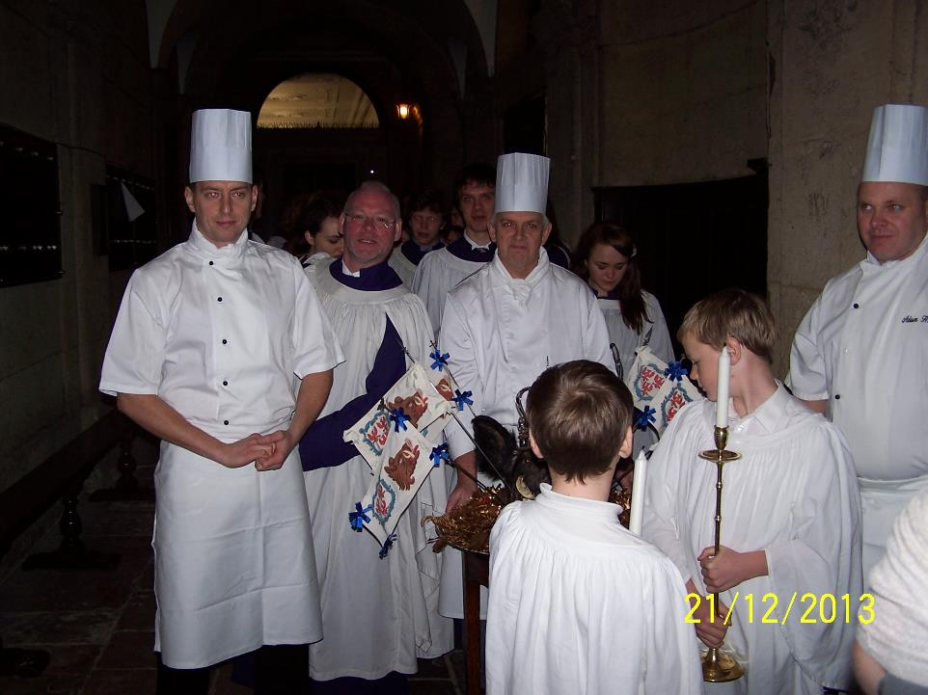

Slide 28
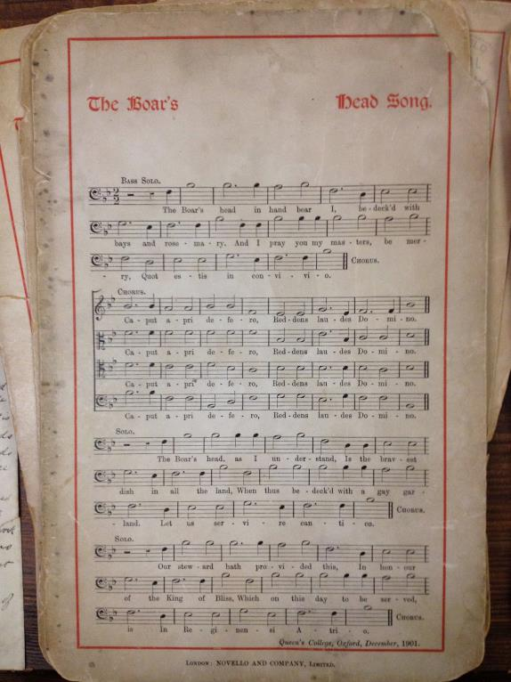

Slide 29
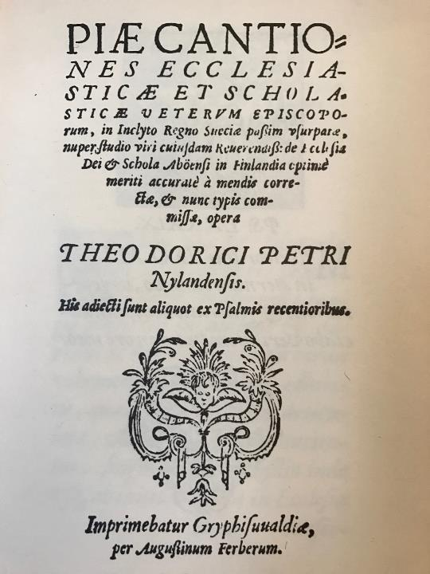

Slide 30
