Slide 1

Something in the Air: the insidious challenge of air pollution
Carolyn Roberts
Frank Jackson Professor of Environment
and
Water and Environmental Consultant

Slide 2
Successes?

Slide 3
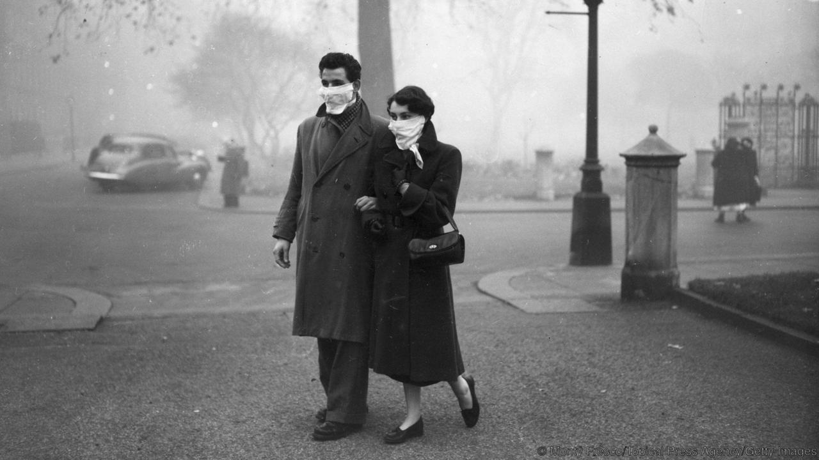
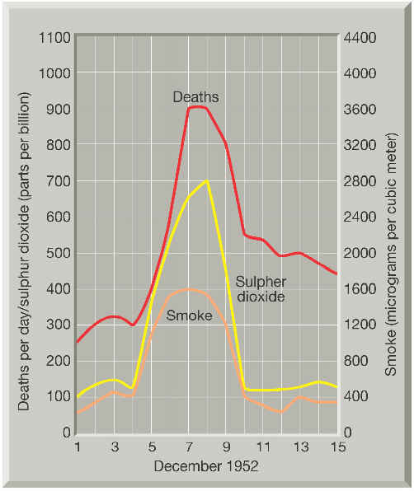
London Air Pollution in the 1950s
A couple walks the streets of London in November 1953; nearly a year after the Great Smog, masks were still necessary (Credit: Monty Fresco/Topical Press Agency/Getty Images. BBC image)

Slide 4
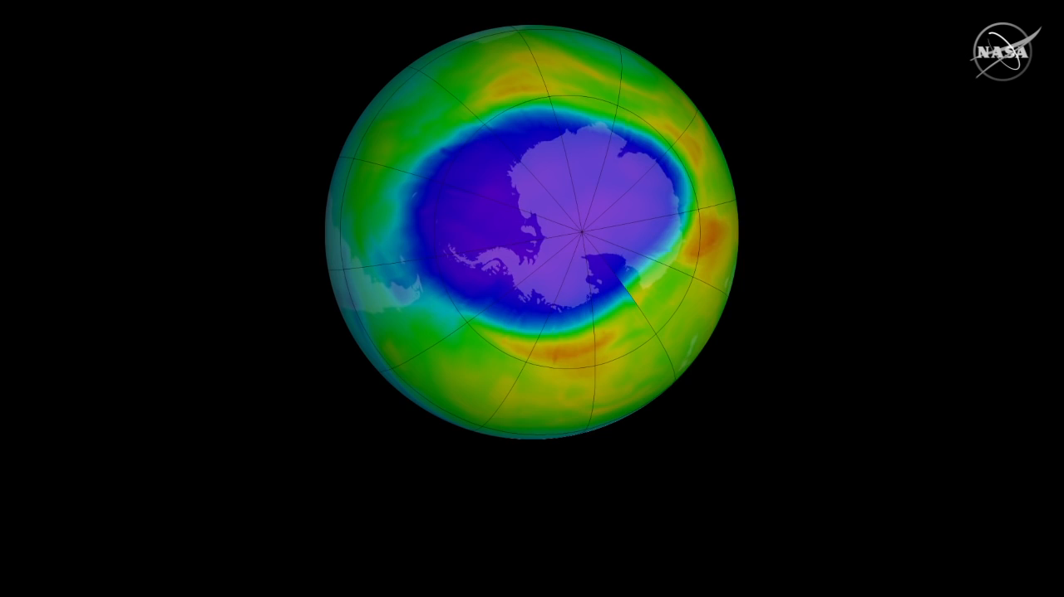
Antarctic ozone hole monitoring

Slide 5
Antarctic ozone hole monitoring

Slide 6
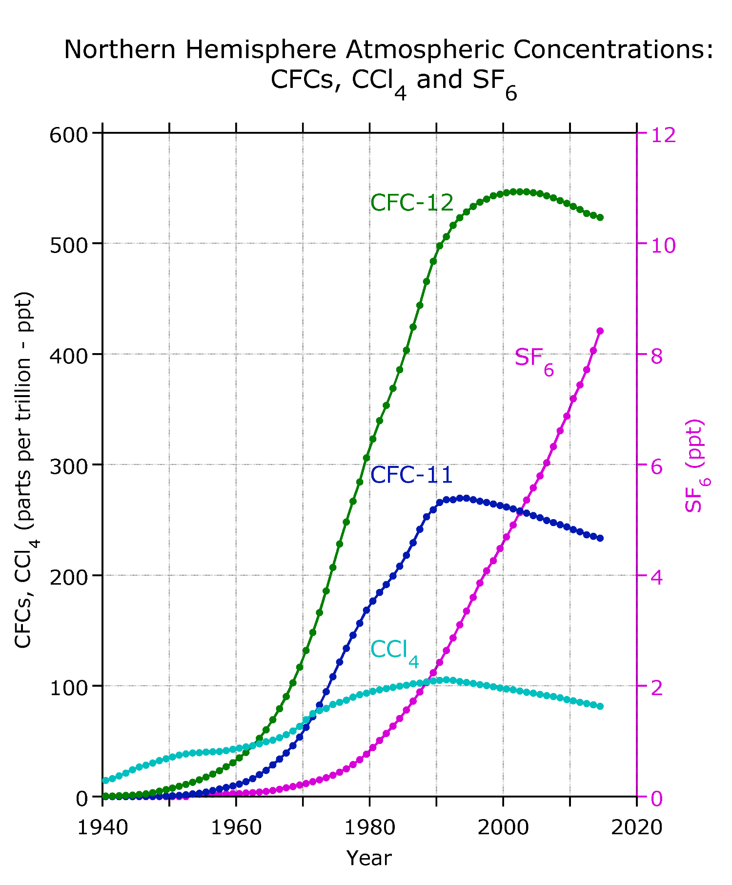

The ozone hole has shrunk, on average, by about 4m sq km since 2000. Measurements are made in September in each year, when the ozone hole starts to open. US and UK scientists found that the phase-out of chlorofluorocarbons means that the ozone layer is “expected to recover in response, albeit very slowly.” CFCs can linger for more than 50 years, so the ozone hole will not be considered healed until 2050 or 2060.
Lead: Professor Susan Solomon, MIT
Scientists measuring Antarctic solar radiation in October 2015, when the ozone hole reached a record size due to Chilean volcanic activity. (Photograph: Felipe Trueba/EPA)

Slide 7
Continuing problems?

Slide 8

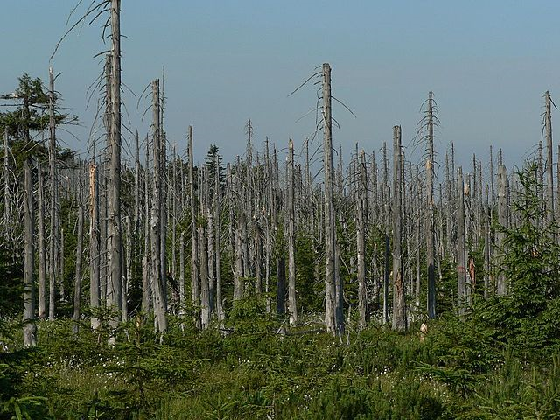
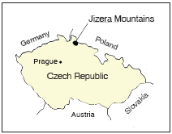
Pine Forest in the Black Triangle in Czech Republic, allegedly damaged by acid rain
By Lovecz - Own work, Public Domain, https://commons.wikimedia.org/w/index.php?curid=938073

Slide 9
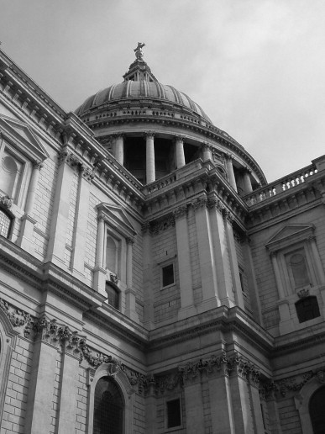
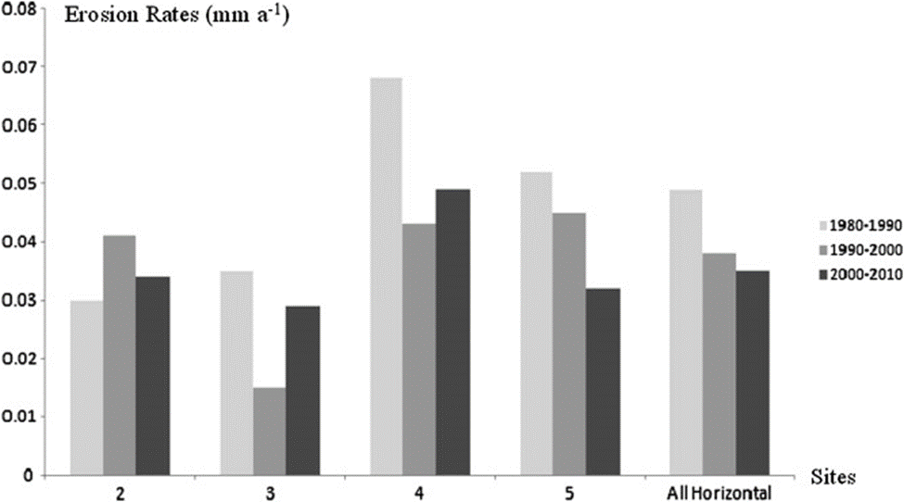
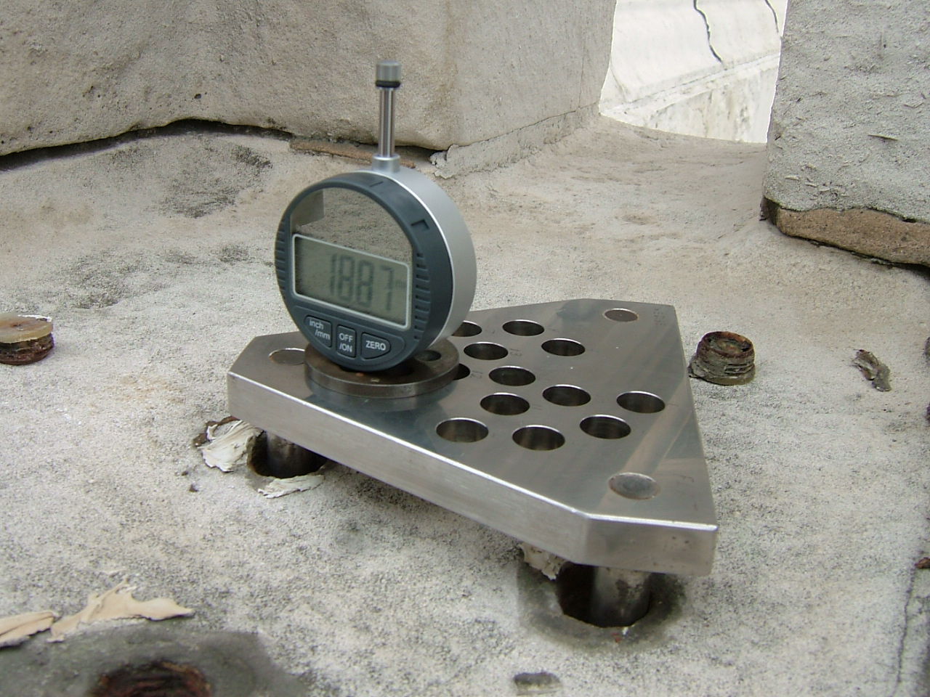
Acid rainfall-induced surface erosion rates on St Paul’s Cathedral have fallen by about 45% since researchers began monitoring in 1980, and by about 50% since construction
R.J. Inkpen, H.A. Viles, C. Moses, B. Baily, P. Collier, S.T. Trudgill, R.U. Cooke, Atmospheric Environment, 2012
Micro Erosion Meter on balustrade for 30 year experiment

Slide 10
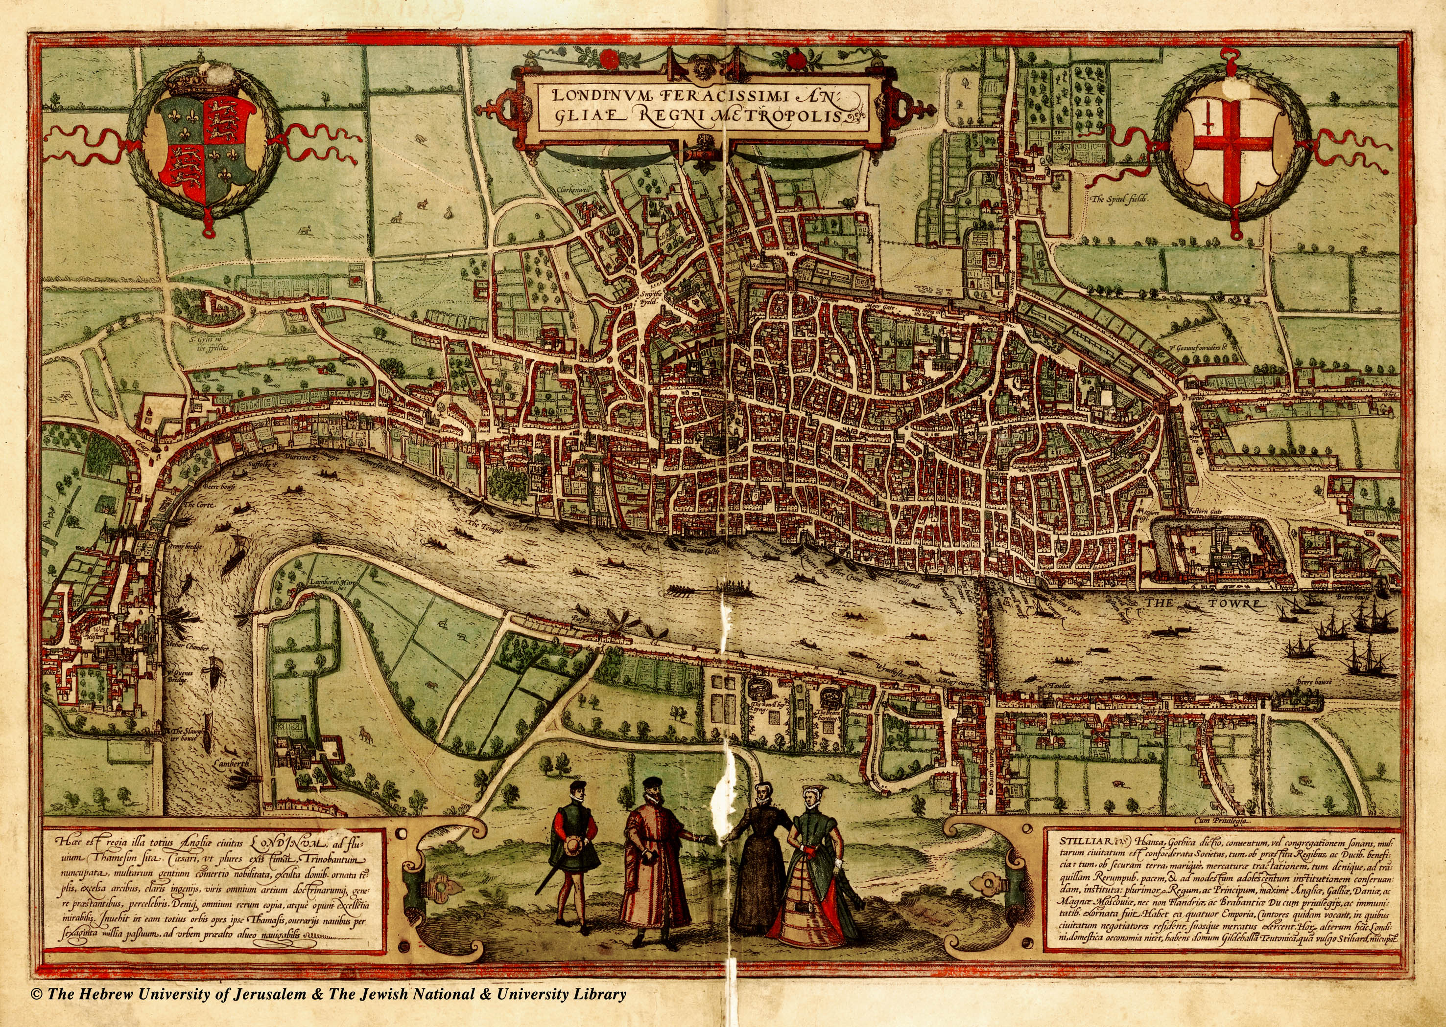
St Paul’s
Barnard’s Inn Hall
Braun and Hogenberg Civitates Orbis Terrarum, c. 1560-72

Slide 11
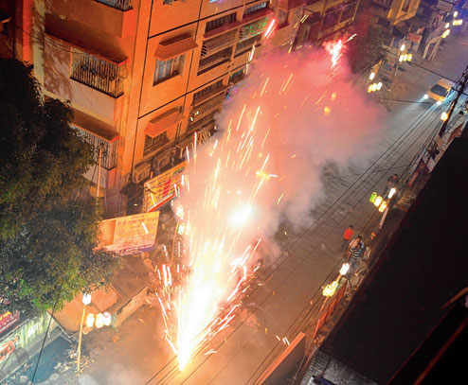
Divali air pollution - A smoke-spewing sparkler in Baguiati, India at Diwali 2013
Picture by Amit Datta, Calcutta Telegraph

Slide 12
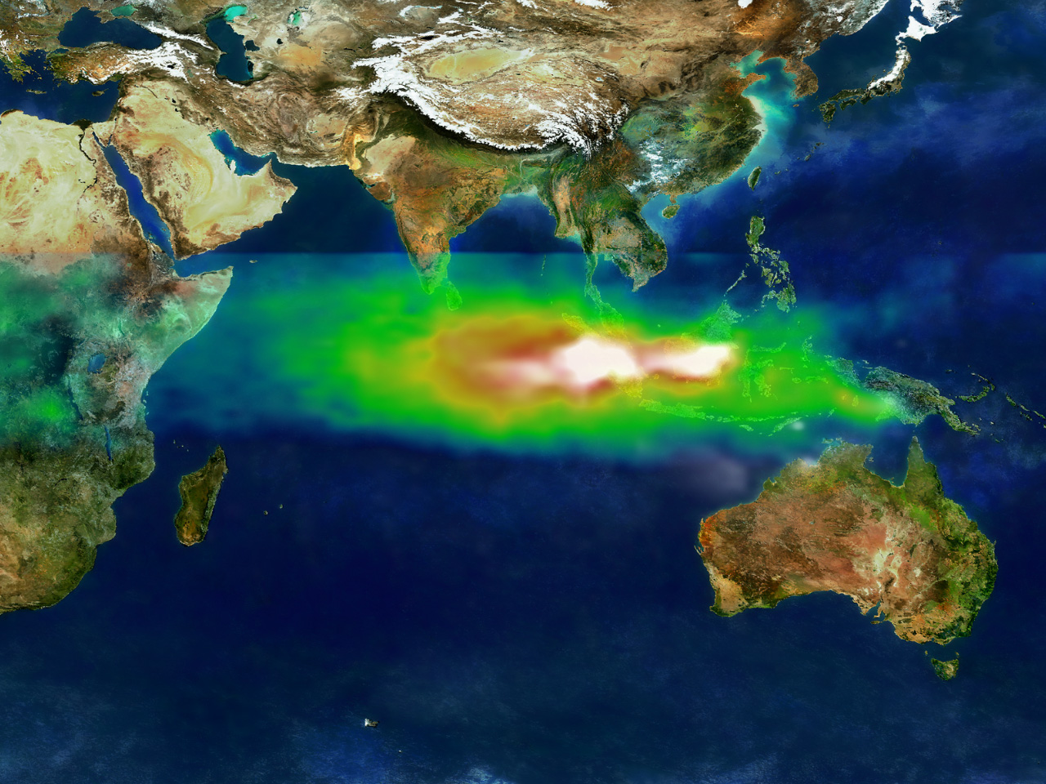
Pollution over the Indian Ocean on October 22, 1997. NASA tracked it using data from the Earth Probe Total Ozone Mapping Spectrometer satellite instrument.
White represents the aerosols (smoke) that remained in the vicinity of the fires. Green, yellow, and red pixels represent increasing amounts of tropospheric ozone (smog) being carried to the west by high-altitude winds.
NASA image

Slide 13
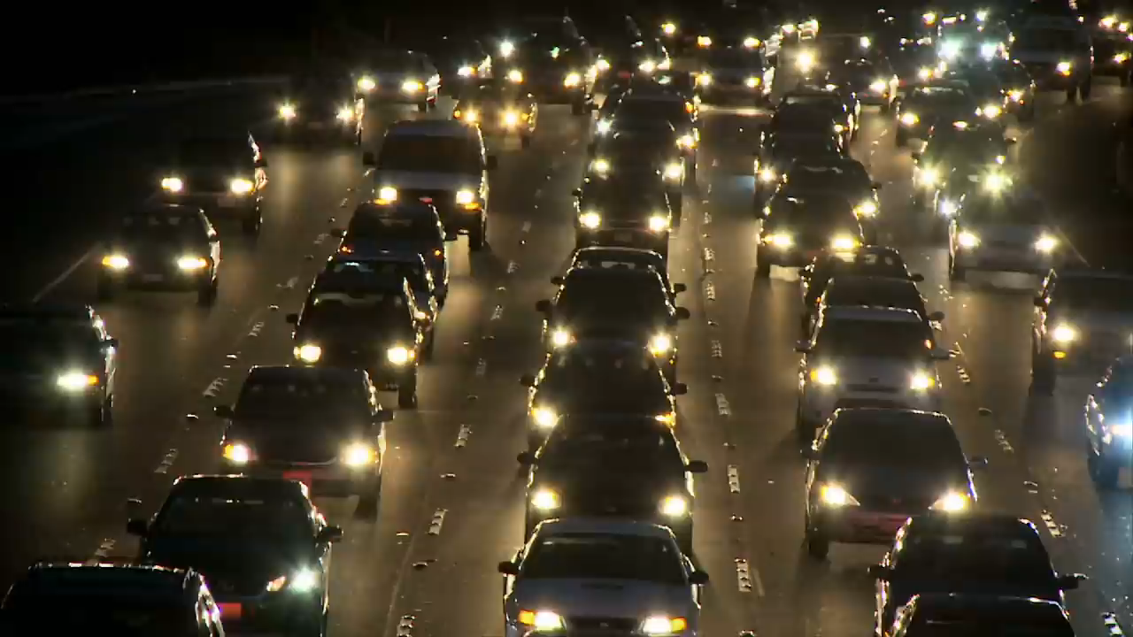

Slide 15
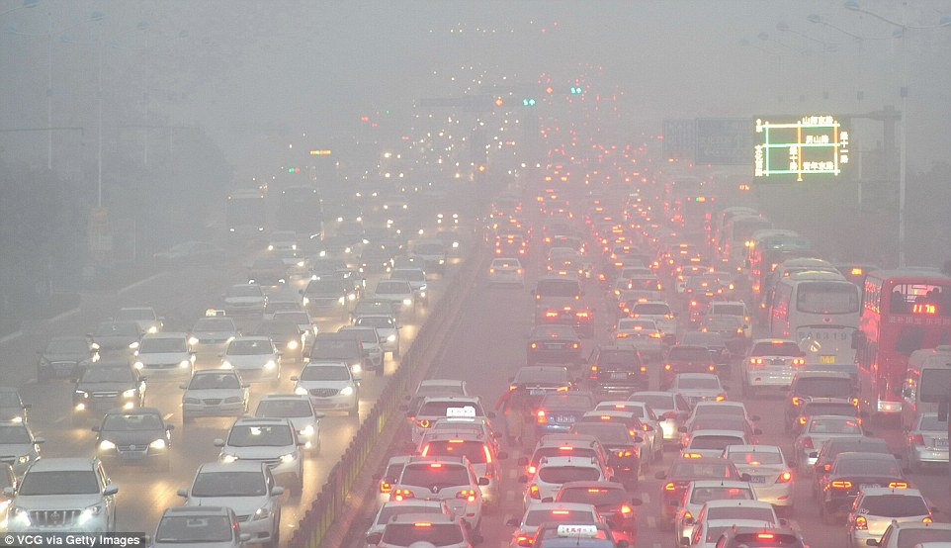
Daily Mail online image of Shandong, Northern China, 19th December 2016

Slide 16
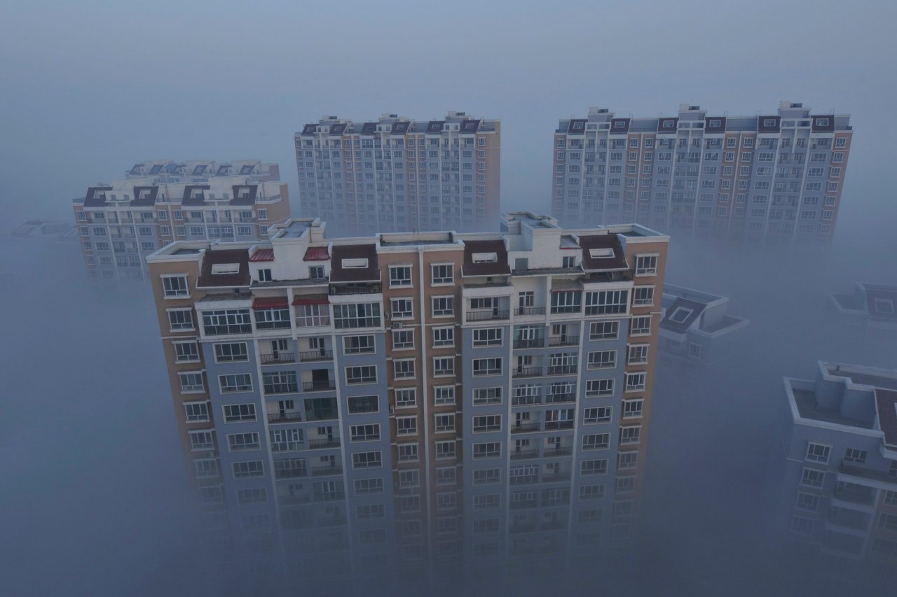
Reuters online image of apartment blocks in Wujiaqu, China

Slide 17
Global patterns

Slide 18
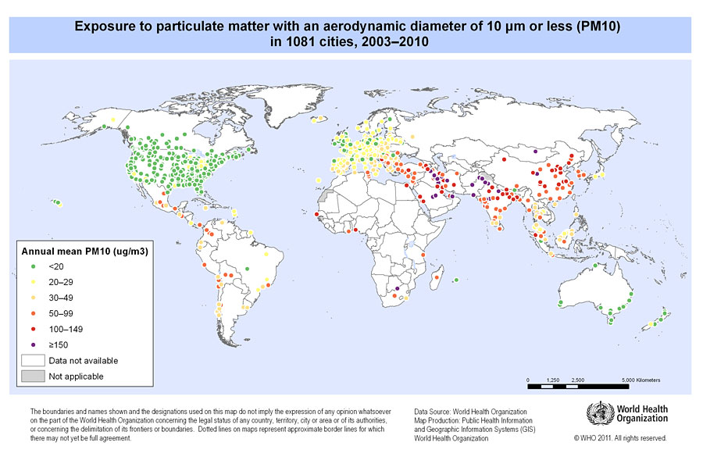

Slide 19
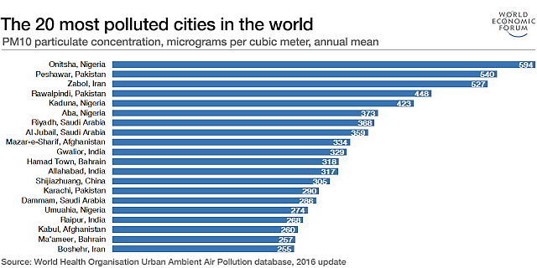
PM₁₀ Particulates and global cities
PM₁₀ is particles less than ten microns across

Slide 20
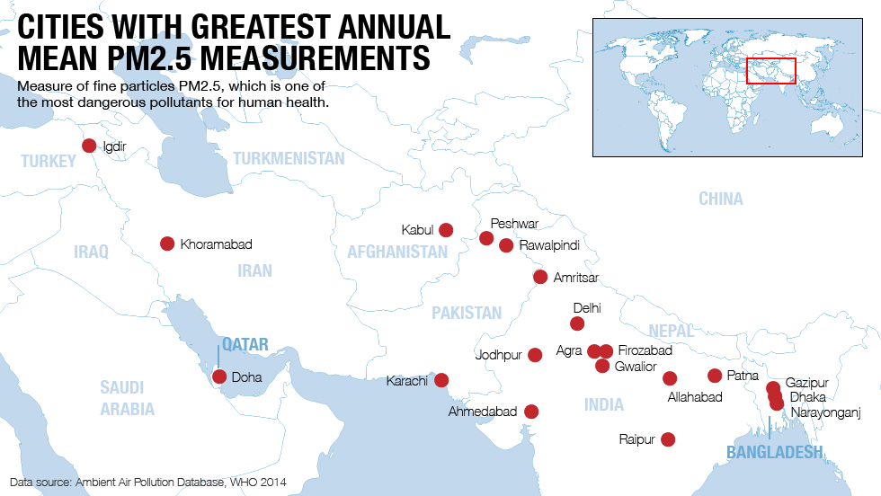
PM_{2.5} Particulates and global cities
PM_{2.5} is particles less than 2.5 microns across, which are readily inhaled

Slide 21
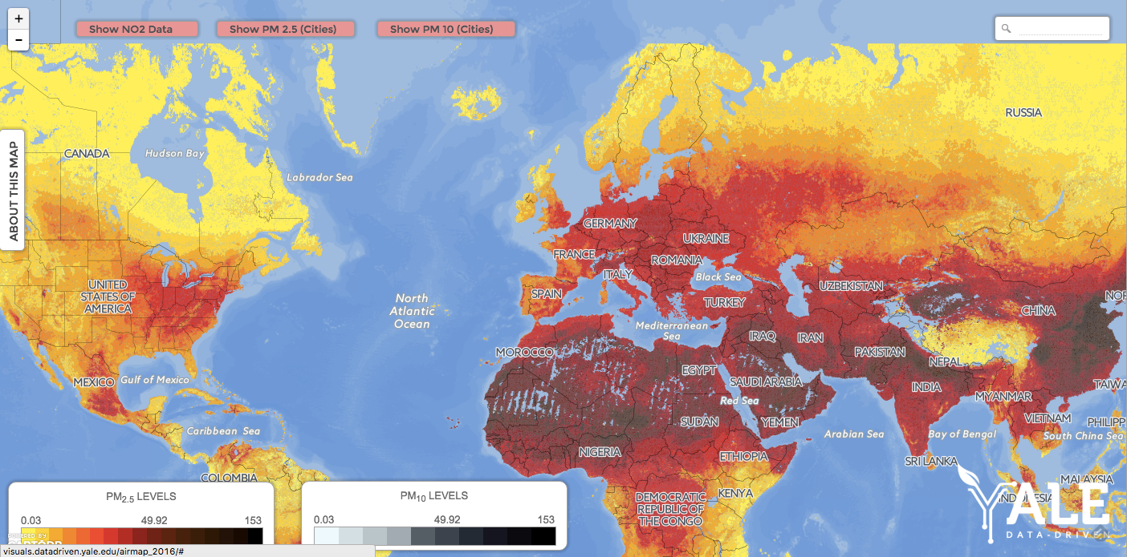
Global PM_{2.5} (yellow/red) and PM₁₀ (dark) levels
The WHO study, using data from 2012, demonstrated that there were an estimated 6.5 million deaths per year around the world linked to air pollution. Representation by Yale University

Slide 22
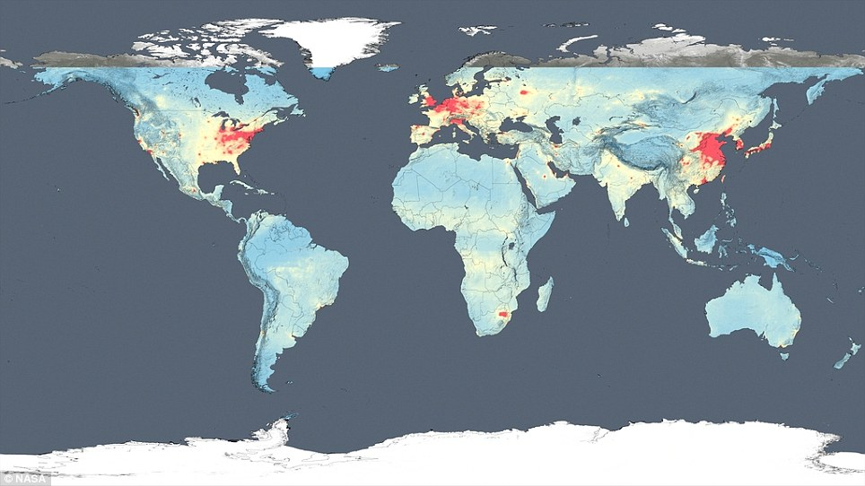
NO₂ global map, based on observations made from 2005 to 2014 by the Dutch-Finnish monitoring instruments aboard Nasa's Aura satellite

Slide 23
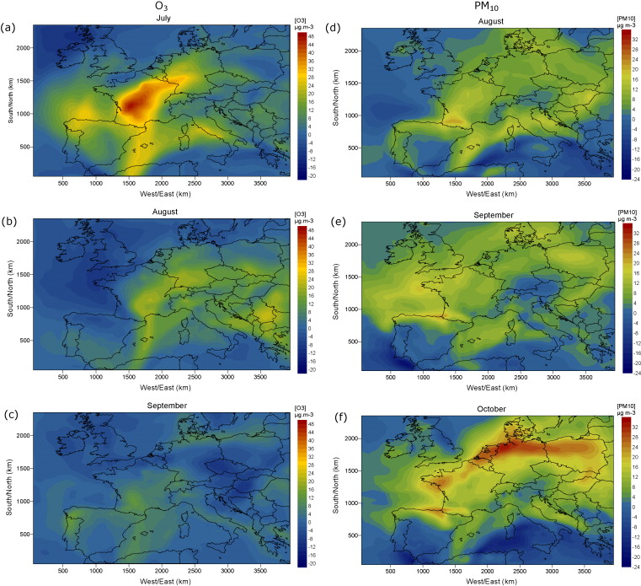
Atmospheric modelling at regional scale is well developed

Slide 24
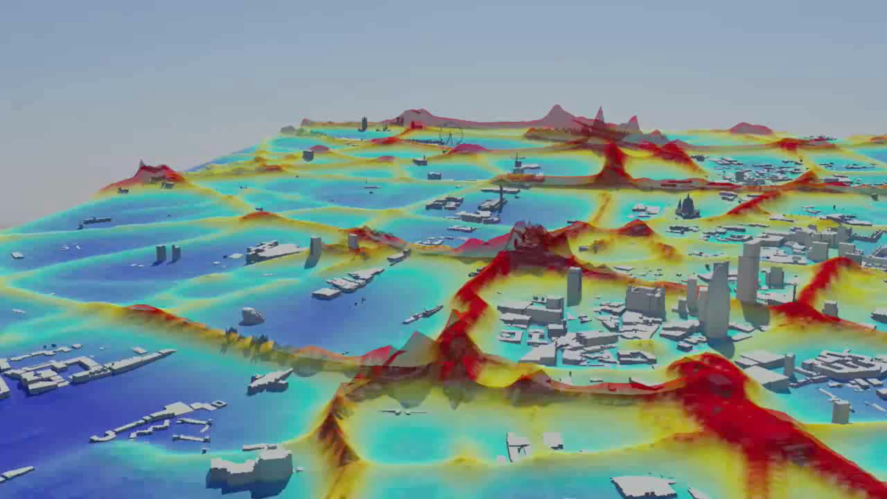
3D visualisation of London air pollution

Slide 25
3D visualisation of London air pollution

Slide 26
Does it matter?

Slide 27
The cost of air pollution
World Bank estimated the cost of lost work days and social costs at $5.4 trillion per year.
Direct costs have been variously estimated by the World Health Organisation as in the billions$
A great deal more cost is probably hidden
Much of the cost relates to health problems and deaths, the implications of which are usually externalised, or felt in ‘other’ budgets

Slide 28
The cost is staggering!
$5.4 Trillion per year
World Bank estimate, 2013

Slide 29
Plant scent plumes, sensitised by bees, modified by air pollution at three different concentrations. (Left β-myrcene; right β -caryophyllene). Fuentes et al, 2016.

Slide 30
Reported health problems, particularly from PM_{2.5} and NO₂
Ischaemic heart disease
Lung and respiratory diseases such as bronchitis and asthma
Strokes
Cancers
Dementia? As many as 11% of dementia cases in people living within 50m of a major road could be related to air quality. A Lancet study followed nearly two million people in the Canadian province of Ontario, between 2001 and 2012. The brain pathology mechanism is uncertain.
7% higher within 50m
4% higher between 50-100m
2% higher between 101-200m
Loss of ability to concentrate amongst school children and others
There is very strong research evidence for most of these impacts

Slide 31
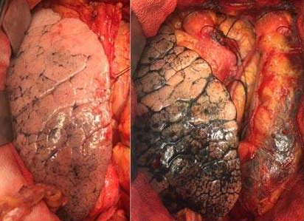
Comparison of a relatively healthy lung, and the lung of a Delhi resident
Photograph in ‘India Today (New Delhi), October 16th 2016

Slide 32
Solutions?

Slide 33
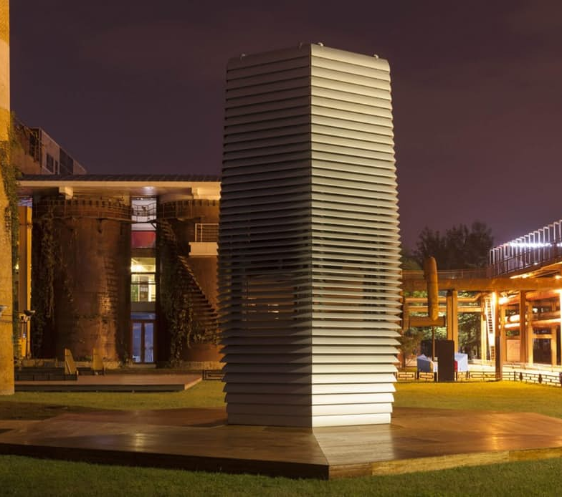
The Smog-Free Tower – ‘360 degree bubbles of clean air’ in Rotterdam, Amsterdam and Beijing
Debuting in the Dutch cities of Rotterdam and Amsterdam in 2015, this Smog-Free Tower opened in Beijing, China, in September 2016 and in 41 days, cleaned 30 million m³ of air, about 10x the volume of Beijing's Bird's Nest stadium.
From that, it is said to have captured billions of the finest harmful airborne particles (those 2.5 micrometers (µM) or less) during that time, and over 75 percent of particles between 2.5 µM and 10 µM in size in the vicinity of the tower
(Credit: Studio Roosegaarde)

Slide 34
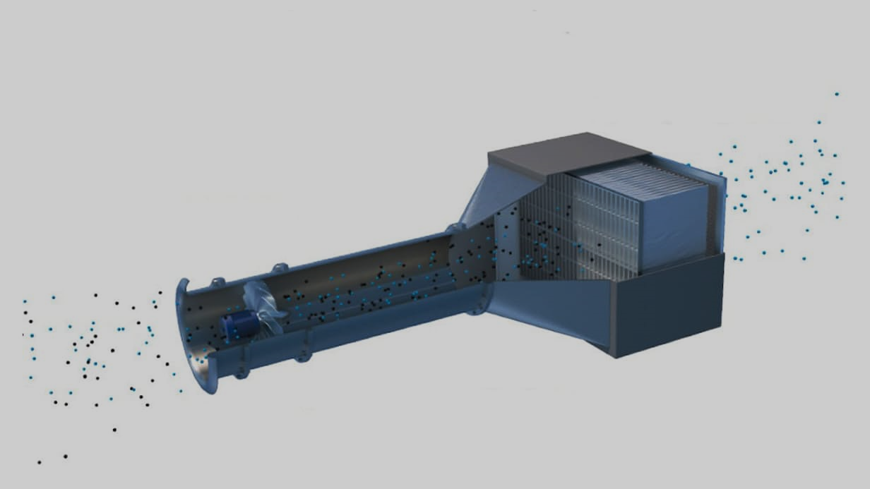
Envinity Group’s outdoor vacuum cleaner is designed to sit on a rooftop in populated areas, or near sources of pollution like factories, and pull in 80,000 cubic meters of air per hour (32 Olympic swimming pools). Its reach extends as far as 300 m around it and 7 km directly upwards.
According to the company, a series of sub-processes filters out 100 % of fine particles and 95 % of ultra-fine ones, leaving the air compliant with European legislation.
The system was unveiled at the Offshore Energy conference in Amsterdam in October 2016

Slide 35
Video on iPhone application
http://www.londonair.org.uk/london/Flash/iPhonePromotion.swf

Slide 36


Slide 37

Daily Mail online image of Jinan, Northern China, 19th December 2016
Chen et al. (2013) used the Huai River winter heating policy as a natural experiment on air pollution impact on Chinese life expectancy. They found that higher particulate matter concentrations in the north, caused by subsidized coal-based winter heating, led to a reduction of 5.5 years life expectancy relative to the south
Chinese consumers spent some £117 M on
4.5 M online transactions purchasing anti-smog products in 2013 (Sun et al, 2017)

Slide 38
So, why aren’t we dealing with it?

Slide 39
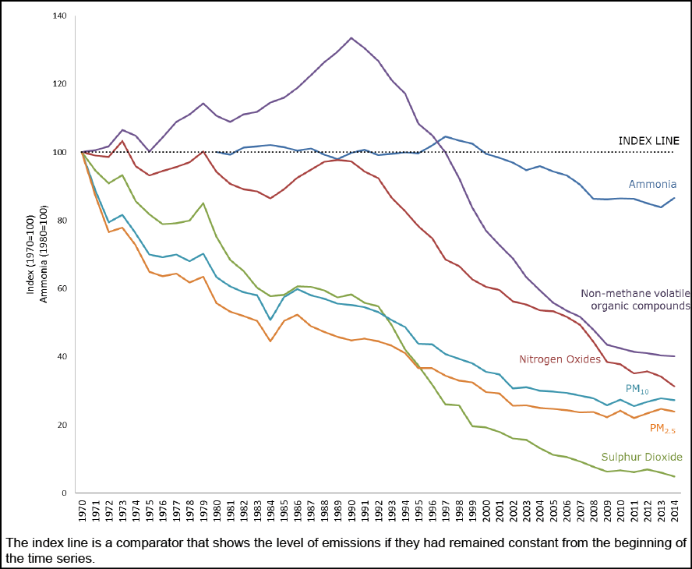
Air Quality in the UK
NB 2013 was the EU ‘Year of Air’
1956 and 1968 Clean Air Acts, on smokeless fuels
1990
Environmental Protection Act
1993 Clean Air Act
1995 Environment Act

Slide 40
Contour plot of atmospheric particle size distribution observed in Leicester on 3rd May 2014. From bottom to top, the parameters are: (i) total Particle number and volume concentrations, (ii) contour plot of particle size distributions, (iii) LDSA and eBC concentrations (iv) wind speed and relative humidity. Hama et al, 2017

Slide 41
UK issues
More than 90% of the UK’s 64.1 million population breathe outdoor air having pollution levels higher than the recommended guidelines, on a daily basis, the 2012 World Health Organisation shows
This figure is based on data from satellite measurements, air transport models and ground-level monitors
Diesel vehicles are the main culprits for nitrogen dioxide and fine particulates. ‘Safe’ limits have been reduced over the years
Brixton Road, South London, breached its annual EU air pollution limit for nitrogen dioxide only five days into 2017
In 2016, the first road to breach the EU’s limits on NO₂ was Putney High Street, which took eight days
Dirty air contributes to 16,000 UK deaths per year, based on research from the World Health Organisation

Slide 42
UK health issues
Breathing in polluted air includes the risk of respiratory and cardiovascular disease, strokes, lung cancer and other acute breathing problems
A Bath University study reported that this resulted in 16,335 deaths in the UK in 2012
7,300 were from ischaemic hearth disease, 5,000 from lung disease and 3,700 from strokes. The rest of the deaths were a combination of other lung and respiratory diseases, such as asthma
More recent Canadian research has suggested that dementia may also be linked to air quality, being more common in residents living close to main roads. In a crowded island, many UK residents do.

Slide 43

Why are there no major public protests about air pollution?

Slide 44
Why does the public not protest when the scientific and economic evidence appears clear?
Perhaps….
The public is ignorant and does not understand the risks
Experts appear to hold contradictory views about approaches
Experts are not believed; the science is ‘wrong’
Individuals suspend disbelief because it is inconvenient
The public is mislead by strong voices saying there is no problem
Cognitive dissonance – two contradictory opinions are held at the same time
Individuals are through to have no power
It is thought to be too expensive to change
Collective insanity

Slide 45
Views published by the Institution of Environmental Sciences, April 2013
Years wasted by getting more and more data…public confused…deploy advertising…’toxic and lethal’….use cars less
General public do not feel that Government will pay attention to the pressure….and are reluctant to vote for less car use…too many agencies involved
Head of Local Authority environment and electric vehicles sections
Professor and Director of Expert Committee
Poor understanding of complex science…non-sensitive individuals are uninterested….discrepancy between measured and perceived air quality…education is the key
Consultant and Public Sector specialist
We don’t look far enough ahead to evaluate a reduced life expectancy of up to six months of possibly already poor quality life
Inability to engage speculatively with the invisible and transient….Humans find it difficult to maintain interest in things that are not tangible in everyday experience….make research emotionally present
Environment Agency lead, and researcher
Researcher on atmospheric science and contemporary art

Slide 46
Influences on individual views of air pollution
Pantavou, Lykoudis and Psiloglou, 2017, based on research in Athens

Slide 47
Air pollution is another ‘Wicked’ Problem
Poorly formulated and complex
With interconnected physical/scientific and human/sociological dimensions…
Where what happens in one place and time affects what happens somewhere else, at a different time
Involving many different stakeholders…
Who don’t agree about what is important…
And who use the terminology in different ways…
And who cannot agree if the problem has been solved, or how to address it
Based on Horst Rittel and Melvin Webber, 1973

Slide 48
Press Release: Daring Cities Make Bold Air Quality Commitment To Remove All Diesel Vehicles By 2025
Mexico City, Mexico (2 December 2016) – Diesel vehicles will be removed from Paris, Mexico City, Madrid and Athens by 2025, as part of unprecedented effort by mayors to improve the quality of air for their citizens. These pioneering cities also pledged to incentivise alternative vehicles and promote walking and cycling infrastructure. The market-shifting commitment was made today at the C40 Mayor’s Summit in Mexico City. Worldwide, 3 million deaths each year are linked to exposure to outdoor air pollution according to WHO, with the vast majority of these deaths occurring in cities.
“Mayors have already stood up to say that the climate change is one of the greatest challenges we face,” said Anne Hidalgo, Mayor of Paris .“Today, we also stand up to say we no longer tolerate air pollution and the health problems and deaths it causes – particularly for our most vulnerable citizens. Big problems like air pollution require bold action, and we call on car and bus manufacturers to join us.”

Slide 49
Implications of BREXIT
An ambient air quality Directive is forthcoming from EU - will the UK be part of it?

Slide 50
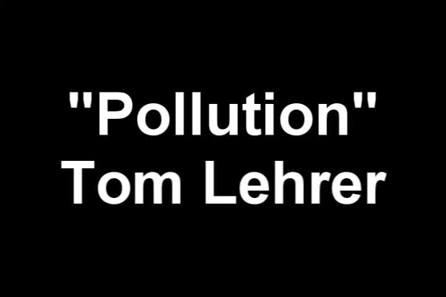
So, thinking about collective insanity – Tom Lehrer sings…

Slide 51
So, thinking about collective insanity – Tom Lehrer sings…

