Slide 1
Did walter scott invent Scotland?

Slide 4
“A hundred years ago there was no Scott known in Scotland. No Scott! No genius of the mountains, shedding colour and light upon their mighty slopes; no herald of past glory, sounding his clarion out of the heart of the ancient ages; no kindly, soft-beaming light of affectionate insight brightening the Lowland cottages [...] No Highland emigration could depopulate those dearest hills and glens as they are depopulated by this mere imagination. A hundred years ago they were bare and naked—nay, they were not, except to here and there a wandering, hasty passenger.”

Slide 5
“There were no novels; and a hundred years ago, the past history of Scotland was a ground for polemics only—for the contentions of a few historical fanatics, and the investigations of antiquarians—not a glowing and picturesque past in which all the world might rejoice, a region sounding with music and brilliant with colour, as living as our own, and far more captivating in the sheen and brightness of romance than the sober-tinted present.”

Slide 6
'If thou would'st view fair Melrose aright, | Go visit it by the pale moonlight [...] | Then view St. David's ruin'd pile; | And, home returning, soothly swear, | Was never scene so sad and fair!' (canto II, stanza I, lines 1-2, 16-18)

Slide 8
“In this nineteenth century, our highest literary man, who immeasurably beyond all others commanded the world’s ear, had, as it were, no message whatever to deliver to the world; wished not the world to elevate itself, to amend itself, to do this or to do that, except simply pay him for the books he kept writing.”
Thomas Carlyle, “Walter Scott” (1833)

Slide 9
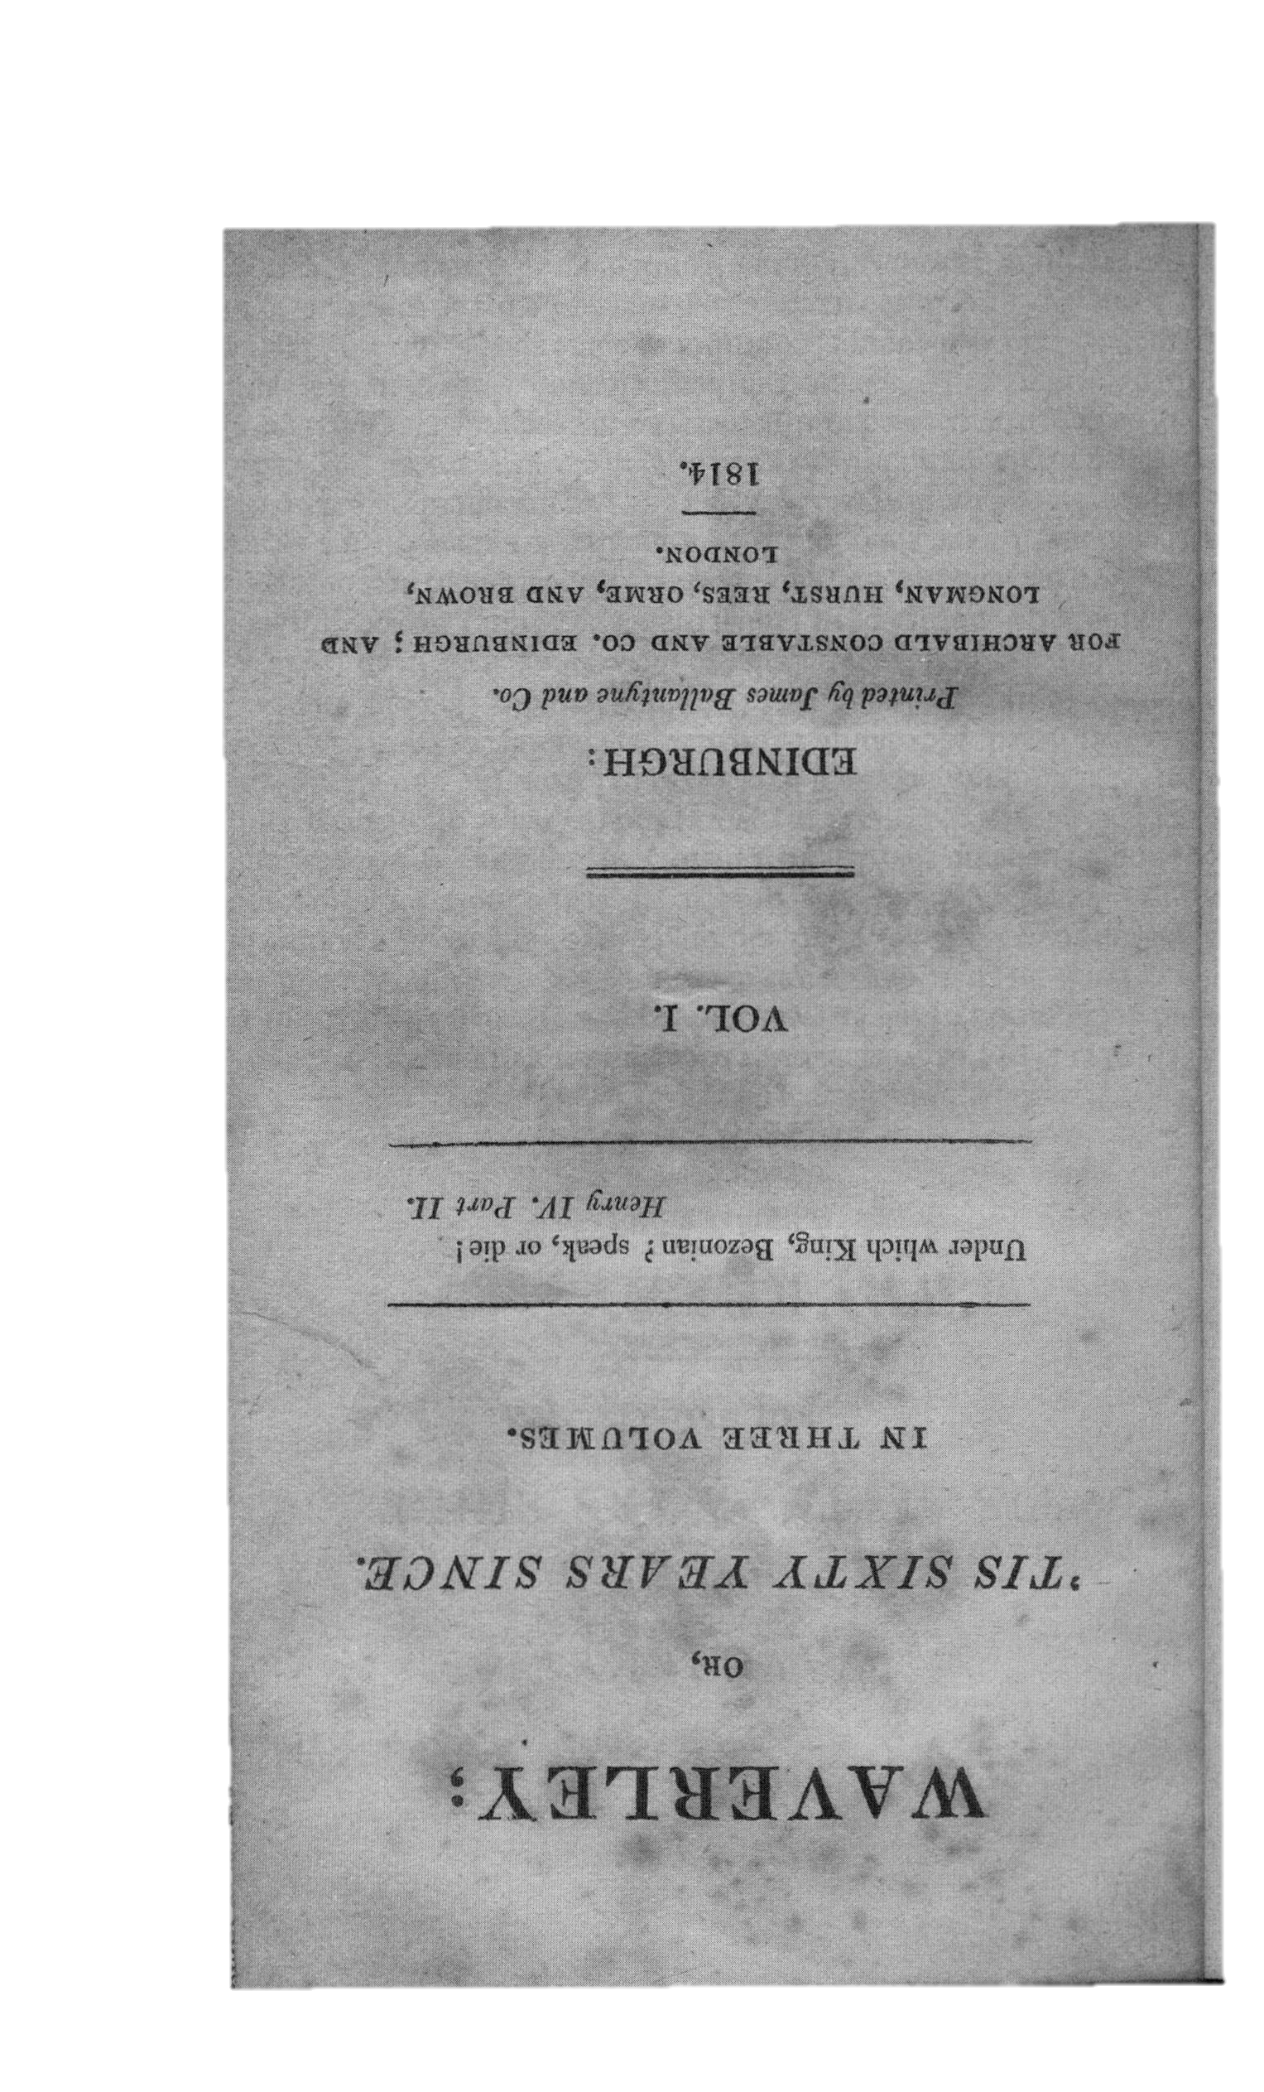
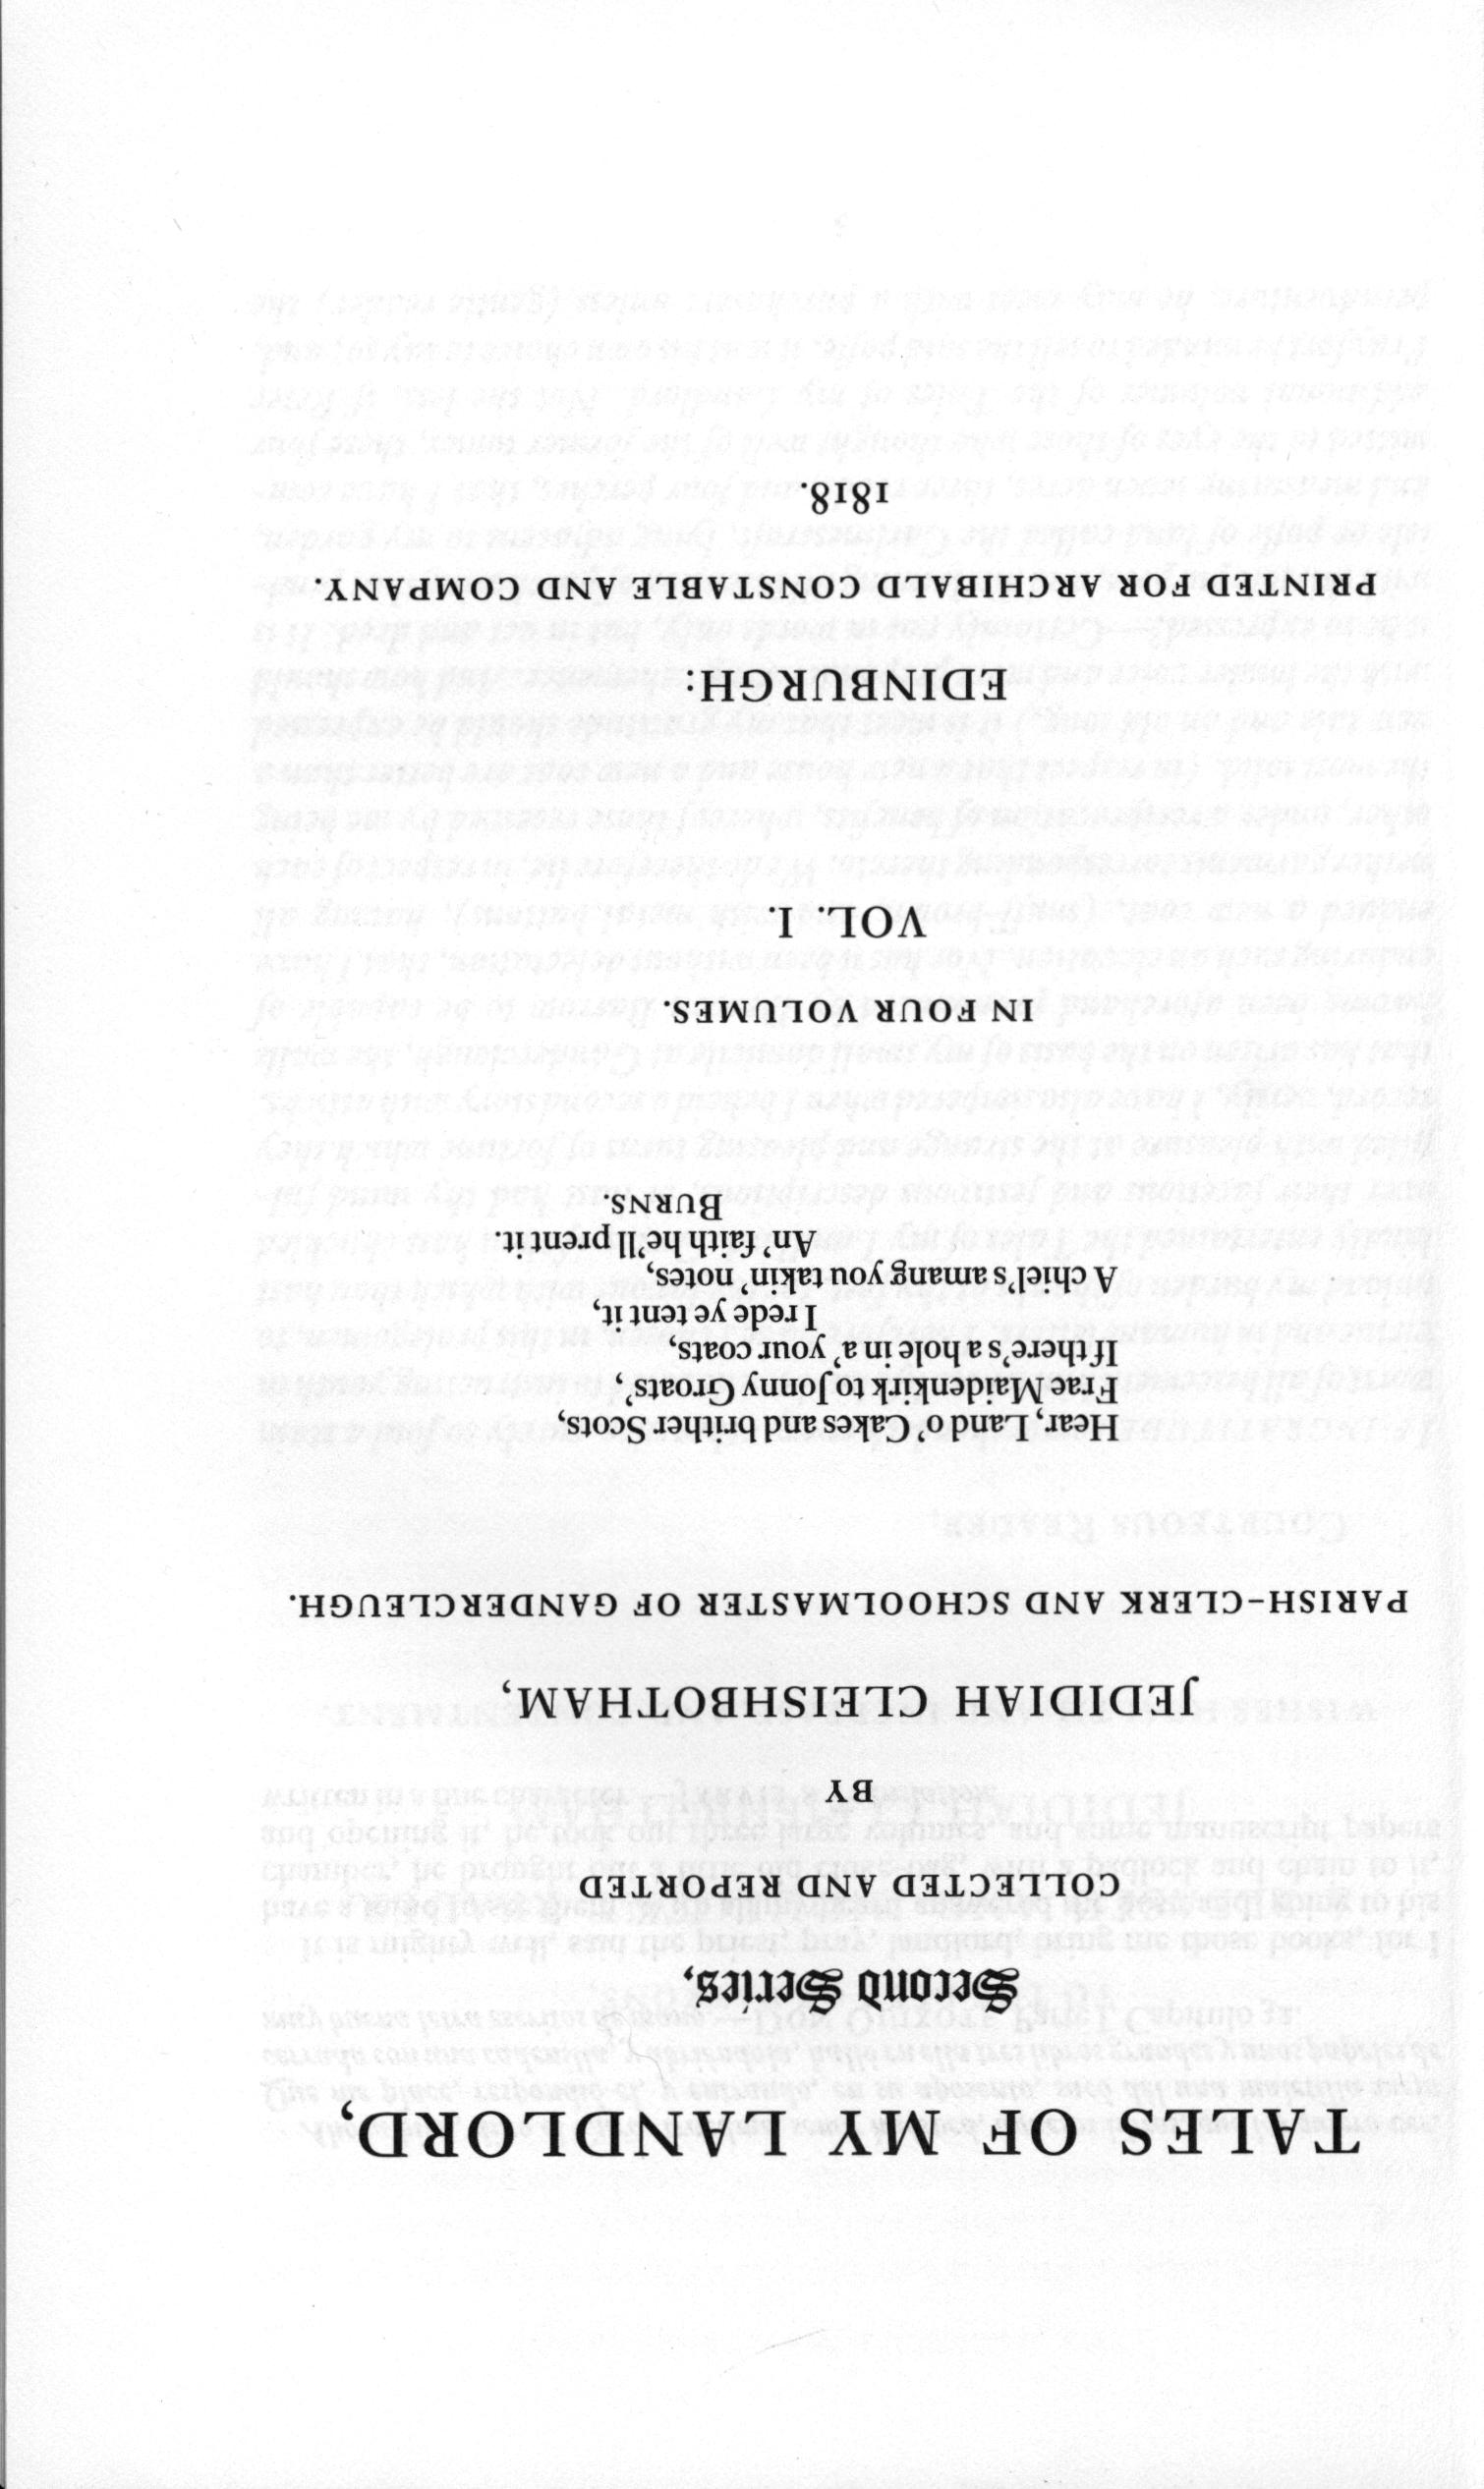
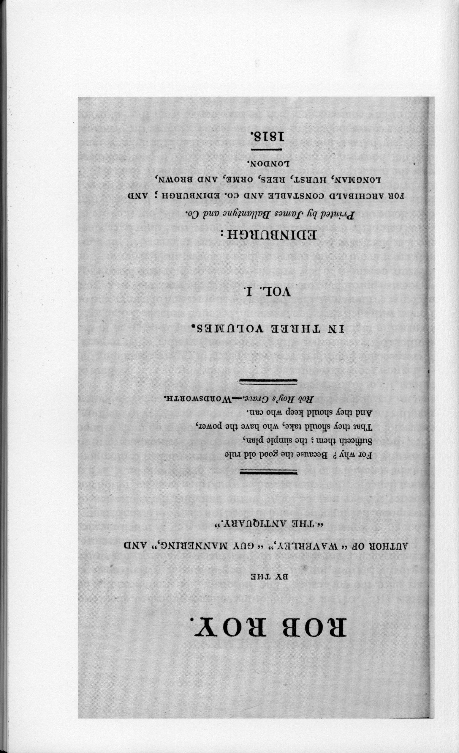

Slide 10
“…those who in my younger time, were facetiously called ‘folks of the old leaven,’ who still cherished a lingering, though hopeless, attachment to the house of Stuart. This race has almost entirely vanished from the land, and with it, doubtless, much absurd political prejudice—but also many living examples of singular and disinterested attachment to the principles of loyalty which they received from their fathers, and of old Scottish faith, hospitality, worth, and honour.”
Waverley; or, ’tis Sixty Years Since (1814)

Slide 11
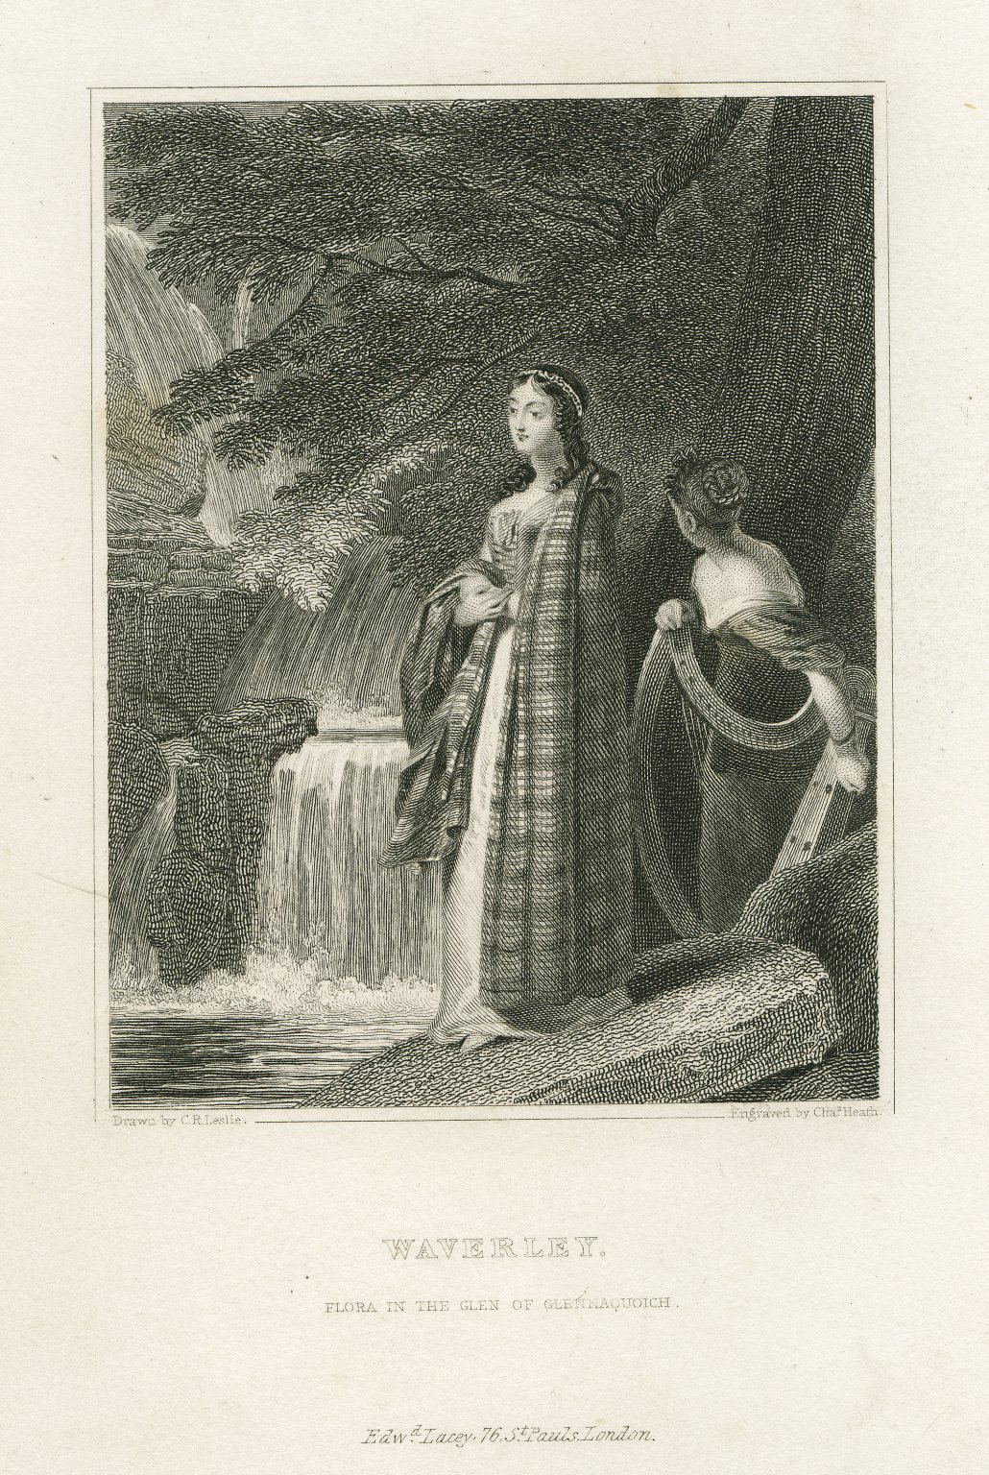

Slide 12
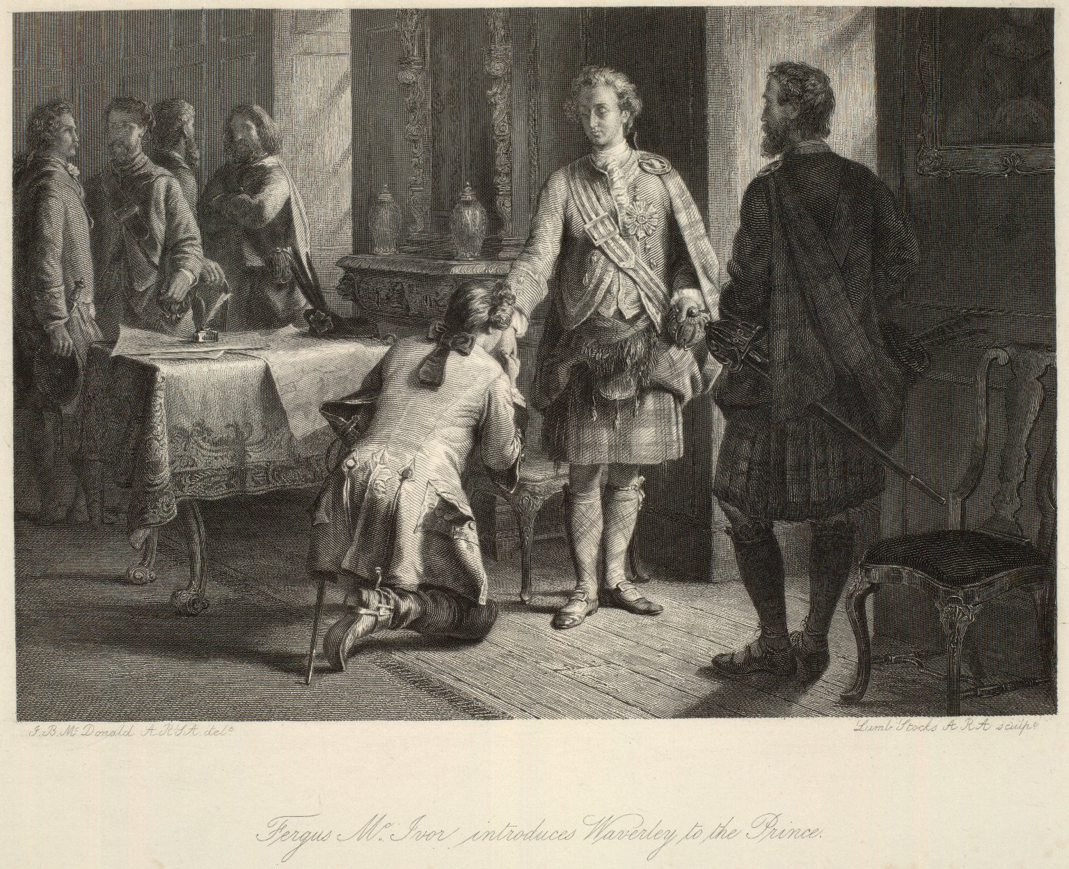

Slide 13
“The scene of our drive today is all described in Rob Roy….high, rugged, and green hills…very fine large trees and beautiful pink heather, interspersed with bracken, rocks, and underwood, in the most lovely profusion, and Ben Lomond towering up before us with its noble range….Hardly a creature did we meet, and we passed merely a very few pretty gentleman’s places, or very poor cottages with simple women and barefooted long-haired lassies and children, quiet and unassuming old men and labourers. This solitude, the romance and wild loveliness of everything here, the absence of hotels and beggars, the independent people, who all speak Gaelic here, all make beloved Scotland the proudest, finest country in the world.”
Queen Victoria, Highland Journals (1869)

Slide 14
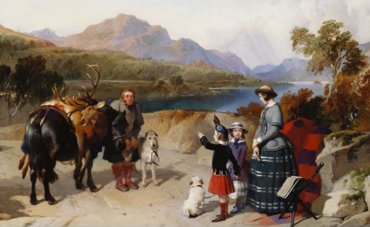

Slide 15
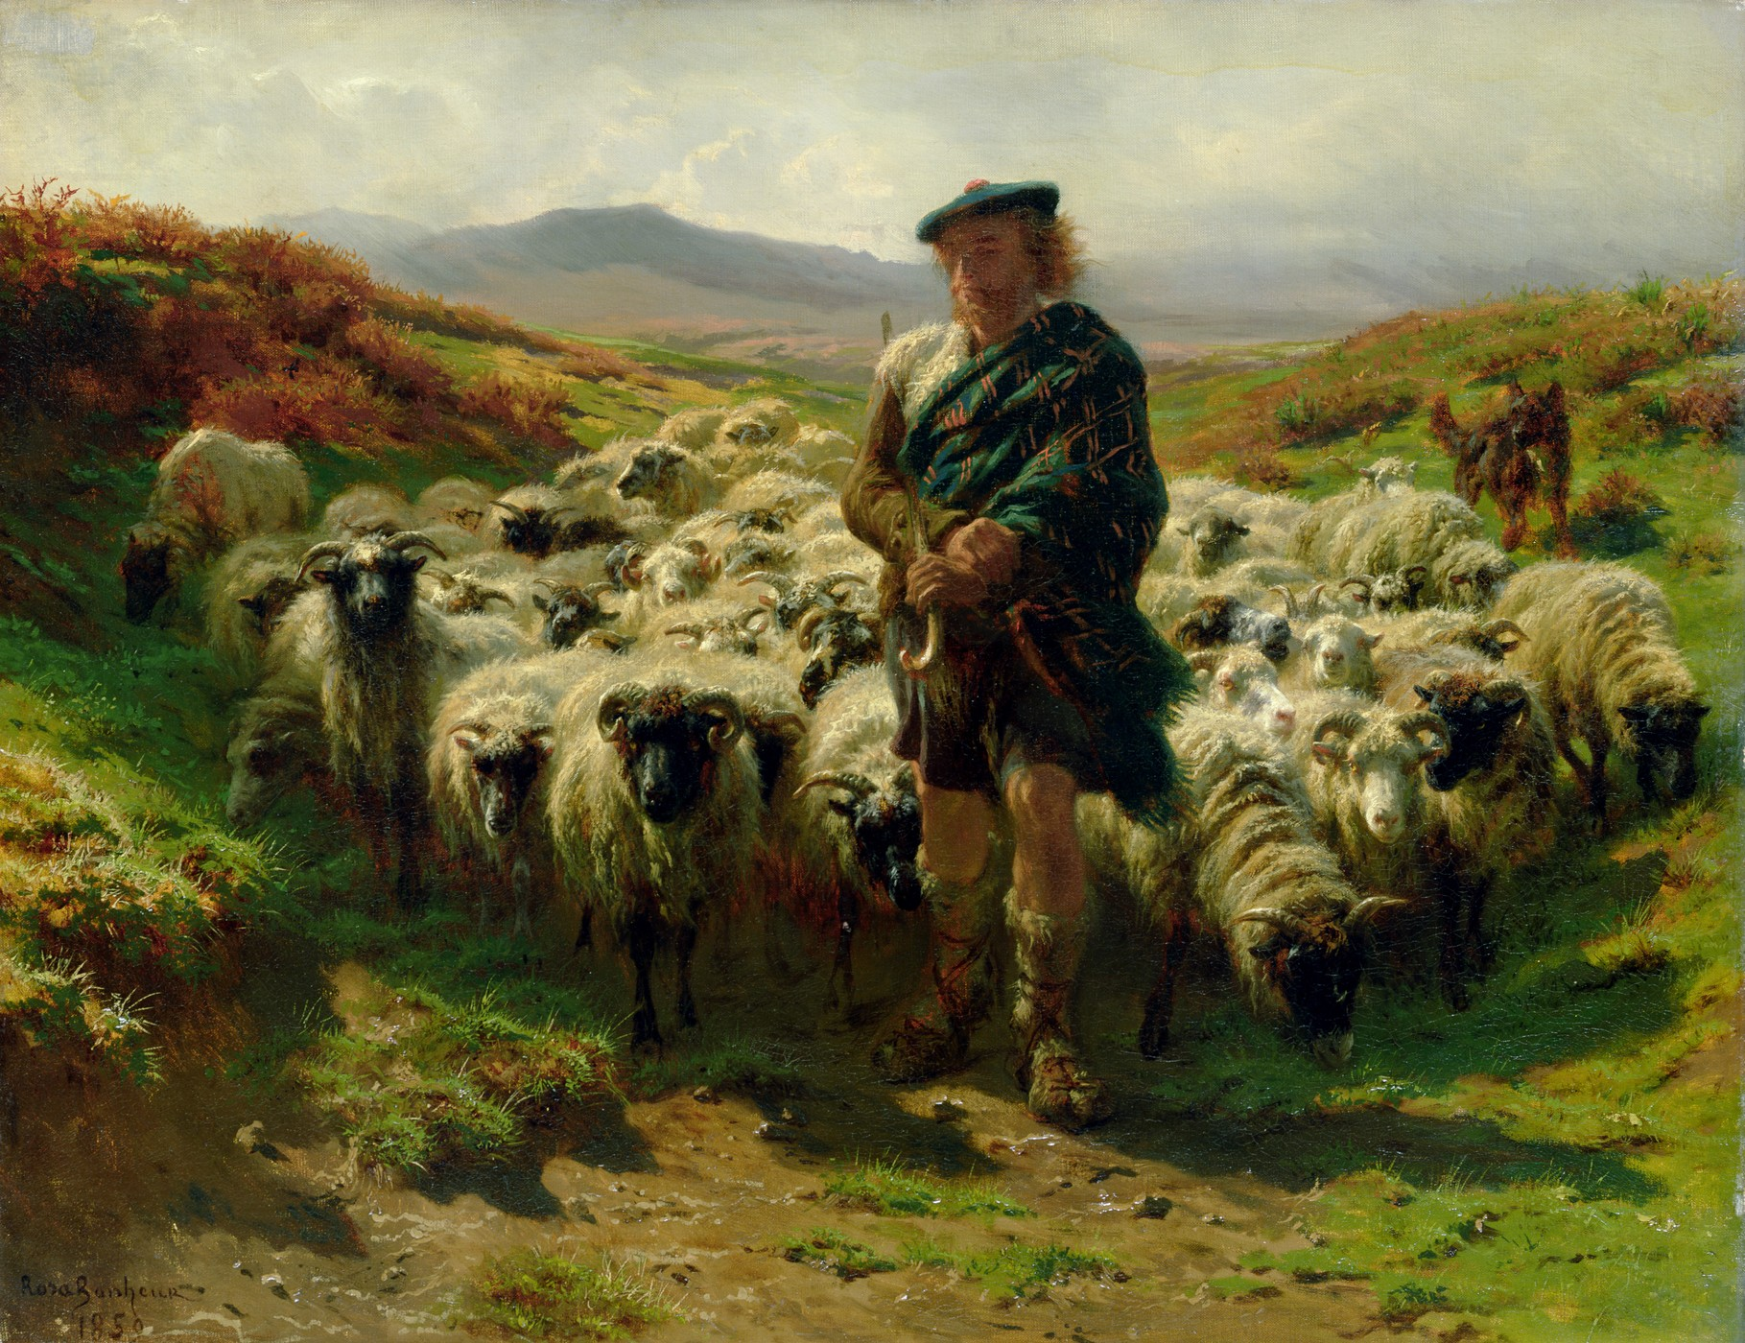

Slide 17
Christian Isobel Johnstone, Clan-Albin (1815)

Slide 18
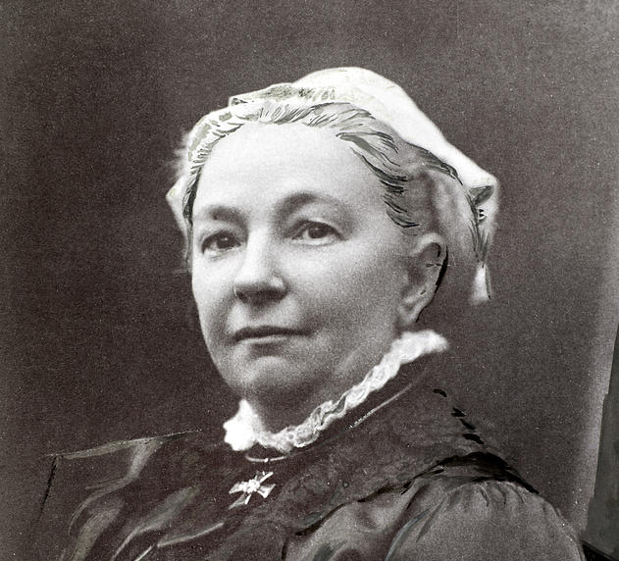
Margaret Oliphant (1828-1897)

Slide 19
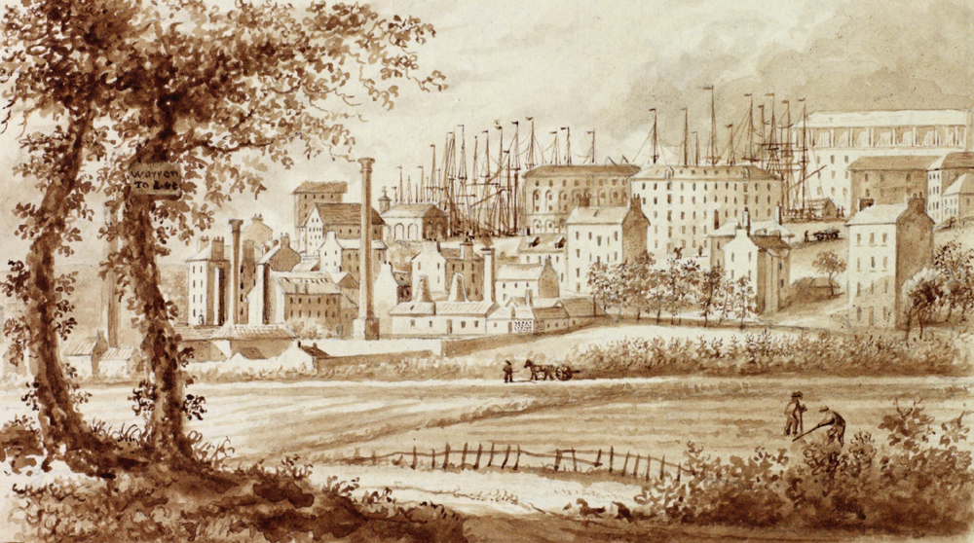

Slide 20
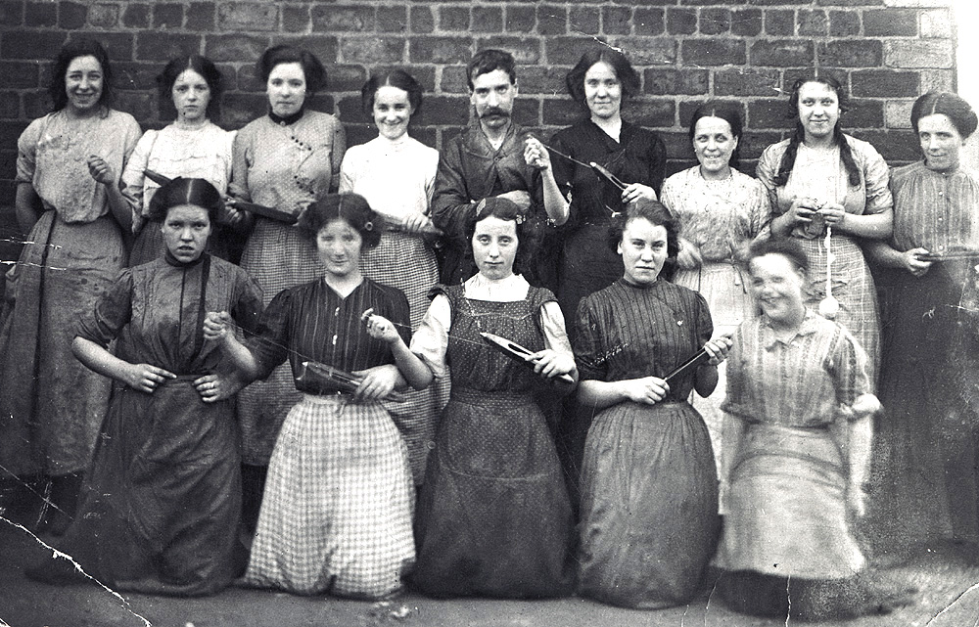

Slide 21
Mary Findlater (1865-1963) with Jane Findlater (1866-1946)

