Slide 1
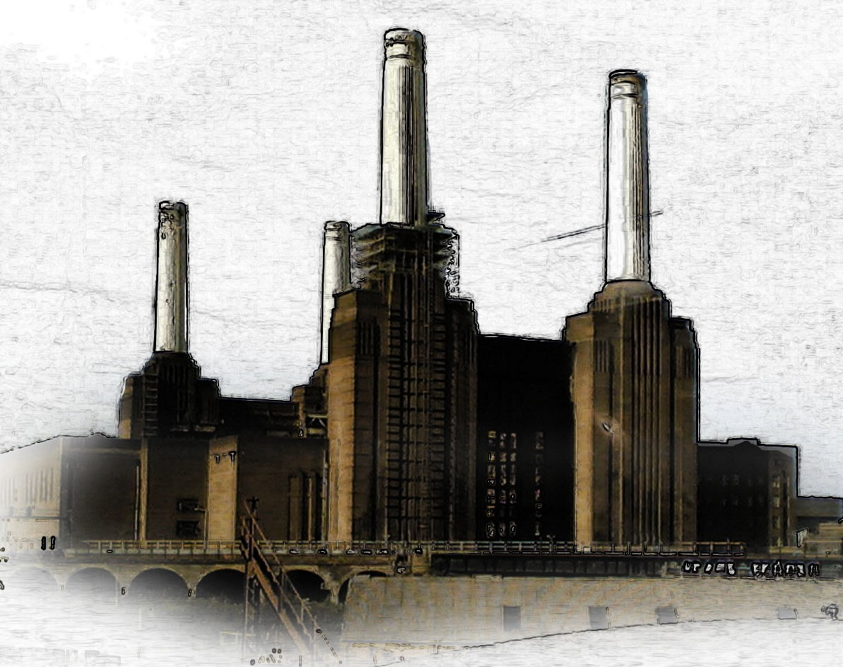
The Mathematical Skyline
Gresham College, London, 18 January 2017

Slide 2
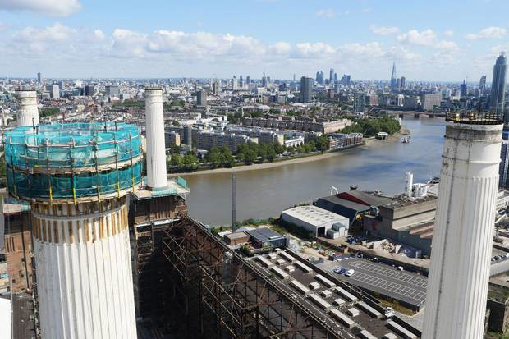
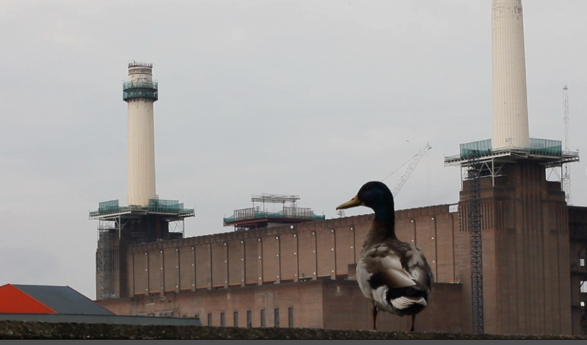
Bad timing
1
Dismantling the chimneys

Slide 3
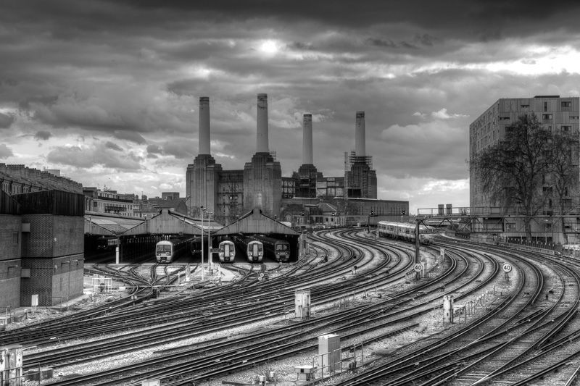
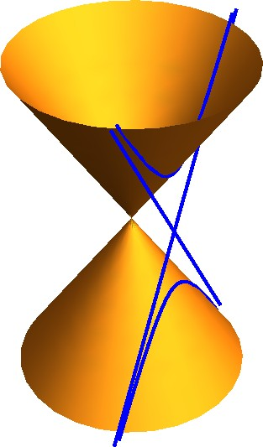
Points and conics
2
4 points marked by the chimneys
© Matthew Train 2013
A hyperbola and its asymptotes

Slide 4
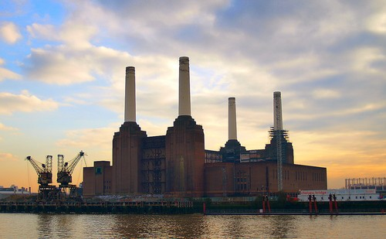
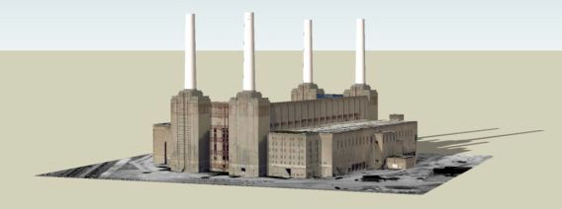
David Singmaster’s question
3
“It appears to me that there will be some point where the chimneys will appear regularly spaced along the skyline . . . where does one have to be to see this effect?” (M500–258.1)
M500 258 Page 9
Problem 258.1 – Battersea Power Station
David Singmaster
For those who don’t know London, Battersea Power Station is a London landmark beside Chelsea Bridge and the Thames. This was (is?) the world’s (or Europe’s?) biggest brick building, using 61M bricks. Giles Gilbert Scott was asked to improve the architecture in 1931. Battersea A was started in 1929 and the first part, of 138MW, started work in 1933, with an additional 105MW in Sep 1935. Construction of Battersea B started in 1937. The first part, of 100MW, was in service in 1941. After the war, another 60MW was added and a final 100MW was added in 1953. The final result is a massive rectangular building with four massive chimneys, at the four corners of the rectangular building, which are visible from much of London. The chimneys are 337ft high. Battersea A closed in 1975. Battersea B closed on 31 Oct 1983. It was planned to be converted into a theme park by 1990, but the idea fell victim to a recession and the building remains half open to the elements. A friend recently described it as looking like a dead table.
The chimneys are basically at the corners of a rectangle, whose long sides run approximately north–south. The dimensions are approximately 50m × 160m. The problem arises because one sees the chimneys on the skyline as one drives into London from the west and one notices that the relative positions of the chimneys shift as one drives along the north side of the Thames. It appears to me that there will be some point where the chimneys will appear regularly spaced along the skyline. Is this true? If so, where does one have to be to see this effect? For consistency, let us label the four chimneys as A, B, C, D, going clockwise from A at the SW corner which we take as the origin of a coordinate system. So A is at (0, 0), B is at (0, 160), C at (50, 160), D at (50, 0). John Sharp has found a site which does architectural views and has sent the view below, but there are no dimensions given. I want to be able to go to a correct viewpoint and take a photo.

Slide 5
The question is well posed!
4
Its solution will involve surprisingly rich mathematics, including:
results concerning permutations (re-orderings) of four objects;
the so-called cross-ratio, a projective invariant;
theorems on conics, curves defined by equations of degree 2;
asymptotes of hyperbolae;
examples of cubic curves, defined by equations of degree 3.
Thanks to John Armstrong and John Silvester for helping to uncover this.

Slide 6
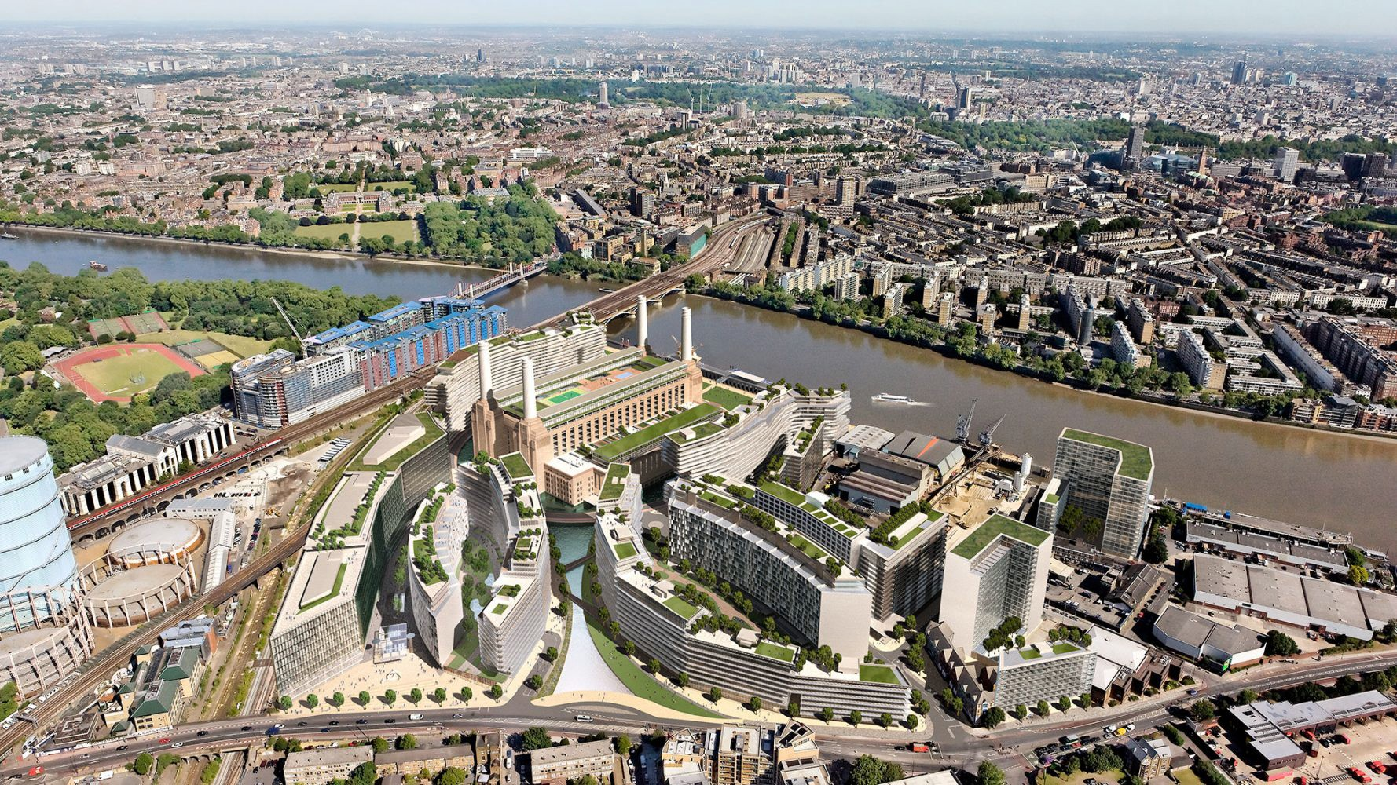
Vin˜oly’s masterplan
5
The boiler house is encircled by curved geometrical forms.

Slide 7
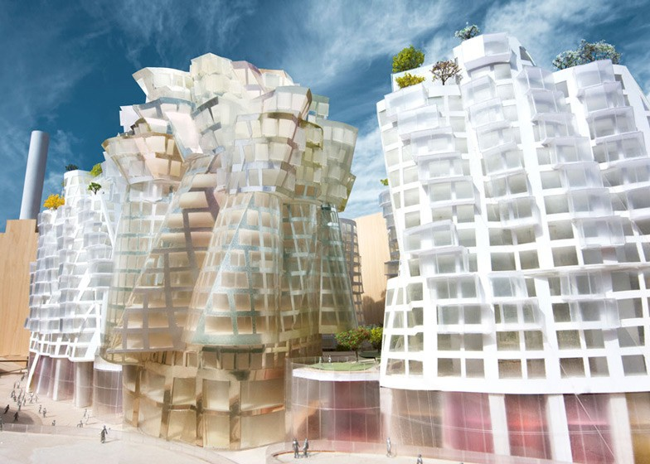
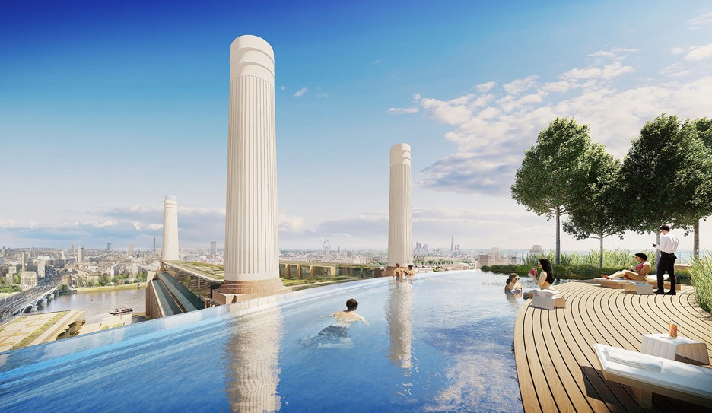
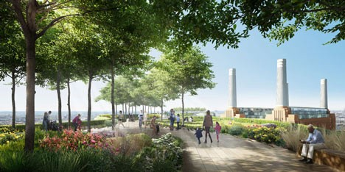
Designs by Gehry, Foster and partners
6
The equal-spacing problem involves: photography and perspective, lengths, not angles,
4 chimneys, not 3!
∞

Slide 8
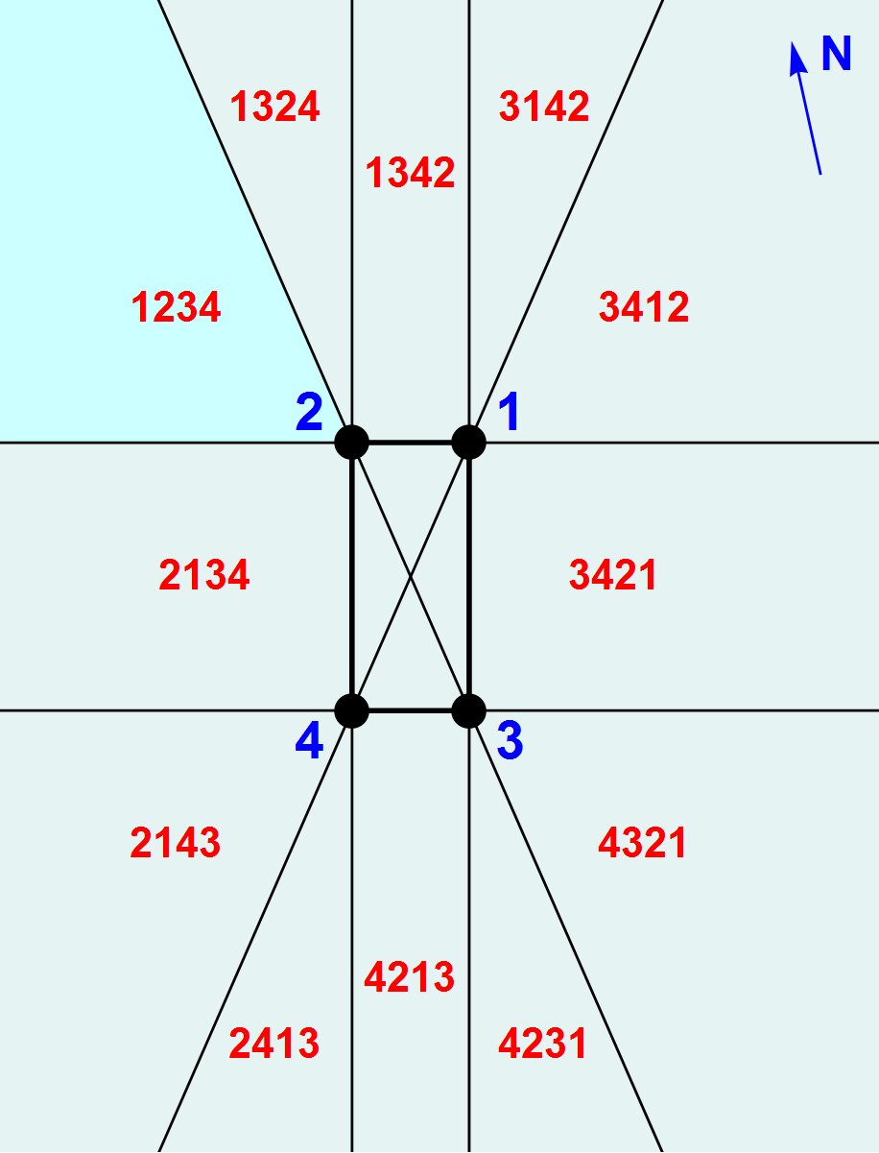
Permutations
7
One can see the chimneys in different orders in various regions, but only 12 of the 4! = 24 permutations are possible:

Slide 9
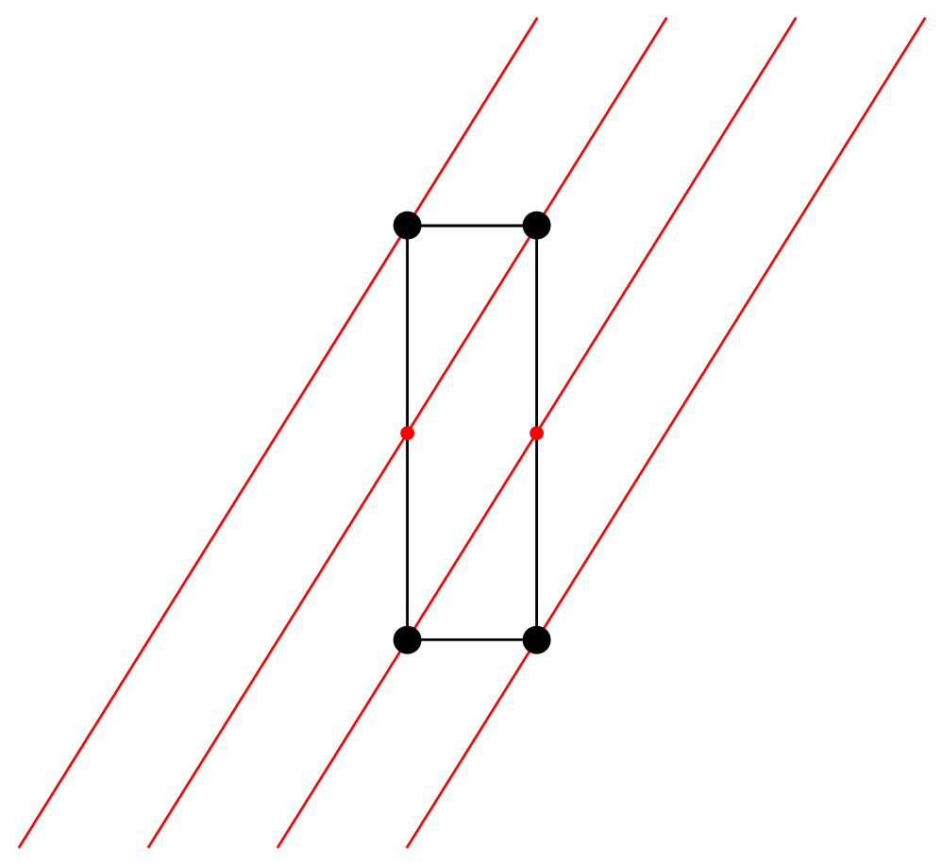
Parallel lines
8
can be spaced equally between the chimneys using midpoints.
The rectangle measures 160m×80m, and these lines have slope 8/5:

Slide 10
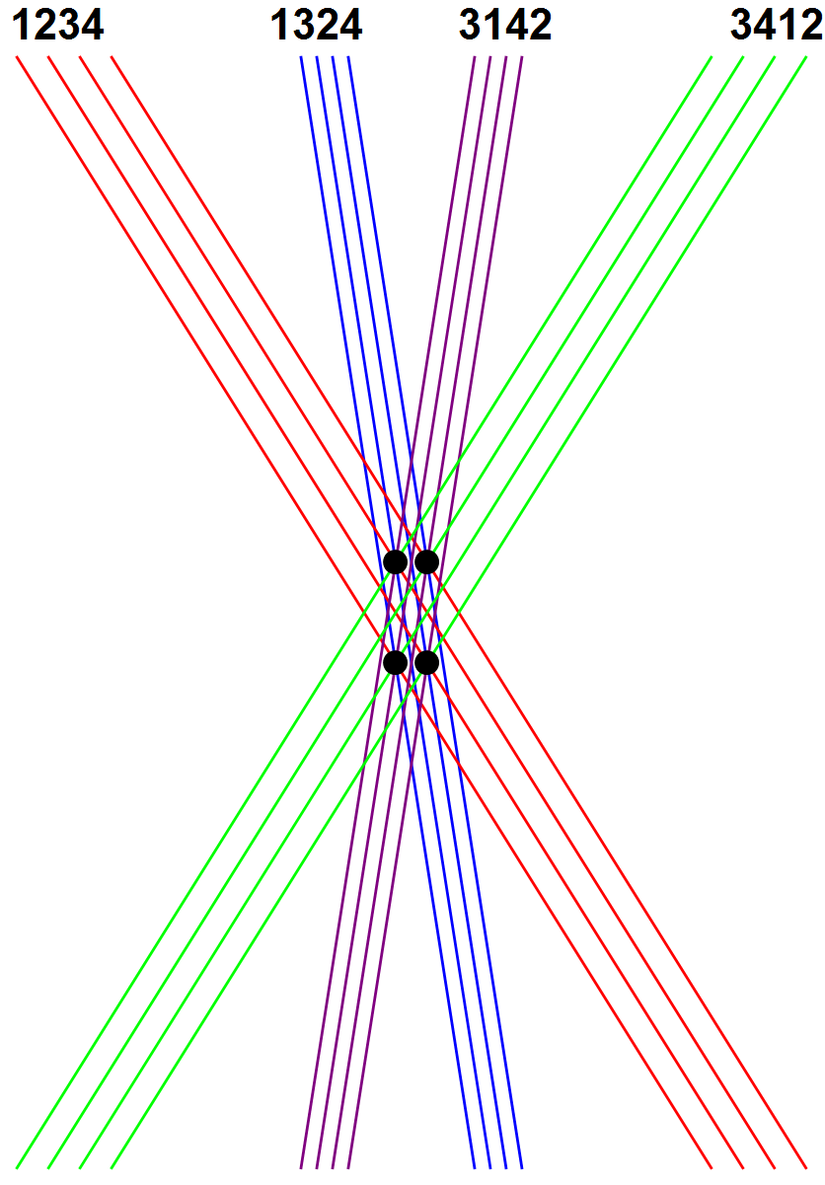
Parallel lines
9
Four sets with different slopes can be drawn to realize 8 of the chimney permutations:

Slide 11
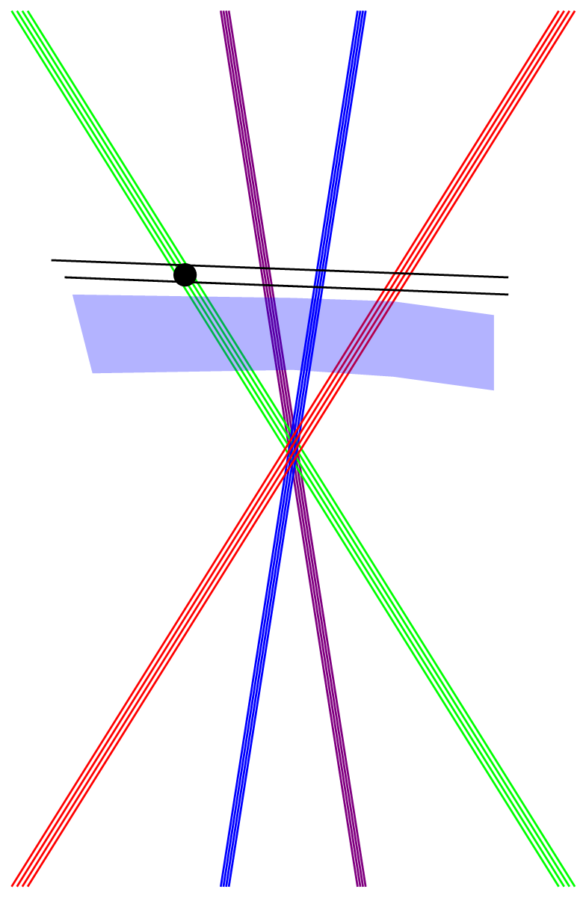

Solution at infinity
10
Ebury Bridge
Grosvenor Road

Slide 12
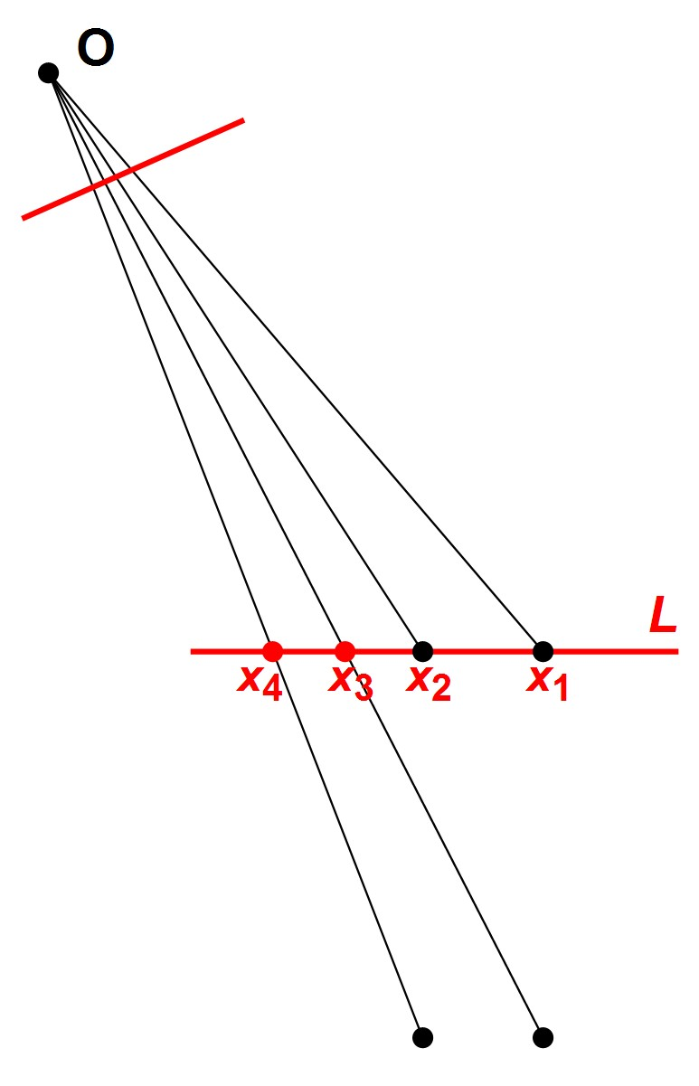
The cross-ratio
11
Draw a line from a point
O to each chimney.
Take note of distances x₁, x₂, x₃, x₄ on any line L that cuts the other four.
The quantity
(x₁ − x₃)(x₂ − x₄) (x₁ − x₄)(x₂ − x₃)
r =
does not depend on the position of the 5th line L.

Slide 13
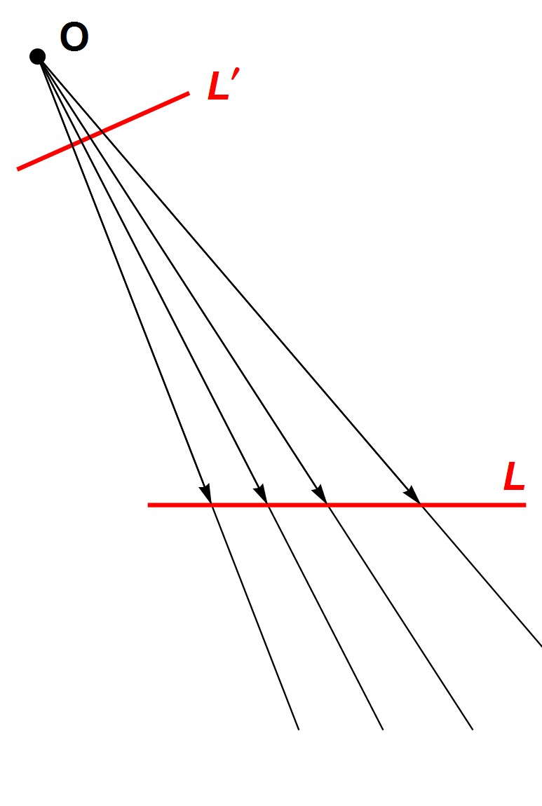
A perspectivity
12
Projection from O defines a mapping
f : L^{I} → L
that preserves the cross-ratio of 4 points.

Slide 14
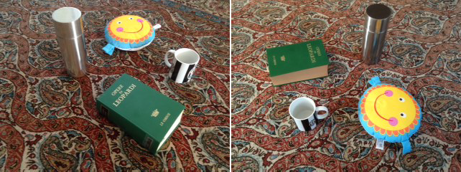
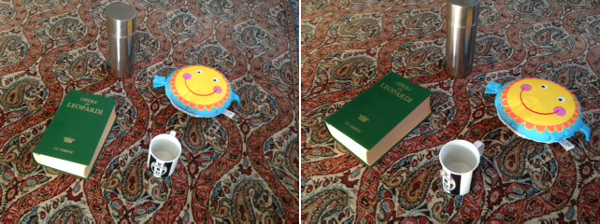
Projective transformations of the plane
13

Slide 15
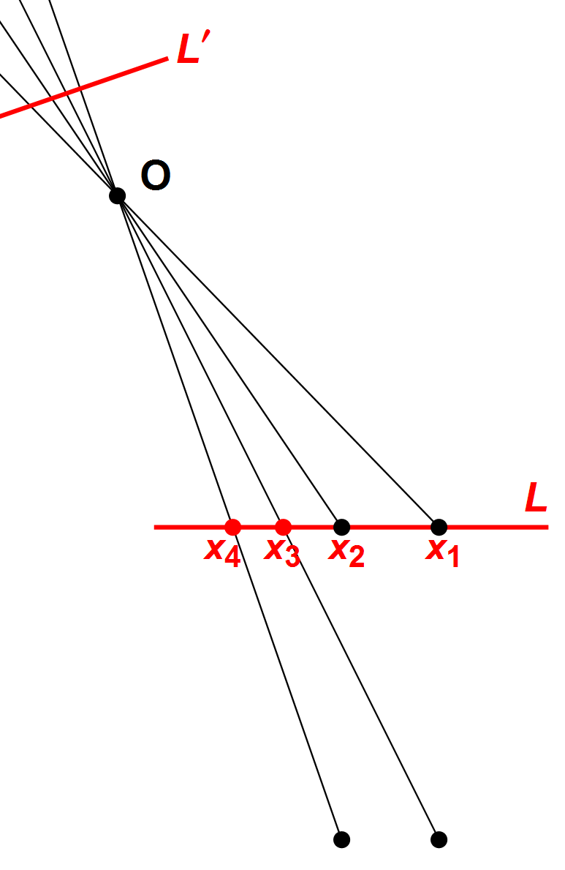
Equal spacing
14
If the 4 lines through O are equally spaced on some film L^{I} then
2 × 2 4
r =
= .
3 × 1 3
The problem becomes:
Find the locus of those points O for which r = ⁴ .
3

Slide 16
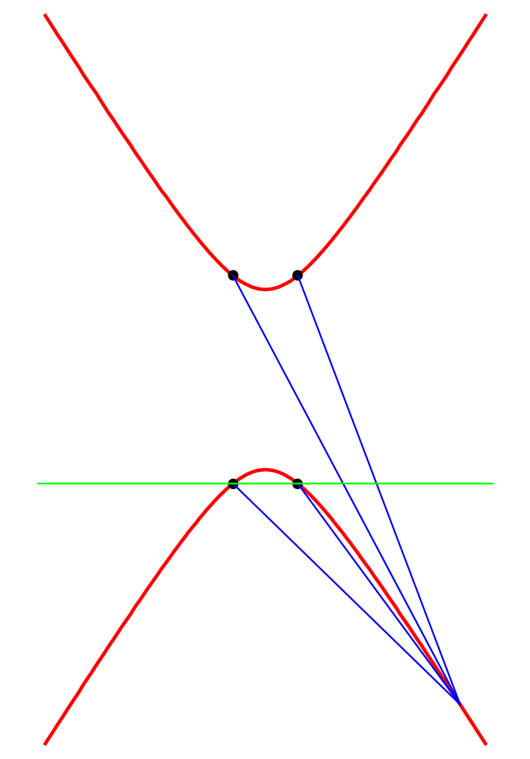
This locus is a hyperbola H
15
The equation of H is 25y ² − 64x ² = 120000
or
₂ ₂
y
x
40 3 25 3
√ − √ = 1.
Its asymptotes are
5y ± 8x = 0.

Slide 17
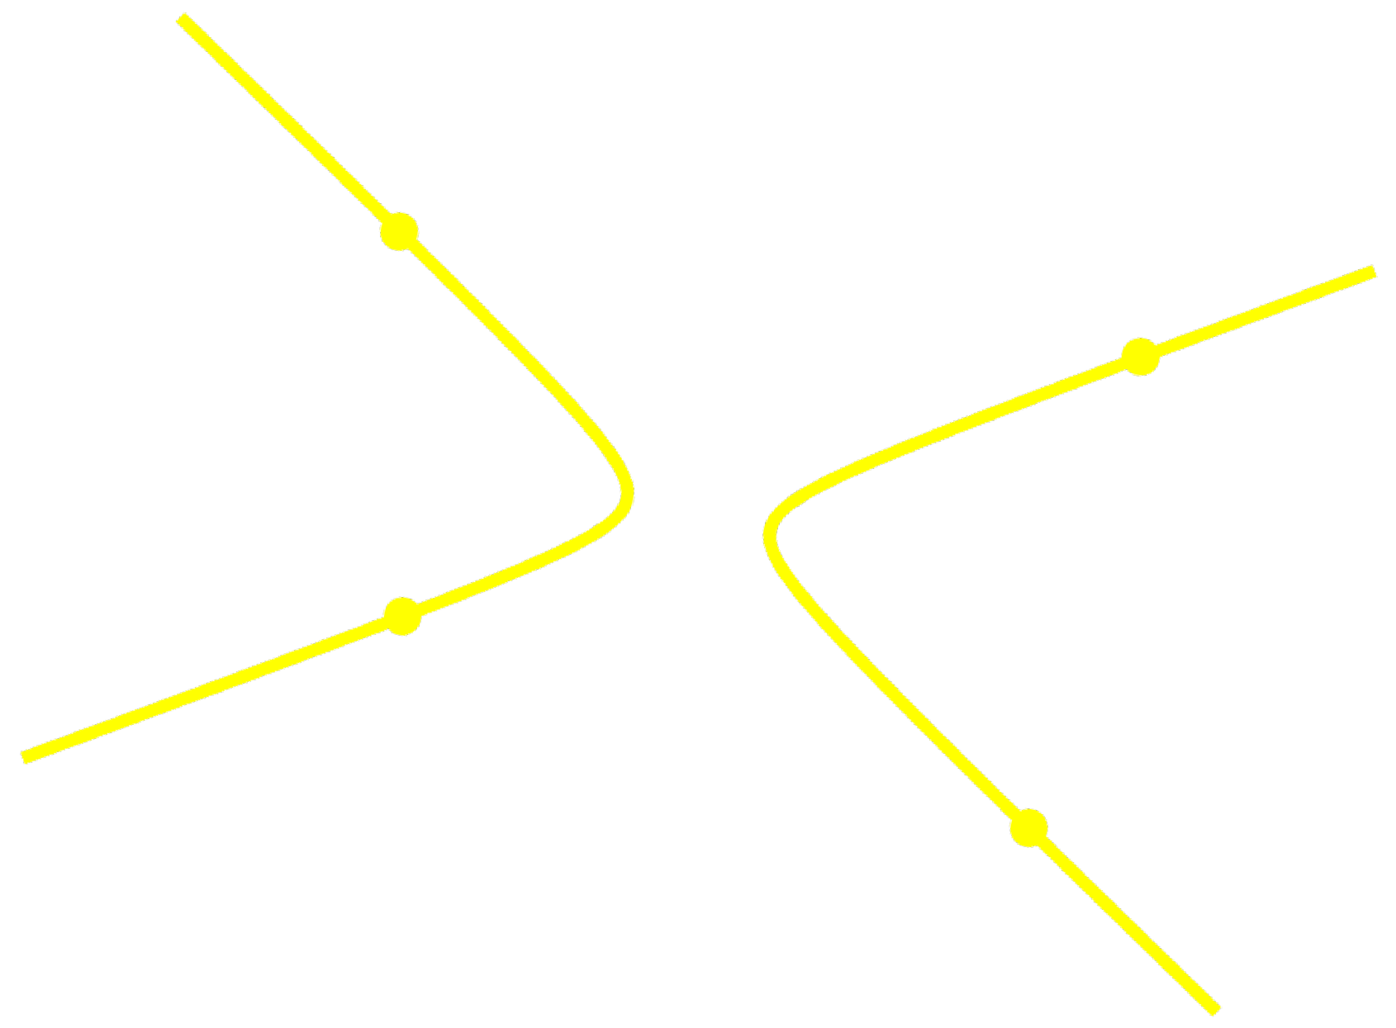
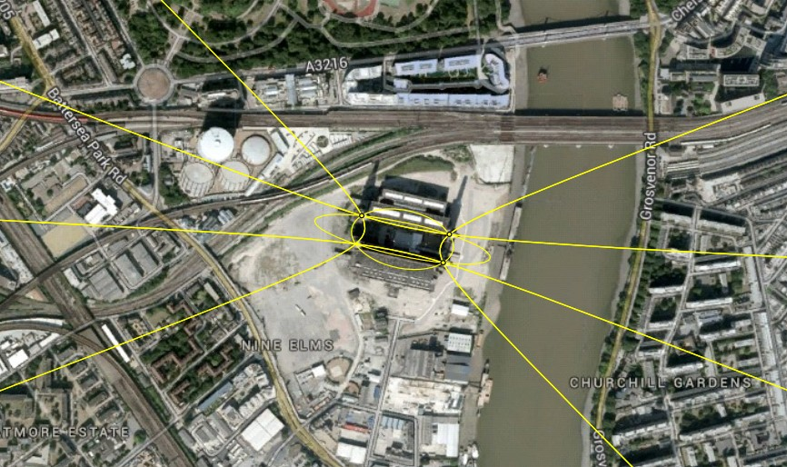
H passes through the chimneys
16

Slide 18
Points and conics
17
2 points lie on a unique line.
3 points (if not collinear) lie on a unique circle.
5 points (no 3 of which are collinear) lie on a unique conic, which is either an ellipse, parabola or hyperbola.
Now let O be a “correct” viewpoint for the chimney order 1234. Then our “viewing hyperbola” H is the unique conic through
C₁, C₂, C₃, C₄, O.
The point O could be the one beyond Ebury Bridge at infinity.

Slide 19
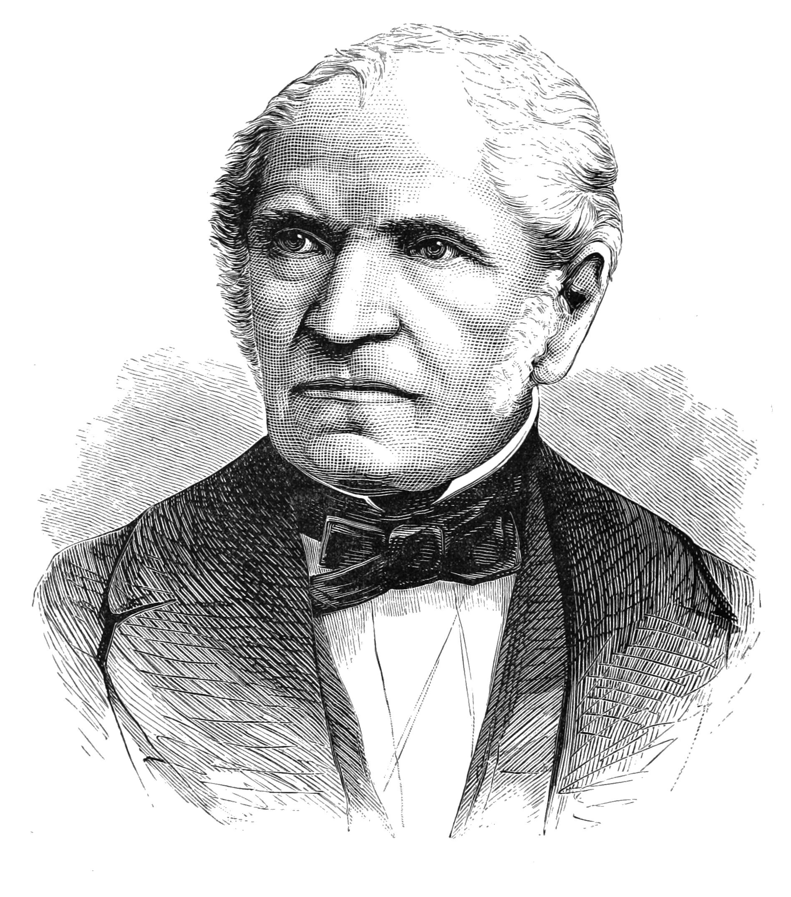
Chasles’ Theorem
18
Given 5 points C₁, C₂, C₃, C₄, O on a conic curve, the cross-ratio r of the lines
OC₁, OC₂, OC₃, OC₄
does not depend on O.
This explains why any point on
H has cross-ratio ⁴ relative to
3
Michel Chasles 1793–1880 Hon. member LMS 1867
AC = AB + BC
C₁, C₂, C₃, C₄.
Š Š š

Slide 20
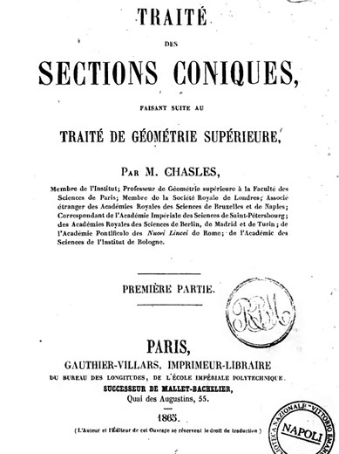
19

Slide 21
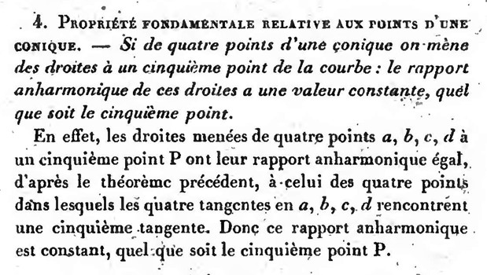
Trait´e des Sections Coniques
20
Extract from page 3:
“rapport anharmonique”=“cross-ratio”

Slide 22
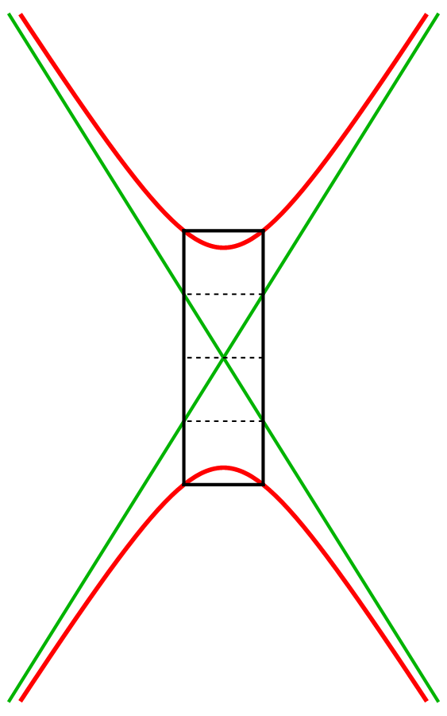
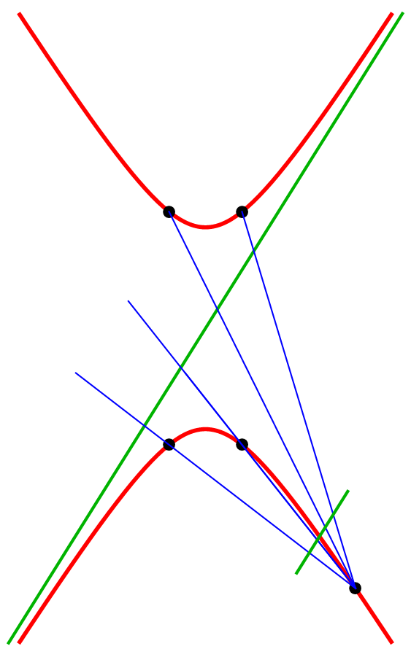
Where to position the camera?
21
Parallel to the other asymptote!

Slide 23
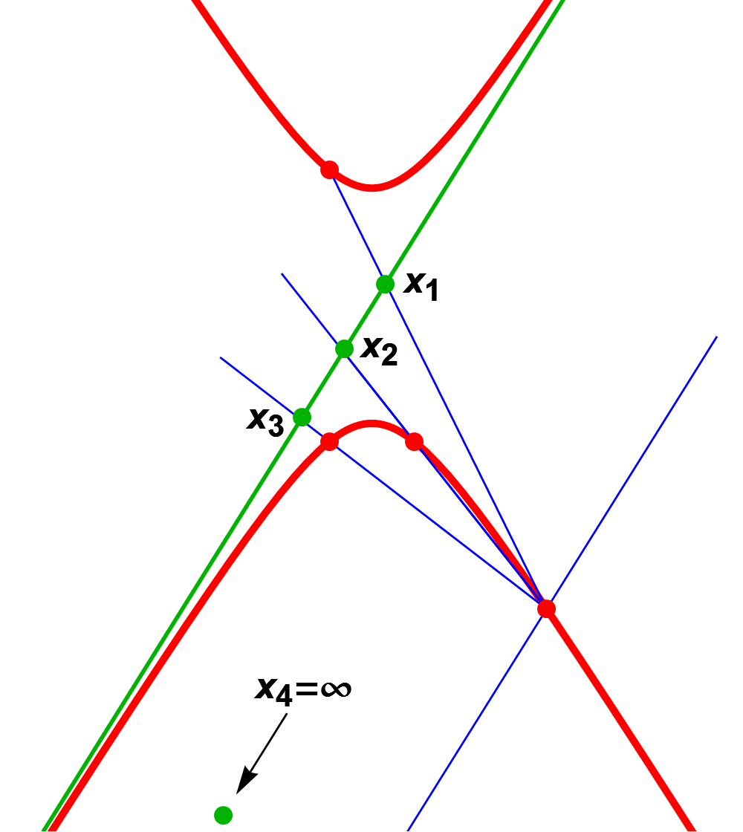
Harmonic ratio
22
Relative to our hyperbola H:
4
the 4 four chimneys define a cross-ratio of .
3
any 3 chimneys and a point at ∞ define a cross-ratio of 2.
Chasles’ theorem then implies that x₁ − x₂ = x₂ − x₃.

Slide 24
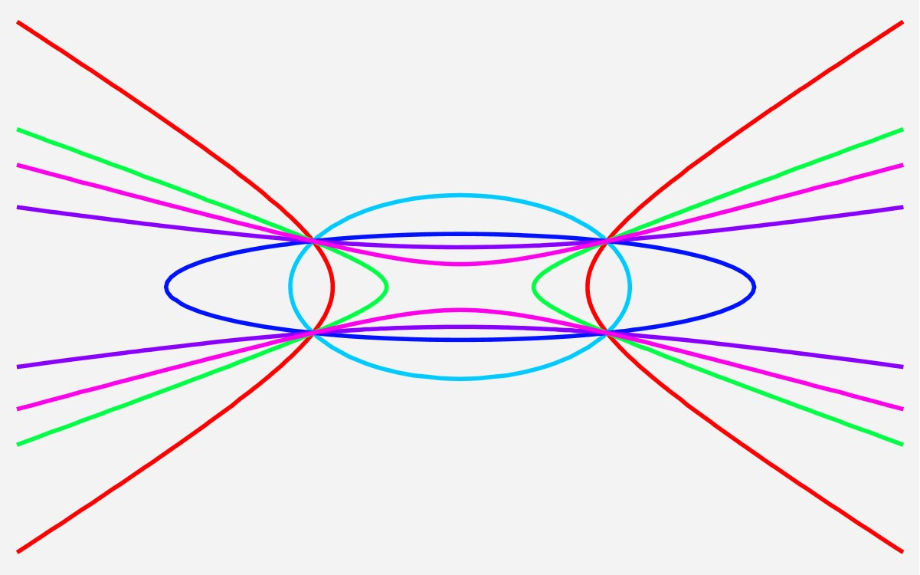
Permutating cross-ratios
23
A re-ordering may or may not affect the cross-ratio r . Swapping two chimneys (like C₂ and C₄) does:
(x1 −x3)(x2 −x4) (x1 −x3)(x4 −x2)
4
⇒
(x1 −x4)(x2 −x3) ⁼ 3 (x1 −x2)(x4 −x3) ^{= 4.}
4 3 1 1
One achieves 6 different values: r = , 4, , −3, , − .
3 4
4 3

Slide 25
Four meaningful conics
24
4
3
The hyperbolas correspond to r = , 4, the ellipses to r = , −3.
3
4

Slide 26
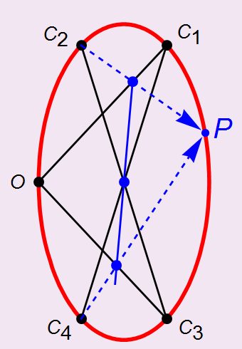
Pascal’s Theorem
25
If a “hexagon” is inscribed in a conic, the points of intersection of opposite sides are collinear.
(Blaise Pascal 1623–1662)
This can be used to construct a generic point P on the conic through C₁, C₂, C₃, C₄, O.

Slide 27
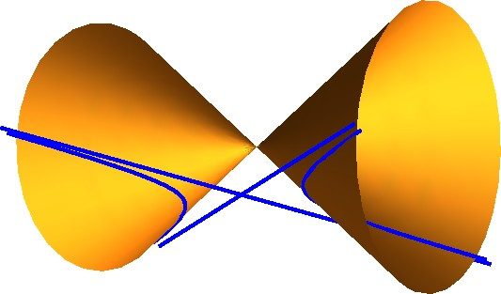
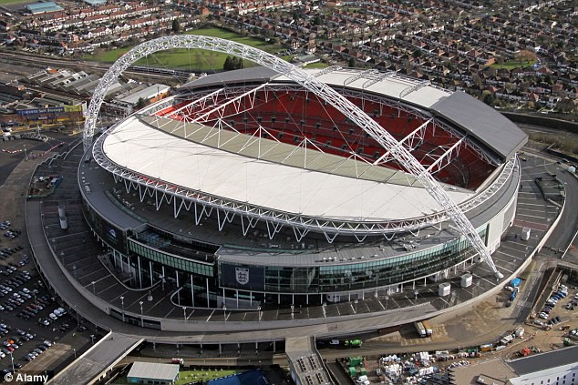
An ellipse over Battersea
26
Let H be the outer hyperbola passing through the chimneys. Consider all the double circular cones in space that contain H. Their vertices trace out an ellipse that lies above the power station like Wembley’s arch, but half the span and truly vertical!

Slide 28
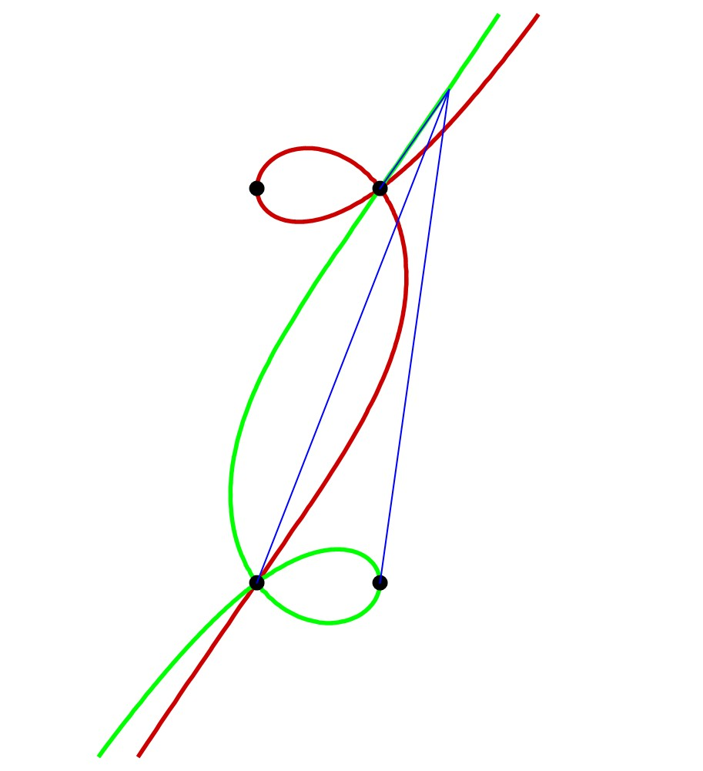
Nodal cubic curves
27
Using gradients and the formula
tan A − tan B
tan(A − B) = _{1 + tan A tan B} ,
the angle subtended by chimneys 1,4 and the angle subtended by chimneys 4,3 are equal if
8x ³ + 200x ² + 46200x + 3125y
−1280xy − 5x ²y + 600y ²
+8xy ² − 5y ³ = 1405000.

Slide 29
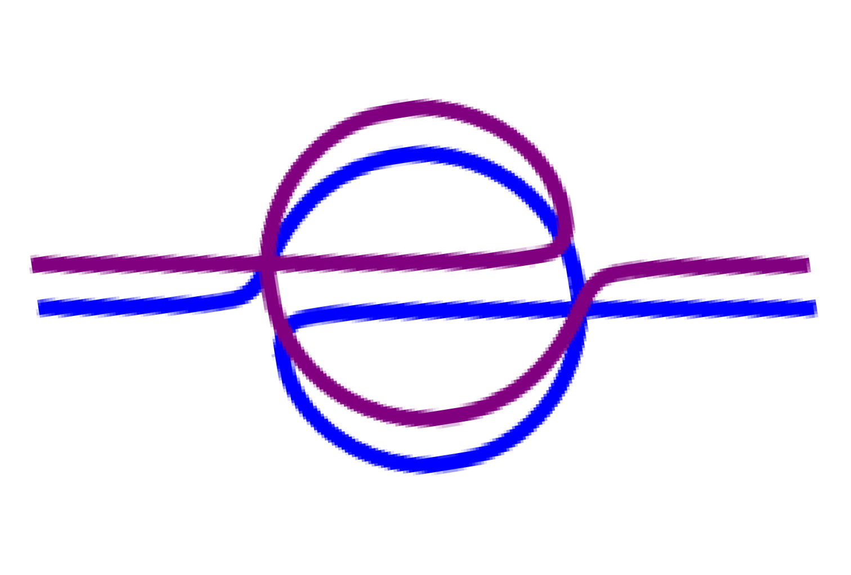
Two designer cubics
28
represent equal pairs of angles
∠24 = ∠41 and ∠41 = ∠13 between the chimney triples 241 and 413:

Slide 30
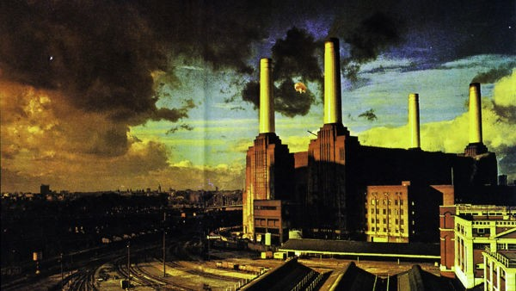
Pink Floyd’s vision
29

Slide 31
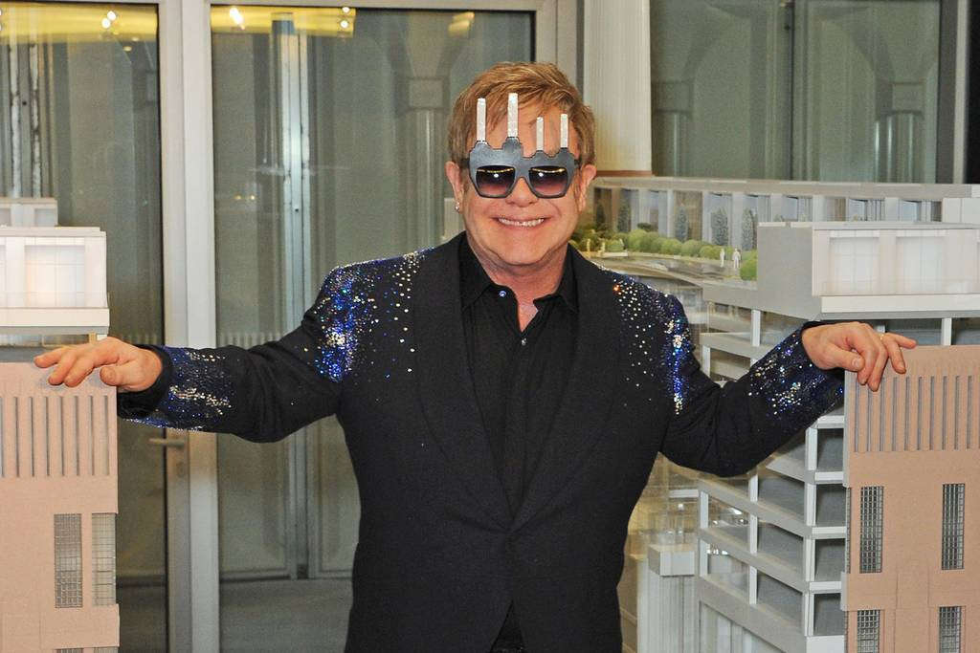
Sir Elton John demonstrates Chasles’ Theorem to a celebrity crowd at Battersea Power Station
30
Qc Dave Benett, LES 7 May 2014

Slide 32
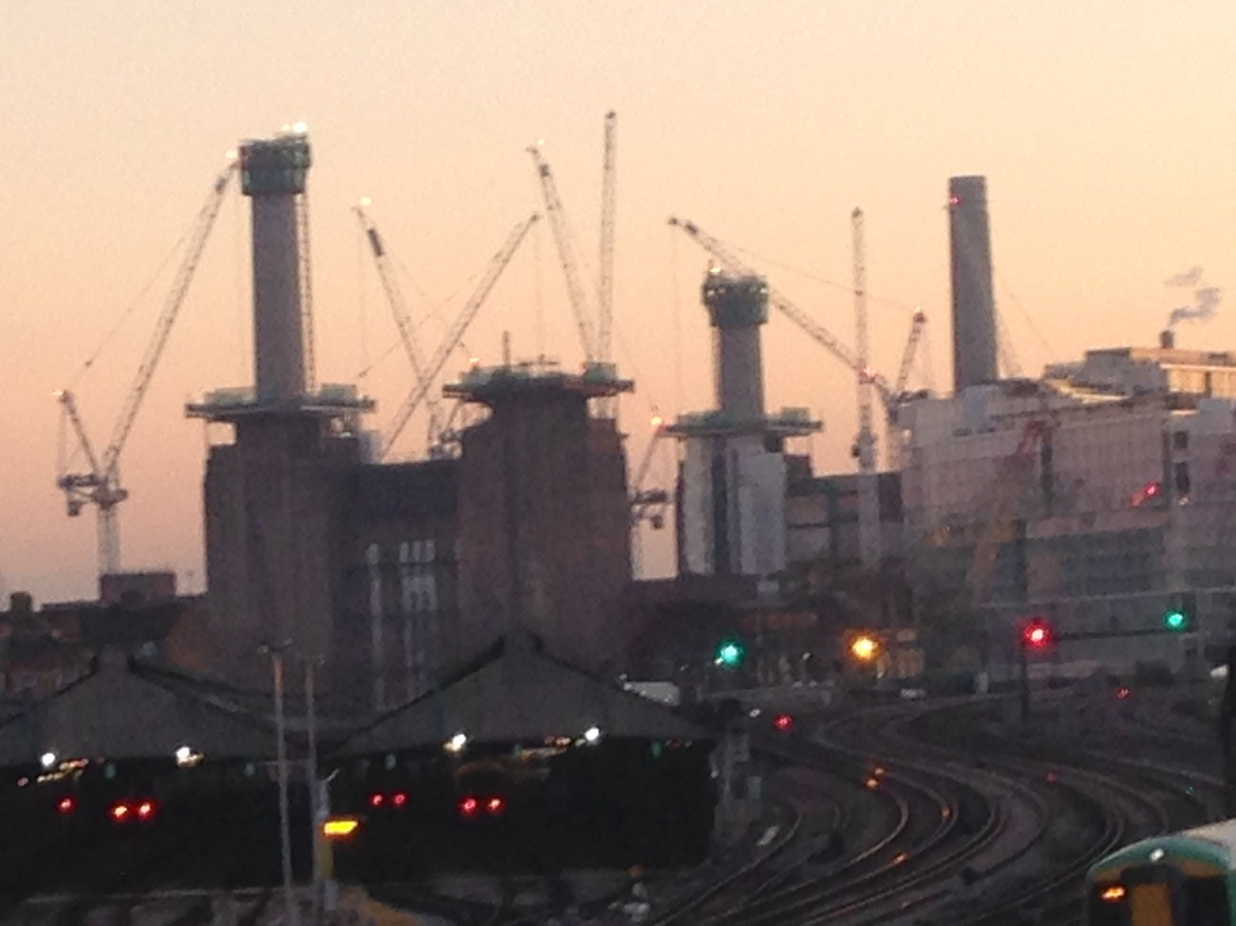
17/01/17

