Slide 1
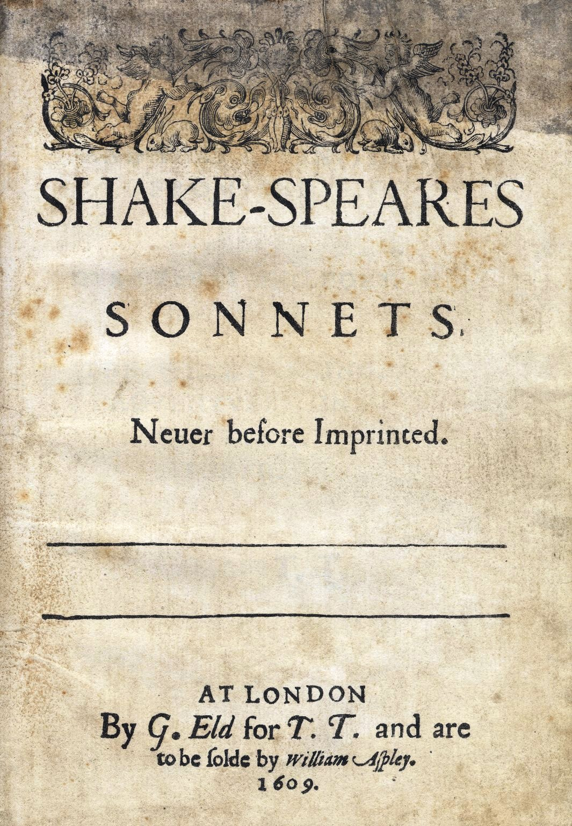

Slide 2
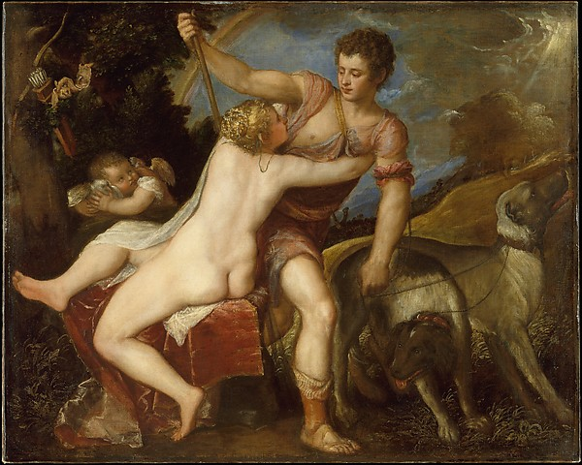
Titian, Venus and Adonis
Notes:
Titian, Venus and Adonis

Slide 3
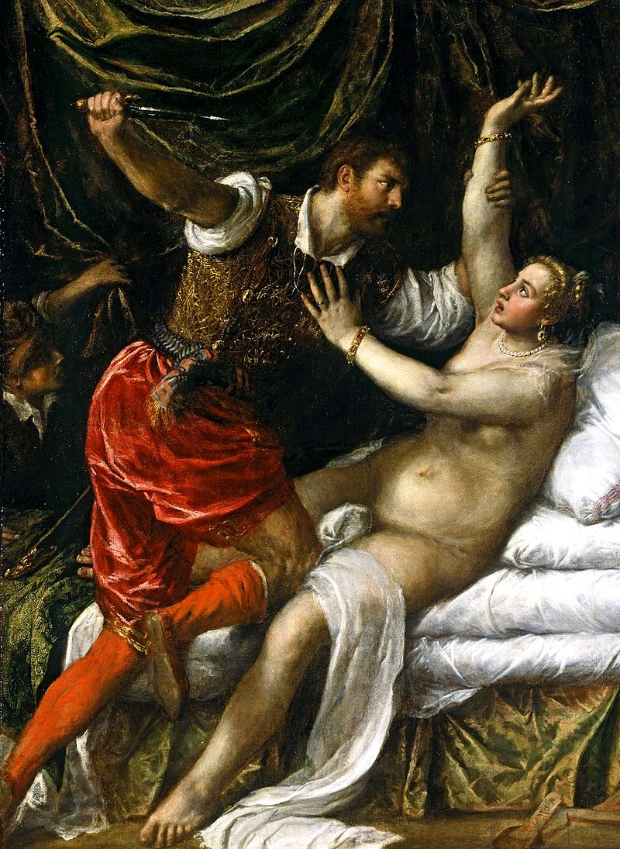
Titian, Rape of Lucrece
Notes:
Titian

Slide 4
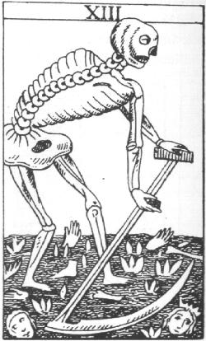

Slide 5
the attribution of a personal nature or human characteristics to something non-human, or the representation of an abstract quality in human form, the Grim Reaper to represent death
or
a figure intended to represent an abstract quality, for example a rose to represent love

Slide 8
SONNET 60
Like as the waves make towards the pebbled shore, So do our minutes hasten to their end; Each changing place with that which goes before, In sequent toil all forwards do contend. Nativity, once in the main of light, Crawls to maturity, wherewith being crown'd, Crooked eclipses 'gainst his glory fight, And Time, that gave, doth now his gift confound. Time doth transfix the flourish set on youth, And delves the parallels in beauty's brow, Feeds on the rarities of nature's truth, And nothing stands but for his scythe to mow. And yet to times in hope my verse shall stand, Praising thy worth, despite his cruel hand.

Slide 9
But looke
As every wave dryves other foorth, and that that comes behind
Bothe thrusteth and is thrust itself: even so the tymes by kind
Doo fly and follow bothe at once, and evermore renew.
For that that was before is left, and streyght there doth ensew
Anoother that was never erst.
[trans. Arthur Golding, The XV Books of… Metamorphoses (1567), ed.J.F.Nims (1965) (200-5)]

Slide 10
SONNET 60
Like as the waves make towards the pebbled shore, So do our minutes hasten to their end; Each changing place with that which goes before, In sequent toil all forwards do contend. Nativity, once in the main of light, Crawls to maturity, wherewith being crown'd, Crooked eclipses 'gainst his glory fight, And Time, that gave, doth now his gift confound. Time doth transfix the flourish set on youth, And delves the parallels in beauty's brow, Feeds on the rarities of nature's truth, And nothing stands but for his scythe to mow. And yet to times in hope my verse shall stand, Praising thy worth, despite his cruel hand.

Slide 11
Each changing place with that which goes before.

Slide 12
Like as the waves make towards the pebbled shore,

Slide 15
Against [in preparation for the time when] my love shall be as I am now,
With time’s injurious hand crushed and o’erworn;
When hours have drained his blood, and filled [?‘filed’, carved with lines, defiled] his brow
With lines and wrinkles; when his youthful morn
Hath travailed on to age’s steepy [difficult to ascend] night,
And all those beauties whereof now he’s king
Are vanishing, or vanished out of sight,
Stealing away the treasure of his spring;
For such a time do I now fortify
Against confounding age’s cruel knife,
That he shall never cut from memory
My sweet love’s beauty, though my lover’s life,
His beauty shall in these black lines be seen,
And they shall live, and he in them still green [‘keep his memory green’; green, unripe, immature, callous].

Slide 18
That time of year thou may'st in me behold When yellow leaves, or none, or few, do hang Upon those boughs which shake against the cold, Bare ruin'd choirs, where late the sweet birds sang. In me thou see'st the twilight of such day, As after sunset fadeth in the west, Which by-and-by black night doth take away, Death's second self, that seals up all in rest. In me thou see'st the glowing of such fire That on the ashes of his youth doth lie, As the death-bed whereon it must expire Consum'd with that which it was nourish'd by. This thou perceivest, which makes thy love more strong, To love that well which thou must leave ere long.

Slide 19
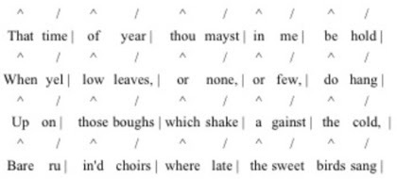
Notes:
Stressed, unstressed, like ticking of clock… drops of water dripping

Slide 20
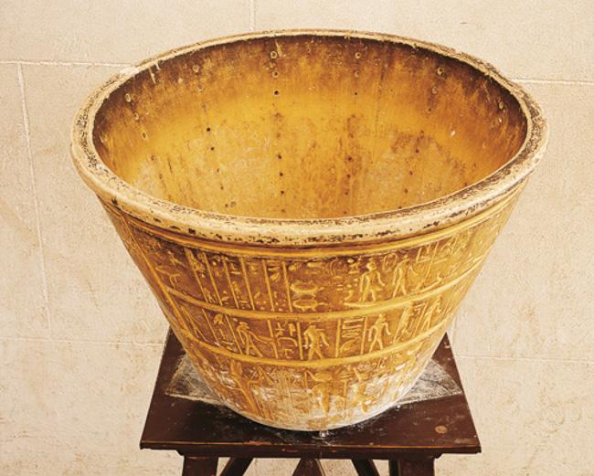
Egyptian water-clock. Copy of a conical alabaster vase with columns of 12 holes. Astronomical signs decoration on the outer surface. Image courtesy of Getty Images DEA Picture Library

Slide 21
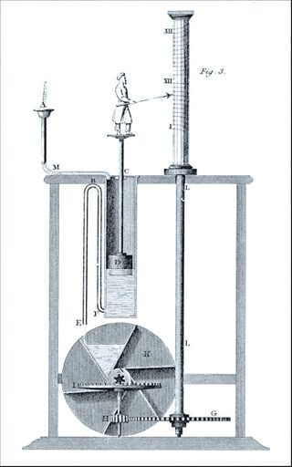
Notes:
3rd century BC

