Slide 1
Crime & punishment #1
- when legal worlds collide.
Johanne Delahunty qc

Slide 2
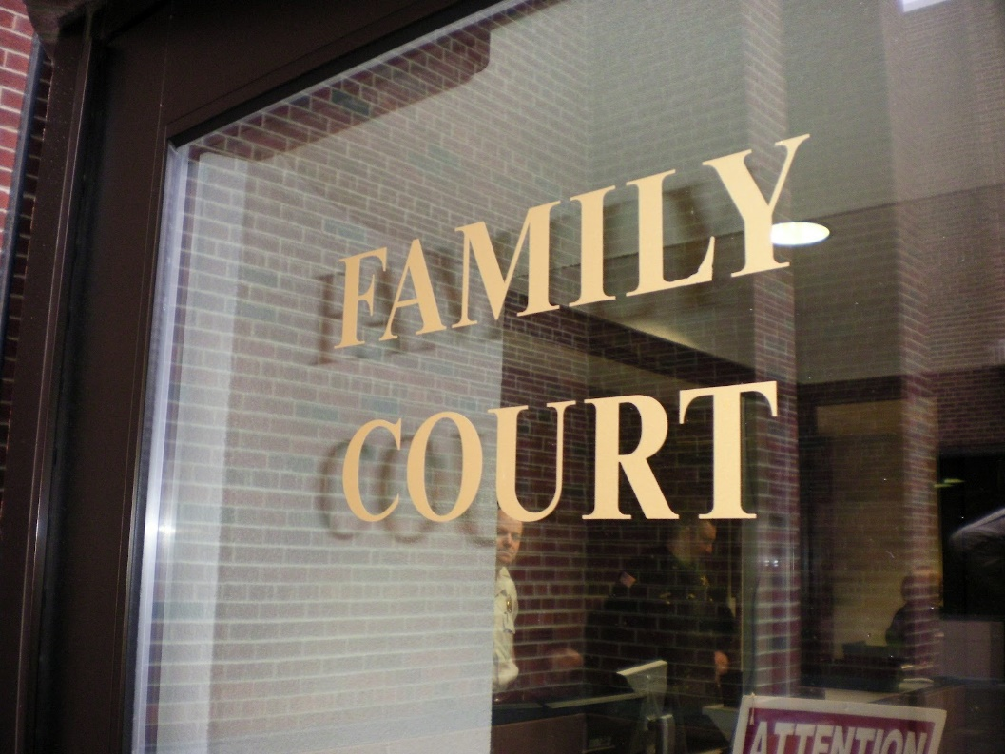
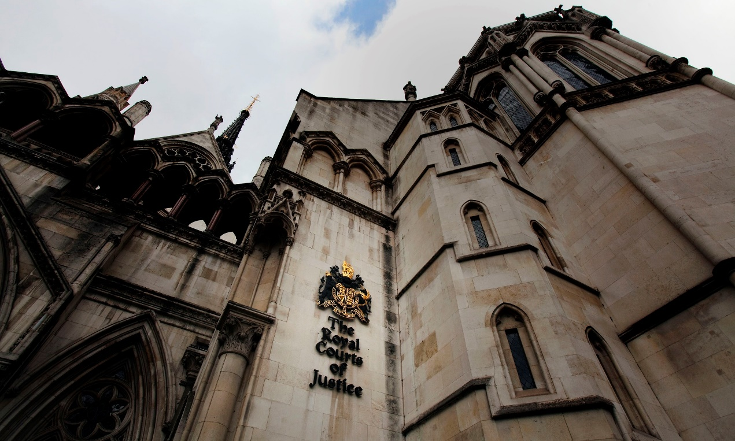
Introduction
Crime & punishment #1: when legal worlds collide
Part 1 of a two part lecture
Part 2: Guilty Until Proven Innocent
Private Law v Public Law
A warning re content
https://en.dailypakistan.com.pk/wp-content/uploads/2015/06/court.jpg
https://static-secure.guim.co.uk/sys-images/Guardian/Pix/pictures/2014/1/16/1389901744786/Royal-Courts-of-Justice-014.jpg

Slide 3
Section a: differences between criminal justice system & family courts
Crime & punishment #1: when legal worlds collide
In both the criminal and care jurisdiction the burden of proof is on the state:
Crime: on the CPS;
Family: on the Local Authority bringing the case.
The burden of proof is something very different to the standard of proof:
burden = who has to prove their case
standard = to what degree of certainty must they prove it
Coroner's Court
Crown Court
Family Court
Burden of proof
Standard of proof

Slide 4
Crime v care
Crime & punishment #1: when legal worlds collide
What is the purpose of proceedings?
What is the legal basis for the trial?
What is the standard of proof?
Where do we hear the cases?
What can the outcome be?
Who decides the case?
Who are the parties to the case?
Crime: Has the defendant committed a criminal offence against the victim or not? The outcome is specific to the adult defendant: conviction or acquittal, prison or freedom.
V
Family: Has a child suffered serious harm? If so, by whose action? What risk is there of future harm? The outcome is focused on the welfare of the subject child, not the respondent adult.

Slide 5
Crime v care
Crime & punishment #1: when legal worlds collide
Crime: A criminal offence is alleged to have been committed i.e. an unlawful act punishable by a state or other authority.
V
Family: The local authority only becomes involved when the problems in the family give rise to professional concern that the children within it have either been seriously harmed or are at risk of serious harm or neglect by their carers or those their carers associate with.
What is the purpose of proceedings?
What is the legal basis for the trial?
What is the standard of proof?
Where do we hear the cases?
What can the outcome be?
Who decides the case?
Who are the parties to the case?

Slide 6
Crime v care
Crime & punishment #1: when legal worlds collide
Crime : Beyond reasonable doubt
V 99:1 v 51:49 balance
Family: Balance of probabilities
Why?
In the criminal court the standard is higher : satisfied so as to be sure because it is thought better that a guilty person goes free than an innocent person be convicted. Taking away someone’s liberty and branding them a criminal is so serious a charge between the state and a citizen that society must be as sure as it can be that they are guilty.
In a family court, the standard is lower (balance of probabilities: more likely than not), because the purpose of any hearing is to protect a child. If there is a risk that they could come to significant harm, the consequences could be too serious to subject them to the risk. So the standard of proof is lower i.e. err on the side of caution rather than risk avoidable significant harm to a child even when this breaches a parent’s right to bring up their child.
What is the purpose of proceedings?
What is the legal basis for the trial?
What is the standard of proof?
Where do we hear the cases?
What can the outcome be?
Who decides the case?
Who are the parties to the case?

Slide 7
Crime v care
Crime & punishment #1: when legal worlds collide
Think about it? We have different courts for different purposes. The Family Court room is, physically, a different place from a Criminal Court. We may have combined centres but the two types of court room have very different functions and facilities and are separated geographically. Cells are not commonly found in Family Courts, we don’t have ‘docks’, we don’t have police level security, we don’t have different entrances and exits for vulnerable witnesses or juries.
What is the purpose of proceedings?
What is the legal basis for the trial?
What is the standard of proof?
Where do we hear the cases?
What can the outcome be?
Who decides the case?
Who are the parties to the case?

Slide 8
Crime v care
Crime & punishment #1: when legal worlds collide
Crime : Acquittal or conviction,
the jury determines the verdict,
the judge determines the sentence.
The purpose of it may be part punishment, part deterrent.
It’s a verdict and sentence focused on THE DEFENDANT.
Family : There is no jury: the judge determines what happened in the past and will happen in the future
what has happened to the child?
Who did what to it?
Who poses a risk to a child?
Where is it safe for a child to live?
Can the child be rehabilitated to a parent or the family or is permanent separation through foster care or adoption required ?
The judge’s decision is focused on THE CHILD. The consequences for the parent or adult are secondary.
What is the purpose of proceedings?
What is the legal basis for the trial?
What is the standard of proof?
Where do we hear the cases?
What can the outcome be and ?
Who decides the case?
Who are the parties to the case?

Slide 9
Crime v care
Crime & punishment #1: when legal worlds collide
Crime : The Crown v The Defendant/s
V
Family : The Local Authority v The Respondents : which automatically includes the parents and the child and other people (interveners) may also be joined with the courts permission
What is the purpose of proceedings?
What is the legal basis for the trial?
What is the standard of proof?
Where do we hear the cases?
What can the outcome be?
Who decides the case?
Who are the parties to the case?

Slide 10
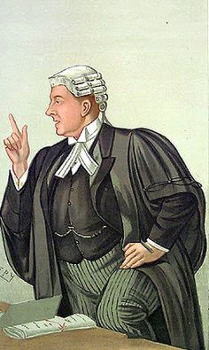
Crime v care
Crime & punishment #1: when legal worlds collide
Crime: (Crown Court) Barrister and judge wear wig, gown, wing collar, bands or collarettes
V
Family: (High Court, County Court) No 18th century dress code but etiquette and the professional Code of Conduct requires ‘business wear’ and a colour palate of black, dark grey, navy.
Continued
What about the lawyers?
Who can hear what's happening in court?
What evidence is heard?
What are the roles of Experts?
Is there a right to silence?
What is the timescale from start to a decision?

Slide 11
Crime: Heard in public: public admitted
V
Family: No public permitted. Only the Local Authority social work team bringing the case, the respondents themselves and the lawyers for each team are in court.
Crime : Press permitted into court and can report within recognised limitations that don’t compromise the fairness of the trial
V
Family: Accredited members of the press are permitted into court but are not permitted to report anything that could lead to identification of the subject children . Press, Parties, witnesses etc. who are involved or have knowledge of the case cannot publish any detail of the case or the documents. That is a contempt of court and can by punished by the court.
s97 Children Act 1989 makes publication of information identifying a child, his school or his address a criminal offence
s12 Administration of Justice Act 1960 defines circumstances where publication may amount to a contempt of court,
Crime v Care v care
What about the lawyers ?
Who can hear what's happening in court?
What evidence is heard?
What are the roles of Experts?
Is there a right to silence?
What is the timescale from start to a decision?
Crime v care

Slide 12
Crime v Care v care
What about the lawyers ?
Who can hear what's happening in court?
What evidence is heard?
What are the roles of Experts?
Is there a right to silence?
What is the timescale from start to a decision?
Crime: Strict rules on evidence used in court with legal argument to determine admissibility on contentious matters (heard in absence of the jury and determined by the judge)
V
Family: a wide canvass of evidence is permitted including hearsay; it’s a question of weight rather than admissibility.

Slide 13
Crime v Care v care
What about the lawyers ?
Who can hear what's happening in court?
What evidence is heard?
What are the roles of Experts?
Is there a right to silence?
What is the timescale from start to a decision?
Crime: A pool of Experts.
V
Family: A drought of Experts.
Why?
There are differences in: their duty; their availability; their willingness to become involved; the use of their report; their interaction with those instructing them in court and outside of it.
Key issues for the family court that affect an expert’s involvement are: necessity; transparency; time scales to report; willingness to become involved; funding of their work; national or international scope of expert instruction.

Slide 14
Crime: the defendant can elect to give no evidence at all and can refuse to answer questions if he/she chooses.
V
Family : the respondent can be witness summonsed to attend court, be threatened with contempt of court if they refuse to give evidence and, if giving evidence, cannot avoid answering a question even if the answer might incriminate him or her (pursuant to s 98 Children Act 1989).
Crime v Care v care
What about the lawyers ?
Who can hear what's happening in court?
What evidence is heard?
What are the roles of Experts?
Is there a right to silence?
What is the timescale from start to a decision?

Slide 15
Crime: How long is a piece of string? It can be a year or years. A trial may be stood down because of witness availability, counsel availability, admin problems etc.
V
Family: The Children And Families Act 2014 introduced profound changes in the way family care cases were dealt with by the courts. We now have to operate under a 26 week timetable from issue of proceedings to conclusion unless there are exceptional and necessary extensions to the trial timetable which have to be authorised by the judge.
Why?
Delay is inimical to the welfare of the child:
Crime v Care v care
What about the lawyers ?
Who can hear what's happening in court?
What evidence is heard?
What are the roles of Experts?
Is there a right to silence?
What is the timescale from start to a decision?

Slide 16
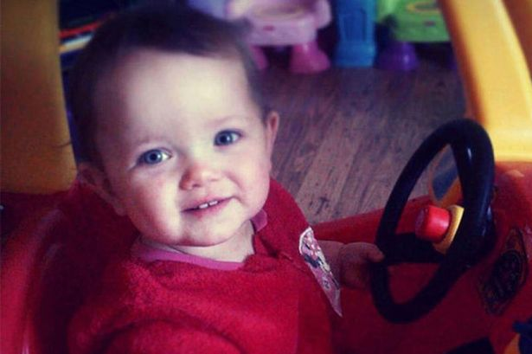
Section b: what impact can these differences have?
Crime & punishment #1: when legal worlds collide
*Warning*
Case 1: Poppi Worthington
December 2012 Poppi dies
February 2013 Poppi buried
June 2013 Post-mortem report
August 2013 Poppi’s parents arrested
March 2014 Fact-finding judgment delivered in private
June 2014 IPCC
October 2014 Death declared as “unexplained”
January 2015 Request for fresh inquest
March 2015 No police charges
April 2015 Publication of fact-finding judgement delayed
July 2015 High Court orders fresh inquest
November 2015 Hearing reviews medical evidence
January 2016 Family judge rules Poppi was sexually assaulted

Slide 17
Case 1: poppi worthington
Crime & punishment #1: when legal worlds collide
What led to the Family Court's decision?
Facts as recited by judge
Crown Prosecution Service (CPS) twice decided not to charge
High Court Judge twice ruled father has sexually assaulted daughter shortly before her death
June 2016 Serious Case Review published
September 2016 Inquest postponed
November 2016 CPS again decide not to charge anyone

Slide 18
Case 2: kye kerr
Crime & punishment #1: when legal worlds collide
11th July 2011 - 6 week old Kye Kerr died
Catastrophic head injury - Cause of death unascertained
No proceedings
September 2013 - conclusions reviewed; parents arrested
Care proceedings - found father caused Kye's death
March 2015 - father charged with manslaughter
November 2015 - father acquitted

Slide 19
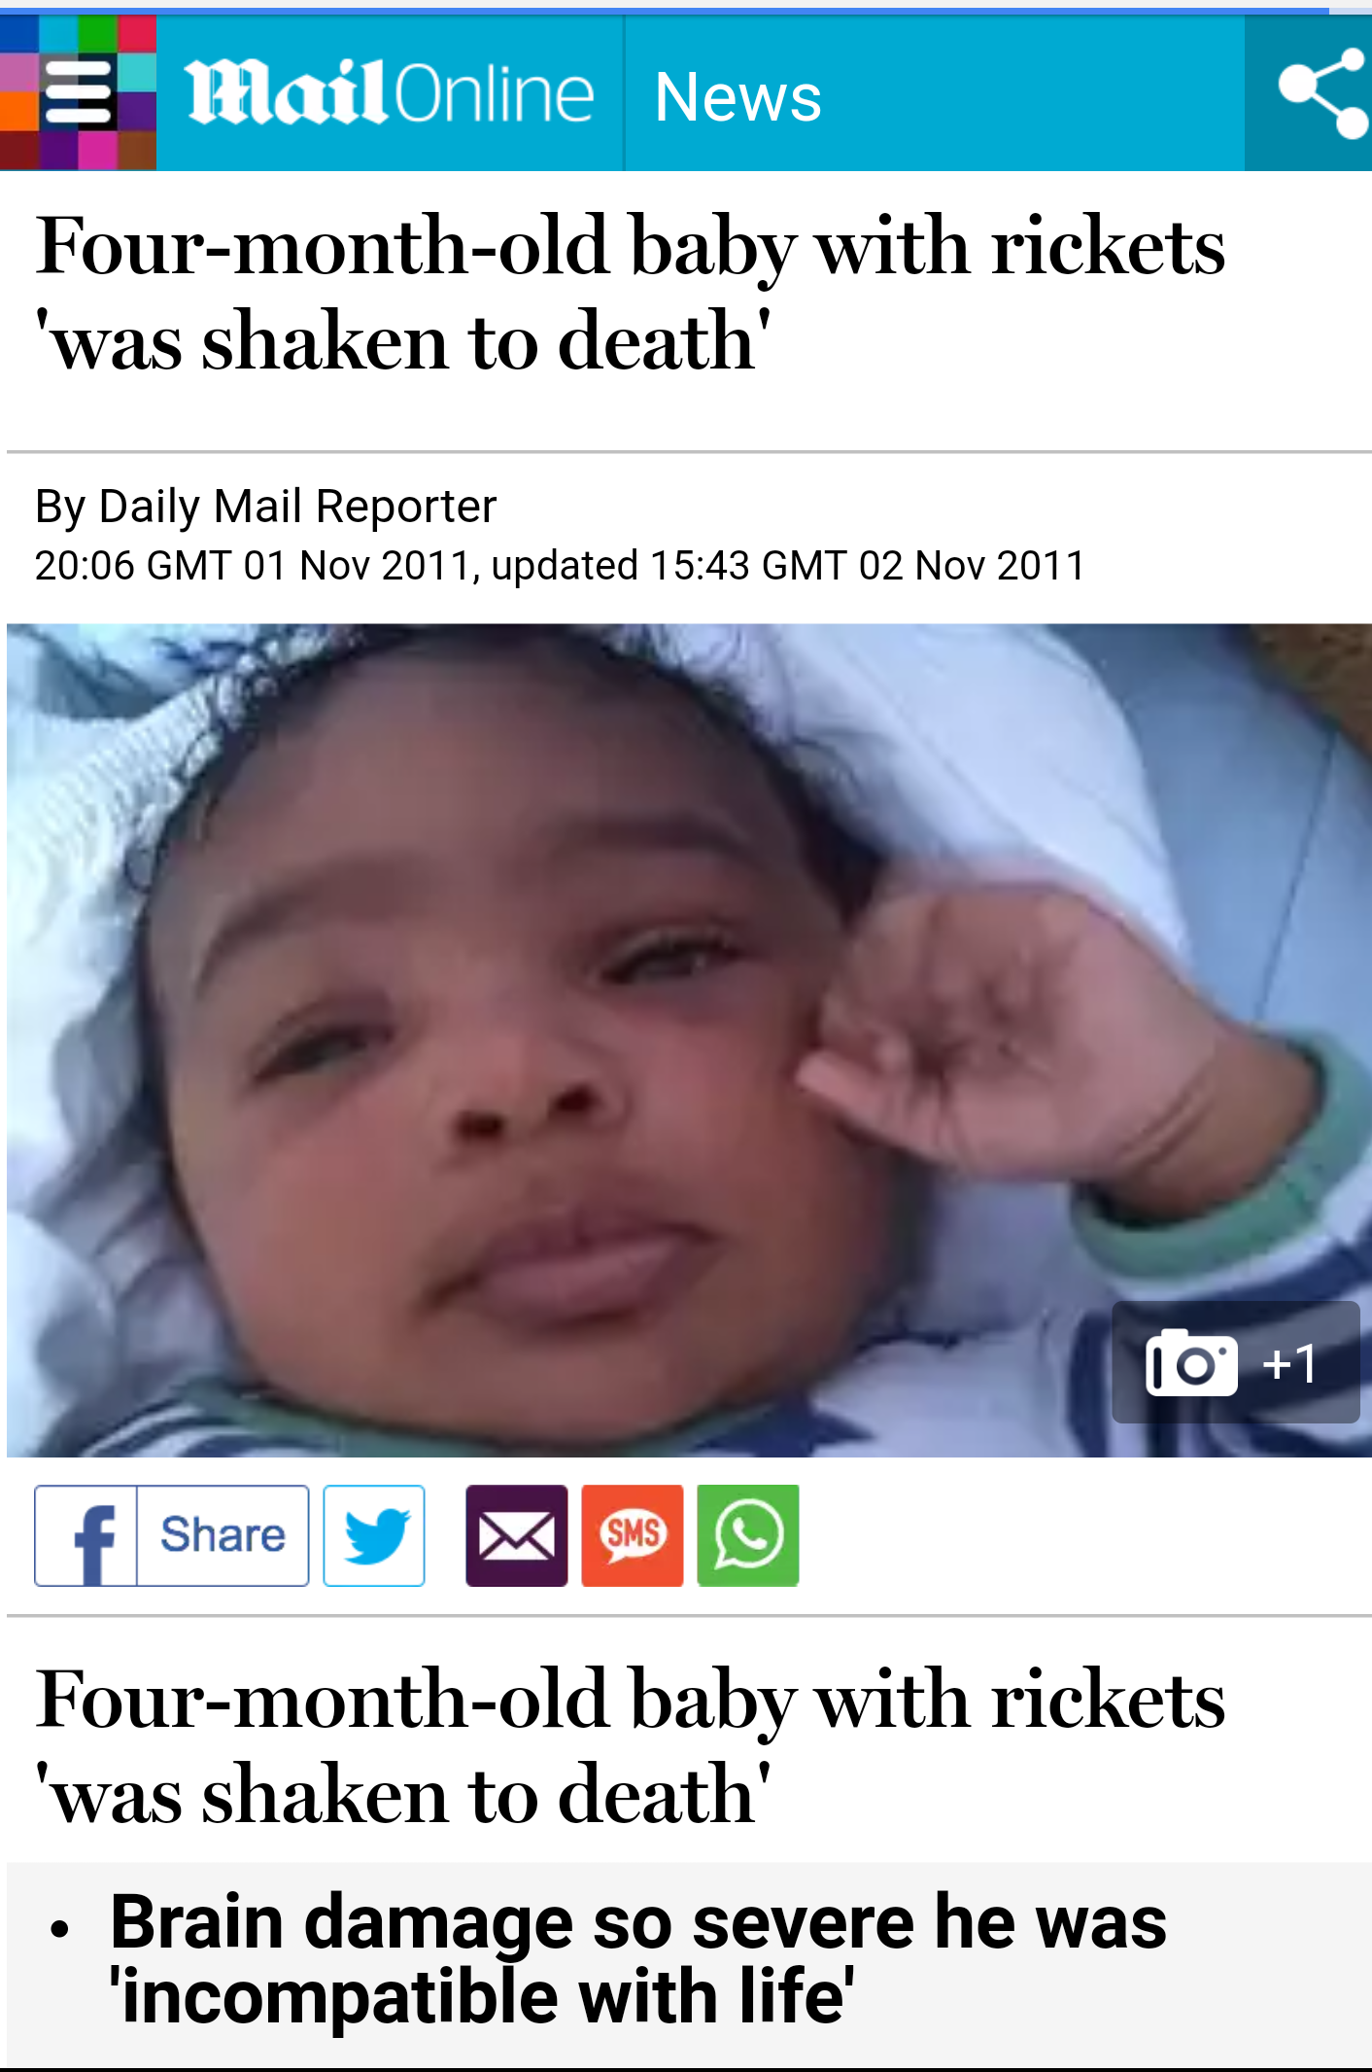
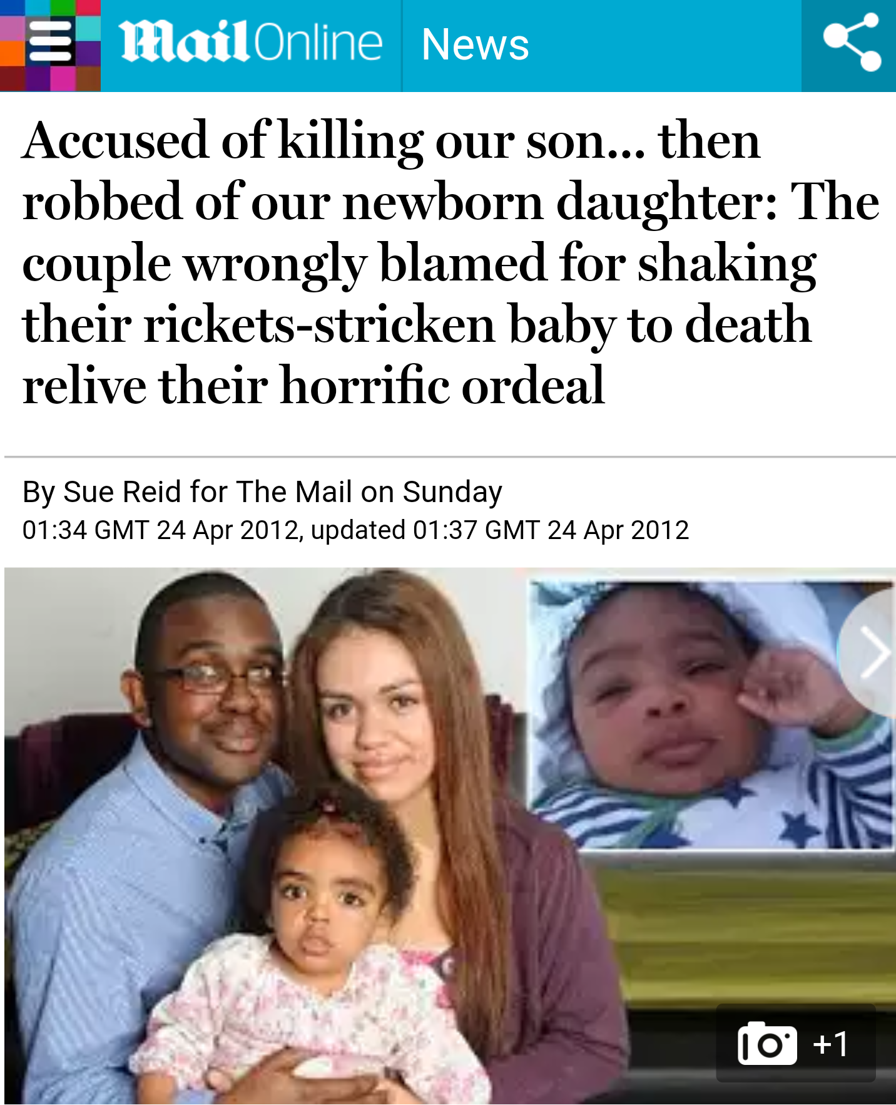
case 3: jayden wray
Crime & punishment #1: when legal worlds collide
Declaration
Birth
Clinical picture pre-collapse
Receiving hospital - University College Hospital (UCH)
Transfer to Great Ormond Street Hospital (GOSH)
Death and Post Mortem
Cause of death?

Slide 20
case 3: jayden wray
Crime & punishment #1: when legal worlds collide
Jayda is born
Criminal trial
Charges withdrawn - not guilty verdict
Care proceedings initiated by local authority
Experts, the Triad and its alternative
Disagreements between experts
Failures in hospital treatment

Slide 21
case 3: jayden wray - findings of family division
Crime & punishment #1: when legal worlds collide
all fractures were a product of rickets;
death was attributed to a constellation of benign causes;
severe vitamin D deficiency rendered the baby vulnerable to infection and seizures;
ongoing seizures led to raised intracranial pressure, retinal haemorrhages, subdural haematoma and culminated in hypoxic ischemia brain injury and death;
Jayden was conscious and suffering from seizures on arrival at UCH which were not adequately brought under control during his treatment at UCH which she described as sub optimal.
Dealing with the triad of injuries, she concluded that the retinal haemorrhages were more likely to be secondary to Jayden’s hypoxic ischaemic injury, and the encephalopathy was not due to inflicted trauma.
Judge concluded that the subdural haemorrhage (SDH) was more likely to be caused by trauma (of undetermined origin) and that further research was required

Slide 22
Concluding remarks
Crime & punishment #1: when legal worlds collide
Child abuse is the stuff of nightmares: but so is being falsely accused of harming your child.
Child abuse is the stuff of nightmares: but so is being falsely accused of harming your child.
It is because the welfare of the child is the paramount consideration of the court that explains the many differences between the legal framework of the criminal and care jurisdictions. Every decision the court makes; the remit of the evidence to be called; what expert evidence is permitted; how the trial is to be structured; who plays a part in it: all of these case management decisions are determined by, what the judge determines to be, the child’s best interest. Their welfare is paramount.
The extent to which family courts get it right or wrong will always be the subject of intense debate, and rightly so.
Science is constantly evolving and miscarriages of justice have happened with parents wrongly accused of shaking their child to death based on scientific research and hypothesis, genuinely held, but discarded or refined as science develops.
For the time being, the criminal justice system offers a remedy ex post facto and the family justice system attempts intervention at an earlier stage before such abuse has occurred, if not to protect the child who has already been harmed or killed, then at least to protect any vulnerable siblings who might also be at risk.
http://quotesgram.com/thank-you-for-listening-quotes/

Slide 23
future lectures
Crime & punishment #1: when legal worlds collide
Crime & Punishment #2: Guilty Until Proven Innocent
Thursday 2nd March 2017
Expert Witnesses: A Zero Sum Game?
Wednesday 12th April 2017
Why There Is No Typical Family In The Family Court
Thursday 4th May 2017

