Slide 1
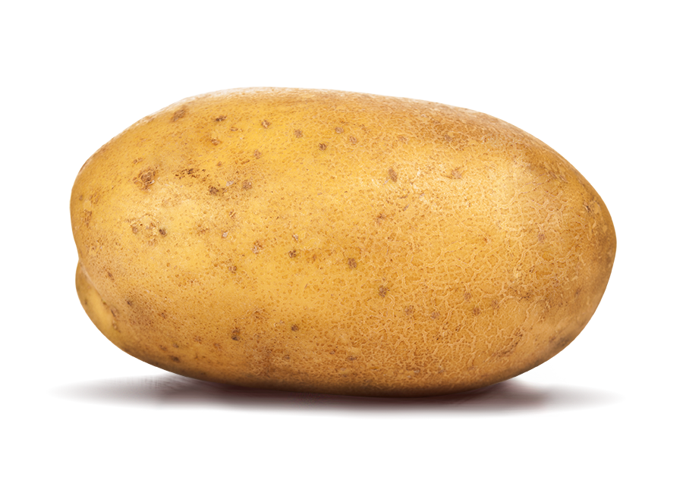



How Much Maths Can You Eat?
Chris Budd

Slide 2
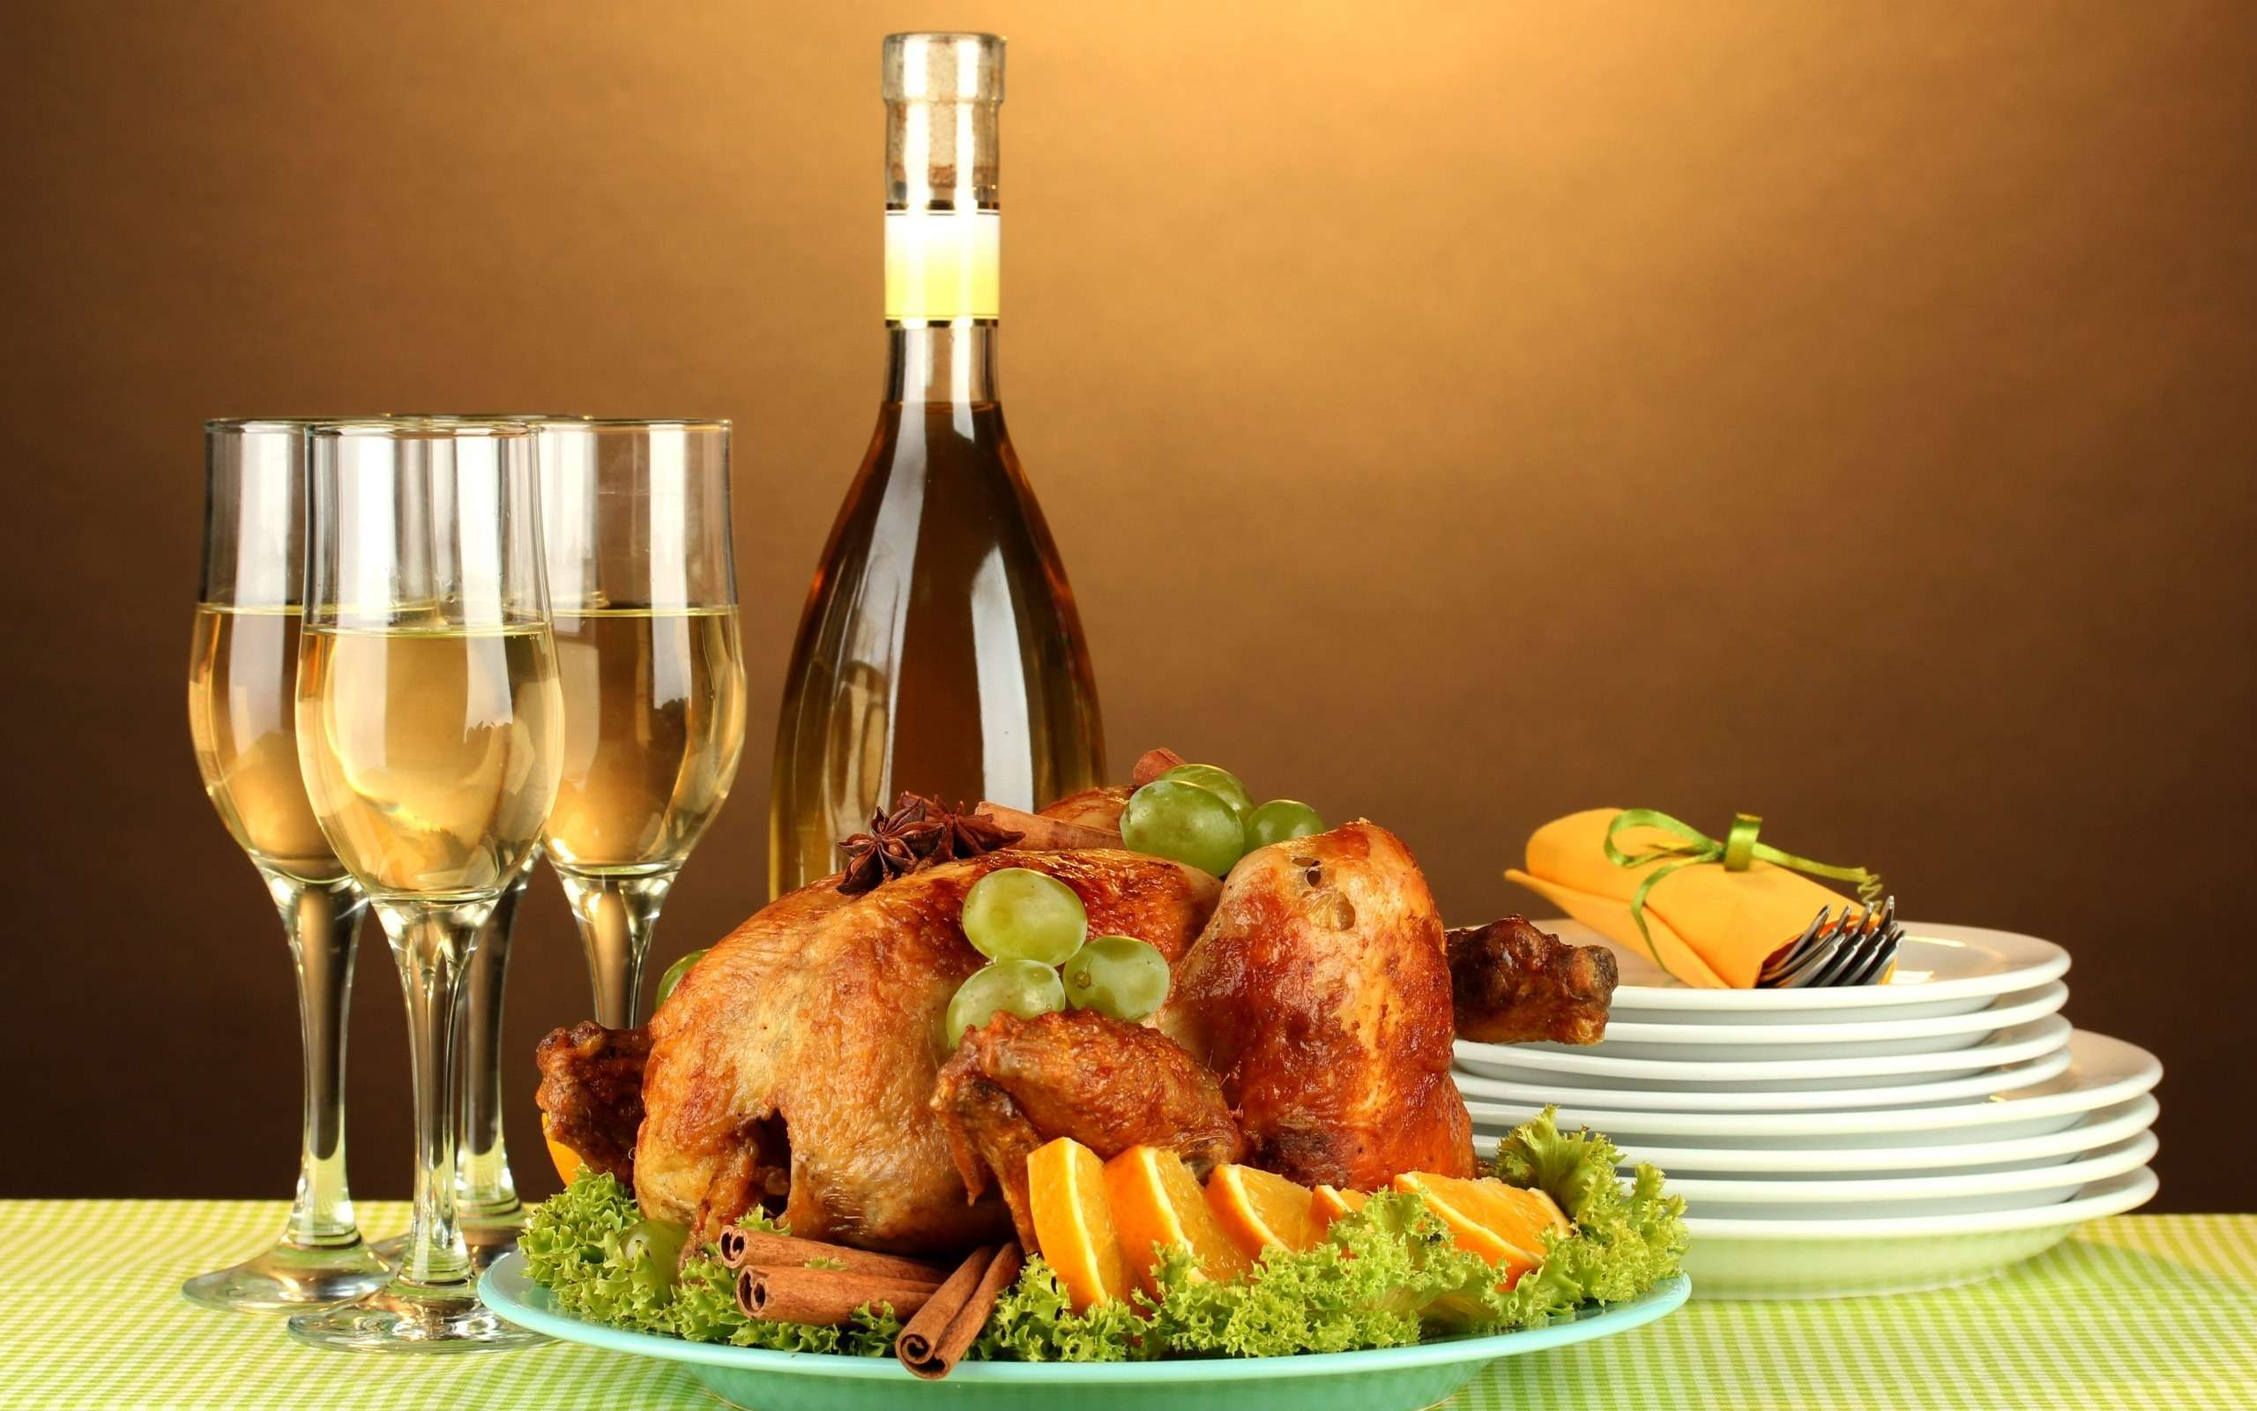
Nothing could be more important to us than food and drink!
Food and drink is THE largest industry in the world

Slide 3
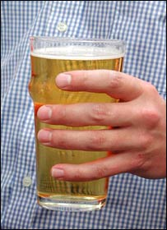
Some food facts
Agri-science is 6th on the list of
HM Government’s 8 Great Technologies
Food industry is worth £100 Bn per year to the
UK economy
Drink industry alone is worth £ 18 Bn per year
5 Bn Pints are drunk per year – 2 per person per week in the UK
We need to grow more food in the next 50 years than in the last 1 000 if we are to feed the world’s population.

Slide 4
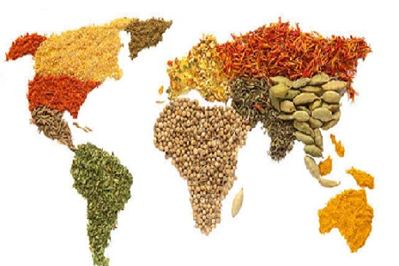
But, can maths feed the world?
Often asked question when I give a maths talk at school is:
Yes, but how is that helping the starving people in Africa?

Slide 5
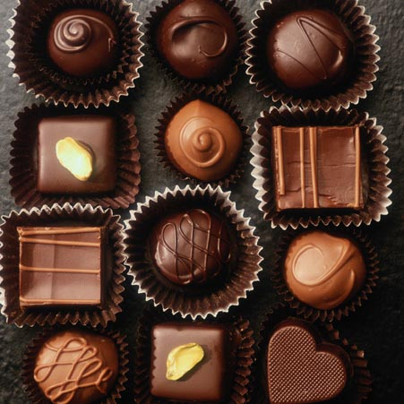
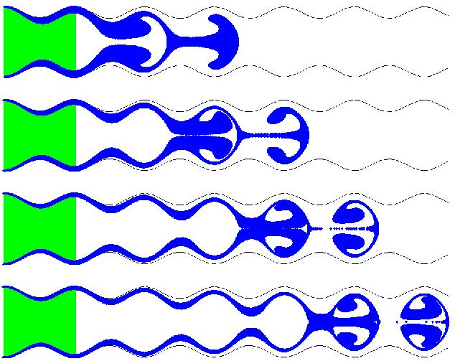
Yes!!!!
From Farm to Fork Mathematics plays an essential role in predicting, optimising and controlling the following food processes
Growing
Irrigation
Pest control
Harvesting
Feeding
Freezing
Storing
Packing
Transporting
Making
Cooking
Eating
Digesting
Getting rid of the waste
Mathematics involves differential equations and optimisation

Slide 6
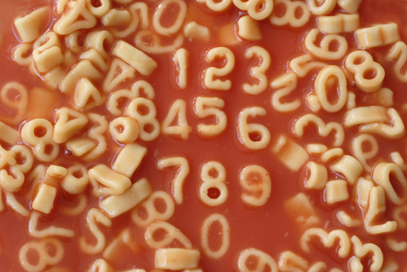
We will now look at some case studies showing maths in action to bring the food to your table

Slide 7
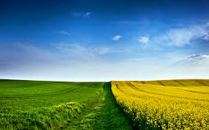
1. It all starts in a field or in the sea
Fields are highly complex systems
Growing food in them involves a careful
combination of
Planting the right seeds
Irrigating them correctly
Using the correct amount of pesticides and fertilisers
Accurate localised weather prediction
Critical to get right. A farmer may well invest their entire savings on the seeds for one harvest

Slide 8
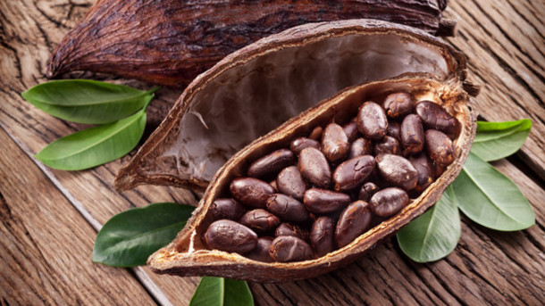
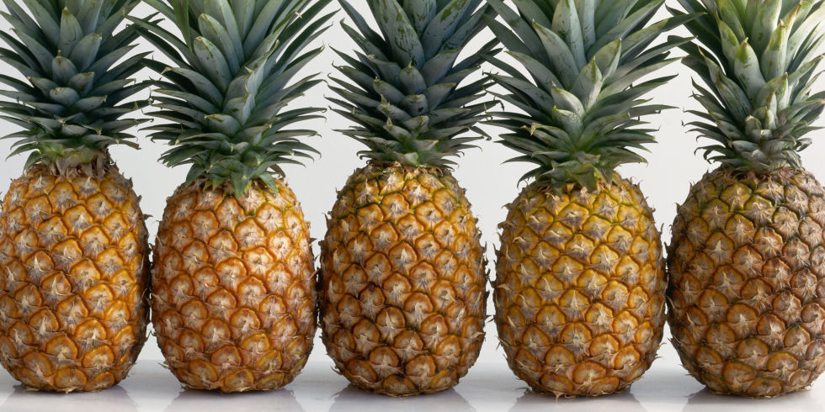
Example: Farming cocoa in Ghana
Farmers grow cocoa beans and pineapples
Both are affected by weather
Different costs for each
Different sale prices for each
Q. How many of each to grow?

Slide 9
Linear optimisation problem:
Grow c cocoa p pineapples
Cost: C = a*c + b*p + labour
Space taken up: S = e*c + f*p
Profit: P = g*c + h*p
Problem: How can we choose c and p to:
Maximise P
Constraints: C < C_max, S < S_max

Slide 10
Can solve this and more complicated problems using Dantzig’s Simplex Algorithm

Slide 11
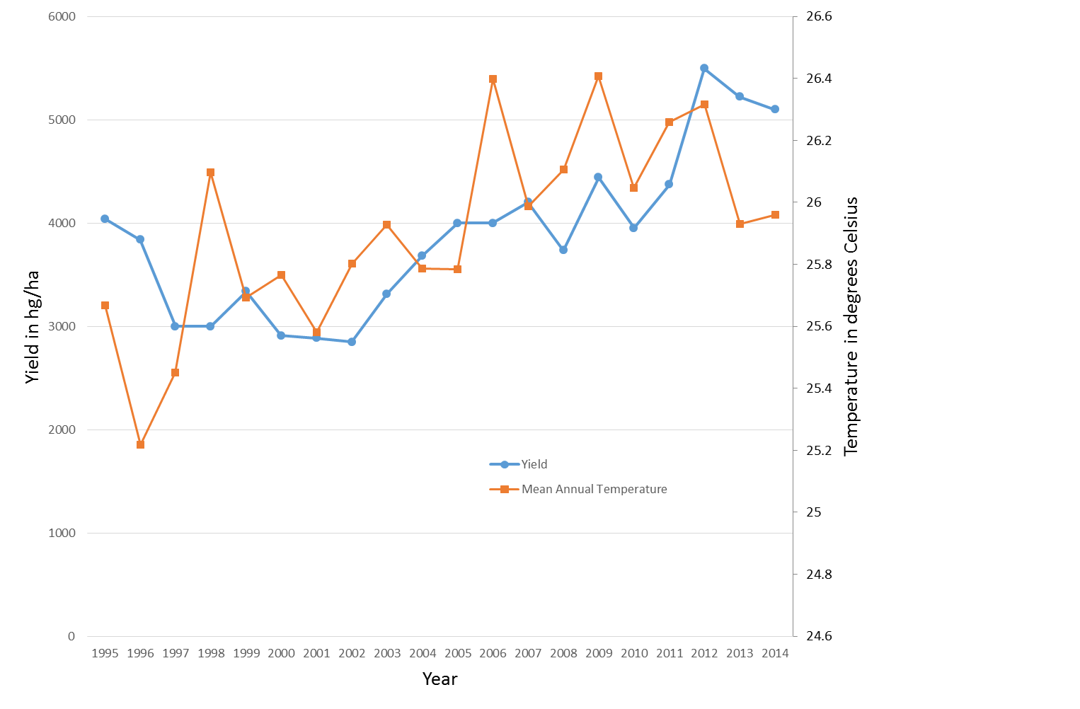
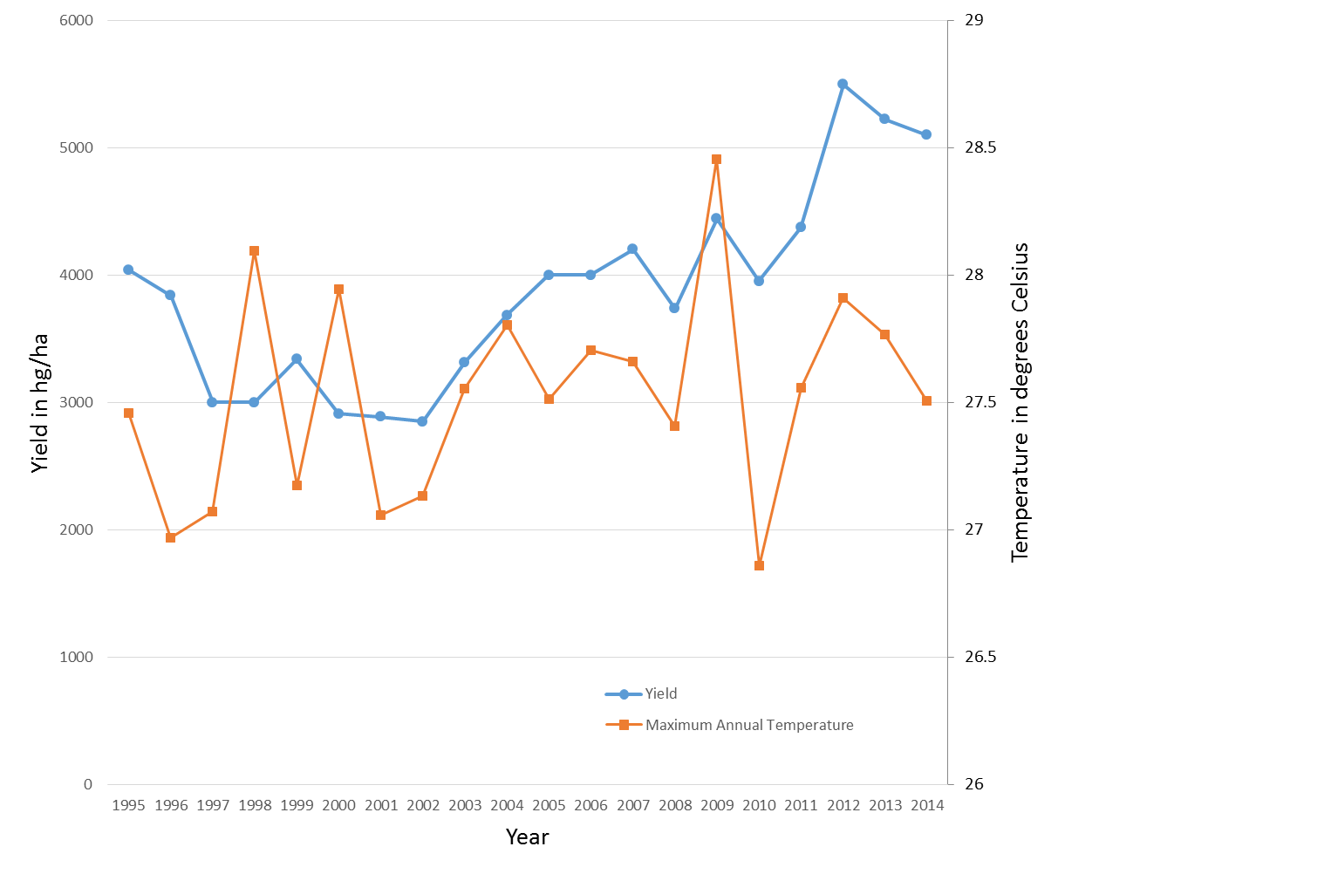
Need more mathematics to predict the weather and determine its impact on production
Effect of temperature on cocoa

Slide 12
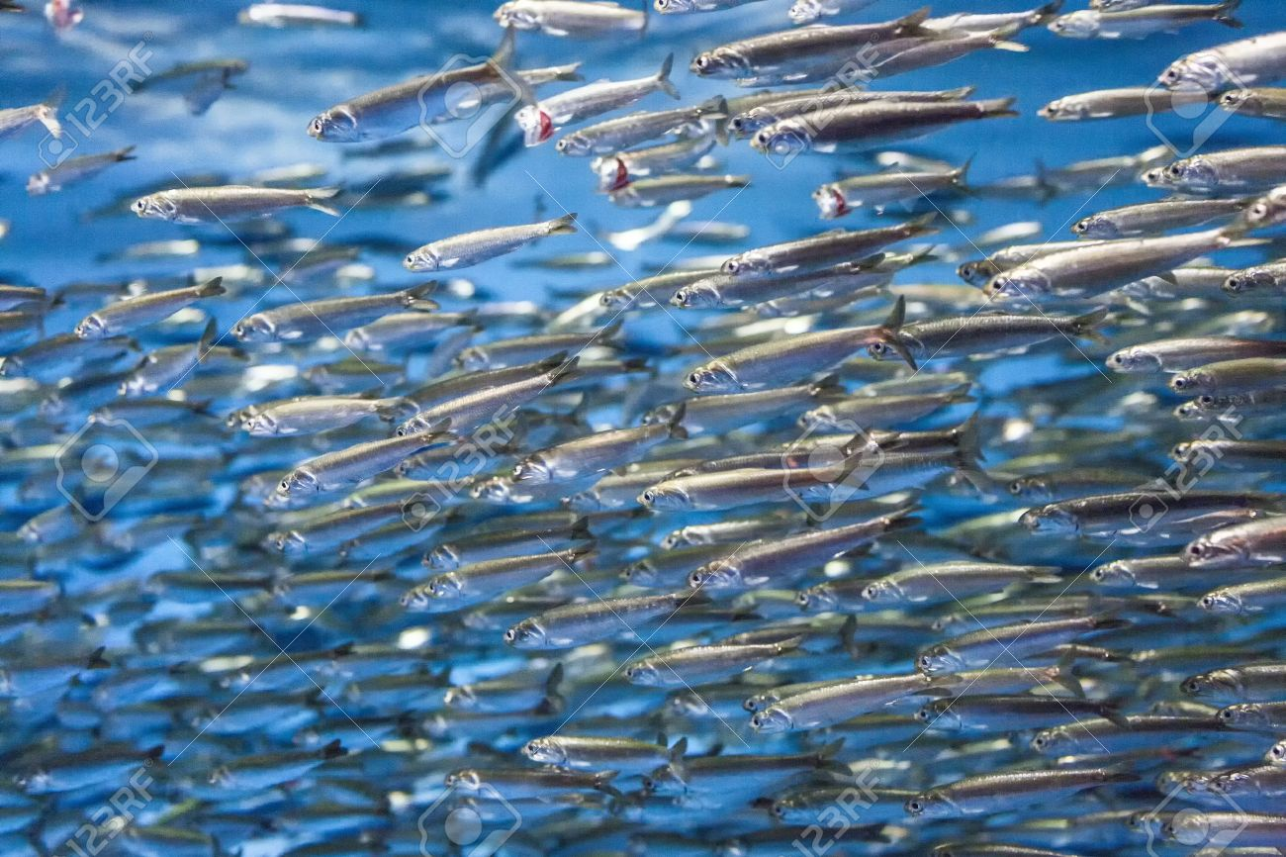
Fishes in the sea
Mathematics is also used to predict and to control fish stocks and fishing
f(t): amount of fish k: maximum sustainable population
a(t): growth rate of the fish b(t): harvesting rate
Logistic
equation

Slide 13
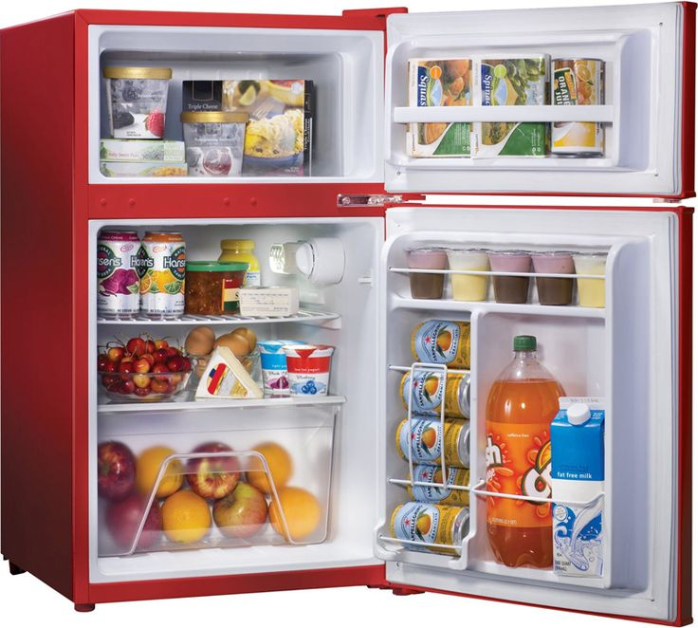
2. How to keep food fresh and test it for freshness
Major advance in 19th Century: Laws of thermodynamics (Kelvin)
Led directly to the development of refrigeration to store fresh food.

Slide 14
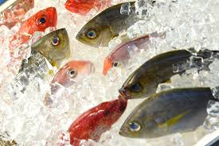
Q. How do we safely freeze food and keep it frozen?

Slide 15
Basic equation for all frozen food
N: Enthalpy T: Temperature
Can extend to a Stefan problem to work out the frozen region

Slide 16
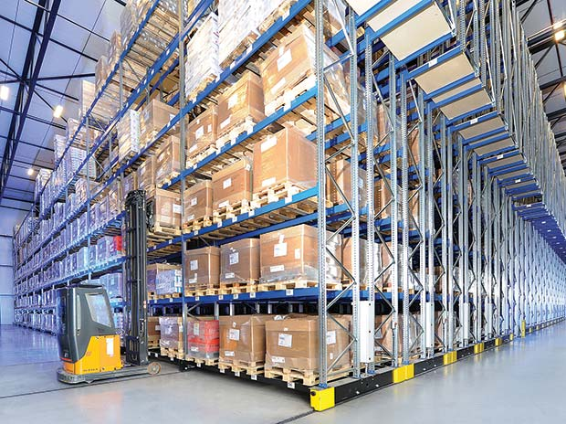
Used to design and maintain huge freezer wharehouses

Slide 17
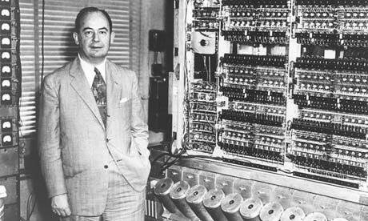
3. I’m Forever Blowing Bubbles
Mathematics can be used to put the foam onto beer
Lager:
Foam is made by bubbles of Carbon Dioxide
Small bubbles are eaten up by larger ones (Oswald Ripening)
Large bubbles make a pattern discovered by von Neumann
Eventually burst

Slide 18
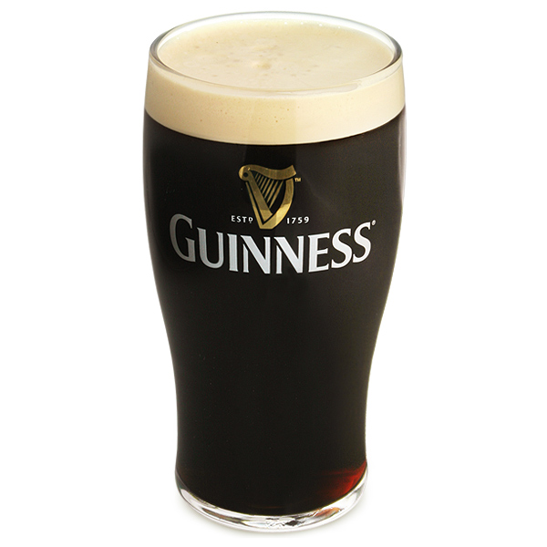
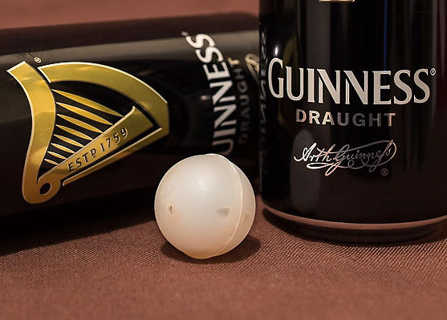
A taste of Ireland
Bubbles in Guinness are smaller and longer lasting than those in other beers
Produced by introducing Nitrogen into the beer
In a pub this uses a pipe
In a can it uses a widget … lots of maths

Slide 19
Important maths paper from the MACSI group in Limerick Ireland
Who says mathematicians can’t have fun!

Slide 20
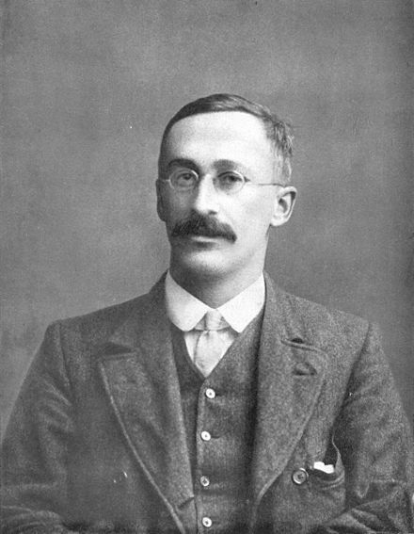
4. Why statisticians couldn’t organise a piss up in a brewery!!
Quality of Guinness in Dublin was monitored by using advanced statistical methods developed by Ghosset
He developed a test to determine
if two batches of Guinness were
Significantly from each other.
Published the test in 1908 under the
pseudonym of Student
Since then it has been known as
Student’s t-test It has very wide applications

Slide 21

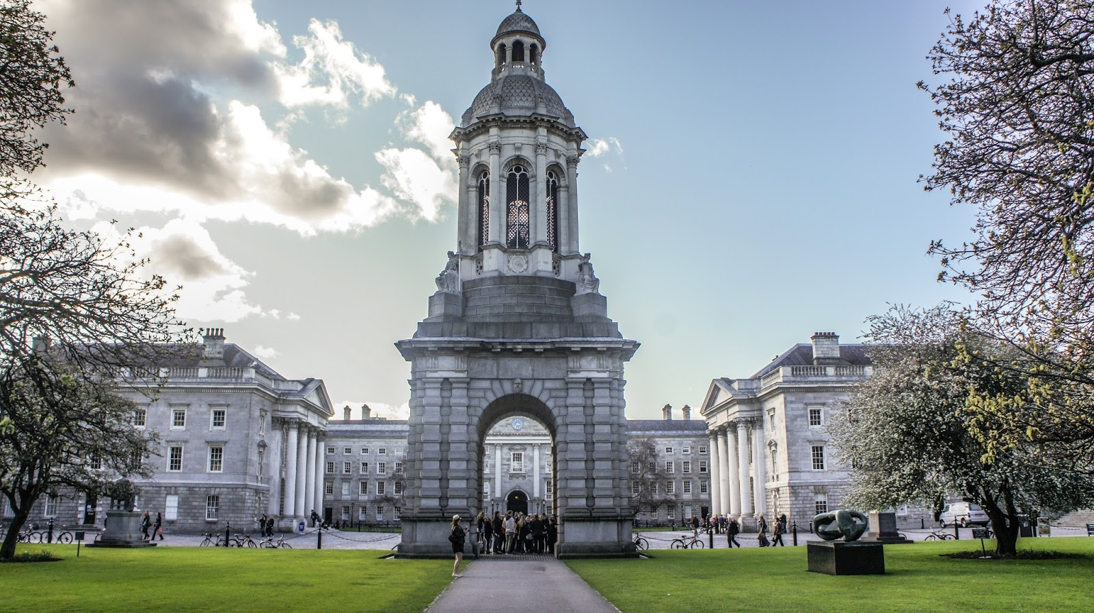

Slide 22

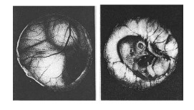
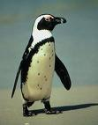
5. Incubation of eggs
Often have to incubate eggs artificially
Need to control
Temperature
Humidity
Turning of the egg
Very sensitive to the turning strategy!
Eggs are turned by mother every 20 minutes

Slide 23
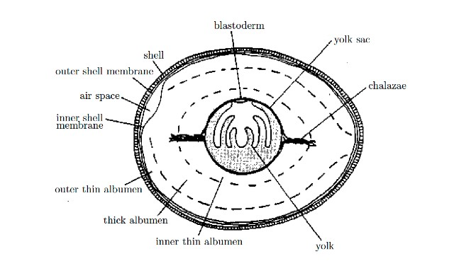
Blastoderm of lower density
Yolk is free to rotate

Slide 24
Some possible reasons for turning eggs ….
Conduction of heat … this is what Bristol zoo believed!
Dispersal of nutrients
Removal of waste products

Slide 25
Modelling the conduction of the heat
Q. Is turning needed to maintain an even temperature?
Radius of egg R = 2cm
Temperature = T
Thermal diffusivity k =
Heat equation

Slide 26
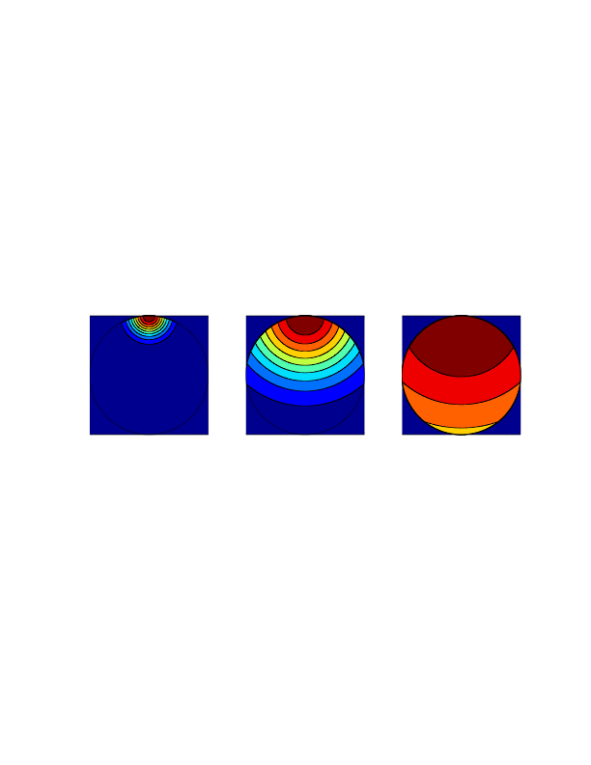
10 seconds
2 minutes
20 minutes
Too short!!! Consistent with results from incubator

Slide 27
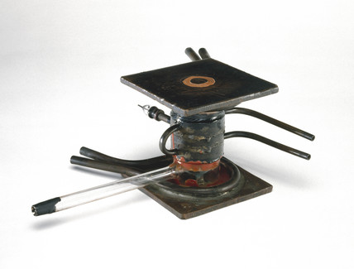
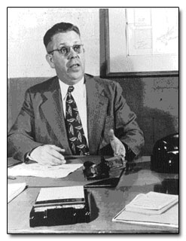
6. How to cook a potato
Cavity Magnetron
Invented by Randall and Boot during the war to produce high power radar waves at centimetre wavelengths
Realised by Percy Spencer that microwaves could be used to heat food (candy)
He invented the microwave cooker

Slide 28
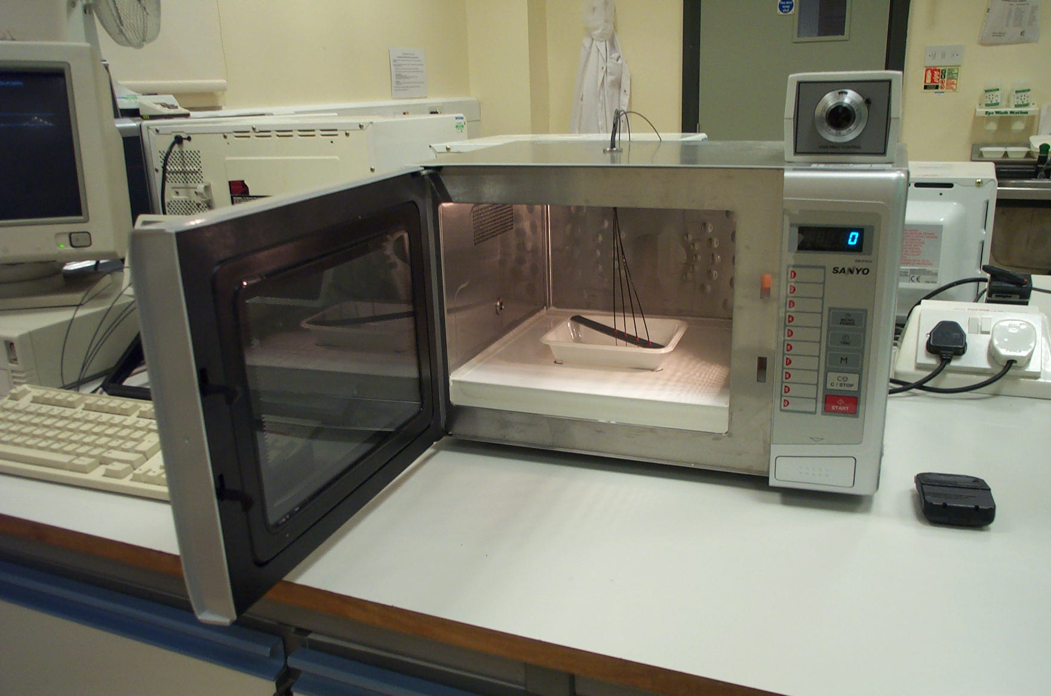
Microwave cooker

Slide 29
How safe is microwave cooking?
If you cook a potato in a microwave cooker what gets hotter?
The outside
The middle
Somewhere else?
What is the best design of a microwave cooker?
Mode stirred
Turntable

Slide 30
Thermal image of the food surface after 5 minutes heating (stirred oven)

Slide 31
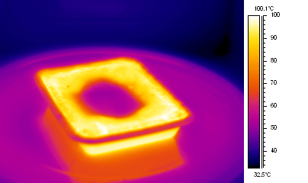
Turntable oven, thermal image taken after 5 minutes heating
Cold Spot

Slide 32
Thermal image of cross section after 3 minutes heating

Slide 33

Cavity .. Maxwells equations here
Foodstuff

Slide 34
Close to foodstuff
Heat loss by radiation and convection
Starchy food containing moisture
Food surface
L = 10cm
Temperature T,
Field strength E
Microwaves
Only really interested in what is happening in the food.
Microwaves absorbed and heat food

Slide 35
Computation of the Electric Field (Maxwell)
Microwaves decrease in strength as they penetrate the food and appear to take on a simple exponential form as the penetrate .. Vital clue!!

Slide 36
The resulting model.
Let N = Enthalpy of the food (thermal energy plus latent heat)
On the boundary
Uniform (stirrer), sine-wave (turntable)

Slide 37
650W Oven, Mode stirrer
Temperature

Slide 38
Compare to data : 650W Point Temperatures
Very good agreement

Slide 39
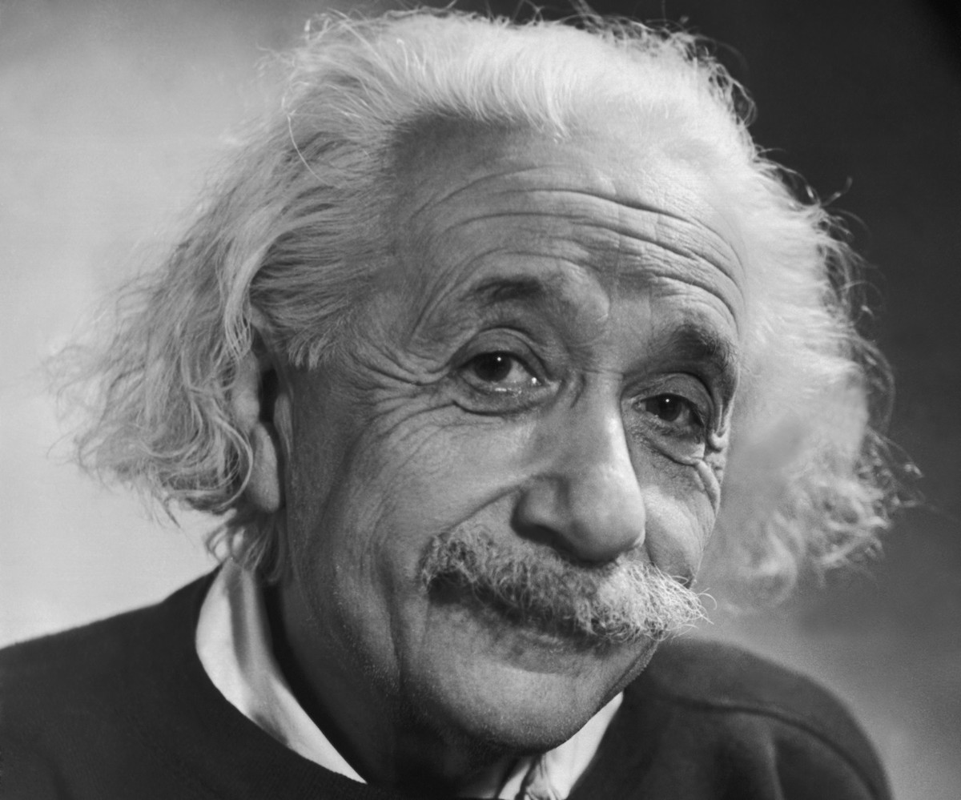
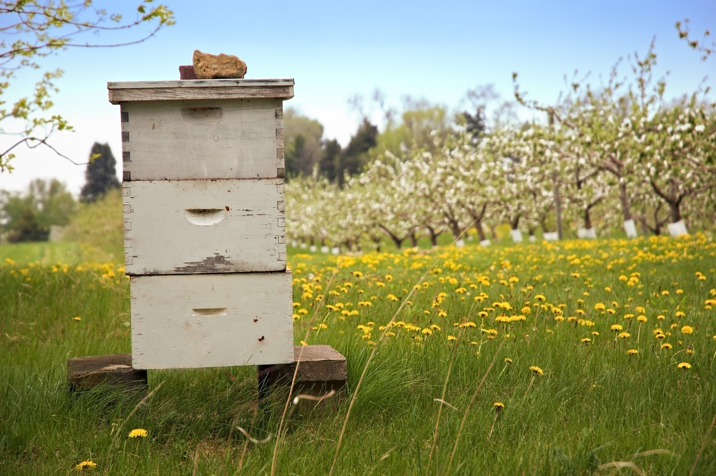
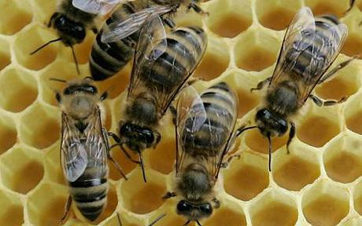
7. Where are the bees?
Einstein: The possible loss of the bees is the greatest threat to mankind

Slide 40
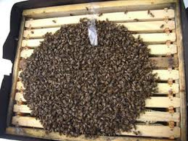
Maths can help the bees in many ways.
In particular to see how they respond to changes on their environment without disturbing them
Bees cluster together to keep themselves warm
Study using the same equation used for frozen food.

Slide 41
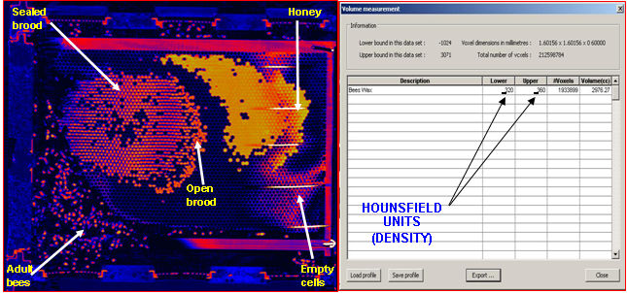
Can also use the maths of medical imaging to look inside a beehive
CT Image of a beehive
[Mark Greco]

Slide 42
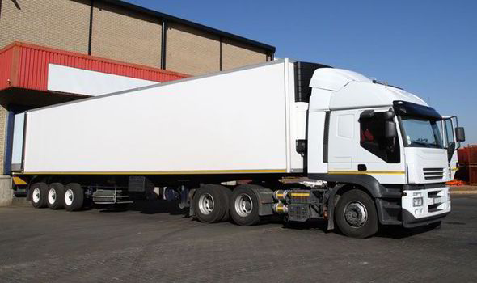
8. Transport and delivery

Slide 43
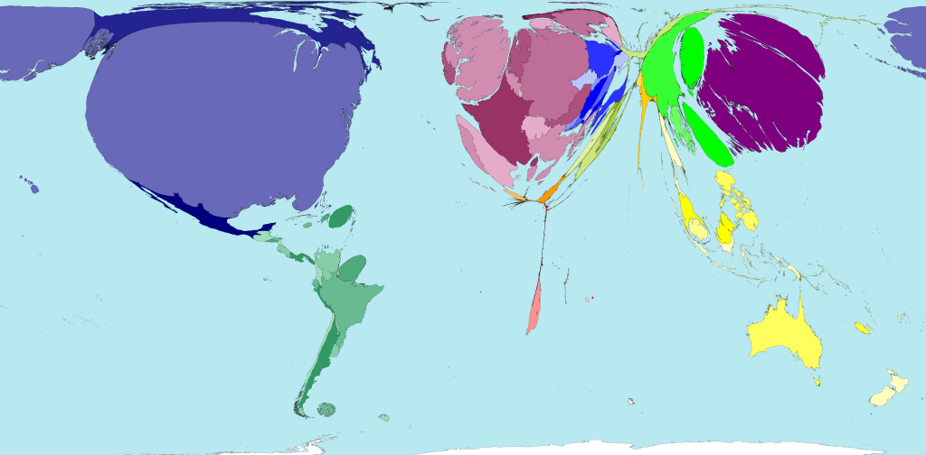
Food distribution is a complex problem
Especially as food can perish quickly

Slide 44
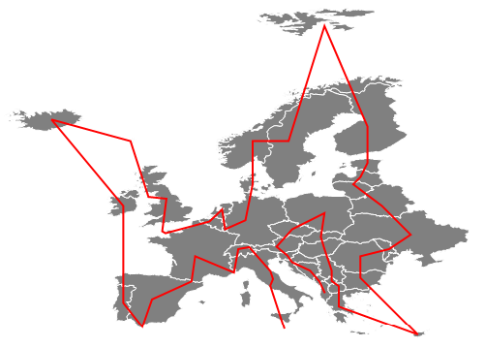
Can be planned efficiently by solving a travelling salesman problem
using stochastic algorithms

Slide 45
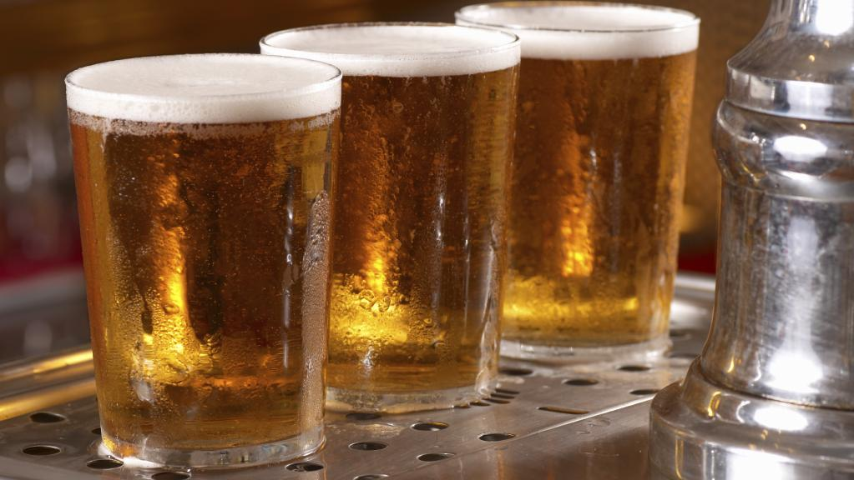
In conclusion: three mathematicians go into a pub

