Slide 1
Gresham Lectures 2016-17 Divinity Lecture 4 Respecting and Transcending Nature: J. R. R. Tolkien’s concerns about technology
Alister McGrath
Gresham Professor of Divinity

Slide 2
Caitlin Moran
On the Black Country around Wolverhampton:
“That’s what your Lord of the Rings is about. Tolkien was from round here. He was writing about how the industrial revolution turned the Midlands from Hobbiton to Mordor.”

Slide 3
Nick Bostrom
It may be tempting to refer to the expansion of technological capacities as “progress”. But this term has evaluative connotations – of things getting better – and it is far from a conceptual truth that expansion of technological capabilities makes things go better.

Slide 4
Nick Bostrom
Bostrom argues that technological enhancement of humanity might lead to the emergence of “posthumans”, so that:
Individuals could expect to live for more than 500 years;
A large section of the population would have cognitive capacities significantly greater than at present;
Psychological suffering becomes rare.

Slide 5
Victor Ferkiss
“What if the new man combines the animal irrationality of primitive man with the calculated greed and power-lust of industrial man, while possessing the God-like powers granted him by technology? This would be the ultimate horror.”

Slide 6
J. R. R. Tolkien
Well the first War of the Machines seems to be drawing to its final inconclusive chapter – leaving, alas, everyone the poorer, many bereaved or maimed and millions dead, and only one thing triumphant: the Machines. As the servants of the Machines are becoming a privileged class, the Machines are going to be enormously more powerful. What's their next move?

Slide 7
J. R. R. Tolkien
Now goblins … make no beautiful things, but they make many clever ones... Hammers, axes, swords, daggers, pickaxes, tongs, and also instruments of torture, they make very well, or get other people to make to their design. ... It is not unlikely that they invented some of the machines that have since troubled the world, especially the ingenious devices for killing large numbers of people at once, for wheels and engines and explosions always delighted them.

Slide 8
J. R. R. Tolkien
[The Machine refers to] all use of external plans or devices (apparatus) instead of development of the inherent inner powers or talents – or even the use of these talents with the corrupted motive of dominating: bulldozing the real world, or coercing other wills. The Machine is our more obvious modern form though more closely related to Magic than is usually recognised.

Slide 9
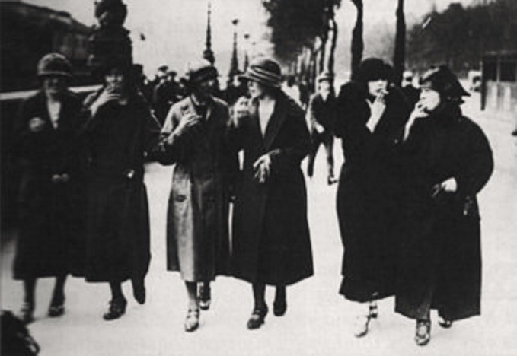
New York Easter Parade 1929

Slide 10
Edward Bernays
“The conscious and intelligent manipulation of the organized habits and opinions of the masses is an important element in democratic society. Those who manipulate this unseen mechanism of society constitute an invisible government which is the true ruling power of our country. We are governed, our minds are molded, our tastes formed, and our ideas suggested, largely by men we have never heard of…. It is they who pull the wires that control the public mind.”

Slide 11
Edward Bernays
Karl von Wiegand, foreign correspondent of the Hearst newspapers, an old hand at interpreting Europe and just returned from Germany, was telling us about Goebbels and his propaganda plans to consolidate Nazi power. Goebbels had shown Wiegand his propaganda library, the best Wiegand had ever seen. Goebbels, said Wiegand, was using my book Crystallizing Public Opinion as a basis for his destructive campaign against the Jews of Germany.

Slide 12
John W. Dodds
[Human technological] development has been accompanied by a progressive dehumanization of society ... Man has gained mastery of his environment but he seems to be less and less master of himself. Today we see him turning the weapons of his brain against himself—groping, amid the noise of a tottering civilization, for some faith in man to which he can cling.

Slide 13
[End]

