Slide 1
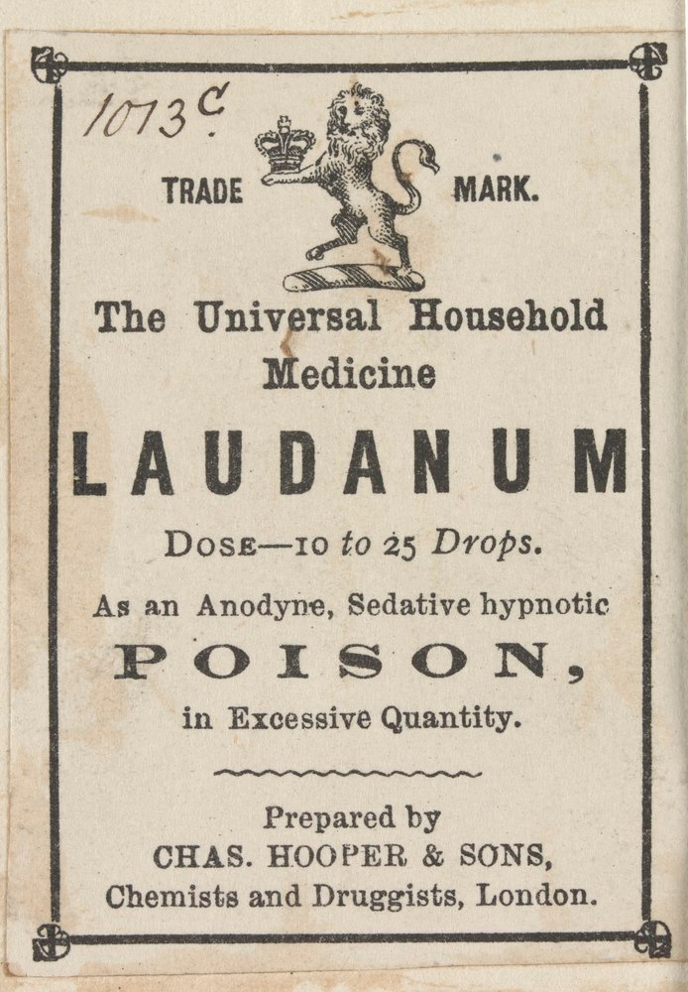

Slide 2
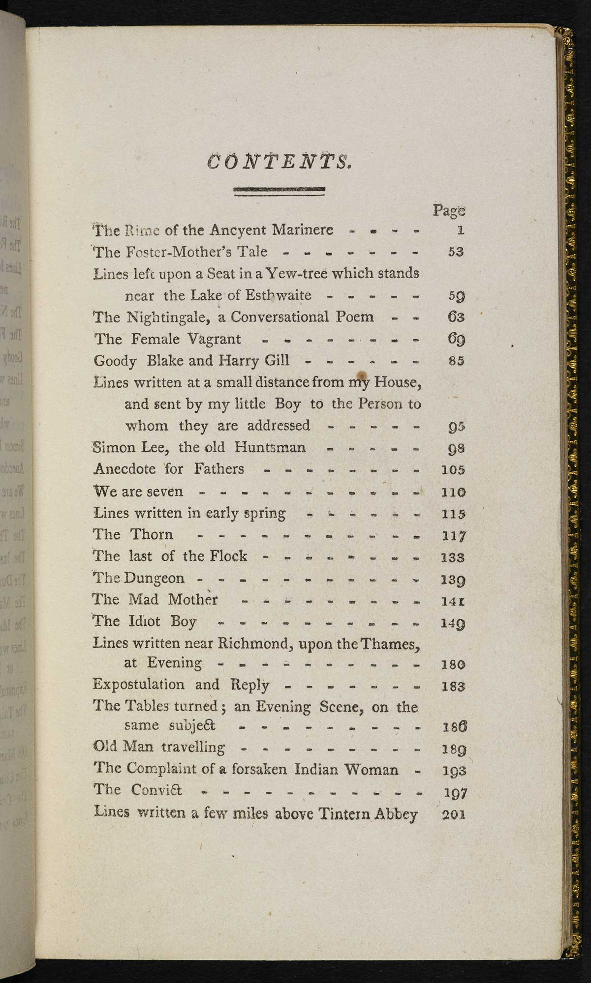

Slide 3
And now the Storm-blast came, and he
Was tyrannous and strong:
He struck with his o’ertaking wings,
And chased us south along.

Slide 4
‘The ship driven by a storm toward the South Pole?’

Slide 5
And now the Storm-blast came, and he
Was tyrannous and strong:
He struck with his o’ertaking wings,
And chased us south along.
‘The ship driven by a storm toward the South Pole?’

Slide 6
The moving moon went up the sky,
And no where did abide:
Softly she was going up,
And a star or two beside.

Slide 7
In his loneliness and fixedness he yearneth towards the journeying Moon, and the stars that still sojourn, yet still move onward; and every where the blue sky belongs to them, and is their appointed rest, and their native country and their own natural homes, which they enter unannounced, as lords that are certainly unexpected, and yet there is silent joy at their arrival.

Slide 8
The moving moon went up the sky,
And no where did abide:
Softly she was going up,
And a star or two beside.
In his loneliness and fixedness he yearneth towards the journeying Moon, and the stars that still sojourn, yet still move onward; and every where the blue sky belongs to them, and is their appointed rest, and their native country and their own natural homes, which they enter unannounced, as lords that are certainly unexpected, and yet there is silent joy at their arrival.

Slide 9
He prayeth best who loveth best,
All things both great and small:
For the dear God, who loveth us,
He made and loveth all.

Slide 10
All things bright and beautiful
All creatures great and small
All things bright and wonderful
The Lord God made them all

Slide 11
“Hold off! Unhand me, grey-beard loon!”
Eftsoons his hand dropt he. (lines 11-12)
The ship drove fast, loud roared the blast (line 49)
And through the drifts the snowy clifts (line 54)
In mist or cloud, on mast or shroud (line 75)
“Why look’st thou so?” – “With my cross-bow
The fair breeze blew, the white foam flew (line 103)

Slide 12
Instead of the cross, the Albatross
About my neck was hung. (lines 141-142)
Instead of "was hung about my neck."
There passed a weary time… (line 143)
“A weary time passed… “
The naked hulk alongside came (line 195)
Instead of "came alongside."
The effects can add drama – delaying a main verb, or slow the line to add emphasis to, for example, ‘weary time…’;

Slide 13
.......Coleridge uses enjambment, running the sense of one line of verse to the next:
And now the storm-blast came, and he
Was tyrannous and strong (lines 41-42)
And through the drifts the snowy clifts
Did send a dismal sheen (lines 55-56)
Instead of the cross, the Albatross
About my neck was hung. (lines 141-142)
'There passed a weary time. Each throat
Was parch'd, and glazed each eye. (lines 143-144)

Slide 14
By thy long grey beard and glittering eye (line 3)
And listens like a three year child (line 15)
The Wedding-Guest here beat his breast,
For he heard the loud bassoon. (lines 31-32)
The furrow followed free (line 104)

Slide 15
He holds him with his skinny hand,
…
He holds him with his glittering eye – (lines 9 & 13)
Below the kirk, below the hill
Below the light-house top. (lines 23-24)
The ice was here, the ice was there,
The ice was all around. (line 59-60)
With throats unslaked, with black lips baked (line 157)
Without a breeze, without a tide (line 169)
Her lips were red, her looks were free,
Her locks were yellow as gold:
Her skin was as white as leprosy (lines 190-192)
They groan'd, they stirr'd, they all uprose,

Slide 16
Water, water, every where,
And all the boards did shrink ;
Water, water, every where,
Nor any drop to drink. (lines 119-122)

Slide 17
The Wedding-Guest he beat his breast, (line 37)
Each turned his face with a ghastly pang,
And cursed me with his eye. (lines 215-216)
Likening the appearance of the eye to a curse
They coil'd and swam; and every track
Was a flash of golden fire. (lines 281-282)
Likening the wake left by the sea snakes to fire

Slide 18
It crack'd and growl'd, and roar'd and howl'd (line 61)

Slide 19
The Sun came up upon the left,
Out of the sea came he!
And he shone bright, and on the right
Went down into the sea. (lines 25-28)

Slide 20
The Wedding-Guest stood still,
And listens like a three year child: (lines 14 & 15)
The bride hath paced into the hall,
Red as a rose is she; (lines 33 & 34)
It cracked and growled, and roared and howled,
Like noises in a swound! (61 & 62)
Every soul, it passed me by,
Like the whizz of my crossbow! (lines 223-224)
The sky and the sea, and the sea and the sky
Lay like a load on my weary eye (lines 251-252)
Her beams bemocked the sultry main,
Like April hoar-frost spread (lines 268-269)
The water, like a witch's oils,
Burnt green, and blue and white. (lines 129-130)

Slide 21
Day after day, day after day,
We stuck, nor breath nor motion;
As idle as a painted ship
Upon a painted ocean. (lines 115-118)

Slide 22
The western wave was all a-flame (line 171)
I fear thee and thy glittering eye

Slide 23
A wicked whisper came, and made
My heart as dry as dust.

Slide 24
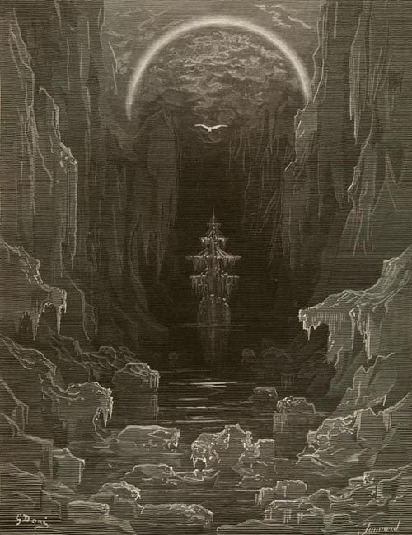

Slide 25
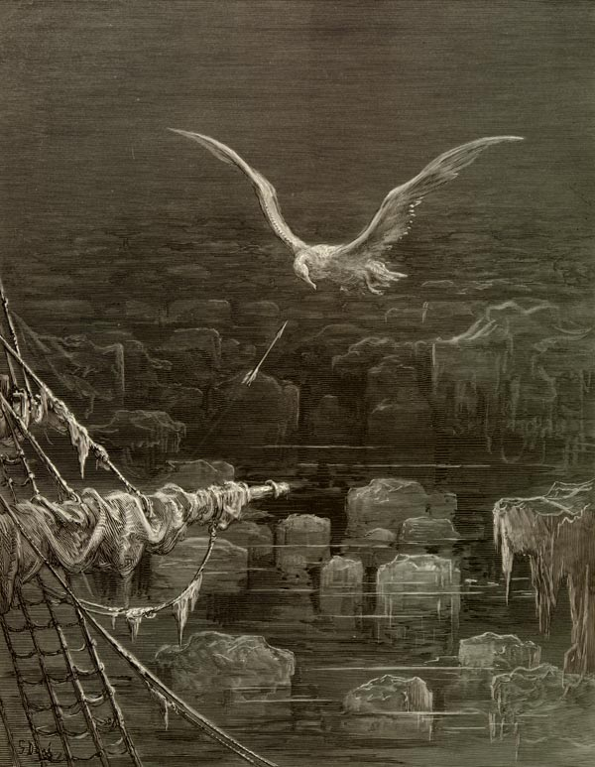

Slide 26
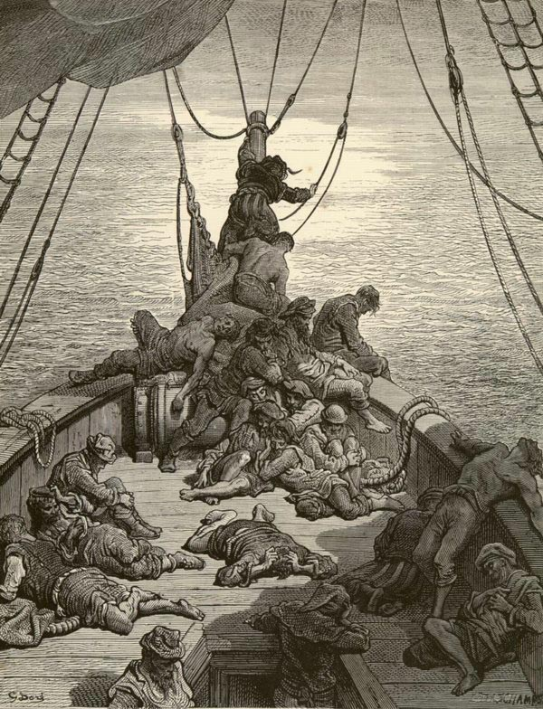

Slide 27
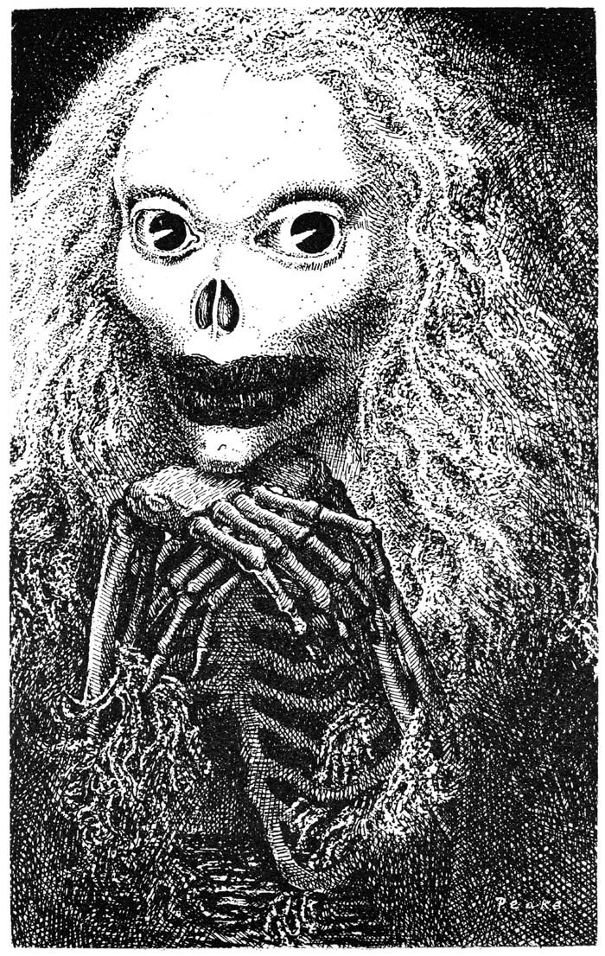

Slide 28
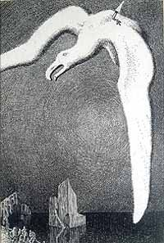

Slide 29
The primary imagination I hold to be the living power and prime agent of all human perception, and as a repetition in the finite mind of the eternal act of creation in the infinite I Am.
Coleridge, Biographia Literaria, chapter 13, ‘On Imagination’

