Slide 1
Living without electricity
Prof Roger Kemp MBE FREng FRSA CEng FIET
Engineering Department, Lancaster University
28 February 2017

Slide 2
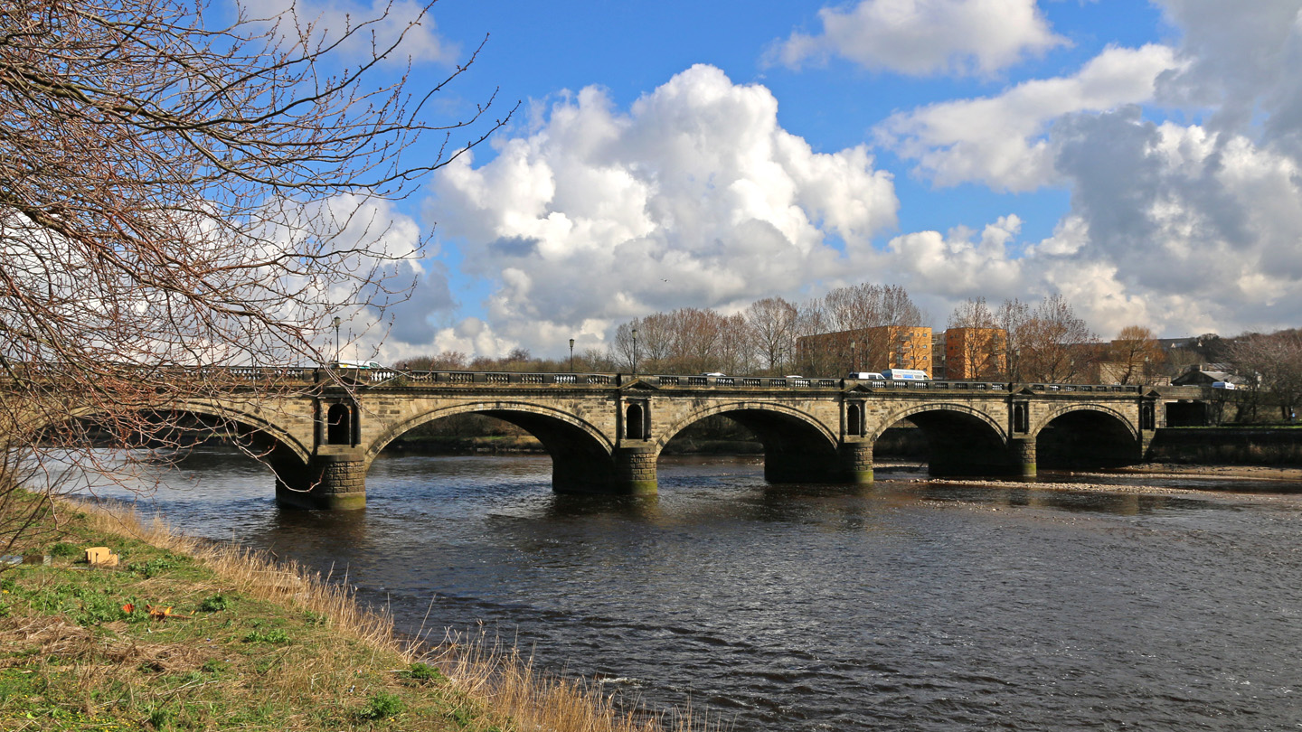
The River Lune

Slide 3
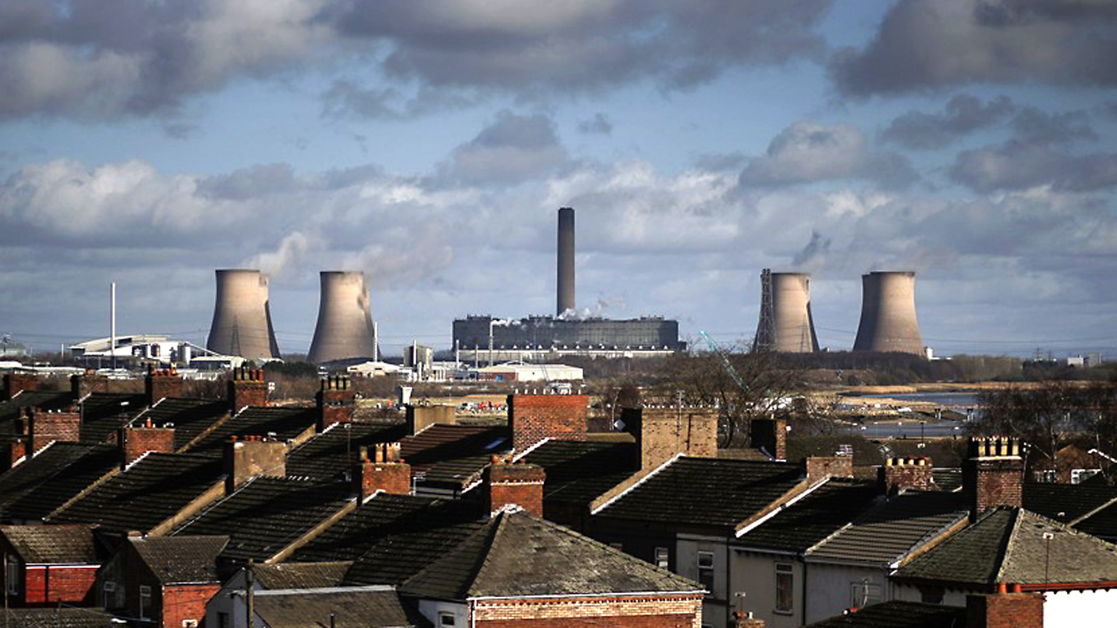
Electricity generation

Slide 4
Electricity fuel mix (1 February 2017)
Image from
BM reports website

Slide 5
The GB Transmission system
275 kV and 400 kV
Operated by National Grid plc
Total length 7,000 km
Power per line ~ 2,000 MW (depends on number of conductors)
Fed by power stations
Feeds DNOs (distribution network operators)

Slide 6
Distribution Networks
From National Grid website

Slide 7
The electricity network (c. 1990)
Generation
Transmission
Distribution

Slide 8
Bi-directional power flows
From: Flexible Plug and Play, Strategic Investment Model for Future Distribution Network Planning Pudjianto, Djapic, Kairudeen, and Strbac (Imperial College), December 2014

Slide 9
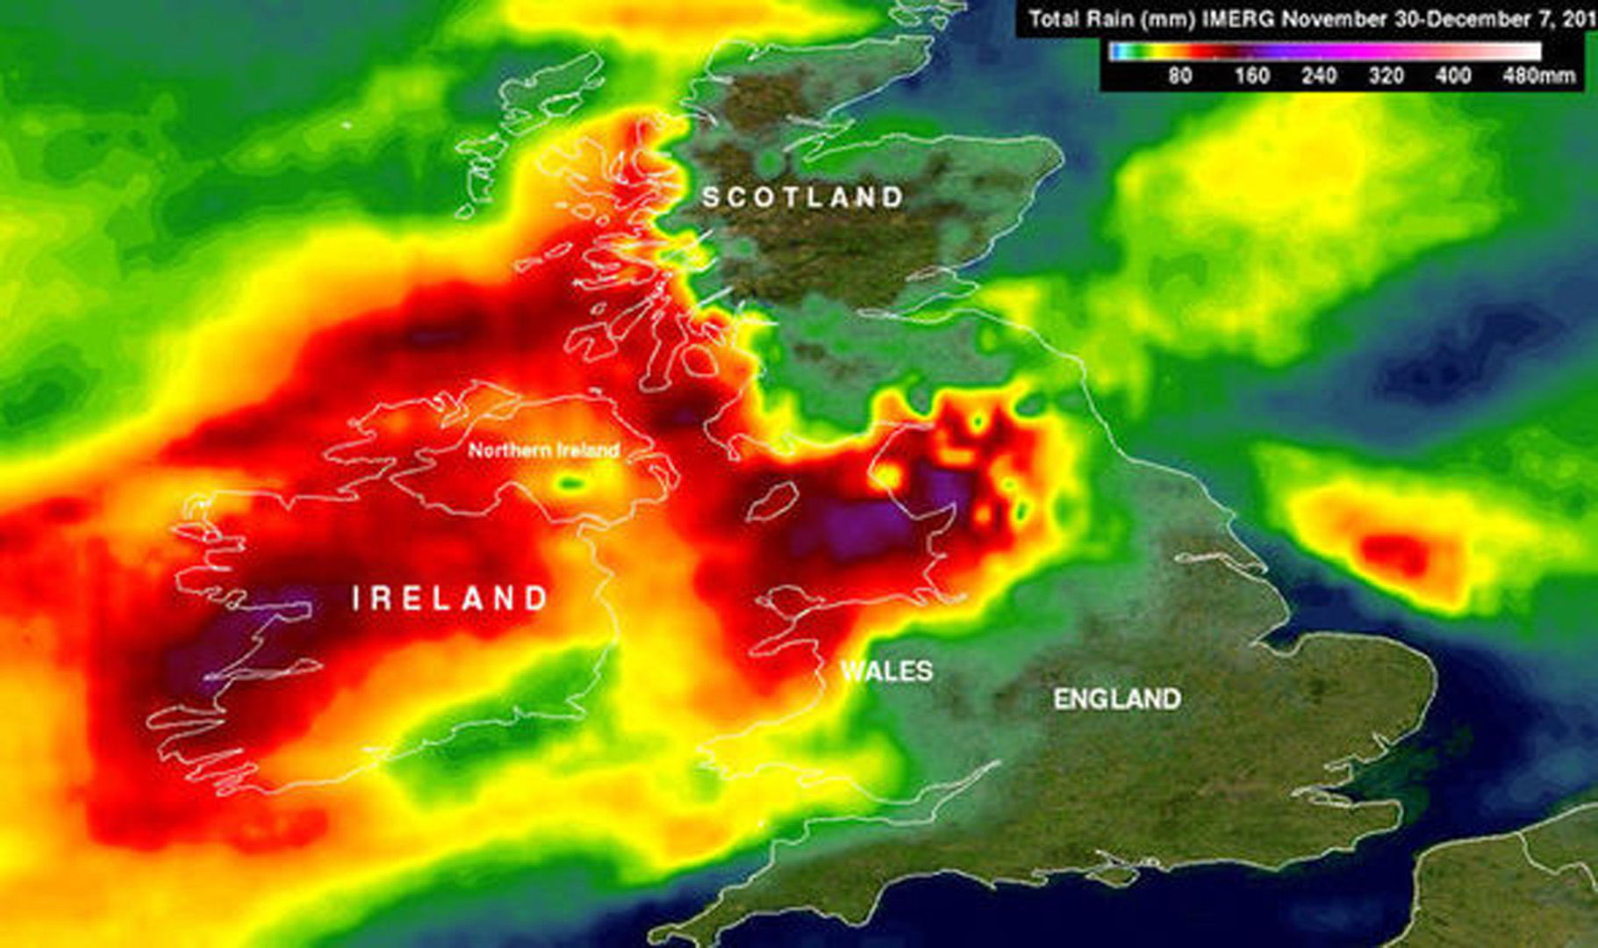
Storm Desmond
Cumbria
350 mm in 24 h
Map from NASA

Slide 10
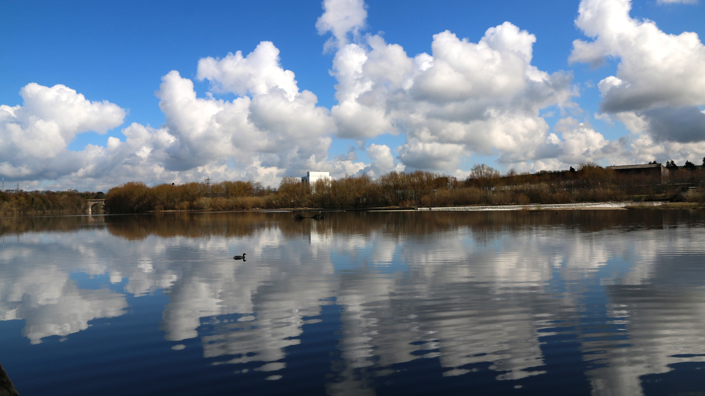
Peak flow: 1,742 m³/sec
Would fill an Olympic pool in 1½ sec

Slide 11
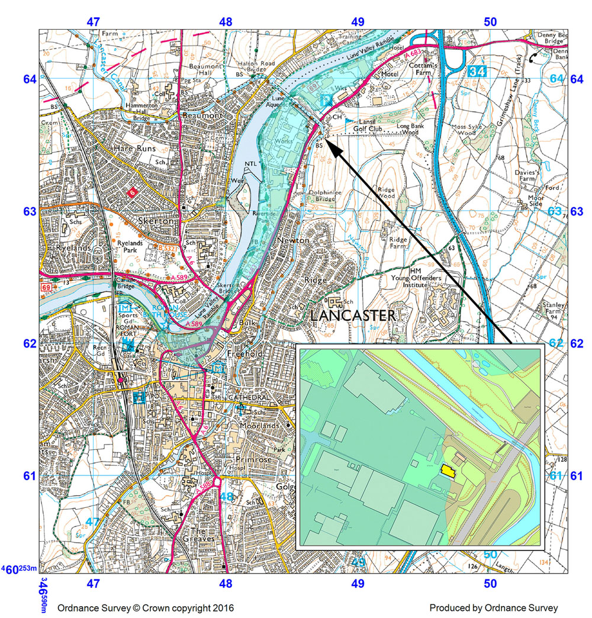
Extent of floods
Substation

Slide 12
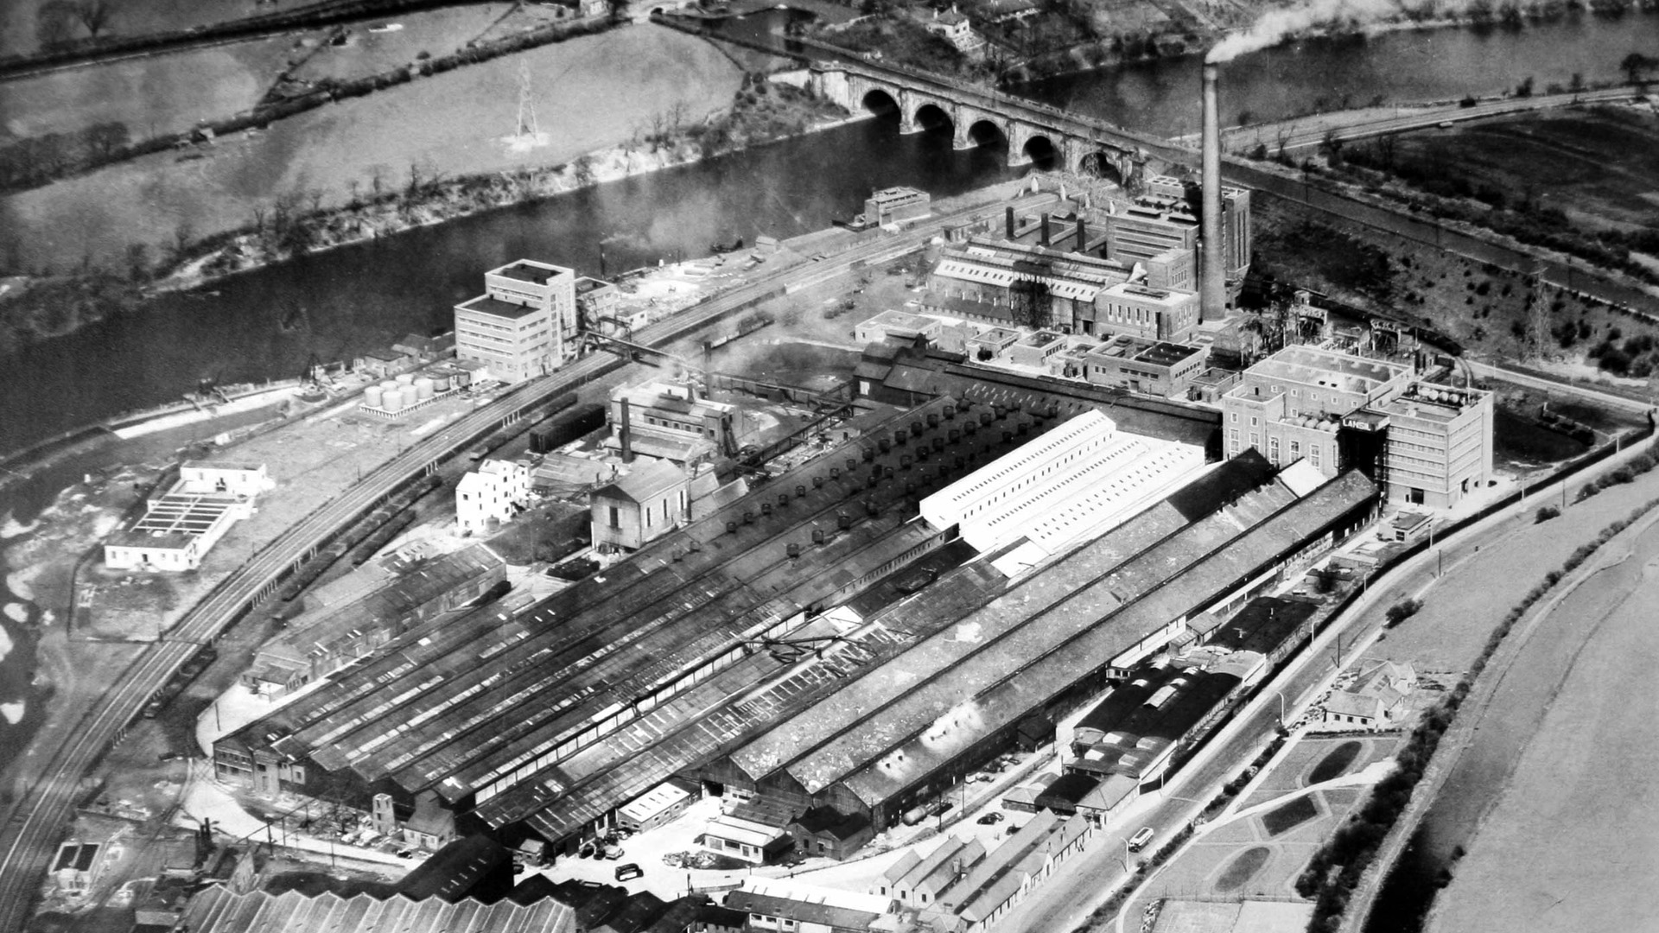
Lancaster power station c.1970
Photo: Lancaster Museum

Slide 13
History of substation
Power station next to River Lune since 1915
When it closed in 1975 substation was left
Last serious flood 1907
No-one could justify the cost and disruption of moving the substation

Slide 14
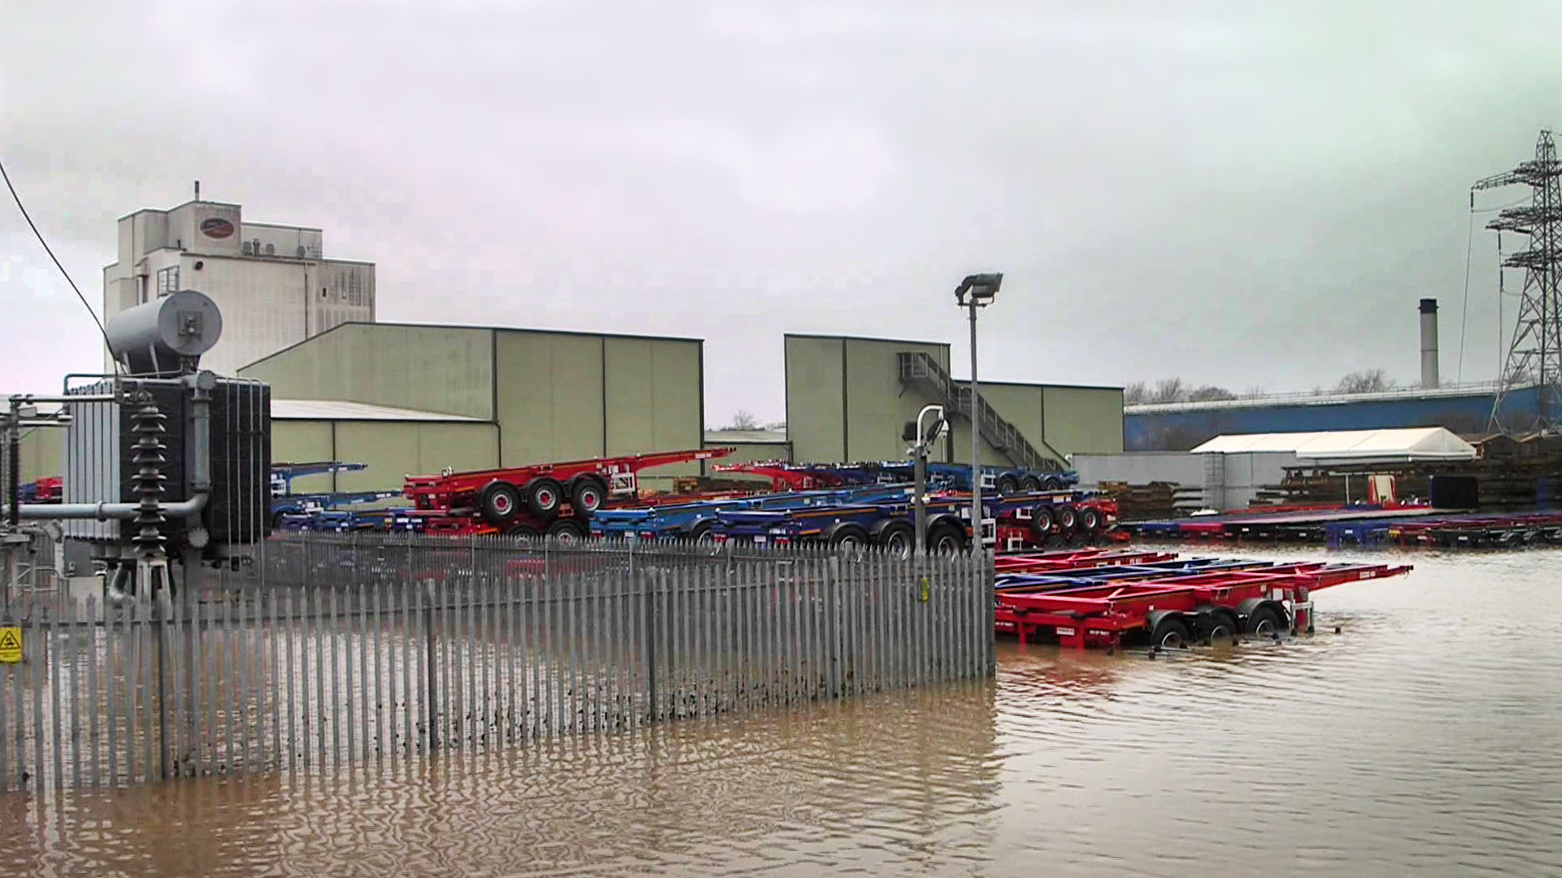
Photo: ENWL

Slide 15
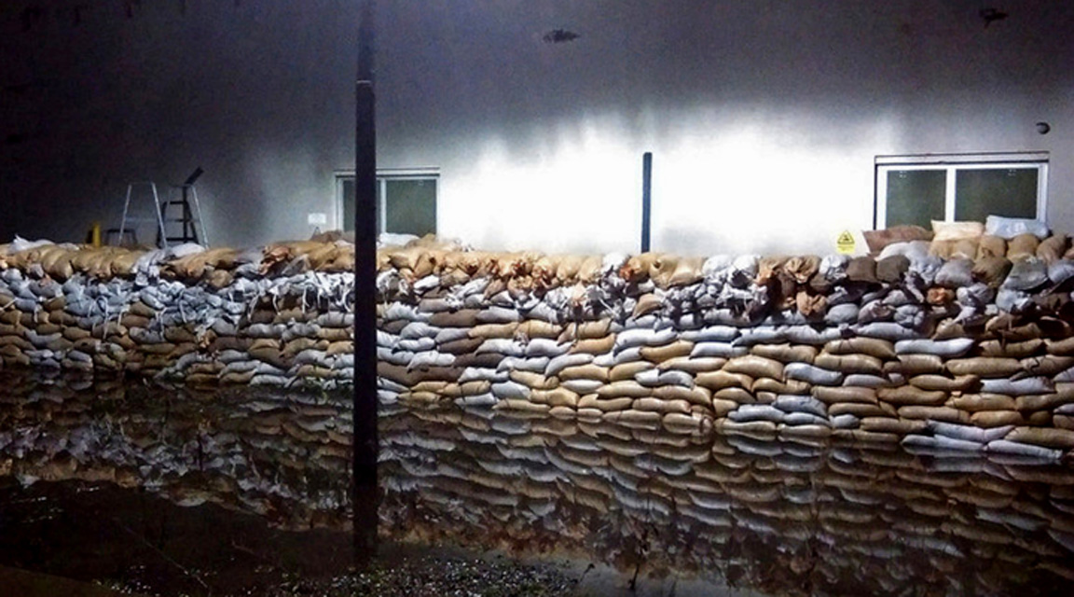
22:39 on 5 December 2015
Supplies lost to 60,987 consumers
Fully restored 19:18 on 8 December
Photo: ENWL

Slide 16
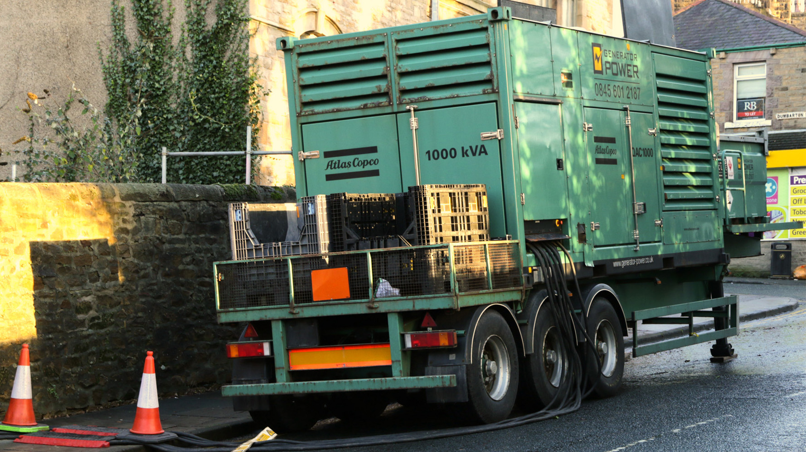
75 generators brought from all corners of the UK

Slide 17
Reconfiguring the substation
Photos: ENWL

Slide 19
Internet
Fibre from exchange to street
Routers, connecting fibre to copper, powered from mains
Broadband hubs in homes powered from mains

Slide 20
Fixed-line phones
✗
✓
✗

Slide 21
Mobile phones
Load on 230V typically 1 kW

Slide 22
Effects on households
No lights
No central heating
No TV or digital radio
Only traditional phones working
No internet
Powered garage doors not working
No street lights
Shops closed
Credit cards not accepted
Cash machines not working
Schools cannot get in touch
No petrol or diesel

Slide 23
OK for those with a log burner and gas hob

Slide 24
Living in flats
No heat
No cooking
No lights
No extractor fans
No water (inc. toilet flushing)
No lifts
No entryphone
Street door unlocked

Slide 25
Fortuitously:
Mains water supply generally reliable
Reservoir full
Filtration/chlorination plant working
Sewage network didn’t flood
Backup supplies for pumps
Gas supplies available
Pumping/pressure reducing stations backed-up or outside affected area

Slide 26
The hospital
Backup generators working
Difficult to contact patients
Some staff unable to get in
More A&E patients – unable to use other health services
People came “off the street” to use canteen and charge their phones

Slide 27
Where to turn in a crisis?

Slide 28
A care home
No light, heat, hot water, cooking, lifts, adjustable beds, powered medical equipment, emergency call alarm, telephone PABX, … … or TV
Chef made BBQ in garden
Relatives brought in camper van with Calor Gas cooking.

Slide 29
Assisted living

Slide 30
Impact on homeless people
Alternative Outcomes
Joint production by The Dukes Theatre and Lancaster District Homeless Action
Production about the floods by a group of people with experiences of street homelessness.
Photo: Darren Andrews, The Dukes Theatre

Slide 31
Primary school
Can’t communicate with staff
Can’t contact parents
Access control not working
Alarm messages routed elsewhere
No road lighting or crossing control
Heads are on their own
Academisation policy
No contact from Gold Command or any other emergency coordinator

Slide 32
Shopping
One supermarket had a backup generator contract
No other stores open
ATM in the supermarket and electronic tills working
No credit/debit card payments
Closed at 16:00 due to Sunday trading laws, when still very busy.

Slide 33
Impact on University
Closed for Christmas a week early
Usual means of communicating with students didn’t work
No fire alarms or lighting so evacuated college bedrooms
Some students went home, others slept in Great Hall

Slide 34
Department for Culture, Media and Sport
“Improved connectivity is revolutionising our quality of life, from how we work and how our children learn, to how we spend our leisure time, how we do our weekly shop, and how we engage with public services.
“Broadband Delivery UK (BDUK), part of DCMS, is delivering superfast broadband and better mobile connectivity to the nation.”
But it increases our dependence on 24/7 internet access
DCMS website

Slide 35
Electricity at the railway station
Power supply and signalling fed from outside the area
Town supply used for:
Platform lighting
Public address and CCTV
Ticket machines & ticket offices
Point heaters, etc.
With no supply, station closed at dusk

Slide 36
A few infrastructure dependencies*
Traffic lights & petrol pumps
Road network
Electricity network
Supplies for power stations
Drainage
Control of road signs
GPS
Supply to pumps
Grid control
Power supply
Data networks
(inc. GPS)
Water and drainage
Control of drainage system
* There are many more!

Slide 37
Complexity

Slide 38
What indicates complexity?
Large numbers of participants sharing responsibilities;
Wide geographical/organisational distribution of a single critical system;
Dependencies between various critical systems;
Unplanned (and unplannable) human interactions;
Many actors with incentives to optimise their own corner of the system.

Slide 39
System control (2015 – CO₂ emission 450 g/kWh)
Grid control
Generator voltage and frequency control
Central
generators
T&D grids
Consumer loads
Distributed generators

Slide 40
System control (2030 - CO₂ emission 50 g/kWh)
Link increasingly tenuous
Real time
price signals
Grid control
Generator voltage and frequency control
Home energy management,
Smart cities, community groups
Controllable consumer loads
Central
generators
T&D grids
Distributed generators

Slide 41
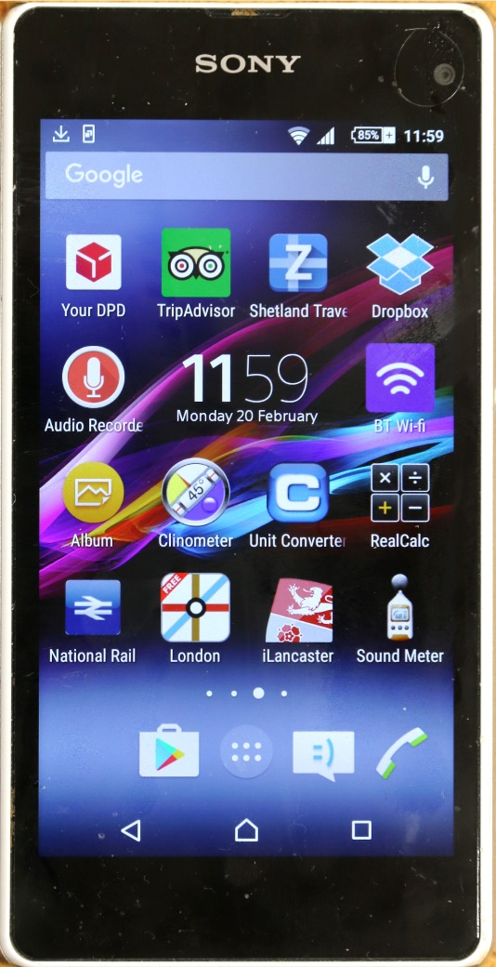
The challenge of Google (and others)
Google, Apple, Microsoft and others developing home automation apps
Integration with smart cities, home and community energy networks and DNOs
Herd effects?
Cyber-crime, sabotage, … … …

Slide 42
Dependent on (addicted to?) electricity
As a society, we are dependent on electricity
Government policy encourages us to become more dependent
The electricity network is becoming more complex with more “interesting” failure modes
Communications depend on the internet
Which, in turn, depends on mains electricity
Policy is for “care in the community”
But many medical services rely on electricity
Safety regulations have reduced risk
But also increase our dependence

Slide 43
Escaping dependency – creating resilience
Where should resilience be located?
In the home or local community?
With the service provider?
e.g. Internet or mobile phone companies, gas and water suppliers
In the local electricity network?
With the central electricity industry?
Experience in Lancaster suggests doing nothing is not an option

Slide 44
Report available on the web
Search for:
“RAEng living without electricity”

