Slide 1
Crime & punishment # 2 - when legal worlds collide. Guilty until proven innocent? Abused baby or benign causes ? Tweet? @jodqc @Greshamcollege
Johanne Delahunty qc

Slide 2
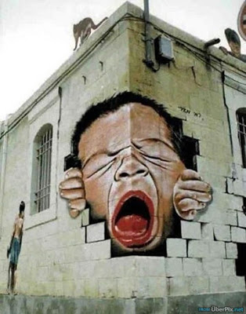
Introduction
Crime & punishment # 2: when legal worlds collide
This is Part 2 of a two part lecture
Part 1: 26th Jan, the basic differences between the criminal and family justice framework
Part 2: ‘Guilty Until Proven Innocent?’ hard choices when physical abuse is suspected
The notes that accompany this lecture have all case references in and significantly more explanatory detail: this is a teaser
@JoDQC @Gresham College

Slide 3
As retired high court judge Sir Mark Hedley told BBC’s Panorama in March 2016 for their aired programme on :
“In cases where children have been harmed allegedly by their parents the stakes are extraordinarily high because in a criminal case a parent is facing a long prison sentence. In family cases they are facing the loss of surviving children because an abused child is taken away.”
The courts duty to protect the child from harm requires hard choices: to return a child to an abusive parent can lead to further injury or death.
But to remove the child and place it for adoption on medical and scientific evidence than turns out to be flawed is to make a mistake that devastates the family.
Adoption is a final, irrevocable step that cannot be undone.
There are few types of case which arouse greater anxiety and controversy than those in which it is alleged that a baby has died as a result of being shaken.
The controversy to which such cases give rise should come as no surprise.
A young baby dies whilst under the sole care of a parent or child minder.
That child can give no clue to clinicians as to what has happened.
Experts, prosecuting authorities must reconstruct, as best they can, what has happened.
Babies die: whether thorough benign causes or abuse: parents can be falsely accused but they can also lie to conceal their actions
Warning : these cases are distressing: whatever the courts determine happened to the babies at the heart of their case, a child has died .
Whether through abuse or benign causes, a baby is dead
The very term’ shaken baby’ is emotive and presumes that you know the cause of the problem, that a baby has been shaken: ‘Non Accidental Head Injury’ ( NAHI) is how I shall refer to the allegation in this lecture

Slide 4
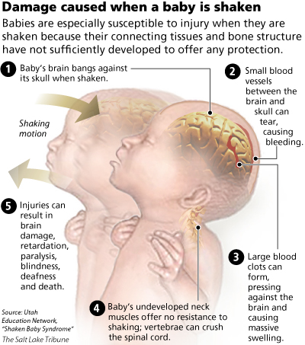
shaking ? Where’s the harm?
Crime & punishment # 2: when legal worlds collide

Slide 5
What can happen?
Crime and punishment no 2 : when worlds collide
Decreased level of consciousness
Inability to suck or swallow
Limp arms and legs
Breathing may stop
Brain damage
Death

Slide 6
the ‘triad’: a hypothesis not a diagnosis
Signs of a non accidental head injury?
subdural haematoma bleeding between the skull and the brain
retinal haemorrhages bleeding behind and in the eyes
Encephalopathy brain dysfunction, swelling

Slide 7
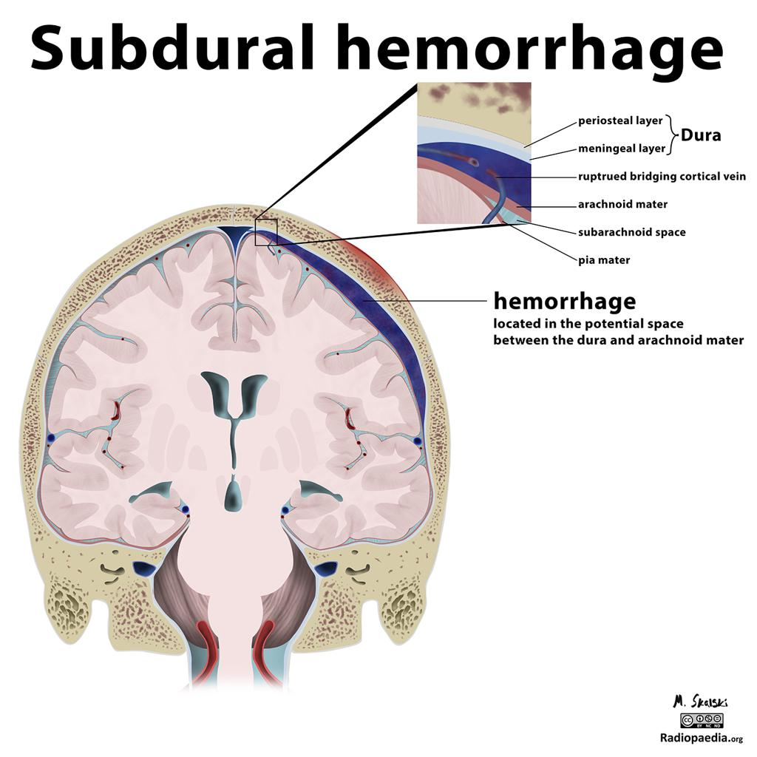
Notes:
Case courtesy of Dr Matt Skalski, Radiopaedia.org, rID: 21542

Slide 9
This Lecture: abuse or tragedy?
Consider: a dead baby, a young couple, the mother mourning her dead son, pregnant, facing a murder charge and proclaiming her innocence and that of her partner.
Question: had this baby been born to a couple too immature to handle the responsibility and demands of parenthood? Shaken him? Hit him? Thrown him? Fractured his skull? Caused catastrophic injuries to his brain with footprints of abuse left behind by bleeding around his brain, his eyes and multiple fractures to the bones of his body?
Or were their protestations of innocence genuine?
If so, how to explain the multiple injuries he had suffered?
Declaration: I acted for Chana Al Alas in the Family Trial before Theis J that I describe below

Slide 10
jayden wray
Crime & punishment #2: when legal worlds collide
Birth
Clinical picture pre-collapse
Receiving hospital - University College Hospital (UCH)
Transfer to Great Ormond Street Hospital (GOSH)
Death and Post Mortem
Cause of death?
Criminal and Care: the due process of law

Slide 11
Crime & punishment # 2: when legal worlds collide
The Community and clinical picture
Community : a ‘visible ‘baby
Home: Jayden had fed and gone to sleep as normal, on waking his tongue 'stuck 'to the roof of his mouth. He wouldn't feed. The parents rang the out of hours emergency medical help line and were told to take him to the GP, At some point they noticed 'fit like' movements.
GP: erred on the side of caution and referred the baby to UCLH walk in clinic: This wasn't seen to be a clinical emergency
UCL: On clinical reception Jayden showed further signs of fitting observable by nursing staff but not identified or immediately acted on by the receiving consultant paediatrician
Jayden's condition deteriorated rapidly: his seizures intensified
Jayden needed intubation and a skull x ray to see if emergency neurological surgery was required. There was a 90 minute delay in intubation, the tube was wrongly inserted and led to the collapse of a lung which was not immediately detected
what was intended to be a 30 minute absence from paediatric care, lapsed into 4 hours after a skull fracture was detected and clinical concern turned to Non Accidental Injury (NAI). He was not given anti seizure meds. Investigation of NAI became the focus

Slide 12
Innocent until proven Guilty?
Transfer to GOSH:
Inadequate information passed on about Jayden's changing presentation and treatment prior to transfer
Jayden's condition swiftly assessed to be incompatible with life; death was imminent
NAI was strongly suspected : THE TRIAD? Iinvestigations undertaken to consider that possibility. Jayden was found to have retinal haemorrhages to add to the picture presented by subdural haemorrhages and encephalopathy : ' in the absence of any explanation this has all the features of inflicted head trauma’.
Radiologist concluded that all 11 fractures detected were likely to have been caused by non accidental injuries : specifically discounting metabolic bone disease as a cause.
The police and social services were notified and child protection protocols initiated.
The parents were now under suspicion of abusing their baby.

Slide 13
Crime & punishment # 2: when legal worlds collide
The death: the suspicion
On 23.7.09 the parents were arrested at GOSH at Jayden's bedside on suspicion of GBH.
They never saw Jayden again.
Jayden was christened and died at GOSH on 25th July 2009.
No parent or family member was allowed to be present.
The parents home was a crime scene

Slide 14
Crime & punishment # 2: when legal worlds collide
The post mortem : a tale of two paediatric pathologists
Dr Scheimberg (instructed by the corner) detected radiological signs of rickets on the GOSH X rays which were confirmed by her physical examination of the ribs and skull.
she deliberately snapped one of the ribs to assess its strength. She described easily snapping it with her fingers by a flicking/twisting motion : ‘brittle’ ‘too easy to crack’.
She initiated requests for Vitamin D testing of Jayden and his mother .She faced subsequent police criticisms in the criminal trial for so doing. It was suggested she had gone beyond her remit as a pathologist.
Dr Scheimberg concluded that the death was as a result of hypoxic ischemic injury (brain injury as a result of inadequate oxygen supply): cause of death undetermined in the context of severe Vitamin D deficiency and rickets
Dr Cary ( instructed by the metropolitan police) attended the post mortem because of medic, social service and police concerns that Jayden had died of unnatural causes. He concluded that Jayden died as a result of non accidental injuries (shake/ impact).

Slide 15
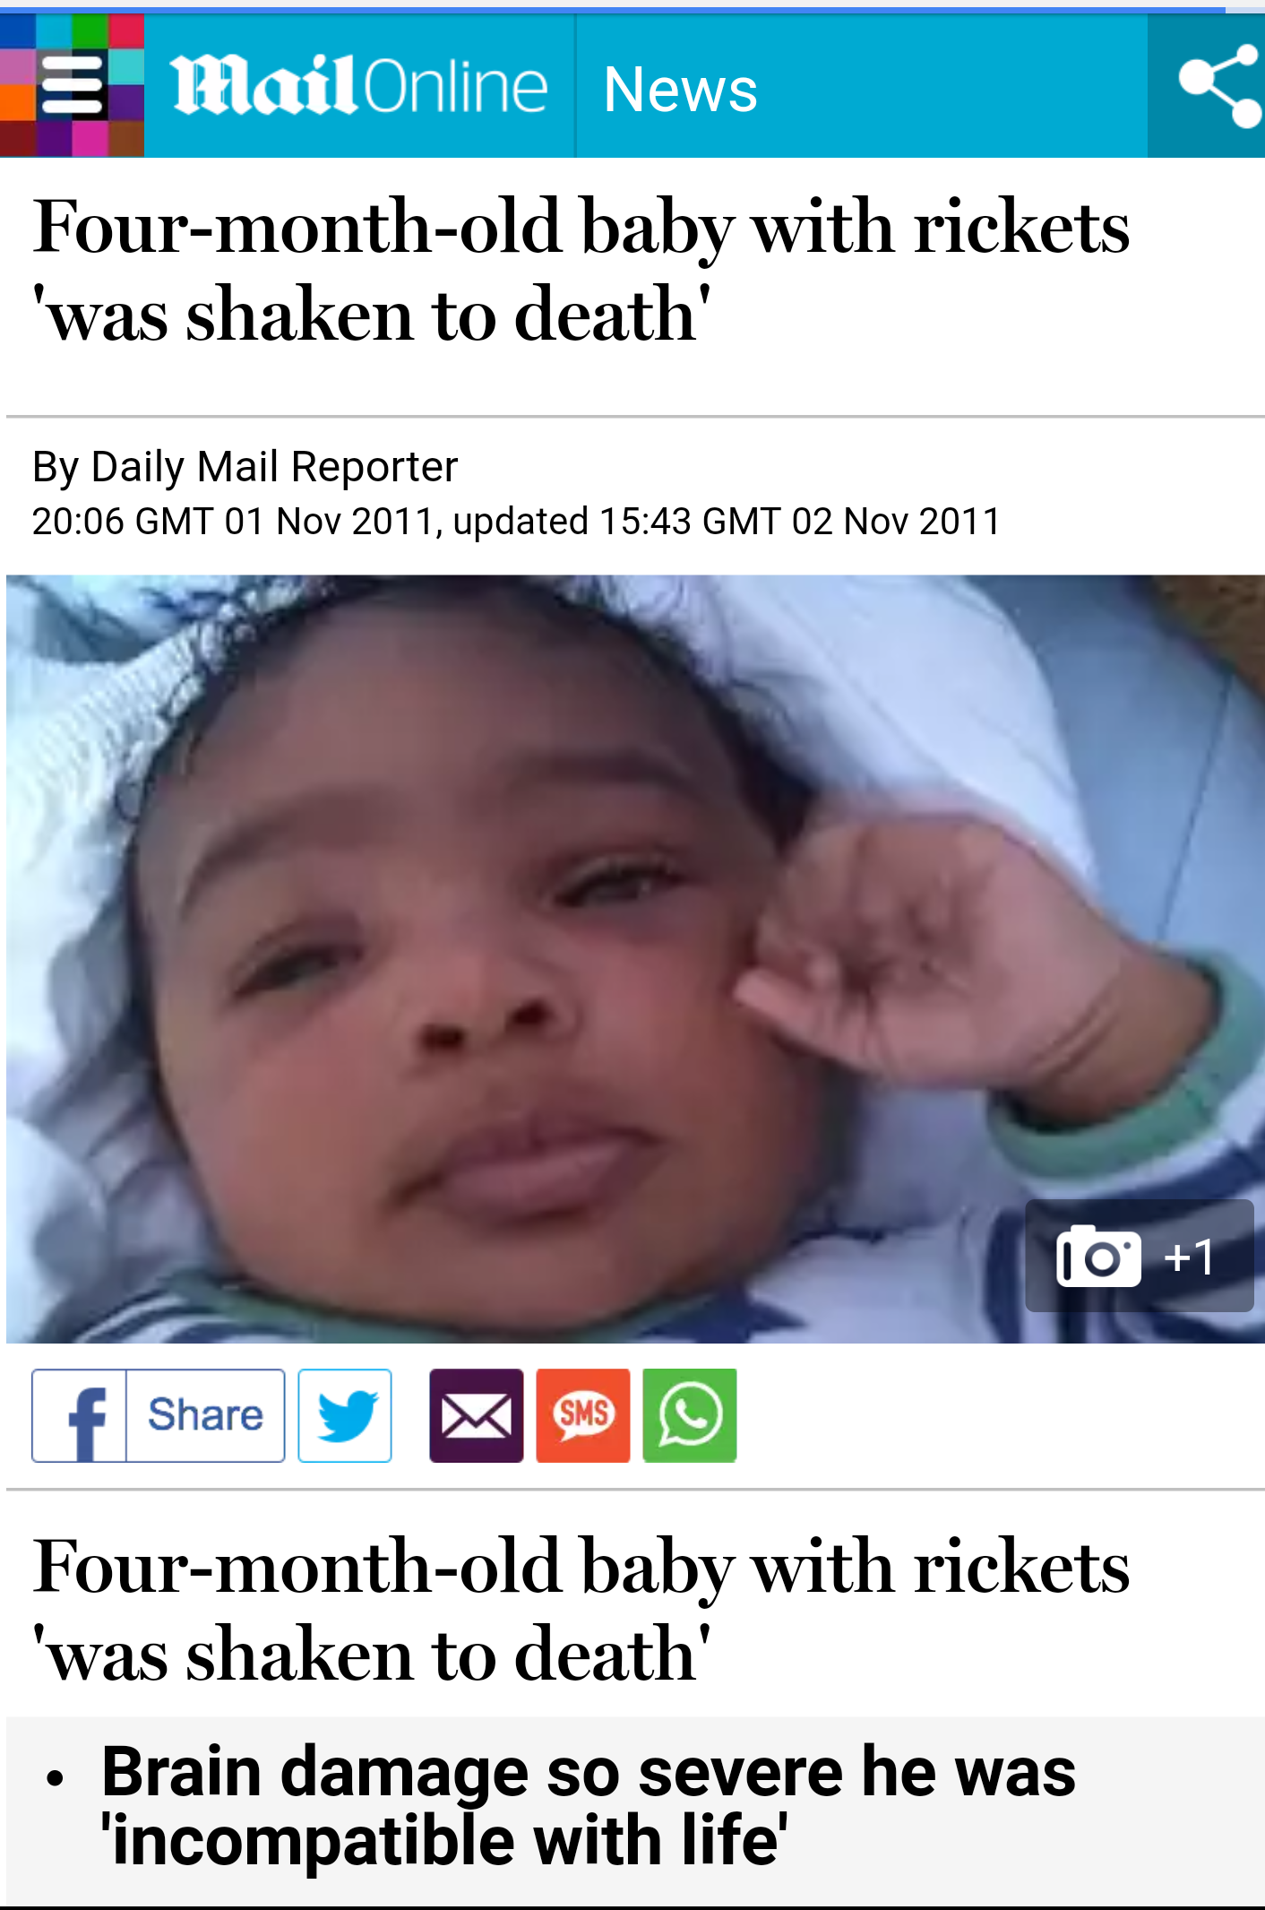

Slide 16
Crime & punishment # 2: when legal worlds collide
The criminal trial : 2009- dec 2011
Chana Al-Alas was by the time of the trial, 19, and Rohan Wray, 22. They had lived under the shadow of suspicion for over 2 years.
Crown case based on their experts: The prosecution said the brain damage could only have been caused by the trauma of Jayden having been shaken or his head having been hit against something. They relied on the TRIAD of injuries. Whilst some fractures could have arisen from rickets, the skull fracture and metaphyseal fractures to the arm and leg and 2 others were NAI
Defence case based on their experts: Jayden had undiagnosed Vitamin D deficiency in life causing rickets. He had weakened bones, including a weak skull, and normal handling could have caused the fractures. RH by raised ICP, SHD and brain dysfunction through seizures and hypoxia
The Old Bailey court heard that Jayden died from brain damage and brain swelling but nearly 60 medical, professional and expert witnesses were unable to agree the cause.
On 9th December 2011, a jury returned not guilty verdicts on the direction of the judge after prosecutors withdrew the charges.

Slide 17
Crime & punishment # 2: when legal worlds collide
In the meantime A child had been born : Jayda oct 2010
Chana and Rohan remained a couple. Chana became pregnant. Social services were informed of her pregnancy by the health services. This was and is normal procedure.
Social Services care plan was immediate removal of the baby at birth
Jayda was born to the couple on 17th October 2010.
Chana , aged 18, was compelled by social services, the hospital and the police to give birth in isolation , neither Rohan nor any family member permitted to support her, witness the birth or to hold the baby.
Jayda was removed; literally, at birth into police protection.
Chana was not allowed to hold her new born baby and was only given a picture to have at the insistence of her mid wife.
The local authority applied to the family court for, and were granted, interim Protective Orders .
Jayda remained in care throughout the criminal and family proceedings with supervised access
Jayda did not return to the parents after the Not Guilty verdict was returned

Slide 18
Abused baby or benign causes?
Question 1:
how can experts in the same discipline examine the same baby with the same medical history and come to such divergent conclusions re Cause of death and NAI fractures ?
Question 2:
why was the criminal verdict not enough for Jayda to go home?

Slide 19
Crime: Has the defendant committed a criminal offence against the victim or not? The outcome is specific to the adult defendant: conviction or acquittal, prison or freedom.
Judge and jury
99:1 Beyond Reasonable Doubt
V.
Family: Has a child suffered serious harm? If so, by whose action? What risk is there of future harm? The outcome is focused on the welfare of the child
Judge
51:49; Balance of Probabilities

Slide 20
Crime & punishment # 2: when legal worlds collide
The care trial 2010-2012
Thus, in 2012, the parents again faced the self-same allegation that Jayden was a victim of baby shaking, demonstrated by the classic TRIAD of injuries to which fractures at multiple sites and of varying ages added additional evidence of violence to substantiate death through non accidental injury.
Crown/ LA experts now fully alert as to the parent's defence : lower standard of proof in family proceedings,
Medics and experts had become polarized in their beliefs.
Had one parent or other of them beaten him and then shaken or thrown him ?
Or was his death a consequence of normal handling , inherent vulnerability, Vit D deficiency, rickets and his seizures?
If medical science is objective: why did the experts not agree on cause of death?
What is a advocate to do when medical experts don’t agree?

Slide 21
Crime & punishment # 2: when legal worlds collide
The final hearing : the judge’s task
The case was heard by Mrs Justice Theis over 6 weeks.
Medics: 40 + medical witnesses : GP, HV, UCL and GOSH: nurses, doctors, radiologists
Expert evidence :
Paediatric pathologists: Drs Shemberg, and Cary
Neuropathologist: Dr Colin Smith, Dr David Ramsay
Ophthalmologists: Professor Luthert and Dr Bonshek
Histopathologist: Professor Malcolm and Dr Cohen
Paediatric Neurologist: Dr Jansen
Endocrinologist: Professor Nussey
Paediatric Neuroradiologist: Dr Barnes
Paediatrics and Obstetrics: Professor Miller
Biomechanics: Dr Van Ee
Midwifery: Professor Page

Slide 22
Crime & punishment # 2: when legal worlds collide
The evidence : unmasking the truth?
The description of Jayden’s rickets as ‘moderate to severe’ by Dr Scheimberg was agreed by Professor Malcolm.
Dr Malcolm conceded that he had only had only ever come across a case of rickets as severe as Jayden’s in the 1970’s.
It emerged that Jayden had been seen by health professionals on 30 occasions right up to 5 days before they brought him to UCLH, and at no stage did they see any signs of bruising or pain.
American experts Professor Barnes’ and Miller said that, as a result of rickets, Jayden’s fractures could have been caused by normal handling
Haemorrhage around the site of the skull fracture took place within 24 hours of death, which was when Jayden was on intensive care at GOSH and denied contact with his family.
It was not evidence of inflicted trauma contemporaneous with Jayden’s collapse i.e.) shake , impact.
The fact he had sustained such bleeding whilst in intensive care and exclusively cared for by medics demonstrated that he was a “very fragile child”.

Slide 23
Crime & punishment # 2: when legal worlds collide
The critical gap explaining the blood and brain signs
Deconstructing the triad : CCTV showed Jayden to have been conscious when he arrived at UCH with intermittent seizure activity
He was assessed as ‘alert’ on the GCS upon reception. He declined at UCH. His seizures increased
The missing 4 hours at UCLH: ‘suboptimal care’ : The key period in understanding Jayden’s decline and death
Jayden was intubated in order for him to be imaged to decide if neurological surgery was required - tube wrongly placed causing one of his lungs to collapse - not identified for at least 20 minutes.
Jayden’s CO2 levels had risen to dangerous levels but by then he was en route to or at the radiology department and it was unclear when the tube had been correctly positioned
Jayden was moved between different imaging departments at UCH investigating NAI after a skull fracture was detected .No effective management of his seizures or his CO2 levels. The 30 minute absence from paediatric care became 4 hours
Seizure meds were drawn but not administered until the GOSH retrieval team arrived at 6pm..
By the time the retrieval team arrived, his condition had deteriorated : clear signs of raised ICP (intra cranial pressure)
There was no examination of his eyes at UCH: by the time they were assessed at GOSH Jayden’s condition was irrecoverable.
GOSH formed a clear view Jayden was a victim of NAHI: they did so without knowledge of what had occurred at UCL

Slide 24
Crime & punishment # 2: when legal worlds collide
The human cost as at march 2012
Jayden was born March 2009, died 4 months later. His parents were 16 and 19. Suspicious death.
The parents never returned home after arrest at hospital as it was ‘the scene as the crime’.
Their names and faces had been all over local and national media.
They had had to confront the medical and police medical evidence: had the other hurt their son?
They stayed together and had another child as the investigations rolled on.
By the time of the family final hearing: Jayden had been dead for 3 years, his parents were now 19 and 22
The parents had faced and been acquitted of a murder charge heard at the Central Criminal Court which had lasted for 6 weeks.
By the time the criminal trial collapsed Jayda was by then 14 months old. She had never lived with her parents and saw them only restricted times under close supervision. Her future was to be determined in the family division.
The parents underwent a 5 week trial in the High Court of the family Division to argue for her return to their care.
Jayden had not yet been buried.
The inquest into his death was awaiting the outcome of the criminal, and then the care proceedings.

Slide 25
findings of family division
Crime & punishment # 2: when legal worlds collide
Severe vitamin D deficiency rendered Jayden vulnerable to infection and seizures;
Jayden was conscious and suffering from seizures on arrival at UCH which were not adequately brought under control during his treatment at UCH
The 4 hours of care by UCL was 'sub optimal'.
The Triad? ‘this is an area of some controversy with strong feelings on both sides of the medical profession’
‘ research is required in relation to the different aspects of the TRIAD and the impact of vitamin D deficiency and rickets on babies under 6 months
retinal haemorrhages were more likely to be secondary to Jayden’s hypoxic ischaemic injury, encephalopathy was not due to inflicted trauma.
subdural haemorrhages more likely to be caused by trauma (of undetermined origin) and that further research was required
encepthalopathy caused by a combination of factors, some unknown, but not including inflicted trauma either by way of impact or shake or other mechanism.
fractures were a product of rickets
LA case not proven
Jayda could return to her parents forthwith

Slide 27
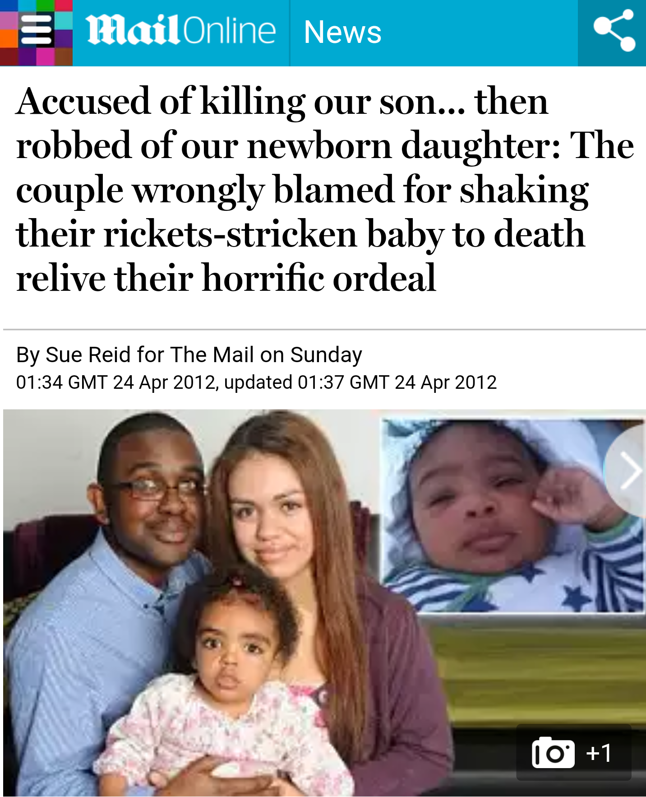

Slide 28
Crime & punishment # 2: when legal worlds collide
The human body is a wondrous thing
Was Al Alas a one off ?
Do we have lessons still be to learnt about the ways in which benign injuries can masquerade as abusive acts of inflicted trauma?
EDS: EHLER DANLOS SYNDROME
Inherited disorder of connective tissue characterised by joint hypermobility, skin extensibility and tissue fragility including increased bleeding
This is a medical condition that affects the connective tissues in your body.
Your connective tissue is what is responsible for structuring and supporting your blood vessels, organs, skin, and bones.
You can bruise easily

Slide 29
Devon County Council v EB & Ors (Minors) [2013] EWHC 968 (FAM)
Crime and Punishment 2:
Twins born to parents with a range of medical conditions ; M had EDS, F had joint hypermobility.
One admitted to hospital with encephalopathy, upon investigation both babies found to have fractures and SDH
Shaken children or injuries through benign causes?
‘ At the outset of the investigation, Dr. Hart and the social workers and the police were faced with two children who had suffered a multiple of bone fractures and subdural bleeding and in the case of E, an episode of encephalopathy. Not surprisingly, they considered that these factors pointed strongly towards a diagnosis of non-accidental injury.
Had this case been decided on the basis simply of the information then available, it is likely that the court would have reached a similar conclusion but, as has been made clear many times in many reported cases, not least by Dame Elizabeth Butler-Sloss President in Re T and in Re U, Re B, as cited above and repeated by counsel in this case, the court surveys a wider canvas.
Children visible, no concerns re care, no bruising, no signs of pain discomfort that would have expected to accompany fractures : the parents medical history and evidence

Slide 30
Crime & punishment # 2: when legal worlds collide
The wisdom of baker j in the devon case
‘ A court hearing application for care orders based on cases of suspected physical abuse of children must follow the evidence and pursue the enquiry in whatever detail and for however long is necessary to arrive at the truth.'
He could not find LA case proven that parents had inflicted injuries in a momentary loss of control. Threshold not proven, application dismissed
Baker J observed that in cases of suspected child abuse it is important that:
There is a full and thorough forensic examination; this requires judicial continuity before a judge of sufficient experience.
That, although judges will be rigorous to resist the unnecessary use of experts, equally, they will not hesitate to endorse expert instruction where they are satisfied this is necessary to determine the relevant issues
Finally, Baker J commented that this case demonstrated again the crucial role played by specialist family practitioners and that not enough recognition is given to the contribution of family lawyers

Slide 31
Crime & punishment # 2: when legal worlds collide
Sherlock Holmes?
The Family Court is not a place where Sherlock Holmes' dictum applies:
"when you have eliminated the impossible, whatever remains, however improbable, must be the truth?"
The simple fact is that the working of the human body is a miraculous and unique things and, much as we know through the evolution of science and medicine, we are still learning about its capacity for surprise and uniqueness
The Child Protection Judge, lawyer and expert must be aware that the conclusion that a child has sustained injuries through an ‘unknown cause’ is not a declaration of failure to find the cause and effect of the truth.

Slide 32
Crime & punishment # 2: Declaration: I acted the father in the case below
Re A and B (Children) [2013] EWHC B22 (Fam
Hedley J was asked to consider whether the Local Authority should have leave to withdraw a case involving a dead child whose death had been considered suspicious by both police and social services.
The court was concerned with a family of three children, A, B and C. In 2010 the mother had been found responsible for three fractures sustained by B.
After an extensive residential assessment, B was placed with the paternal grandmother while A returned home to M and B's father (F).
At around this time, C was born but died at age 10 weeks. The "triad" was present at death.
As a result of extensive enquiries, two expert medical opinions emerged
one which diagnosed that non-accidental injury remained the "leading possibility" for cause of death;
the other that C's skull was of a particularly unusual nature such that it was not possible to say how it would react to any level of force applied

Slide 33
Crime & punishment # 2: when legal worlds collide
The wisdom of hedley j:‘Unknown cause'
'I have been impressed over the years by the willingness of the best paediatricians, and those who practise in the specialties of paediatric medicine, to recognise how much we do not know about the growth patterns and what goes wrong in them, particularly in infants. Since they grow at a remarkable speed and cannot themselves give any clue as to what is happening inside them, and since research using controlled samples is self-evidently impossible in many areas, perhaps we should not be surprised.
In my judgment, a conclusion of unknown aetiology in respect of an infant represents neither professional nor forensic failure.
It simply recognises that we still have much to learn,
it also recognises that it is dangerous and wrong to infer non-accidental injury merely from the absence of any other understood mechanism.
Maybe it simply represents a general acknowledgement that we are fearfully and wonderfully made.'

Slide 34
Crime & punishment # 2: when legal worlds collide
Miscarriages of justice?
Science is constantly evolving
Miscarriages of justice have happened with parents wrongly accused of shaking their child to death based on scientific research and hypothesis, genuinely held, but discarded or refined as science develops.
The judge can only make a decision based on the evidence made known to the court at the time a decision has to be made
Human justice is inevitably fallible however hard we struggle to avoid them, and however rigorous the procedural and other safeguards we strive to erect against them.
In the investigation of possible miscarriages of justice and in righting judicially inflicted wrongs, dedicated legal aid lawyers, investigative journalists and the informed public have an absolutely vital role to play.

Slide 35
Crime & punishment # 2: when legal worlds collide
Concluding remarks
child abuse is the stuff of nightmares:
but so is being falsely accused of harming your child.
In cases where a child dies, and the Local Authority alleges that a carer caused the death, medical evidence plays a pivotal role in informing the court as to how a child came to die

Slide 36
Crime & punishment # 2: when legal worlds collide
The need to learn and challenge and debate
In cases involving allegations of shaking we have a small pool of willing and available experts.
The science on which their opinions depend is complex and sometimes controversial.
The acceptance or rejection of those opinions by the court has a pivotal effect on the outcome for the family at the heart of the case.
But for the vigilance of Dr Irene Scheimberg, the paediatric pathologist who conducted the post mortem, Jayden's Vitamin D deficiency and rickets may have gone undetected in death as it had been in life and the outcome of the criminal and care case for the parents and Jayda may have been very different.
The importance of open minded experts in cases such as this cannot be under estimated.

Slide 37
Do not rush to judgement
Crime and punishment no 2: guilty until proven innocent?
Science doesn’t stand still
Expert evidence is an art; not a science
Medical understanding on NAI develops through mutually respectful challenge and scientific respect

Slide 38
Crime & punishment # 2: when legal worlds collide
The need for an informed and open debate
As the legal profession struggles to keep up with the evolving science in relation to alleged inflicted trauma, the Court in care proceedings is enjoined to
‘never forget that today’s medical certainty
may be discarded by the next generation of experts
or that scientific research will throw light into corners that are at present dark’
R v Cannings [2004] EWCA Crim 1; [2004] 1 WLR 2607

Slide 39
Crime & punishment # 2: when legal worlds collide
My next lecture
The link between science, emerging medical research and the welfare of a child has never been so intertwined and important.
Next lecture 12th April:
‘Expert Witnesses: A Zero Sum Game?

Slide 40
Crime & punishment #1: when legal worlds collide
http://quotesgram.com/thank-you-for-listening-quotes/

