Slide 1
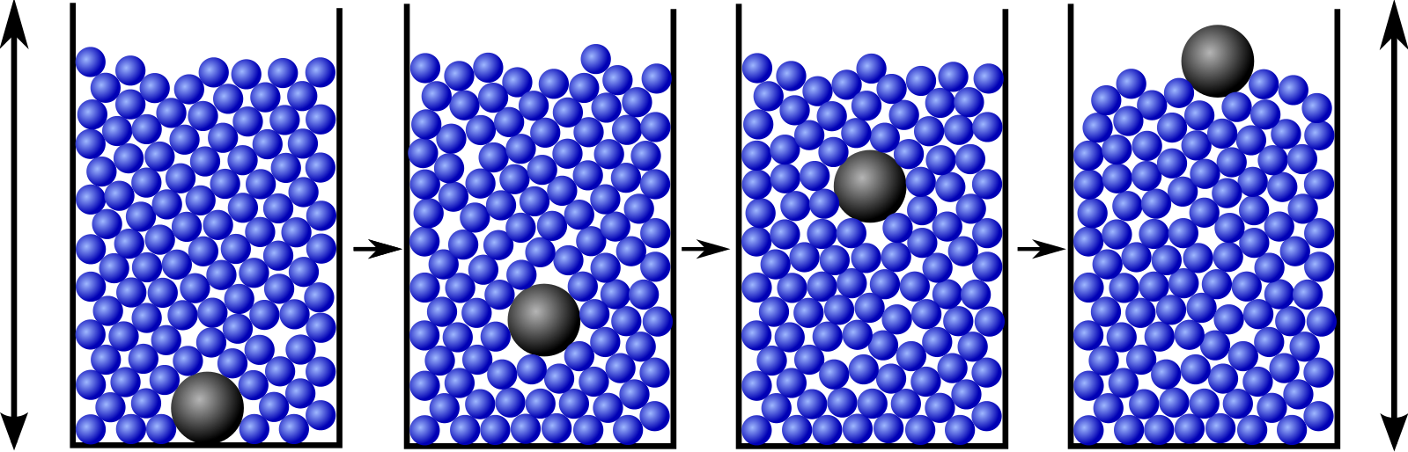



Mathematical Materials
Chris Budd

Slide 2
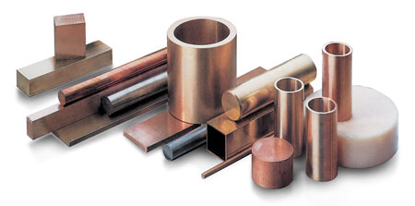
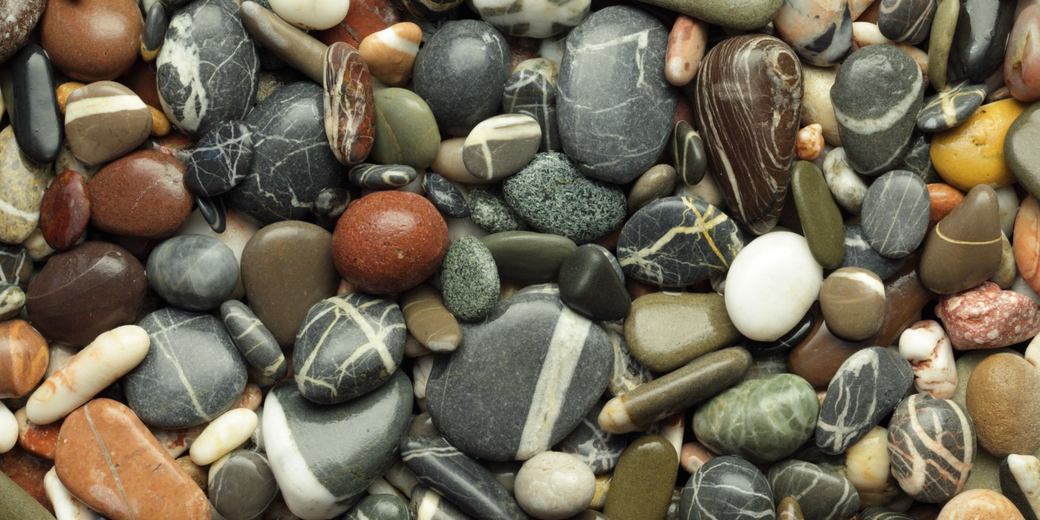
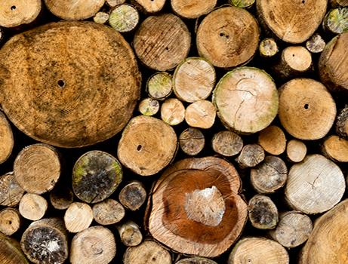
Materials are everywhere and define our civilisation!
Natural
Rock, wood, ivory, bone, skin, fur, leather, metal, wax, sand, crystals

Slide 3
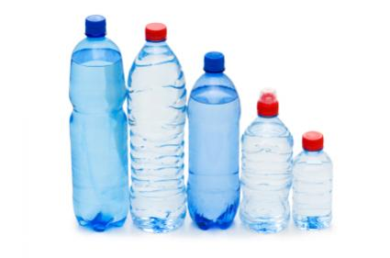
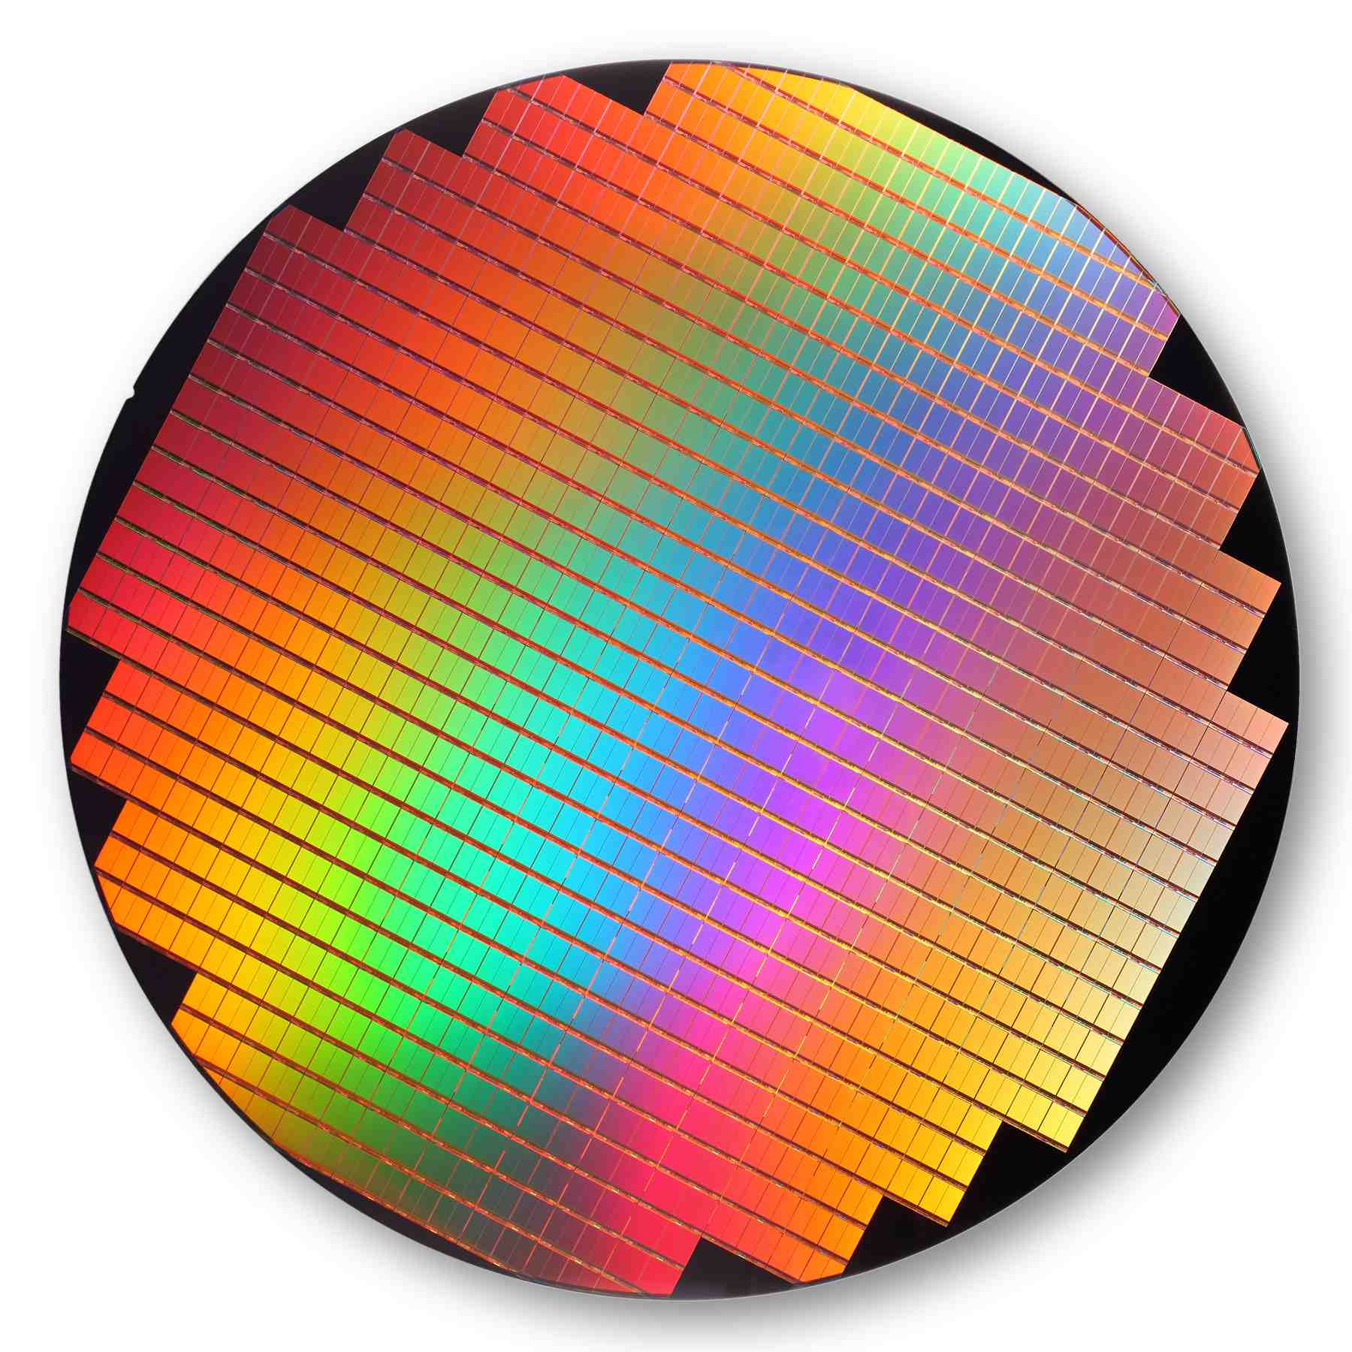

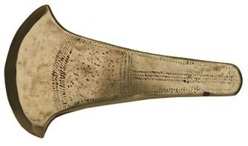
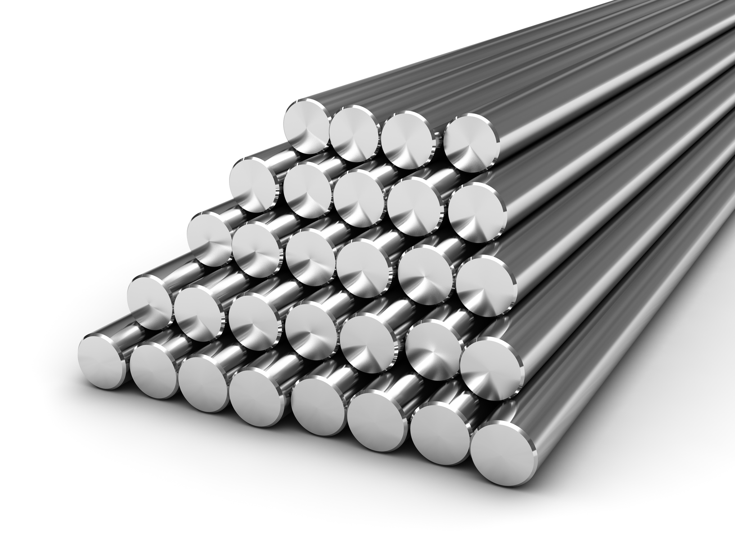
Artificial
Glass, paper, plastics, cloth, bronze, steel, nylon, polymers, concrete, semi-conductors, liquid crystals, composites

Slide 4
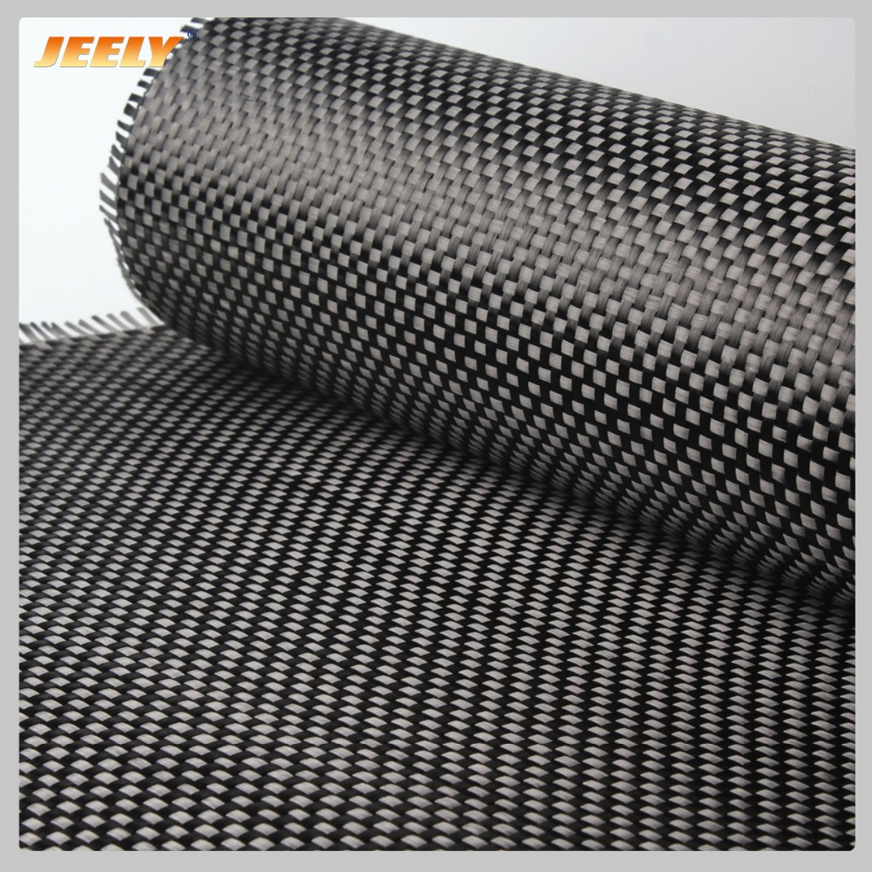
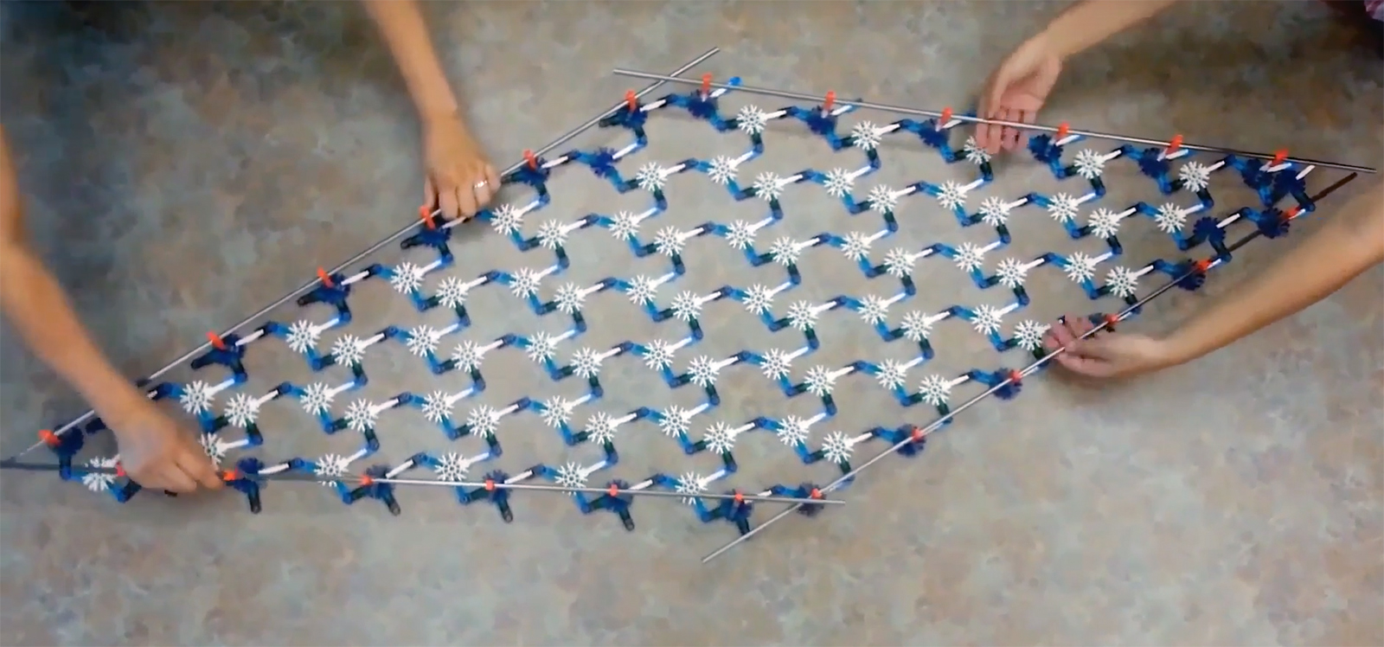
Mathematics can help in both understanding the properties of existing materials and in designing new ones with special properties called meta-materials.

Slide 5
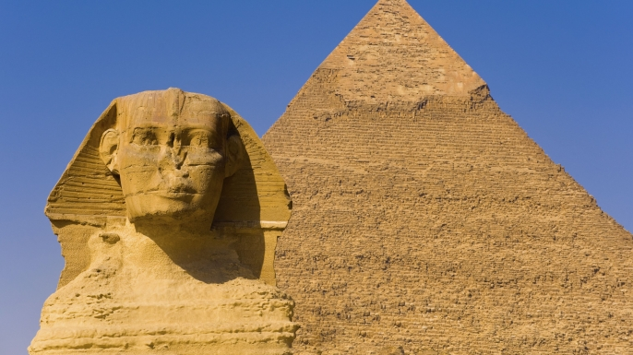
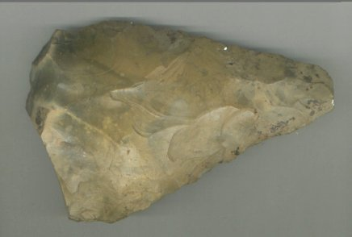
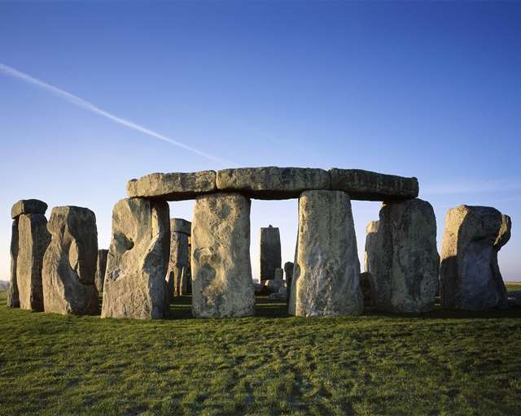
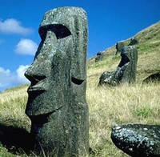
1. Let’s rock .. One of earliest building and tool materials

Slide 6

Q. What sort of a material is a rock?
Short time-scales (1s – 1000 years) rock is elastic
Displacement is proportional to the force acting
Other elastic materials include wires, springs and rubber

Slide 7
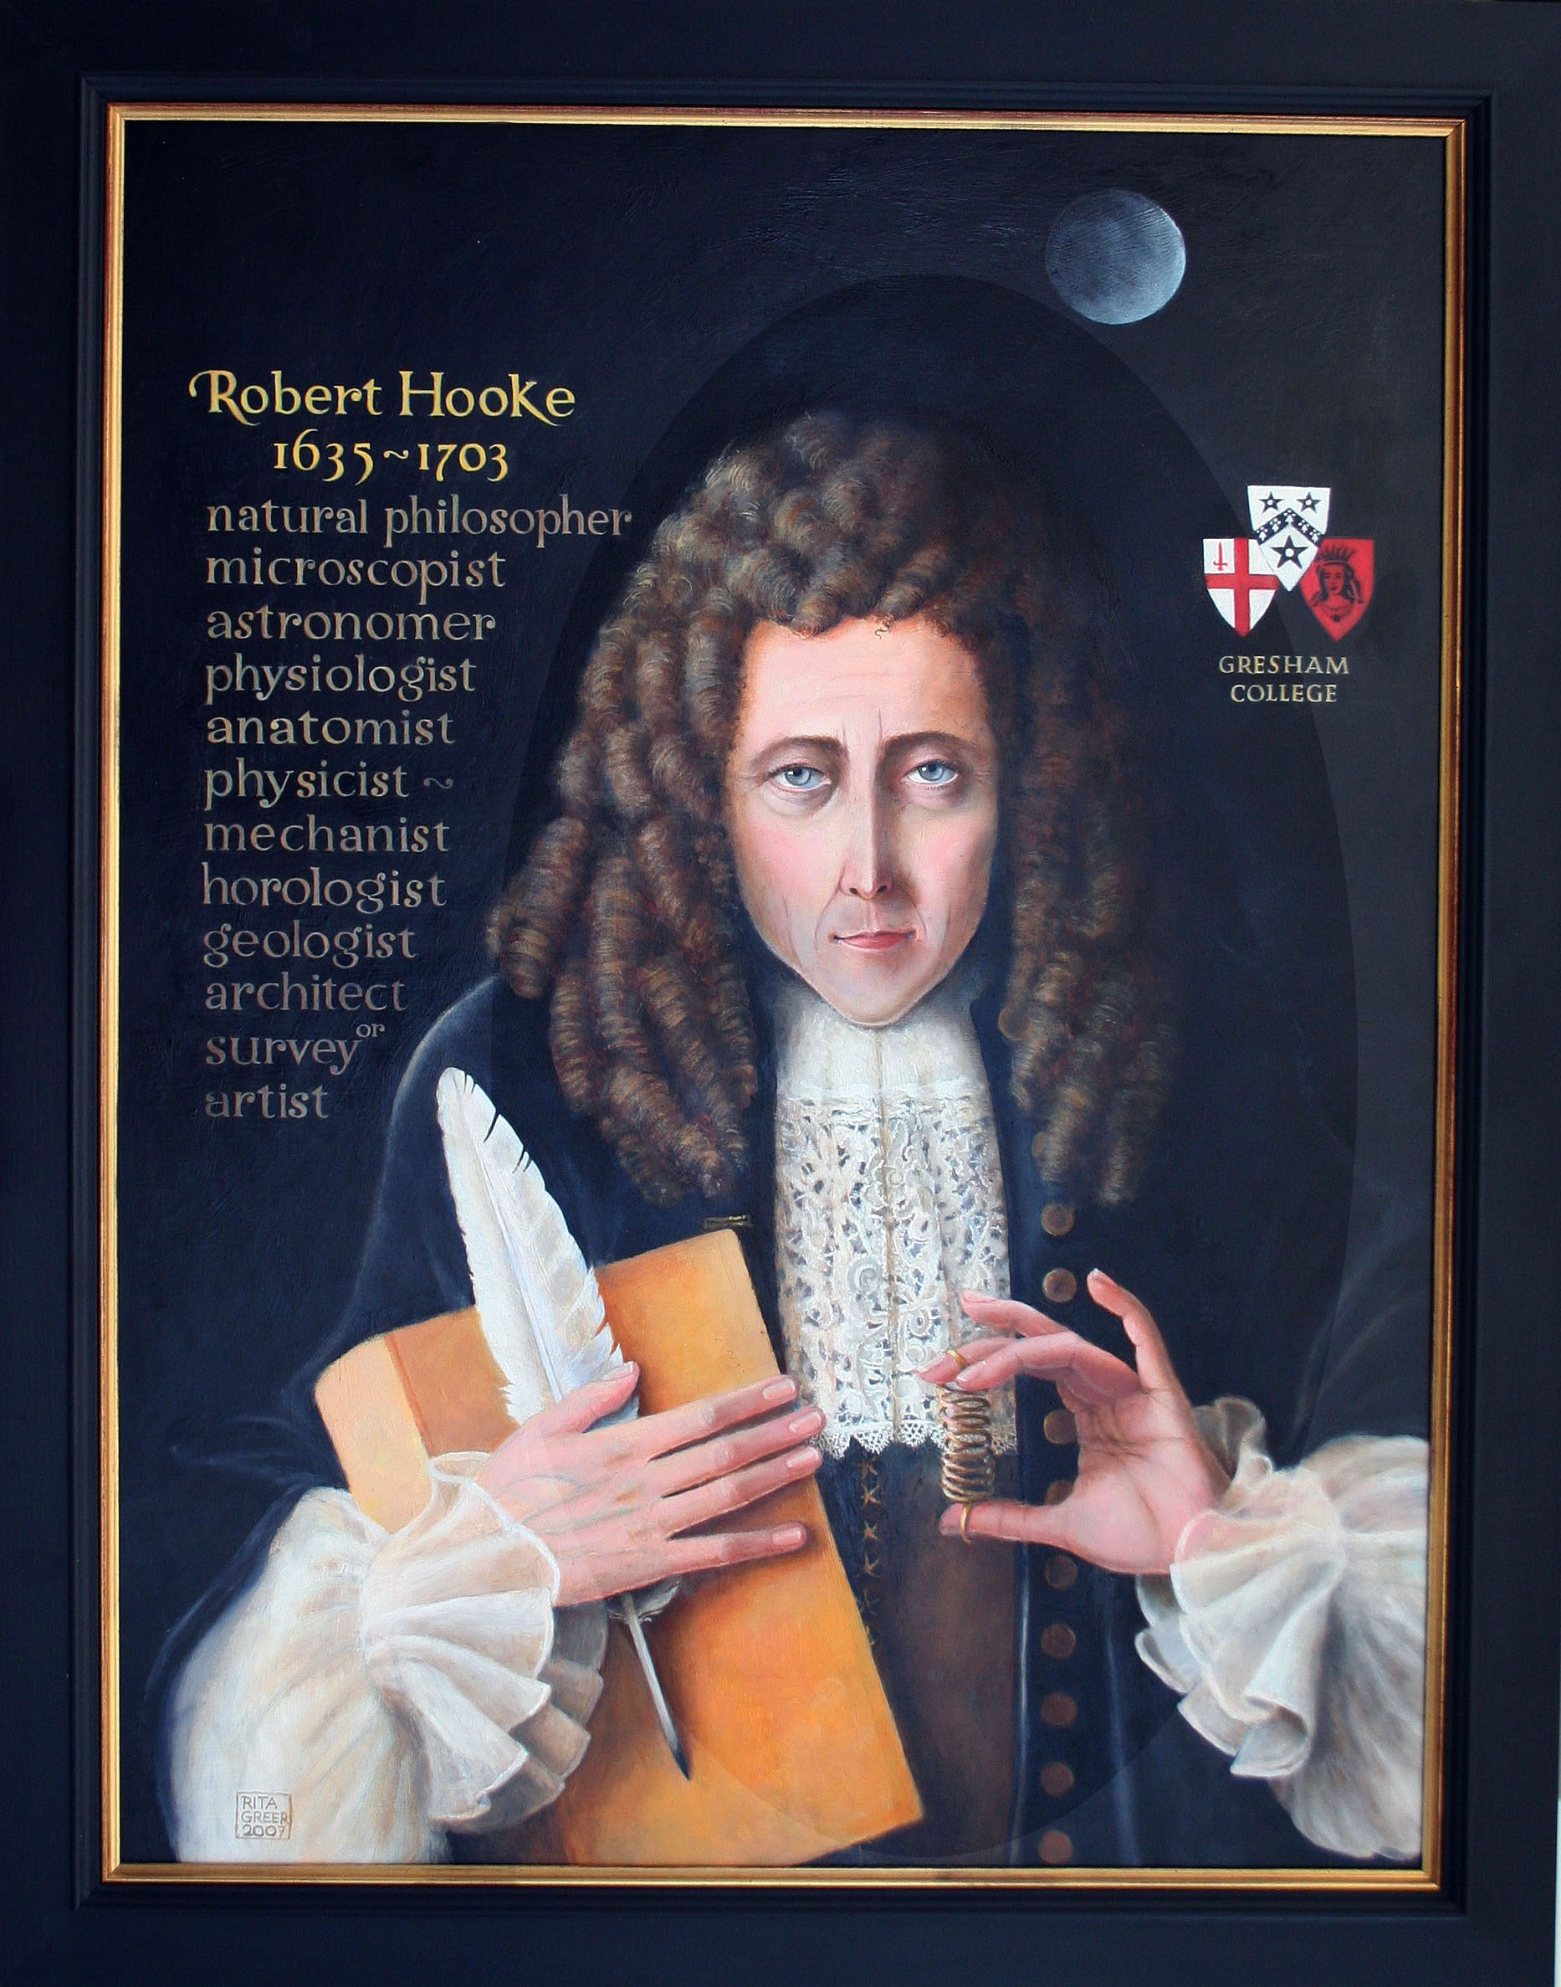
Robert Hooke

Slide 8
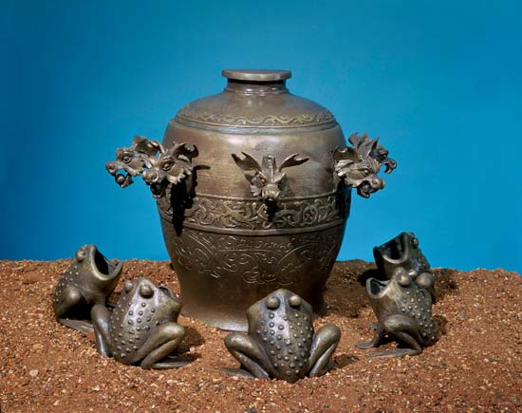
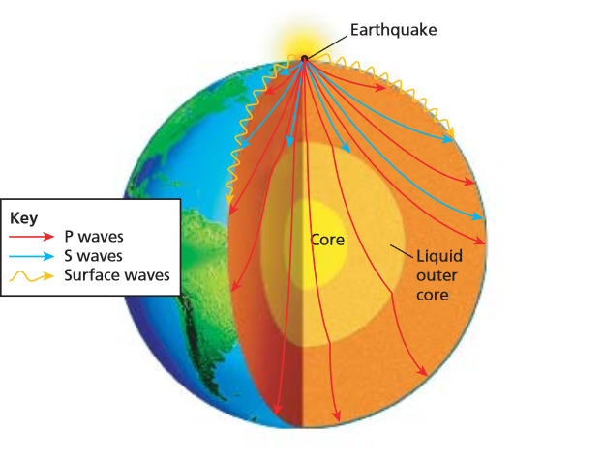
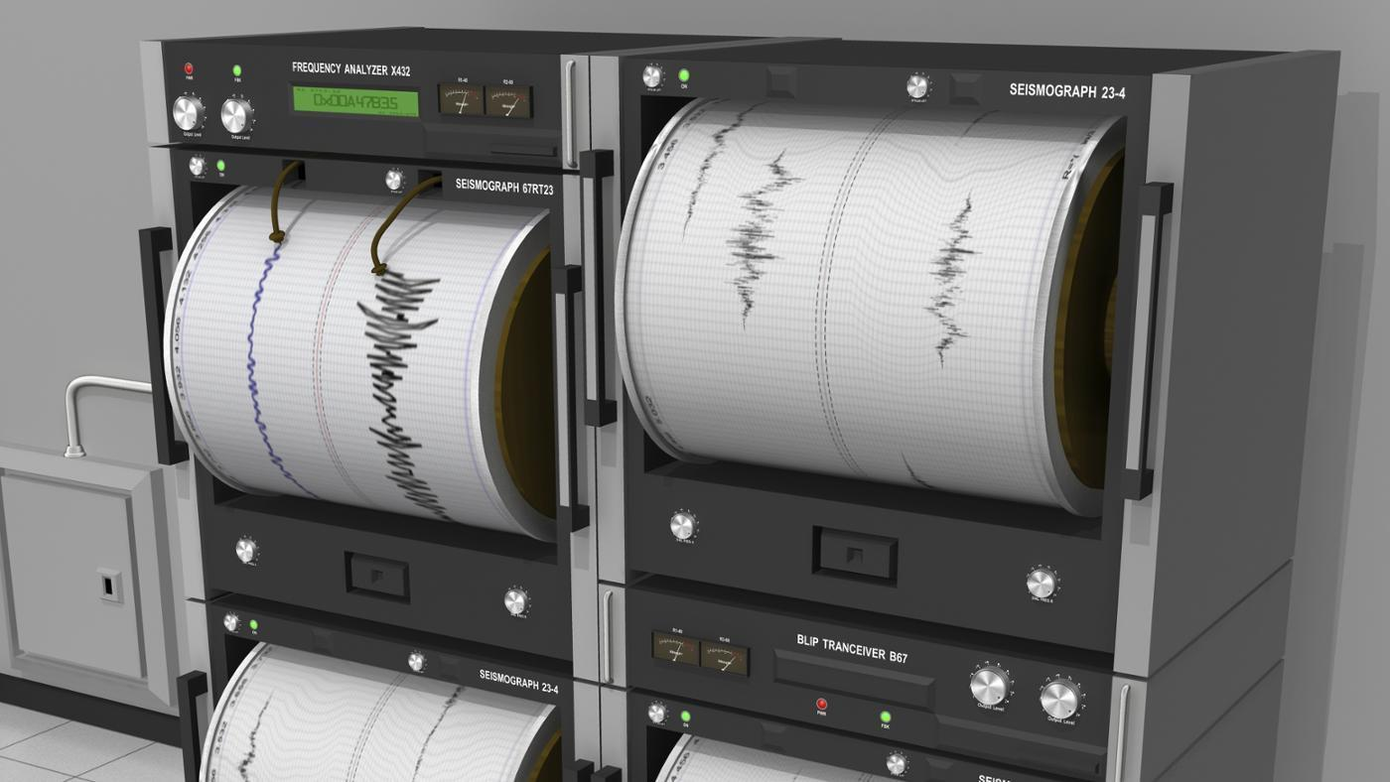
Elastic waves are seen in earthquakes

Slide 9
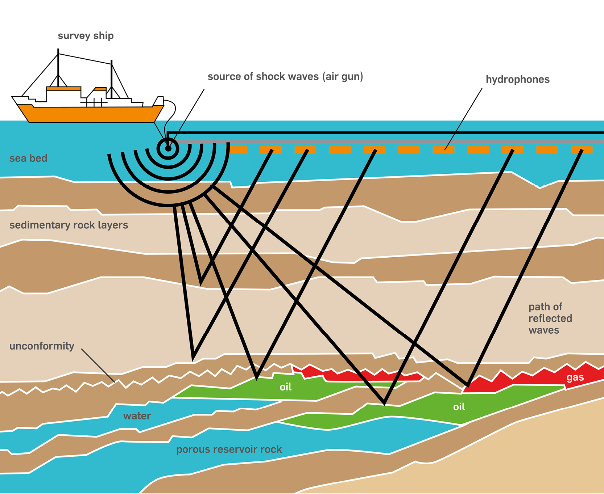
Used by oil companies to prospect for oil

Slide 10
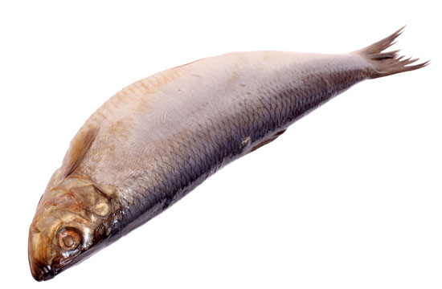
Over longer times (millions of years) rocks behave as a
visco-elastic material
Viscous material: Velocity is proportional to force
Viscous: Treacle, lava, toothpaste
Visco-elastic: Rock, human and other flesh

Slide 11
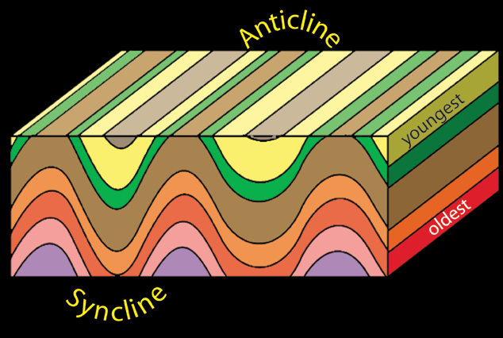
Equation for single layer rock deformation:
P
P

Slide 12
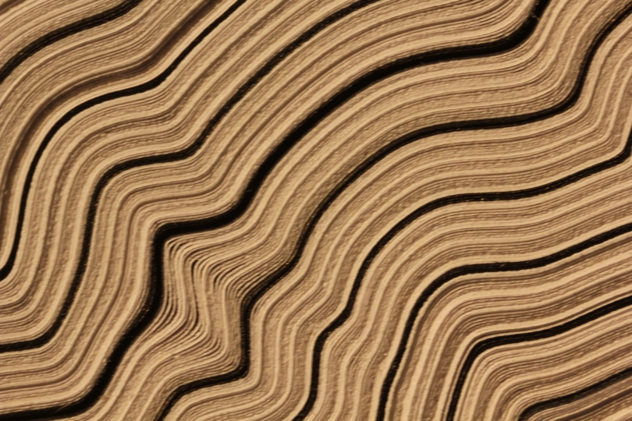
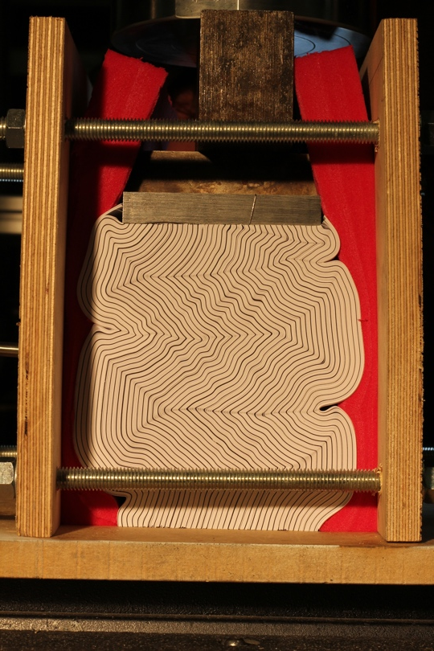
Most rocks are examples of layered materials: eg. Paper
When these deform the layers interact

Slide 13
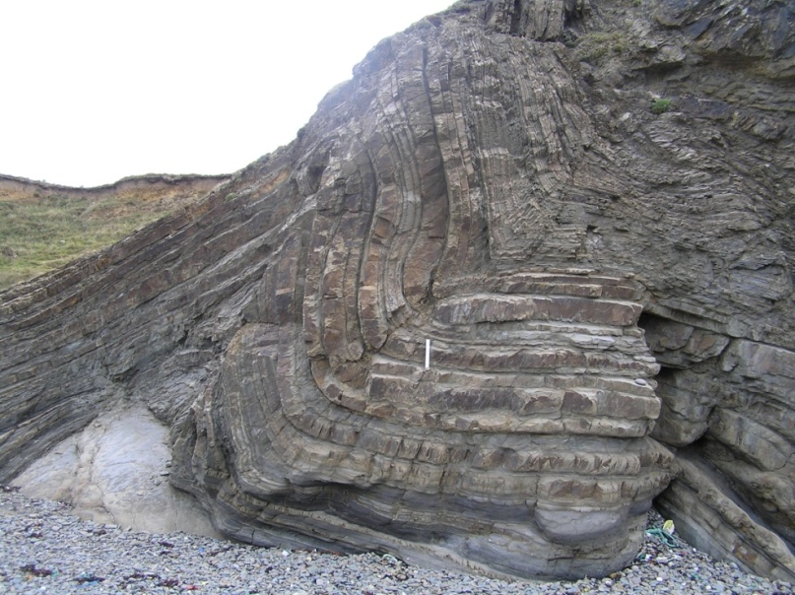
Folded rocks in Bude Cornwall

Slide 14
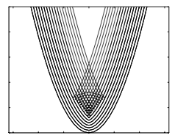
Swallowtail caustic curve

Slide 15
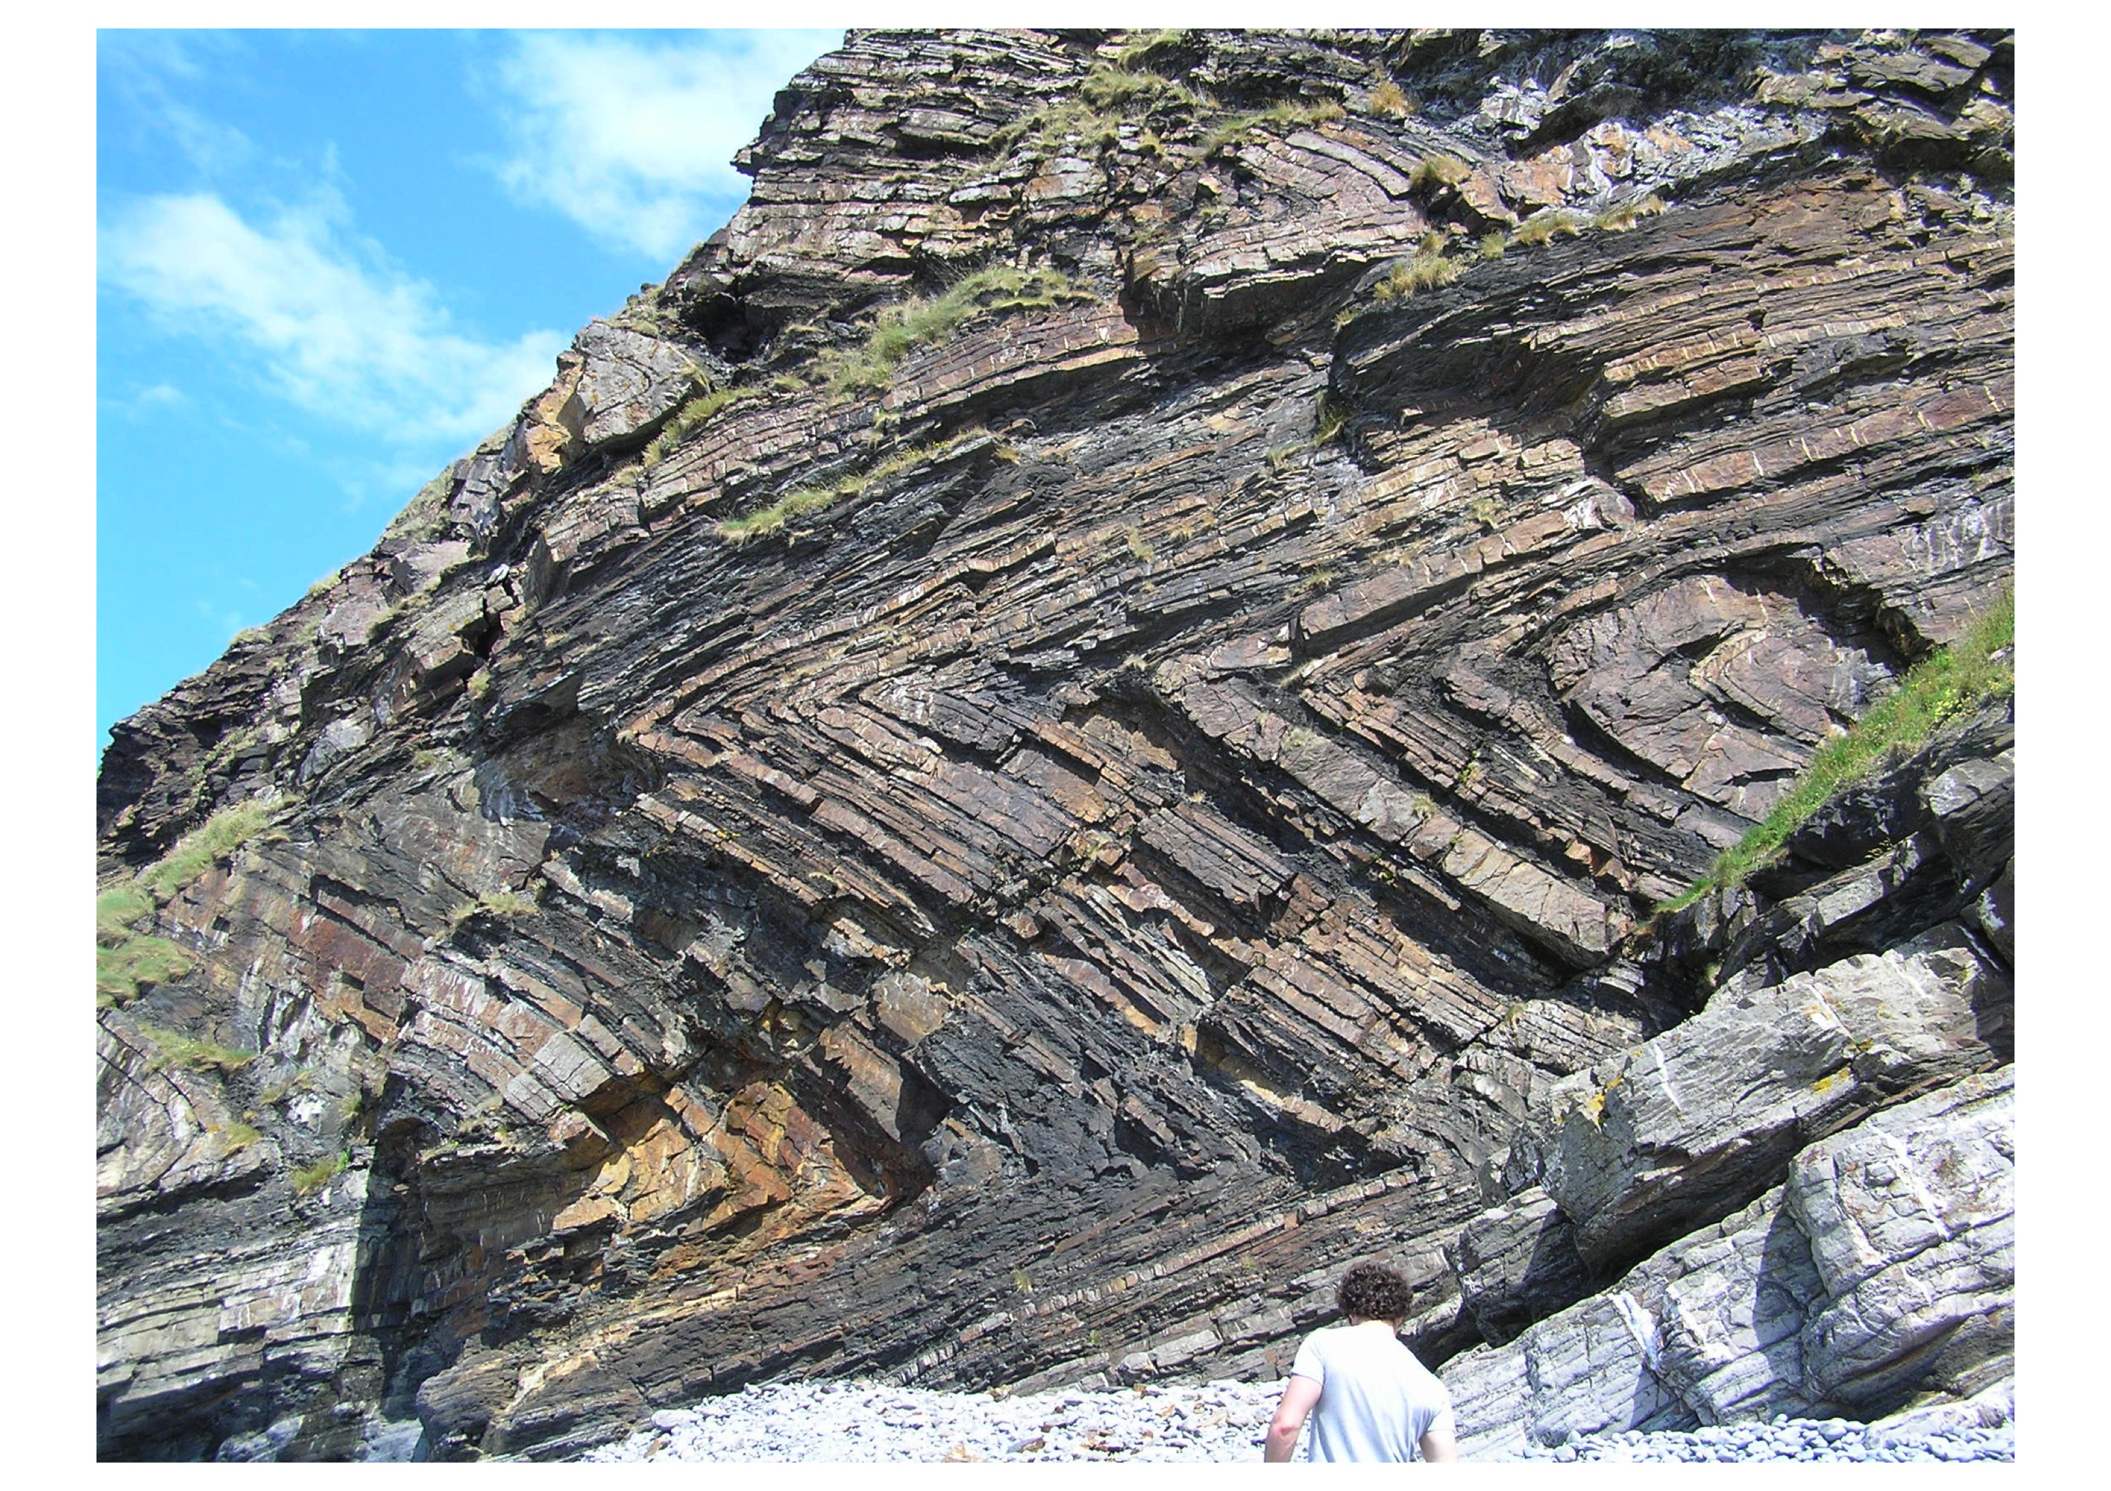
Chevron Folds at Millook Haven, Cornwall
mathematician

Slide 16

Folding can lead to separation between the layers
Void

Slide 17

2. Let there be light
Modern communication uses optical fibres made of glass

Slide 18
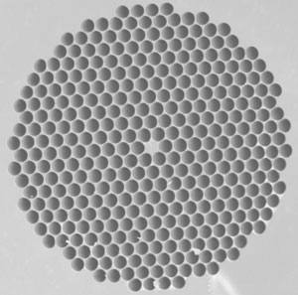
Photonic crystal
Meta-material. Small holes drilled in the fibre act as resonators and prevent any loss of energy

Slide 19
Analysed by using multi-scale methods to solve the Helmholtz equation
in this complicated geometry
Multi-scale methods are also used to study:
Wood, bone, composite materials
Climate, weather, WiFi systems

Slide 20
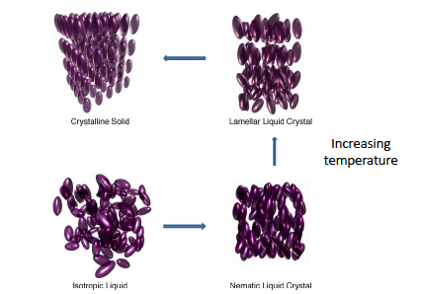
3. Getting Liquid
Material which is in an intermediate state between a liquid and a solid
Molecules are aligned and can change direction: anisotropic

Slide 21
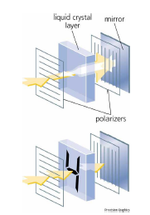
LCD Displays: work by changing the alignment

Slide 22
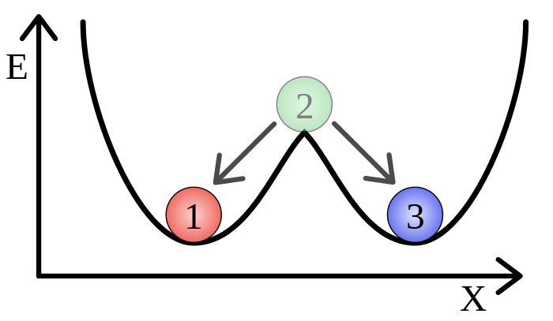
This is a bi-stable system.
Exists in one of two stable states
Energy is only needed to change between the states
The mathematical approach to such a design is to find a formula describing the energy E of the liquid crystal state and then prove that this energetic state has two stable configurations.

Slide 23
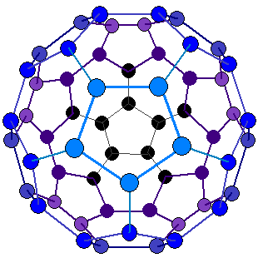
4. Crystals
Crystals play a vital role in modern technology and have a strongly mathematical form
Bucky Ball

Slide 24
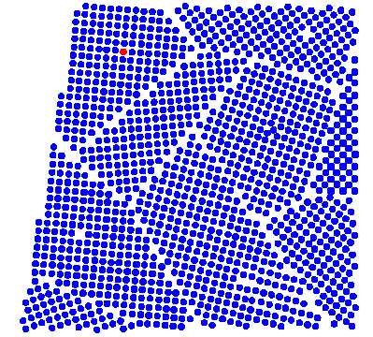
Poly-Crystal

Slide 25
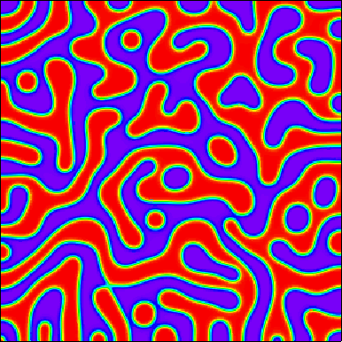
Two-phase material

Slide 26
Patterns in two-phase materials are described by the
Cahn-Hilliard equation
Applications in: polymer science, complex fluids and many other industrial applications)
Major tool in allowing mathematicians to predict the behaviour and form of complex mixtures of materials

Slide 27
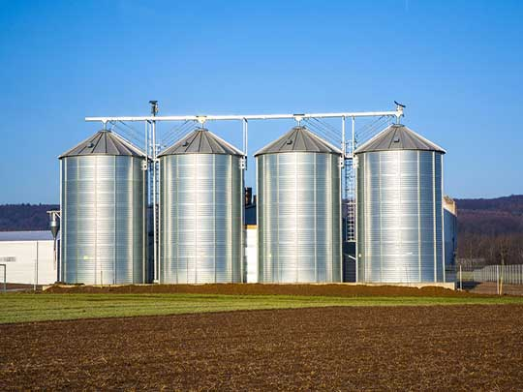
5. Granular Materials
Many materials are mixtures of grains. Their properties depend upon how much energy you put into the system

Slide 28
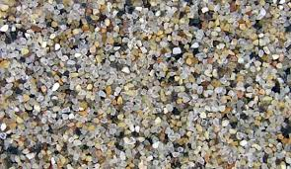
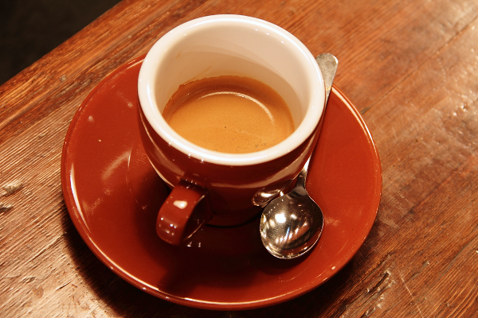

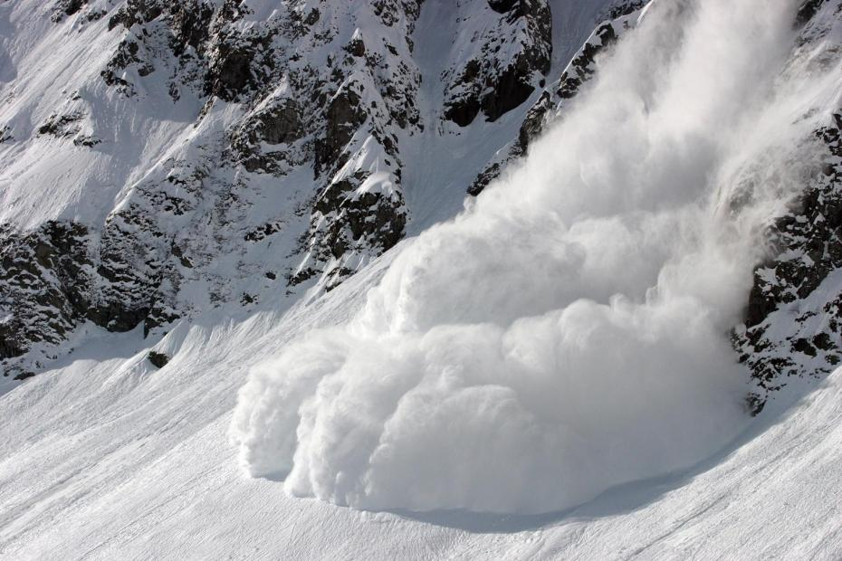

Slide 29
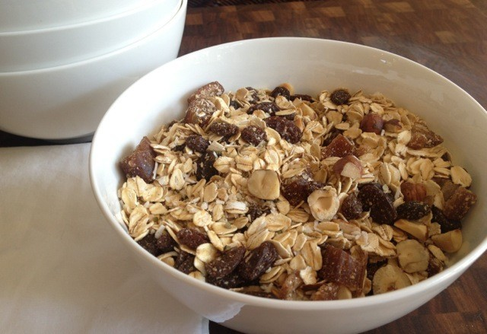
Example: The Brazil nut effect

Slide 30
Material changes depending upon how much you shake it

Slide 31
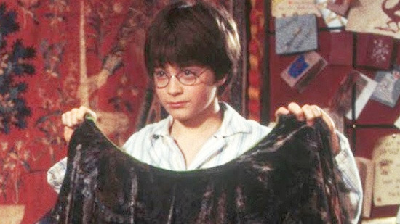
6. Is the Harry Potter Cloak possible?

Slide 32
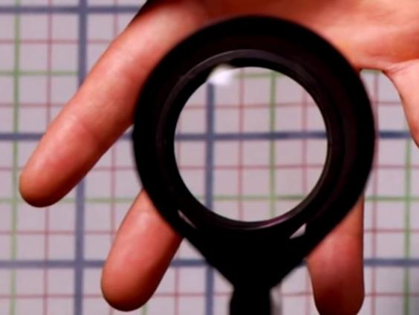
Effect can now be achieved with clever optical materials
Rochester Cloak

Slide 33
As the viewpoint shifts, the image keeps aligned with the background
Invisibility cloaks are meta-materials made up of a lattice with the spacing between elements less than the wavelength of light, which is then bent by the material.

Slide 34

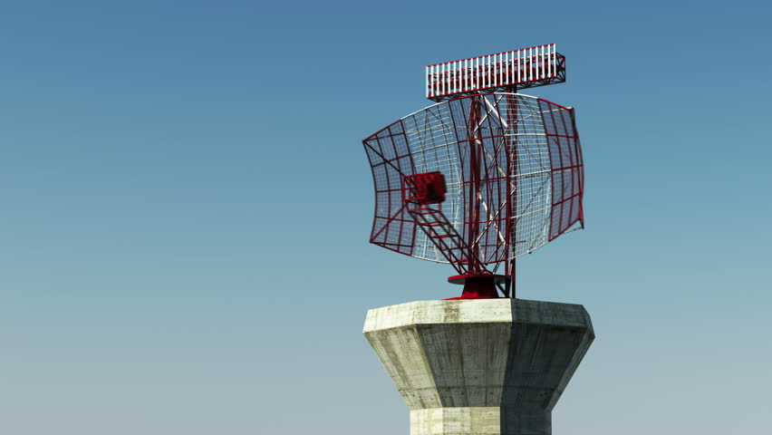
7. Getting Electrical
Design a meta-material to coat a building with

Slide 35
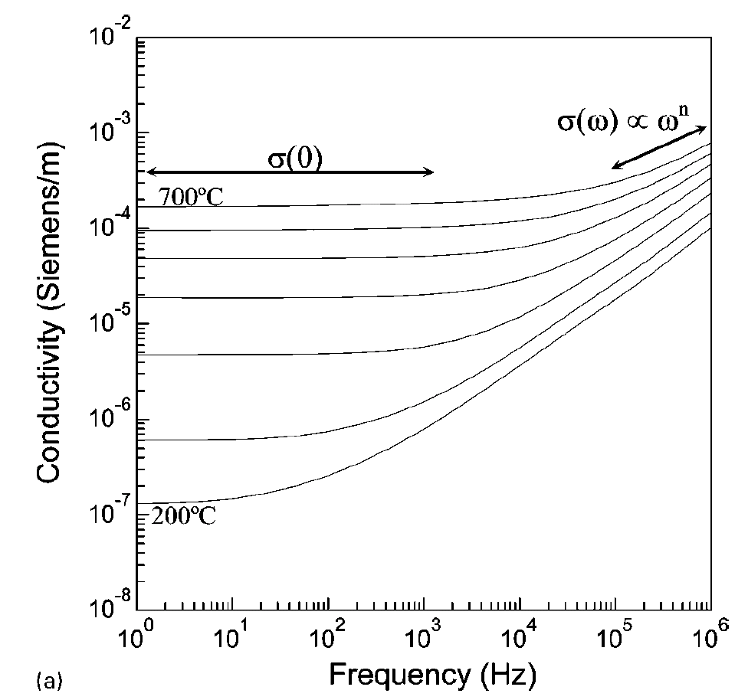
Desired electrical properties

Slide 36
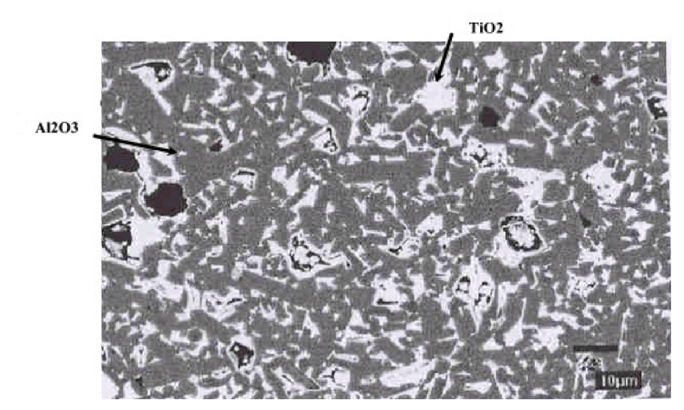
Complex random material. Extremely hard to analyse directly

Slide 37
Represent this as a series of randomly placed resistors and capacitors
Analyse this random system using random matrix theory
Also useful in quantum theory and number theory

Slide 38
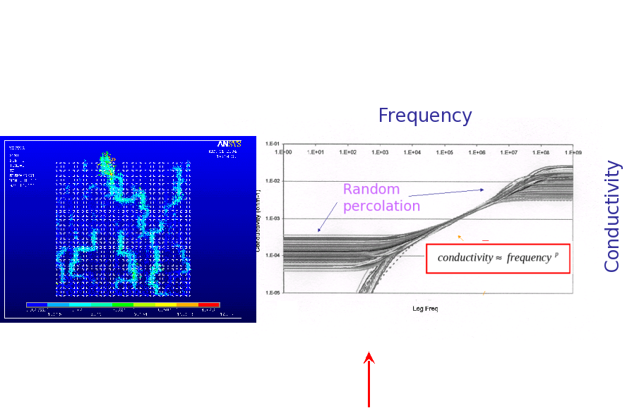
Results .. Good agreement with experiment

Slide 39
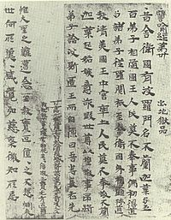
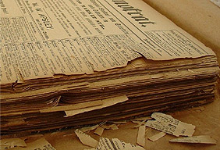
8. News of Paper

Slide 40
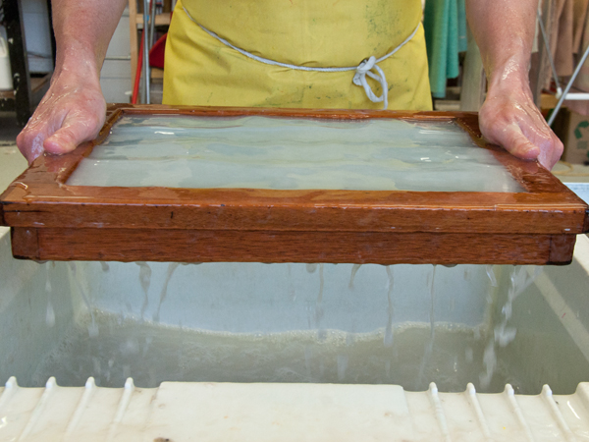

Slide 41
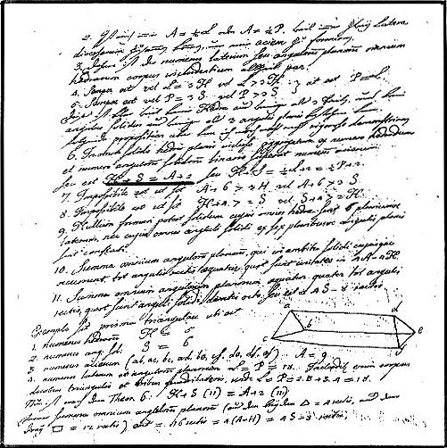

Slide 42
A4

Slide 43
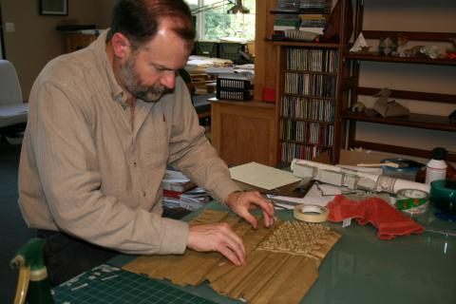
Robert J Lang: Mathematician and Origamist
Uses mathematical techniques to deliver great art

Slide 44
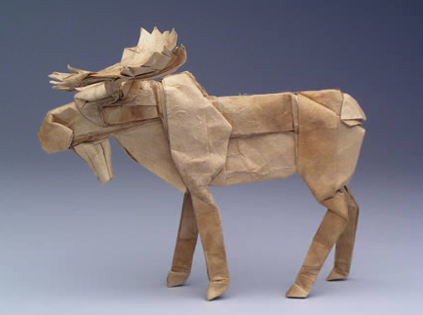

Slide 45

Spot the maths!

Slide 46
And finally ….
We stop at 3/14 1:59:26

