Slide 1
the dark ages
of the universe
5 April 2017
Joseph Silk
IAP/JHU

Slide 2
We have made remarkable progress
in cosmology in past 100 yrs.
its now a precision science
But the big questions are unanswered
What is the matter?
Dark matter, dark energy
Where do we come from?
Inflation....

Slide 3
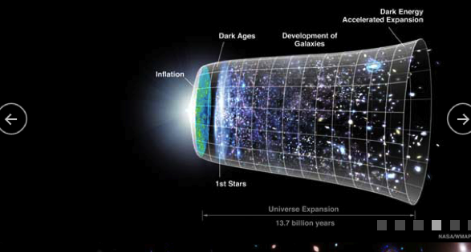
INFLATION
Slow roll
p=-ρ
DARK AGES

Slide 4
THE DARK AGES OF THE UNIVERSE

Slide 5
three new challenges
Find building blocks of galaxies
Find gravity wave background
Detect nongaussianity of fluctuations

Slide 6
LONG AGO
predicted by theory!
Dwarf
galaxies
Large-scale
structure
NOW

Slide 7
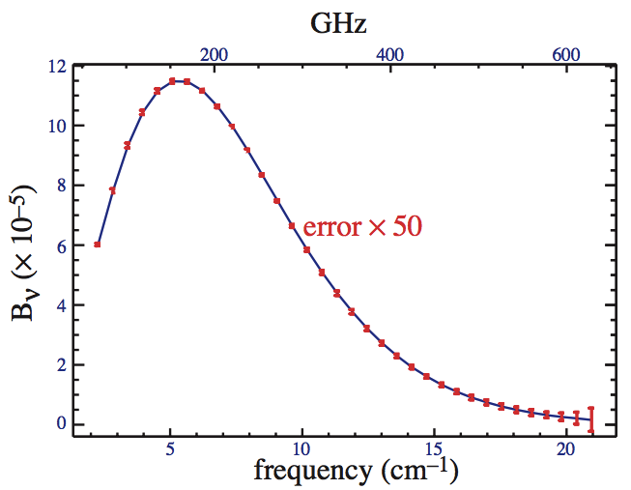
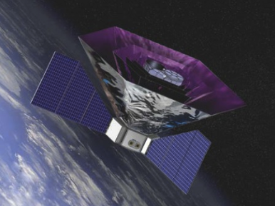
Density fluctuation damping gives μ=10⁻⁸
complements CMB acoustic peaks
search for deviations from near-perfect radiation
guaranteed signal from clumps
predicted by cold dark matter!
perfect blackbody
clusters
Large-scale
structure
Dwarf
galaxies
dwarfs
PIXIE (for 2022 launch?)
Predicted!
Probes back to 1 yr after beginning
but can we do more?
Pajer & Zaldarriaga 2013
The first star-forming dwarfs

Slide 8
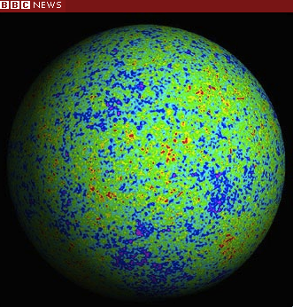
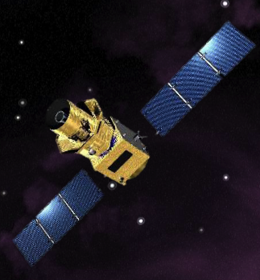
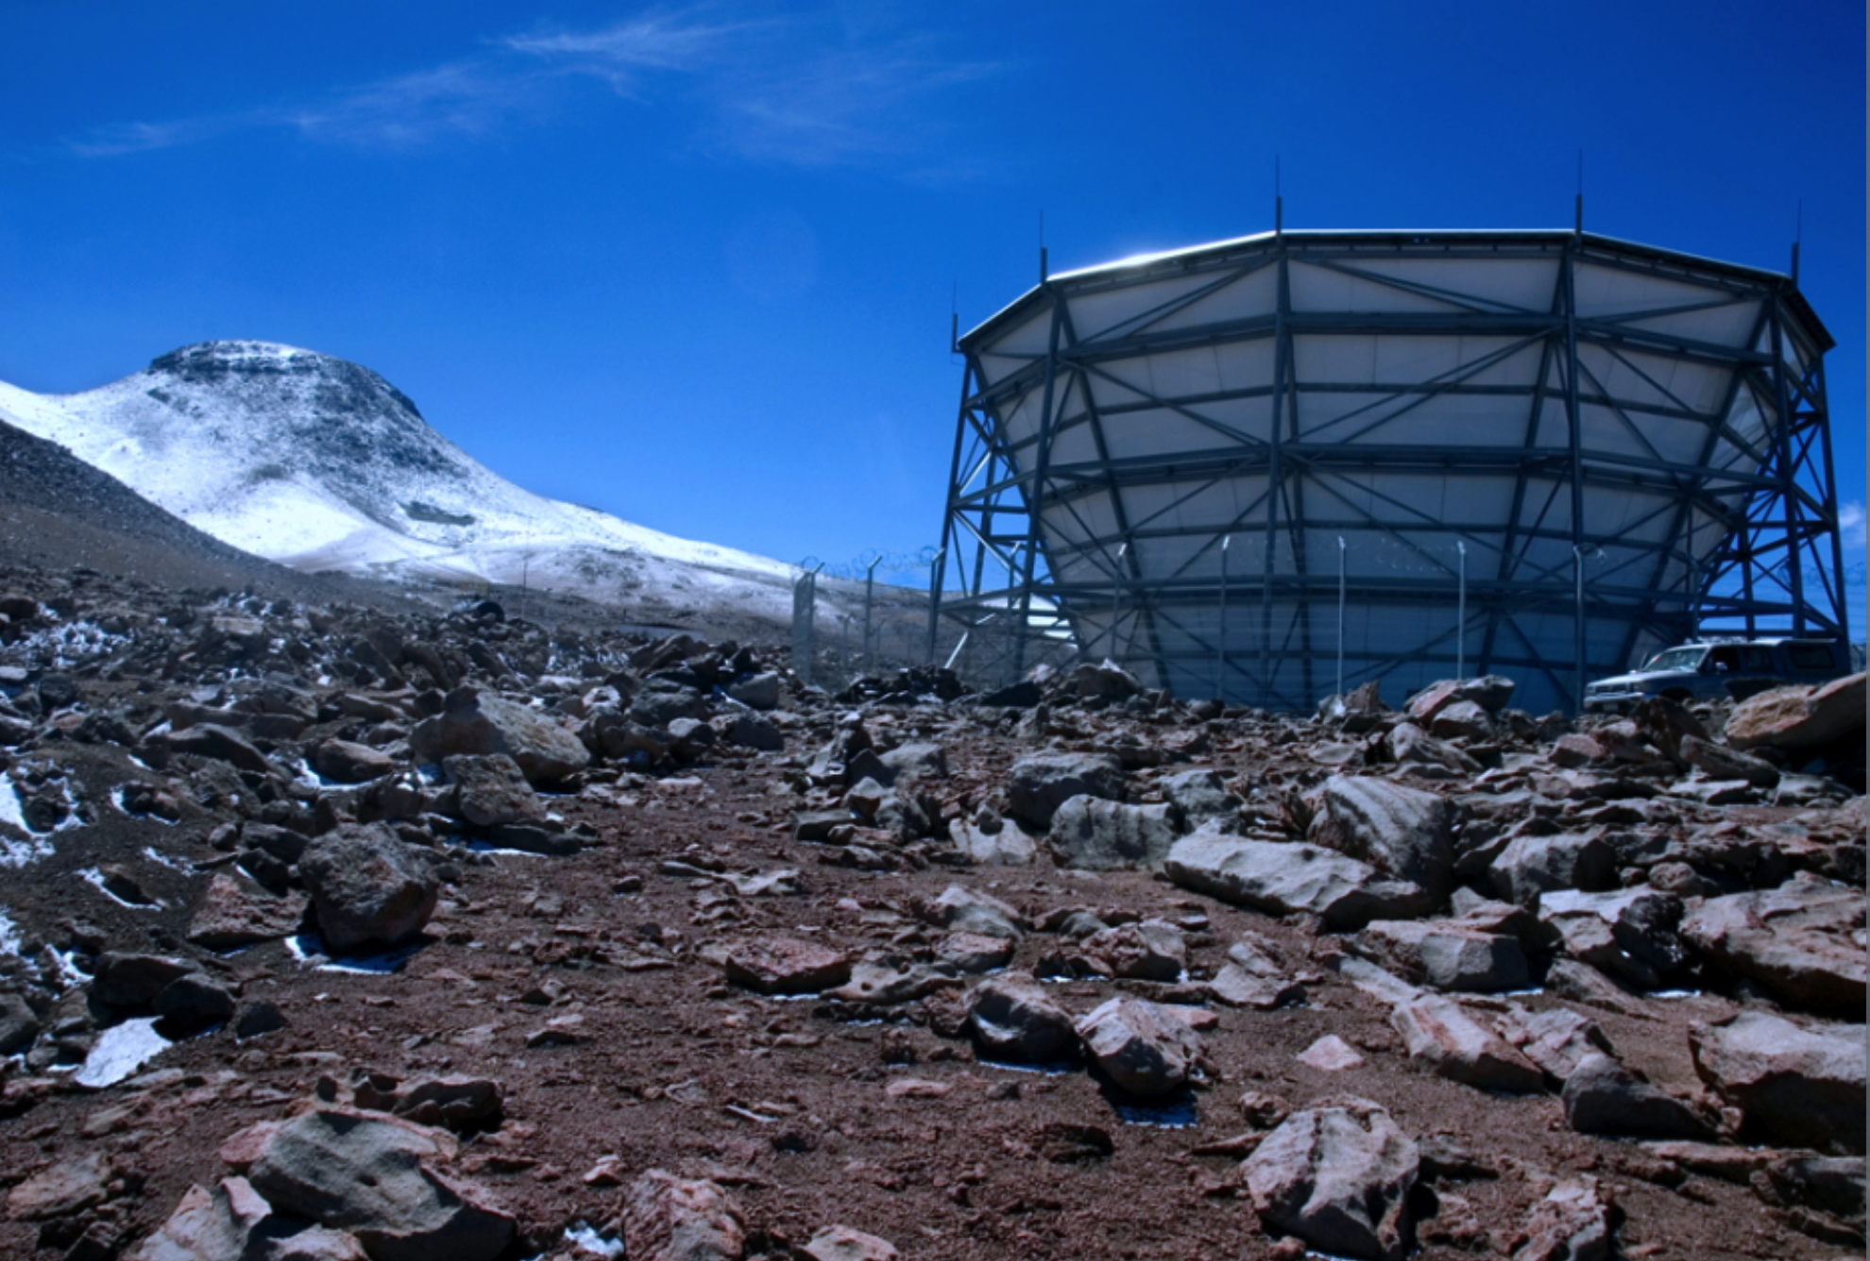
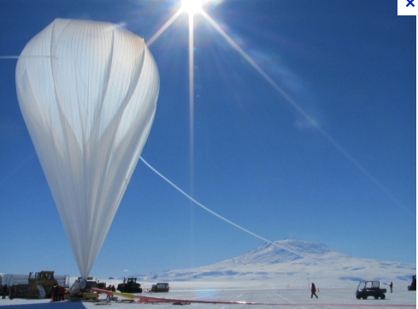
Inflation at 10⁻³⁷ sec predicts gravity waves that distort the Cosmic Microwave Background
Gravity waves:
polarization
Lensing fluctuations:
E mode
Temperature fluctuations:
scalar mode
To B or not to B?
Satellites: LiteBIRD (JAXA launch in 2022?)
PIXIE (NASA launch in 2022?)
ground/balloon: CMB-S4, c. 2020
South Pole
Atacama
The ultimate goal!
But there is no guarantee of a signal

Slide 9
SEEK NON-RANDOM PATTERNS ON THE SKY TO PROBE INFLATION we call this non-gaussianity and its guaranteed!
A different direction
Inflation most likely is complex,
predicts very low gravity waves
but generically predicts non-gaussianity
there is always some non-gaussianity, since corrections
involve square of a gaussian , which is non-gaussian.
But its very small!
its larger in complex inflation models
Ideally you want gravity wave and non-gaussianity signals
Notes:
But is this a robust goal Eg string-inspired inflation
generically predicts unmeaurably low r

Slide 10
NON-GAUSSIANITY
is an essential part of the observed universe
This is us
This is not us
These simulations of galaxy clustering have exactly the same power

Slide 11
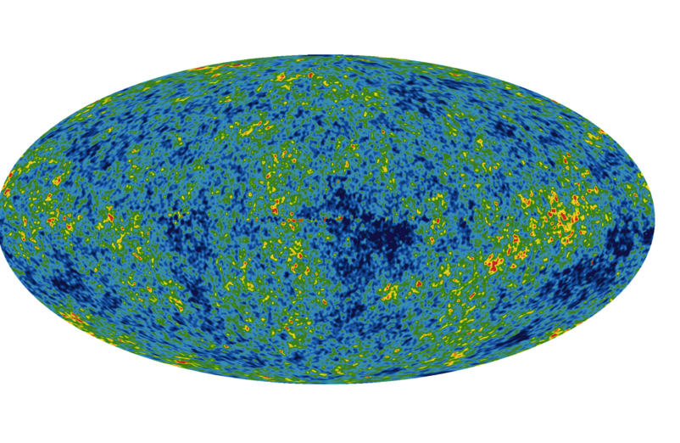
An example of nongaussian foregrounds
Seek primordial nongaussianity
But be very careful with your statistics!
!MAP7

Slide 12
ULTIMATE PROBE OF INFLATION
Only robust prediction of inflation is non-gaussianity.
The signal is a small fraction f_{nl} δT/T of temperature fluctuations
f_{nl} < 10 (current limit) vs ~1 (multifield prediction)
but we’d like to get to ~0.01 (vanilla inflation, guaranteed)
Maldacena 2003 f_{nl} ~ n_{s}-1 with Planck n_{s}=0.96..
simple inflation already is strongly constrained by the failure to
detect gravitational waves in the cosmic microwave background
Can we improve on Planck precision by 100 or more?

Slide 13
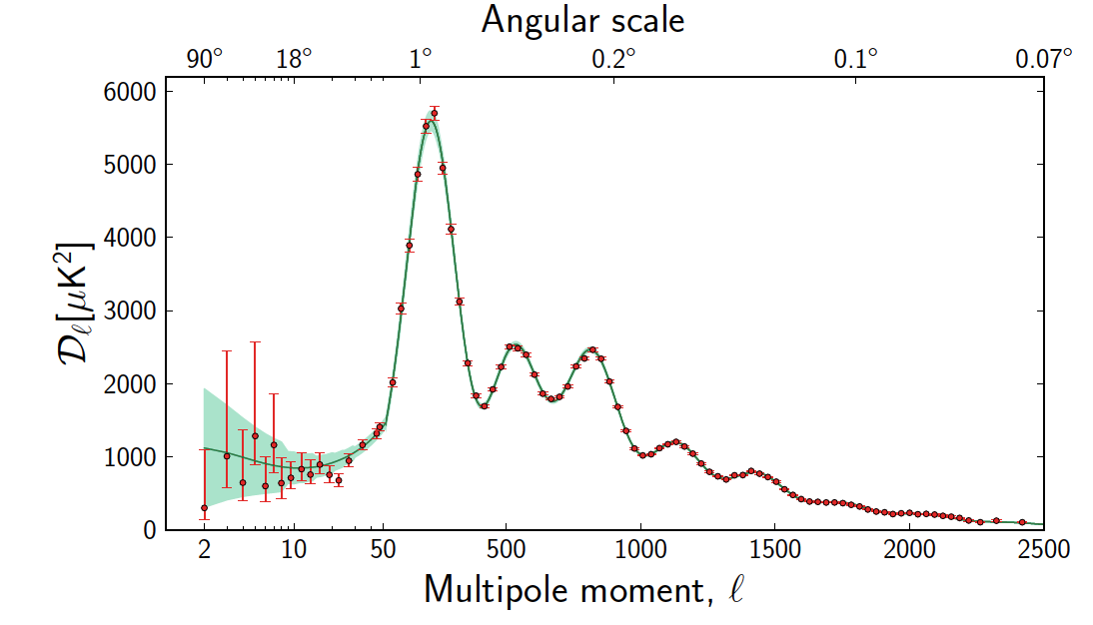
Microwave background probes N~10⁶ independent samples
to l~1000
2D limiting accuracy N^{-1/2} ~ 0.1%
How do we increase N ?
galaxy surveys? 3D probe
allow N~ 10⁹ but galaxies are biased probes
Long ago
Need to go back to the dark ages and use
gas clouds, the building blocks of galaxies.
This allows N > > 10¹⁰ in 3D
NOW

Slide 14
in absorption against cosmic microwave background
Observing atomic hydrogen

Slide 15
The best one can ever do, via the smallest hydrogen clouds that condense
Detectable in absorption against the cosmic microwave background
temperature
Highly redshifted from a wavelength of 21 cm or a very precise frequency 1420.40575177 GHz
redshift 50!
a very challenging experiment!

Slide 16
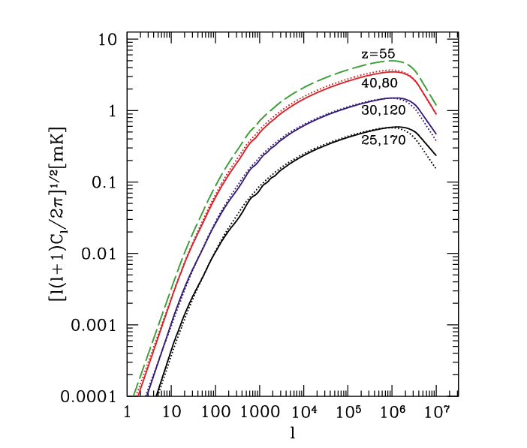
Sweet spot is at redshift around 50 or a frequency of 30 MHz
f_{nl}δφ ~ (n_{s}-1) δφ ∼10⁻⁶ requires N~10¹² modes (at few arc-sec resolution)
slice sky in 3D using redshift: eg Δν/ν~0.01 for N ~ 10¹⁰ x 10²
Precision increases as 1/√N ~ 1/l
can gain ~ 1000 over cosmic microwave background
cluster
CMB
galaxy
optical
cloud building blocks
21cm predicted
10’
1”

Slide 17
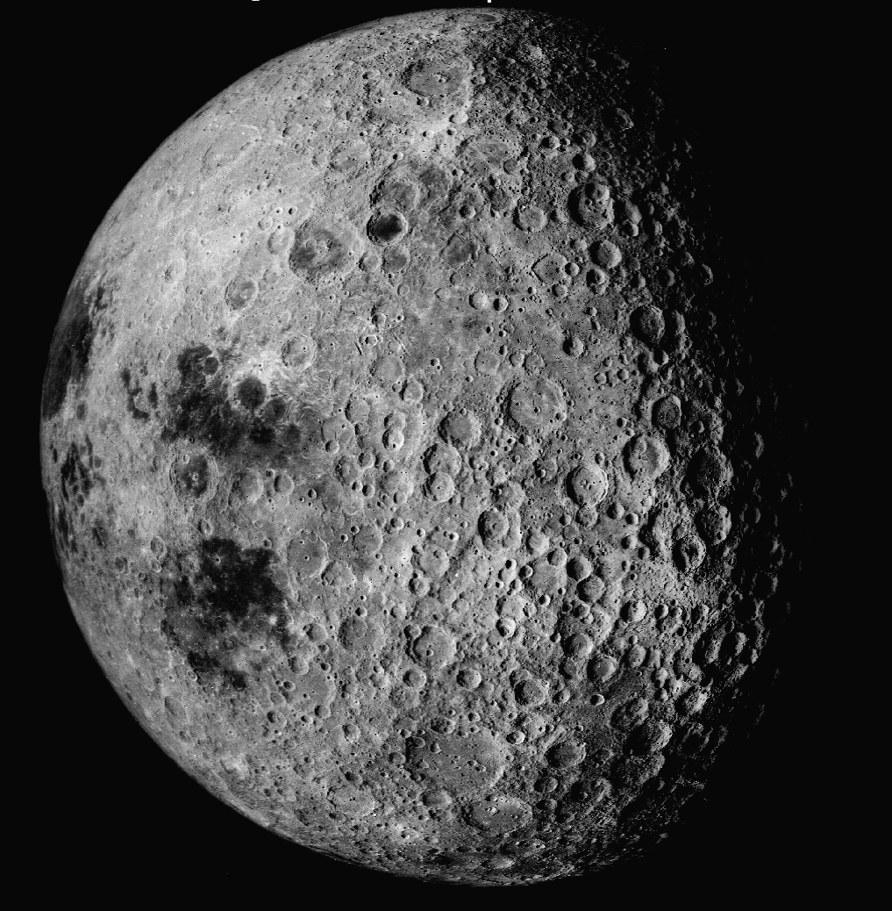
30-40 MHz is a very difficult frequency range to map from the Earth
Need to go to far side of MOON for low radio interference
Most radio-quiet environment
in inner solar system

Slide 18
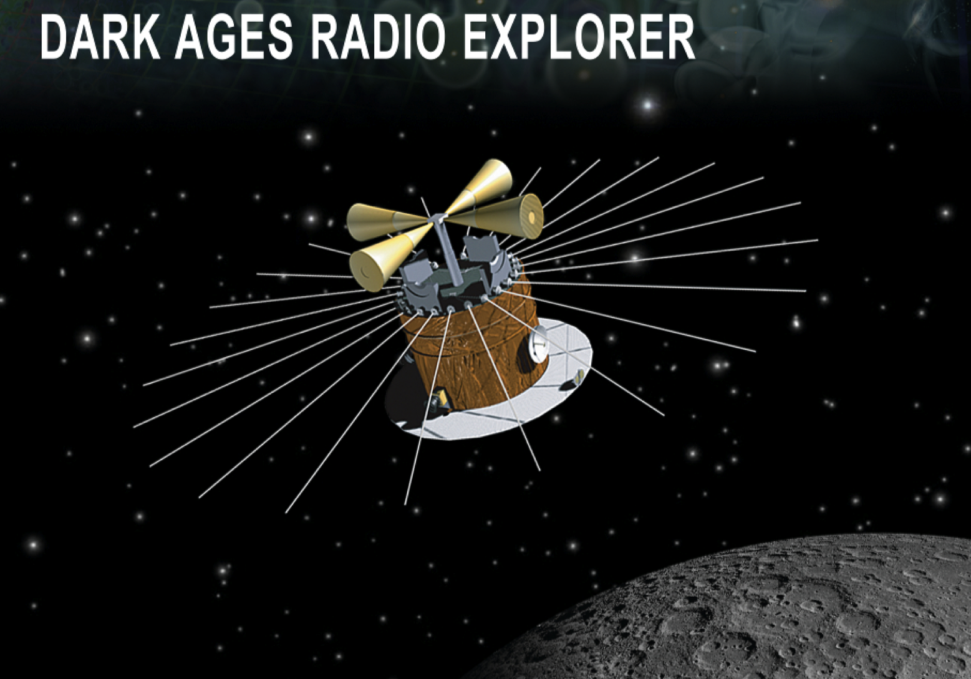
A vision for the ultimate future of cosmology
Control of foregrounds…
1far side of the Moon:
first, launch a 30 MHz pathfinder: lunar satellite dipole
Circumlunar orbit
Aim: probe reionization epoch z ~ 10

Slide 19
STRATEGY
Need to resolve ( l ~ 10⁵) a few arc-seconds
Optimal telescope array size is l λ/2π or a few100 km
Far side of the moon is unique site for radio interferometer dipole array
Allows N ~ 10¹⁰ patches on the sky x 10² along line of sight
attain 10¹² modes versus 10⁶ in the cosmic microwave background
Optimal bandwidth L=0.1 Mpc (Δν/0.01MHz)
Need millions of dipoles for resolving a weak signal
gain up to ~10³ in N^{1/2} relative to CMB
This enables precision cosmology at a part in a million
need lunar satellites to add baselines, download data to Earth

Slide 20
Lunar Radio Array of ~ 10⁶ dipoles sensitivity and high angular resolution at 40 MHz
Far side of the Moon ~ 2040
The ultimate dark ages explorer: a lunar dipole array with > 10⁶ dipoles
J. Lazio
Notes:
Discuss NlogN corelator

Slide 21
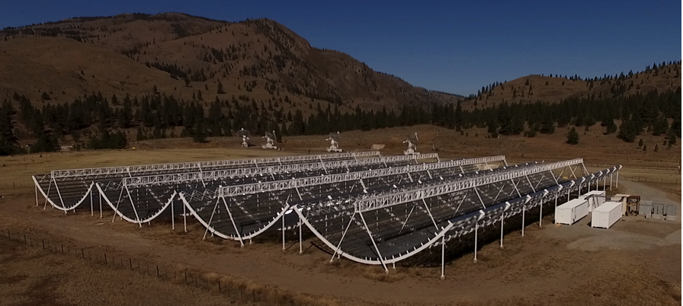
CHIME: the world’s most powerful radio telescope in British Columbia
10¹⁵ multiplies/sec for 1024 antennae at 400 MHz in 2017
LUNAR RADIO ARRAY: 10²⁰ multiplies/sec for 10⁶ antennae at 30 MHz
computing power achievable in 15 years from now?

Slide 22
in 16 yrs, compute power should
increase by 2¹⁶ or 100,000

Slide 23
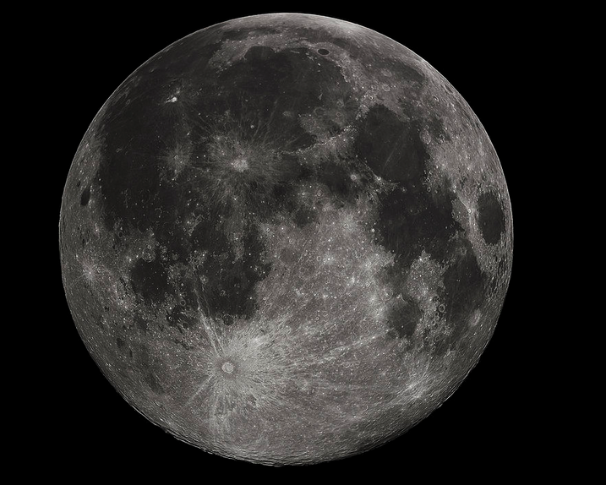
Moon viewed from earth

Slide 24
Viewed from lunar orbiter

Slide 25
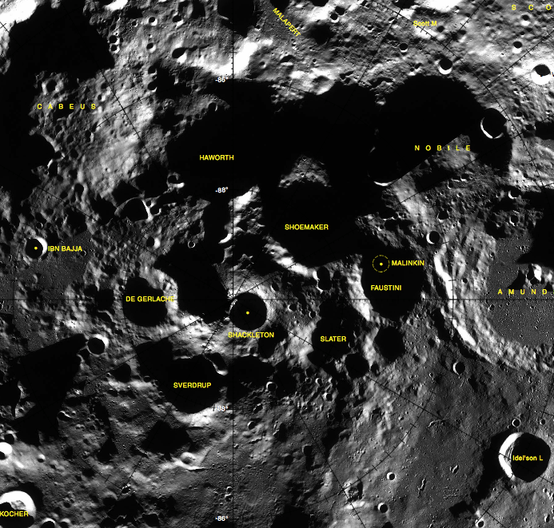
Close-up of south pole

Slide 26
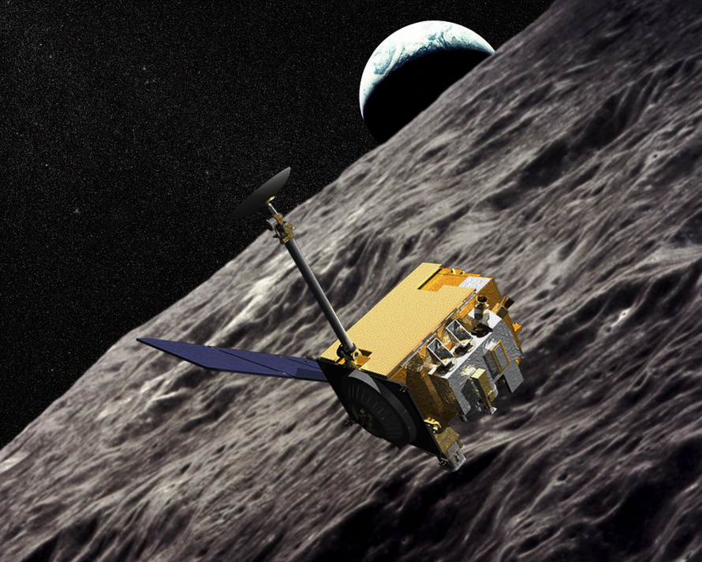
Diviner spacecrsaft

Slide 27
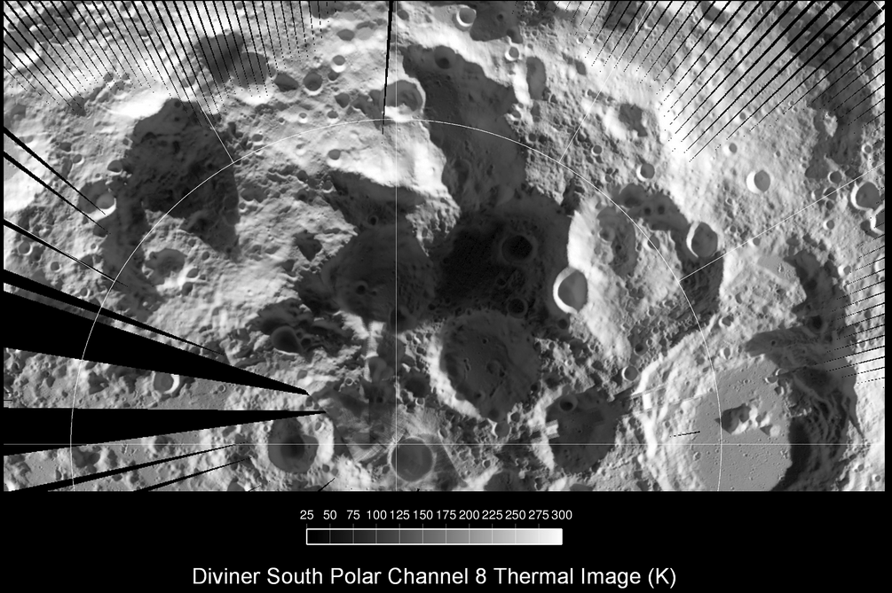
Thermal image of south pole region

Slide 28
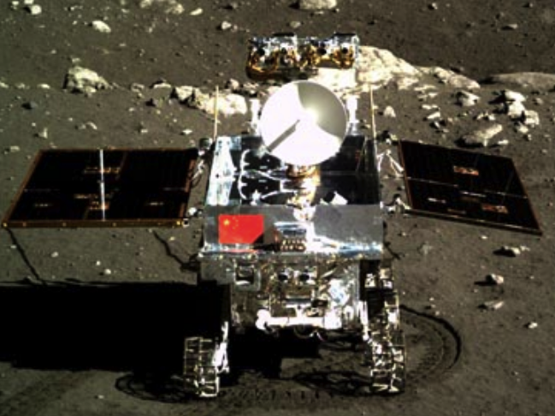
Chang’e lander December 2013
Yutu (jade rabbit) moon rover

Slide 29
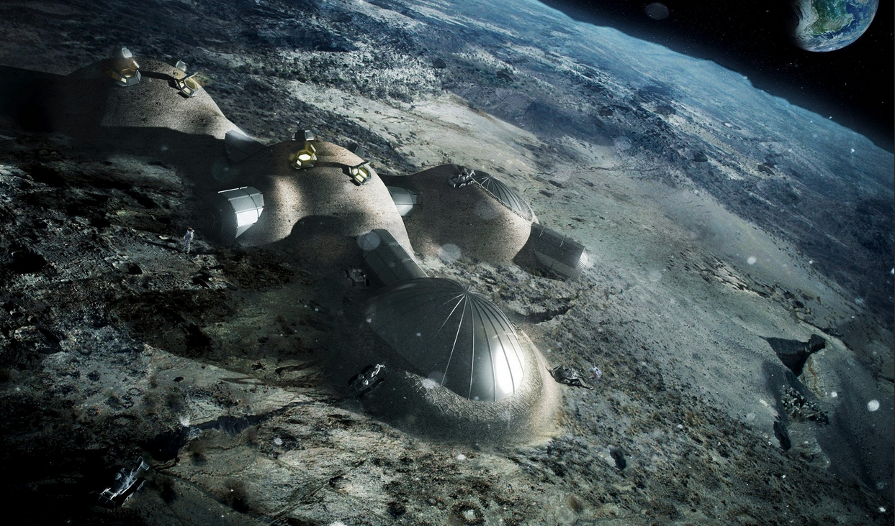
Concept: Moon Village

Slide 30
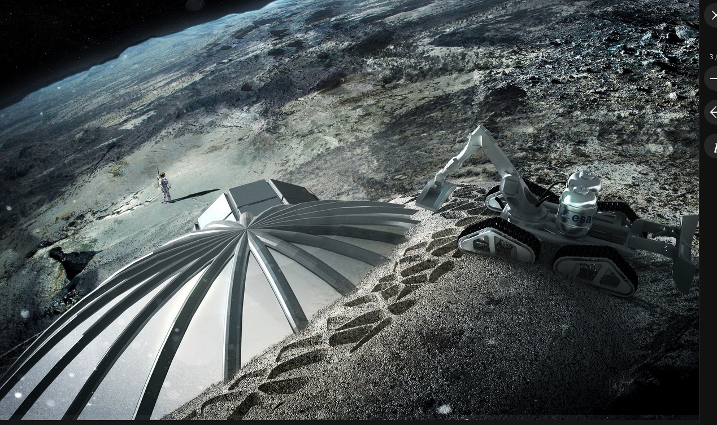

Slide 31
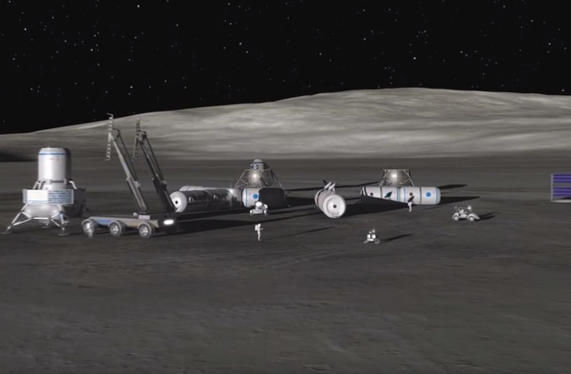
ESA moon base: 2030s

Slide 32
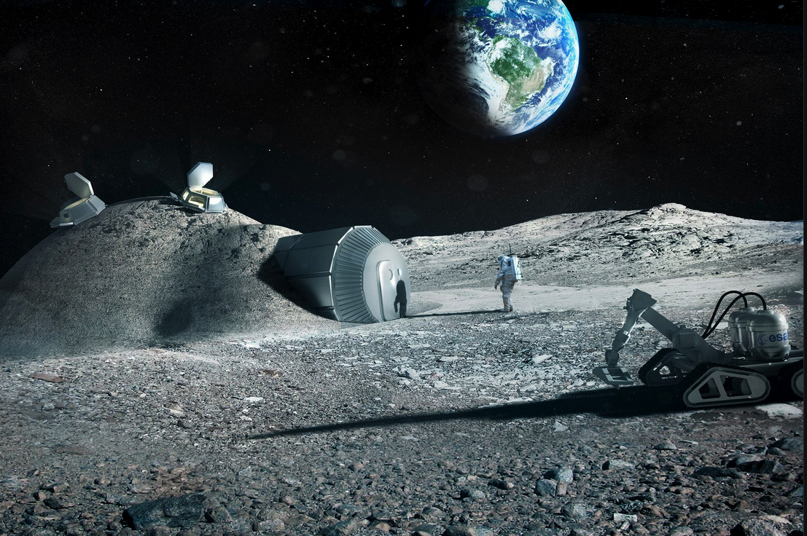
WORKING ON THE MOON
ESA’s moon village concept

Slide 33
A non-gaussianity program
CMB: suborbital +space N~10⁶ f_{nl}~10 (>3σ)
Optical/IR galaxy surveys N~10⁸ f_{nl}~1
Radio: far side of Moon… N~10¹⁰ f_{nl}~0.1
and eventually N~10¹² f_{nl}~0.01
Foregrounds???
f_{nl}~1 is a generic prediction in multifield inflation
Aim: detect pattern of nongaussianity on the sky
Meerburg + 2015

Slide 34
THE LIMITS OF COSMOLOGY
Where did we come from?
The ultimate probe of inflation
science on the far side of the moon
A radio interferometer will provide at least
> 100 improvement in precision cosmology.
We’ll be able to study the creation of the observable universe via inflation at 10⁻³⁶ second after the Big Bang
Joe Silk (IAP, CEA, JHU, BIPAC)
Sep1-3 2015

