Slide 1
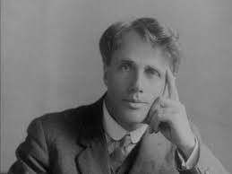

Slide 2
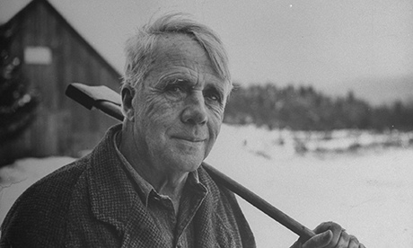

Slide 3
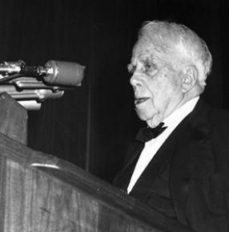

Slide 4
His laughter was submarine and profound Like the old man of the sea’s Hidden under the coral isles Where worried bodies of drowned men drift down in the green silence Dropping from fingers of surf.

Slide 5
I looked for the head of Mr. Apollinax rolling under a chair Or grinning over a screen With seaweed in its hair.

Slide 6
But hardly have we, for one little hour,
Been on our own line, have we been ourselves-
Hardly had skill to utter one of all
The nameless feelings that course through our breast,
But they course on for ever unexpressed.

Slide 7
I see him there,
Bringing a stone grasped firmly by the top
In each hand like an old-stone savage armed.

Slide 8
And then we saw him bolt. We heard the miniature thunder where he fled, And we saw him, or thought we saw him, dim and gray, Like a shadow across instead of behind the flakes.
(‘The Runaway’, 1923)

Slide 9
How countlessly they [that is, the stars] congregate
O’er our tumultuous snow,
Which flows in shapes as tall as trees
When wintry winds do blow!-

Slide 10
As if with keenness for our fate,
Our faltering few steps on
To white rest, and a place of rest
Invisible at dawn –

Slide 11
And yet with neither love nor hate,
Those stars like some snow-white
Minerva’s snow-white marble eyes
Without the gift of sight.

Slide 12
O Star (the fairest one in sight), We grant your loftiness the right To some obscurity of cloud- It will not do to say of night, Since dark is what brings out your light. Some mystery becomes the proud. But to the wholly taciturn In your reserve is not allowed. Say something to us we can learn By heart and when alone repeat. Say something! And it says, 'I burn.' But say with what degree of heat. Talk Fahrenheit, talk Centigrade. Use Language we can comprehend. Tell us what elements you blend. It gives us strangely little aid, But does tell something in the end And steadfast as Keats' Eremite, Not even stooping from its sphere, It asks a little of us here. It asks of us a certain height, So when at times the mob is swayed To carry praise or blame too far, We may choose something like a star To stay our minds on and be staid.

Slide 13
‘Design’
I found a dimpled spider, fat and white, On a white heal-all, holding up a moth Like a white piece of rigid satin cloth -- Assorted characters of death and blight Mixed ready to begin the morning right, Like the ingredients of a witches' broth -- A snow-drop spider, a flower like a froth, And dead wings carried like a paper kite. What had that flower to do with being white, The wayside blue and innocent heal-all? What brought the kindred spider to that height, Then steered the white moth thither in the night? What but design of darkness to appall?-- If design govern in a thing so small.

Slide 14
As I came to the edge of the woods,
Thrush music – hark!
Now if it was dusk outside,
Inside it was dark
Too dark in the woods for a bird
By sleight of wing
To better its perch for the night,
Though it still could sing.
The last of the light of the sun
That had died in the west
Still lives for one sing more
In a thrush’s breast.
Far in the pillared dark
Thrush music went –
Almost like a call to come in
To the dark and lament.
But no, I was out for stars:
I would not come in.
I meant not even if asked,
And I hadn’t been.

Slide 15
The birds that came to it through the air At broken windows flew out and in, Their murmur more like the sigh we sigh From too much dwelling on what has been.

Slide 16
‘In a Glass of Cider’:
It seemed I was a mite of sediment
That waited for the bottom to ferment
So I could catch a bubble in ascent.
I rode up on one till the bubble burst,
And when that left me to sink back reversed
I was no worse off than I was at first.
I’d catch another bubble if I waited.
The thing was to get now and then elated.

Slide 17
We dance round in a ring and suppose,
But the Secret sits in the middle and knows.

