Slide 1
EXPERT WITNESSES in the family court : medicine matters
Twitter
@jodqc
@Greshamcollege
Johanne Delahunty qc

Slide 2
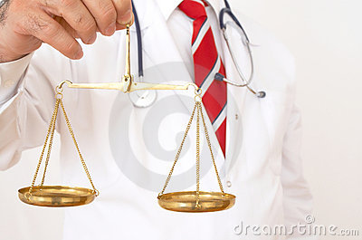
Introduction
When worlds collide: medicine and family law
This lecture explores the use of medical experts in family cases and builds on previous lectures , particularly …..
‘Guilty Until Proven Innocent? ’ 2.3.17
The notes that accompany this lecture have all case references in and significantly more explanatory detail: this is a summary of the main points
@JoDQC @Gresham College

Slide 3
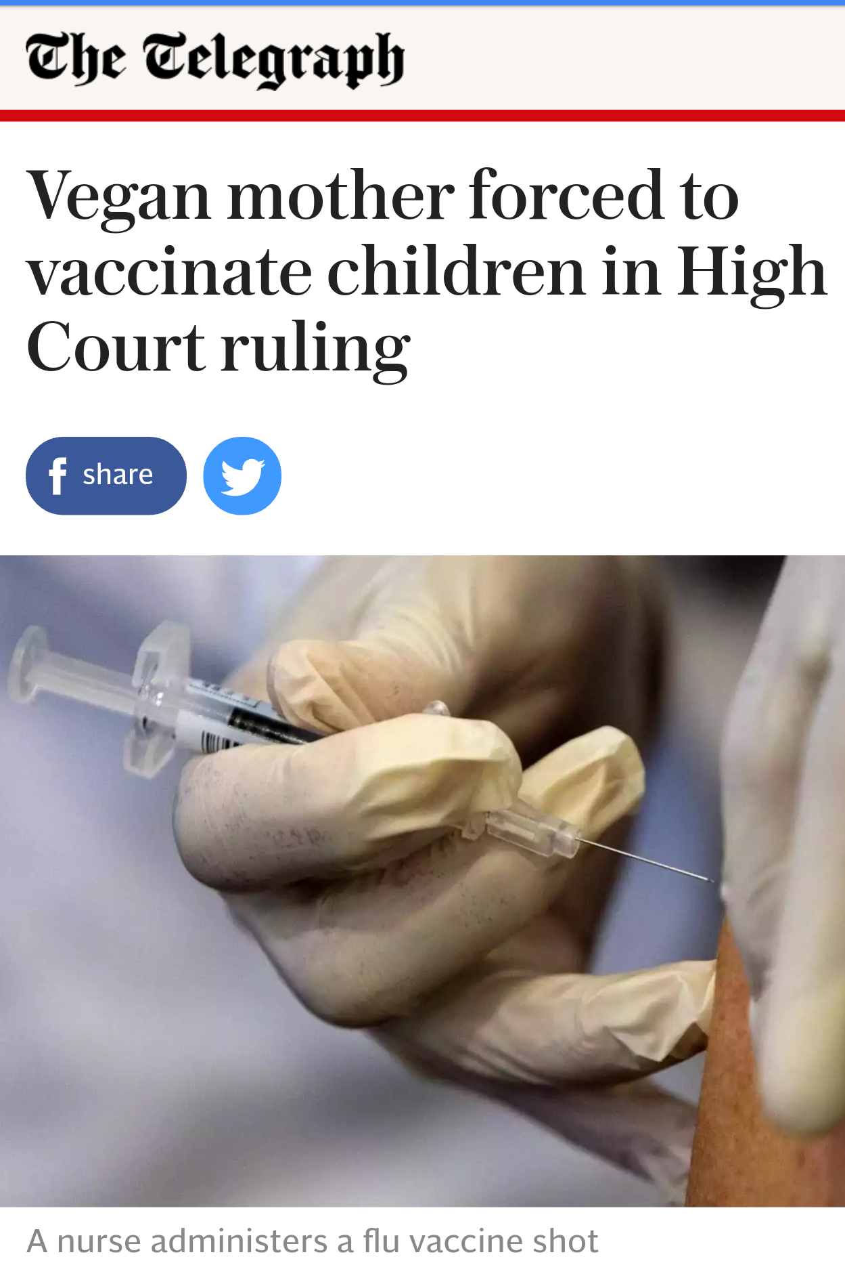
'I am truly sorry that the mother will regard the decision as wrong, but my objective duty is clear,' says Judge Mark Rogers
Mark Rogers

Slide 4
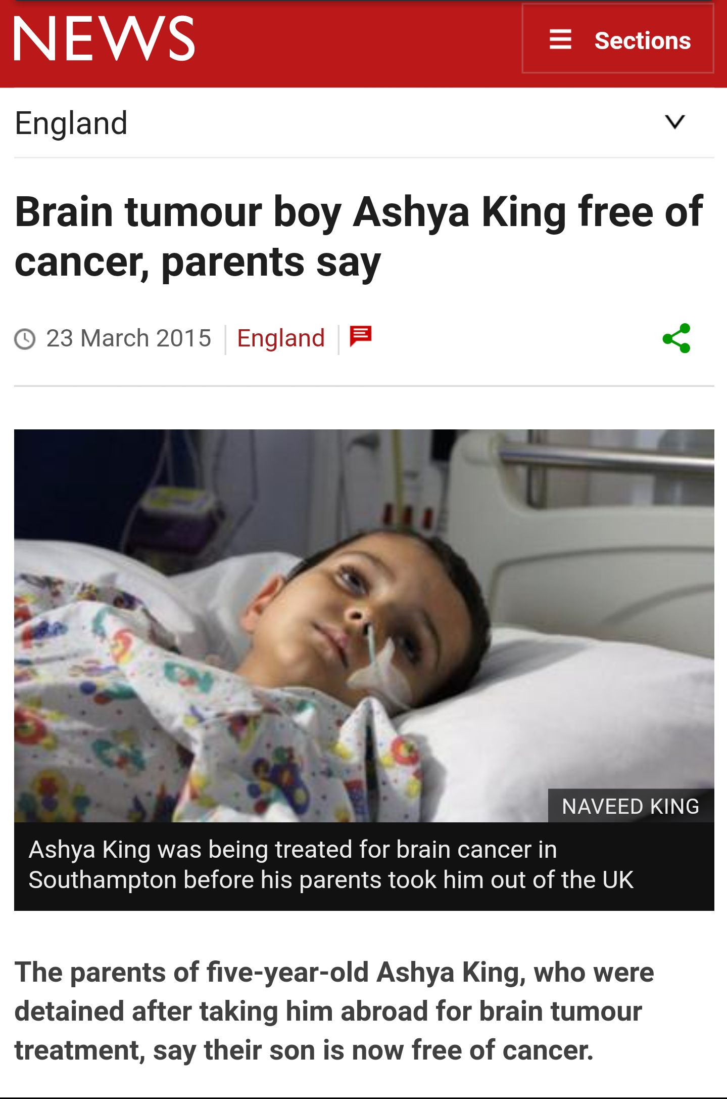

Slide 5
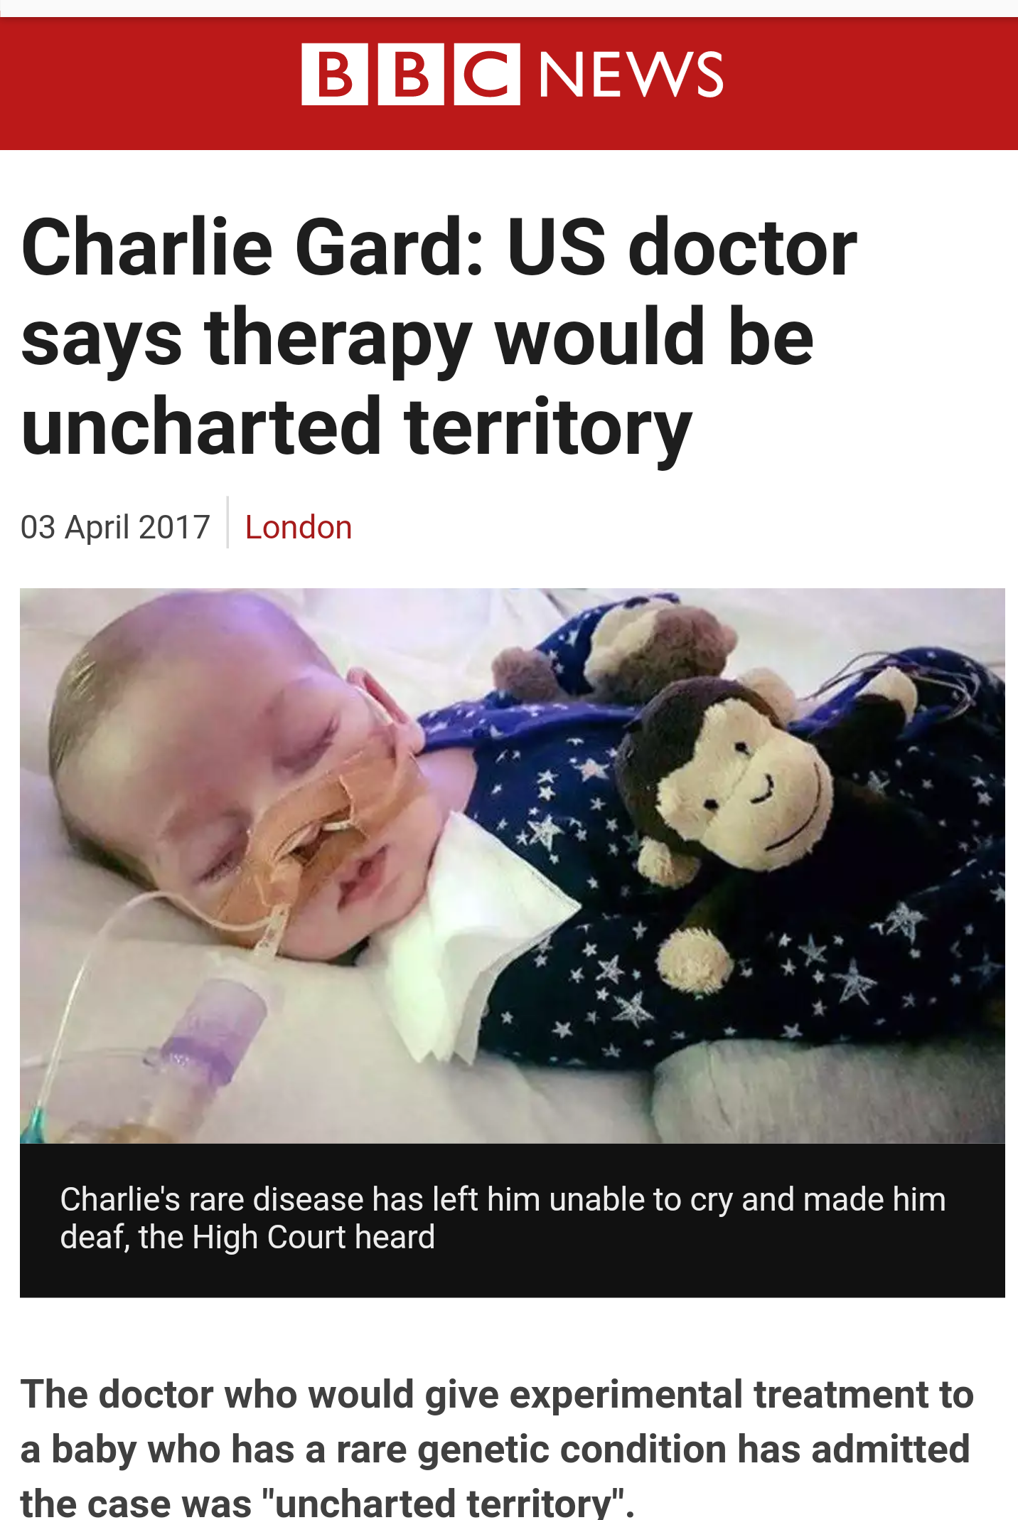

Slide 6
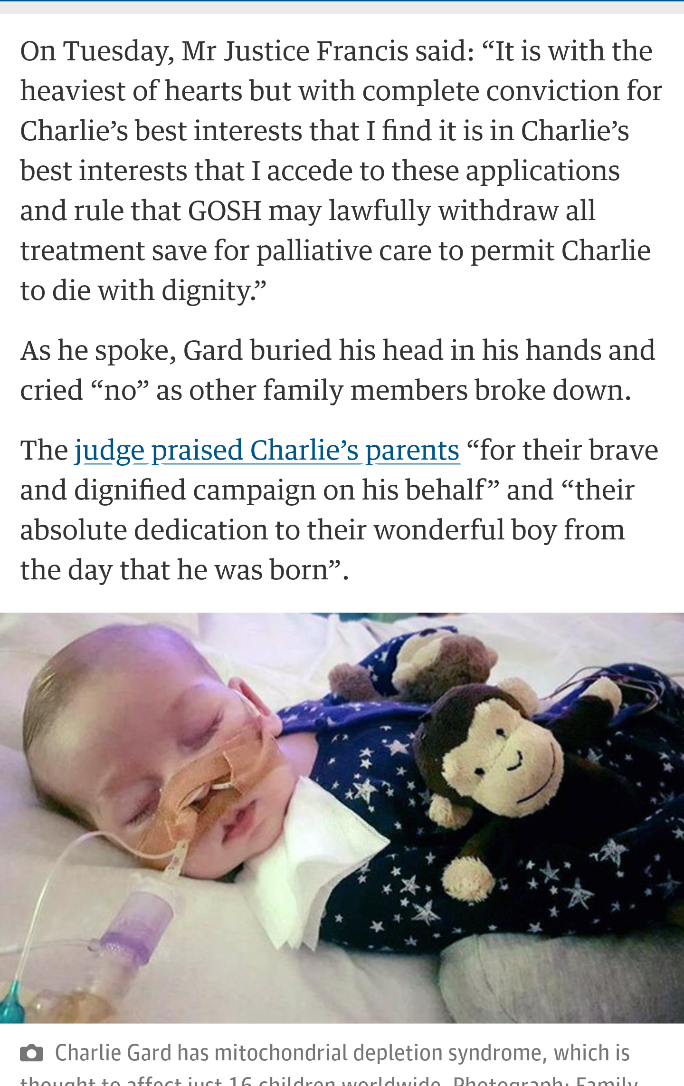
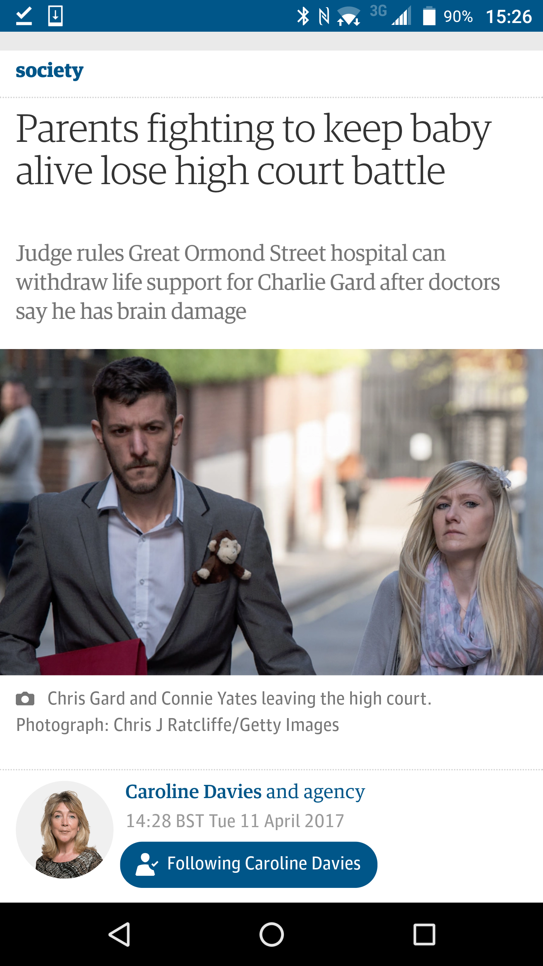
Photograph: Family handout/PA
Notes:
Pictures Press Association (PA) and Guardian Article by Caroline Davies

Slide 7
The court does not decide what decision it might make for itself if it was, hypothetically, in the situation of the patient; nor for a child of its own if in that situation;
objective test : decision depends entirely on the unique facts of the individual case.
That test is the best interests of the patient : medical, emotional, sensory (pleasure, pain and suffering) and instinctive (the human instinct to survive)
"a very strong presumption’ attached to the prolongation of life because the individual human instinct and desire to survive is strong
But it is not absolute, nor necessarily decisive, and may be outweighed if the pleasures and the quality of life are sufficiently small and the pain and suffering or other burdens of living are sufficiently great.
opinions of both the doctors and parents carefully considered. But parents own wishes, however understandable in human terms, are wholly irrelevant to consideration of the objective best interests of the child save to the extent in any given case that they may illuminate the quality and value to the child of the child/parent relationship.
Re J (A minor) (wardship: medical treatment) [1991] Fam 33 at page 46

Slide 8
A young baby dies whilst under the sole care of a parent or child minder.
That child can give no clue to clinicians as to what has happened.
Experts, prosecuting authorities and lawyers must reconstruct, as best they can, what has happened.
Babies die: whether thorough benign causes or abuse:
parents can be falsely accused but they can also lie to conceal their actions
The courts duty to protect the child from harm requires hard choices: to return a child to an abusive parent can lead to further injury or death.
To remove the child and place it for adoption on medical and scientific evidence than turns out to be flawed is to make a mistake that devastates the family.
Adoption is a final, irrevocable step, cannot be undone.

Slide 9
‘with the state’s abandonment of the right to impose capital sentences, orders of the kind which family judges are typically invited to make in public law proceedings are amongst the most drastic that any judge in any jurisdiction is ever empowered to make.
When a judge makes placement order or an adoption order in relation to a twenty year old mother’s baby, the mother will have to live with the consequences of that decision for what may be upwards of 60 or even 70 years, and the baby may be upwards of 80 or even 90 years’ Re J (A Child) [2013] EWHC 2894 (Fam)

Slide 10
Warning:
the cases discussed can be distressing: they involve very serious, sometimes fatal, injuries to a child and the discussion about the injuries they have sustained will sound dispassionate:
but no professional or parent who deals with these cases can forget that a child has suffered pain that everyone would wish it had been spared in its short life

Slide 11
Medicine and science in the family court
Questions for todays lecture
Why the use of experts in family cases is so different to the approach towards them in crime
What the duties of experts are in family cases
Why treating medics may be experts in their clinical practice but they are to avoided as ‘experts ‘ in care cases
Why science has to be placed in the context of all the evidence known to the family court
The burden on the legal aid lawyers representing the alleged abusers in these case
Why science and the courts don’t have all the answers : why we get it wrong

Slide 12
Medicine and science on the family court
A child dies in suspicious circumstances
The post mortem
The clock starts ticking
The local authority apply
The criminal trial
The care time table
Green eyes
A zero: sum game?

Slide 13
Green eyes : the welfare of the child REQUIRES TRANSPARENCY
Necessity, necessity, necessity
No party can instruct an expert without the permission of the court
That requires a formal application on notice to all the parties ( PART 25)
Uk based
Draft questions, CV, time scale, cost : all out for argument
The court will want this to be a ‘joint instruction’ :
All communication regulated, recorded and disclosed to all parties
the report to be served on all parties, in its final form, simultaneously
Unfavourable reports cannot be suppressed,
No discussion with any barristers instructed
The experts duty is to the court to give a balanced and informed decision
Stick to their area of expertise
Mainstream view
No duty to the person instructing him or her
In court NO phone a friend/ no whispering

Slide 14
Experts in family cases
Q: Why is the use of experts in family cases so different to in crime?
A Welfare of the child paramount
Q: What is the duties of an experts in family cases ?
A duty to the court, not a party
Now for q 3: why do we need experts when we have medics?

Slide 15

Why do we need experts when we have excellent medics?
Treating medics form opinions in less than ideal circumstances
because timely medical analysis and intervention is the clinical imperative.
there was a clear distinction to be drawn between a medical decision as to what was clinically required for a child’s treatment and a forensic decision about what was necessary to ensure a proper determination of an issue”
Per Thorpe J ; O-M, GM ( and KM) v the local authority ( 2009) EWCA civ 1405
The hospital is not immune from suspicions being aired between stressed colleagues as soon as Non Accidental Injury is raised as a possible cause.
Corridor discussions inevitably take place (unrecorded)
opinions are formed as evidence is emerging and facts are unclear.
if their evidence is put before a Court by a LA it is likely to be because they have decided that injuries have been inflicted.

Slide 16
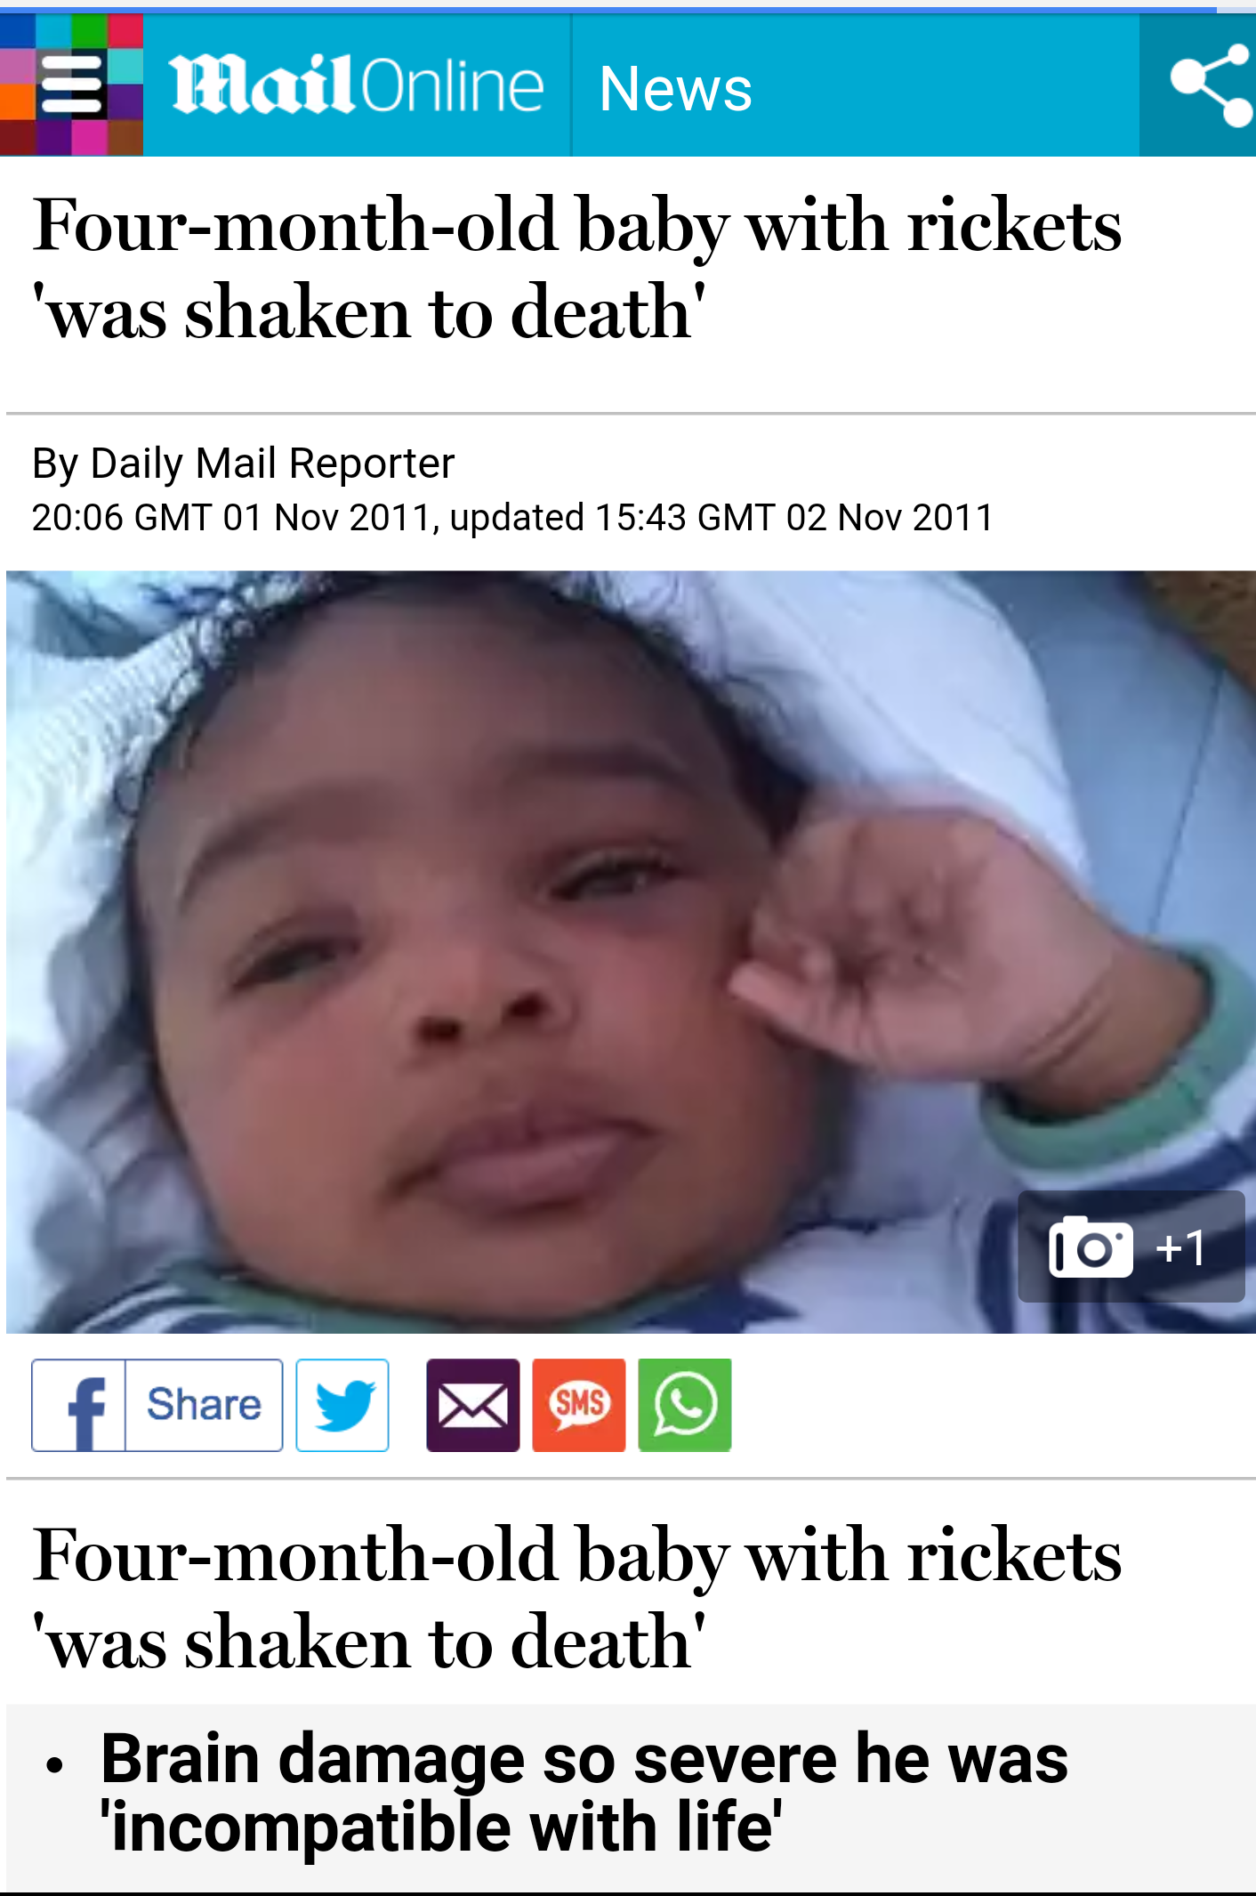

Slide 17
Crime & punishment # 2: when legal worlds collide
What the trial evidence unearthed : cross examination
CCTV: bus and UCL: alert / with intermittent seizure activity
Nurses: GCS ‘A’+ ‘alert’ upon reception. His seizures increased
The records : intubation to decide if surgery needed - tube wrongly placed , a lung collapses, 20 min .
The sats charts : CO2 levels had risen to dangerous levels
The med charts :Sseizure meds were drawn but not administered
The grey hole : Jayden was moved between different imaging departments investigating NAI after a skull fracture was detected . 30 min absence from paediatric care became 4 hours
The missing 4 hours at UCLH: ‘suboptimal care’ :
GOSH : Jayden’s condition was irrecoverable. His brain was effectively dead , eye examination
GOSH formed a clear view Jayden was a victim of NAHI: they did so without knowledge of what had occurred at UCL
Haemorrhage around the skull fracture timed to within 24 hours of death, Jayden on intensive care at GOSH and denied contact with his family. ‘ a very fragile child’
Radiological evidence of rickets missed / dismissed
Jayden’s rickets as ‘moderate to severe’ by Dr Scheimberg was agreed by Professor Malcolm who had only seen one case of rickets as severe as Jayden's in the 1970’s

Slide 18
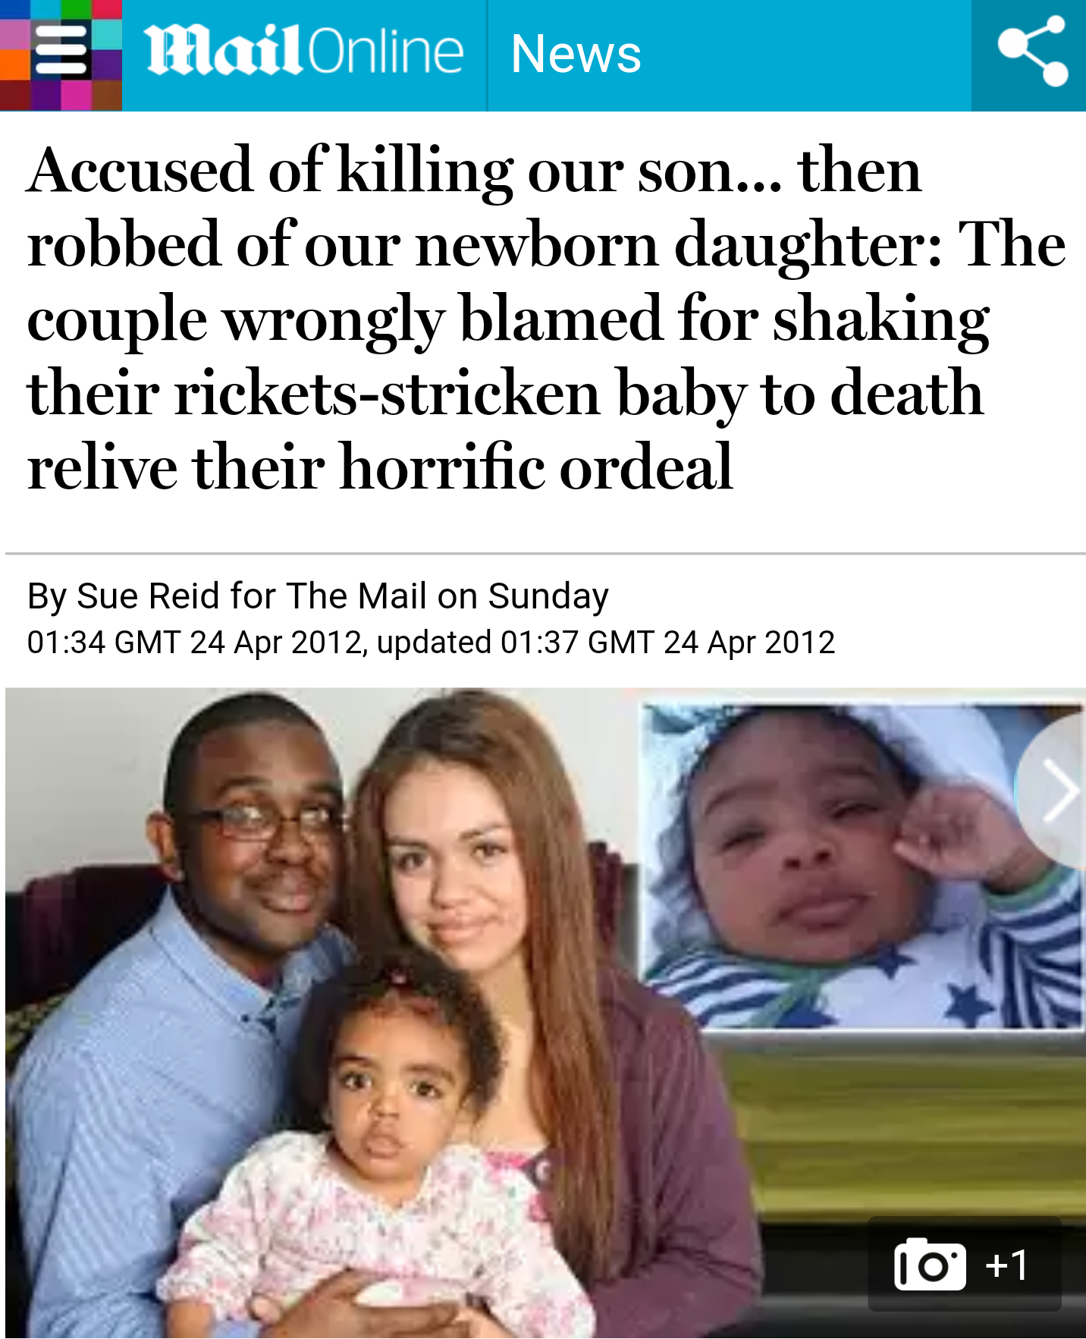
http://i.dailymail.co.uk/i/pix/2012/04/24/article-2134226-12AD3B78000005DC-73_634x838.jpg

Slide 19
medicine in the family courts
The need to learn and challenge and debate
In cases involving allegations of shaking we have a small pool of willing and available experts.
The science on which their opinions depend is complex and sometimes controversial.
The acceptance or rejection of those opinions by the court has a pivotal effect on the outcome for the family at the heart of the case.
But for the vigilance of Dr Irene Scheimberg, the paediatric pathologist who conducted the post mortem, Jayden's Vitamin D deficiency and rickets may have gone undetected in death as it had been in life and the outcome of the criminal and care case for the parents and Jayda may have been very different.
The importance of open minded experts in cases such as this cannot be under estimated.

Slide 20
The barristers task : challenging Medicine and science in court
Medics: GP, HV, nurses, doctors, radiologists, paramedics
Expert evidence : ‘David and Goliath’
Paediatric pathologists the body in death
Paediatrician the body in life
Neuropathologist the nervous system tissue: brain and its blood
Ophthalmologists the eyes and its blood
Histopathologist the study of tissue inc bones
Paediatric Neurologist the nervous system , the brain , spinal cord
Endocrinologist the hormonal system / endocrine system
Paediatric Neuroradiologist imaging (CT and MRI) of the brain and skull
Odontology dental analysis (bites)
Immunologist the immune system
Microbiologist the study of cells and micro-organisms
Psychiatrist mental illness
Psychologist mental process, emotions and behaviours

Slide 21
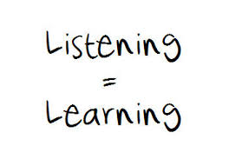
Q : Why does science have to be placed in the context of all the evidence ? Aka ‘the broad canvas’
The child in life
The neighbours
The parents
The 999 call
The story
Body cam
social media
The records
The research

Slide 22

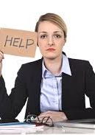
Q 4:The burden on the legal aid lawyers representing the alleged abusers
We ‘inhabit’ our clients lives
We decode and dig into the medical records
We research
We work as a team
We prepare
We enter the court room to tackle the expert on issues in their own field
There are no second chances when you are on your feet
We are as good as our last cross examination
Picture Abovethelaw.com

Slide 23
medicine in the family courts
The wisdom of baker j
‘ A court hearing application for care orders based on cases of suspected physical abuse of children must follow the evidence and pursue the enquiry in whatever detail and for however long is necessary to arrive at the truth.'
      Devon County Council v EB & Ors (Minors) [2013] EWHC 968 (FAM

Slide 24
The wisdom of Baker J (cont)
this case required the involvement of a range of experts from different disciplines. If the case had been decided purely on the basis of the treating doctors, the outcome may have been very different.
Judges will be rigorous in resisting the call for unnecessary use of experts in family proceedings but equally will not hesitate to endorse the instruction of experts where, under the new rules, they are satisfied that they are necessary for the determination of the issues in proceedings.

Slide 25


Legal aid lawyers ; per baker j
Finally, this case demonstrates again the crucial role played by the specialist family bar and solicitors. The role played by all of the representatives for all of the parties in this case has been of the utmost importance.
All judges are very concerned at the prospect of an increase in self-represented litigants and the consequences for the family justice system.
Not enough recognition is given to the contribution to the family justice system made by family lawyers.

Slide 26
medicine in the family courts
Miscarriages of justice?
Science is constantly evolving
Miscarriages of justice have happened with parents wrongly accused of shaking their child to death based on scientific research and hypothesis, genuinely held, but discarded or refined as science develops.
The judge can only make a decision based on the evidence made known to the court at the time a decision has to be made
Medical evidence mustn’t be seen in isolation of the child’s life, the ‘broad canvass’
Human justice is inevitably fallible however hard we struggle to avoid them, and however rigorous the procedural and other safeguards we strive to erect against them.
In the investigation of possible miscarriages of justice and in righting judicially inflicted wrongs, dedicated legal aid lawyers, investigative journalists and the informed public have an absolutely vital role to play.

Slide 27
medicine in the family courts
The wisdom of hedley j:‘Unknown cause'
'I have been impressed over the years by the willingness of the best paediatricians, and those who practise in the specialties of paediatric medicine, to recognise how much we do not know about the growth patterns and what goes wrong in them, particularly in infants.
Since they grow at a remarkable speed and cannot themselves give any clue as to what is happening inside them, and since research using controlled samples is self-evidently impossible in many areas, perhaps we should not be surprised.
In my judgment, a conclusion of unknown aetiology in respect of an infant represents neither professional nor forensic failure.
It simply recognises that we still have much to learn,
it also recognises that it is dangerous and wrong to infer non-accidental injury merely from the absence of any other understood mechanism.
Maybe it simply represents a general acknowledgement that we are fearfully and wonderfully made.'

Slide 28
Last Question :
Why science and the courts don’t have all the answers: why we get it wrong
medicine and science in the family courts
Science doesn’t stand still
Expert evidence is an art; not a science
Medical understanding on NAI develops through mutually respectful challenge and scientific respect
Do not rush to judgement
Please

Slide 29
Medicine in the family court
The need for an informed and open debate
As the legal profession struggles to keep up with the evolving science in relation to alleged inflicted trauma, the Court in care proceedings is enjoined to
‘never forget that today’s medical certainty
may be discarded by the next generation of experts
or that scientific research will throw light into corners that are at present dark’
R v Cannings [2004] 1 WLR 2607

Slide 30
medicine in the family courts
Concluding remarks
Isn’t it simply unrealistic to expect advocates who are not medics and who operate under time constraints and restricted funds to advance a forensic case with an appropriate degree of knowledge to inform an inquisitorial process considering such a complex area of science?
Do we not risk creating a lottery for those lucky clients who can be represented by those “in the know” on the science and those who unfortunately are not?
Some experts are simply not prepared to become involved in family proceedings.
well renowned experts are busy not only with their clinical and research commitments but are much sought after for their opinion evidence. Time and cost is a problem
Al Alas 26 weeks : no realistic prospect of obtaining the expert evidence which exonerated them : the delay of 2 years would have been unacceptable for Jayda.
Adoption is irrevocable

Slide 31
Last in the series
My next lecture
Next lecture 3rd May
‘2.1 children …or …..
why there is no such thing
as a ‘Typical’ family
in the family court ‘

Slide 32

medicine in the family courts
http://quotesgram.com/thank-you-for-listening-quotes/

