Slide 1
Eradication of infectious diseases.
Gresham College 2017
Christopher Whitty

Slide 2
When this College was founded medicine was dominated by infectious diseases.
Plague
Typhus
Typhoid
Cholera
Dysentery
Malaria (marsh fever)
Leprosy
Puerperal sepsis
Festering wounds
Syphilis
Tuberculosis

Slide 3
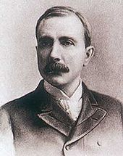
Eradication of a major infection: the case for it is simple and compelling.
By the efforts of our generation we will spare all future generations.
Invest now, save for all time.
Excites, involves and motivates, including people outside public health.

Slide 4
Few health stories get journalists more excited than eradication.

Slide 5
“Be bold, be bold, but not too bold.”
Edward Jenner, 1749-1823
Smallpox declared eradicated 1979

Slide 6
Eradication v elimination.
Eradication is the complete and permanent removal of an infection everywhere in the world.
It will never occur again.
Only one human disease to date- smallpox.
One animal disease, Rinderpest.
Elimination is the complete cessation of transmission of an infection in a geographical area.
It can still be imported.
Examples in the UK:
Malaria
Cholera

Slide 7
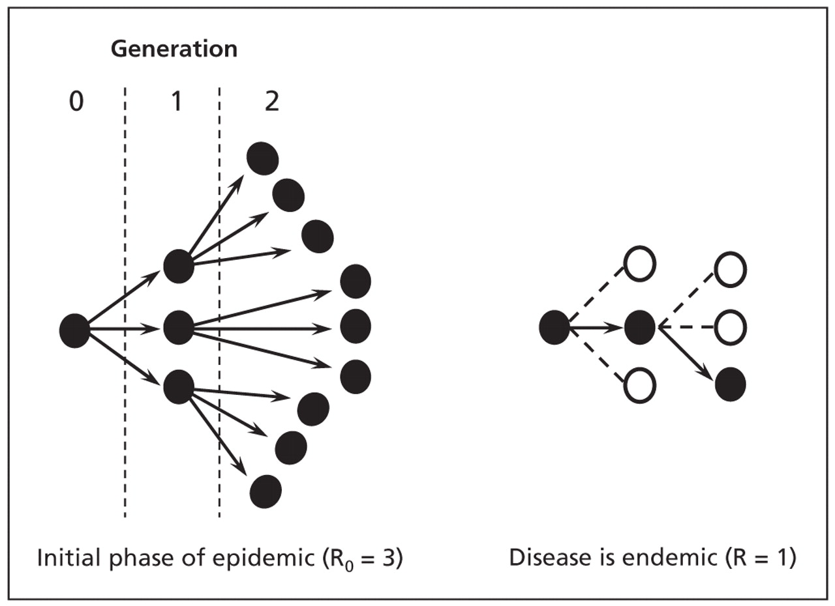
The mathematics of transmission- R₀
If R greater than 1 an infection will spread.
If=1 stable.
If less than 1 decreasing. Elimination possible.
If R less than 1 everywhere for long enough- eradication.

Slide 8
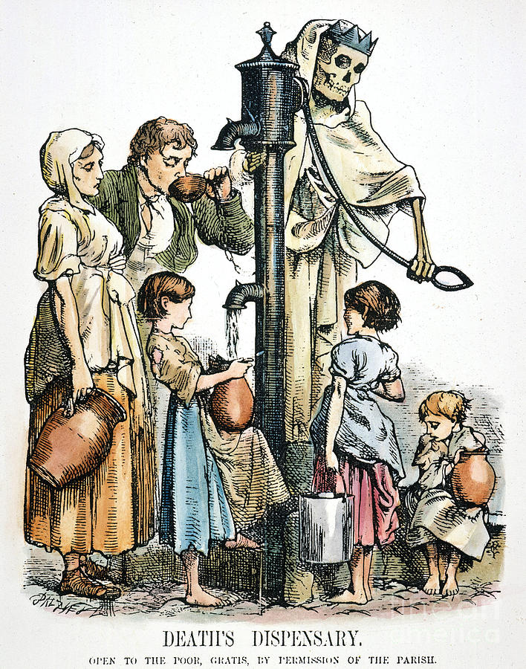
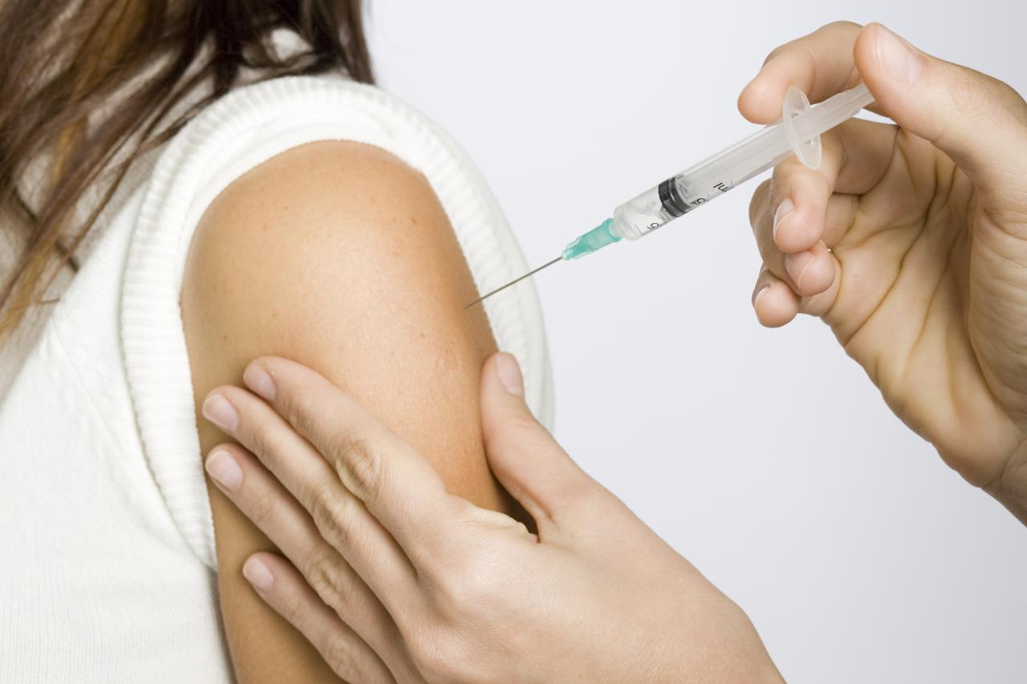
How you get R below 1 depends on the disease.

Slide 9
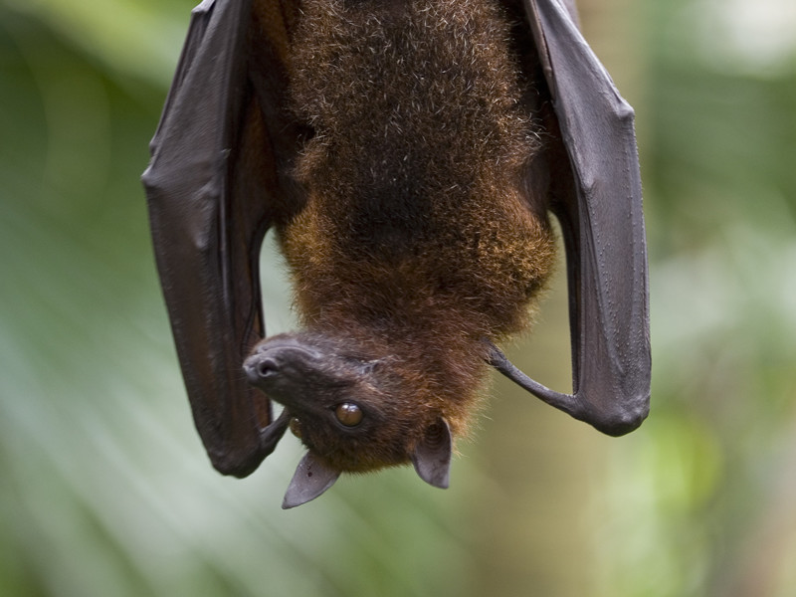
For eradication you need:
-an effective intervention to interrupt transmission
-easy to diagnose and detect cases
-no major animal reservoir
Credits: Batworld, Carla Possamai

Slide 10
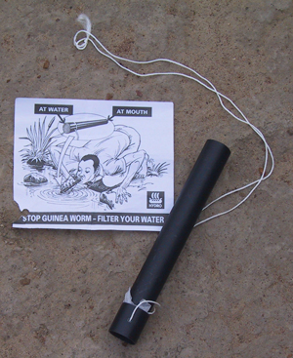
You also need simple-to-use technology…

Slide 11
Great organisation….

Slide 12
Sustained political will and money.

Slide 13
PREPARATION
Elimination and control
ATTACK
CONSOLIDATION / CONTROL
ELIMINATION/ERADICATION
R = 1

Slide 14
Smallpox
Variola major mortality >30%, >80% children.
300–500 million deaths during the 20th century.
Eradication agreed 1959 (USSR), when 2m a year dying; declared 1979.

Slide 15
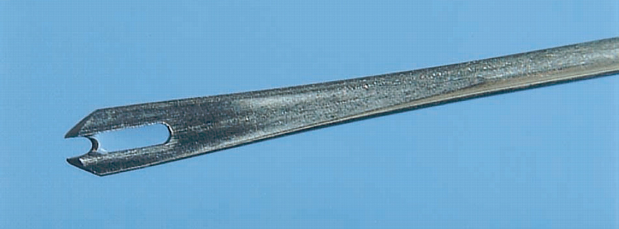
Smallpox was a good target for eradication.
A simple-to-administer, highly effective vaccine.
Strong public support.
Little ability to evolve around the vaccine.
Easy to identify cases.
Excellent organisation.
Even so, politics almost derailed eradication on several occasions.
Bifurcated needle: smallpox vaccination NY 1947

Slide 16
Smallpox
1967
1975
1976-7
Last continuous case – Somalia October 1977
(last case from lab in Birmingham, 1978)
Total cost of programme = c. $300 million
savings estimated at c. 1.5 billion $ per annum- ratio 160:1.

Slide 17
PREPARATION
Lessons from smallpox: tactical rigidity, then tactical flexibility.
ATTACK
CONSOLIDATION / CONTROL
ELIMINATION/ERADICATION
R = 1

Slide 18
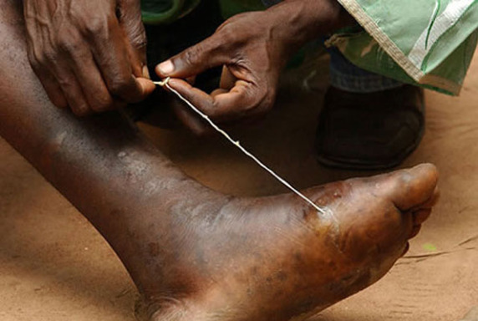
Guinea worm (Dracunculiasis)
World Health Assembly calls for eradication in 1986 and 1991, by 1995.
At that time estimated 3.5M cases.
1058 cases reported 2011.
126 in 2014. Mali, South Sudan, Chad, Ethiopia.
25 cases 2016 (99.9% reduction).
Unexpected canine host.
Cost around $30m a year.

Slide 19
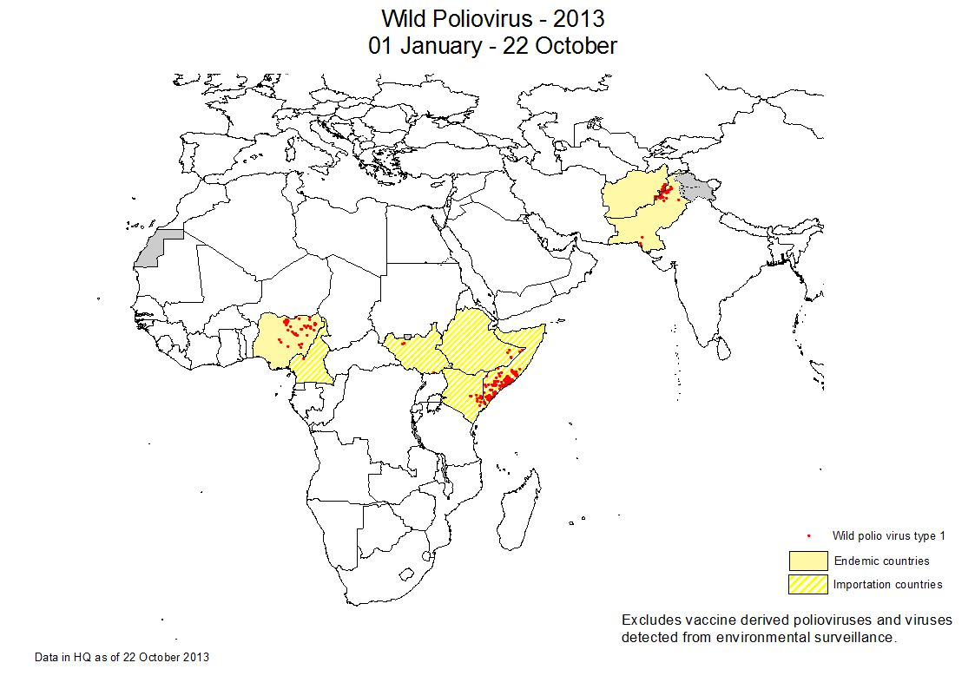
Polio 1988-2013. Around 350,000 cases 1988.
Polio endemic countries

Slide 20
Polio 2017- tantalisingly close. 28 known cases last 12 months (37 in 2016).
Long term excretion by immunodeficients.
VDPVs (vaccine derived polio viruses).
Support from local populations.
Security in Pakistan, Afghanistan, Northern Nigeria.
Cost
> $12 billion to date
WHO May 2017: polio last 12 months

Slide 21
A few previous eradication or elimination campaigns.
1907 Rockefeller Foundation (RF): aims to eradicate hookworm.
1915 RF aims to eradicate yellow fever.
1954 Yaws eradication goal declared by World Health Organization (WHO).
1955 World Health Assembly (WHA) adopts goal of global malaria eradication.
1978 U.S. goal of measles elimination by 1982 is announced. 1985 Europe sets goal of measles elimination by 2000.

Slide 22
Malaria 1948

Slide 23
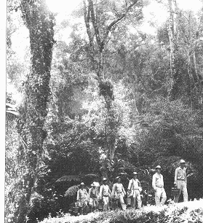

Slide 24
Malaria 1977

Slide 25
Malaria now.

Slide 26
Why did (first) malaria eradication attempt fail?
Biological factors included:
-many areas where it proved impossible to interrupt transmission.
-developing insecticide and drug resistance.
Social and political factors included:
-organisational problems.
-flagging enthusiasm and money drying up.

Slide 27
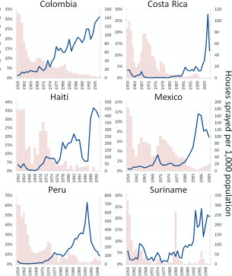
In areas where transmission was not marginal, when control stopped malaria roared back (Cohen et al 2012)

Slide 28
Malaria elimination. In some places it stuck but much lower incidence than 1940s. (Gething et al, Nature 2010)

Slide 29
‘Sticky’ control and elimination
Elimination is much less risky when it is ‘sticky’.
High energy gains maintained even if the elimination/eradication efforts stop.
Area cleared, reintroduction unlikely.
R₀ now around or below 1. What you have, you hold.

Slide 30
Optimism bias- the greatest risk to potentially rational eradication attempts.
Without optimism we would never start.
V
With irrational optimism we will inevitably fail.
Both are true.

Slide 31
The first three phases will go well.
The big problems start near the end.
PREPARATION
ATTACK
CONSOLIDATION / CONTROL
ELIMINATION/ERADICATION
Ro = 1

Slide 32
Leprosy- defining success
A terrible disease- decision to eliminate as a public health problem 1991.
“Reduction in prevalence below 1 per 10 000”
Prevalence fell dramatically. Reached goal 2000.

Slide 33
Prevalence (all cases) fell fast, incidence (new cases) did not...
Identifying new cases, cleaning registries, shortening treatment...
Prevalence fell fast, new cases fell minimally.
265,661 new cases in high burden countries 2006, 210,758 in 2015 (WHO)
What is being eliminated? Disease, or funding and expertise? (Fine)
Rodrigues & Lockwood.
Brazil- prevalence and incidence

Slide 34
Yaws- latency and complacency
In 1949 Haiti alone had 1m cases out of a population of 3.5m. By 1959 only 40 cases reported.
Almost invisible by 1970s so attention switched. By 1978 almost back to status quo ante in parts of Africa. New resolution.
Little appreciation of latent cases.
Now: azithromycin, better diagnostics, India has shown it can be done.
PNG, DRC et al- not the easiest places…

Slide 35
Eradication cannibalism- a potential risk
Two major campaigns requiring worldwide buy-in probably less than the sum of their parts.
Malaria eradication campaign almost derailed smallpox eradication.
Same personnel on the ground, same donors.
Smaller campaigns can be synergistic to start with (attack phase)- but may diverge at the end (surveillance).

Slide 36
A few targets by 2020...... (WHO 2012)
Global eradication yaws.
Global eradication Guinea worm.
Global elimination human African trypanosomiasis.
Global elimination lymphatic filariasis.
Global elimination trachoma.
Elimination human rabies Latin America, SE Asia, W. Pacific.
Eliminate visceral leishmaniasis Indian subcontinent.
Eliminate schistosomiasis Americas, Western Pacific, Caribbean.

Slide 37
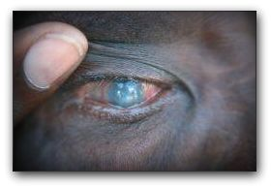
Trachoma- Target- global elimination by 2020

Slide 38
Lymphatic filariasis- Target- global elimination by 2020
Mass drug administration.
Vector (mosquito) control.
We have eliminated filariasis from small countries, but no large ones.

Slide 39
2804 African trypanosomiasis cases 2015: 89% reduction from 2008 but it is capable of rebounding.
Cases 2008-2015 (WHO)
HAT DRC/Zaire/Congo 1090-1012. Hasker et al

Slide 40
Measles, HIV…
Really?

Slide 41
HIV
+
“The world has halted and reversed the spread of HIV…. New HIV infections and AIDS-related deaths have fallen dramatically since the peak of the epidemic. Now the response is going one step further—ending the AIDS epidemic by 2030.”
UNAIDS 2015

Slide 42
Measles. Effect of one ‘utterly false’ paper.

Slide 43
Single disease advocates often enthusiastic about a call for eradication. They should fear it.
By definition an overinvestment compared to control- and other priorities.
Gets ‘your’ disease talked about.
Even partial success is seen as failure- and failure is an orphan.
Malaria, leprosy, yaws: overinvestment on the promise of success led to chronic underinvestment for years after the attack phase.

Slide 44
The political paradox- space. Eradication most popular where it is least easy.

Slide 45
The political paradox- time
Eradication most popular when it is least achievable- near the start.
Ro = 1

Slide 46
The endgame- epidemiological and biological challenges.
It gets harder to identify islands of transmission as you get to the end-game: they fragment and become smaller.
Extreme selection pressure being exerted- drug and insecticide resistance, evolving around vaccines.
New modes of transmission and reservoirs identified.

Slide 47
Local social and political risks of the endgame.
Recent tragic deaths with polio an extreme example- violence also with smallpox and malaria.
Government and international workers saturating a problem people never see.
Easy to weave into existing conspiracy narratives.
Government/ West publicly assures success.
People prioritise current problems, not historic ones.
Biomedical model of disease not universal.

Slide 48
Unless we are very selective eradication can distort public health priorities.
“I believe it is critical that we should not be blinded to a range of new public health programme paradigms by staring too fixedly at the blinding beacon of a few eradication dreams.”
DA Henderson, leader of smallpox eradication, 1998.

Slide 49
Conclusions- elimination
Elimination demonstrated for multiple diseases in many countries.
If they are sticky (usually R₀ 1 or lower), we should keep gains from elimination attempts.
Several neglected tropical diseases potentially targets for this.
Onchocerciasis. Credit Carter Centre.

Slide 50
Eradication
You need good technology, the maths must be right...
and the social, economic and political science for the end-game before you start.
Calling for eradication is easy. Achieving it is not.
It will take a long time, most in ‘the final mile’ when political will and money evaporates.
Everything that can go wrong, will.
Where it works- large investment for indefinite gain.

Slide 51
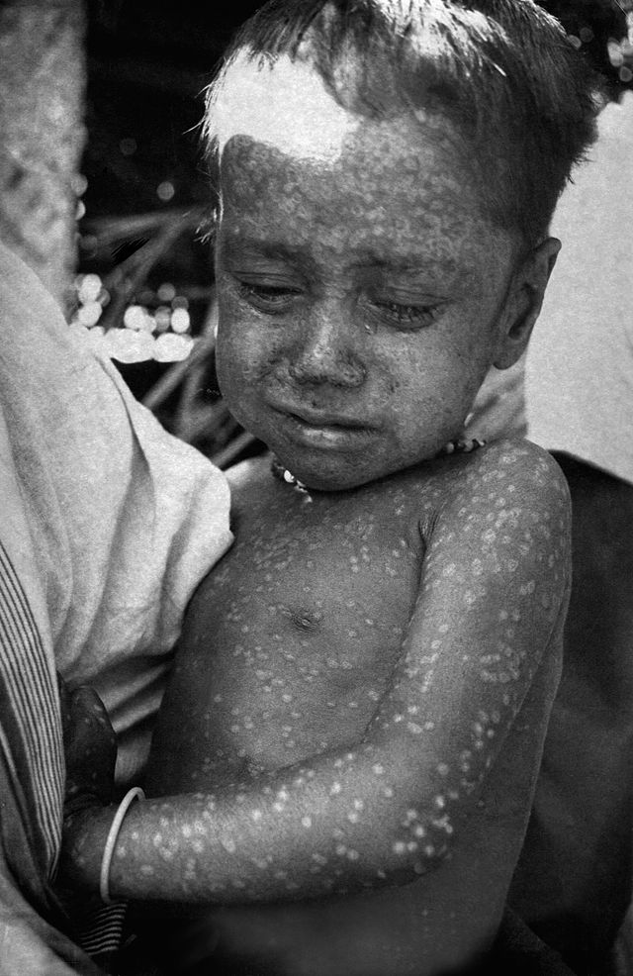
Eradication:
Smallpox is gone.
Guinea worm eradication will succeed.
Polio will if we can sustain a long haul.
Several NTDs could be eradicated (slowly).
Excitement about malaria eradication has triggered widespread innovation.
Trying and failing eradication is costly, pulls resources from other priorities, breeds cynicism, may destroy good control programmes for decades.
Don’t call for it when we can’t do it. For most infectious diseases we can’t.
Last case of wild smallpox: polio outbreak USA 1960.

Slide 52
Be bold, be bold, but not too bold.

