Slide 1
Making Software Correct by Construction
Martyn Thomas CBE FREng
Livery Company Professor of Information Technology

Slide 2
Those who want really reliable software will find that they must find means of avoiding the majority of bugs to start with, and as a result the programming process will become cheaper.
Dijkstra 1972

Slide 3
Program Correctness
Perform the required functions and nothing else
… for all possible inputs,
… with verifiable evidence
So that you have justified confidence that the software is fit for purpose and cybersecure

Slide 4
Watts Humphrey’s experiment Software Engineering Institute, Carnegie-Mellon 810 programmers, more than 8000 programs
Notes:
Another study, this time by Watts Humphrey, of the Software Engineering Institute at Carnegie-Mellon University, analysed the fault density of more than 8000 programs written by 810 industrial software developers. This was the result:
A “KLOC” is 1000 Lines Of Code. These figures show that even the best 1% of these programmers were introducing a fault in every 100 lines of program that they wrote. The average programmer was introducing a fault in every 9 lines.
Different researchers and authors may describe faults as “flaws”, “errors”, “defects”, “anomalies” or “bugs” but they will almost always mean functional faults, that cause the software to crash or to give the wrong results. A functional error may be a simple typing mistake, such as omitting a minus sign in a mathematical formula, or testing that value A is greater than value B [A>B], when they should have written a test that value A is less than value B [A<B] .
Or it may be a design error that means that the program sometimes attempts to divide by zero, or runs out of the available memory. http://resources.sei.cmu.edu/asset_files/SpecialReport/2009_003_001_15035.pdf page 132

Slide 5
Program Correctness
Perform the required functions and nothing else
… for all possible inputs,
… with verifiable evidence
“It is not only the programmer's responsibility to produce a correct program but also to demonstrate its correctness in a convincing manner” Edsger Dijkstra (EWD249)

Slide 6
Stating “the required functions”
Completely, Unambiguously, Self-consistently
or you cannot be certain what is required
Not “user stories” or hundreds of “shoulds”
System states and operations
Mathematics (often basic) and logic: “formal methods”
Z, VDM, Alloy, Lustre/SCADE, Méthode B (and others) are all used on important real-world projects

Slide 7
Correct “For all Possible Inputs” … … with verifiable evidence
We cannot test all possible inputs
But we can use analysis and proof, if the specification, design and code are written in formal languages
… and this also provides verifiable evidence
This is Correctness by Construction

Slide 8
1949. Alan Turing Reasoning about a large routine
annotating a flowchart with claims that should be true at each point in the execution of the program.
Showing that loops terminate.
“A workable method for reasoning about correctness” Professor C B Jones

Slide 9
Automated Analysis of Programs
NATO 1968, RRE 1972-4, Southampton Uni…
“Any significant advance in the programming art is sure to involve very extensive automated analyses of programs. … … Doing thorough analyses of programs is a big job. … It requires a programming language which is susceptible to analysis”.
Bob Philips led a secret research project in program
Analysis at the Royal Radar Establishment
in Malvern, UK, collaborating with Bernard Carré of Southampton University.
This work was declassified by Brian Gladman and led to
two commercial analysis tools :Malpas and SPARK

Slide 10
SPARK see SPARK: the proven approach to High Integrity Software by John Barnes
SPARK 2014 is a powerful programming language with very strong structuring, abstraction, and specification features.
Ada 2012, excluding a few features that cannot be analysed (access types, function side effects, aliasing, goto, controlled types and exception handling) - but including tasks.
Specification of pre- and post-conditions, data flow and data dependencies, assertions, data ranges …
Automated static analysis and proof tools – no run-time failures
More details at http://www.spark-2014.org/about

Slide 11
SPARK properties
Logically sound: the runtime behaviour is completely predictable from the program source
Formally defined: SPARK has precise semantics that can be checked statically
SPARK programs can be bounded in space and time. Resource needs can be verified statically.
Minimal run-time system: SPARK can be compiled to run on bare hardware.

Slide 12
Correctness by Construction Principles
Avoid introducing errors
Find errors as close to where you introduce them as possible.
Use formal notations
Take small steps, checking each step against the previous one
Use powerful tools to check for errors
Do the hard things first
Write software that is as simple as possible

Slide 13
Defect Rates for some early C by C Projects
From Correctness by Construction: A Manifesto for High-Integrity Software,
Martin Croxford and Roderick Chapman, Crosstalk December 2005

Slide 14
The Tokeneer experiment for the US National Security Agency

Slide 15
ITSec Common Criteria
EAL1: Functionally Tested
EAL2: Structurally Tested
EAL3: Methodically Tested and Checked
EAL4: Methodically Designed, Tested and Reviewed
EAL5 Semiformally Designed and Tested
EAL6 Semiformally Verified Design and Tested
EAL7 Formally Verified Design and Tested
Industry told NSA that EAL5 was too difficult and expensive so the NSA asked Altran (Praxis) to carry out an experiment

Slide 16
Tokeneer ID Station the referenced report gives full details

Slide 17
Functions to be implemented
Controlling User access to the enclave
Checking the pass token and fingerprint, and unlocking the door
Creating an audit trail of all activity
Monitoring the door state and raising alarms if the door is left open
Plus various administrative functions
Guard -Override Door
Security Officer –Shutdown or Change Configuration
Audit Manager –Archive Log
Software to simulate all hardware peripherals

Slide 18
Tokeneer Development Process

Slide 19
Tokeneer Assurance Process

Slide 20
Tokeneer ID Station Code Sizes

Slide 21
Tokeneer Code Productivity

Slide 22
The Path to Security Assurance
Randolph Johnson
National Security Agency

Slide 23
Project metrics
Total effort 260 person days
Total cost – $250k
Total schedule – 9 months
Team – 3 people part-time
Testing criterion – 99.99% reliability with 90% degree of confidence
Total critical failures – 0 [Yes, zero!]

Slide 24
The NSA wanted to know whether this was due to C-by-C or could only be done by the Altran team led by Janet Barnes Phase Two - Beginners
Two undergraduate students studying mathematics & computer science + one computer science graduate student
10-12 weeks
No previous Z
One had prior exposure to SPARK

Slide 25
Task - Adapt & Extend the System
Adapt the Praxis code to run in the real demo system (change Ada & SPARK code with help from SPRE)
Add new functionality (use entire C-by-C methodology to add keypad device and required password)

Slide 26
Support Given
Training
3-4 days on reading and writing Z
3 days on TOKENEER ID Station
1 day on Ada
4-5 days on SPARK & tools
Z & SPARK textbooks & manuals
Email support on SPARK from Altran

Slide 27
Results Achieved
Added new functionality to
requirements document
functional specification in Z
design document in Z
SPARK code and annotations
Ran SPARK tools (Examiner & Simplifier)
Created SparkPlug Eclipse plugin for SPARK tools

Slide 28
NSA Concluded … WHY use Correct by Construction?
Meets Common Criteria and ITSEC security requirements for EAL5 + (including much of EAL 6/7)
Produces code more quickly and reliably and at lower cost than traditional methods
Is commercially supported
Reasonable learning curve
Correct by Construction is proven and practical
Notes:
Common Criteria requires languages whose statements leave unambiguous meaning-ALC_TAT;ADV_IMP;ADV_INT;ADV_RCR.
U.K. Defence Standard 00-55 for military systems and DO-178B for civil avaition use Spark which is designed for high integrity systems. As a restricted subset of Ada with its annotations, it allows data & information flow analysis and proof of partial code correctness

Slide 29
Tokeneer was Published in 2008
All the specifications, code and other deliverables are online.
The SPARK tools and Ada compiler are also online for free download. http://www.adacore.com/sparkpro/tokeneer/
Many academic teams have analysed and worked with the system. Very few errors have been found, despite new analysis methods and tools becoming available.
In 2011, Janet Barnes and Roderick Chapman won the inaugural Microsoft Research Verified Software Milestone Award

Slide 30
2011 Microsoft Research Verified Software Milestone Award

Slide 31
A few important CbyC Projects
Lockheed C130J Hercules Flight Software
SHOLIS: a system to enable deck officers to determine whether a helicopter can safely land on a ship at sea.
Mondex Smart Card Certification Authority
iFACTS air traffic management tools for NATS

Slide 32
Lockheed C130J
Flight critical software developed to DO-178B Level A, using SPARK as part of the development process
The costs of testing were reduced by over 80%
Code quality improved by a factor of 10 over industry norms for DO 178B Level A software.
Productivity improved by a factor of four over previous comparable programs. With re-use and process maturity, there was a further productivity improvement of four on the C27J airlifter program.
Quoted in Peter Amey, Correctness by Construction: Better Can Also Be Cheaper, published in Crosstalk, March 2002

Slide 33
Defect rates in the software for the Lockheed C130J
Notes:
One detailed analysis of defence software, a paper called Software Static Code Analysis Lessons Learned was published in Crosstalk, the journal of defence software engineering, by Andy German, a software engineer in QinetiQ who worked on military aircraft systems at the UK Ministry of Defence at Boscombe Down.
He analysed a range of software systems that had been developed for an American military aircraft. The systems included:
Automatic flight control.
Engine control.
Fuel and centre-of-gravity management.
Warning systems.
Anti-icing systems.
Flight management.
Weapons management.
Air data units.
Radio altimeters.
Anti-skid brakes.
These systems varied in size from 3,000 lines of code to 300,000 lines of code and were written in several different languages. He reported that he found the following level of “anomalies”.
The developers were following the then current standard for civilian aircraft software DO-178A, because the aircraft had to be certified to fly in civil airspace.
Again, I do not want to focus on the definition of an “anomaly” or how lines of code are defined (when a single line in a program listing could contain several program statements or none); I am simply illustrating that every detailed study finds that there are a lot of defects in most software.

Slide 34
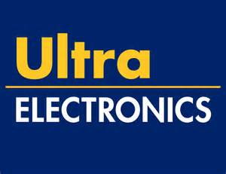
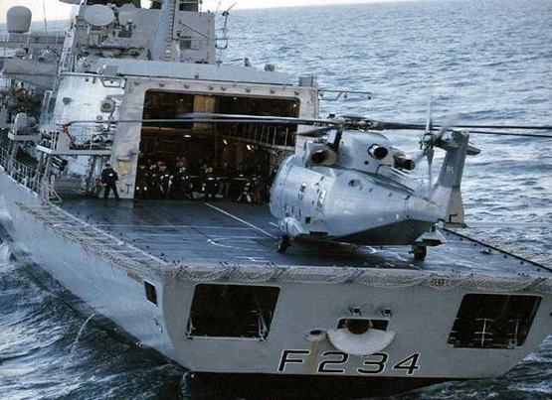
SHOLIS
CONTEXT & OBJECTIVES
A military system that displays whether ship and helicopter parameters are within safe landing limits.
UK MOD required the system certified to Def Stan 00-55.
Def Stan 00-55 required full functional proof.
First software ever developed to this standard.
APPROACH & SOLUTION
Specification written in Z.
Z type checking performed.
Code developed in SPARK.
Z specification translated to SPARK specifications.
Code proven to be compliant with SPARK specifications.
RESULTS & ADDED VALUE
System passed as Def Stan 00-55 compliant.
42 kloc / 9000 VCs.
0.22 defects per kloc.
Demonstrated low value of unit testing when formal methods used.

Slide 35
MGKC
CONTEXT & OBJECTIVES
Smart card security
Flaws in software could lead to very high financial impact and reduced confidence in the product
Security standard ITSEC E6
APPROACH & SOLUTION
Specification written in Z
Z type checking performed
Code developed in SPARK
Security properties translated to SPARK specifications
Code proven to maintain security properties
RESULTS & ADDED VALUE
100,000 lines of SPARK, Ada, C, C++ and SQL
Three trivial defects, one spec defect – fixed under warranty in first year of operation
0.04 defects per kloc

Slide 36
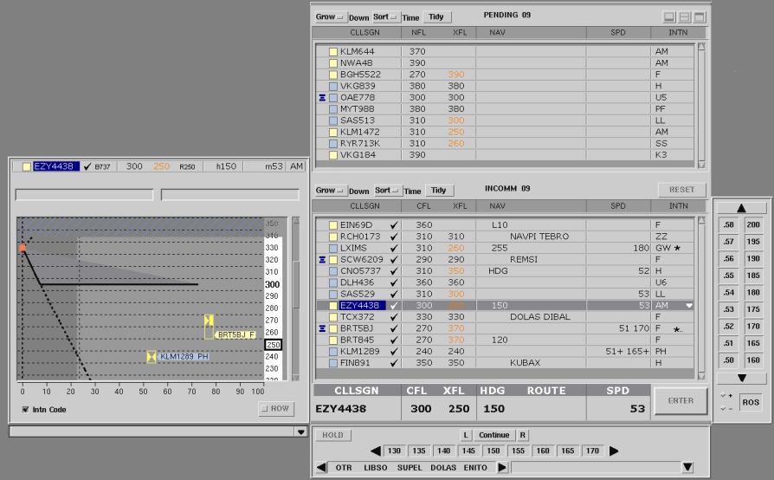
iFACTS
NATS
iFACTS enables controllers to handle more traffic safely
It increases ‘look ahead’ from 2 to 15 minutes
Provides controller tools
Medium Term Conflict Detection (MTCD)
Trajectory Prediction (TP)
Monitoring aids
Altran appointed to develop new software for iFACTS
Needs to meet CAA’s stringent SW01 objectives
In full operational service since December 2011.
Formal functional specification in Z.
Almost all code in SPARK – 250kloc logical.
Proved “type (and memory) safe” – i.e. for any input data and state, no undefined behaviour, no crashes, no exceptions.
152,927 VCs, of which 98.76% discharged automatically. User-defined lemmas and review for the remainder.
“"The iFACTS system and operational concept is ground breaking and genuinely unique in the world of Air Traffic Control. The new working process is already seeing significant benefits across the NATS business, and airports and airline customers are seeing the benefit too.“
Jonathan Astill, General Manager, Area Control, NATS

Slide 37
Why Doesn’t every company use Correct by Construction?
Much programming is just changes to legacy programs
“We don't believe it really works”
“It doesn’t fit our culture, or our skills”
“We don’t have time to learn a new process”
“If we train our software staff they will leave for a higher salary”
Etc …

Slide 38
Those who want really reliable software will find that they must find means of avoiding the majority of bugs to start with, and as a result the programming process will become cheaper.
Dijkstra 1972

Slide 39
Making Software Correct by Construction
Questions?

