Slide 1
'Two Point One Children': Why There is no Typical Family in the Family Court
Jo Delahunty qc
Tweet @jODQC @ Gresham college

Slide 2
Introduction
2.1 Children: Why there is no such thing as a typical family in the family court
This lecture will explore vulnerable parties and children in the Family Court, especially where the common denominator is frequently one of poverty - in education, income and expectations.
It will consider the range of disabilities which can be encountered in court and how law and practice responds to protect an affected person’s rights.
It will outline the general principles which the court has to address if it is to deliver a fair system to the most vulnerable.

Slide 3
Parents involved in care proceedings: three common threads
2.1 Children: Why there is no such thing as a typical family in the family court
Poverty – of income, education or opportunity places parents at a disadvantage in terms of asking for help when they are in crisis and engaging with social work professionals.
Vulnerability – drug addiction, alcoholism, domestic violence, historical abuse as a child can all impact on parenting.
Disability – mental health, learning difficulties or physical disability often tied to other vulnerabilities can impact parenting.

Slide 4
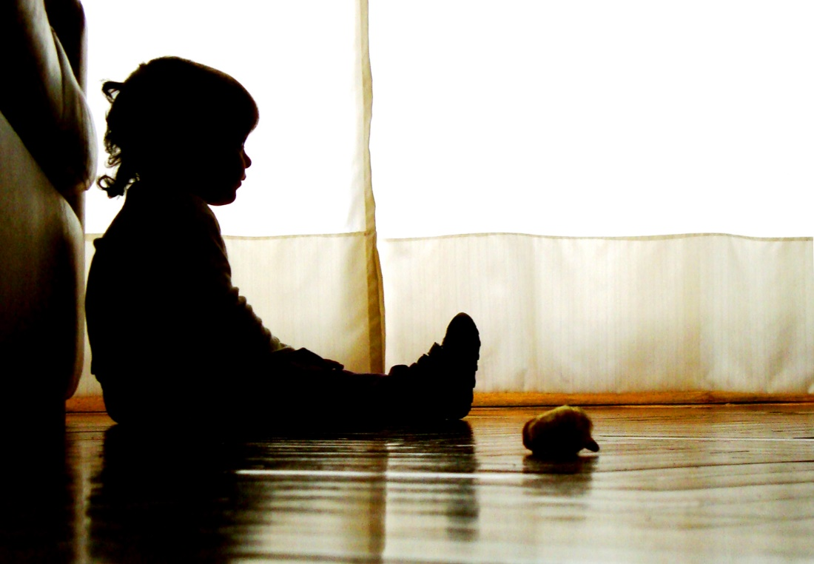
When is a child at risk at home?
2.1 Children: Why there is no such thing as a typical family in the family court
Finding of Facts) NAI_ : Re BR ( Proof of Facts) (2015)EWFC 41 ( 11.5.15) by Jackson J
Risk factors – linked to abuse
Domestic abuse
History of physical or sexual abuse (as a child)
Criminal activity
Substance abuse

Slide 5
2.1 Children: Why there is no such thing as a typical family in the family court
Risk factors – linked to social factors
Social isolation of families
Lack of family cohesion
Parental immaturity
Single or non-biological parents

Slide 6
2.1 Children: Why there is no such thing as a typical family in the family court
Risk factors – linked to disability
Physical or mental disability in children that may increase caregiver burden
Parental stress and distress, including depression or other mental health conditions

Slide 7
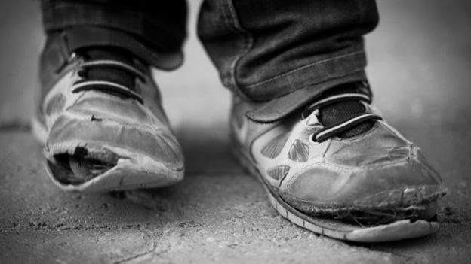
2.1 Children: Why there is no such thing as a typical family in the family court
Risk factors – linked to poverty the last pointer……..
Poverty and other socioeconomic disadvantage

Slide 8
Protective factors
2.1 Children: Why there is no such thing as a typical family in the family court
Nurturing parenting skills
Stable relationships
Supportive family
adults role models/mentors
Adequate housing
Adequate finances
Community support
Household rules and monitoring of the child
Access to health care and social services

Slide 9
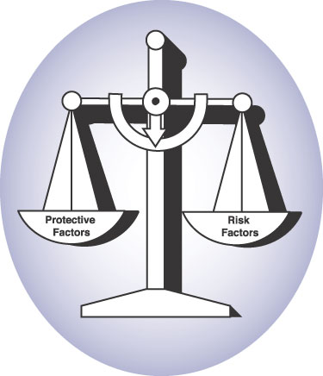
2.1 Children: Why there is no such thing as a typical family in the family court
But do remember, as Jackson J was at pains to make clear,
‘the presence or absence of a particular factor proves nothing. Children can of course be well cared for in disadvantaged homes and abused in otherwise fortunate ones. As emphasised above, each case turns on its facts. The above analysis may nonetheless provide a helpful framework within which the evidence can be assessed and the facts established’.

Slide 10
2.1 Children: Why there is no such thing as a typical family in the family court
THE LEAST INTERVENTIONIST APPROACH
The overarching principle Hale LJ, in Re C and B para 34:
"intervention in the family may be appropriate, but the aim should be to reunite the family when the circumstances enable that, and the effort should be devoted towards that end. Cutting off all contact and the relationship between the child or children and their family is only justified by the overriding necessity of the interests of the child.“
VC v United Kingdom para 134:
"Family ties may only be severed in very exceptional circumstances and … everything must be done to preserve personal relations and, where appropriate, to 'rebuild' the family. It is not enough to show that a child could be placed in a more beneficial environment for his upbringing."

Slide 11
2.1 Children: Why there is no such thing as a typical family in the family court
The United Kingdom is unusual in Europe in permitting the total severance of family ties without parental consent.
A stringent and demanding test.
Adoption should be ordered only when ‘nothing else will do’ and the consent of parent to it can only be dispensed with if the welfare of the child "requires" this.
"Require" here has the Strasbourg meaning of necessary,
"the connotation of the imperative, what is demanded rather than what is merely optional or reasonable or desirable"

Slide 12
2.1 Children: Why there is no such thing as a typical family in the family court
“Nothing else will do”
Re B (A Child) [2013] UKSC 22:
The courts paramount consideration is the child’s welfare ‘throughout his life.
Wherever possible, consistent with their welfare needs, children deserve an upbringing within their natural families But the child’s welfare remains the paramount consideration and the relationship between parent and child is one factor to be taken into consideration .
The court "must" consider all realistic options before coming to a decision. It is "necessary to explore and attempt alternative solutions".
The court's assessment of the parents' ability to discharge their responsibilities towards the child must take into account the assistance and support which the authorities would offer
Crime v care

Slide 13
2.1 Children: Why there is no such thing as a typical family in the family court
‘The local authority cannot press for a more drastic form of order, least of all press for adoption, because it is unable or unwilling to support a less interventionist form of order.
Judges must be alert to the point and must be rigorous in exploring and probing local authority thinking in cases where there is any reason to suspect that resource issues may be affecting the local authority's thinking.

Slide 14
2.1 Children: Why there is no such thing as a typical family in the family court
Law and practice
The State owes parents duties under the Human Rights Act:
Article 6 rights to fair trial not just in Court, but involves fairness in all decisions.
Article 8 interference with rights to private and family life can only be done where it is PROPORTIONATE and NECESSARY.
section 31 Children Act 1989 : threshold.
significant harm?
Least interventionist order.

Slide 15
Risk to child and “good enough” parenting
2.1 Children: Why there is no such thing as a typical family in the family court
The Local Authority can apply to court for orders to protect a child at risk of harm when the parenting is not “good enough”:
Child Assessment Order
Supervision order
Care order
Adoption order

Slide 16
The State’s Duty to Support a Child in Need
2.1 Children: Why there is no such thing as a typical family in the family court
Section 17 of the Children Act 1989
The DUTY to promote the upbringing of such children by their families, by providing a range and level of services appropriate to those children's needs.
Mis-match:
The state’s ability (and willingness) to provide support to a family
and
A family’s ability to make use of it to effect the changes needed for the child.

Slide 17
2.1 Children: Why there is no such thing as a typical family in the family court
There is no right, per se, to bring up one’s own child if, to do so exposes that child to the risk of significant serious harm, abuse or neglect and that risk cannot be ameliorated adequately by support. If there is at risk of that happening then the state will apply to the court.

Slide 18
2.1 Children: Why there is no such thing as a typical family in the family court
Munby P endorsed at [26] the approach of Hedley j in Re L (Care: Threshold Criteria) [2007] 1 FLR 2050, para 50:
"society must be willing to tolerate very diverse standards of parenting, including the eccentric, the barely adequate and the inconsistent ... it is not the provenance of the state to spare children all the consequences of defective parenting. in any event, it simply could not be done."

Slide 19
2.1 Children: Why there is no such thing as a typical family in the family court
Measures to Address Disability in the Courtroom: An Insider Guide
There are ‘toolkits’ available that provide advocates with general good practice guidance when preparing for trial in cases involving a witness or a defendant with communication needs http://www.theadvocatesgateway.org/toolkits
Links provided in the lecture handouts

Slide 20
Looking at a Particular Type of Vulnerability: taking Learning Disability as an Illustrative Example
2.1 Children: Why there is no such thing as a typical family in the family court
In Re D (A child) (no 3) [2016] EWFC 1 Munby P set out key principles
Too narrow a focus must not be placed exclusively on the child’s welfare without addressing a parent’s needs arising from their disability which might impact adversely on their parenting capacity,
The court must be careful to ensure that the supposed inability of parents to change might itself be an artefact of professional ineffectiveness in engaging with the parent in appropriate terms.

Slide 21
KEY POINTS OF LAW AND PRACTICE
2.1 Children: Why there is no such thing as a typical family in the family court
People with a learning disability are individuals first and foremost and each has a right to be treated as an equal citizen.
Courts must take all steps possible to ensure that people with a learning disability are able to actively participate in decisions affecting their lives.
Their competences must not be judged against stricter criteria or harsher standards than other parents.
Too narrow a focus must not be placed exclusively on the child's welfare with an accompanying failure to address parents' needs arising from their disability which might impact adversely on their parenting capacity.
The court must also take steps to ensure there are no barriers to justice within the process itself
The courts must be careful to ensure that the supposed inability of parents to change might itself be an artefact of professionals' ineffectiveness in engaging with the parents in appropriate terms.
A shift must be made from the old assumption that adults with learning difficulties could not parent to a process of questioning why appropriate levels of support are not provided to them so that they can parent successfully.

Slide 22
PARENTING WITH SUPPORT
2.1 Children: Why there is no such thing as a typical family in the family court
The concept of "parenting with support" must move from the margins to the mainstream in court determinations
It represents the positive and broad obligation upon the state to provide the specific support that is needed for parents to retain the care of their child(ren).
The question becomes: Whether the parents, if provided with all the necessary support and services, would be able to provide their child(ren) with adequate care and parenting in a setting which promotes their welfare and does not cause harm.

Slide 23
An invitation : Disability
2.1 Children: Why there is no such thing as a typical family in the family court
Change in attitude towards people with a learning disability in society
Wider acceptance that people with a learning disability can bring up children successfully with assistance
People with a learning disability not always given the help that they need to parent.
Little evidence of effective joint working between adult and children’s services

Slide 24
GOOD PRACTICE GUIDANCE ON WORKING WITH PARENTS WITH A LEARNING DISABILITY
2.1 Children: Why there is no such thing as a typical family in the family court
clear / co-ordinated referral assessment procedures,
support designed to meet the parent's needs & strengths,
long-term support where necessary,
access to independent advocacy;

Slide 25
Care isn’t a panacea
Nor is adoption.

Slide 26
The Bridget Lindley OBE Memorial Lecture 2017 Entitled’ Holding The Risk: The Balance Between Child Protection and The Right to Family Life.
2.1 Children: Why there is no such thing as a typical family in the family court
Making an adoption order radically shifts the tectonic plates of an individual’s legal identity (and those of others) for life.
That is a very big thing to do in order to protect that individual from harm during their formative years.
Is an order of that magnitude necessary?
How do we know that it is indeed the best outcome for the young person whose future life is being decided by the court?
And, if I am right that we can no longer be certain that it is, how is it possible to say that by making adoption orders, particularly in the middle to low range of abuse cases, we are indeed getting the balance right between child protection and the right to family life.”

Slide 27
2.1 Children: Why there is no such thing as a typical family in the family court
We are all frail human beings, with our fair share of unattractive character traits, which sometimes manifest themselves in bad behaviours which may be copied by our children.
But the state does not and cannot take away the children of all the people who commit crimes, who abuse alcohol or drugs, who suffer from physical and mental illnesses or who espouse antisocial political or religious beliefs.
Re B (A child) (care proceedings: threshold criteria) [2013] UKSC 33:

Slide 28
Previous lectures
2.1 Children: Why there is no such thing as a typical family in the family court
Sex, death and witchcraft: what goes on in the family court room?
Is one individual’s radicalism another’s right to free speech?
When legal worlds collide
Guilty until proven innocent
Expert witnesses: a zero sum game
Available at https://www.gresham.ac.uk/series/when-worlds-collide-the-family-and-the-law/

Slide 29
GOODBYE UNTIL SEPTEMBER !
2.1 Children: Why there is no such thing as a typical family in the family court
http://quotesgram.com/thank-you-for-listening-quotes/

