Slide 1


What is Noise?
Beauty and Taste in 20th century music
Dr Toby Young
University of Oxford
toby.young@music.ox.ac.uk

Slide 2

Definitions
Unwanted sound, being especially loud or unpleasant … a ‘pollutant’
  Council implementing decibel limits
  Police use to evacuate buildings / dissipate hostage situations
  Psychological effect (e.g. Guantanamo)
Acoustic phenomena: ‘irregular fluctuations that accompany a transmitted electrical signal but are not part of it and tend to obscure it.’
  Relationship with dissonance

Slide 3

Case Study: John Cage 4’33”

Slide 4
Case Study: John Cage 4’33”
Questions our definitions of noise, and by definition, beauty
‘If the music can accept ambient sounds and not be interrupted thereby, it’s a modern piece of music’
John Cage claims the work is NOT silence (‘everything we do is music’)
  Against Roger Scruton’s definition of music as necessarily requiring melody
Sounds in our environment have aesthetic qualities in the same way music does, but we do not appreciate them in day-to-day life

Slide 5
Case Study: John Cage 4’33”
Vulfpeck’s ‘Sleepify’
  The release did not contain any audible music, consisting only of 10x30-second-long tracks of silence
  Written for Spotify, in protest of the low royalty payments offered by the platform
  The band encouraged consumers to play the album on a loop while they slept.
  In return turn, royalties (totalling $20,000) from the playing of each track were to be used to crowdfund a free concert tour by the band, visiting all the towns that had played the album the most.
  The album was pulled by Spotify on April 26, 2014, citing violations of the service's content policies

Slide 6
Noise is Defined by Context
Framing functions:
  The work-concept (cf. Lydia Goehr)
  The ‘performance-concept’
Music as organisation … the composer as a painter of sound
Case Study: Thunder (Hannah Rickards)
  A recording of an eight-second thunderclap was stretched into a seven-minute passage
  Transcribed and arranged into a score for an instrumental ensemble
  The subsequent performance was recorded, and compressed to last eight seconds

Slide 7
Use of Language
Attached notions of value judgement in vocabulary
  Creates a context where ‘noise is bad/music is good’
Categorical definition
  According to Locke, abstract ideas are ‘mixed mode’ concepts, made out of simpler elements
  This leads the notion of organised sound, but this negates intention and perception
  Ludwig Wittgenstein claims that we can extend Locke’s concepts by a ‘family resemblance’ structure, where shared features prevail between objects (or traits)
  We therefore compare new cases to existing prototypes to decide whether it should be called music.

Slide 8
Politics, Power and Value Judgement
Why might you want to position yourself as noise?
‘It is sounds and their arrangements that fashion societies. With noise is born disorder and its opposite: the world. With music is born power and its opposite: subversion … when it becomes music, noise is the source of purpose and power. It is at the heart of the progressive rationalization of aesthetics, and it is a refuge for residual irrationality; it is a means of power and a form of entertainment.’ (Jacques Attali)
    E.g. Censorship (Entartete Musik)

Slide 9
‘Found Sound’ and Representation
Musique Concrète – using recordings and electronics to explore ‘real world’ sounds
Stems out of futurist art
  Luigi Russolo suggests that the industrial revolution gave modern audiences a greater capacity to appreciate more complex sounds
Noise as disruption
Found sound attached to labour (readdressing social norms)
  e.g. Nono using factory noises in La Fabricca Illuminata

Slide 10
Is Noise Completely Subjective?
Does inherent noise exist?
What might it sound like?
Does it change over time? (like dissonance)

Slide 11
Beauty, Taste and Critique
Immanuel Kant (1724 - 1804):
  Argues that our perception of human experience stems from the structure of the human mind and way we think (e.g. reason is the source of morality, rather than God or another external force)
  Categories of the mind limit our possibilities of experience, because reality must conform to the human mind's active concepts to be conceivable and at all possible for us to experience

Slide 12
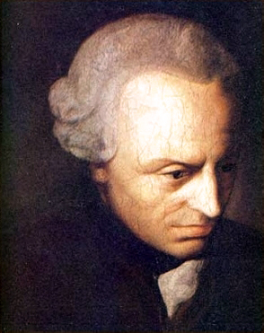
Beauty, Taste and Critique
Immanuel Kant (1724 - 1804)

Slide 13
Beauty, Taste and Critique
Believes that aesthetic judgments are fundamentally ‘judgments of taste’, based on an individual’s subjective feelings and the relationship between imagination and perception.
There are qualities inherent in the art-object that make it beautiful and those qualities of the object affect the human subject, but it is up to the subject to be receptive (Bowie 2014).
Beauty is immediately apparent but the sublime – another type of ‘aesthetic experience’ is inconceivable to reason, and therefore holds an air of mystery.
Aesthetic judgment is made with the belief that other people ought to agree with this judgment (an imaginary ‘sensus communis’ or community of taste), even if we know that many will not agree.
→ Yes, noise is subjective

Slide 14
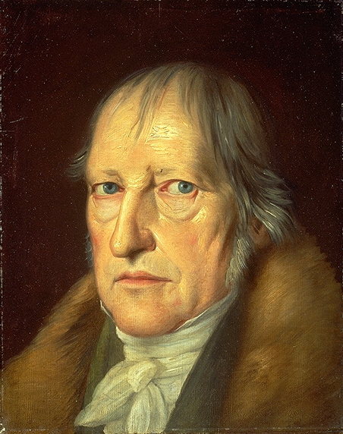
Beauty, Taste and Critique
Georg Wilhelm Friedrich Hegel (1770 – 1831)

Slide 15
Beauty, Taste and Critique
Wants to make a scientific / objective study of beauty
Notices a dichotomy between the content and the representation of beauty where ‘we begin with what presents itself immediately to us, and after that go on to consider what is its significance or content.’
Hegel is not concerned with art representing things as they are or how we experience them as sensuous beings. He is more interested in the act of art capturing something of the spiritual essence of nature (humans included). For Hegel, art is a way of representing the Absolute, the absolute spirit and the absolute truth. If a work of art cannot rise to meet the higher spiritual ideal, if it is not significant in any other higher sense other than representation and imitation, it is not art.
Fundamental element of the beautiful is something inherent in the object's content (or the Idea), which is the work of art’s truth. When the material reality of art aligns perfectly with the Idea, they merge to become beautiful (the Ideal)
Beauty cannot necessarily be understood, but we can objectively experience it
→ No, noise is absolute

Slide 16
Lo-Fi and Imperfection
Can noise be beautiful in either Kant or Hegel’s eyes?
Using out-dated equipment (e.g. vinyl)
Use of extreme volume or distortion
  Jimi Hendrix's use of feedback
Industrial and glitchcore styles explore an ‘aesthetic of failure’
Music which challenges the distinction that is made in conventional musical practices between musical and non-musical sound
Music that is ‘characterised by the expressive use of noise within a musical context’ (Born 2013), shows an aligning of ideal and representation, which brings us closer to the world around us.

Slide 17
MUZAK and the Mundane
Precursor in Gebrauchmusik (or ‘utility music’)
Brian Eno ‘Music for Airports’ (1978)
  ‘Ambient Music’
  Explores ‘the products of the various purveyors of canned music’
Exploitation of the mundane elements of society as culturally encoded
Boredom / meditation / mindfulness as ways to see through the problems of artifice of objective/collective experience
Ambience as a ‘technology of the self’ (cf. Foucault)

Slide 18
Lacan and Epistemology
For Lacan, we spend our whole lives trying to find the Real (or ideal)
The Real resists representation
We can never know it
  It loses its ‘reality’ once it is symbolized (made conscious) through language or image
Turning the mundane into art is a way of questioning representation in a search for the Real → manifestation of ideal/representation dichotomy

Slide 19
Imperfection as Reflection of Society
“But even the portrait painter....must flatter….the purely natural side of the imperfect existence, little hairs, pores, little scars, warts, all these he must let go, and grasp and reproduce the subject in his universal character and enduring personality. It is one thing for the artist to simply imitate the face...and quite another to be able to portray the true features which express the inmost soul of the subject….necessary for the Ideal that the outer form should explicitly correspond with the soul....In case of the human form...the artist does not proceed...like a restorer of old paintings who...reproduces cracks...[instead] the portrait painter will omit folds of skin and, still more freckles, pimples, pock-marks, warts, etc....Denner, in his so-called “truth-to-nature,” is not to be taken as an example. Similarly, muscles and vein are indicated indeed, but they should not appear in the distinctness and completeness which they have in reality. For in all this there is little or nothing of the spirit, and the expression of the spiritual is essential in the human form.” (Naomi Schor 2016)

Slide 20
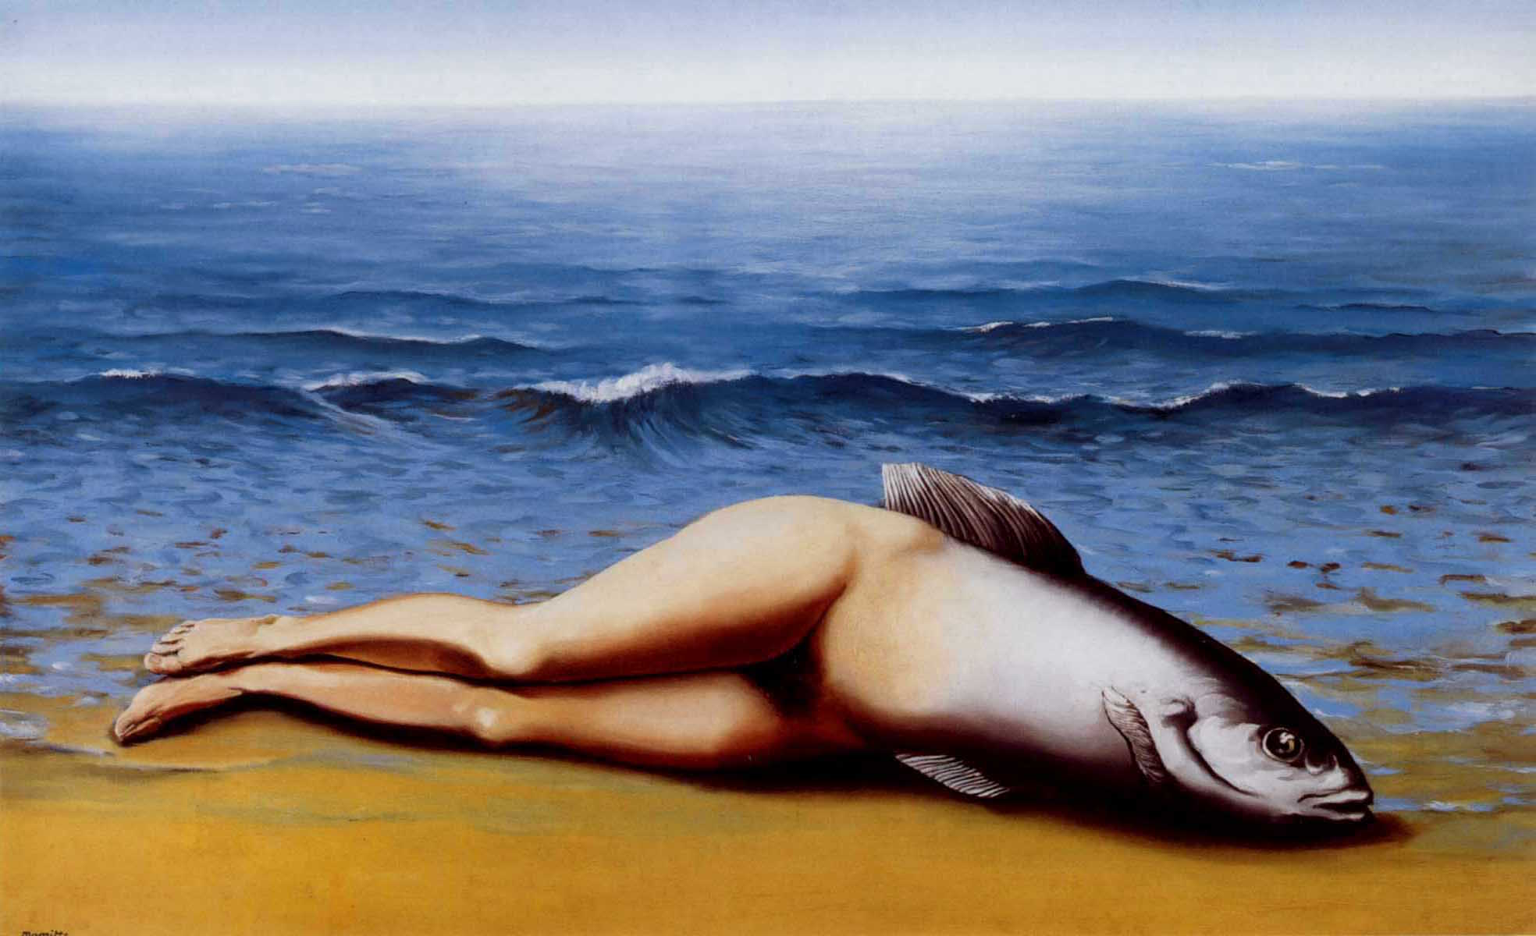
Imperfection as Reflection of Society

Slide 21
Imperfection as Reflection of Society
René Magritte’s ‘The Collective Invention’.
Presents familiar objects and scenes in unfamiliar contexts, forcing the viewer to question the relationship between them
  John Berger cites Magritte as having “commented on this always-present gap between words and seeing … we are always looking at the relation between things and ourselves” (Berger 2008, 9).
The imperfections and ugliness in the work subverts the reality we take for granted, by making the representations we have come to know as familiar, typical, or cliché become thought-provoking and strange, making the viewer uncomfortable.
It also questions it’s own context (i.e. the canon of beautiful nudes)
‘Everything we see hides another thing, we always want to see what is hidden by what we see. There is an interest in that which is hidden and which the visible does not show us. This interest can take the form of a quite intense feeling, a sort of conflict, one might say, between the visible that is hidden and the visible that is present.’ (Rene Magritte)

Slide 22
Imperfection as Reflection of Society
Kant argues that aesthetic ideas ‘strive towards something beyond the boundary of experience’, which Magritte does by putting the viewer in a place of self-reflection
Under modernism, we hold certain truths to be “self-evident.”
  Postmodernism questions the “evidential” basis for those truths, but the idea that there may be truths at all and operates instead under the subjective (Jameson 1991).
Magritte moves further by subverting that subjectivity as well as the flaws come with objectivity.
With the big changes in society throughout the 20th century, it becomes increasingly more difficult to determine how to view reality, and indeed whether we can assert that there is a reality at all.
Magritte wrote that his ‘paintings are visible images which conceal nothing...they evoke mystery and, indeed, when one sees one of [his] pictures, one asks oneself this simple question, ‘What does it mean?’ It does not mean anything, because mystery means nothing either, it is unknowable’.

Slide 23
Noise as Reflection of Society
Art is a lens to deal with society in experience of modernity and technology
  E.g. Art during industrialisation
Noise reflects, reveals and empathises with the complexities and imperfections of the modern world
Lyotard – the Postmodern Condition is defined by the end of 'grand narratives' or metanarratives (e.g. reductionism and teleological process), which he considers a key feature of modernity
Noise as ultimate breaking of these ‘grand narratives’ – something to be welcomed!

Slide 24
Conclusion(s)
We are culturally and genetically coded to understand certain sounds
  ‘Acoustic niche’ and adaption for survival
  Ethnographic differences
  Sounds beyond the realms of perception
How do we understand data that we are not coded to process? What is the truth in this mass of data?
  The term ‘noise’ implies disorderly system (i.e. negative value judgement)
  But in systems theory, ‘noise’ refers to data which is not understood (rather than meaningless)
  In a post-truth world, maybe the onus is on us to find our own meaning in the world?

Slide 25
Conclusion(s)
New experiences can bring new meaning to old art
  Help us to decode the noise
Human beings, just like art, are works in progress that mistakenly think they are finished
Great art is timeless; but nostalgia creates warped views of the world
Art offers a view beyond this – a way to (ironically) get closer to the reality of the world, and noise is vital in revealing this.

Slide 26
Thank you!

