Slide 1

Fourier’s Series
Raymond Flood
Gresham Professor of Geometry

Slide 2
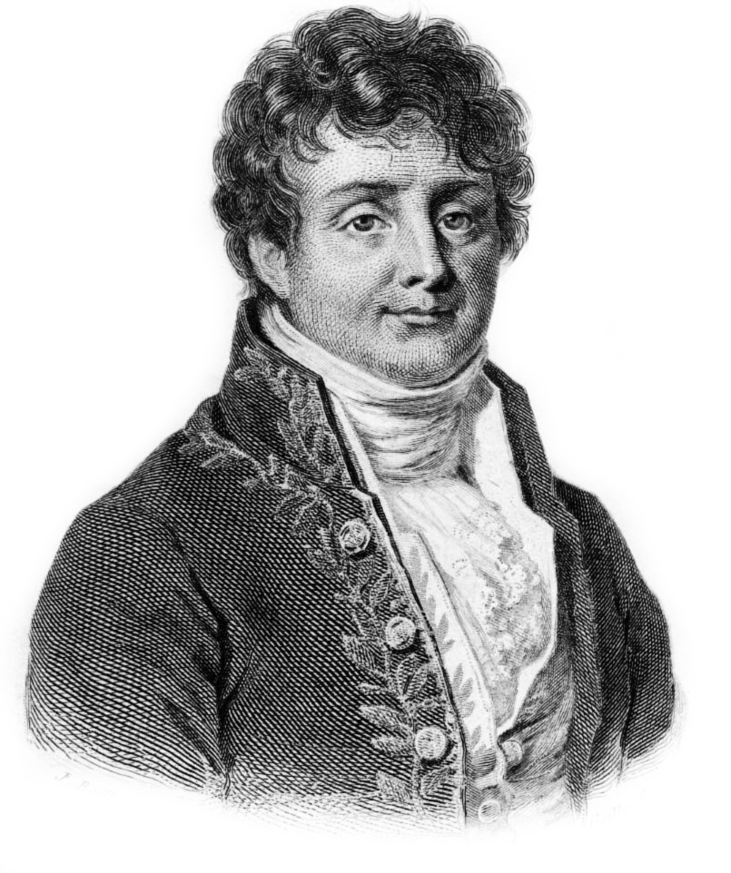
Joseph Fourier (1768–1830)
Overview
Fourier’s life
Heat Conduction
Fourier’s series
Tide prediction
Magnetic compass
Transatlantic cable
Conclusion

Slide 3
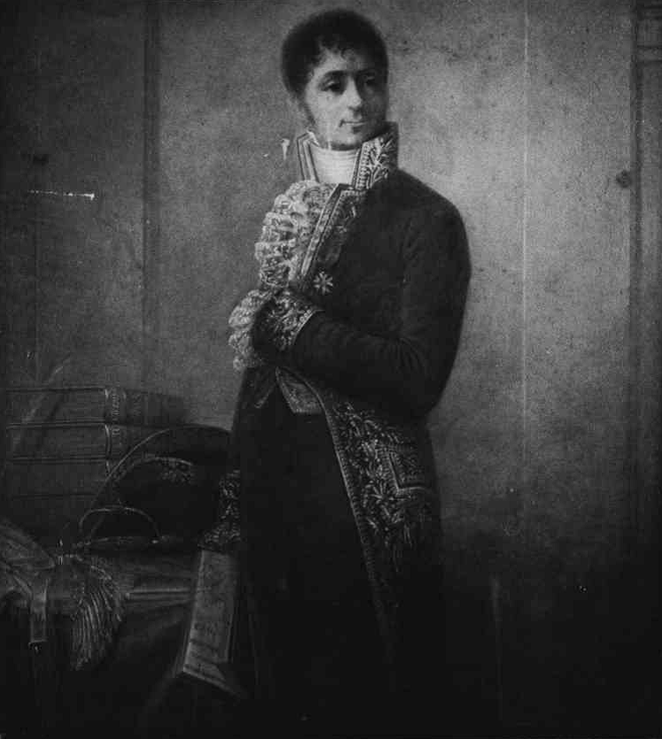
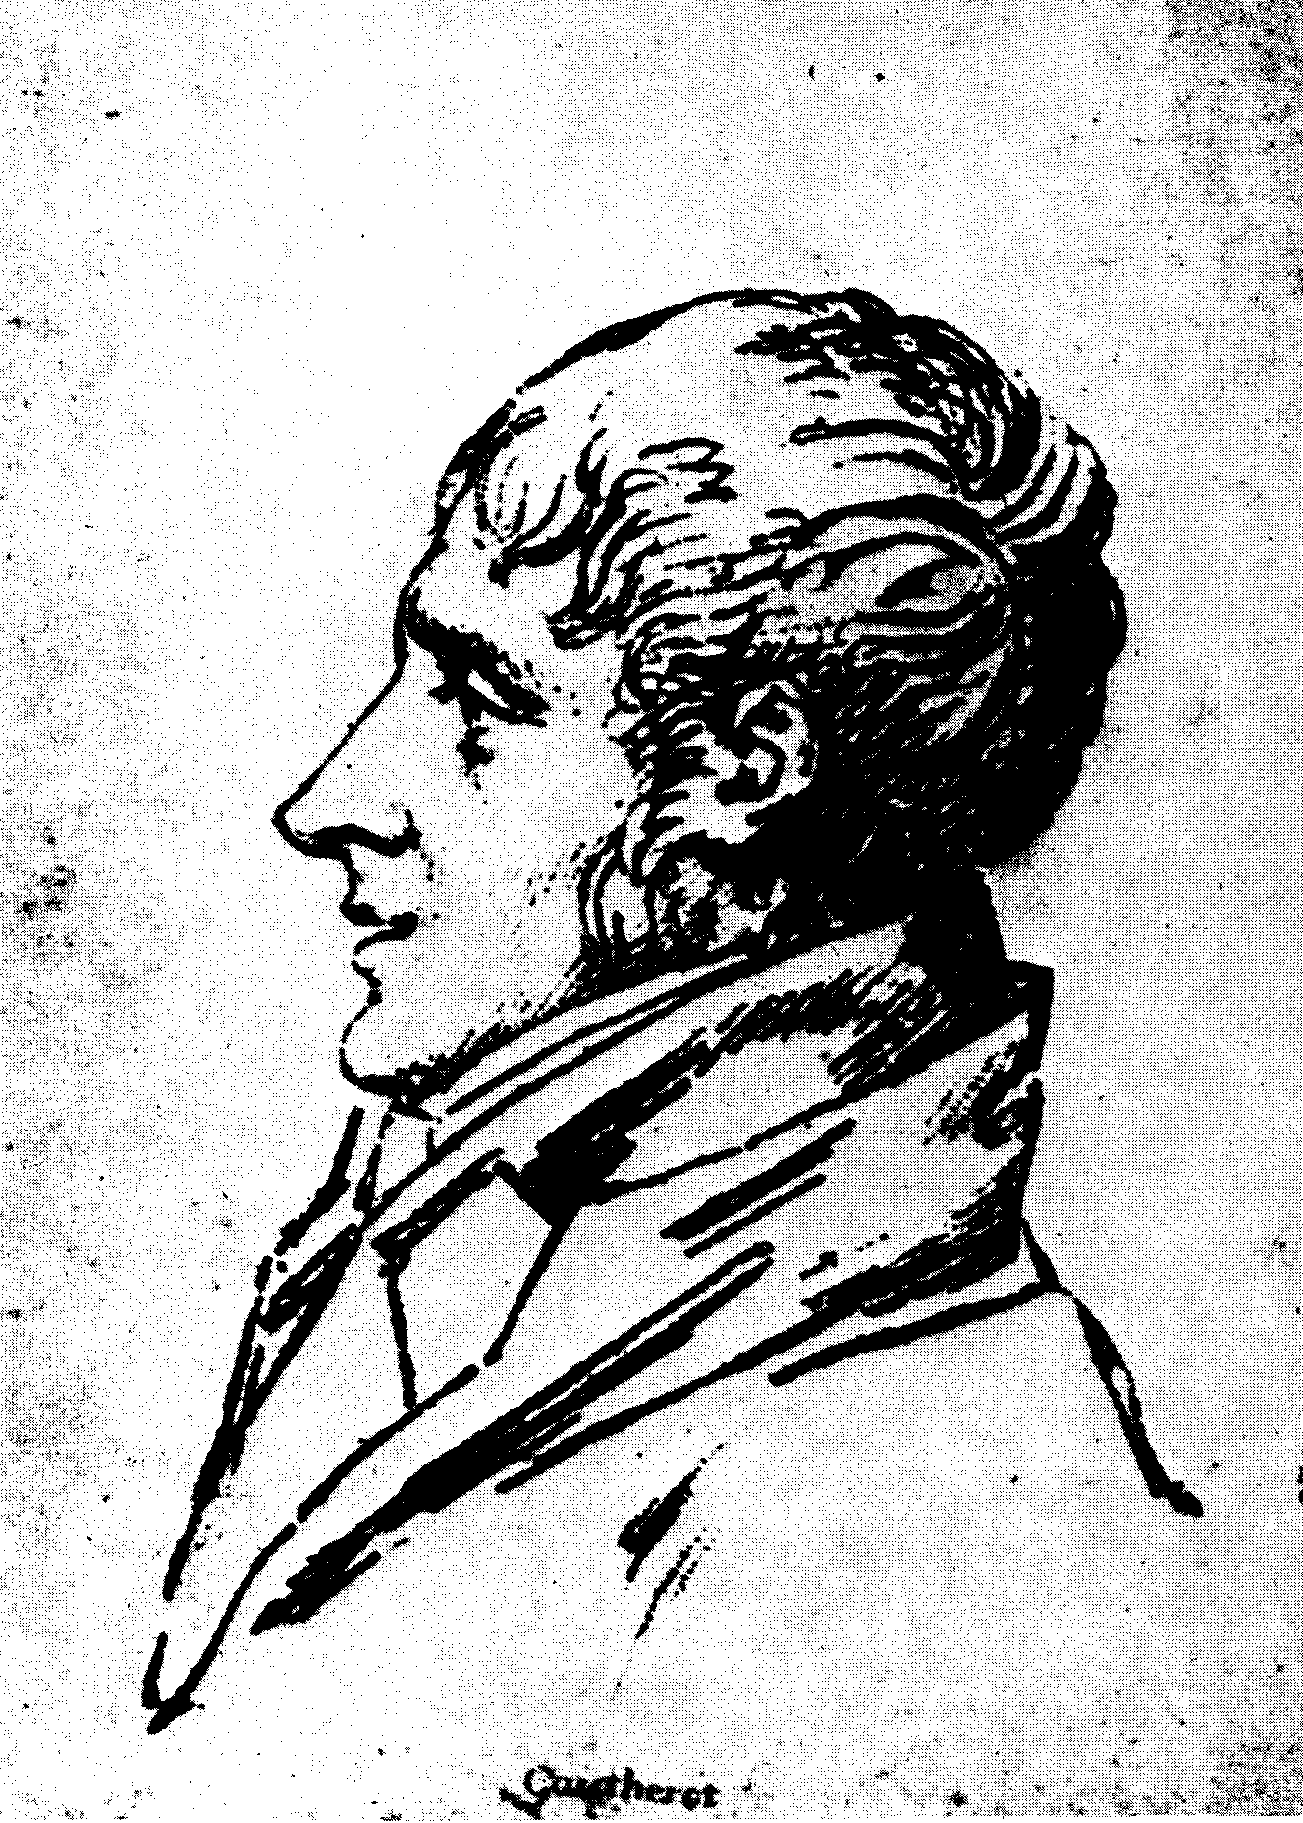

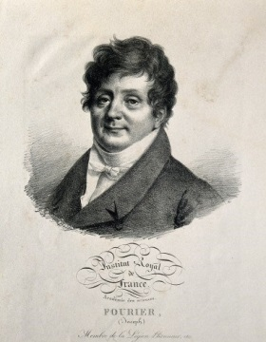
Joseph Fourier 1768–1830
Left: a portrait by an unknown artist, possibly his friend Claude Gautherot, of Fourier in a Prefect’s uniform
Above: sketch of Fourier as a young man by his friend Claude Gautherot
Two portraits of Fourier by J. Boilly, left 1823, above from his Collected works

Slide 4
Part of a letter written later from prison, in justification of his part in the Revolution in Auxerre in 1793 and 1794, Fourier describes the growth of his political views
As the natural ideas of equality developed it was possible to conceive the sublime hope of establishing among us a free government exempt from kings and priests, and to free from this double yoke the long-usurped soil of Europe. I readily became enamoured of this cause, in my opinion the greatest and the most beautiful which any nation has ever undertaken.

Slide 5
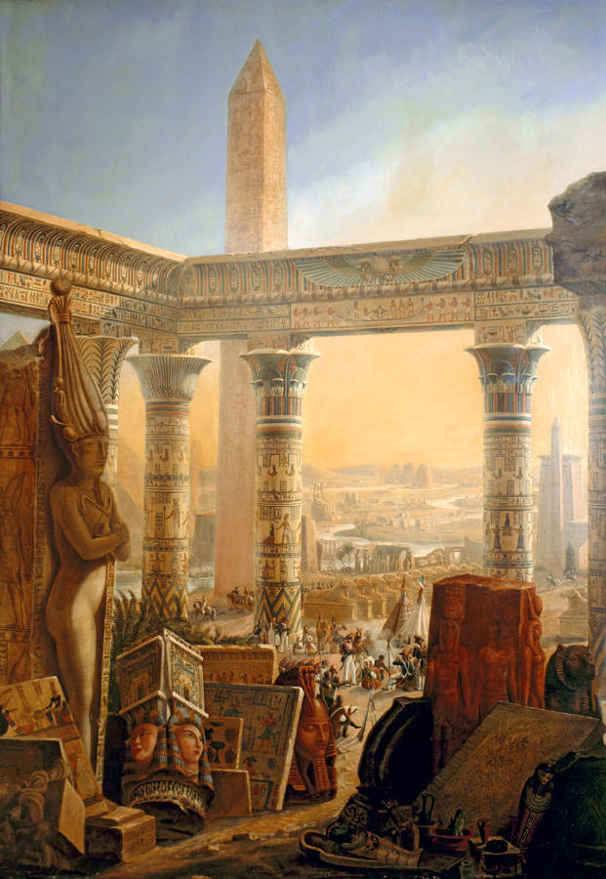
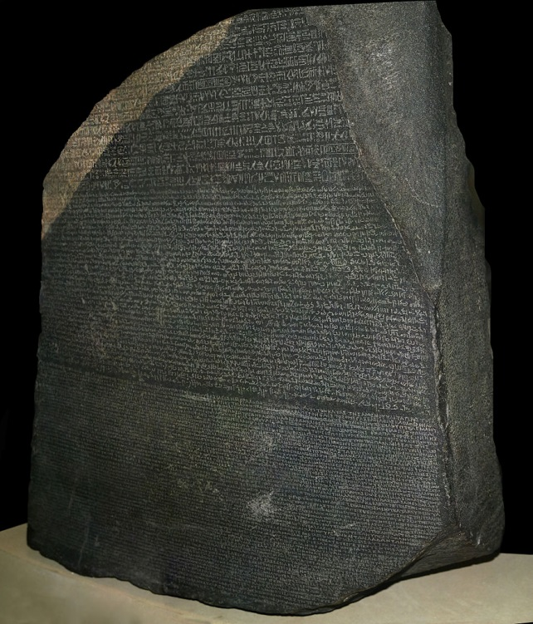
Egyptian expedition
Frontispiece of Description of Egypt
Rosetta Stone

Slide 6
Yesterday was my 21st birthday, at that age Newton and Pascal had [already] acquired many claims to immortality.

Slide 7
Yesterday was my 21st birthday, at that age Newton and Pascal had [already] acquired many claims to immortality.
But during three remarkable years from 1804 to 1807 he:
Discovered the underlying equations for heat conduction
Discovered new mathematical methods and techniques for solving these equations
Applied his results to various situations and problems
Used experimental evidence to test and check his results

Slide 8
Report on Fourier’s 1811 Prize submission
…the manner in which the author arrives at these equations is not exempt of difficulties and that his analysis to integrate them still leaves something to be desired on the score of generality and even rigour.

Slide 9
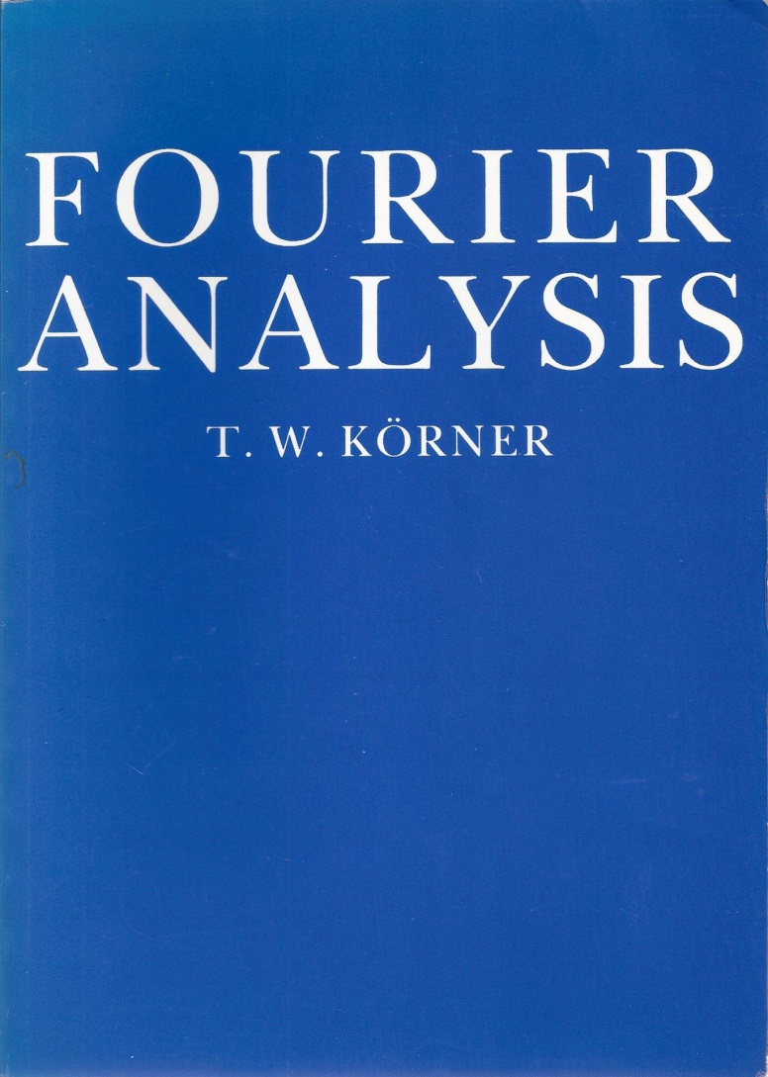
Report on Fourier’s 1811 Prize submission
…the manner in which the author arrives at these equations is not exempt of difficulties and that his analysis to integrate them still leaves something to be desired on the score of generality and even rigour.
Laplace and Lagrange [the referees] could not see into the future and their doubts are surely more a tribute to the originality of Fourier’s methods than a reproach to mathematicians who Fourier greatly respected (and, in Lagrange’s case, admired).

Slide 10
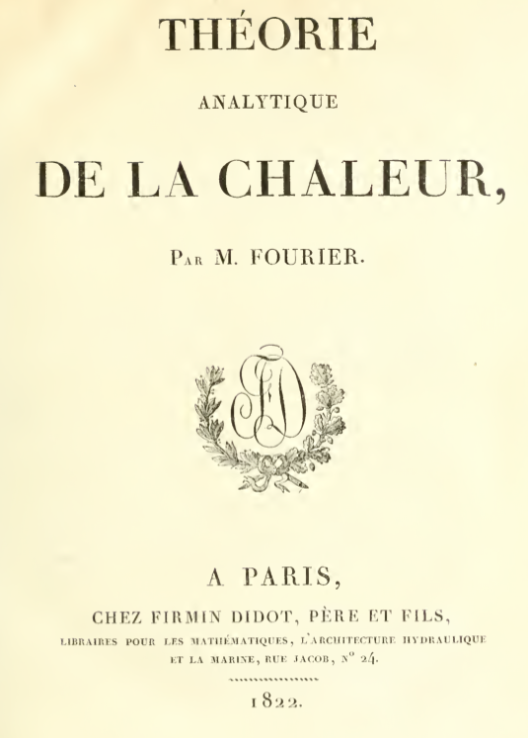

Slide 11
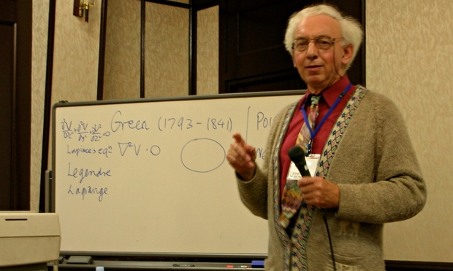
He preserved his honour in difficult times, and when he died he left behind him a memory of gratitude of those who had been under his care as well as important problems for his scientific colleagues.
Joseph Fourier, 1768-1830: A Survey of His Life and Work by
Ivor Grattan-Guinness and Jerome R Ravetz, MIT Press, 1972
Ivor Grattan-Guinness
1941 – 2014
Obituary by Tony Crilly at
http://www.theguardian.com/education/2014/dec/31/ivor-grattan-guinness

Slide 12
Fundamental causes are not known to us; but they are subject to simple and constant laws, which one can discover by observation and whose study is the object of natural philosophy.

Slide 13
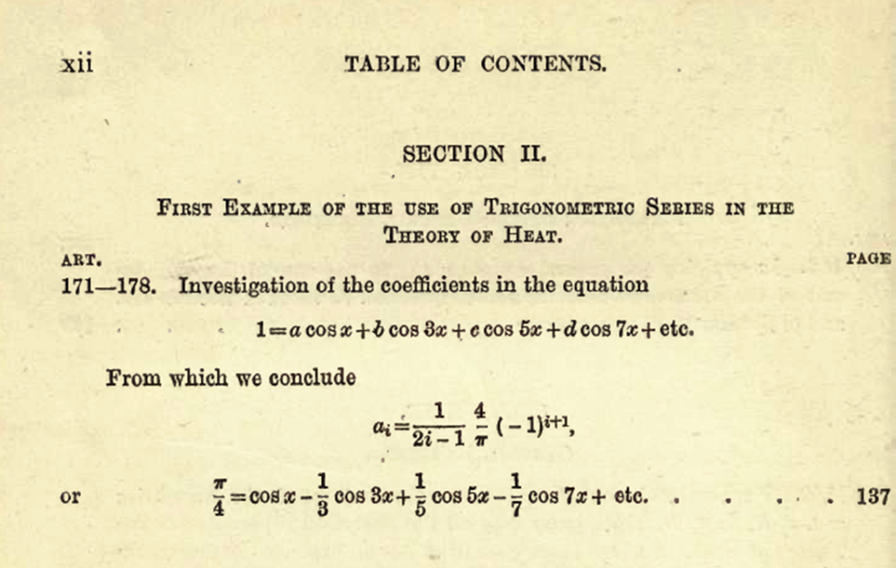
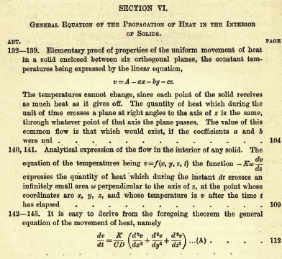

Slide 14
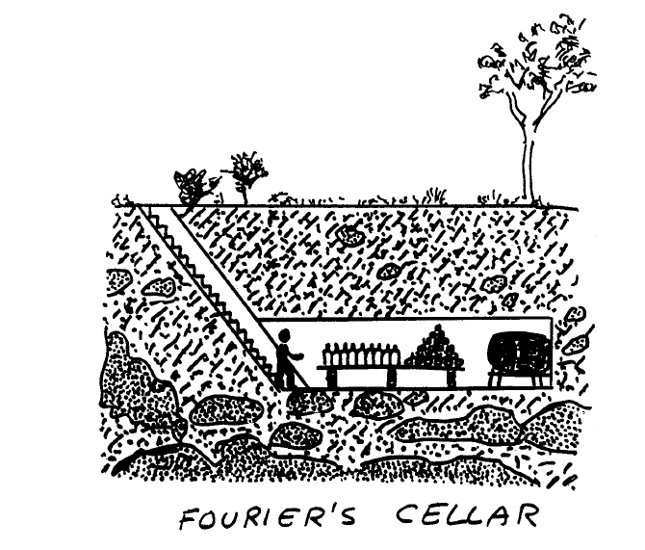
Drawing by Enrico Bomberieri

Slide 15
One dimensional partial differential equation of heat diffusion
u(x , t) is the temperature at depth x at time t.
Drawing by Enrico Bomberieri

Slide 16
One dimensional partial differential equation of heat diffusion
u(x , t) is the temperature at depth x at time t.
The fundamental observation we are going to use to describe the change in temperature at depth x over time is that:
the rate of change of temperature u(x , t) with time at depth x is proportional to the flow of heat into or out of depth x.
Drawing by Enrico Bomberieri

Slide 17
One dimensional partial differential equation of heat diffusion
u(x , t) is the temperature at depth x at time t.
The left hand side is the change of temperature over time at depth x.
The right hand side is the flow of heat into the point at depth x.
K is a constant depending on the soil.
Drawing by Enrico Bomberieri

Slide 18
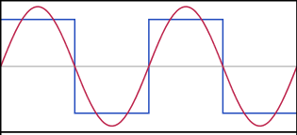
Approximating a square waveform by a Fourier series
cos u

Slide 19
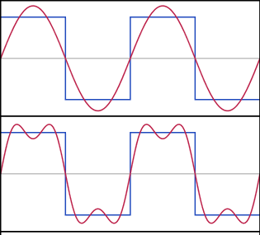
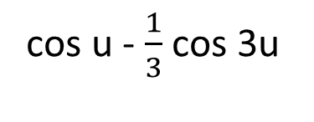
Approximating a square waveform by a Fourier series
cos u - $\frac{1}{3}$ cos 3u

Slide 20
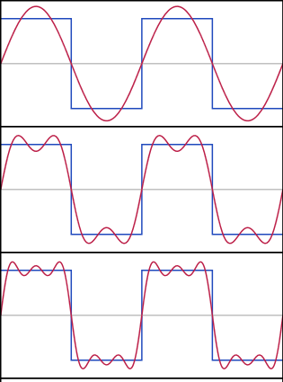
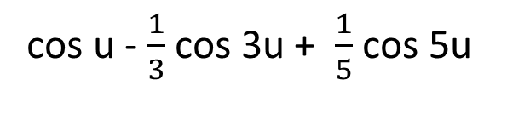
Approximating a square waveform by a Fourier series
cos u - $\frac{1}{3}$ cos 3u + $\frac{1}{5}$ cos 5u

Slide 21
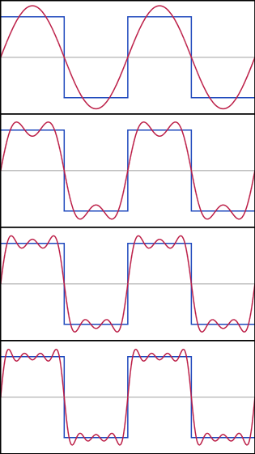
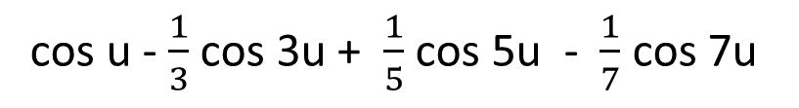
Approximating a square waveform by a Fourier series
cos u - $\frac{1}{3}$ cos 3u + $\frac{1}{5}$ cos 5u - $\frac{1}{7}$ cos 7u

Slide 22
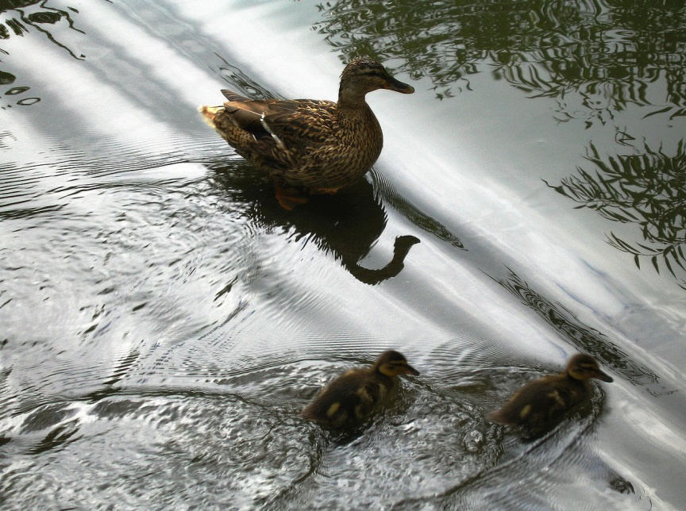
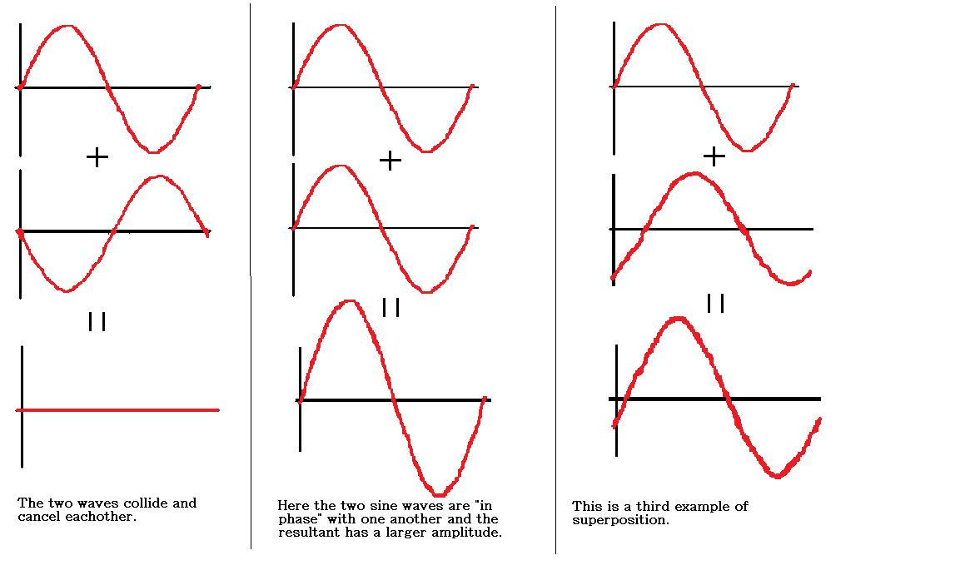
Linearity

Slide 23
One dimensional partial differential equation of heat diffusion
Linearity
If u₁ and u₂ are solutions then so is α u₁ + β u₂ for any constants α and β.
He then represented the temperature distribution as a Fourier series
The temperature variation at the surface can also be written as a Fourier series.
Drawing by Enrico Bomberieri

Slide 24
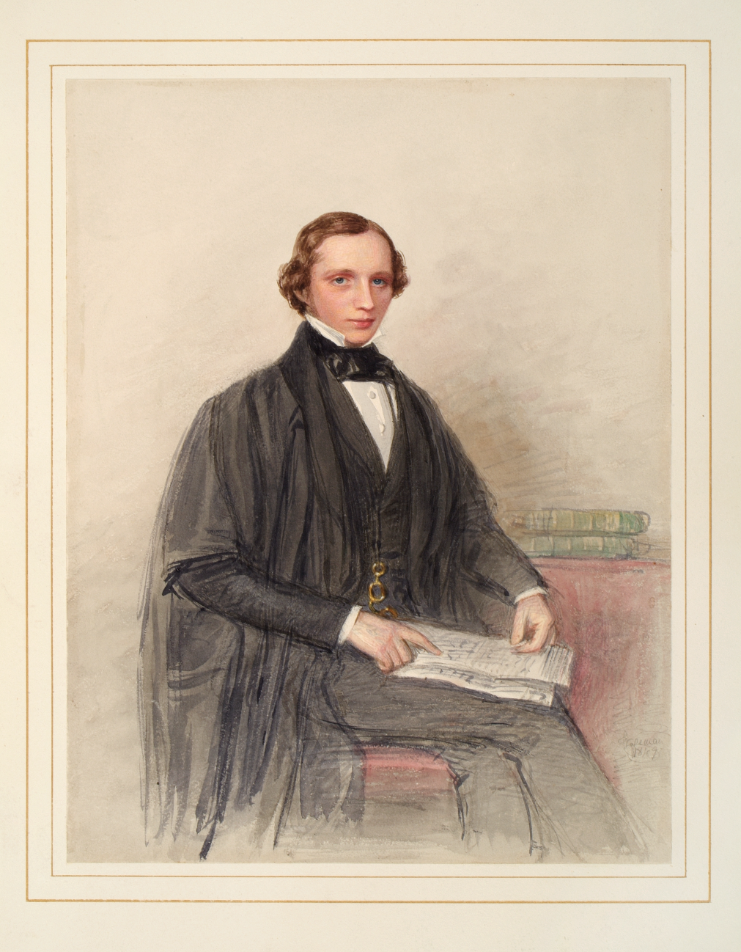
William Thomson (1824 – 1907), soon after graduating at Cambridge in 1845. He became Lord Kelvin in 1892.

Slide 25
Tide Prediction
Describing the tide
Calculating the tide theoretically
Calculating the tide practically

Slide 26
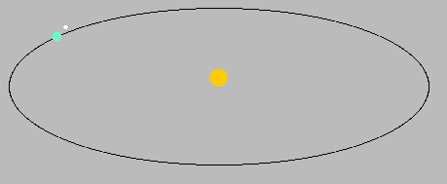
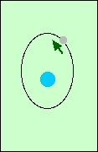
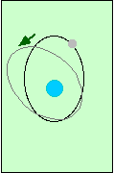
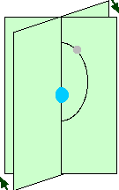
Astronomical frequencies
Length of the year
Length of the day
The rate of precession of the
axis of the moon’s orbit
The rate of precession of the
plane of the moon’s orbit
The lunar month

Slide 27
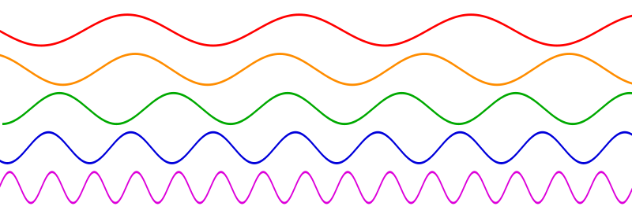
Sine waves with different frequencies

Slide 28
Height of the tide at a given place is of the form
A₀ + A₁cos(v₁t) + B₁sin(v₁t) + A₂cos(v₂t) + B₂sin(v₂t) + ... another 120 similar terms
The Frequencies v_{1’} v₂ etc. are all known – they are combinations of the astronomical frequencies.
We do not know the coefficients A₀, A₁, A₂, B₁, B₂ ,… these numbers depend on the place.

Slide 29
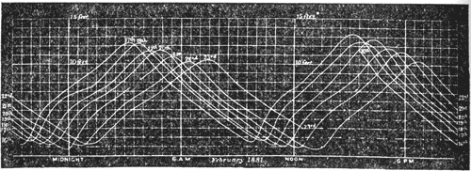
Weekly record of the tide in the River Clyde, at the entrance to the Queen’s Dock, Glasgow
How to find the coefficients A₀, A₁, A₂, B₁, B₂ ,…?

Slide 30
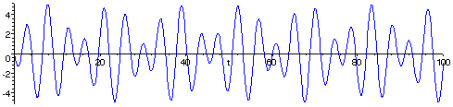
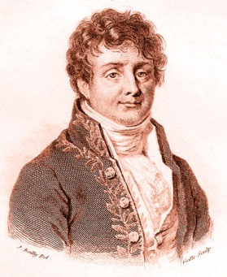
The French Connection - Fourier Analysis
Asin(t) + Bsin(2^{1/2}t)
We know that this curve is made up of sin t and sin(2^{1/2}t). We do not know how much there is of each of them i.e. we do not know the coefficients A and B.
Joseph Fourier 1768 - 1830

Slide 31
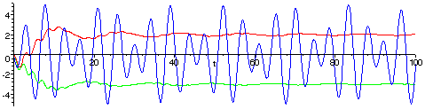
The French Connection - Fourier Analysis
A sin(t) + B sin(2^{1/2}t)
Multiply by sin(t) to get A sin(t)sin(t) + B sin(2^{1/2}t) sin(t).
Now calculate twice the long term average which gives A because the long term average of B sin(2^{1/2}t) sin(t) is 0.
Similarly to find B multiply by sin(2^{1/2}t) and calculate twice the long term average.
Joseph Fourier 1768 - 1830

Slide 32
The method followed in the sample problem can be extended to the complete calculation.
Given the tidal record H(t) over a sufficiently long time interval
A₀ is the average value of H(t) over the interval.
A₁ is twice the average value of H(t) cos(v₁t) over the interval.
B₁ is twice the average value of H(t) sin(v₁t) over the interval.
A₂ is twice the average value of H(t) cos(v₂t) over the interval.
etc.

Slide 33
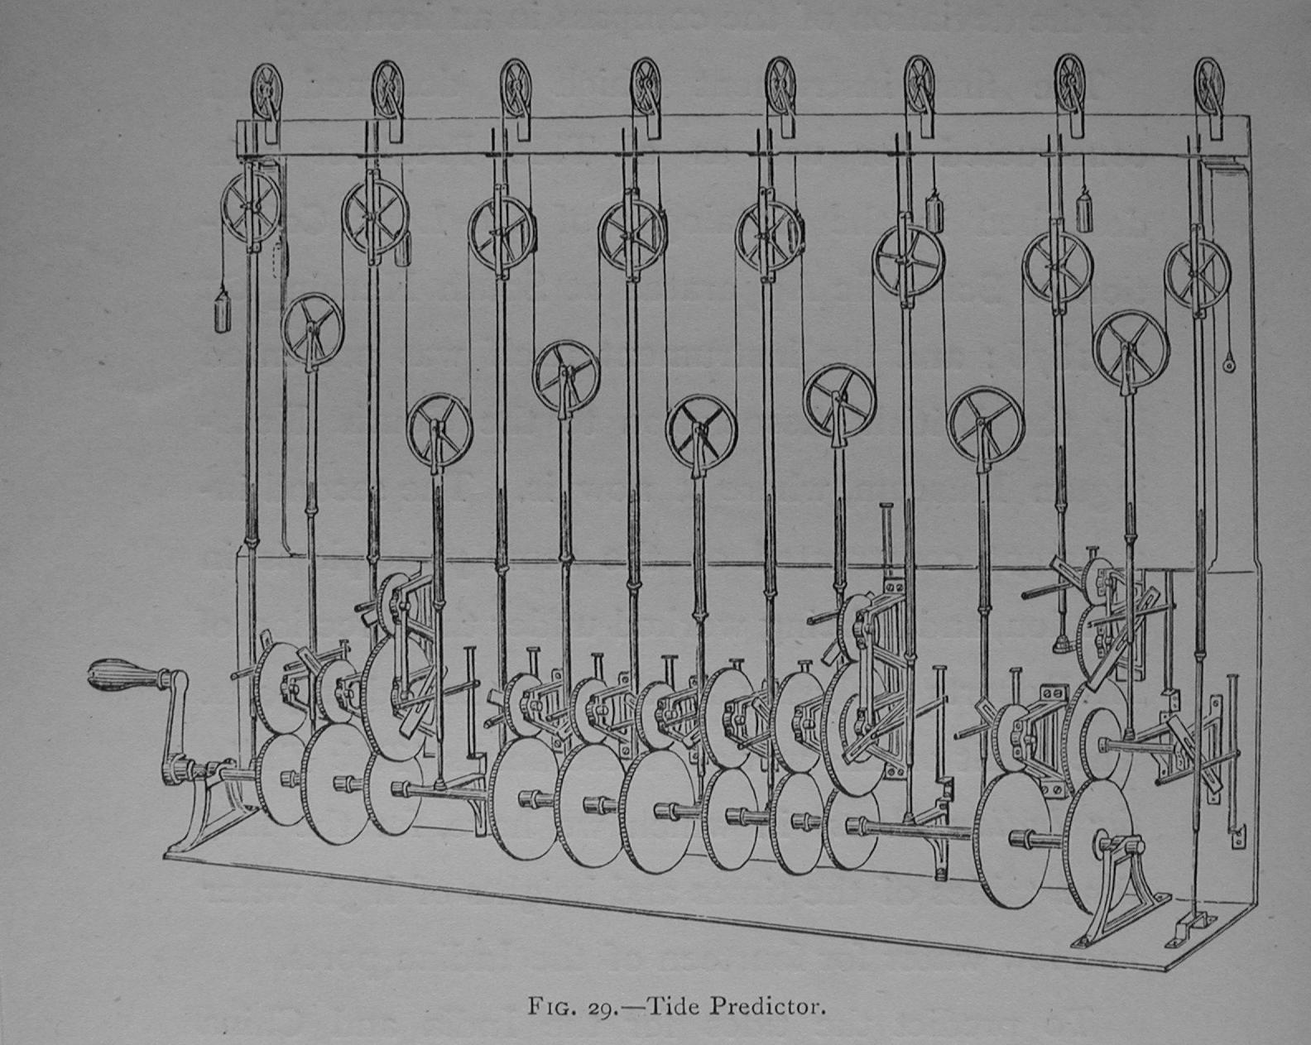
The tide predictor.
www.ams.org/featurecolumn/archive/tidesIII2.html

Slide 34
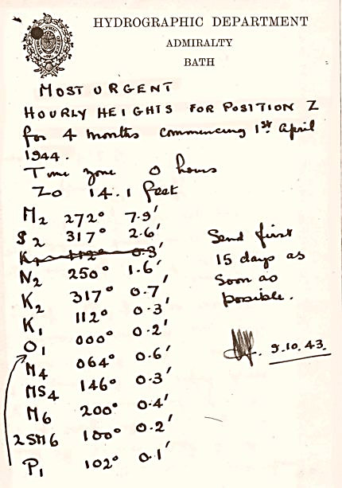
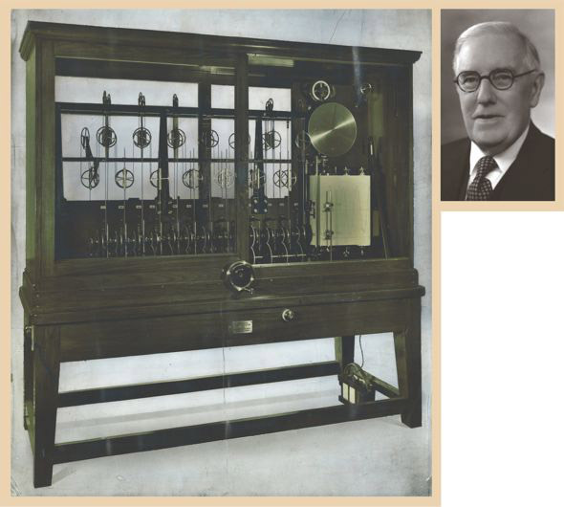
A “most urgent” October 1943 note to Arthur Doodson from William Farquharson, the Admiralty’s superintendent of tides, listing 11 pairs of tidal harmonic constants for a location, code-named “Position Z,” for which he was to prepare hourly tide predictions for April through July 1944. Doodson was not told that the predictions were for the Normandy coast, but he guessed as much.
Kelvin’s tide machine, the mechanical calculator built for William Thomson (later Lord Kelvin) in 1872 but shown here as overhauled in 1942 to handle 26 tidal constituents. It was one of the two machines used by Arthur Doodson (above) at the Liverpool Tidal Institute to predict tides for the Normandy invasion

Slide 35
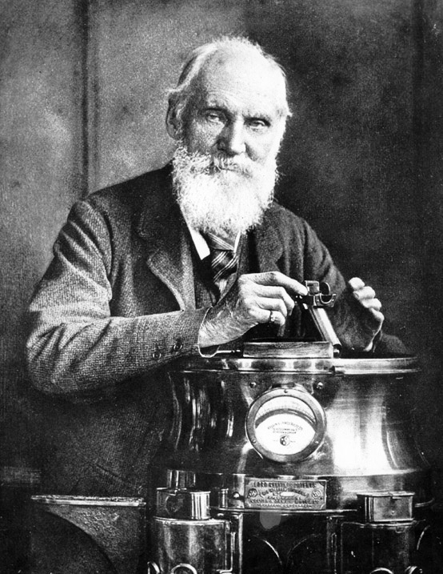
Kelvin’s magnetic compass
True compass heading = displayed heading, β, + error term
Assume error term is a combination of trigonometric functions in the displayed heading
Error = a₀ + a₁ cos β + a₂ cos 2β + b₁ sin β + b₂ sin 2β
point the ship in various known directions

Slide 36
Kelvin’s compass card
These magnetised needles are symmetrically disposed about the NS [North – South] axis of the [compass] card and parallel to it. The small size of the needles allows the magnetism of the ship to be completely compensated for by soft iron globes of an acceptable size

Slide 37
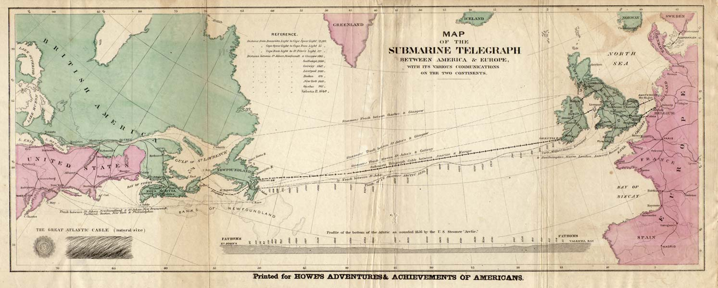
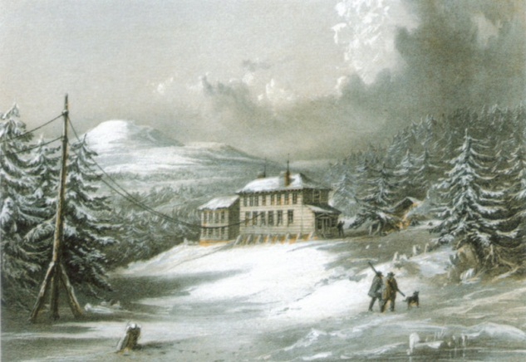
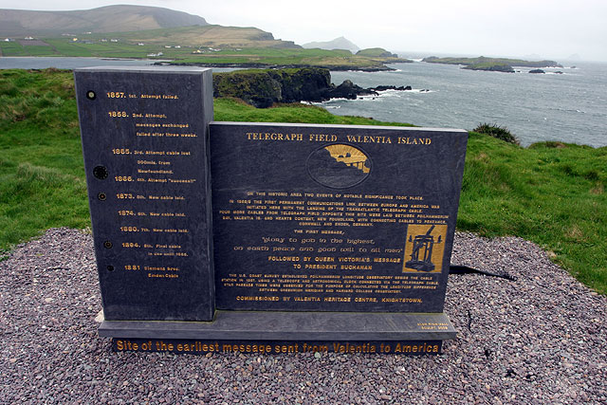
Transatlantic cable route

Slide 38
Transmission over a telegraph cable
In air
Under water
Wave equation (approximately)
A pulse travels with a well defined speed with no change of shape or magnitude over time.
Signals can be sent close together
Heat equation (approximately)
A pulse spreads out as it travels and when received rises gradually to a maximum and then decreases
Signals sent too close together will get mixed up.
Law of squares: Maximum rate of signalling is inversely proportional to the cable length

Slide 39
From the Introduction to Fourier’s Théorie analytique de la chaleur
The in-depth study of nature is the richest source of mathematical discoveries. By providing investigations with a clear purpose, this study does not only have the advantage of eliminating vague hypotheses and calculations which do not lead us to any deeper understanding; it is, in addition, an assured means of formulating Analysis itself, and of discovering those constituent elements which will make the most important contributions to our knowledge, and which this science of Analysis should always preserve: these fundamental elements are those which appear repeatedly across the whole of the natural world.
Translation by Conor Martin

Slide 40
1 pm on Tuesdays
Museum of London
Fermat’s Theorems: Tuesday 16 September 2014
Newton’s Laws: Tuesday 21 October 2014
Euler’s Exponentials: Tuesday 18 November 2014
Fourier’s Series: Tuesday 20 January 2015
Möbius and his Band: Tuesday 17 February 2015
Cantor’s Infinities: Tuesday 17 March 2015

