Slide 1
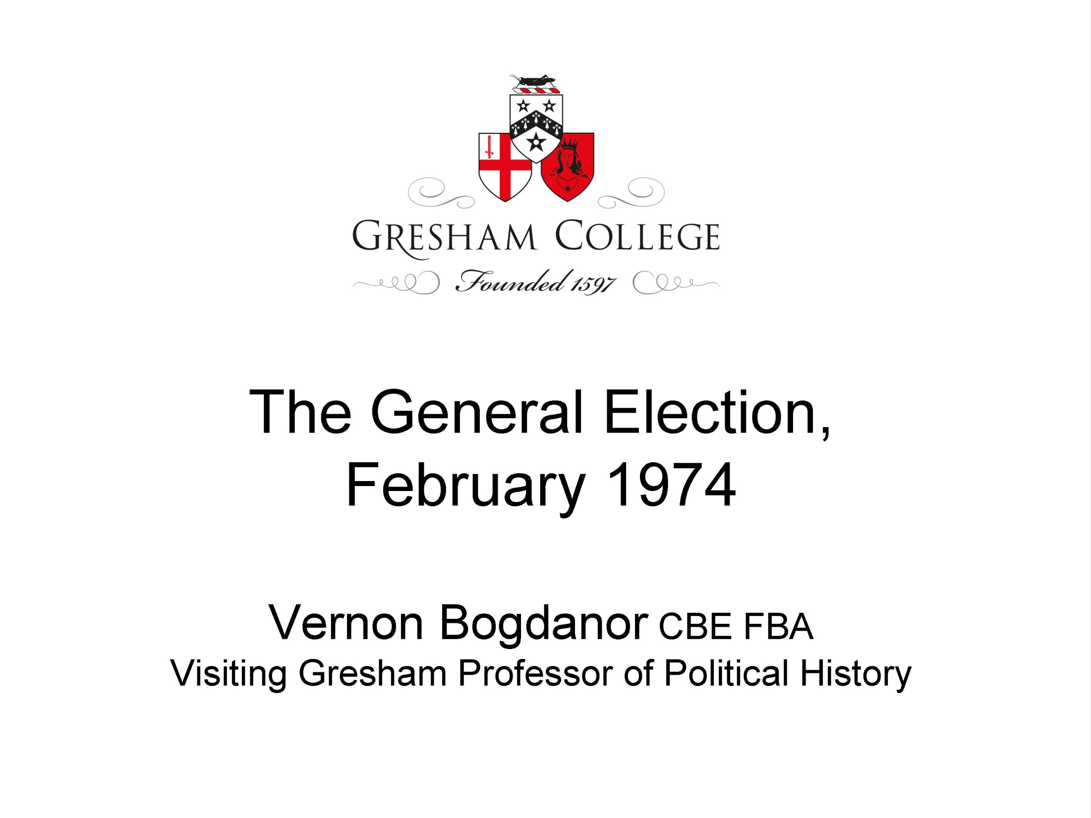

Slide 2
General Election 1970
 | Seats | % Votes
Conservatives | 330 | 46.4
Labour | 287 | 43.0
Liberals | 6 | 7.5
Other | 7 | 3.1
Total | 630 | 100
Turnout: 72.0%

Slide 3
General Election 1974
 | Seats | % Vote
Conservatives | 297 | 37.9
Labour | 301 | 37.1
Liberals | 14 | 19.3
SNP | 7 | 2 (22% of Scottish Vote)
Plaid Cymru | 2 | 0.6 (10.8% of Welsh Vote)
Northern Irish Parties | 12 | 3.1
Others | 2 | 0.4
Total | 635 | 100
Turnout: 78.7%
Swing: 0.8%

