Slide 1
Surfaces and Topology
Raymond Flood
Gresham Professor of Geometry

Slide 2
Overview
Leonhard Euler
Difference between geometry and topology - bridges of Königsberg
Euler’s formula for polyhedra – examples, an application and outline of a proof
Classification of surfaces
Hairy ball theorem

Slide 3
Leonhard Euler, 1707–1783 Read Euler, read Euler, he is the master of us all
Notation
e for the exponential number, f for a function and i for √−1.
Infinite series
Euler’s constant
(1 + ¹/₂ + ¹/₃ + ¹/₄ + ¹/₅ + . . . + ¹/_{n}) – log_{e} n
Basel problem
1 + ¹/₄ + ¹/₉ + ¹/₁₆ + ¹/₂₅ + . . . = π²/6
4th powers π⁴/90
6th powers π⁶/945, and up to the 26th powers!
Portrait by Jakob Emanuel Handmann, 1756

Slide 4
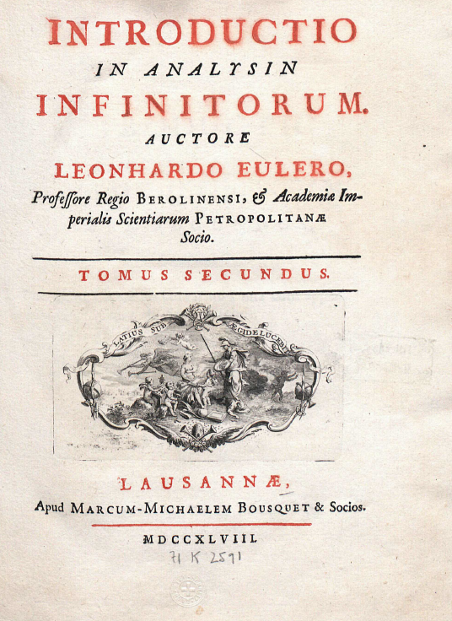
Euler’s books

Slide 5
The Exponential Function
Exponential functions 2^{n} or 3^{n} or e^{n}, where e = 2.6182818…
e^{x} = 1 + x/1! + x²/2! + x³/3! + . . . e = 1 + ¹/_{1!} + ¹/_{2!} + ¹/_{3!} + …
e^{ix} = cos x + i sin x
e^{iπ} = −1 e^{iπ} + 1 = 0
The exponential function e^{x}
The slope of this curve
at any point x is also e^{x}

Slide 6
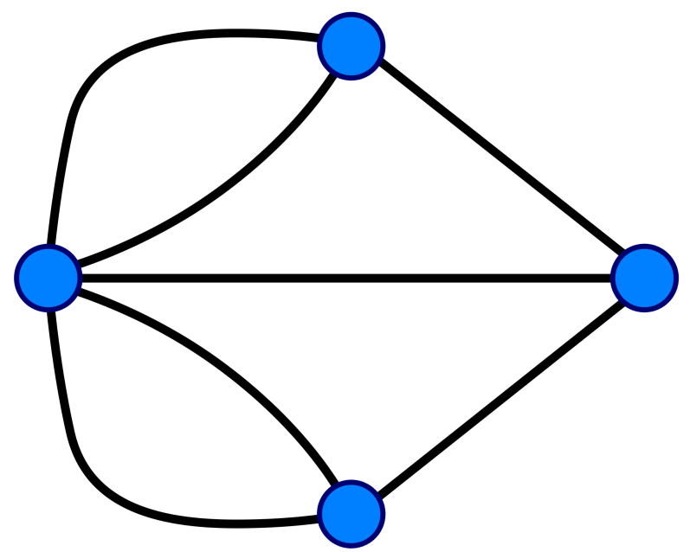
Bridges of Königsberg
Euler’s drawing of the seven bridges
The graph associated with the seven bridges of Königsberg problem
The seven bridges of Königsberg

Slide 7
A graph has an Euler walk precisely when it is connected and there are no or only two vertices of odd degree.
A graph is made up of points called vertices and lines joining these points, called edges.
A graph is connected if it is possible to get from any vertex to any other vertex by following a sequence of edges.
The degree of a vertex is the number of edges coming out of it.
An Euler walk on a graph visits each edge exactly once

Slide 8
Bridges of Königsberg
All vertices have odd order
A graph has an Euler walk precisely when it is connected and there are no or only two vertices of odd degree.
The graph associated with the seven bridges of Königsberg problem

Slide 9
New bridge added in Königsberg!
Source: Euler’s Gem, David S. Richardson, Princeton University Press, 2008

Slide 10
London Tube Map

Slide 11
Geometry and Topology
Geometry
Topology
Geometry from the Greek geo- "earth", -metron "measurement"
Concerned with the properties of space and of figures in space.
Concerned with measurement, for example of angles and distances
Topology from the Greek τόπος, "place", and λόγος, "study“ and was originally called analysis situs - analysis of position
Concerned with those properties of geometrical figures that are unchanged under continuous deformation – rubber sheet geometry
Topology tackles the question: What shape is this thing?

Slide 12
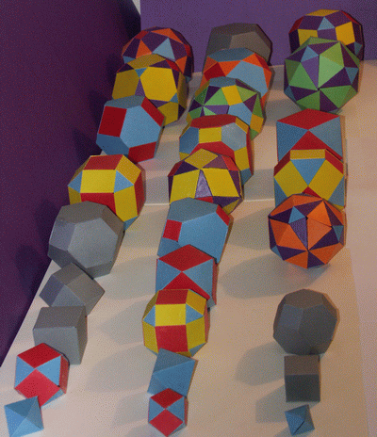
Polyhedra
Comes from the Greek roots, poly meaning many and hedra meaning seat.
Convex polyhedron has the property that the line joining any 2 points in the object is contained in the polyhedron, or it can rest on any of its faces.
A polyhedron has many seats – faces - on which it can be set down

Slide 13
Polyhedra
Convex
Non convex
Icosidodecahedron
Hexagonal torus

Slide 14
Euler’s formula for convex polyhedra, V – E + F = 2
V = number of vertices
E = number of edges
F = number of faces

Slide 15
Tetrahedron V – E + F = 2
Vertices, V = 4
Edges, E = 6
Faces, F = 4
V – E + F = 4 – 6 + 4 = 2

Slide 16
Cube or Hexahedron V – E + F = 2
Vertices, V = 8
Edges, E = 12
Faces, F = 6
V – E + F = 8 – 12 + 6 = 2

Slide 17
Octahedron V – E + F = 2
Vertices, V = 6
Edges, E = 12
Faces, F = 8
V – E + F = 6 – 12 + 8 = 2

Slide 18
Dodecahedron V – E + F = 2
Vertices, V = 20
Edges, E = 30
Faces, F = 12
V – E + F = 20 – 30 + 12 = 2

Slide 19
Icosahedron V – E + F = 2
Vertices, V = 12
Edges, E = 30
Faces, F = 20
V – E + F = 20 – 30 + 12 = 2

Slide 20
icosidodecahedron V – E + F = 2
Vertices, V = 30
Edges, E = 60
Faces, F = 32
V – E + F = 30 – 60 + 32 = 2

Slide 21
V – E + F
If we remove an edge and a face at the same time then number of vertices – number of edges + number of faces stays the same. Because you are talking away one less edge but adding on one less face
Similarly we remove an edge and a vertex at the same time then number of vertices – number of edges + number of faces stays the same. Because you are talking away one less edge but adding on one less vertex.

Slide 22
1: Deform the convex polyhedron into a sphere V – E + F left unchanged

Slide 23
2: Remove an edge so as to merge two faces. Leaves V – E + F unchanged
Remove this edge, so merging the two adjacent faces into one

Slide 24
3: End up with only 1 face and the edges and vertices forming a graph with no loops – a tree
Remove this edge, so merging the two adjacent faces into one

Slide 25
4: remove a terminating vertex and edge from the tree. Leaves V – E + F unchanged
Remove this edge, so merging the two adjacent faces into one
Remove this terminating edge and vertex from the tree

Slide 26
5: As F = 1, E = 0 and V = 1 V – E + F = 2
Remove this edge, so merging the two adjacent faces into one
Remove this terminating edge and vertex from the tree
Picture Source: 17 Equations that Changed the World, Ian Stewart, Profile Books, 2012

Slide 27
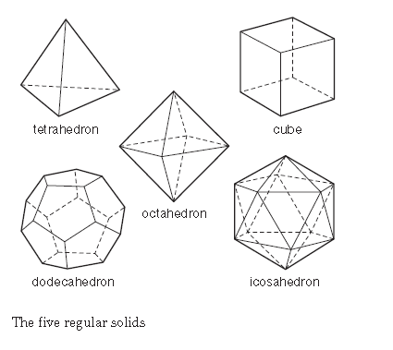
In a regular polyhedron all the faces are the same and the arrangement of faces at each vertex is the same.
Tetrahedron – four faces each an equilateral triangle
Cube – six faces, each a square
Octahedron – eight faces each an equilateral triangle
Dodecahedron – twelve faces each a regular pentagon
Icosahedron – twenty faces each an equilateral triangle

Slide 28
There are exactly five regular polyhedra
Assume the polyhedron is regular. Call the number of sides of each face n. Call the number of faces meeting at each vertex, m.

Slide 29
There are exactly five regular polyhedra
Assume the polyhedron is regular. Call the number of sides of each face n. Call the number of faces meeting at each vertex, m.
E = $\frac{1}{2}$ F n and V = $\frac{1}{m}$ F n

Slide 30
There are exactly five regular polyhedra
Assume the polyhedron is regular. Call the number of sides of each face n. Call the number of faces meeting at each vertex, m.
E = $\frac{1}{2}$ F n and V = $\frac{1}{m}$ F n
Substitute into Euler’s formula V – E + F = 2 and solve for F
F = $\frac{4m}{2n −mn+2m}$

Slide 31
There are exactly five regular polyhedra
Assume the polyhedron is regular. Call the number of sides of each face n. Call the number of faces meeting at each vertex,
E = $\frac{1}{2}$ F n and V = $\frac{1}{m}$ F n
Substitute into Euler’s formula V – E + F = 2 and solve for F
F = $\frac{4m}{2n −mn+2m}$
As F and 4m are positive the same is true for 2n – mn + 2m.

Slide 32
There are exactly five regular polyhedra
Assume the polyhedron is regular. Call the number of sides of each face n. Call the number of faces meeting at each vertex, m.
E = $\frac{1}{2}$ F n and V = $\frac{1}{m}$ F n
Substitute into Euler’s formula V – E + F = 2 and solve for F
F = $\frac{4m}{2n −mn+2m}$
As F and 4m are positive the same is true for 2n – mn + 2m.
There are only five pairs of integers (n, m) that satisfy this condition.
If n = 3 then 2n – mn + 2m = 6 – 3m + 2m = 6 – m so m = 3 or 4 or 5.

Slide 33
There are exactly five regular polyhedra
Polyhedron is regular. Call the number of sides of each face n. Call the number of faces meeting at each vertex, m.
E = $\frac{1}{2}$ F n and V = $\frac{1}{m}$ F n
Substitute into Euler’s formula V – E + F = 2 and solve for F
F = $\frac{4m}{2n −mn+2m}$
As F and 4m are positive the same is true for 2n – mn + 2m.
There are only five pairs of integers (n, m) that satisfy this condition.
If n = 3 then 2n – mn + 2m = 6 – 3m + 2m = 6 – m so m = 3 or 4 or 5.
(3, 3) the tetrahedron: (3, 4) the octahedron: (3, 5) the icosahedron

Slide 34
There are exactly five regular polyhedra
Assume the polyhedron is regular. Call the number of sides of each face n. Call the number of faces meeting at each vertex, m.
E = $\frac{1}{2}$ F n and V = $\frac{1}{m}$ F n
Substitute into Euler’s formula V – E + F = 2 and solve for F
F = $\frac{4m}{2n −mn+2m}$
As F and 4m are positive the same is true for 2n – mn + 2m.
There are only five pairs of integers (n, m) that satisfy this condition.
If n = 3 then 2n – mn + 2m = 6 – 3m + 2m = 6 – m so m = 3 or 4 or 5.
(3, 3) the tetrahedron: (3, 4) the octahedron: (3, 5) the icosahedron
n = 4 gives only (4, 3) the cube:
n = 5 gives only (5, 3) the dodecahedron

Slide 35
The Five regular or Platonic Solids
Tetrahedron – four faces each an equilateral triangle
Cube – six faces, each a square
Octahedron – eight faces each an equilateral triangle
Dodecahedron – twelve faces each a regular pentagon
Icosahedron – twenty faces each an equilateral triangle

Slide 36
Toroidal polyhedron V – E + F = 0
F = 24 as 6 x 4 quadrilateral faces
E = 24 + 24 = 48
V = 6 x 4 = 24
V – E + F = 24 – 48 + 24 = 0

Slide 37
Any solid deformable into a torus will have V –E + F = 0

Slide 38
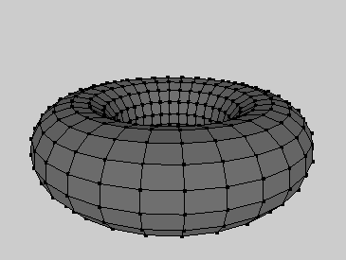
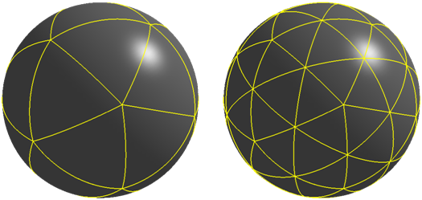
Surfaces
A surface is a two dimensional shape like the surface of a sphere or the surface of a torus.
Given a surface, S, we can partition it into vertices, edges and faces and calculate the Euler Characteristic, χ(S), as
χ(S) = V – E + F
χ(Sphere) = 2 and χ(Torus) = 0
The Euler Characteristic is a topological invariant for surfaces

Slide 39
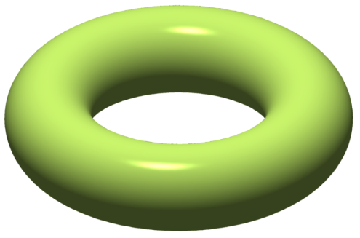
torus: V – E + F = 0
Two holed torus: V – E + F = -2
Three holed torus: V – E + F = -4

Slide 40
Any solid deformable into a g holed torus satisfies V – E + F = 2 – 2g
torus: V – E + F = 0
Two holed torus: V – E + F = -2
Three holed torus: V – E + F = -4

Slide 41
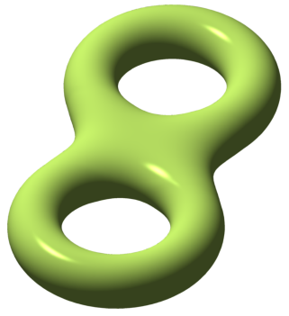
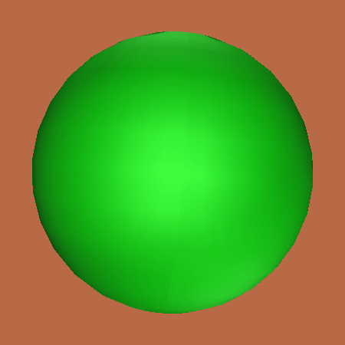
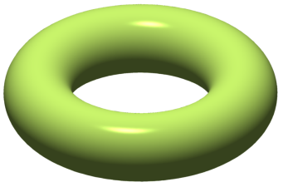
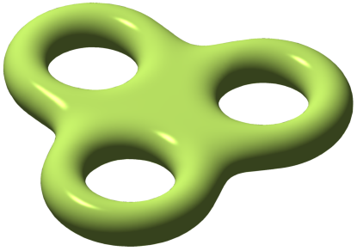
Classification of surfaces
Suppose the surface is of finite extent and has no boundary
And suppose the surface is two-sided
Then the surface is uniquely determined by its Euler characteristic.
It is the same as one of the family:
a sphere, torus, one-holed torus, two holed torus, three-holed torus, four-holed torus etc.

Slide 42
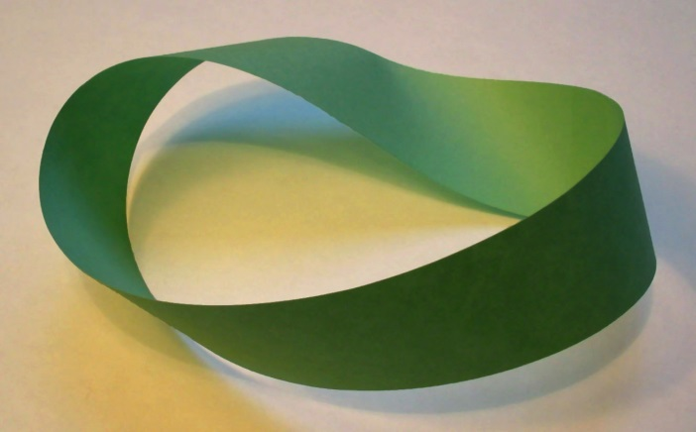
Classification of one sided surfaces
Möbius Band
A family of one sided surfaces without boundary can be constructed by taking a sphere, cutting discs out of it and gluing in Möbius Bands instead of the discs.

Slide 43
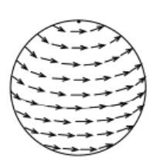
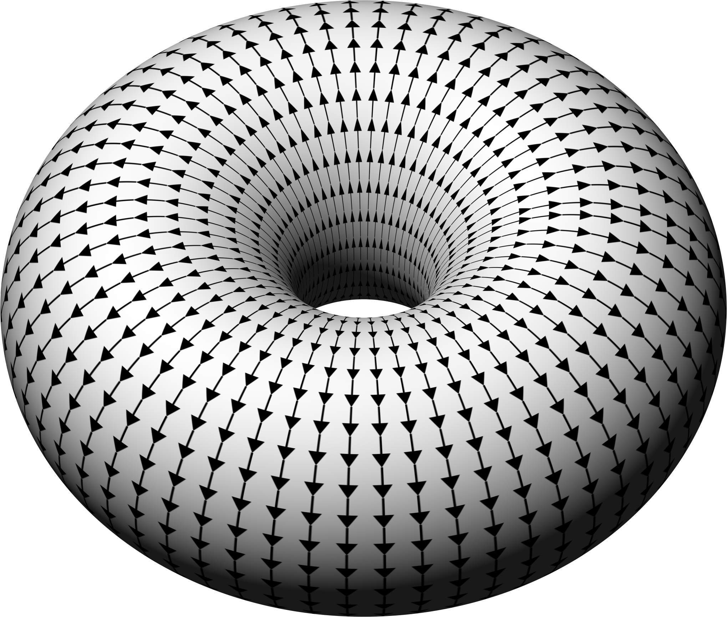
Vector fields
A vector has magnitude and direction, for example velocity.
A vector field on a surface is obtained by associating a vector with each point on the surface.

Slide 44
Index of a zero
Index of a centre is 1

Slide 45
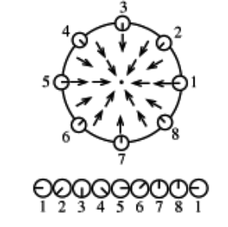
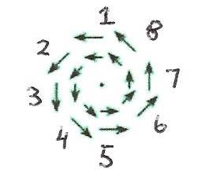
Index of a zero
Index of a centre is 1
dipole centre saddle sink source
Index: 2 1 -1 1 1

Slide 46
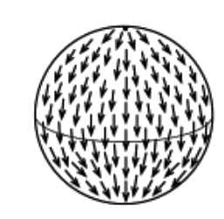
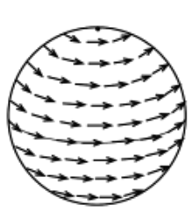
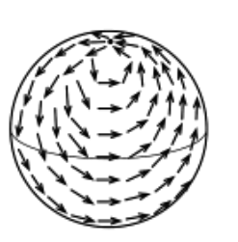
Poincaré–Hopf theorem
The sum of the indices of the zeroes of a vector field on a closed surface equals the surface’s Euler characteristic.
Example: For a sphere with Euler characteristic 2
A source and a sink – each of index 1
Two centres – each of index 1
A dipole of index 2

Slide 47
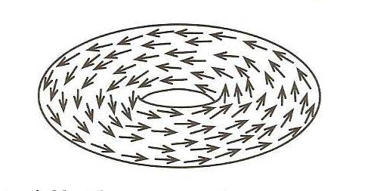
Poincaré–Hopf theorem
The sum of the indices of the zeroes of a vector field on a closed surface equals the surface’s Euler characteristic.
Example: For a torus with Euler characteristic 0
Examples of two vector fields on a torus with no zeros

Slide 48
Probability and its Limits Tuesday 18 February 2014

