Slide 1
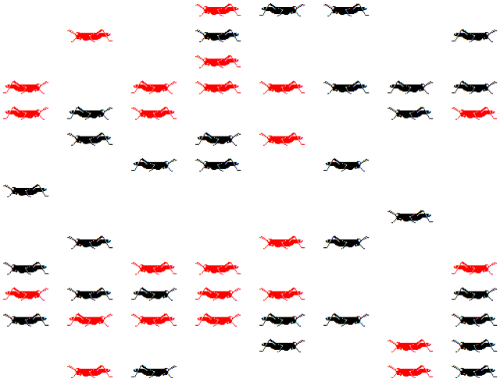

Slide 2
John Harle, Michael Mainelli graphics by William Joseph
Metamorphoses
The Terrible Beauty Of Change

Slide 3
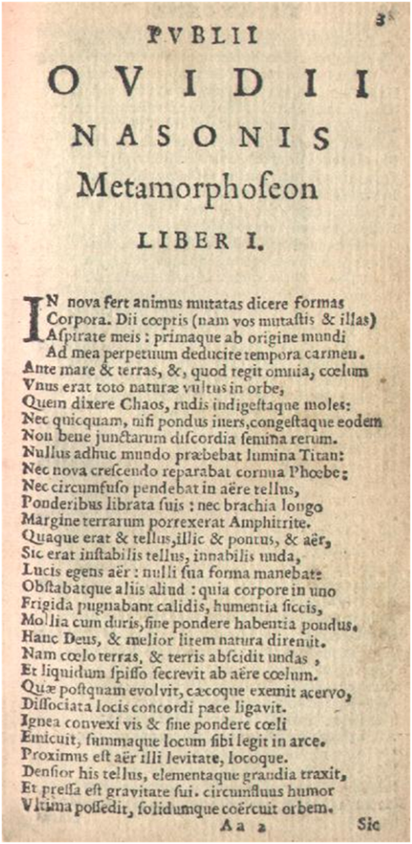
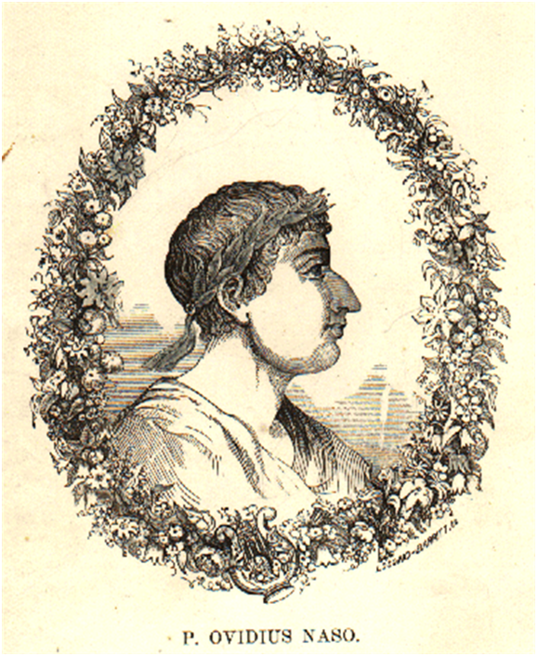
Publius Ovidius Naso

Slide 4
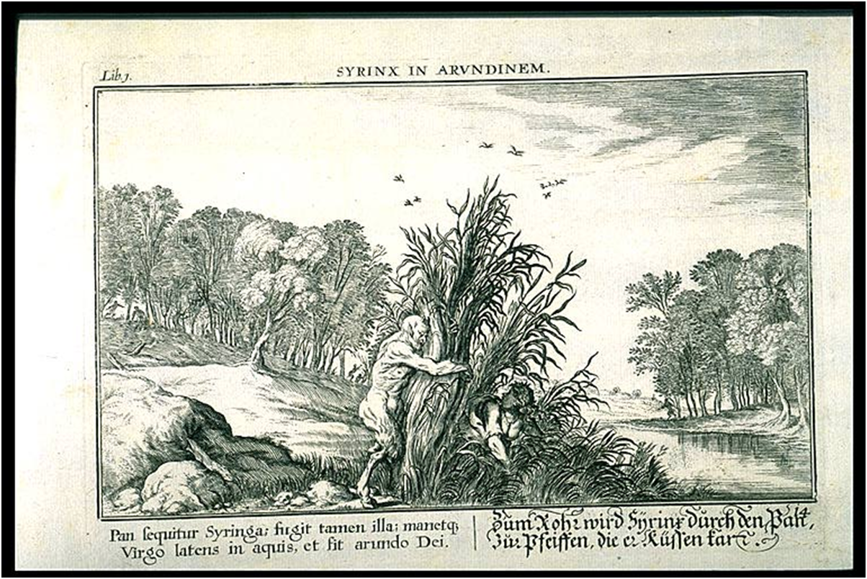
Pan
[http://www.uvm.edu/~hag/ovid/baur1703/baur1703b1p14.jpeg]

Slide 5


Slide 6
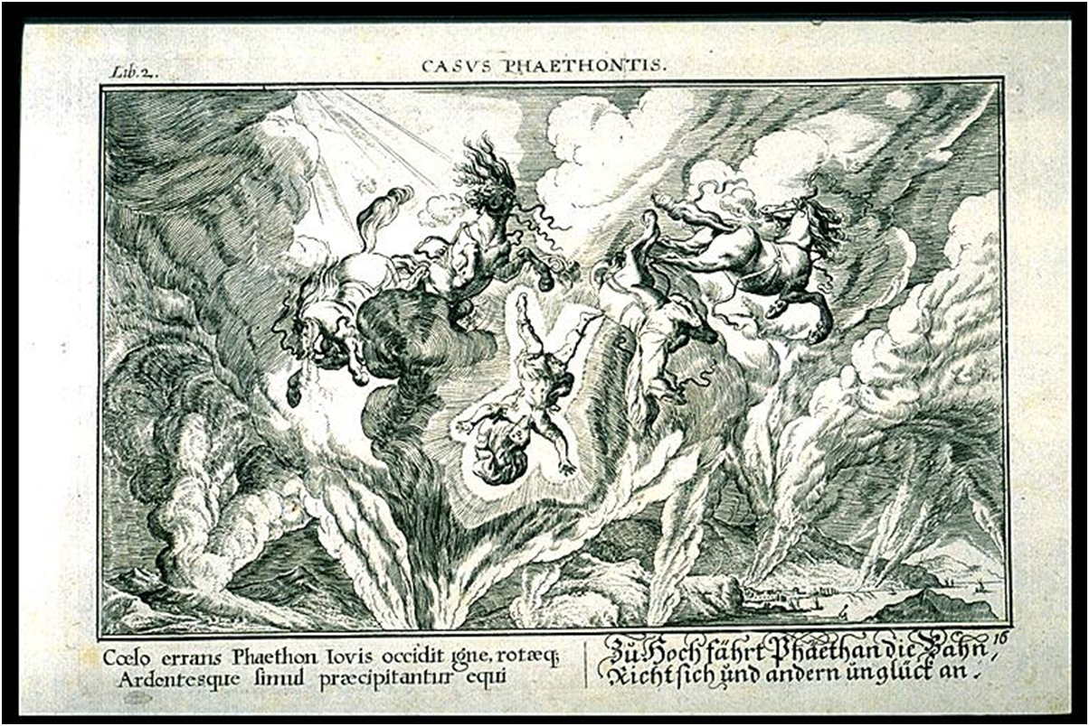
Phaeton
[http://www.uvm.edu/~hag/ovid/baur1703/baur1703b2p16.jpeg]

Slide 7
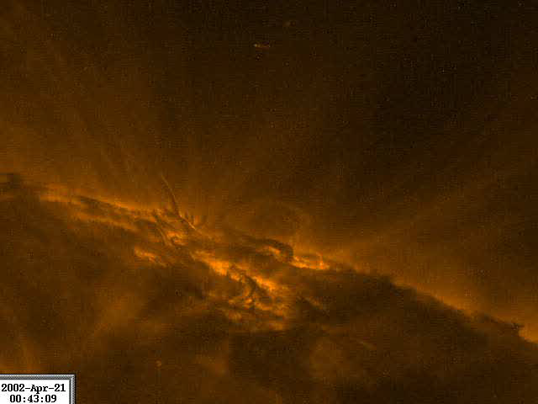

Slide 8
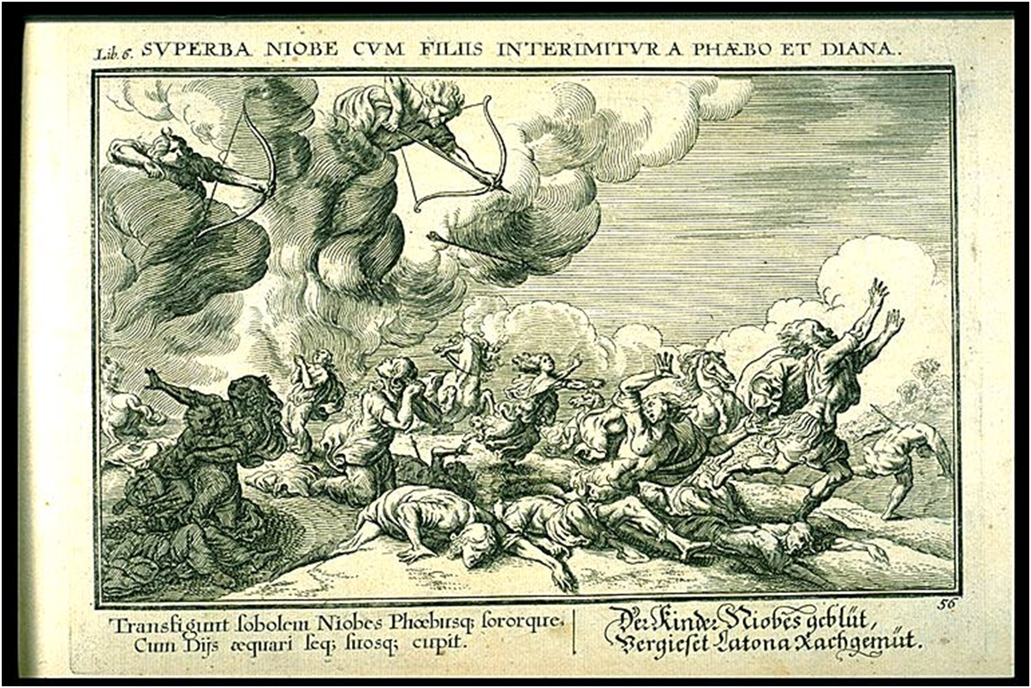
Niobe
[http://www.uvm.edu/~hag/ovid/baur1703/baur1703b6p56.jpeg]

Slide 10
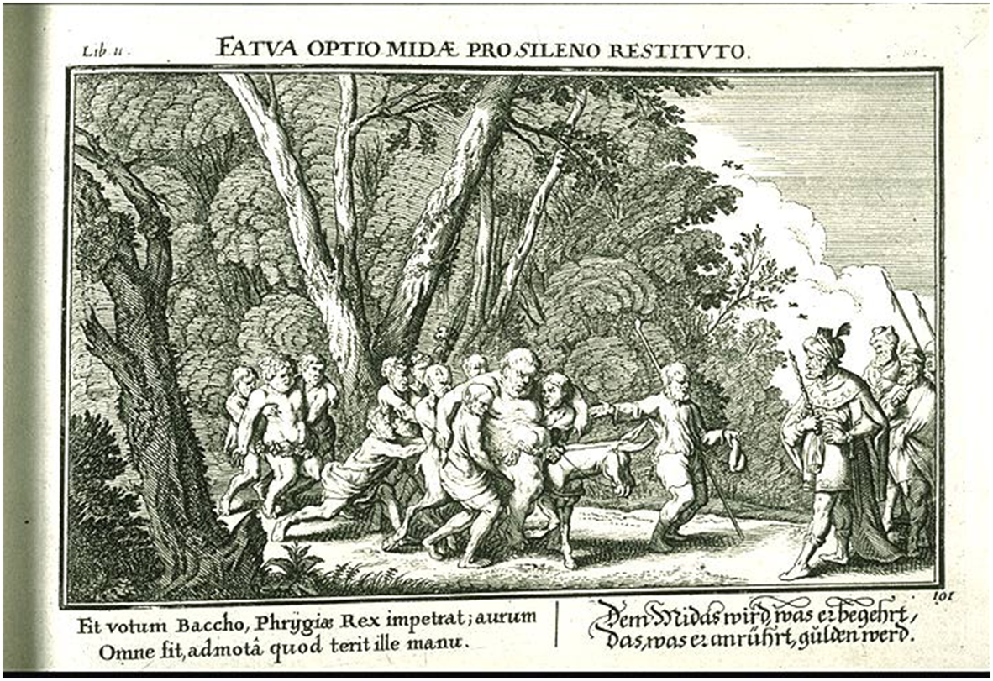
Bacchus
[http://www.uvm.edu/~hag/ovid/baur1703/baur1703b11p101.jpeg]

Slide 12
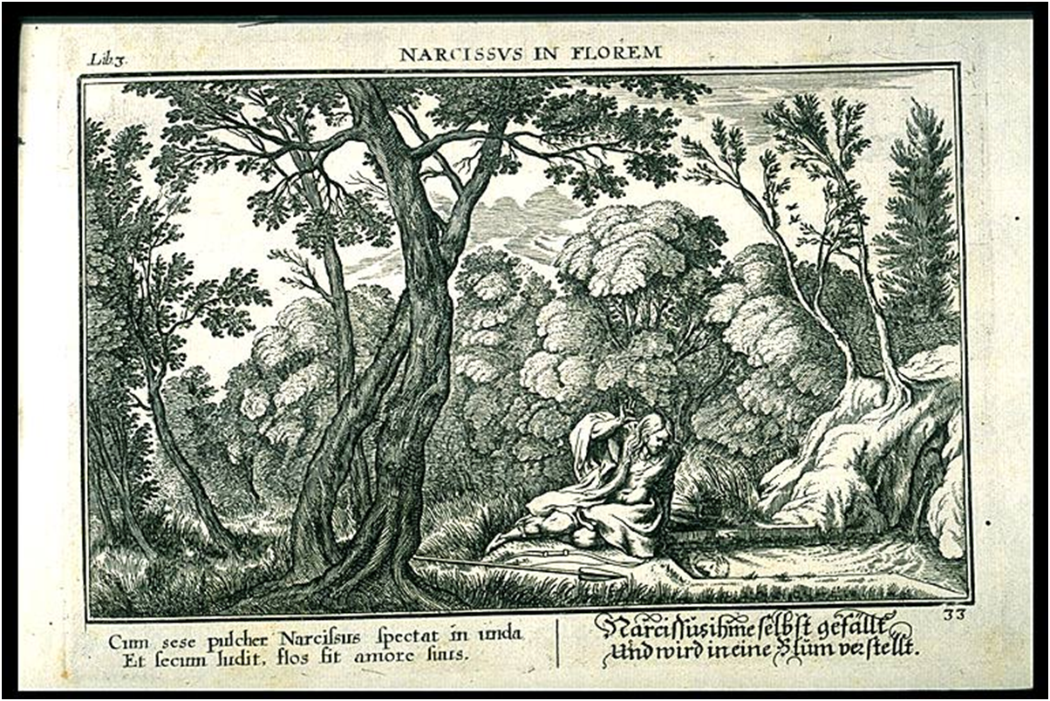
Narcissus
[http://www.uvm.edu/~hag/ovid/baur1703/baur1703b3p33.jpeg]

Slide 14
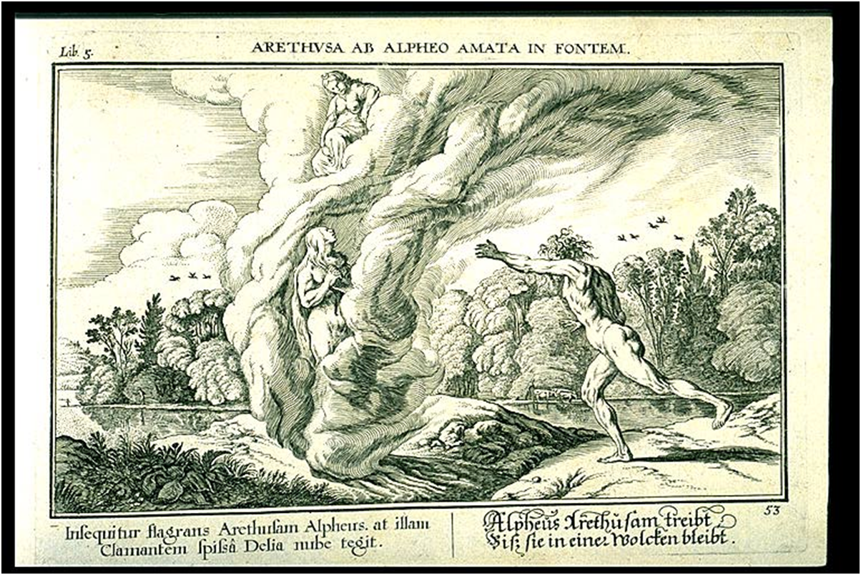
Arethusa
[http://www.uvm.edu/~hag/ovid/baur1703/baur1703b5p53.jpeg]

Slide 15


Slide 16
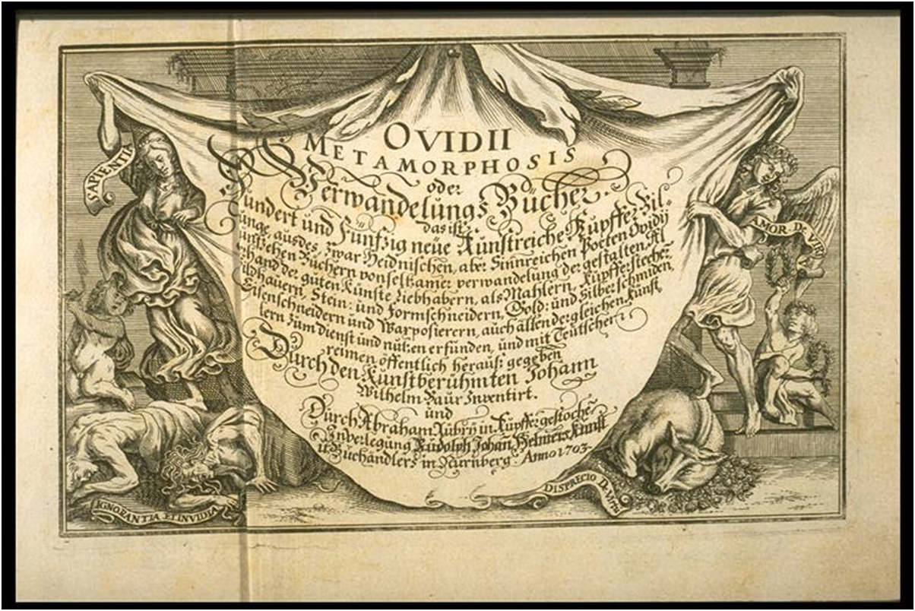
Metamorphoses
[http://www.uvm.edu/~hag/ovid/baur1703/ovidm00.jpeg]

Slide 18
Credits
Ovidii Metamorphosis, oder Verwandelungs Bucher
The Metamorphoses by Ovid. Engravings by Johannes Baur, 1703.
The Images
Artist Johann Wilhelm Baur (1600-1640) designed 151 illustrations for the Metamorphoses. They first appeared in Vienna, possibly as early as 1639, and were reissued several times. This edition, printed at Nuremberg in 1703, includes a title page from an earlier edition dated 1687.

