Slide 1
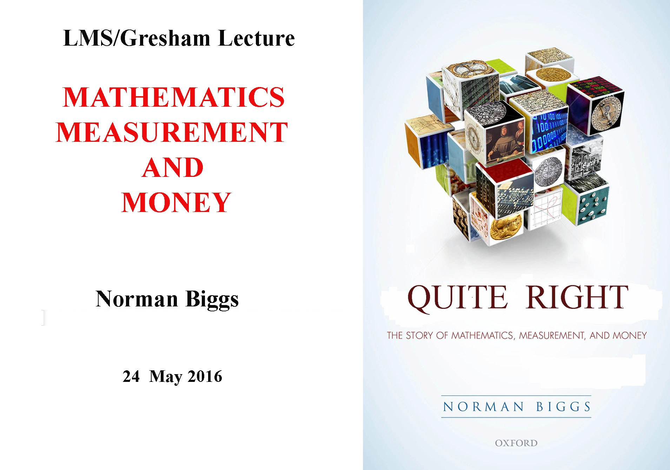

Slide 2
A STORY IN THREE EPISODES
The Awakening: Ancient Mesopotamia (c.3000-1500 BC)
A New Beginning: Early Modern Europe (c.1600-1800 AD)
Today and Tomorrow: Global Problems (c.1970 onwards)

Slide 3
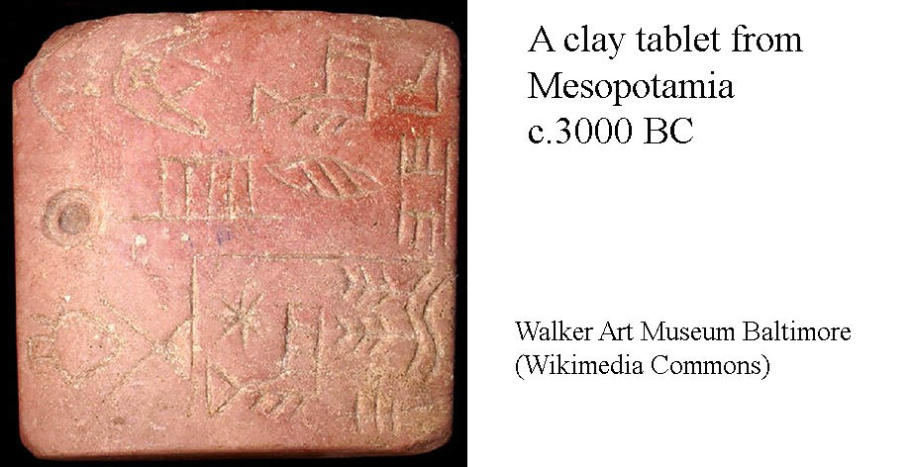
Episode 1: The Awakening

Slide 4
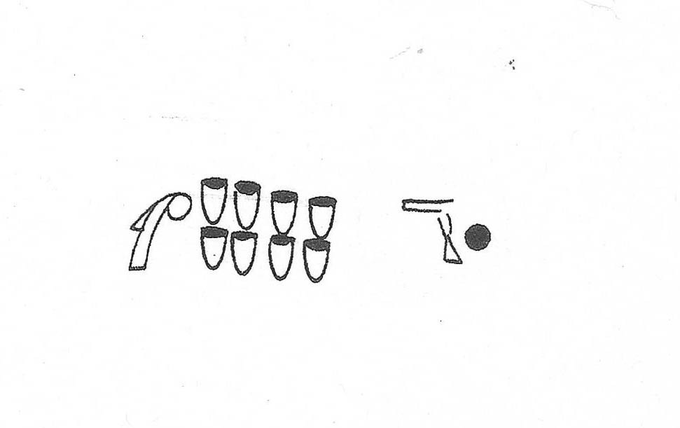
Signs on an early clay tablet

Slide 5
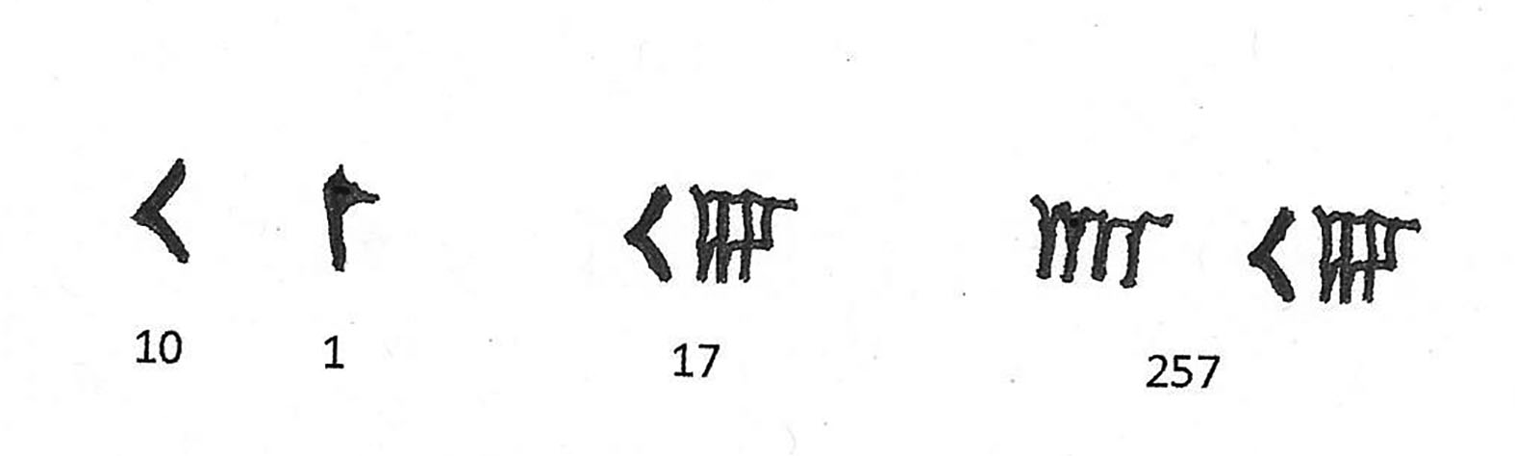
Number-signs in cuneiform script c.2000 BC

Slide 6
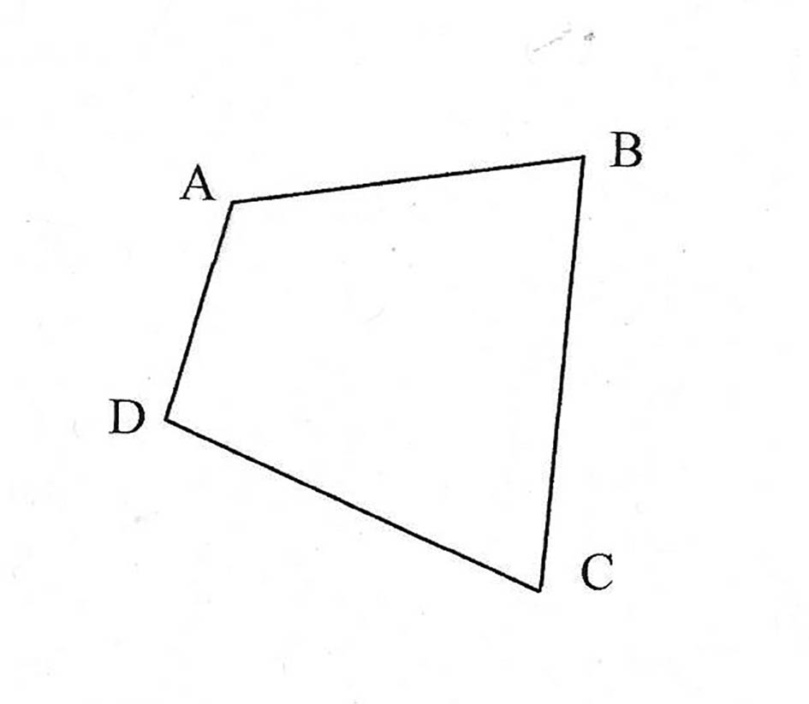
How big is this field?

Slide 7
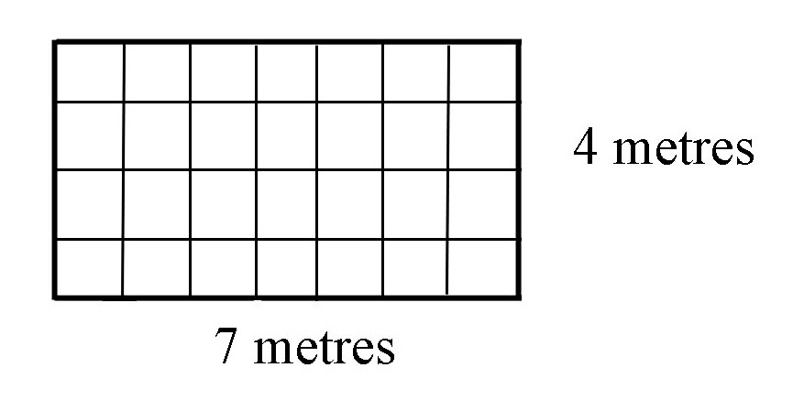
Area measurement by multiplication

Slide 8
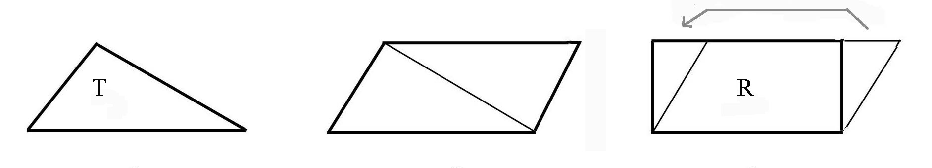
The area of a triangle, by multiplication

Slide 9
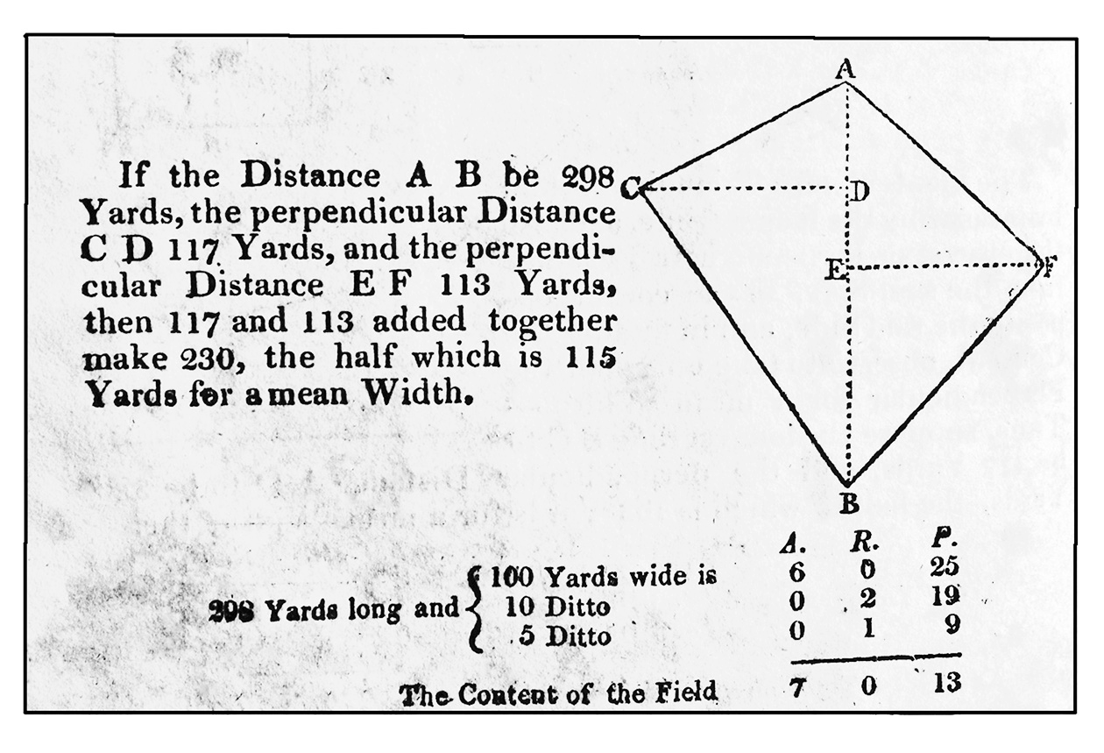
The area of a field, 19th century (AD)

Slide 10
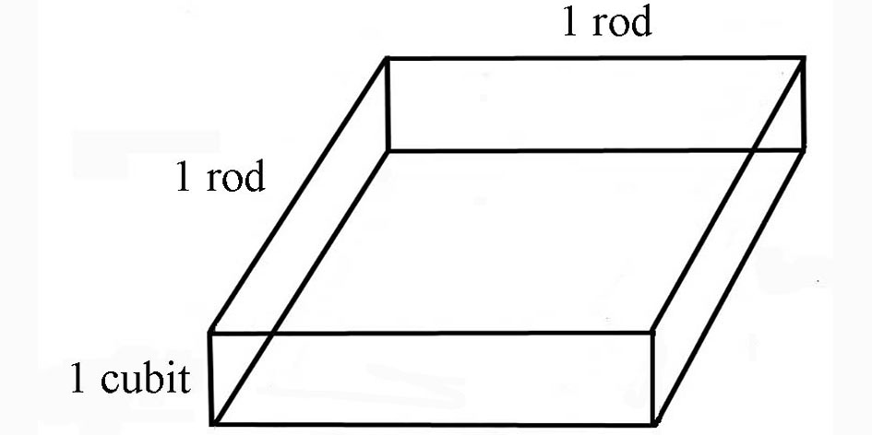
A pit for storing grain

Slide 11
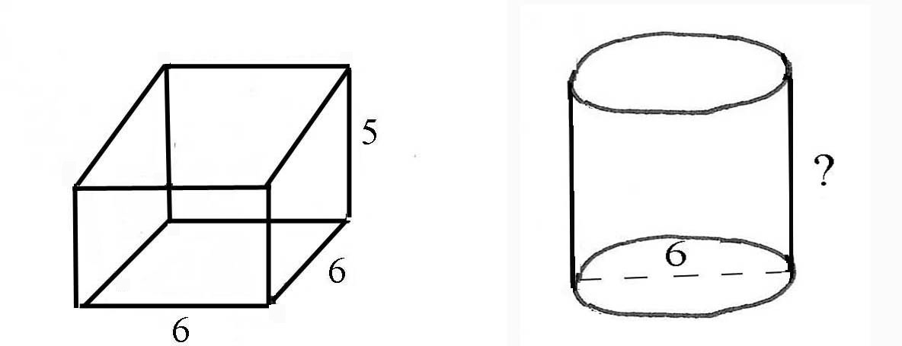
Measures for distributing grain

Slide 12
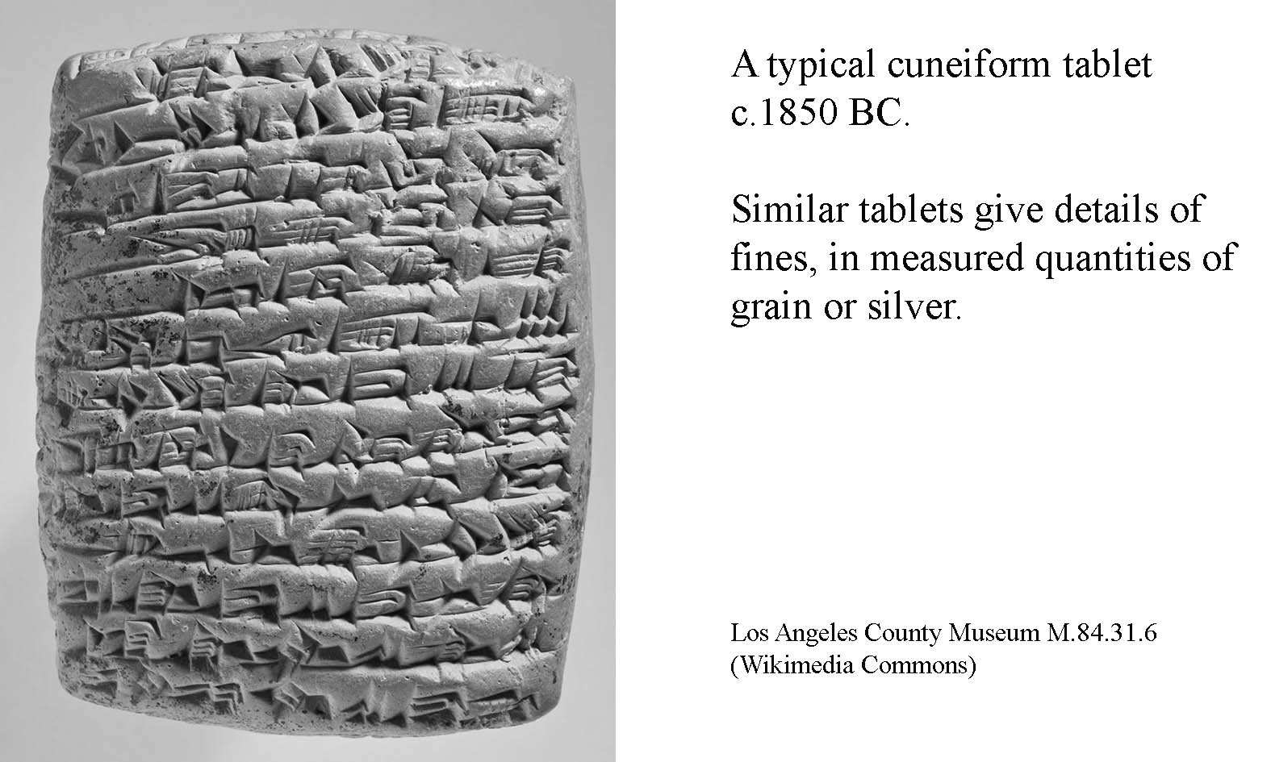

Slide 13
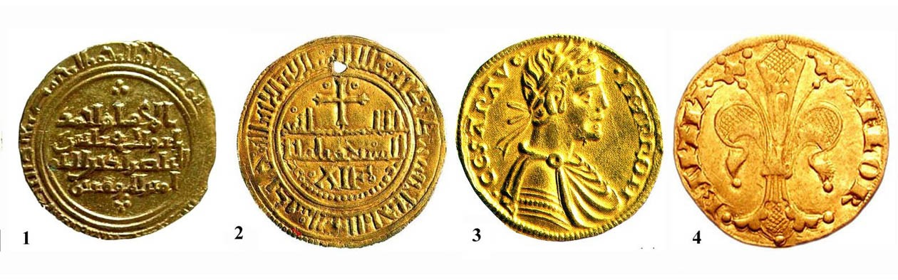
Episode 2: A New Beginning
Some gold coins circulating c.1100-1300

Slide 14
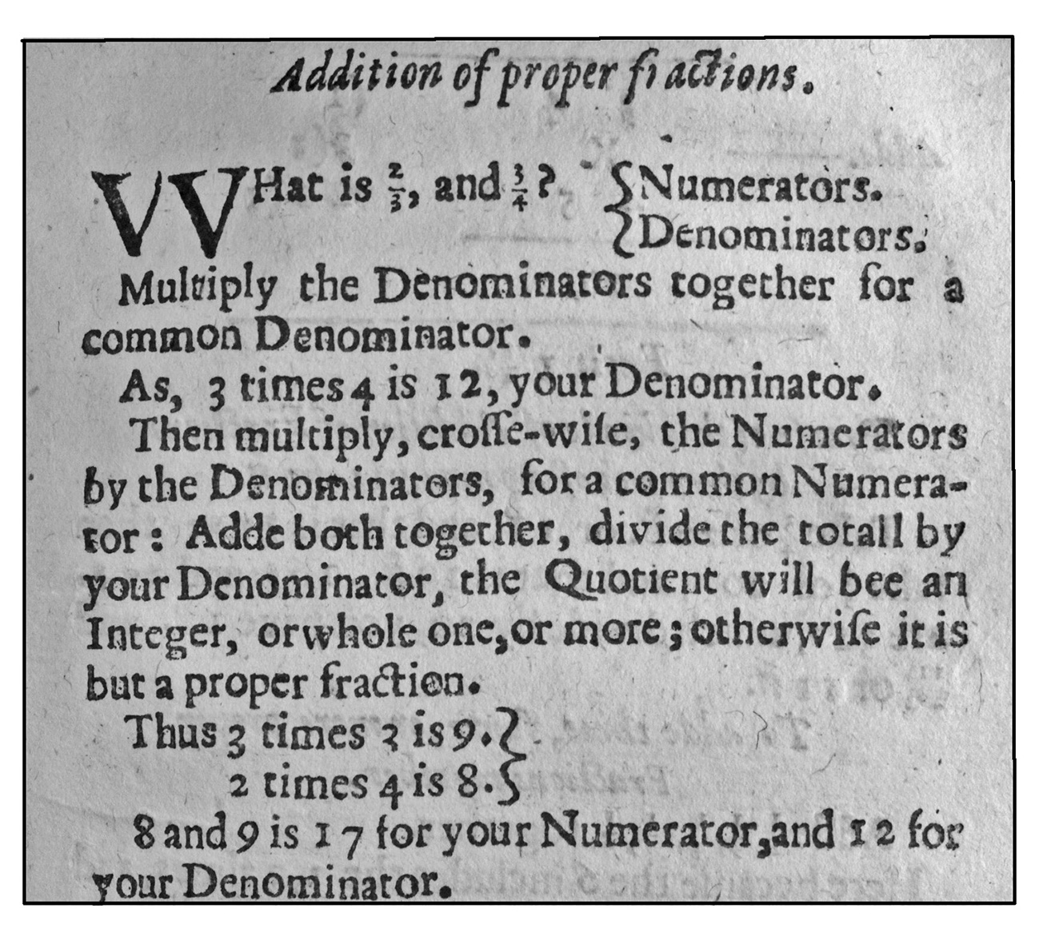
Arithmetic 1633

Slide 15
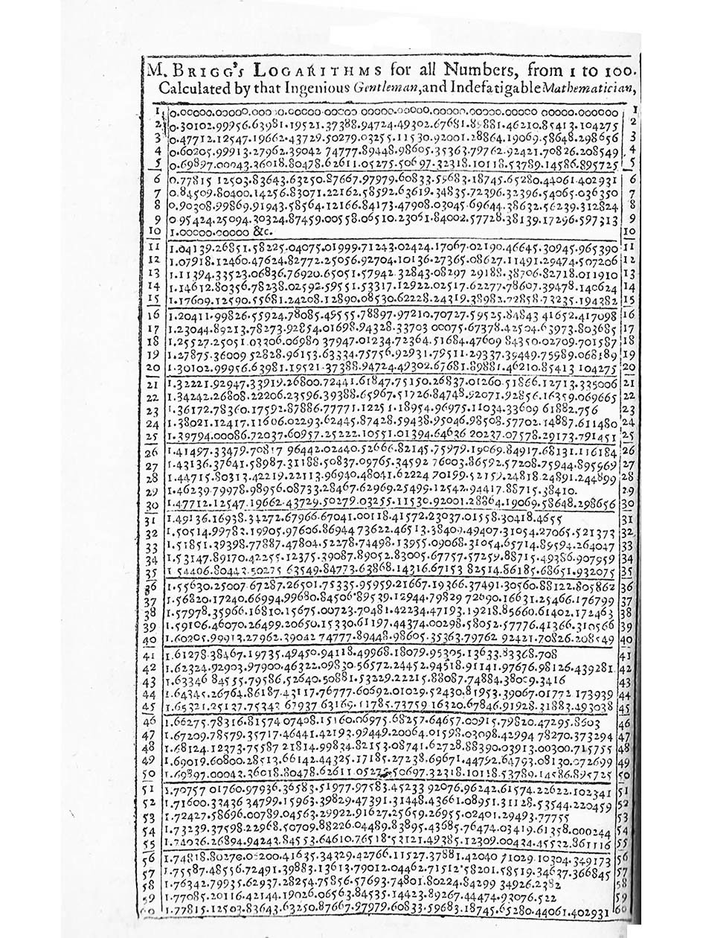
Logarithms

Slide 16
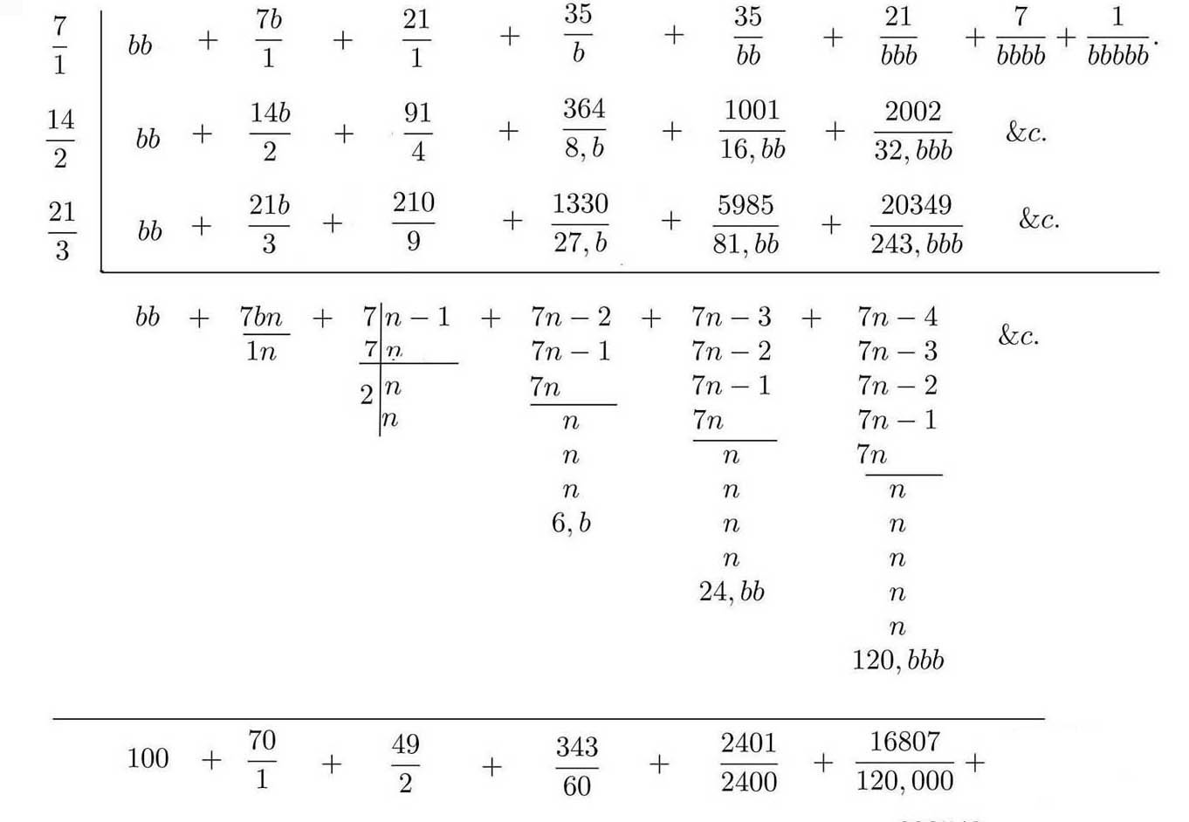
Transcript of ms. on compound interest, written by Thomas Harriot, c.1600

Slide 17
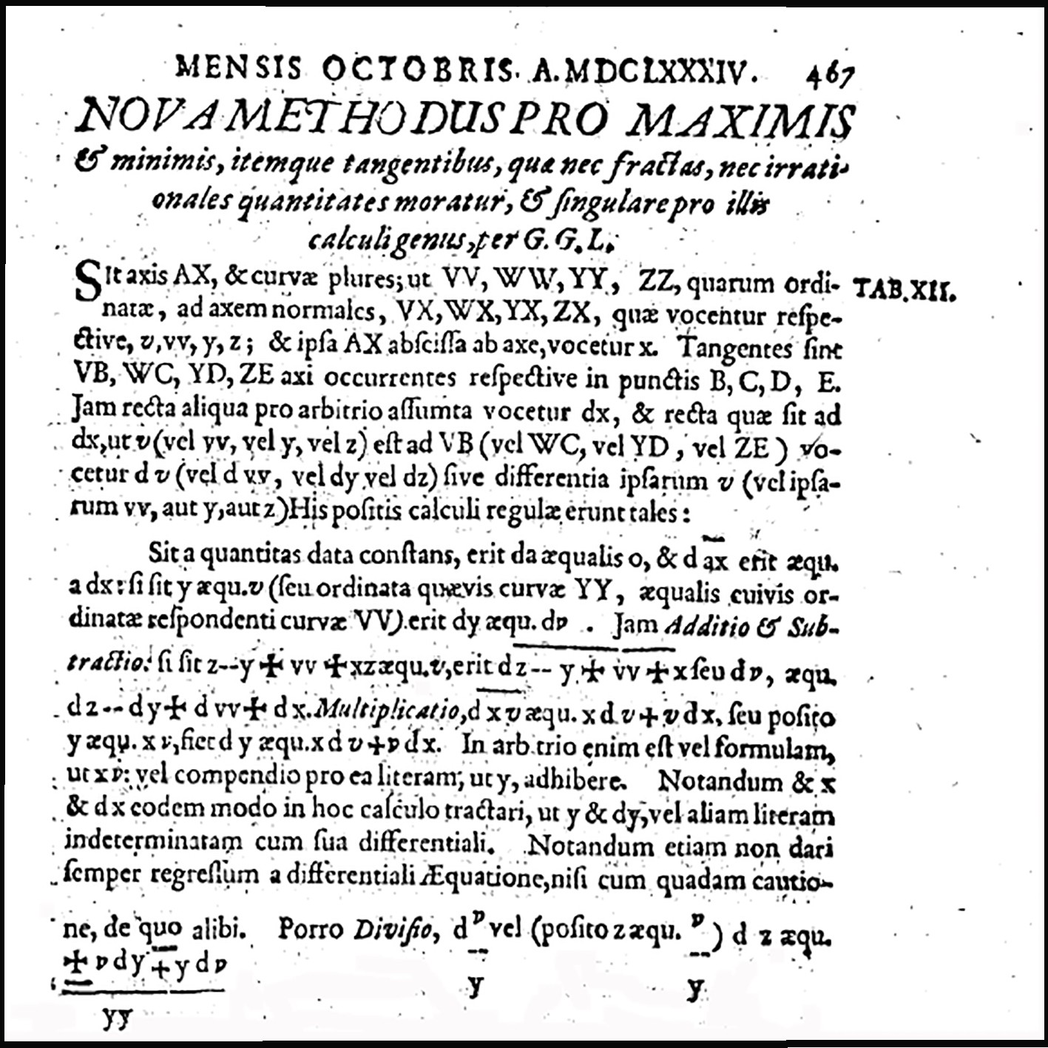
Differential calculus, according to Leibniz 1684

Slide 18
. . . the Lewis d’or passes for for fourteen livres and the Ecu or French crown for three livres and sixteen sols. At which rate the Lewis d’or is worth 16s 7d sterling, supposing the Ecu worth 4s 6d as it is reckoned in the court of exchange and I have found it by some Assays. The proportion therefore between Gold and Silver is now become the same in France as it has been in Holland for some years.
Newton on the valuation of French coins, 1702

Slide 19
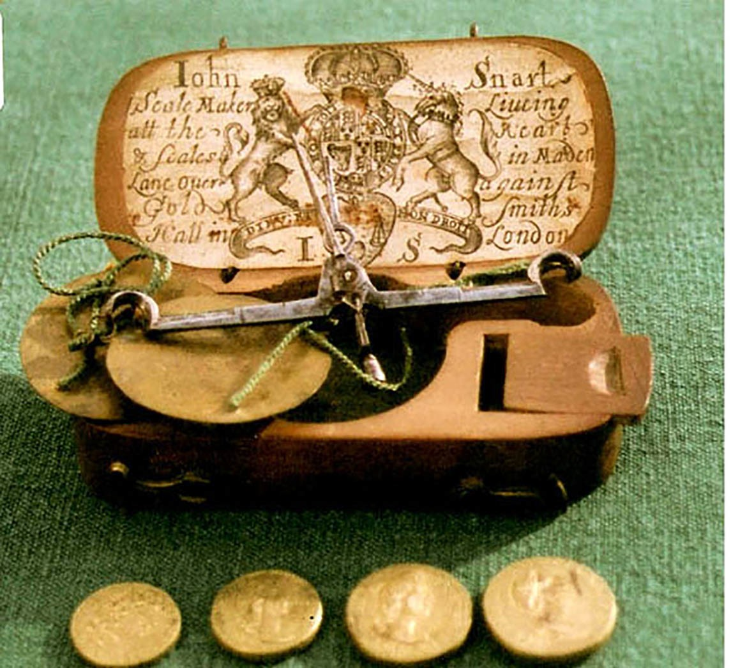
Coin-scales and weights, c1700

Slide 20
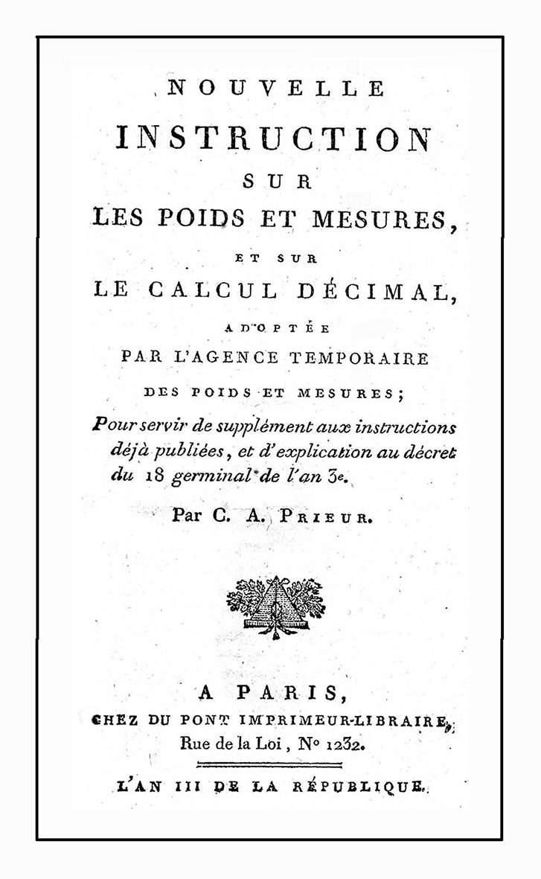
The new Metric System 1795

Slide 21
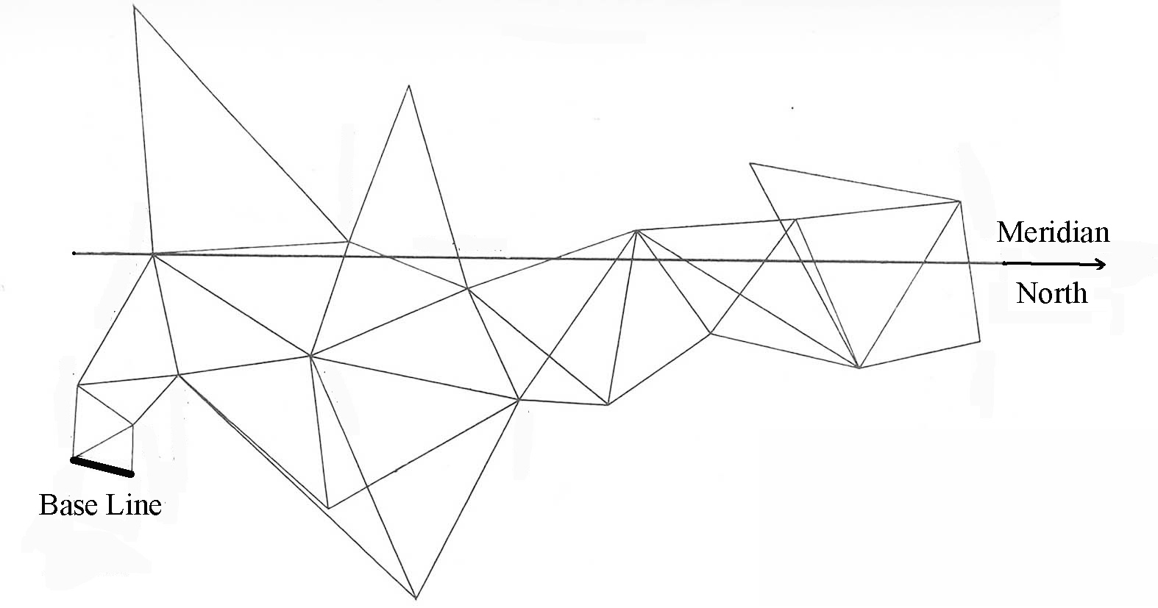
Surveying for the new Metric System

Slide 22
Episode 3: Two Global Problems
Problem 1: Too many forms of money

Slide 23
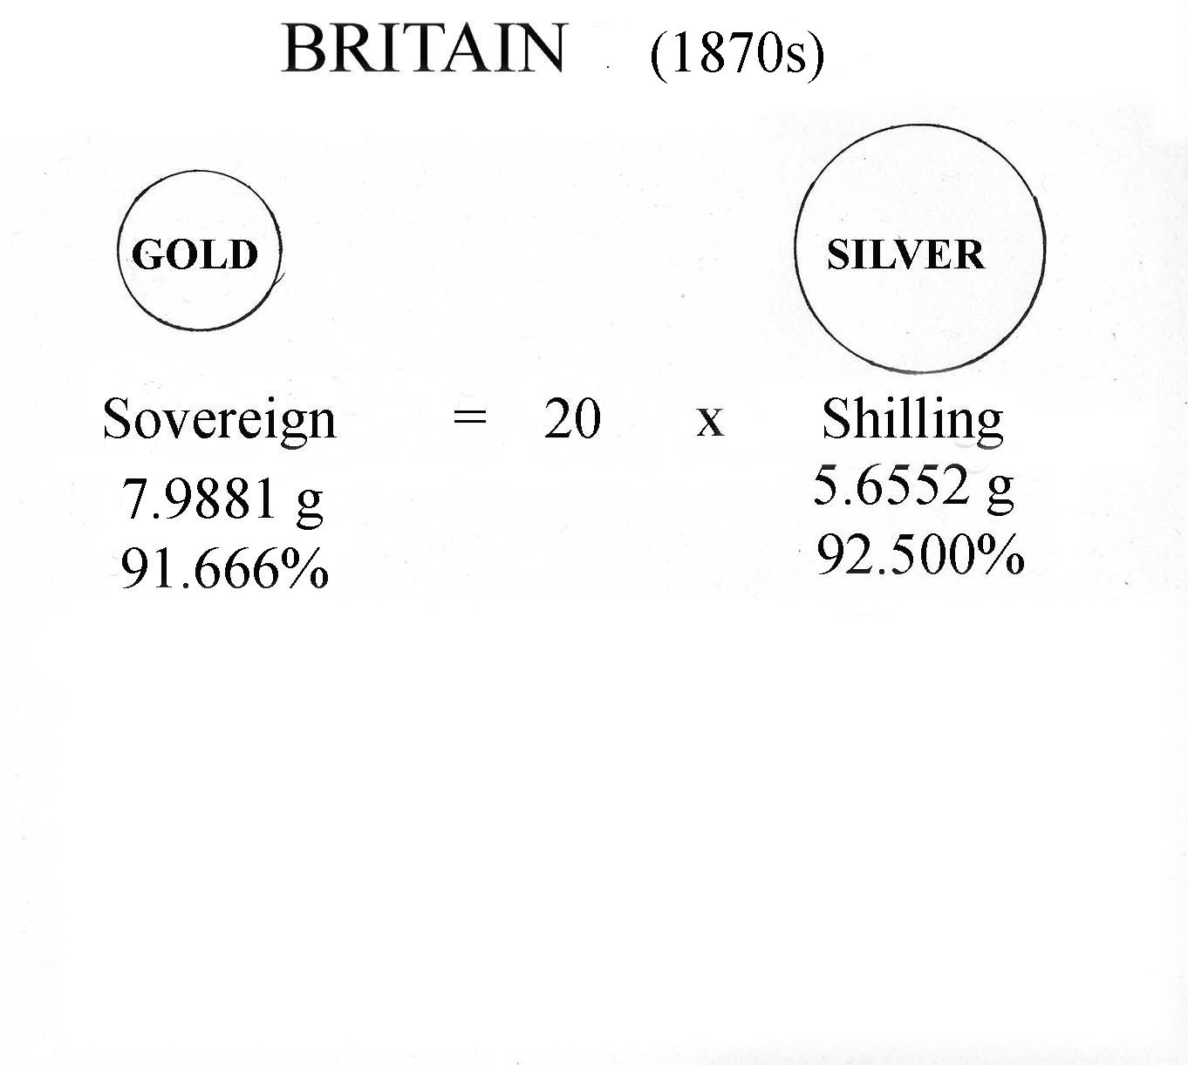

Slide 24
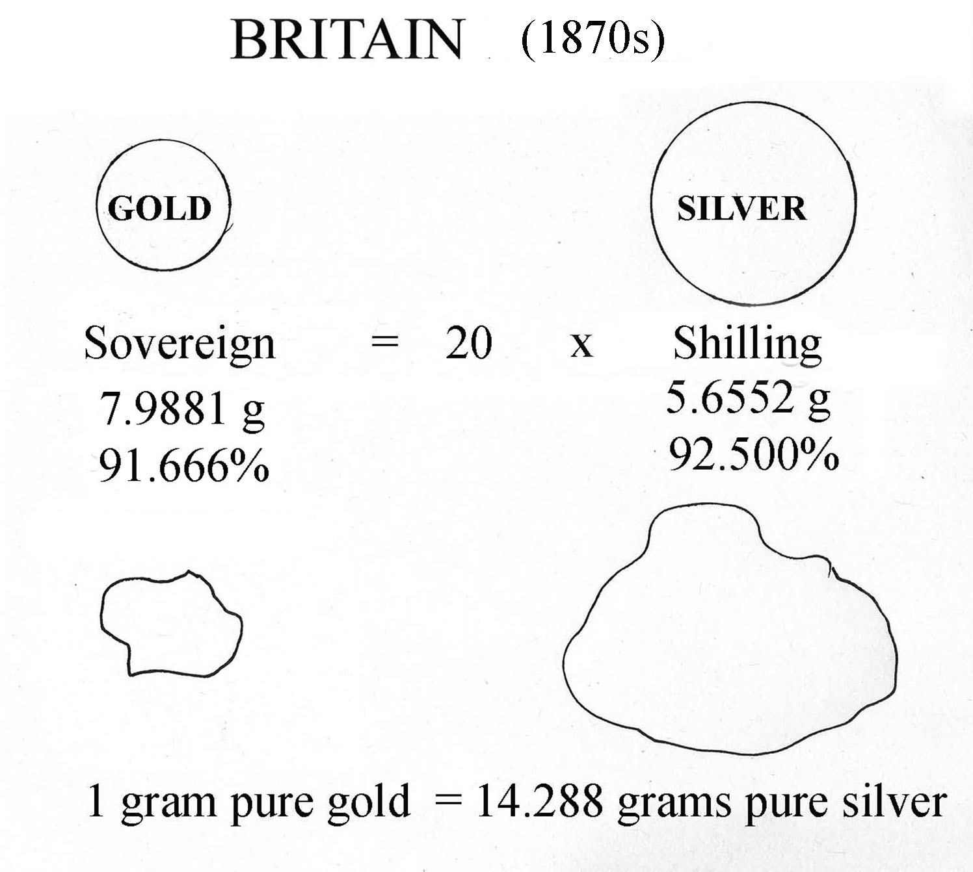

Slide 25
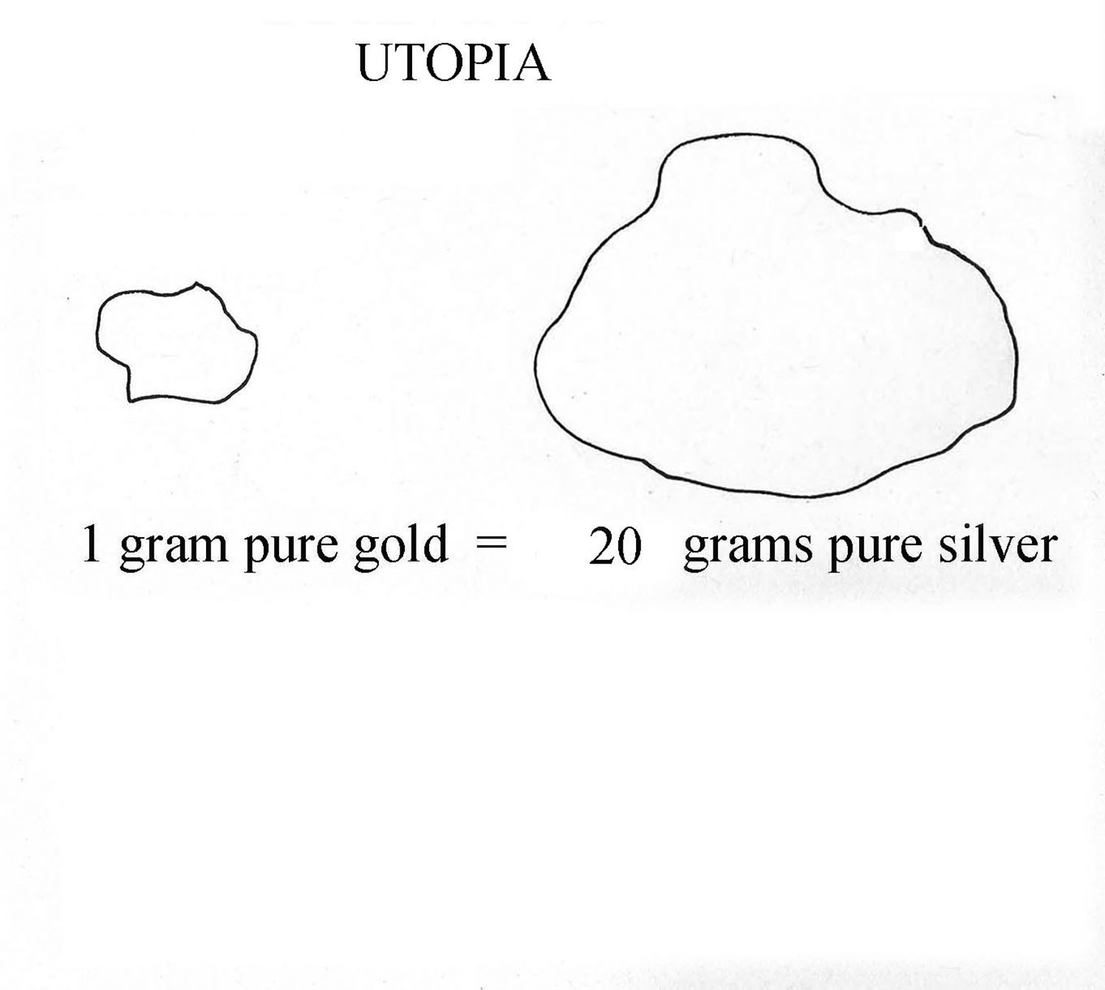

Slide 26
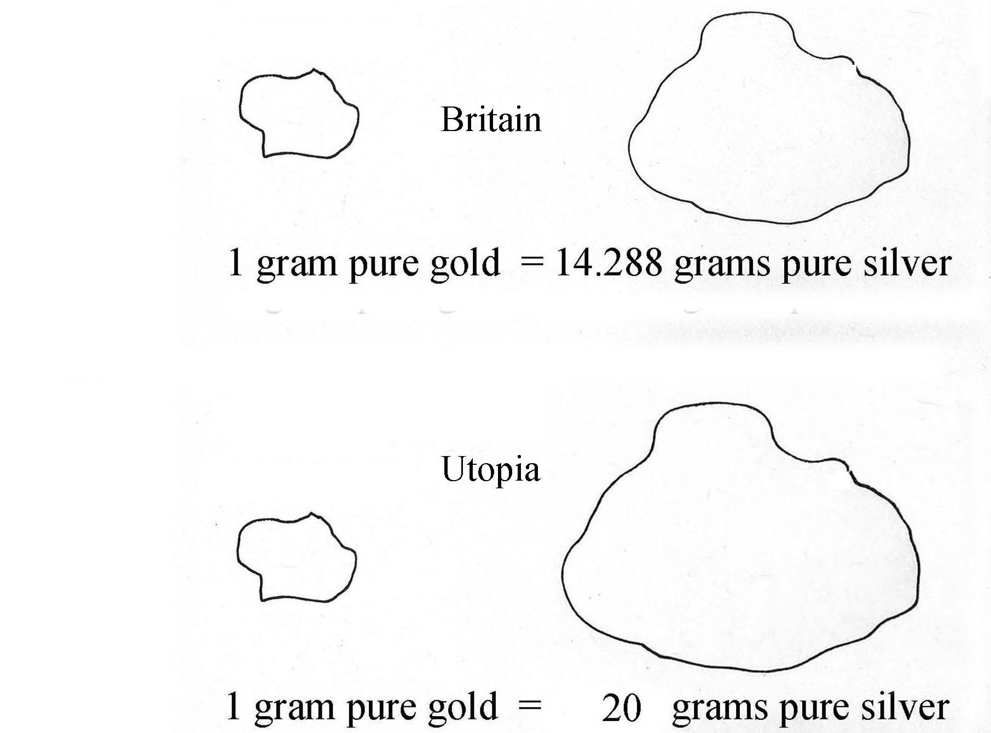

Slide 27
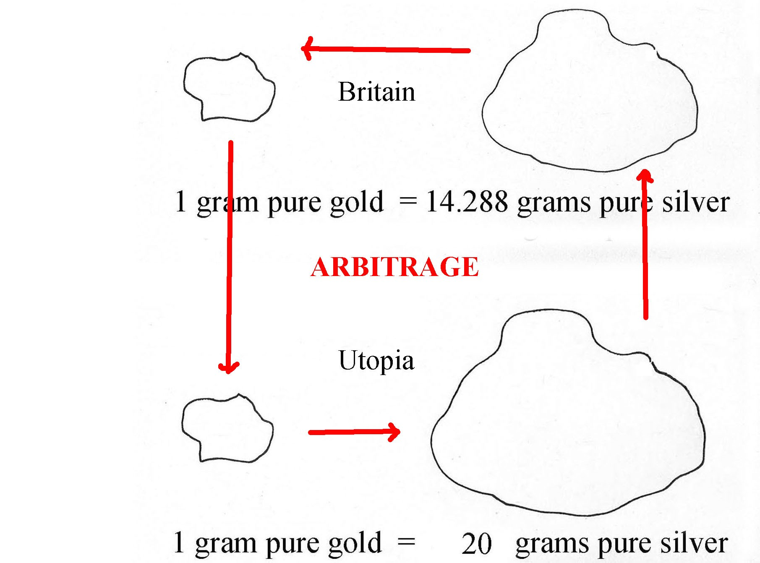

Slide 28
Modern forms of money: Shares and Options.
Let the price of a share at time t be S_{t}.
An option allows you to buy the share at future time T . The price you pay (say E) is fixed.
If S_{T} > E you will take up the option, otherwise not.

Slide 29
What price V_{t} should you pay for the option at time t?
Clearly, V_{t} should be related to S_{t} in some way.
This problem was unsolved for a long time, until . . .

Slide 30
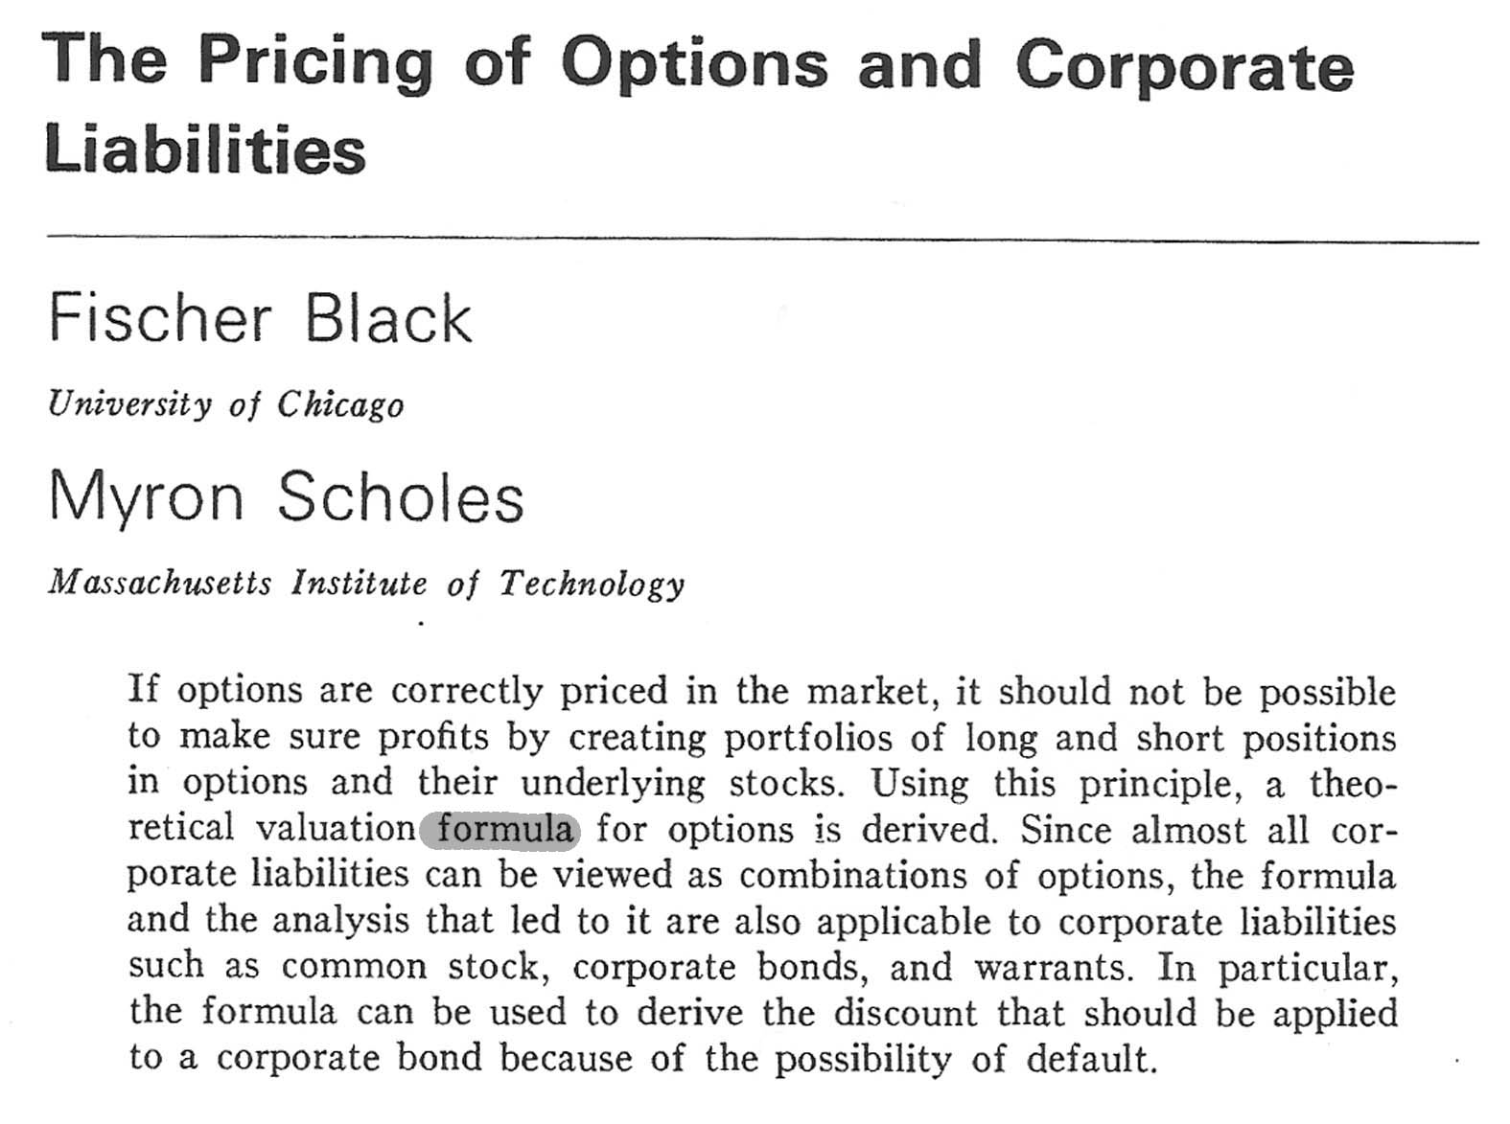
The formula is based on the ‘no arbitrage’ principle
– and some assumptions about the function S_{t}

Slide 31
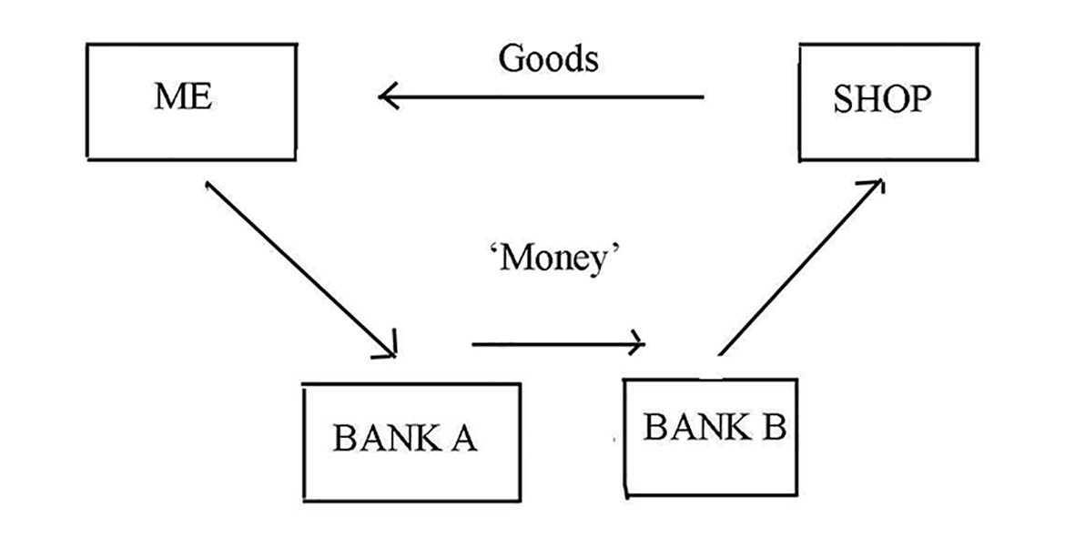
Problem 2: Is it safe?
Plastic money = information

Slide 32
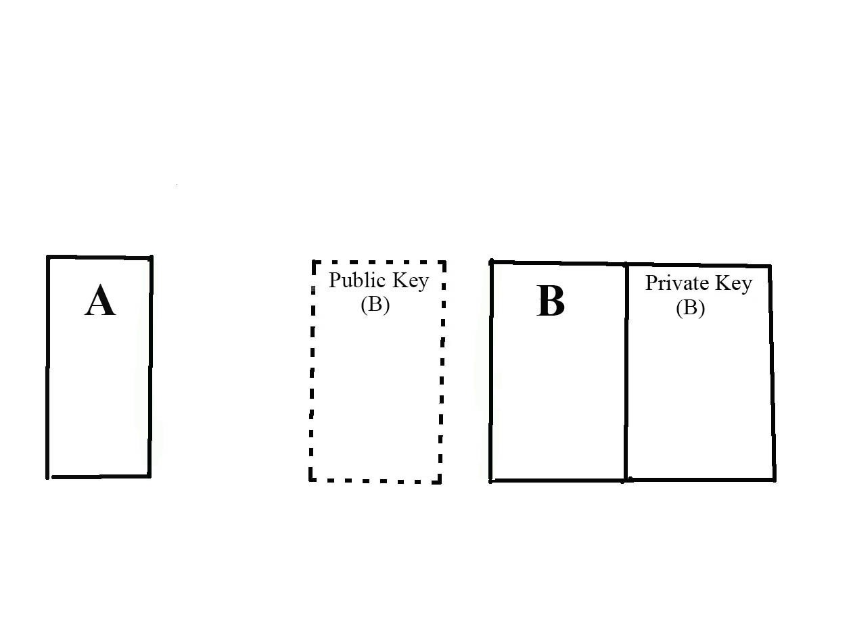
Public-key cryptography

Slide 33
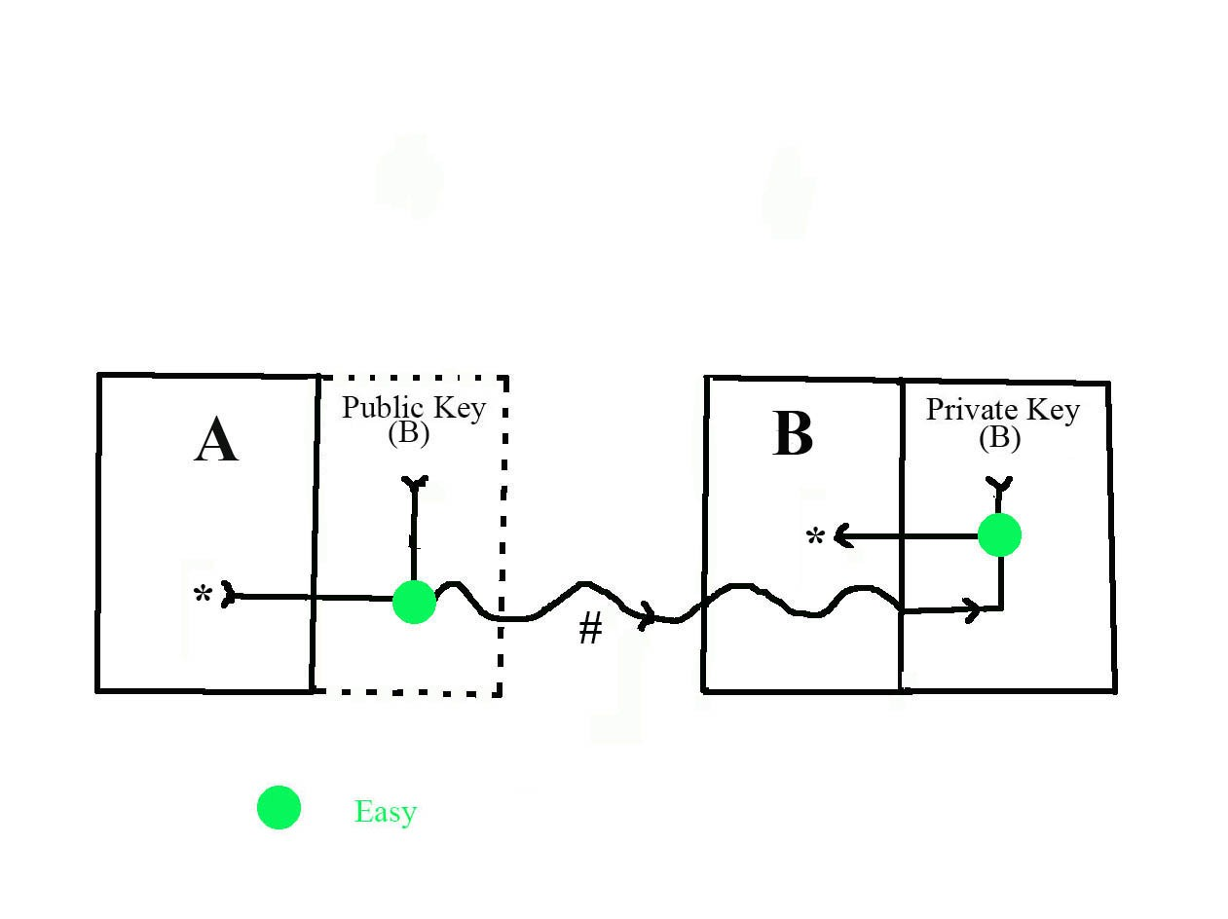

Slide 34
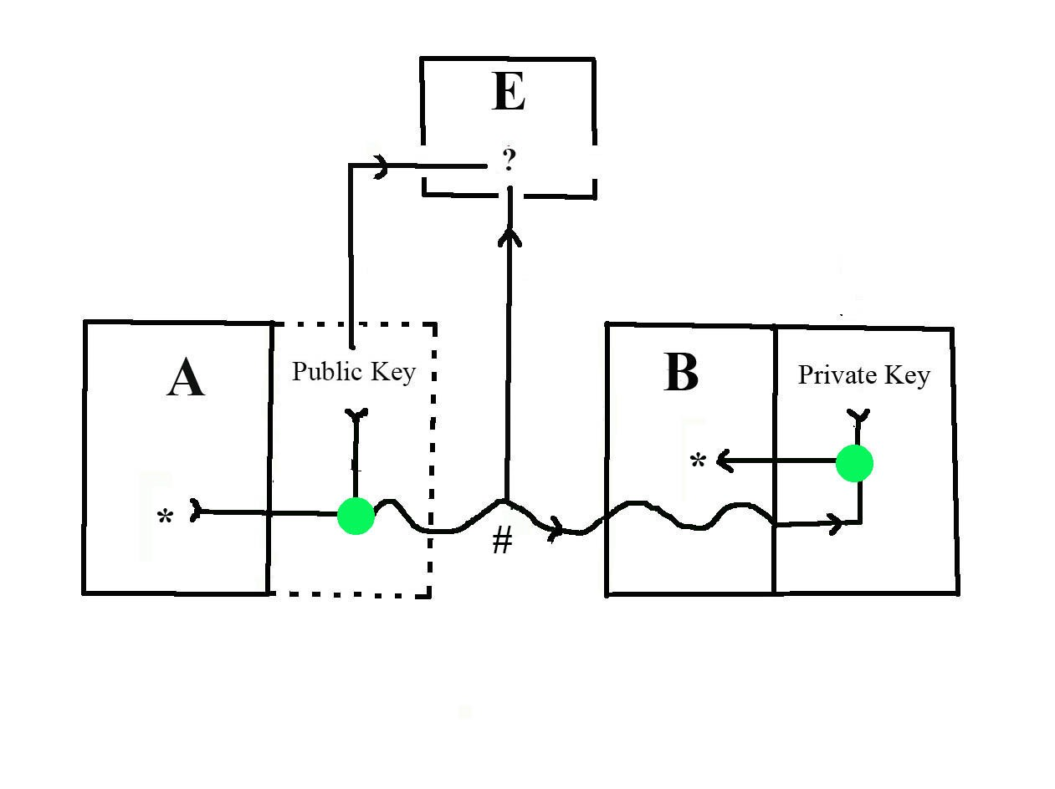

Slide 35
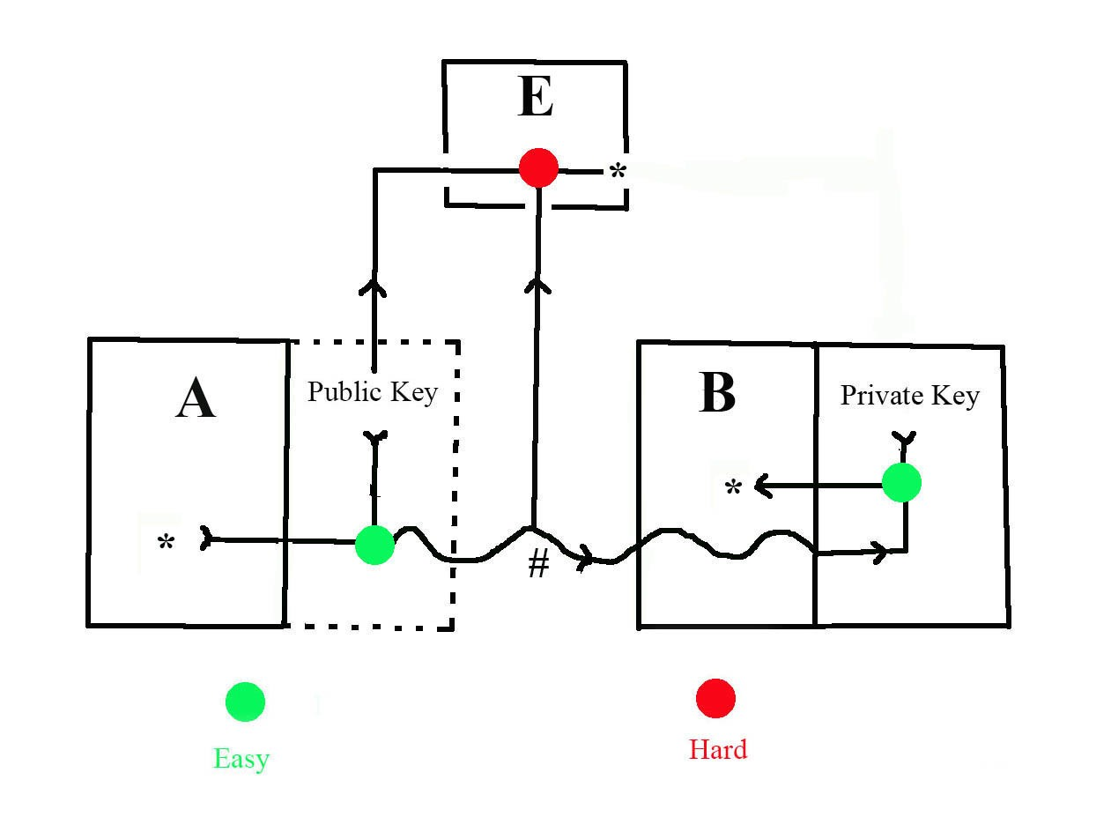

Slide 36
