Slide 2
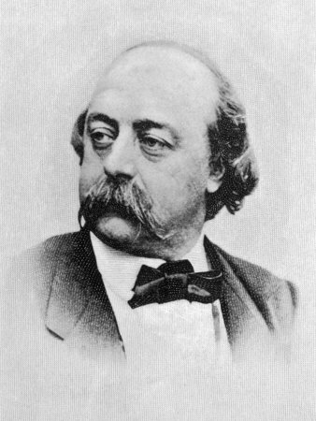

Slide 3
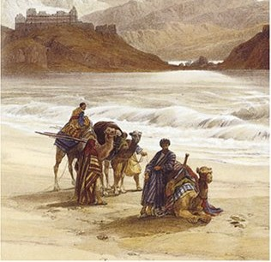
“We shall not cease from exploration And the end of all our exploring Will be to arrive where we started And know the place for the first time.” ― T.S. Eliot, Four Quartets(1943)

Slide 4
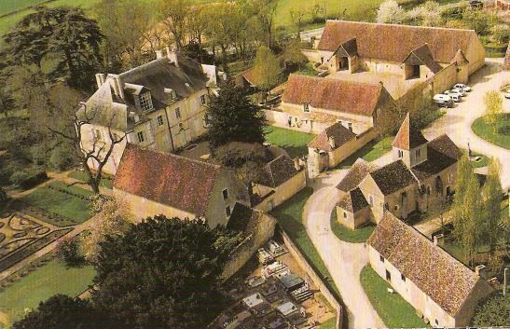

Slide 5
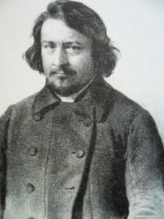
Pierre Leroux (1797-1871)

Slide 6
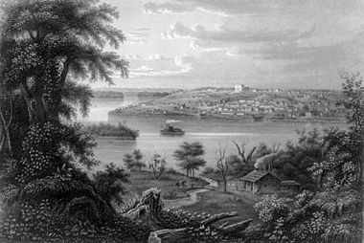
The Mississippi River town of Nauvoo, Illinois as it appeared circa 1855, during the time of its occupation by Icarian colonists.

Slide 7
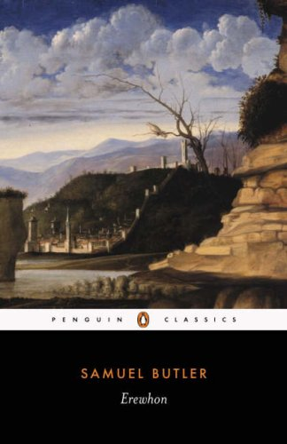

Slide 10
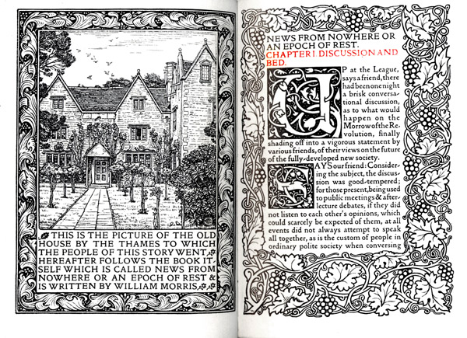

Slide 12
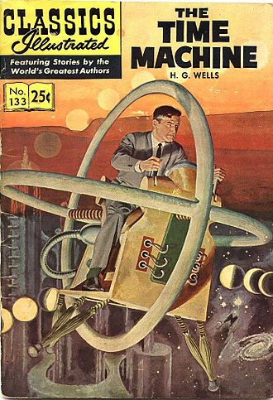

Slide 13
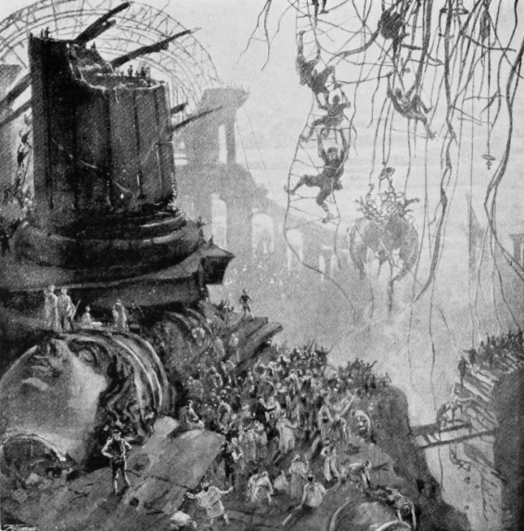

Slide 14
