Slide 1

The Novel as Political History:
Stendahl’s Le Rouge et Le Noir
By
Professor Belinda Jack
Gresham Professor of Rhetoric

Slide 2
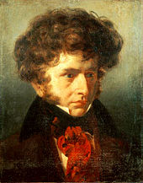
Emile Signol, 1832, Berlioz

Slide 3
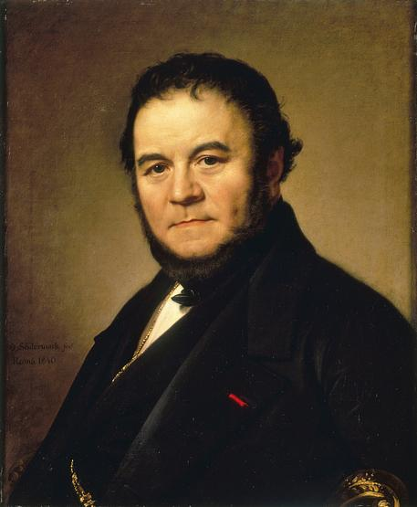
Marie-Henri Beyle , better known by his pen name Stendhal

Slide 4
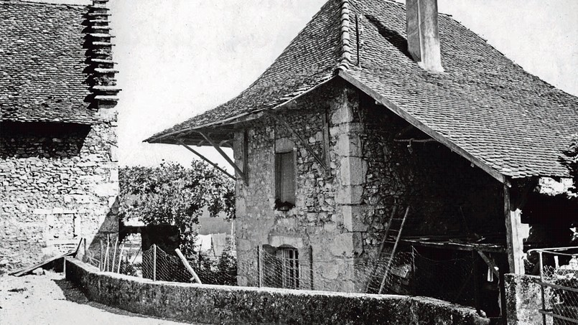

Slide 5
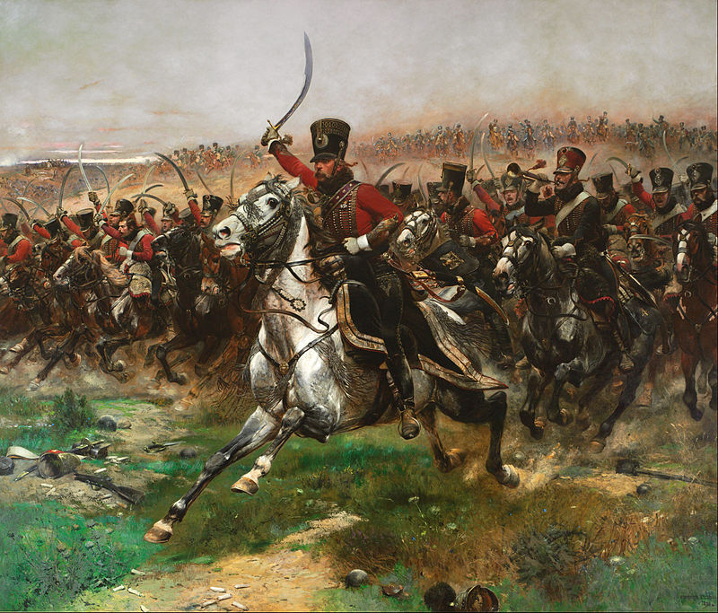

Slide 6


Slide 7
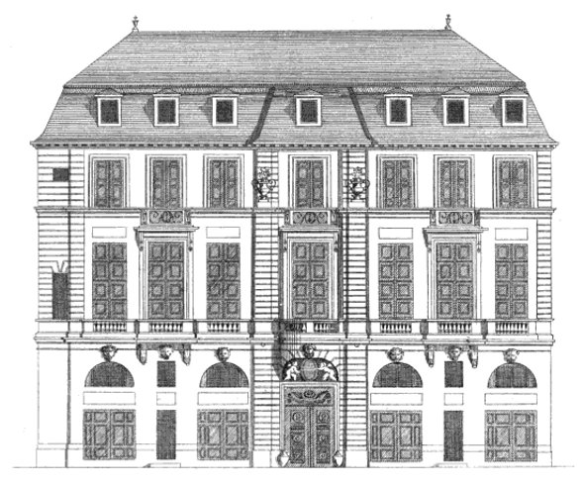

Slide 8
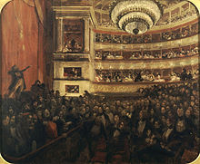

Slide 9
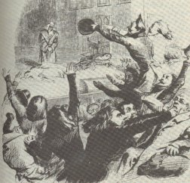

Slide 10
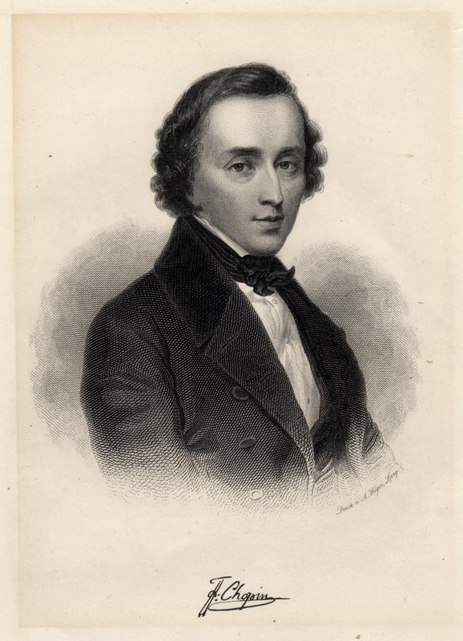

Slide 11

Future Rhetoric Lectures
The Novel and Idealism: George Sand
27 January 2015
The Novel and Psychology: Edith Wharton
24 February 2015
Poetry and Remembrance: Thomas Gray
14 April 2015
Poetry and Immortality: John Keats
12 May 2015

