Slide 1
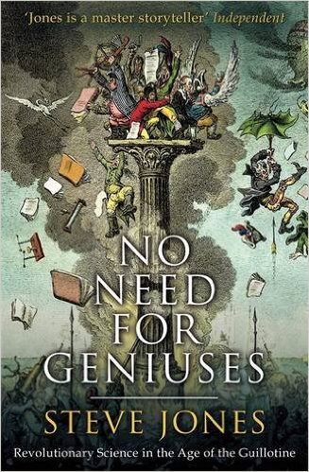

Slide 2
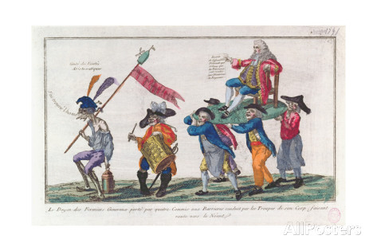
Lavoisier is carried by his fermiers to extract taxes from the poor

Slide 3
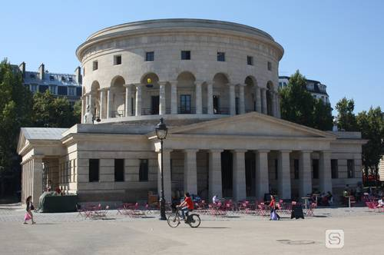
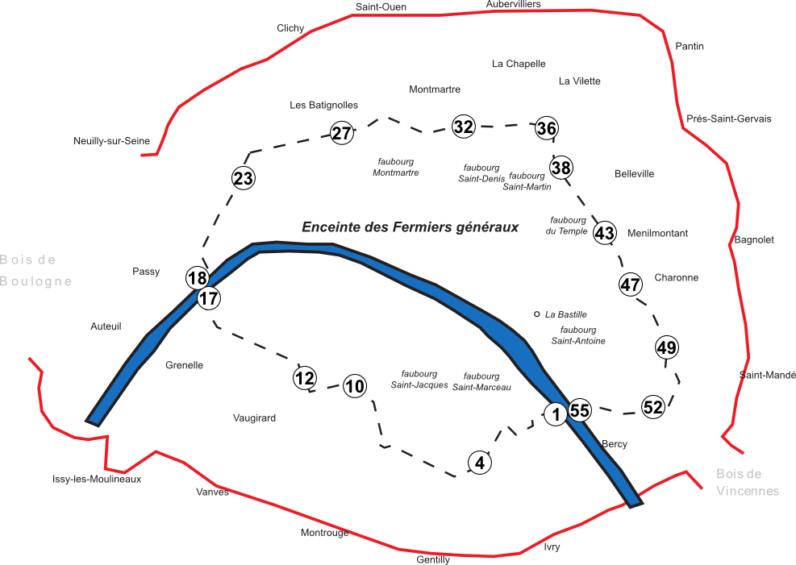
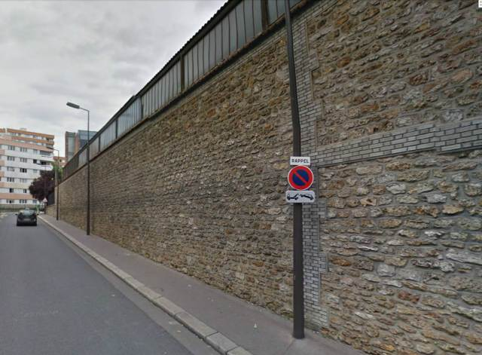
Lavoisier’s 1784 Wall around Paris with La Rotonde, one of the surviving tollgates, and a fragment of wall

Slide 4
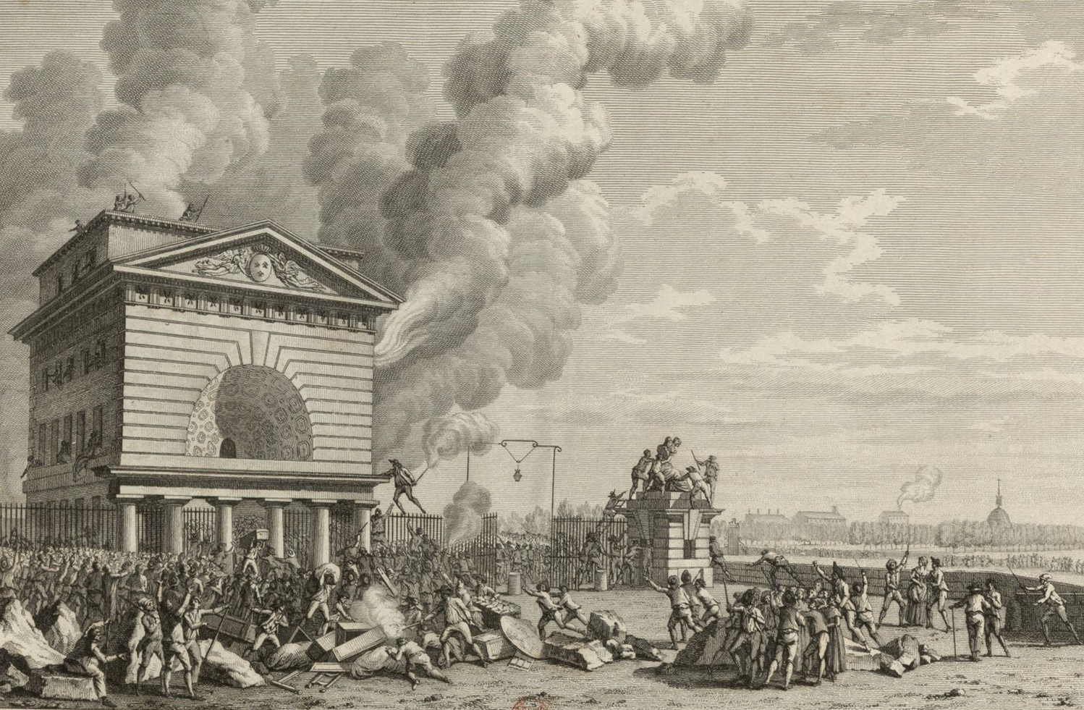
13th July 1789: the Paris mob storm the Wall

Slide 5
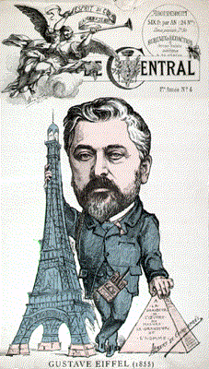
‘It will be an observatory and a laboratory such as science has never had at its disposal’

Slide 6
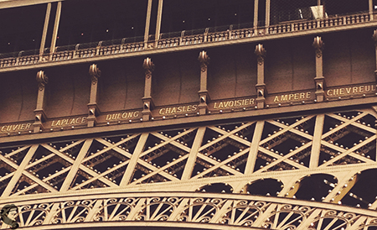
72 scientists’ names on the Eiffel Tower

Slide 7
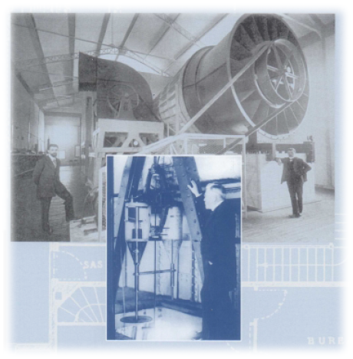
Eiffel’s drop test machine and wind tunnel

Slide 8
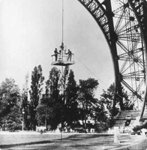
The drop test experiment on the Eiffel Tower

Slide 9
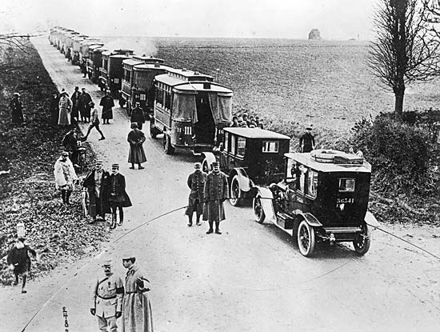
Saved by the Tower: French troops use taxis to get to the Marne, 1914

Slide 10
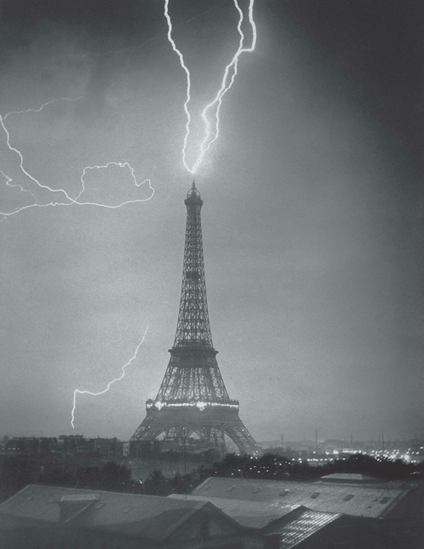
The tallest building in the world struck by lightning in 1890

Slide 11
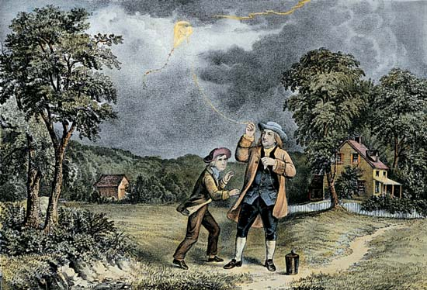
Benjamin Franklin’s lightning experiment (which never happened)

Slide 12
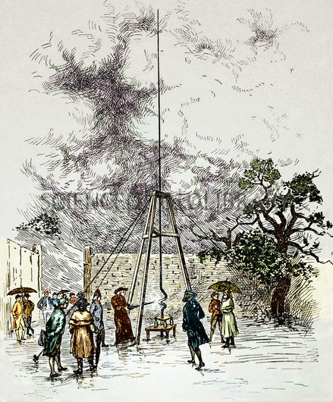
The world’s first lightning conductor, Marly-la-Ville, 1752

Slide 13
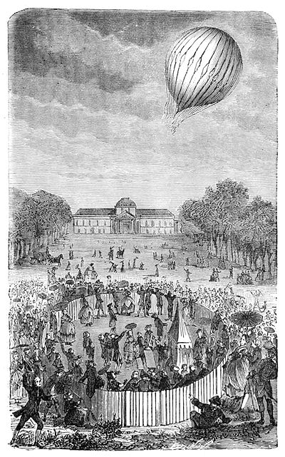
1783 – the world’s first hydrogen balloon above the site of the Eiffel Tower

Slide 14
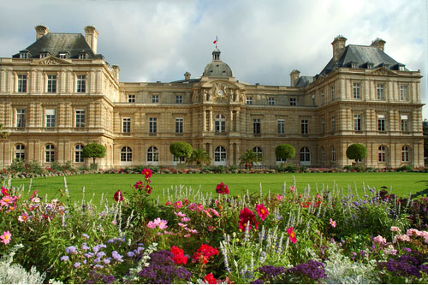
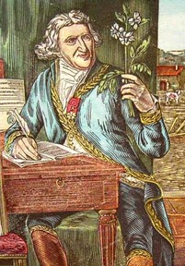
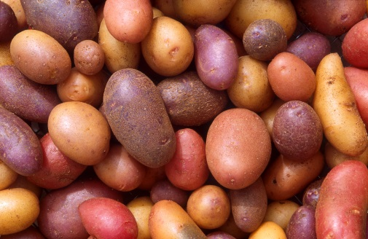
Gardens of the Luxembourg and its revolutionary vegetable

Slide 15
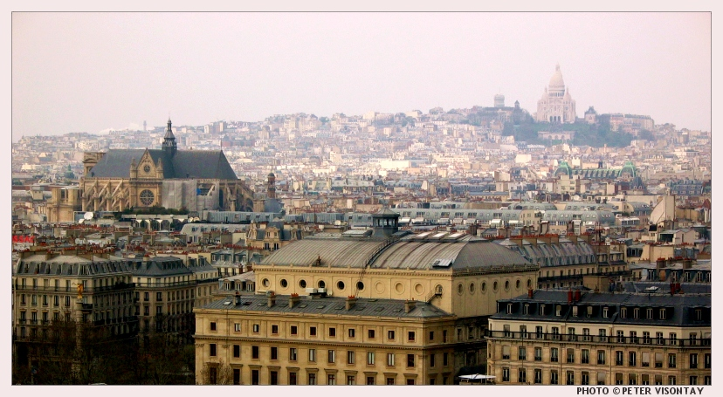
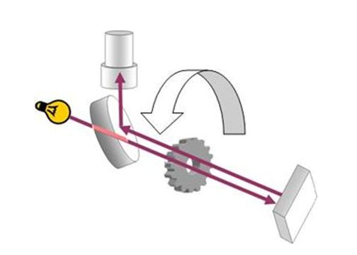
The hill of Montmartre and the first measurement of the speed of light

Slide 16
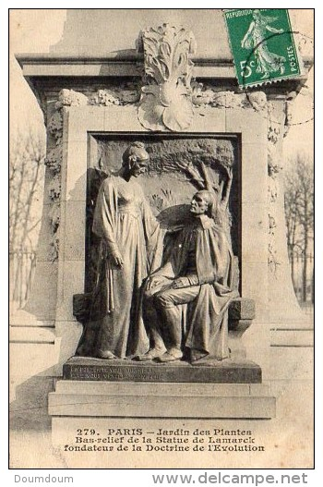
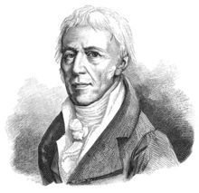
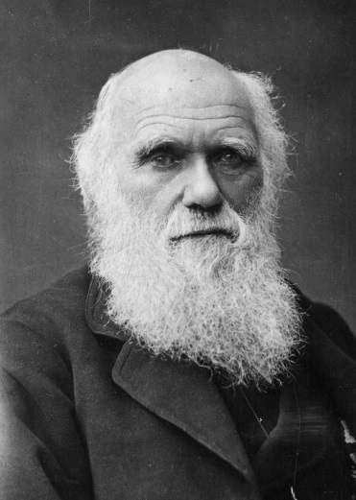
“Fondateur de la Doctrine d’Evolution” in the Jardin des Plantes: Lamarck or Darwin?

Slide 17
History as necessity
Lamarck: There is power in life.
De Tracy: Ideology is part of Zoology
Condorcet: the general laws that direct the phenomena of the universe, known or unknown, are necessary and constant. Why should this principle be any less true for the development of the intellectual and moral faculties of man?
Bailly: The universal language of science will brng a golden age.

Slide 18
Across the Channel
Charles Darwin “Heaven forfend me from Lamarck nonsense of a “tendency to progression” [or] “adaptations from the slow willing of animals”.

Slide 19
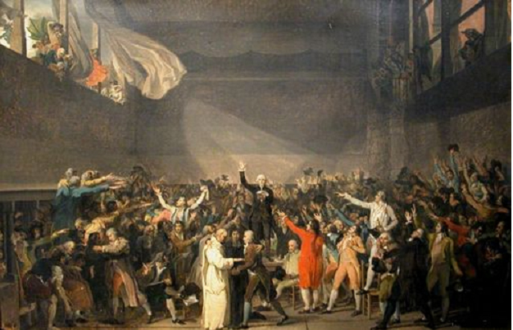
Jacques-Louis David, The Tennis Court Oath, 1790

Slide 20
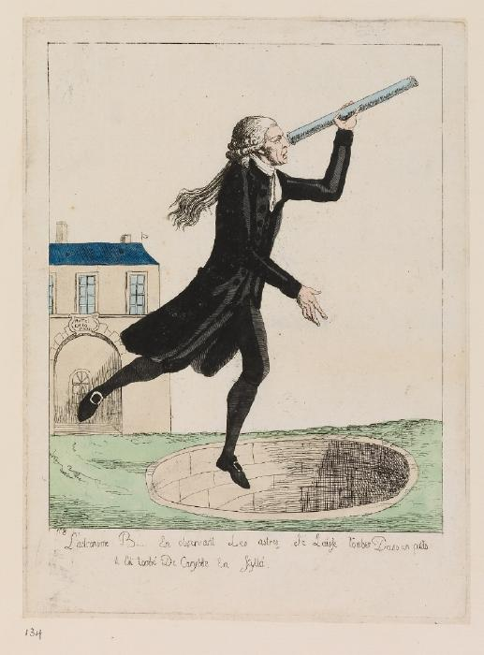
Bailly, first Mayor of Paris, distracted by astronomy

Slide 21
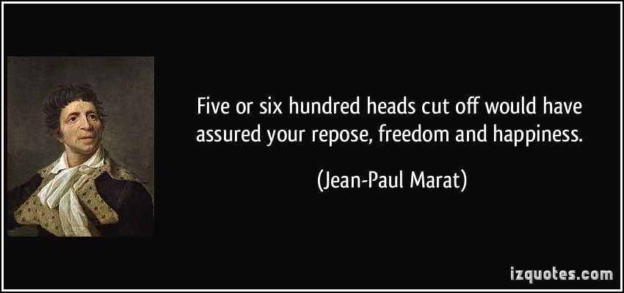

Slide 22
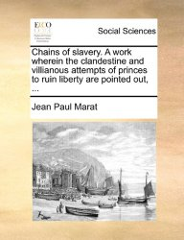

Slide 23
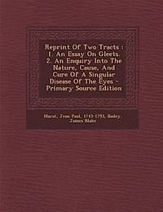

Slide 24
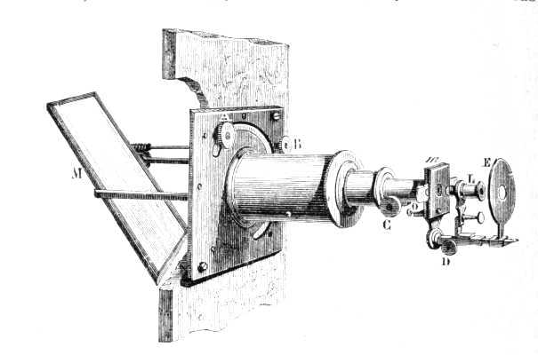
Marat’s Solar Microscope

Slide 25
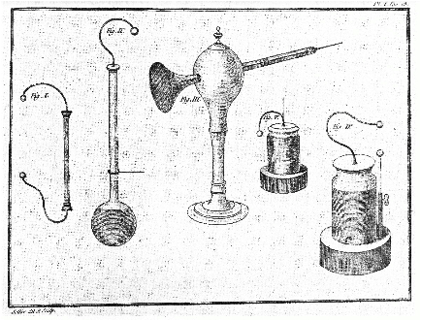
Marat’s electrical apparatus: used to stimulate frog nerves before Galvani

Slide 26
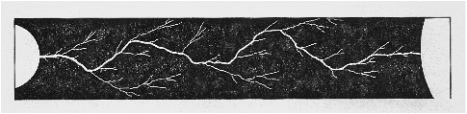
Marat: electric sparks and lightning as a fluid

Slide 27
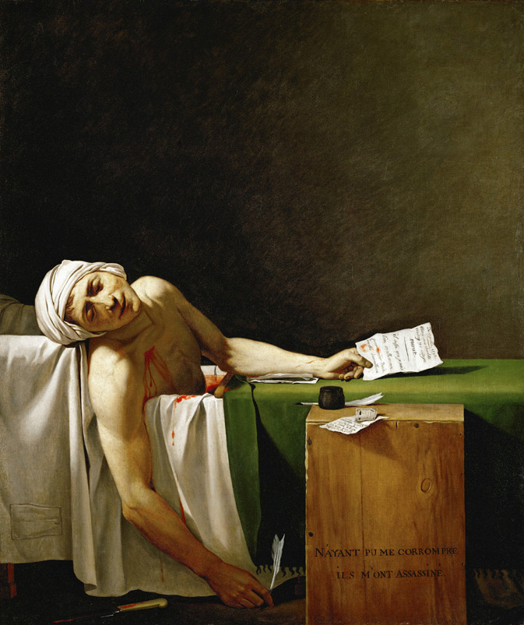
Marat, murdered in his bath, by David

Slide 28
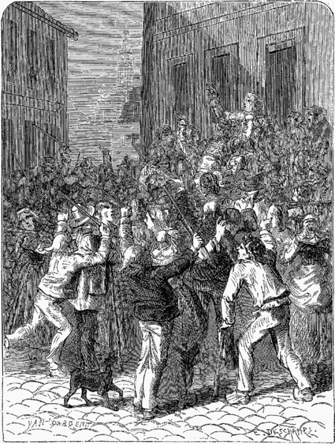
The citizens of St-Omer riot against the new lightning-conductor, which will “attract thunder from all over France”

Slide 29
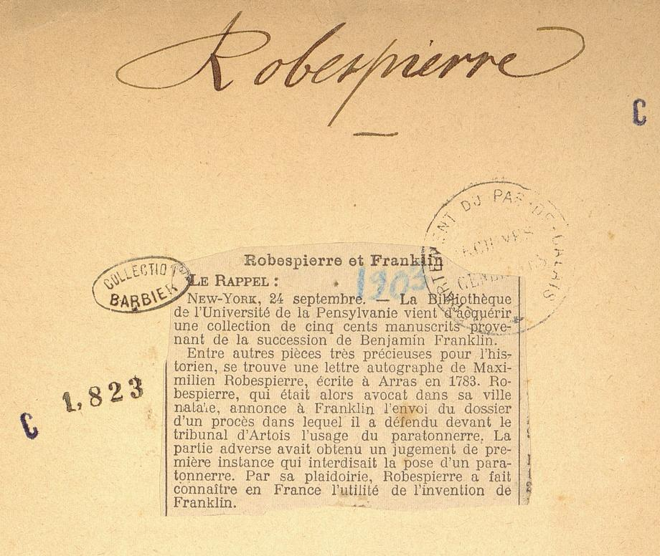
Robespierre writes to Benjamin Franklin

Slide 30


Slide 31
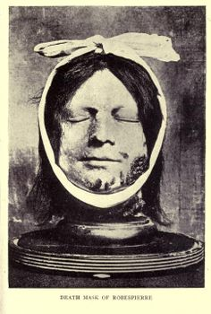
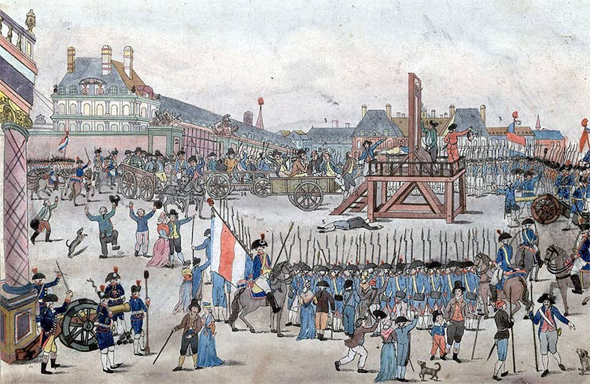
The Death of Robespierre

Slide 32
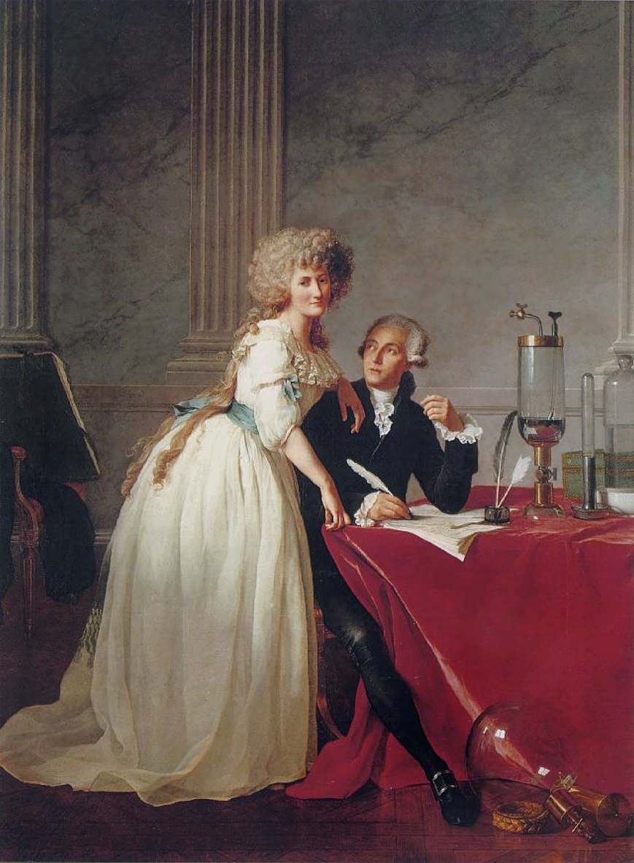
Lavoisier and his wife in the laboratory, by David

Slide 33
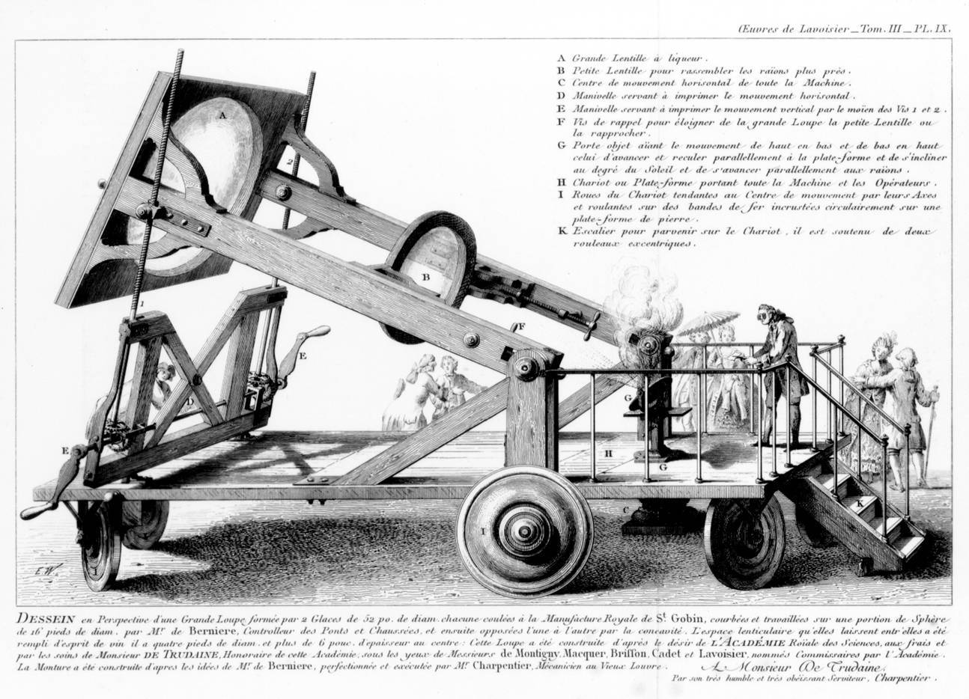
Lavoisier’s Burning-Glass Experiment

Slide 34
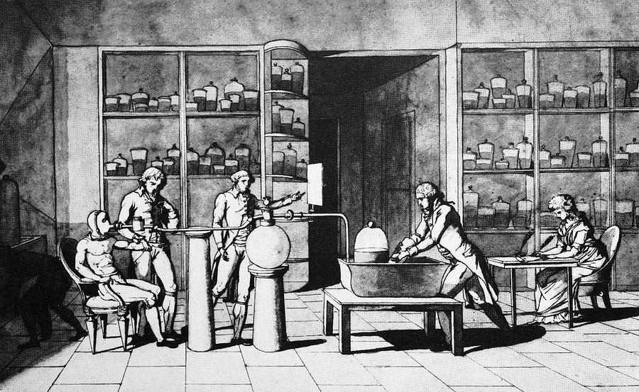
Lavoisier’s respiration experiment: Mme Lavoisier taking notes

Slide 35
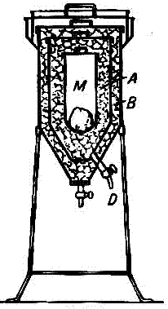
Lavoisier’s calorimeter

Slide 36
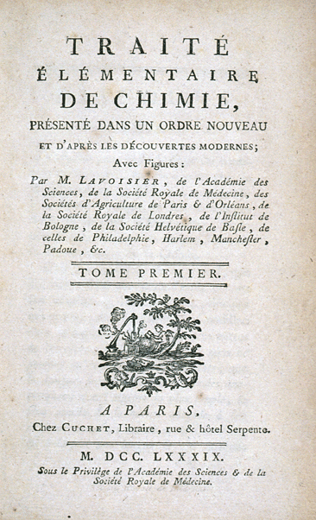
‘The animal machine is governed by three types of regulators: respiration, that consumes hydrogen and carbon and furnishes heat, digestion, which replenishes … that which is lost in the lungs and transpiration, that increases or diminishes in accordance with the necessity to carry away more or less heat.’
Antoine Lavoisier 1789

Slide 37
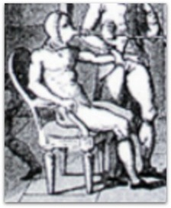
Armand Seguin: Lavoisier’s Man in the Iron Mask and the discoverer of opium

Slide 38
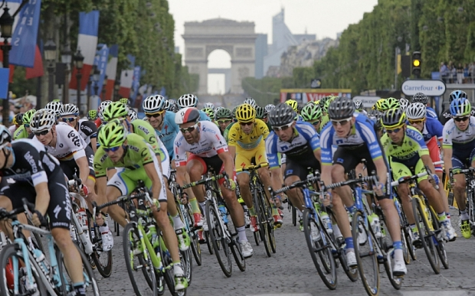
2015 Tour de France

Slide 39
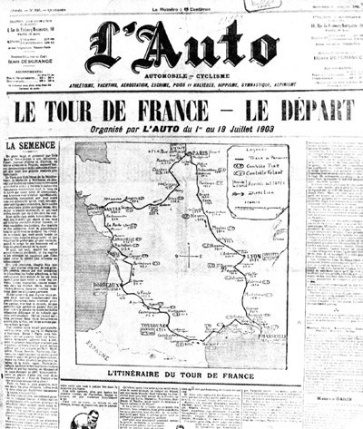
Announcement of the first Tour de France, 1903

Slide 40
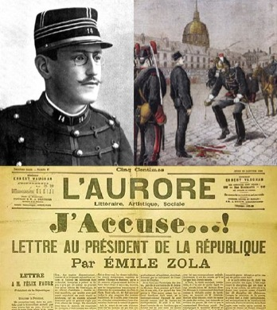
The catalyst for the Tour de France: the Dreyfus Affair

Slide 41
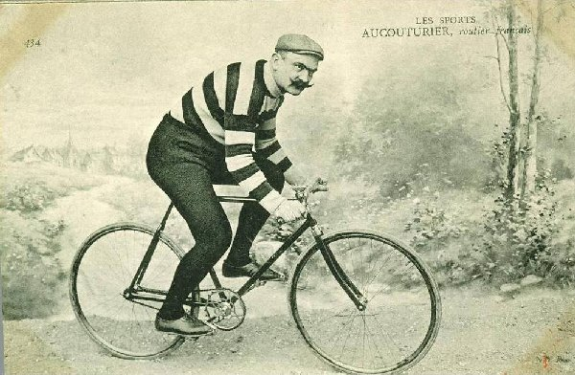
An early cheat in the Tour de France (he took the train)

Slide 42
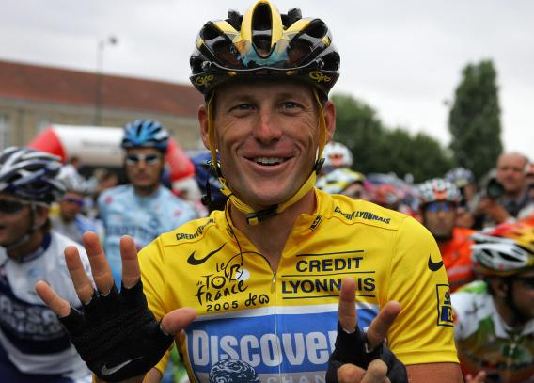
His (un)worthy successor: Lance Armstrong

Slide 43
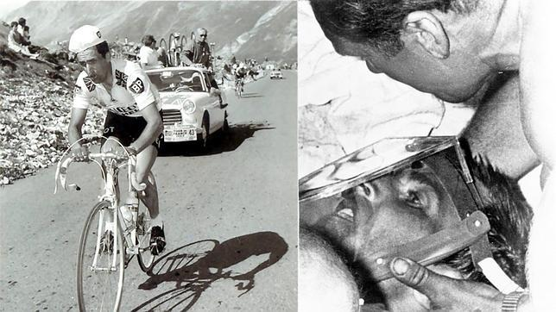
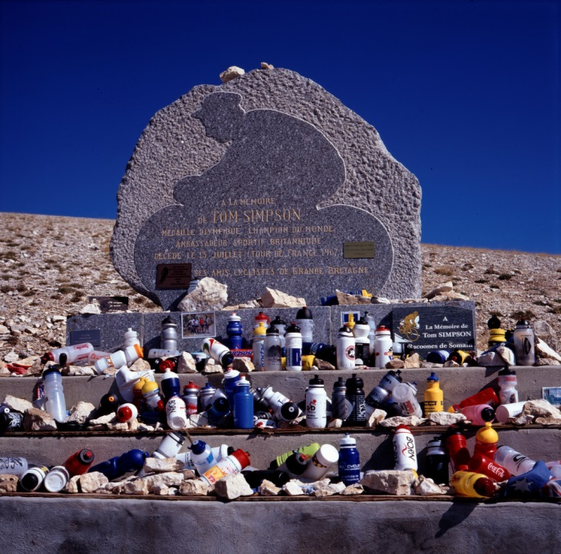
Heat death of Tom Simpson on Mt Ventoux 1967: “Put me back on my bike”

Slide 44
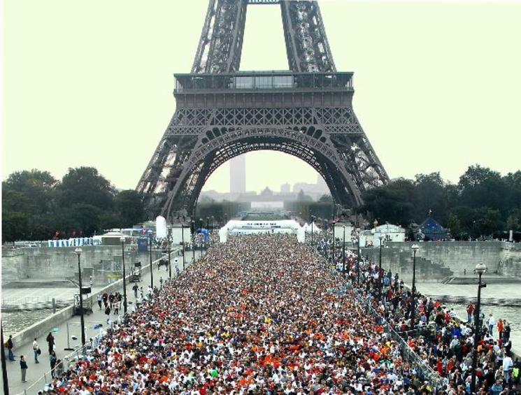
The Paris Marathon: 42.2km

Slide 45

Oxygen levels with height

Slide 46


Bar-headed goose: migrates over the Himalayas

Slide 47


Bar-headed goose: bigger lungs, hungrier haemoglobin

Slide 48


Bar-headed goose: denser muscle fibres with more capillaries than two lowland species.

Slide 49



Inhabitants of Tibet, the Andes, and the Amhara Mountains in Ethiopia

Slide 50

Different high altitude strategies in two mountain ranges

Slide 51

African-Americans: less pain sensitivity than other groups

Slide 52


The death of Phidippides in 490 BC (one view) and the disqualification of Dorando Pietri in 1908 Olympic Marathon – heat and shortage of breath

Slide 53
Kalinjin athletes: 1/2000th of the world population; 1/5th of top marathon runners –
better heat loss through body build
homeland is at 2000 m – acclimation
share Amhara low-oxygen genes
low basal metabolic rate
tolerate higher body temperatures
?lower pain sensitivity

Slide 54
African-Americans: less pain sensitivity than other groups

Slide 55

World’s 25 top marathon runners – now all African

Slide 56


Slide 57

Angiotensin converting enzyme ACE

Slide 58

Angiotensin levels and the ACE polymorphism

Slide 59

Ace Gene – climbers and controls; and improvement in endurance after training
Annual Reviews

Slide 60

Spot the athlete: Mo Farah and his car-mechanic identical twin

Slide 61

African riders in the 2015 Tour de France

Slide 62

“the claim that any human group is of its essence less – or more – blessed with particular abilities than others is an attempt to make Nature herself an accomplice of political inequality”
Nicolas Condorcet (political philosopher and mathematician; murdered in prison 1794)

Slide 63
Apres la Deluge – Scientists in French politics in revolutionary times
Arago (geographer) – Prime Minister
Carnot (physicist) – Minister of War
Chaptal (chemist) – Minister of the Interior
Berthollet (chemist), de Bougainville (explorer)
Daubenton (botanist), Lacepede (herpetology) Lagrange (maths), Laplace (astronomy), Monge (chemist), de Tracy (physiology) – all Senators

Slide 64

Across the Channel: “Scientists should be on tap, and not on top”.

