Slide 1
The Language of the King James Bible
Monday 26th September 2011
Mercers’ Hall

Slide 2
In principio erat Verbum, et Verbum erat apud Deum, et Deus erat Verbum. Hoc erat in principio apud Deum. Omnia per ipsum facta sunt: et sine ipso factum est nihil, quod factum est. In ipso vita erat, et vita erat lux hominum: et lux in tenebris lucet, et tenebrae eam non comprehenderunt.

Slide 3
1 Ecce Ursus scalis occipite gradus pulsante post descendens. 2 Est quod sciat unus et solus modus gradibus descendendi, nonnunquam autem sentit, etiam alterum modum exstare, dummodo pulsationibus desinere et de eo modo meditare posit. 3 Deinde censet alios modos non esse. 4 En, nunc ipse in imo est, vobis ostentari paratus. Nomen audiens primum, sicut vos dicturi estis, etiam ego dixi.

Slide 4
Gutenberg Bible
1In the beginning was the Word, and the Word was with God, and the Word was God. 2The same was in the beginning with God. 3All things were made by him; and without him was not any thing made that was made. 4In him was life; and the life was the light of men. 5And the light shineth in darkness; and the darkness comprehended it not.

Slide 5
Winnie ille Pu

Slide 6
William Tyndale

Slide 7
European Day of Languages

Slide 8
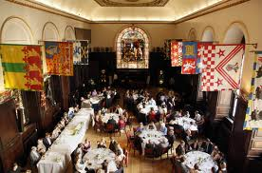
Stationers’ Hall

Slide 9
Pilgrim’s Progress 1678

Slide 10
The Gustave Doré Bible

Slide 11
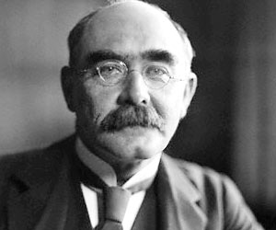
Rudyard Kipling

Slide 12
International Translation Day

Slide 13
Cardinal Cisneros - Ximenes

Slide 14
The Honey Bear Bible

