Slide 1
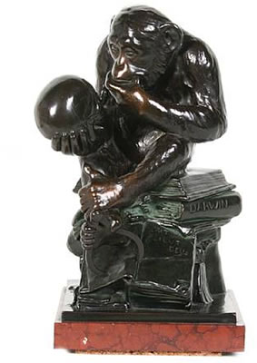
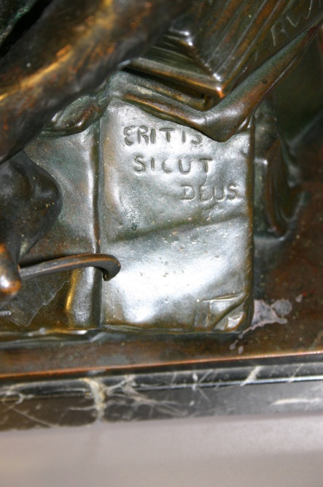
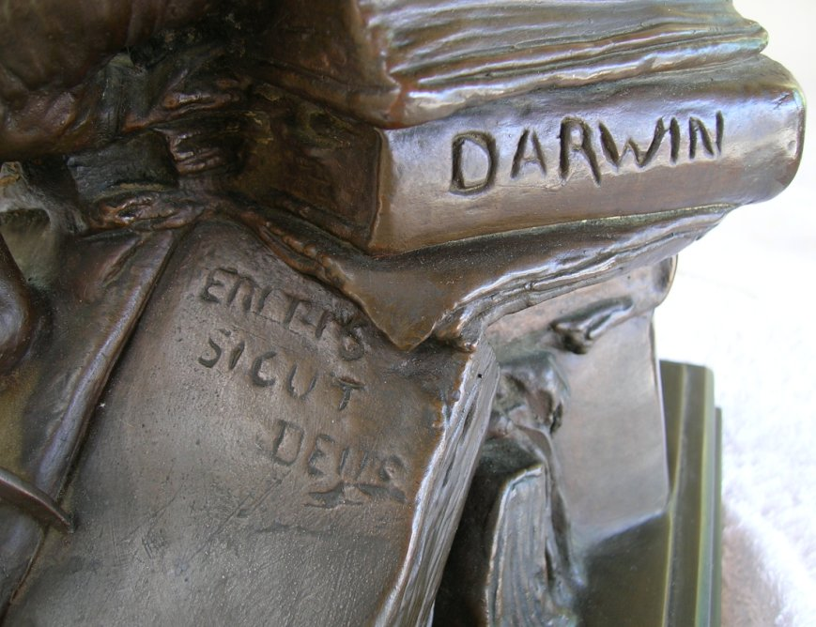
Eritis sicut deus

Slide 2
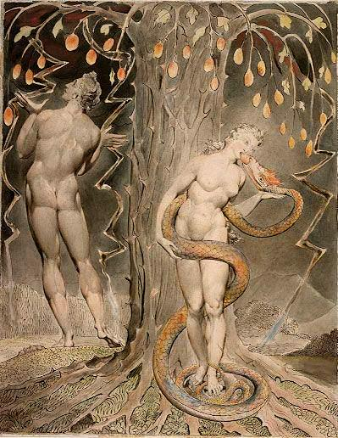
The Serpent’s Promise
“Eritis sicut Deus: scientes bonum et malum”
‘In the day ye eat thereof, then your eyes shall be opened, and ye shall be as gods, knowing good and evil’

Slide 3
“Man has risen, by slow and interrupted steps, from a lowly condition to the highest standard as yet attained by him in knowledge, morals, and religion.”
Charles Darwin, 1871

Slide 4
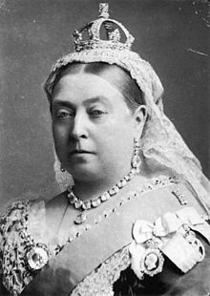
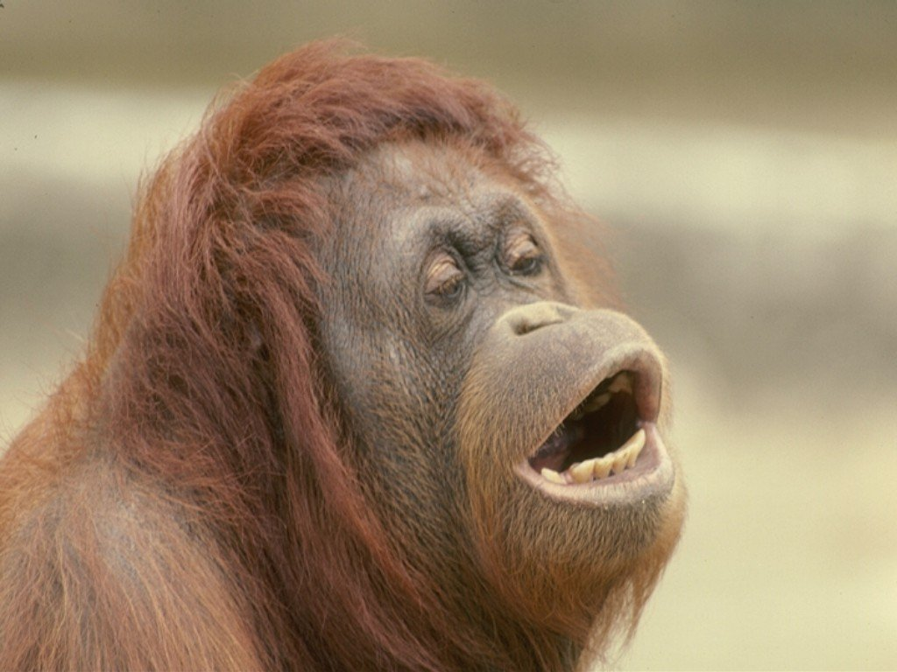
“Frightfully, and painfully, and disagreeably human …”

Slide 6
 |  | Average Life Expectancy.
Members of Royal houses | 97 in number | 64.04
Clergy | 945 in number | 69.49
Medical Profession | 244 in number | 67.31
Gentry | 1,632 in number | 70.22
Officers in the Royal Navy | 366 in number | 68.40
Officers of the Army | 569 in number | 67.07
GALTON:THE STATISTICAL EFFICACY OF PRAYER: The sovereigns are literally the shortest lived of all who have the advantage of affluence. The prayer has therefore no efficacy….

Slide 7
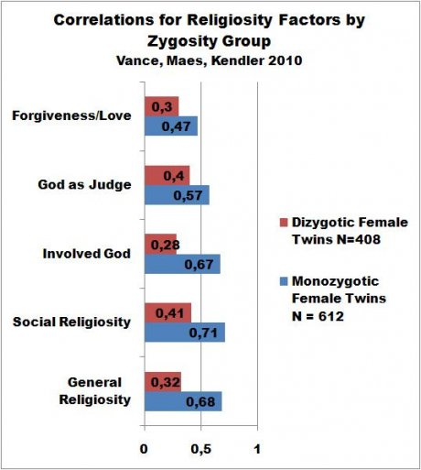

Slide 8
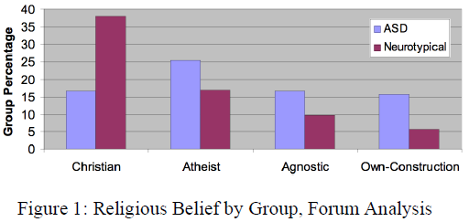
Autism spectrum disorder associated with atheism

Slide 9
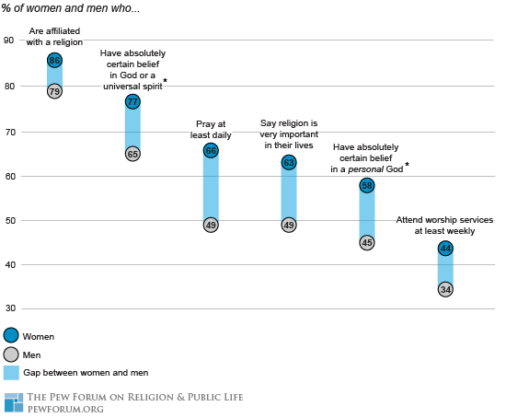
Religiosity and the Y Chromosome USA

Slide 10
Hildegard of Bingen’s Visions
‘I saw a great star most splendid and beautiful, and with it an exceeding multitude of falling stars … and suddenly they were all annihilated, being turned to black coals … and cast into the abyss.’

Slide 11
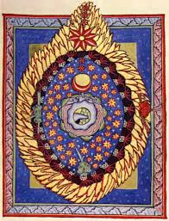
Hildegard’s visions

Slide 12
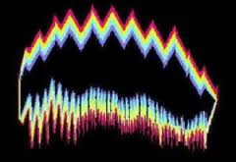
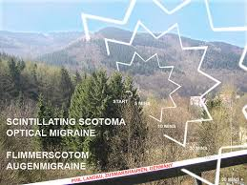
Migraine and Scotoma

Slide 13
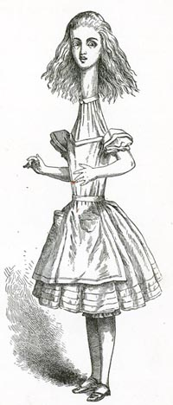
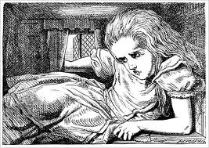
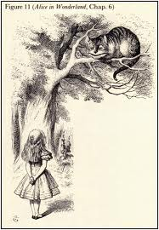
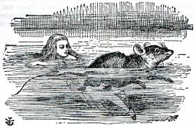
Alice in Migraine Land: Visions of Lewis Carroll

Slide 14
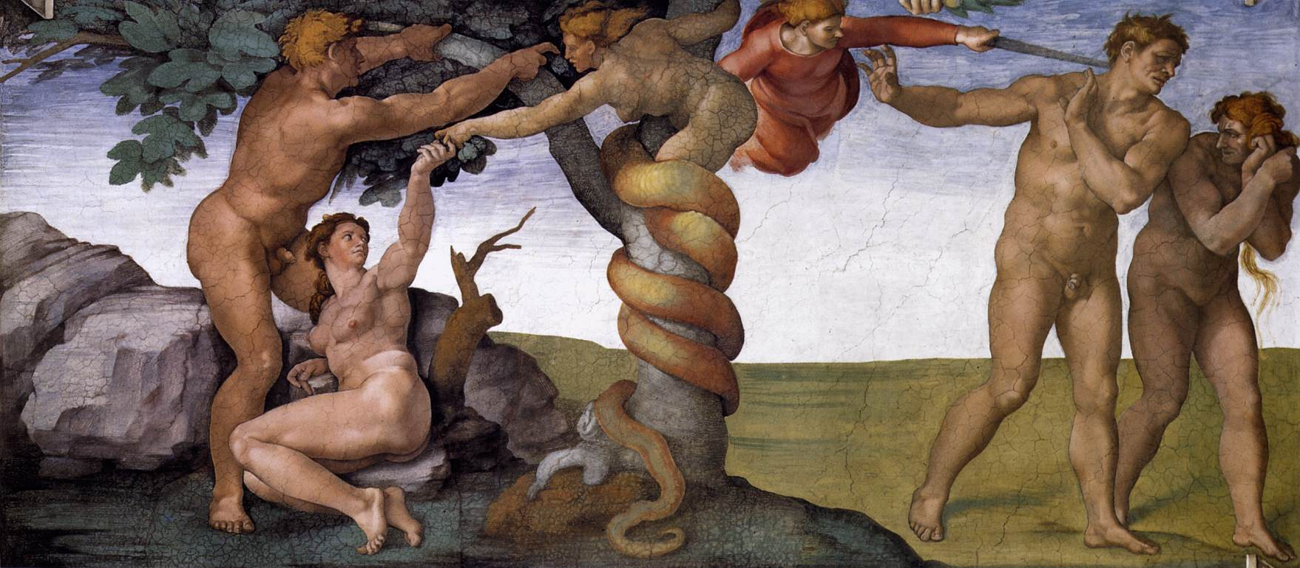
The expulsion from Eden and the origin of farming: “In the sweat of thy face shalt thou eat bread … the Lord God sent him forth from the garden of Eden to till the ground ...”

Slide 15
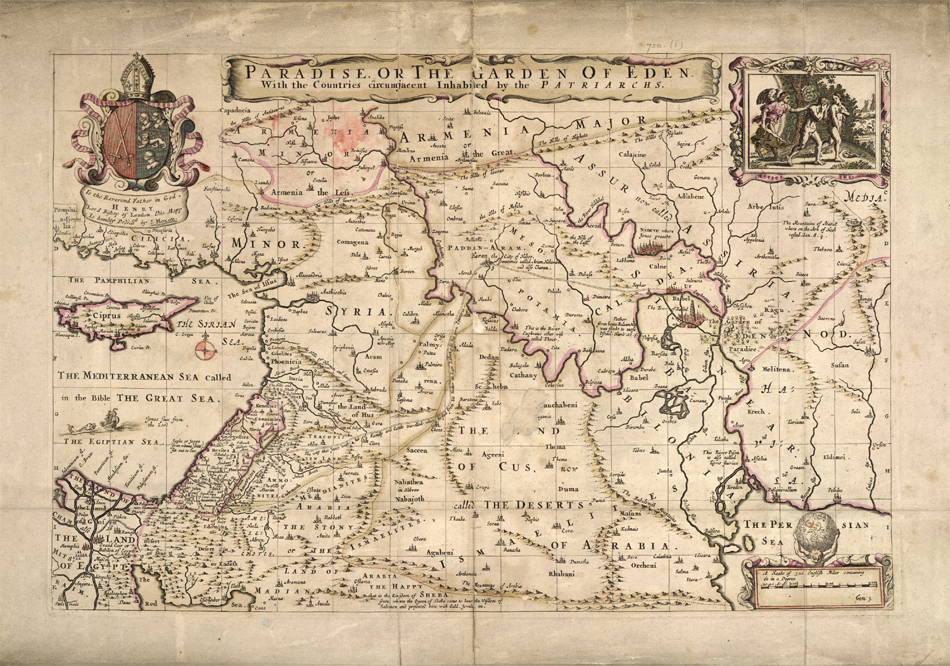
East of Eden, to the Land of Nod …

Slide 16
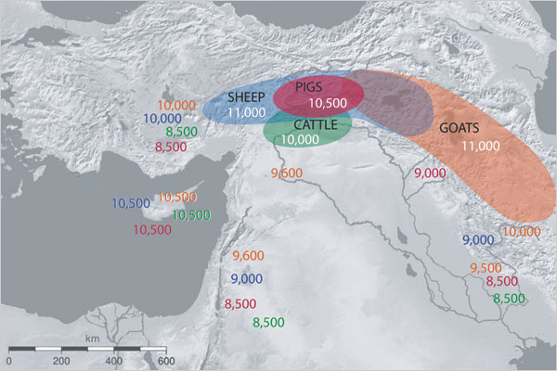

Slide 17
… and the Tower of Babel

Slide 18
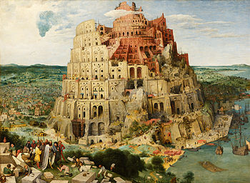
A creationist view of the origin of languages

Slide 20
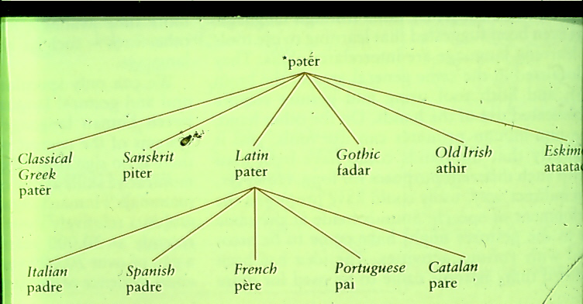

Slide 21
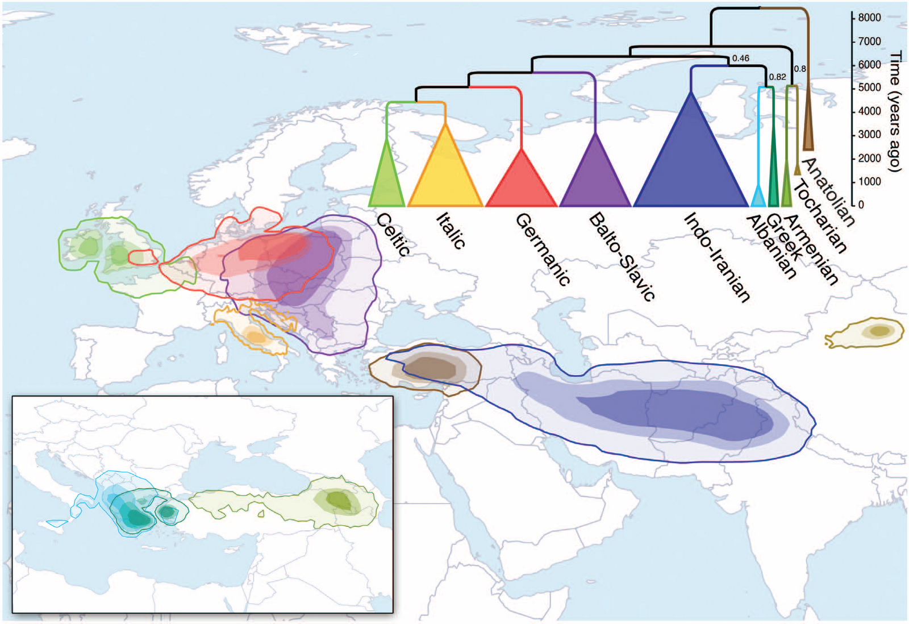
Anatolia; the home of Proto-Indo-European language

Slide 22
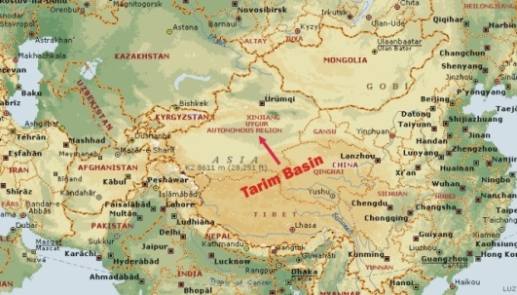
And even to China (Tokharians of Tarim Basin)
English | Tocharian A | Tocharian B | Ancient Greek | Sanskrit | Latin | Gothic | Old Irish | Proto-Indo-European
one | sas | ṣe | heĩs, hen | sa(kṛ́t) | semel | simle | samail | PToch *sems ← *sḗm
two | wu | wi | duo | dvā́ | duo | twái | dá | *duoh₁
three | tre | trai | treis | tráyas | trēs | þreis | trí | *tréi̯es
four | śtwar | śtwer | téssares | catvā́ras, catúras | quattuor | fidwōr | cethair | *kʷetu̯óres
five | päñ | piś | pénte | páñca | quīnque | fimf | cóic | *pénkʷe

Slide 23
Population booms (red) after arrival of farming in Europe (blue arrows)

Slide 24
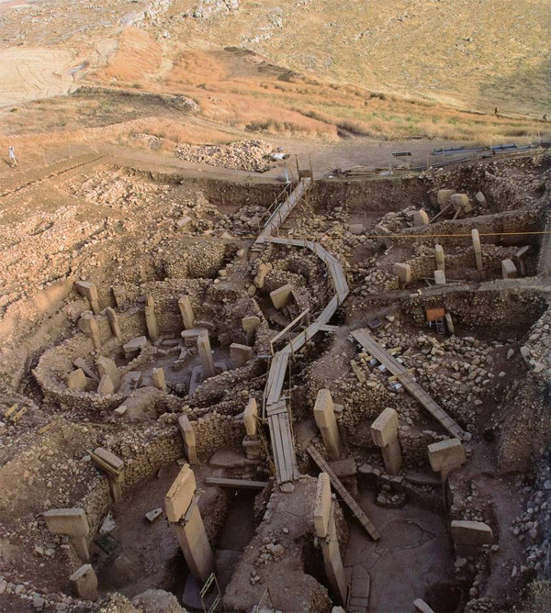
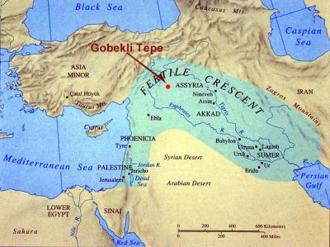
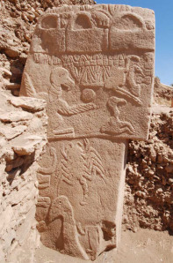
Göbekli Tepe - the oldest religious site, c10 000BC?

Slide 25
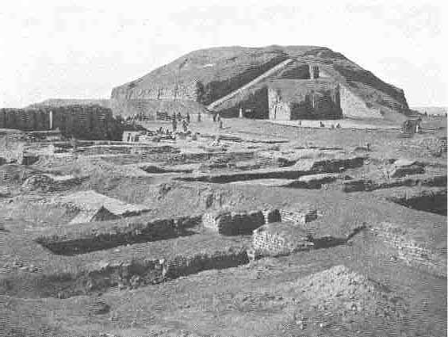
Ur of the Chaldees: birthplace of Abraham, and of inequality
‘Now the weight of gold that came to Solomon in one year was six hundred threescore and six talents of gold. He had forty thousand stalls of horses for his chariots …’

Slide 26
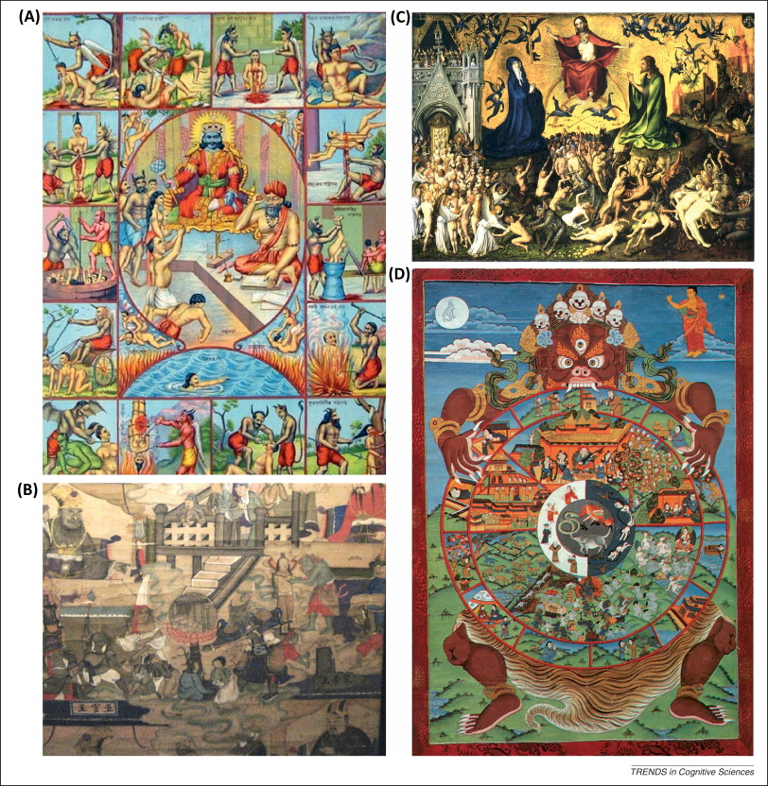
(A) God Punishes:… A -Hindu – Yama, the God of Death; B) Chinese – the Ten Kings of Hell C) Christianity – Judgment Day: sinners cast into perdition: D) Buddhist – the Wheel of Life and the Realms of Suffering for bad karma

Slide 27
I the Lord thy God am a jealous God, visiting the iniquity of the fathers upon the children … Powerful (“jealous”) gods in foragers/herders

Slide 28
I the Lord thy God am a jealous God, visiting the iniquity of the fathers upon the children … Powerful (“jealous”) gods in peasants/land-owners

Slide 29
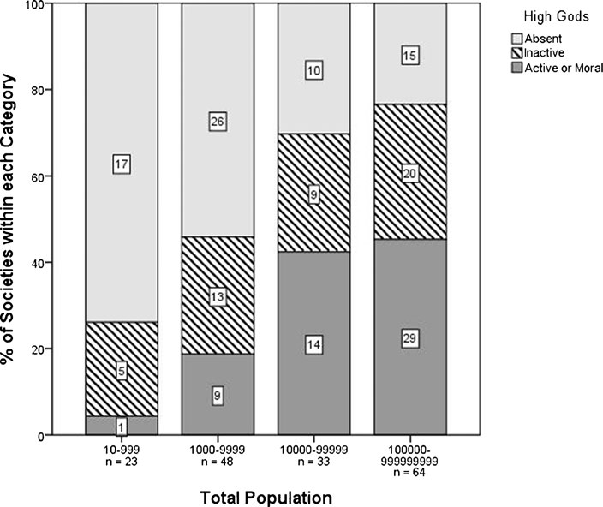
Jealous Gods and population density

Slide 30
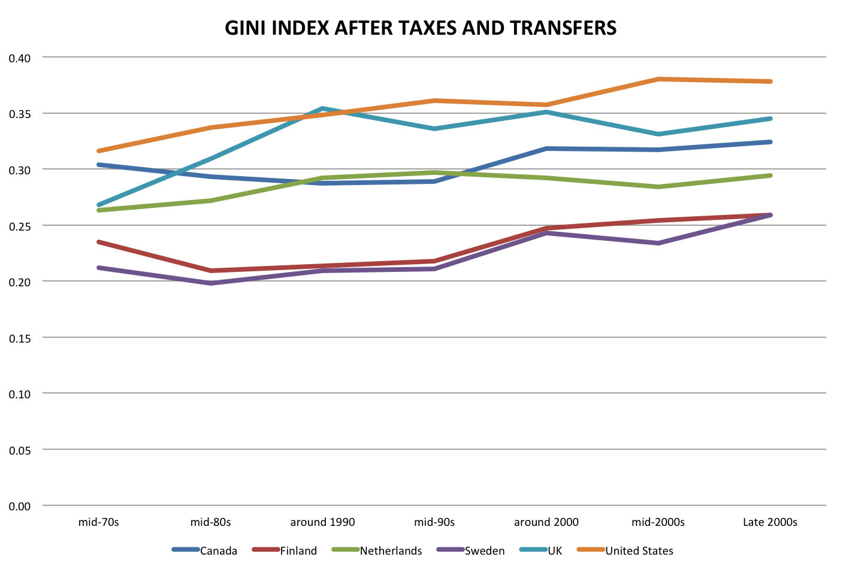
The Inequality (“Gini”) Index

Slide 31
Gini (horizontal axis) and God
Notes:
Average Religiosity by Income Inequality, WVS/EVS 1981–2007
© This slide is made available for non-commercial use only. Please note that permission may be required for re-use of images in which the copyright is owned by a third party.

Slide 32
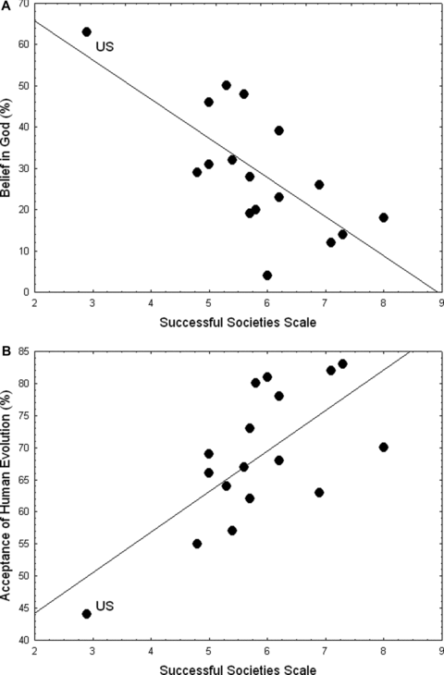
BELIEF IN GOD IN RELATION TO SUCCESSFUL SOCIETIES SCALE IN 17 DEVELOPED COUNTRIES
Notes:
The correlation among 17 First World countries between social functionality on the Successful Societies Scale—ranging from 1 (least successful) to 10 (most successful)—and belief in God (A) or acceptance of human evolution (B). Figures are replotted from data given by Paul (2009). “US” indicates points for the United States. (A) Correlation among all points is −0.709 (P= 0.0014); correlation excluding the United States is −0.551 (P= 0.027). Least‐squares regression line for all points is y= 84.68 − 9.48x. (B) Correlation among all points is 0.690 (P= 0.0022), correlation excluding the United States is 0.501 (P= 0.048). Least‐squares regression line for all points is y= 31.51 + 6.33x.
© This slide is made available for non-commercial use only. Please note that permission may be required for re-use of images in which the copyright is owned by a third party.

Slide 33
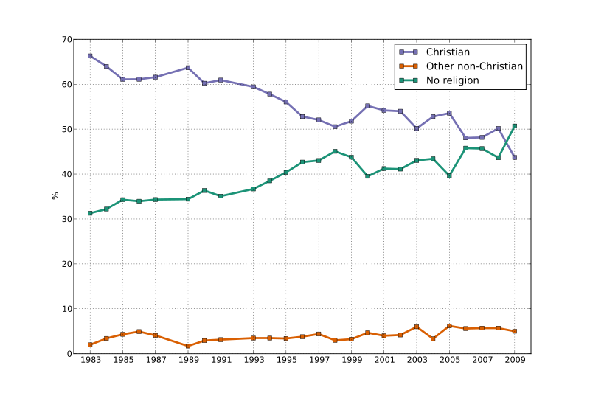
Decline in religion in UK 1983-2009

Slide 34
Here, then, I had at last got a theory by which to work … Charles Darwin 1838

Slide 35
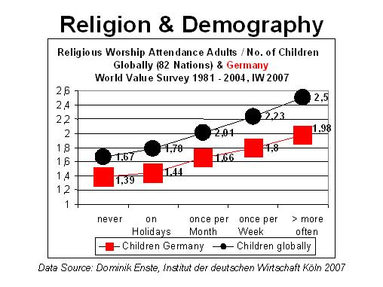

Slide 36
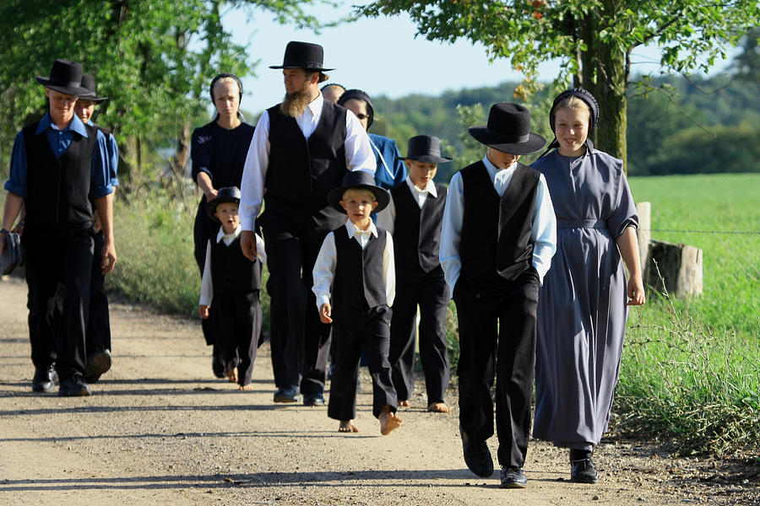
Amish Family

Slide 37
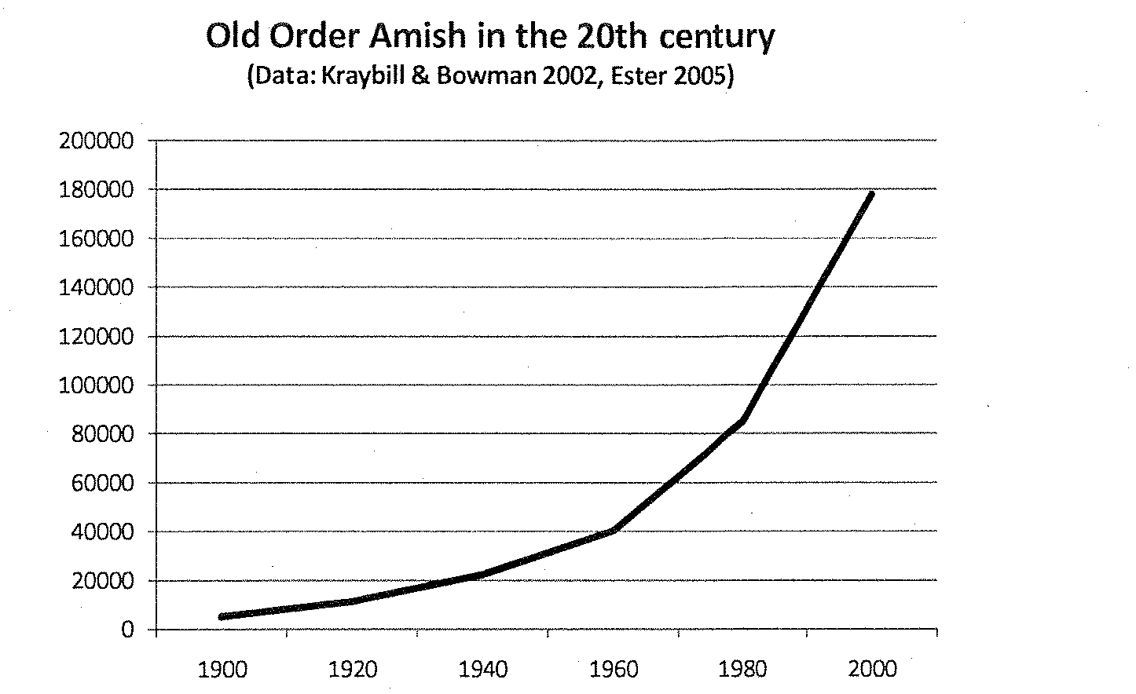

Slide 38
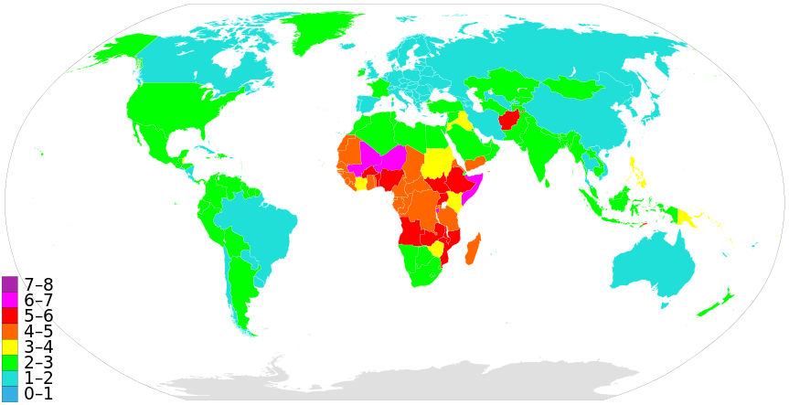
Global fertility – number of children per woman

Slide 39
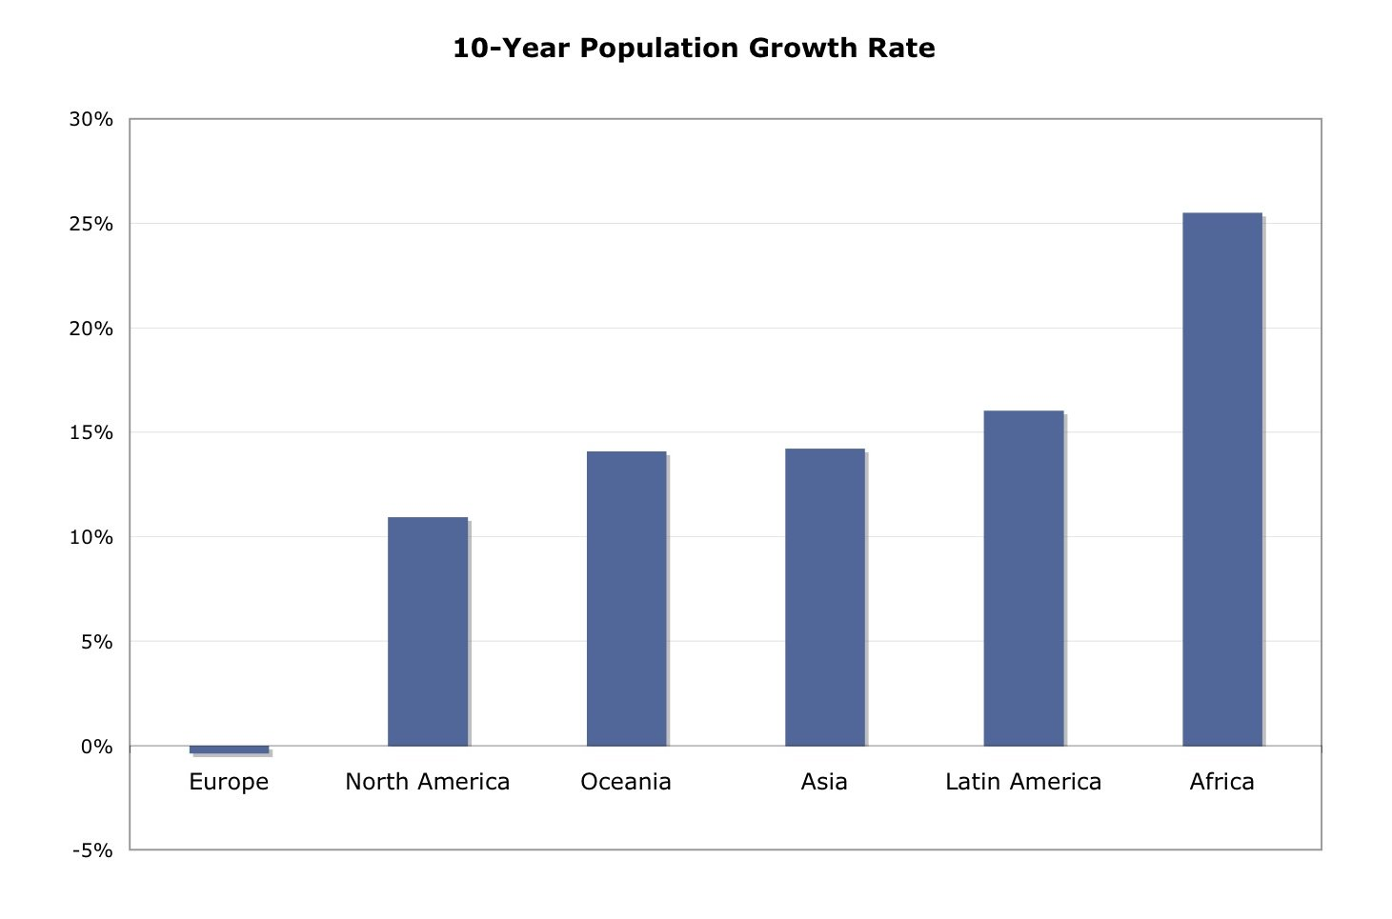

Slide 40
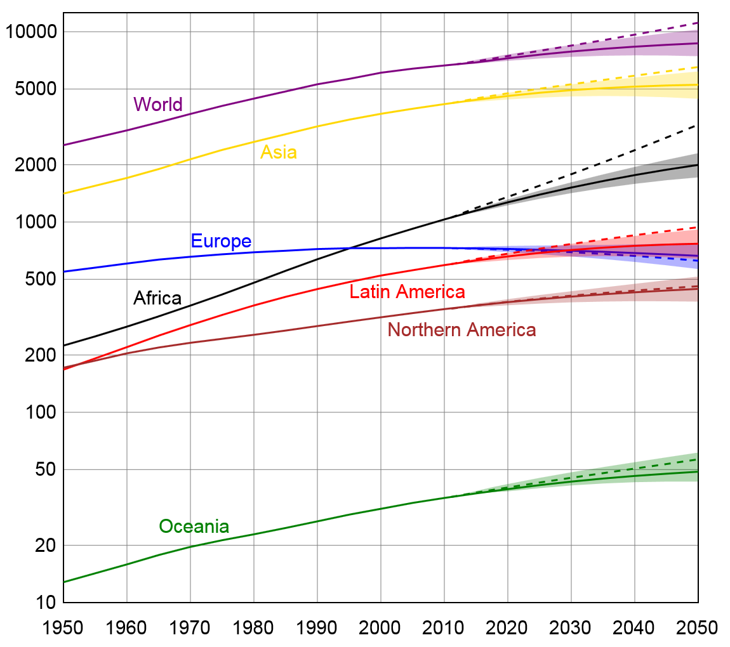
Future population growth (log scale)

Slide 41
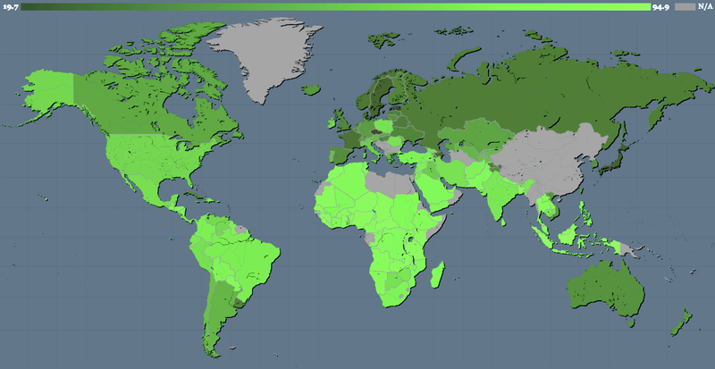
Gallup Religiosity Map 2010 – Light colour; most religious, dark colour; least religious (grey – no data)

