Slide 1
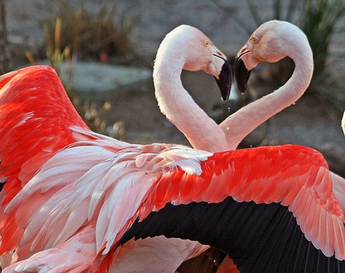
WHAT IS THIS THING CALLED LOVE?
Glenn Wilson PhD, Gresham College, London

Slide 2
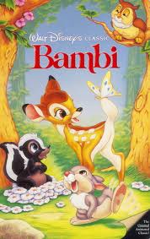
TWITTERPATED
Nearly everybody gets twitterpated in the springtime….You’re walking along, minding your own business, looking neither to the left nor the right …. when all of sudden you run into a pretty face. You begin to get weak in the knees. Your head’s in a whirl… and then you feel light as a feather, and before you know it you’re walking on air…. you’re knocked for a loop and completely lose your head.
(The Wise Old Owl)

Slide 3
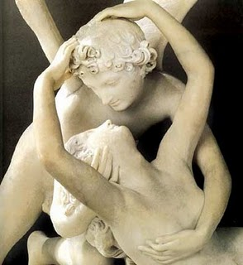
LOVE IS UNIVERSAL
Sometimes said that romantic love is a Western invention dating from medieval “courtly love”. However, the phenomenon is recognised in all cultures at all times, though not always tied with marriage (often elopement or divorce).

Slide 4
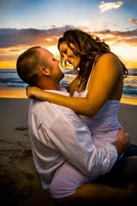
SYMPTOMS OF BEING “IN LOVE”
Preoccupation with loved one
Energy/euphoria/mood swings
Pounding heart/sweaty palms
Sleeplessness
Loss of appetite
Alteration of habits/dress
Intrusive thoughts
Feeling out of control
Possessiveness/jealousy
Separation anxiety

Slide 5
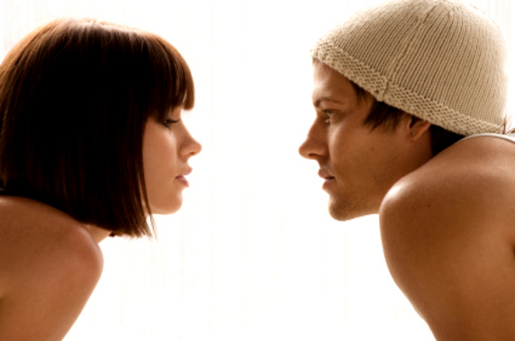
“DON’T SIGH AND GAZE AT ME”
Couples in love spend much time in mutual eye contact. Adopting mutual gaze with a stranger combined with self-disclosure may generate love in the laboratory.
Especially if there are other cues supporting a romantic interpretation, e.g. music, candlelight.

Slide 6
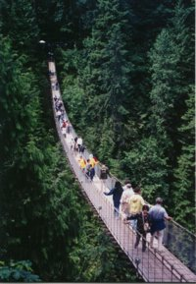
MISATTRIBUTION OF AROUSAL
Emotional arousal of any kind (even fear) may be misattributed as love. Men crossing a swing bridge were more likely to seek a date from a female confederate than men crossing a safe bridge (Dutton & Aron, 1974).

Slide 7
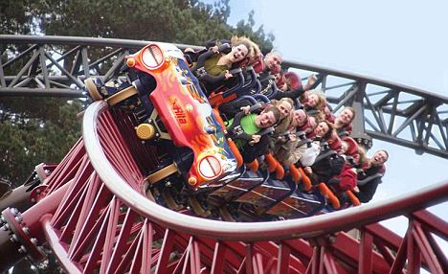
ADRENALINE DATES
The principle of fear-inspired love has been applied by dating agencies in “adrenaline dates”.

Slide 8
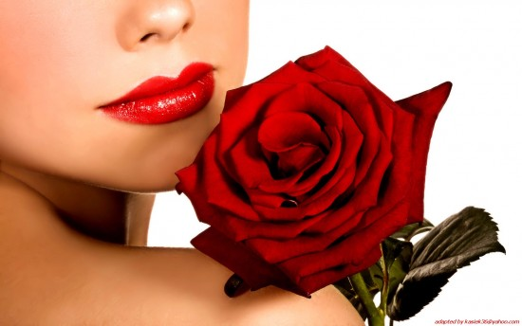
ROMANTIC RED
Wearing red makes men more attractive to women (status signal) and women more attractive (passionate) to men. These effects are subliminal and derive from arousal connections in nature.

Slide 9
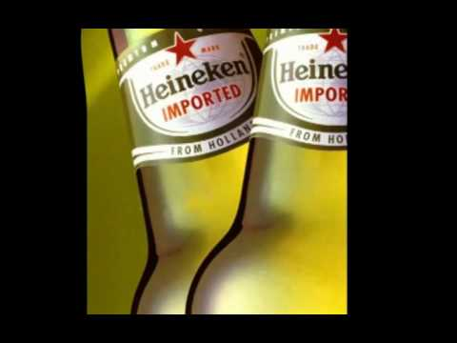
SEX PRIMES LOVE
Exposure to erotic images increases intimate thoughts, self-disclosure, willingness to make sacrifices for a partner and positive conflict resolution strategies
(Gillath et al, 2008).
Effect is stronger when sexual stimuli are subliminal.

Slide 10
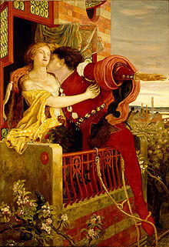
THE ROMEO & JULIET EFFECT
If lovers encounter parental interference, or other obstacles to their relationship, this is likely to intensify their passion via the mechanisms of arousal and cognitive dissonance.

Slide 11
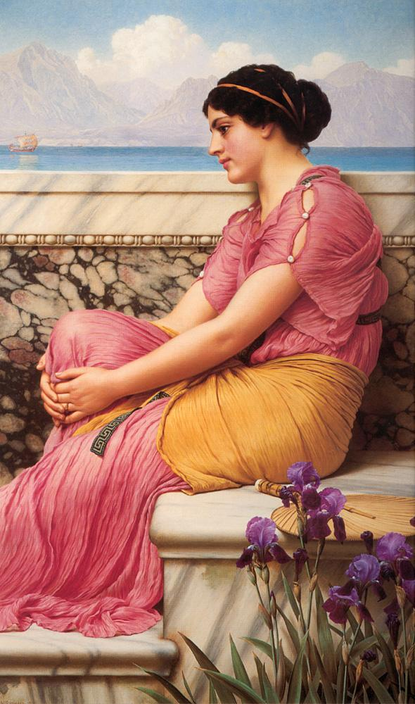
DOES ABSENCE MAKE THE HEART GROW FONDER?
It may be so for introverts but for extraverts it is often “out of sight – out of mind”.
There are also sex differences; work-related travel enhances marital satisfaction for men but diminishes it for women.

Slide 12
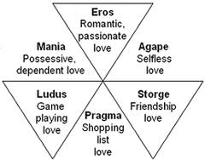
LEE’S LOVESTYLES
Canadian sociologist John Lee proposed a 6-way typology of love: (three primary styles and three compounds).

Slide 13
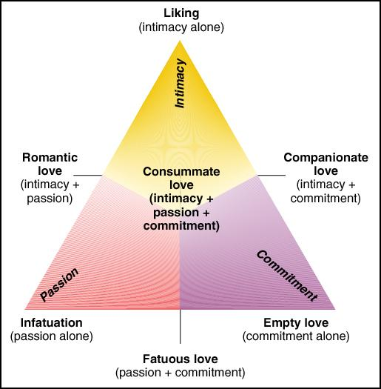
STERNBERG’S TRIANGLE
Robert Sternberg has identified three major components of love: Intimacy, Passion, and Commitment.
A relationship may be described in terms of the relative strength of these three.

Slide 14
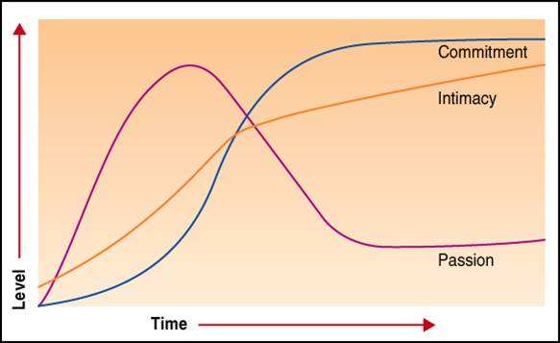
PHASING OF COMPONENTS
Garcia (1998) showed that the three components of love
Vary with duration of the relationship.

Slide 15
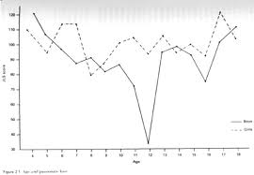
PUPPY LOVE
Passionate love begins in childhood, though denied by teenage boys (Hatfield et al, 1988).

Slide 16
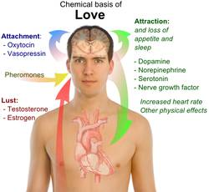
THREE NEURAL SYSTEMS
Fisher et al (2002) identify three separate evolutionary mating systems in birds and mammals:
Lust – General sexual desire
Attraction – Focus on a particular mate
Attachment – Instinct toward caretaking
Each is associated with a specific neural circuitry, chemistry and behaviours.

Slide 17
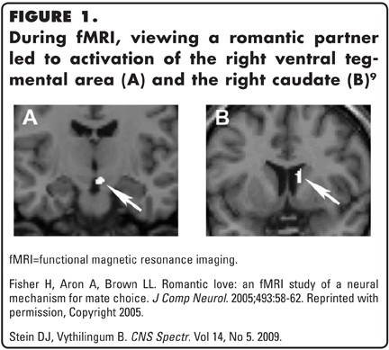
VIEWING A LOVED ONE IS REWARDING

Slide 18
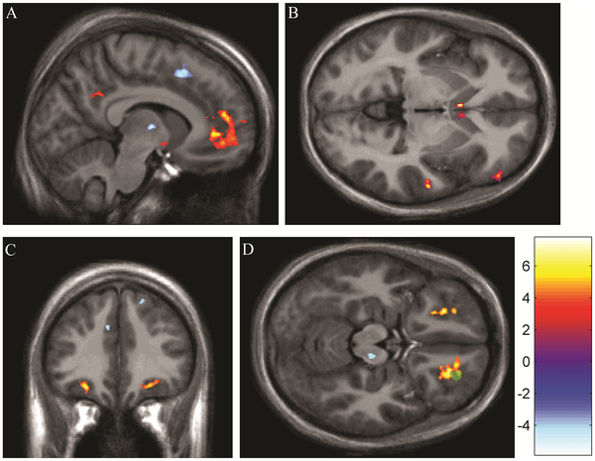
LOVE IS THE DRUG
Viewing pictures of one’s lover reduces pain. The effect is similar in degree to that of painkilling drugs and operates in the same “reward” centres of the brain.
From Younger et al, 2010

Slide 19
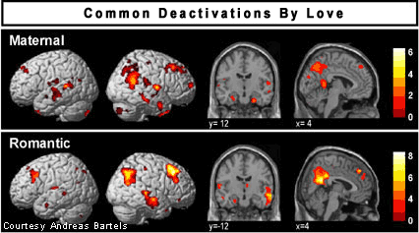
MATERNAL vs ROMANTIC LOVE
Maternal & romantic love produce similar neural deactivation patterns, suggesting a link between them.

Slide 20
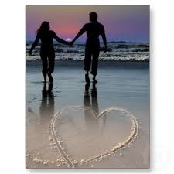
INFANTILE LOVERS
The bonding of lovers derives partly from parent-child attachments. Similar hormones are involved (e.g. oxytocin) and similar body language/terms of endearment are used. Kissing may come from mouth-to-mouth feeding still seen in some tribal peoples.

Slide 21
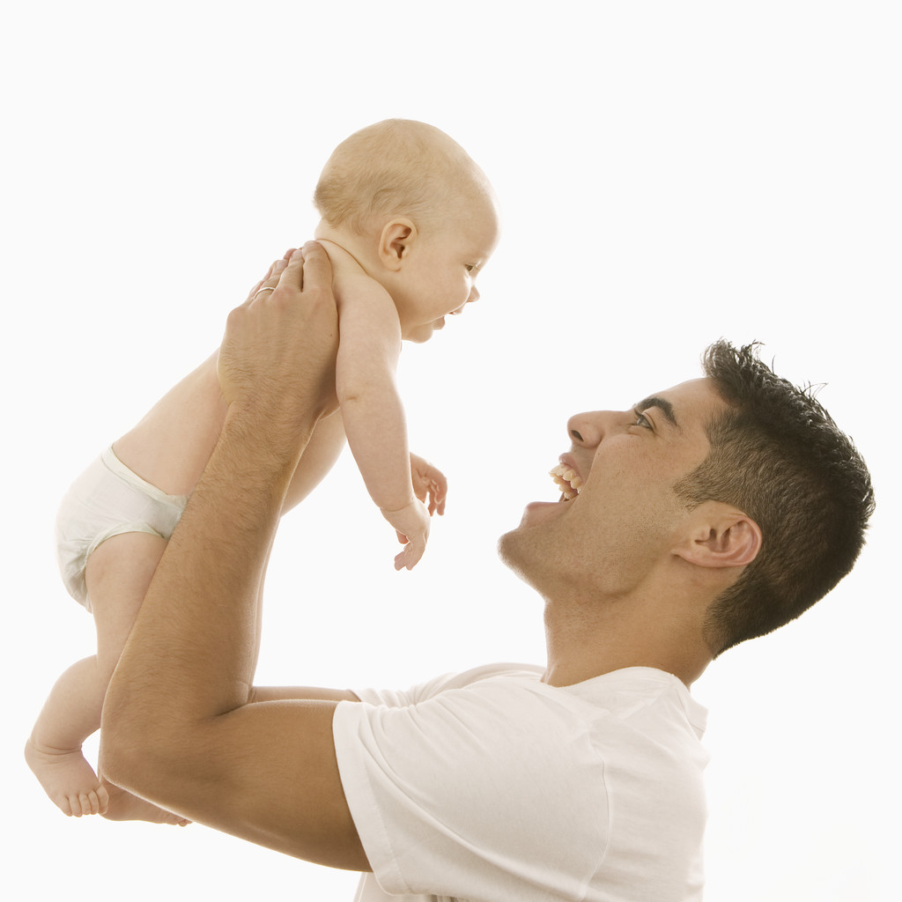
OXYTOCIN IN NEW FATHERS
It is well-known that oxytocin rises in child-birth for mothers but recently recognised that it increases in new fathers also. The nursing hormone prolactin is also secreted in fathers in support of parental bonding.

Slide 22
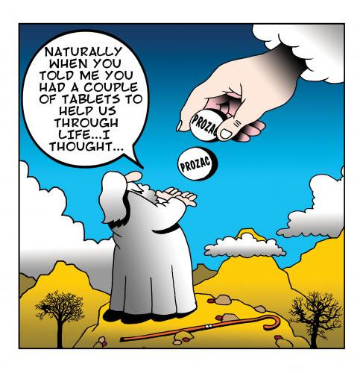
OTHER CHEMICALS
Italian research has revealed low serotonin levels in romantic (c.f., OCD). Prozac may interfere with capacity to fall in love, or “cure” it once it has happened.
U. Pavia researchers find early-stage love correlates with levels of nerve growth factor (NGF) in blood. Effect is short-lived but might account for health benefits of love.

Slide 23
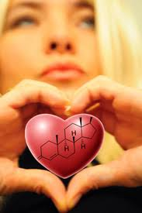
CHOCOLATE IN LOVE
Phenylethylamine (PEA) is a neuromodulator that releases nor-epinephrine & dopamine (like an endogenous amphetamine). This would produce the euphoria and energy associated with love and was suggested as a key chemical basis.
PEA is contained in chocolate, so thought this could be a love substitute. However, there is more PEA in cheese & sausages and little of it reaches the brain anyway.

Slide 24
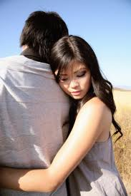
ATTACHMENT STYLES
Attachment styles acquired in early childhood (e.g., secure, anxious, avoidant, dismissing) are carried over and affect adult relationships.
Experiences like separation, divorce & widowhood may reactivate early attachment experiences.

Slide 25
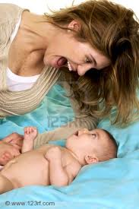
PARENTAL IMPRINTING
We are primed to find certain partners attractive because they are reminiscent in some way of our opposite sex parent (as we experienced them in early childhood).
This may account for certain instances of “love at first sight” as well as so-called “genetic sexual attraction”.

Slide 26
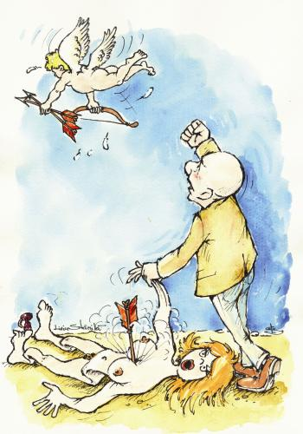
STUPID CUPID
Love is one of the few behavioural phenomena with little genetic determination (highest estimates are no more than one-third). This leaves much room for environmental and “random” factors to contribute (e.g. being at right time/right place).

Slide 27
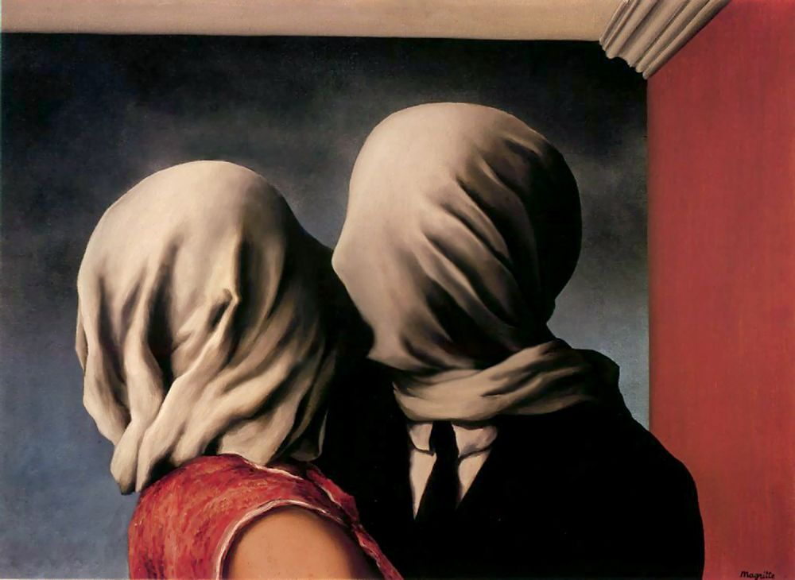
HOW BLIND IS LOVE?
Love deactivates brain areas concerned with negative social judgements and moral control (Bartels & Zeki, 2000).
Rose-tinted specs support attachment/make relationship happier.
People idealise their lover as compared with previous lovers. Once committed we strive to see the best in the partner.
People “in love” are less accurate in recognising love in the body language of others.

Slide 28
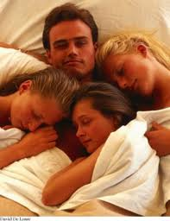
CAN WE LOVE MORE THAN ONE PERSON AT THE SAME TIME?
Not in the “consummate” sense, but just as parents bond with several children equally, this mechanism can create multiple adult attachments.
Because Fisher’s three systems are independent, one can feel bonded to one person, attracted to another, and lust towards several others simultaneously.

Slide 29
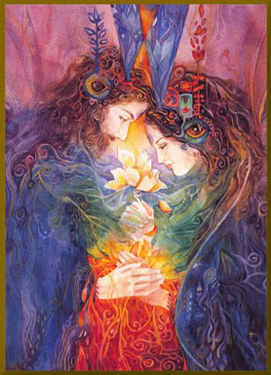
SELF-EXPANSION BY MERGER
Some theorists argue that love is a quest to expand the sense of self by merging as an “item” with a “better half”.
Yearning for deep union with a partner may derive from an evolutionary trend toward ganging together of larger organisms.

Slide 30
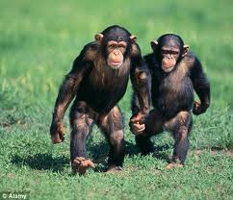
CONCLUSIONS
Romantic/passionate love is a powerful emotion experienced in all cultures.
It leads to radical alterations in life arrangements (marriage, divorce, parenthood).
Instincts which evolved to promote parental care have been co-opted in evolution to bond parents together long enough for offspring to reach viability. Beyond that, companionate love may preserve the relationship.
Useful to study these mechanisms for better understanding of various deficits and disorders of love.

